Slide 1
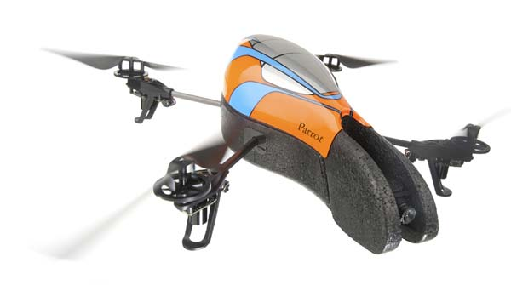
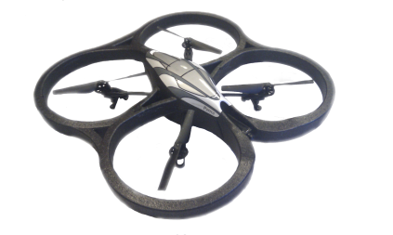
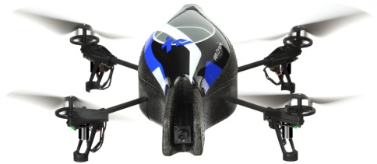
Image Processing Cluster
DRONE NETWORK
Slave Instance
Slave Instance
Slave Instance
Celery Image Processing Task Queue
Drone Interface
Central Linux Server

