Slide 1

ATLIQ HARDWARE
Consumer Goods Ad-Hoc Insights
Presented by Ajay Jaiswar

Slide 2
AGENDA
Company Overview
Business Model & Product Portfolio
Problem Statement
Data Overview (Dataset)
Ad-hoc Analysis & Visualizations
Recommendations

Slide 3
Company Overview
Atliq Hardware is a global manufacturer and distributor of technology products, including personal computers, mice, printers, and other peripheral devices. The company sells its products through retail partners and online marketplaces, serving a diverse and widespread customer base.

Slide 4
Business Model & Product Portfolio
PC
P&A
N&S
Desktop
Notebook
Peripherals
Accessories
Networking
Storage
Business Laptop
Gaming Laptop
Processors
Batteries
Wi-Fi Extender
USB Flash Drives
Personal Laptop
Business Laptop
Motherboard
Keyboard
External SSD
Personal Laptop
Internal HDD
Mouse
Graphic Card

Slide 5
Problem Statement
The management at Atliq Hardware lacks timely and actionable insights to support quick, data-driven decision-making.
To address this gap, the company aims to strengthen its data analytics capabilities by expanding the team with junior data analysts.
As part of the hiring process, a SQL-based assessment has been introduced to evaluate candidates on both technical expertise and problem-solving skills.

Slide 6
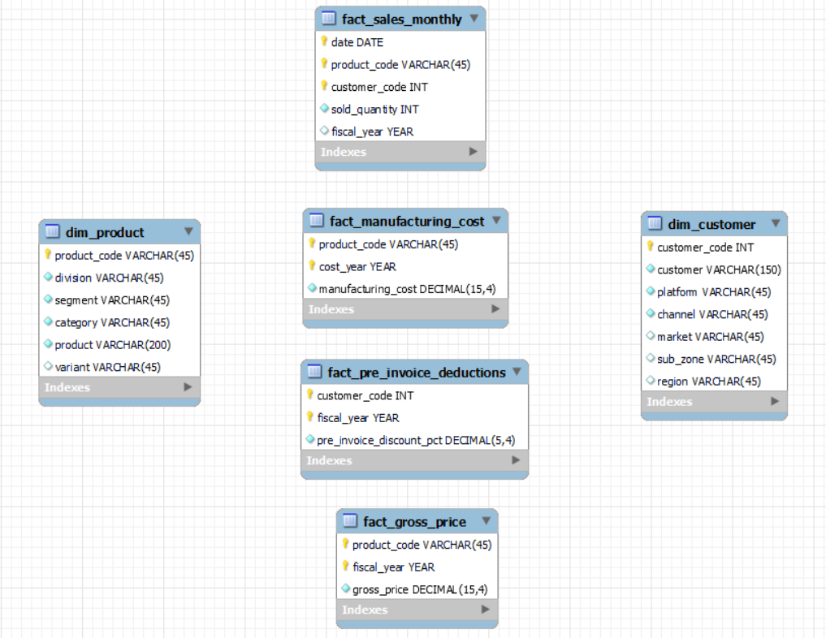
Data Overview (Dataset)

Slide 7
Provide the list of markets in which customer "Atliq Exclusive" operates its business in the APAC region.
Ad-hoc Analysis & Visualizations
Request 1
SELECT
DISTINCT market
FROM dim_customer
WHERE customer = 'Atliq Exclusive' AND region = 'APAC';
SQL Query

Slide 8
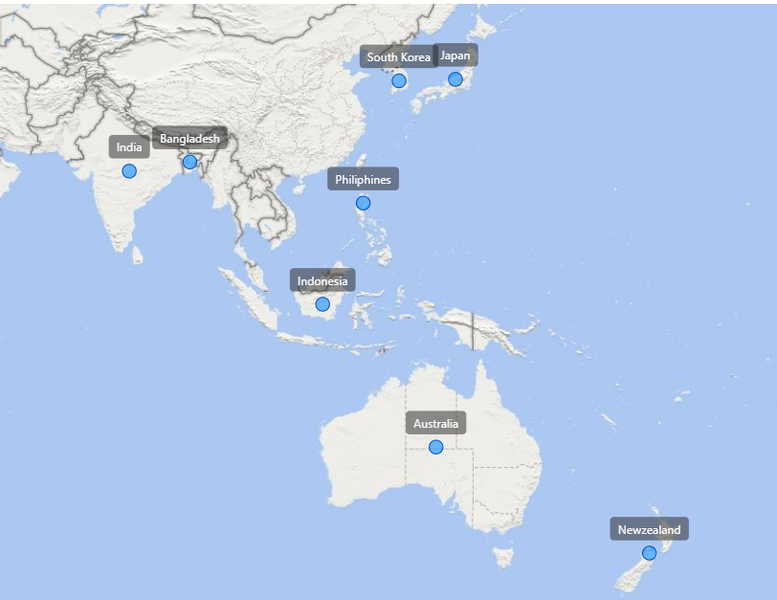
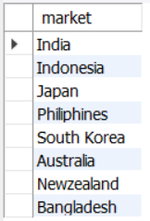
Output
Insights
Atliq Hardware’s operations are strongly concentrated in the APAC region, spanning both high-growth emerging markets (India, Indonesia, Bangladesh) and mature economies (Japan, South Korea, Australia).
This balanced geographic presence enables the company to capture growth opportunities while maintaining revenue stability.

Slide 9
What is the percentage of unique product increase in 2021 vs. 2020? The final output contains these fields, unique_products_2020, unique_products_2021, percentage_chg.
Request 2
WITH CTE1 AS ( SELECT COUNT(DISTINCT product_code) AS unique_products_2020 FROM fact_sales_monthly WHERE fiscal_year = 2020 ), CTE2 AS ( SELECT COUNT(DISTINCT product_code) AS unique_products_2021 FROM fact_sales_monthly WHERE fiscal_year = 2021 ) SELECT unique_products_2020, unique_products_2021, ROUND((unique_products_2021 - unique_products_2020) * 100 / unique_products_2020, 2) AS percentage_change FROM CTE1, CTE2;
SQL Query

Slide 10
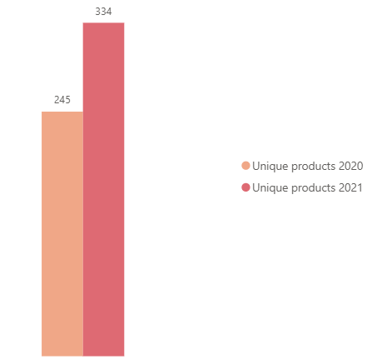

Output
36.33%
Insights
Strong product growth: Unique products increased from 245 in 2020 to 334 in 2021, showing solid expansion.
+36.33% year-over-year growth: This significant rise indicates successful product development and/or assortment strategy. Accelerated portfolio diversification: The increase suggests a broader offering, likely improving customer reach and competitiveness.
Positive momentum: The upward trend reflects sustained business growth and potential scaling opportunities.

Slide 11
Provide a report with all the unique product counts for each segment and sort them in descending order of product counts. The final output contains 2 fields, segment product_count.
Request 3
SELECT
segment,
COUNT(DISTINCT product_code) AS product_count
FROM dim_product
GROUP BY segment
ORDER BY product_count DESC;
SQL Query

Slide 12
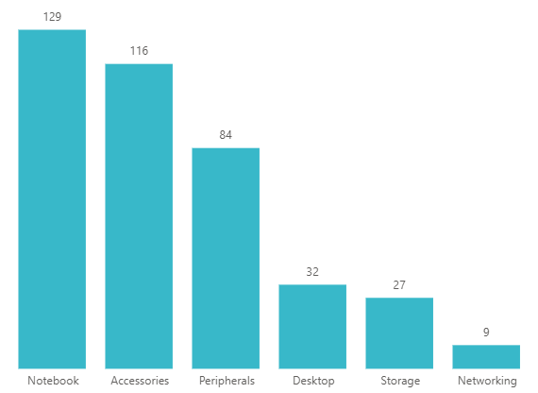
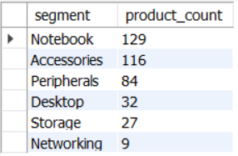
Output
Insights
Notebooks lead the portfolio with 129 products, making it the largest category.
Accessories (116) and Peripherals (84) together form a strong secondary cluster, indicating focus on high-demand, complementary products.
Sharp drop after top 3 categories: Desktop (32), Storage (27), and Networking (9) show significantly smaller product ranges.
Portfolio concentration: ~70% of products are concentrated in the top three categories, suggesting strategic prioritization.
Opportunity areas: Underrepresented segments like Networking and Storage may offer expansion potential.

Slide 13
Follow-up: Which segment had the most increase in unique products in 2021 vs 2020? The final output contains these fields, segment, product_count_2020, product_count_2021, difference.
Request 4
WITH CTE1 AS ( SELECT p.segment, COUNT(DISTINCT p.product_code) AS product_count_2020 FROM fact_sales_monthly s JOIN dim_product p ON s.product_code = p.product_code WHERE s.fiscal_year = 2020 GROUP BY p.segment
),
CTE2 AS ( SELECT p.segment, COUNT(DISTINCT p.product_code) AS product_count_2021 FROM fact_sales_monthly s JOIN dim_product p ON s.product_code = p.product_code WHERE s.fiscal_year = 2021 GROUP BY p.segment
)
SELECT x.segment, product_count_2020, product_count_2021, (product_count_2021 - product_count_2020) AS difference FROM CTE1 x JOIN CTE2 y ON x.segment = y.segment ORDER BY difference DESC;
SQL Query

Slide 14
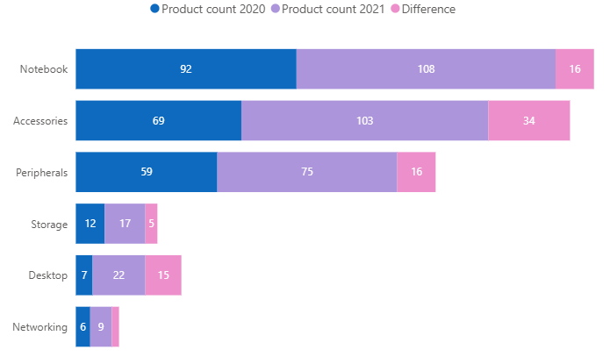
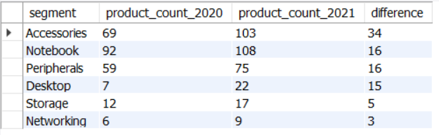
Output
Insights
Accessories +49% (69 → 103) — highest growth driver.
Desktop +214% (7 → 22) — fastest growth from a small base.
Notebooks +17% (92 → 108) and Peripherals +27% (59 → 75) — steady core growth.
Storage +42% and Networking +50% — emerging categories gaining traction.

Slide 15
Get the products that have the highest and lowest manufacturing costs. The final output should contain these fields, product_code, product, manufacturing_cost.
Request 5
SELECT p.product_code, p.product, m.manufacturing_cost FROM dim_product p JOIN fact_manufacturing_cost m ON p.product_code = m.product_code WHERE m.manufacturing_cost = ( SELECT MAX(manufacturing_cost) FROM fact_manufacturing_cost ) OR m.manufacturing_cost = ( SELECT MIN(manufacturing_cost) FROM fact_manufacturing_cost ) ORDER BY m.manufacturing_cost DESC;
SQL Query

Slide 16



Output
$263.42
$0.86
Insights
AQ HOME Allin1 Gen 2 has a manufacturing cost of $263.42, making it the primary cost driver.
AQ Master Wired x1 MS costs just $0.87, contributing <1% of the desktop’s cost.
The desktop is ~300x more expensive to manufacture than the mouse, highlighting a strong cost gap.
Mouse offers high bundling potential with negligible cost impact on overall pricing.

Slide 17
Generate a report which contains the top 5 customers who received an average high pre_invoice_discount_pct for the fiscal year 2021 and in the Indian market. The final output contains these fields, customer_code, customer, average_discount_percentage.
Request 6
SELECT c.customer_code, c.customer, ROUND(AVG(p.pre_invoice_discount_pct) * 100, 2) AS avg_discount_pct FROM fact_pre_invoice_deductions p JOIN dim_customer c USING (customer_code) WHERE p.fiscal_year = 2021 AND c.market = 'India' GROUP BY c.customer_code, c.customer ORDER BY avg_discount_pct DESC LIMIT 5;
SQL Query

Slide 18
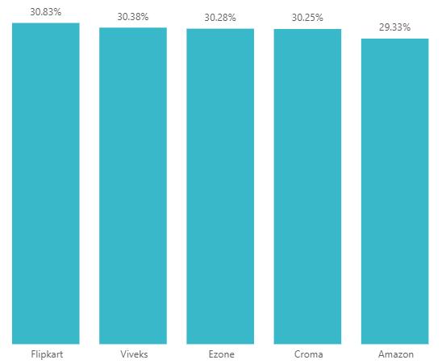
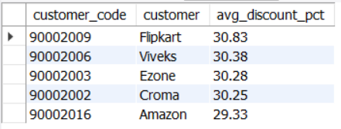
Output
Insights
In 2021, discount rates before invoicing were distributed quite evenly across the top five customers, with Flipkart receiving the highest at 30.83%.
The near-equal distribution suggests the company aimed to maintain strong relationships across multiple major clients, rather than heavily favoring just one.

Slide 19
Get the complete report of the Gross sales amount for the customer “Atliq Exclusive” for each month. This analysis helps to get an idea of low and high-performing months and take strategic decisions. The final report contains these columns: Month, Year, Gross sales Amount.
Request 7
SELECT MONTHNAME(s.date) AS month, s.fiscal_year AS fiscal_year, ROUND(SUM(g.gross_price * s.sold_quantity) / 1000000,2) AS gross_sales_amt_mln FROM fact_sales_monthly s JOIN fact_gross_price g ON s.fiscal_year = g.fiscal_year AND s.product_code = g.product_code JOIN dim_customer c ON c.customer_code = s.customer_code WHERE c.customer = 'Atliq Exclusive' GROUP BY MONTHNAME(s.date), s.fiscal_year ORDER BY fiscal_year, gross_sales_amt_mln DESC;
SQL Query

Slide 20
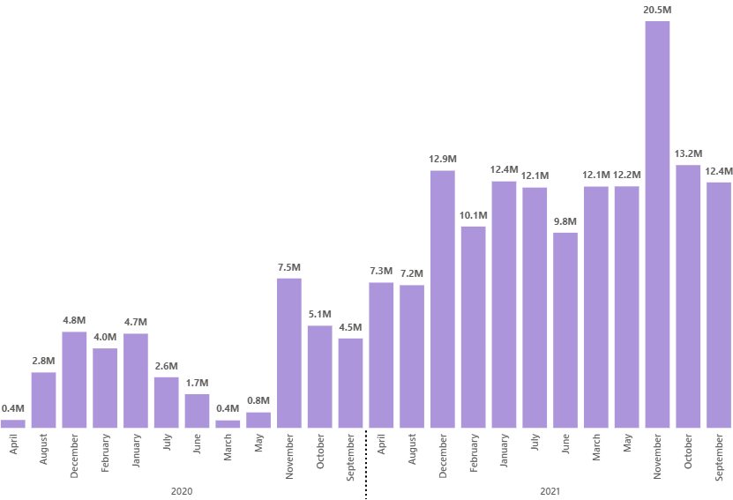
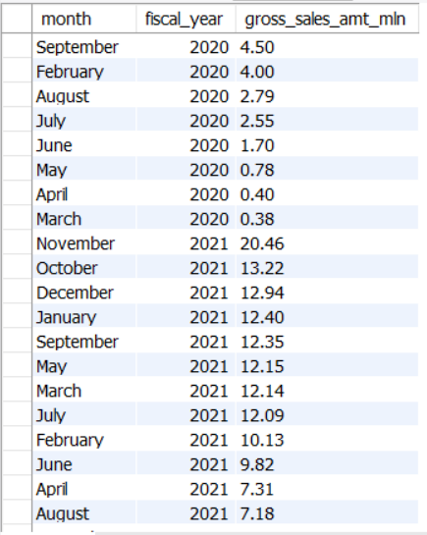
Output
Insights
Sales show a clear seasonal pattern—peak performance in Oct–Dec (highest in Nov 2021: 20.5M) and weak performance in Mar–Jun (lowest around 0.4–1.7M in 2020).
Strong recovery and consistent growth in 2021, with most months maintaining ~10M+ sales.
Key takeaway: Business is heavily driven by festive demand, while mid-year months remain vulnerable.

Slide 21
In which quarter of 2020, got the maximum total_sold_quantity? The final output contains these fields sorted by the total_sold_quantity, Quarter, total_sold_quantity.
Request 8
SELECT CASE WHEN MONTH(date) IN (9,10,11) THEN "Q1" WHEN MONTH(date) IN (12,1,2) THEN "Q2" WHEN MONTH(date) IN (3,4,5) THEN "Q3" WHEN MONTH(date) IN (6,7,8) THEN "Q4" END AS quarter_of_2020, SUM(sold_quantity) AS total_sold_quantity FROM fact_sales_monthly WHERE fiscal_year = 2020 GROUP BY quarter_of_2020 ORDER BY total_sold_quantity DESC;
SQL Query

Slide 22
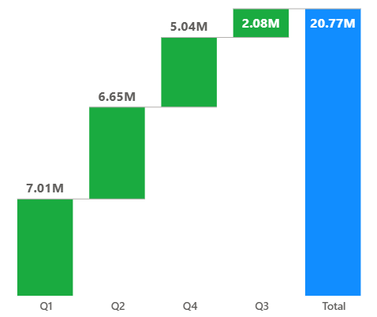
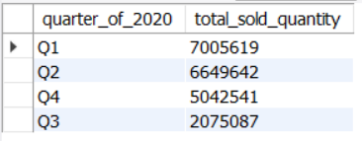
Output
Insights
Q1 (Sep–Nov) peak (7.01M): Strong festive season demand (pre-/early pandemic phase) drove the highest sales performance.
Q2 (Dec–Feb) slight dip (6.65M): Post-festive slowdown combined with early signals of COVID-19 impact.
Q3 (Mar–May) sharp decline (2.08M): Severe impact due to nationwide lockdowns, supply chain disruptions, and demand contraction.
Q4 (Jun–Aug) partial recovery (5.04M): Gradual reopening improved sales, but performance remained below pre-pandemic levels.
Action point: Strengthen digital channels, ensure supply chain flexibility, and align inventory with demand fluctuations during uncertain periods.

Slide 23
Which channel helped to bring more gross sales in the fiscal year 2021 and the percentage of contribution? The final output contains these fields, channel, gross_sales_mln, percentage.
Request 9
WITH CTE1 AS ( SELECT c.channel, ROUND(SUM(g.gross_price * s.sold_quantity) / 1000000,2) AS gross_sales_mln FROM fact_sales_monthly s JOIN fact_gross_price g ON s.fiscal_year = g.fiscal_year AND s.product_code = g.product_code JOIN dim_customer c ON c.customer_code = s.customer_code WHERE s.fiscal_year = 2021 GROUP BY c.channel )
SELECT *, ROUND(gross_sales_mln * 100 / (SELECT SUM(gross_sales_mln) FROM CTE1), 2) AS pct_contribution FROM CTE1 ORDER BY pct_contribution DESC;
SQL Query

Slide 24
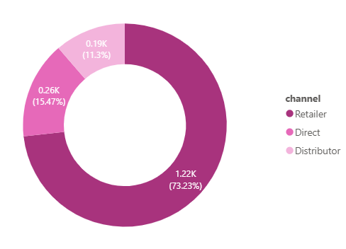
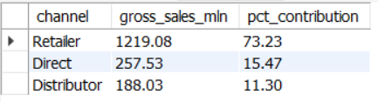
Output
Insights
Retailer channel dominates (73.23% | 1.22K): Primary revenue driver, indicating strong reliance on retail partners.
Direct sales contribution (15.47% | 0.26K): Moderate share, showing opportunity to expand direct-to-customer strategy.
Distributor channel lowest (11.3% | 0.19K): Underutilized segment with potential for growth.
Action point: Diversify channel mix by strengthening direct and distributor networks to improve resilience and margins.

Slide 25
Get the Top 3 products in each division that have a high total_sold_quantity in the fiscal_year 2021? The final output contains these fields, division, product_code, product, total_sold_quantity, rank_order.
Request 10
WITH CTE1 AS ( SELECT p.division, p.product_code, p.product, SUM(s.sold_quantity) AS total_sold_quantity FROM fact_sales_monthly s JOIN dim_product p ON s.product_code = p.product_code WHERE s.fiscal_year = 2021 GROUP BY p.division, p.product_code, p.product ),
CTE2 AS ( SELECT *, DENSE_RANK() OVER(PARTITION BY division ORDER BY total_sold_quantity DESC) AS DRNK FROM CTE1 ) SELECT * FROM CTE2 WHERE DRNK <= 3;
SQL Query

Slide 26
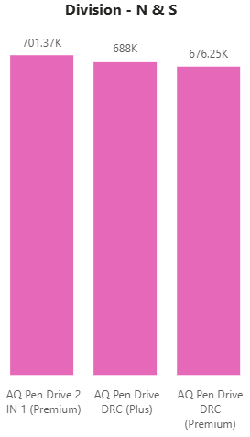
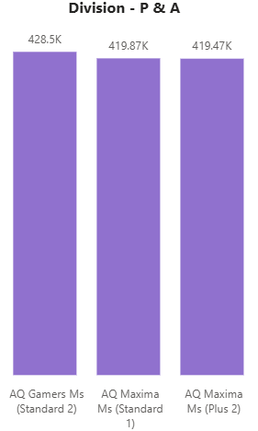
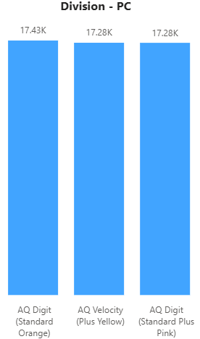
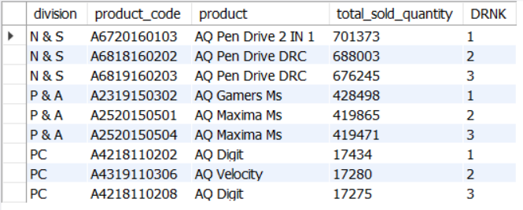
Output
Insights
N & S (Pen Drives) records the highest sold quantity (~701K → 676K) but shows a declining trend, indicating weakening demand despite volume leadership.
P & A (Mouse) stands second (~428K → 419K) with slight drop but largely stable sales, reflecting consistent market demand.
PC (Personal Laptops) has the lowest sold quantity (~17K), remaining almost flat, suggesting a limited but steady market segment.

Slide 27
Key Recommendations
Diversify channels to reduce reliance on retail and grow direct sales.
Maximize festive season (Q1) and improve mid-year (Mar–Jun) sales.
Invest in high-growth segments (Accessories, Desktop, Networking).
Expand weaker categories to balance the product portfolio.
Use low-cost products (mouse/peripherals) for bundling strategies.
Revive declining N & S segment with pricing and innovation.
Strengthen supply chain for demand fluctuations.
Leverage data analytics for faster decision-making.

Slide 28
Thank You!

