Slide 1
FLYHIGH Cheap Flight Fare Predictor
Team 10
Zalak Shah Abhijeet Singh Ashish Maheedhara Arvind Venkatasubramanian Shanmughasudan Veerabahu

Slide 2
PROBLEM STATEMENT
Unpredictability and no definite pattern to identify Flight fares.
Various factors which may affect the daily flight fares.
The concept about “the earlier you plan – the cheaper your tickets” which is not true.
Flight ticket reservation websites are dominated by big market aerospace carriers, by establishing their market monopoly.

Slide 3
PROPOSED SOLUTION
Based on the dataset, predict the Flight fares for the future
Predict the best date to travel for the customer if their dates are flexible.
Predict the best date to book a ticket for a customer to ensure cheapest fare possible.

Slide 4
USEFUL INFORMATION
Ticket Fare = Base Fare + Fluctuation
Fluctuation is the change in the ticket price as the Base fare remains constant for a source and destination combination.
Fluctuations can depend on the following factors
Date of Travel (Holiday seasons etc)
Number of unsold seats
Foreign Currency Rate
Oil Prices for the day

Slide 5
STEPS FOLLOWED
Data Cleaning and Pre process
Data Normalizing
Feature Selection
Applying Machine Learning Algorithms
Getting the prediction over the Ticket Fare
Loading the predicted data to a big data base
Using a User Interface to retrieve data stored in the database

Slide 6
Tools and Techniques Used
Data Cleaning – R Script and Excel
Data Preprocess and Normalizing – R Script and Excel
Machine Learning Algorithm
Linear Regression – R Script
Neural Network – Microsoft Azure
Big Database setup – Hbase
User Interface – Ajax, HTML,MVC

Slide 7
DATASET DESCRIPTION
Data is the airline data for 13 carriers extracted from the official ‘Bureau of Transportation Statistics’.
It is the fare of the airlines travelled between 274 combination of source and destination.
Key Features of the Dataset – CARRIER, DATE_OF_TRAVEL,DATE_OF_BOOKING, Basefare, TICKET_FARE,Origin, DEST
Source - http://www.transtats.bts.gov/

Slide 8
DATA PREPROCESS
Data extracted from multiple files from the official ‘Bureau of transportation Statistics website”
Extracted the dates to Month of year, Day of week, Day of Month.
Compared with the latitude and longitude of the Airport codes to get the distance between the origin and destination.

Slide 9
DATA NORMALIZING
Carriers was normalized by identifying the frequency of the number of times it occurs.
Origin and destination was normalized based on the location value that is assigned.
All the values once converted to numeric were converted to normalized form by using standard normalization.

Slide 10
FEATURE SELECTION
Feature selection was performed on a sliced dataset.
All the columns were pushed into the algorithm
Features were decided based on the p-values and correlation information after running a linear regression model on a sample data.
Final Features are
Month Number of Travel
Carrier Normalized
Origin Normalized Value
Destination Normalized value
Seats
BaseFare

Slide 11
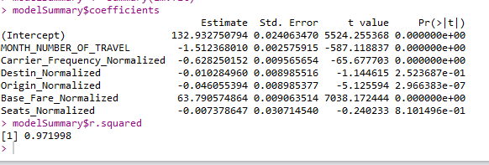
LINEAR REGRESSION
Linear regression model was used to find the relation between the features.
It was also used on prediction of the ticket fare
Training Data – 2015 Full Year
Test Data – 2016 Q1 and Q2
The prediction values were written to a csv to be used to enter into the database.

Slide 12
Neural Network
Neural Network was implemented using Microsoft Azure.
For the neural network, they give optimized results only on normalized or standardized data.
Parameters were set as the default values
Predicted the ticket Fare based on the model score with the 2016 data.

Slide 13
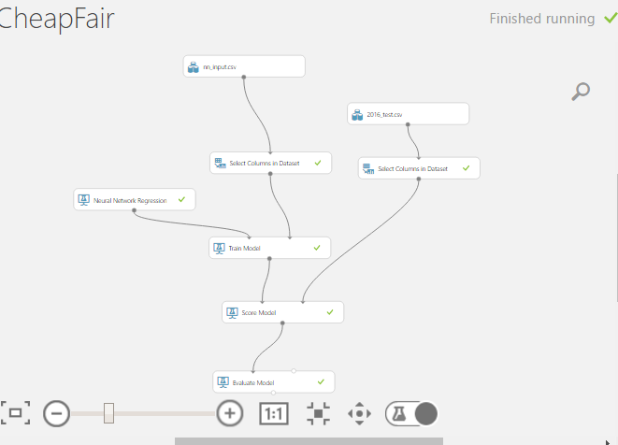
NEURAL NETWORK AZURE SETUP

Slide 14
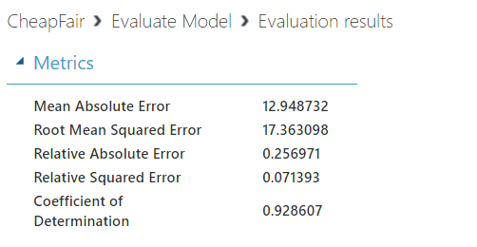
NEURAL NETWORK RESULTS

Slide 15
Hbase
If your application has a variable schema where each row is slightly different, then you should look at HBase.
When you can’t add columns fast enough and most of them are NULL in each row, you should consider HBase
If you need key based access to data when storing or retrieving, then you should consider HBase.

Slide 16
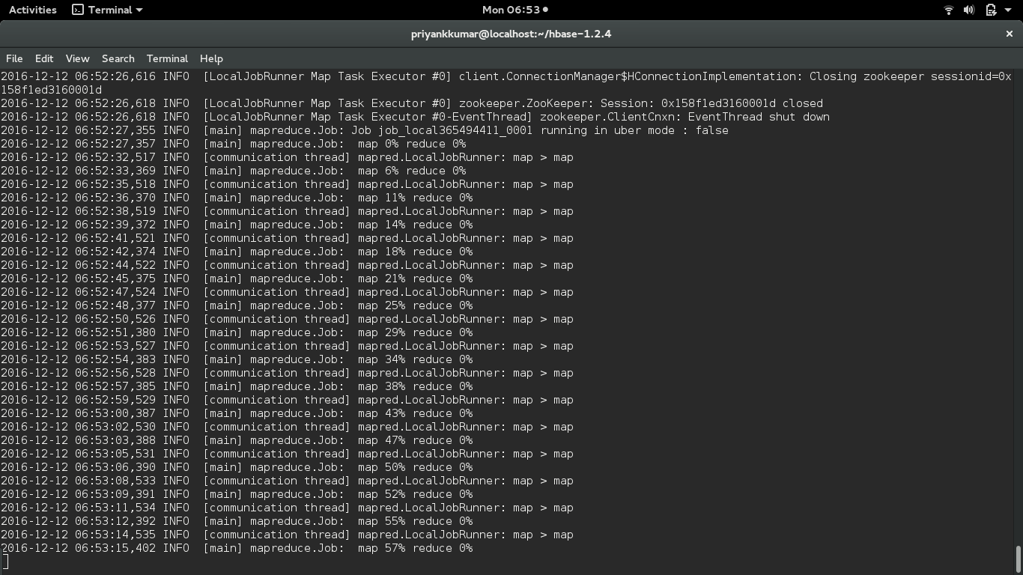
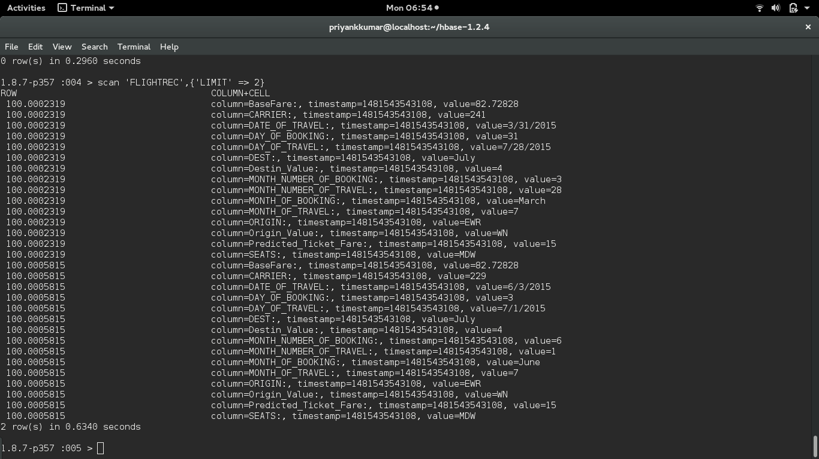
Bulk Load in Hbase

Slide 17
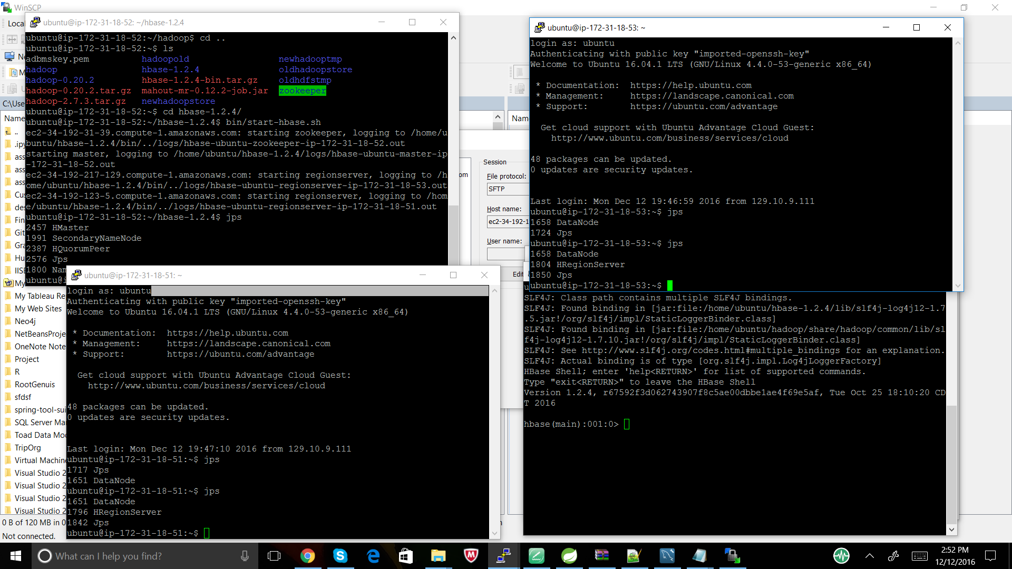
Hbase On AWS

Slide 18
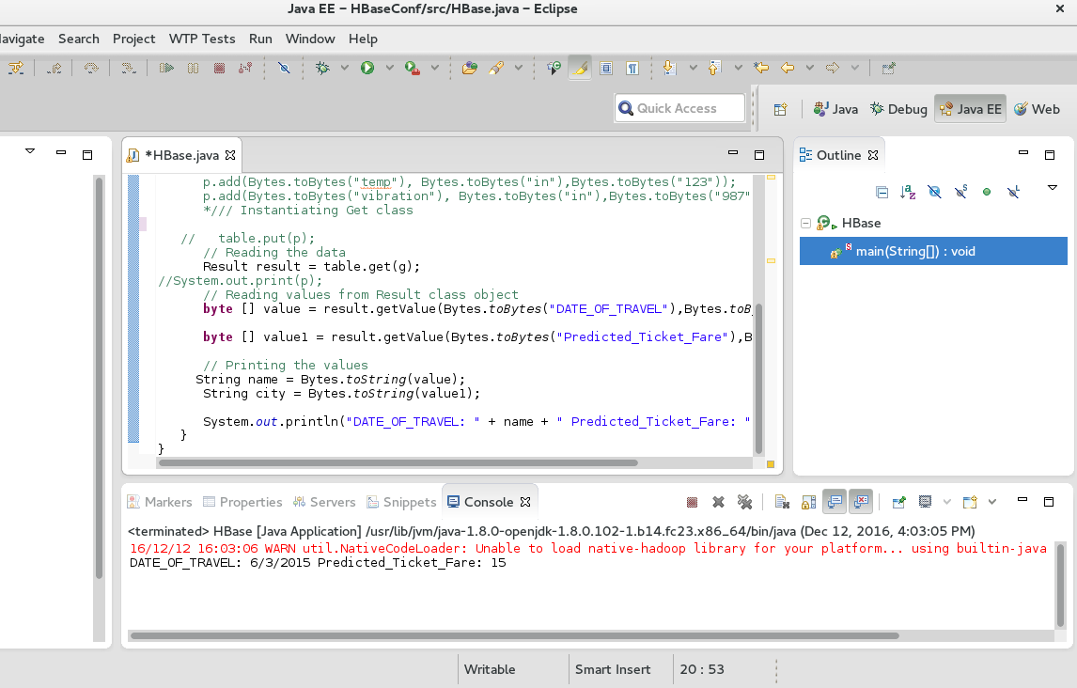
Data Fetch

Slide 19
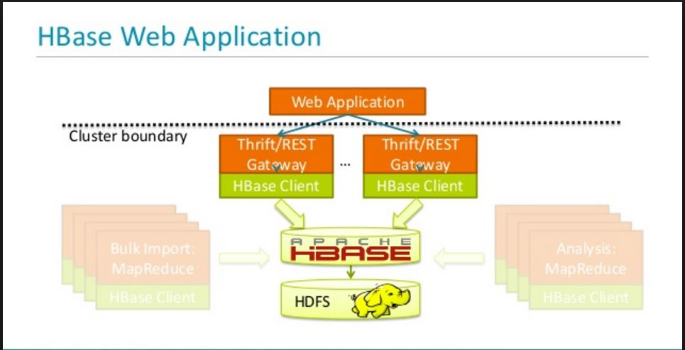
Web-App Architecture
There are many ways to access and interact with Hbase, Java provides most functionality. The two major approaches were
Thrift Interface ( light weight)
Rest Interface

Slide 20
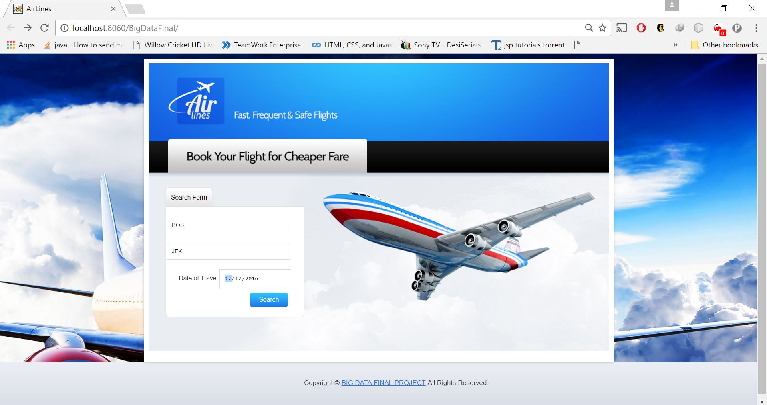
Home Page for User

Slide 21
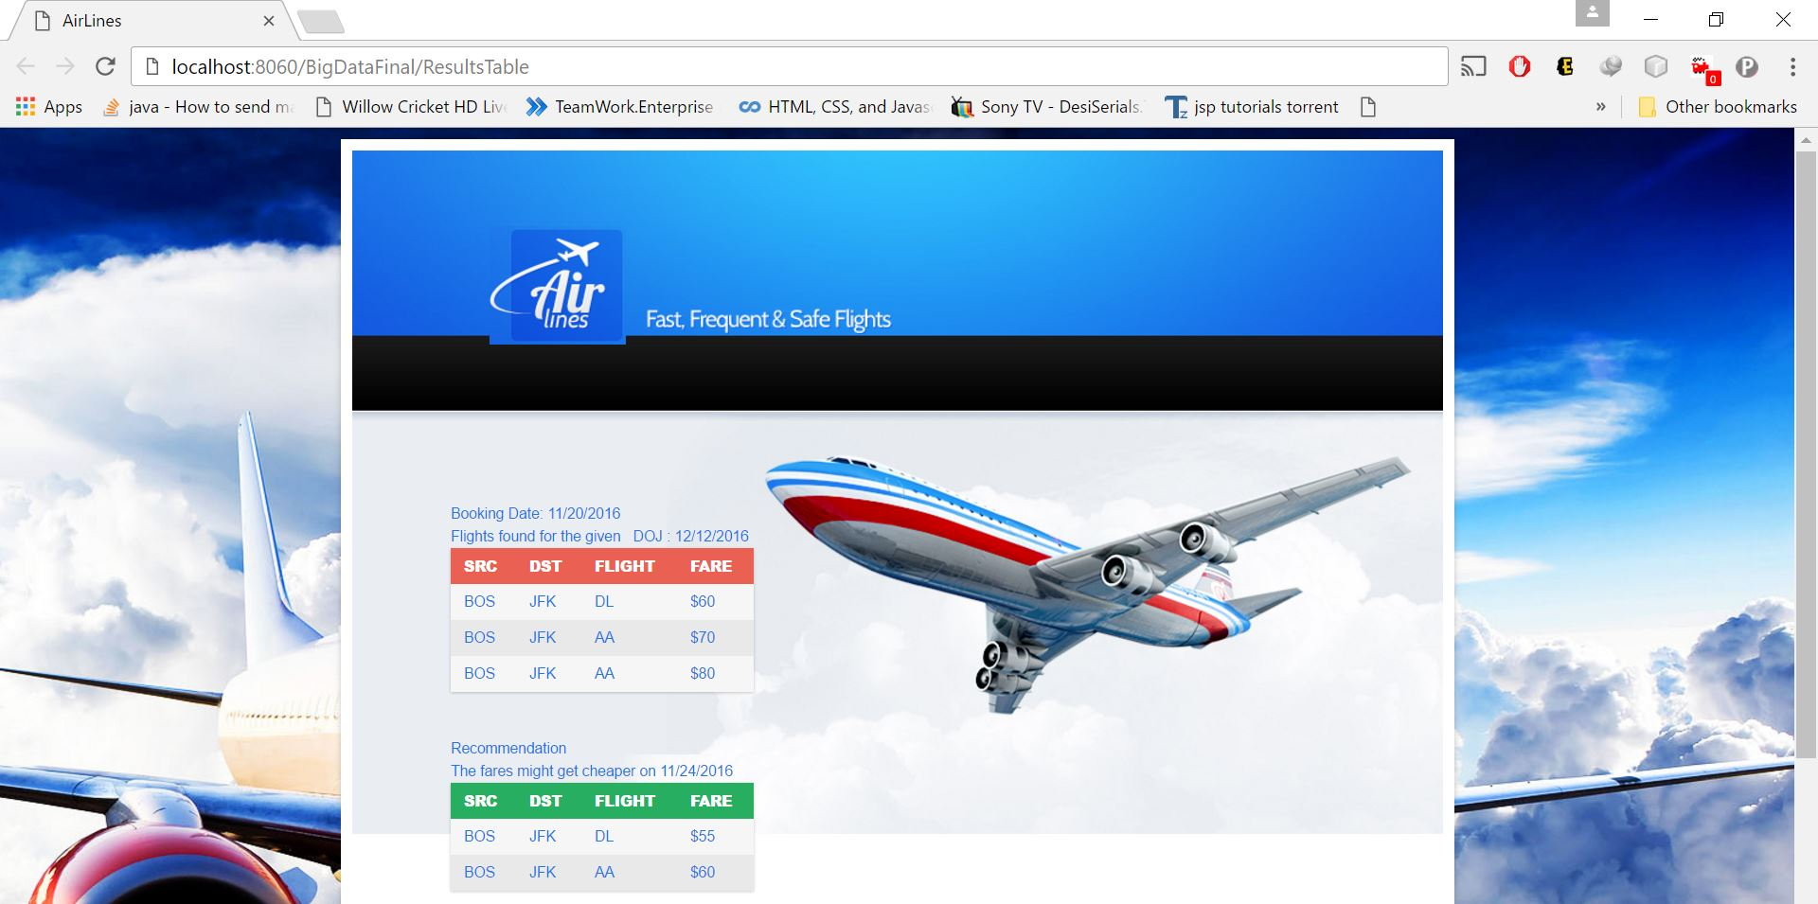
Results
Generic results for the user input
Recommendation

Slide 22
Challenges Faced
All the data was treated as categorical, was not sure if to perform 1-N encoding to make around 1000 columns.
Dataset was combined using multiple source files. The common join resulted in a number of Null and missing values which had to be handled.
Very difficult to narrow down which was is the best method for standardization.

Slide 23
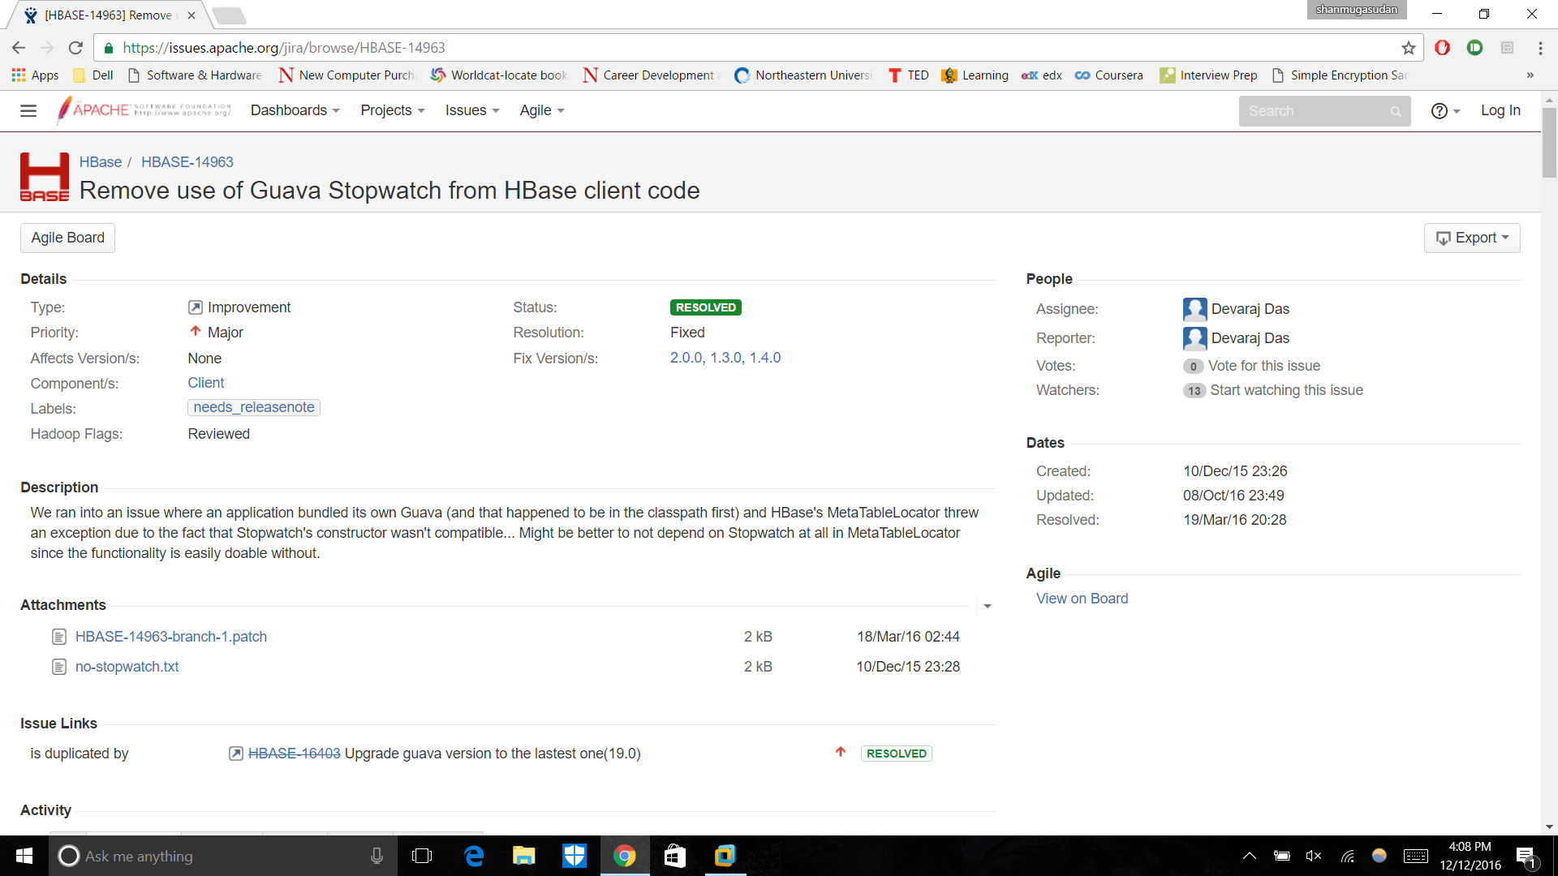
Challenges in HBASE with Drill

Slide 24
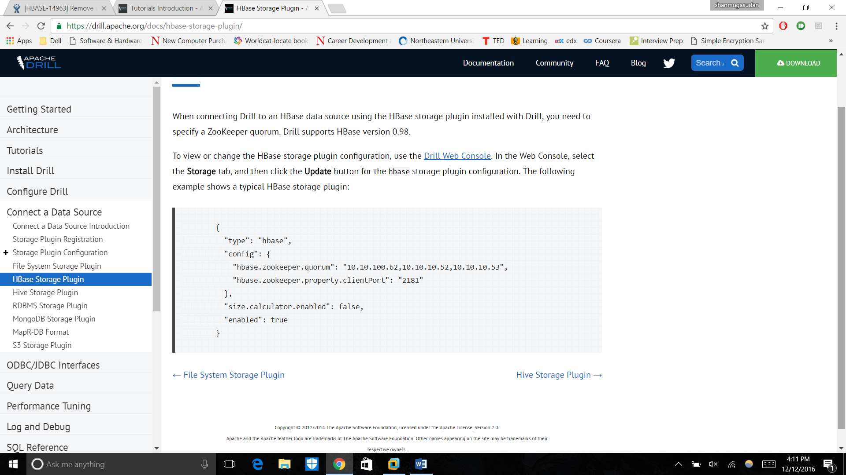
Connecting to web UI of Drill

Slide 25
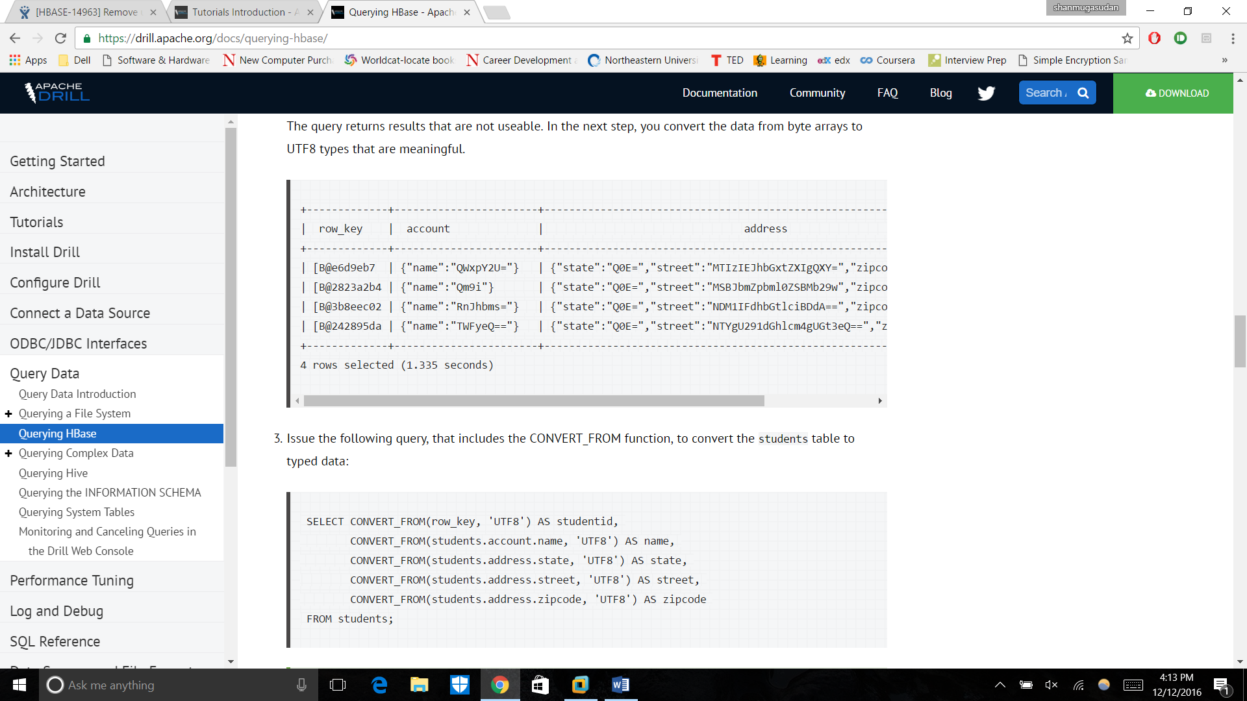
Querying on Drill

Slide 26
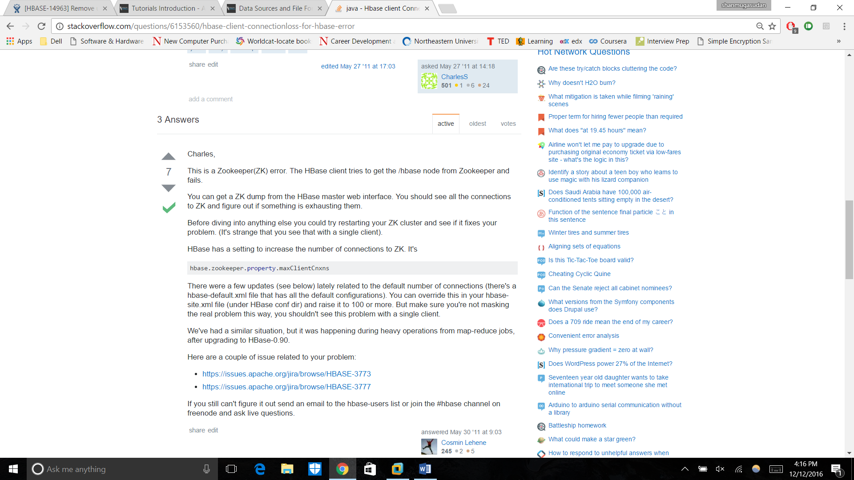
Zookeeper constraints and Connection Issues

Slide 27
FUTURE SCOPE
Integrating all airlines and storing historic data to get better prediction results.
Using Business intelligence to give graphical views on the data as it changes over time.

Slide 28
THANK YOU ☺

