Slide 1
MarketScope: Sales Dynamics Dashboard
Sales Performance Analysis by Region, Category & Segment
Presented by: Junjipelli Ajay

Slide 2
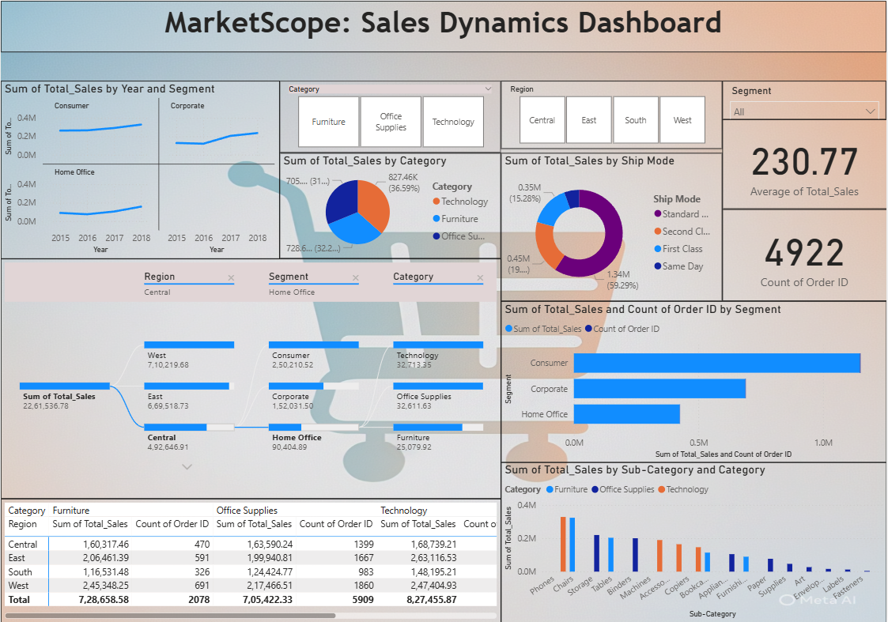

Slide 3
Overview of the Dashboard
Purpose: To analyze sales dynamics across categories, segments, and regions.
Key Metrics Displayed:
Total Sales and Order Count
Category & Segment Breakdown
Regional Performance Sales Trends (Year wise

Slide 4
Sales by Year and Segment
Trend observed from 2015 to 2018.
Corporate and Consumer segments show a steady increase.
Home Office also shows a moderate upward trend.

Slide 5
Category wise Sales Distribution
Technology leads with 36.59% of total sales.
Followed by Furniture and Office Supplies.
Visual: Pie Chart indicating relative contributions.

Slide 6
Ship Mode Analysis
Second Class dominates shipping with 59.29%.
Others include First Class, Standard Class, and Same Day.
Insight: Most customers prefer standard and economic delivery.

Slide 7
Regional Performance
West region is the top performer ( 7.1M sales).
Followed by East and South .
Central has the lowest regional sales.

Slide 8
Segment wise Sales and Orders
Consumer segment leads in both sales and order count.
Followed by Corporate and Home Office .
Bar chart shows strong correlation between sales volume and order count.

Slide 9
Category Performance by Region
Highest sales:
Furniture: West (2.45M) Office Supplies: West (2.17M)
Technology: West (2.47M) West region leads in all categories.

Slide 10
Sub Category Sales Breakdown
Top Performing Sub Categories: Phones, Chairs, Storage, Tables
Visual Insight: Technology products dominate high revenue sub categories.

Slide 11
Key Insights & Recommendations
Focus on high performing regions like West for strategic marketing. Increase investment in Technology sub categories.
Optimize shipping methods to balance cost and customer preference. Explore potential in Central region to boost underperformance.

