Slide 1
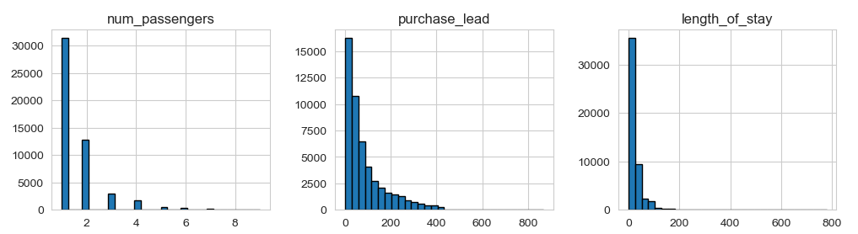
Here is the finding after complete analysis.
Numerical Feature Distributions.

Slide 2
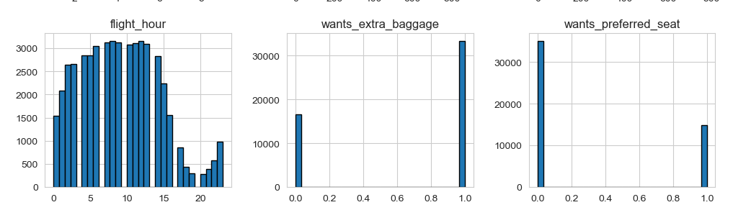
Numerical Feature Distributions.

Slide 3
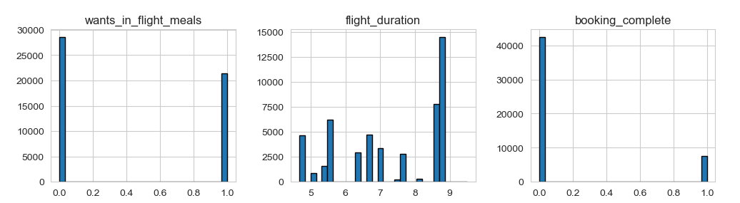
Numerical Feature Distributions.

Slide 4
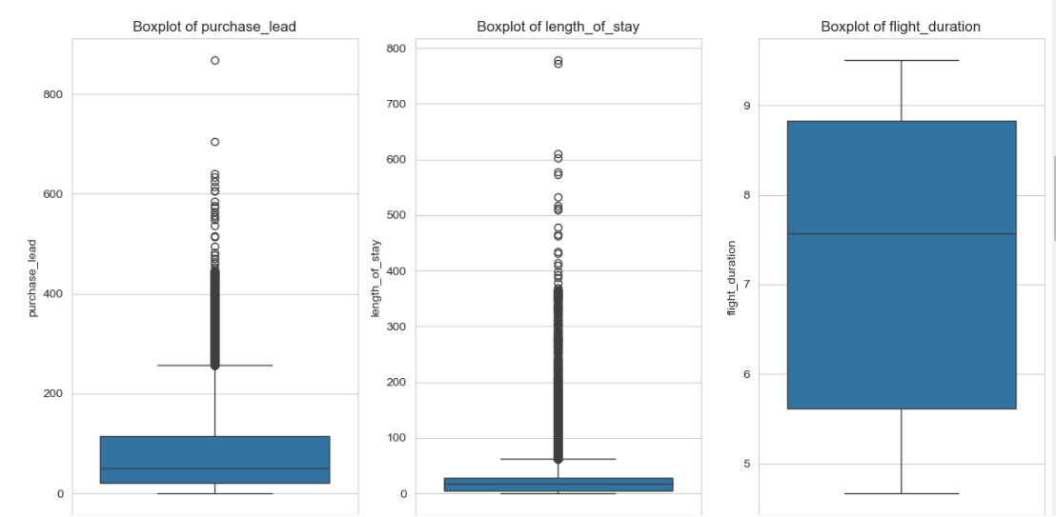
Numerical Feature Distributions.

Slide 5
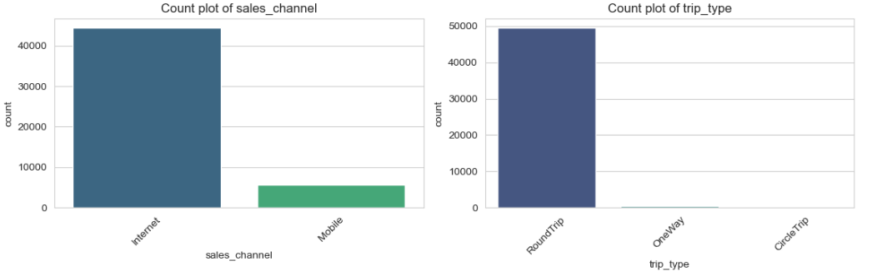
Numerical Feature Distributions.

Slide 6
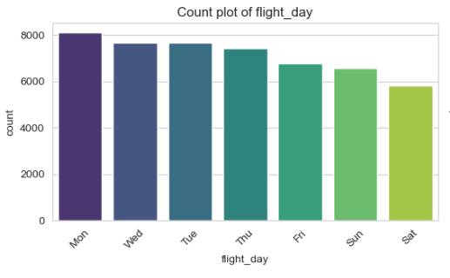
Numerical Feature Distributions.

Slide 7
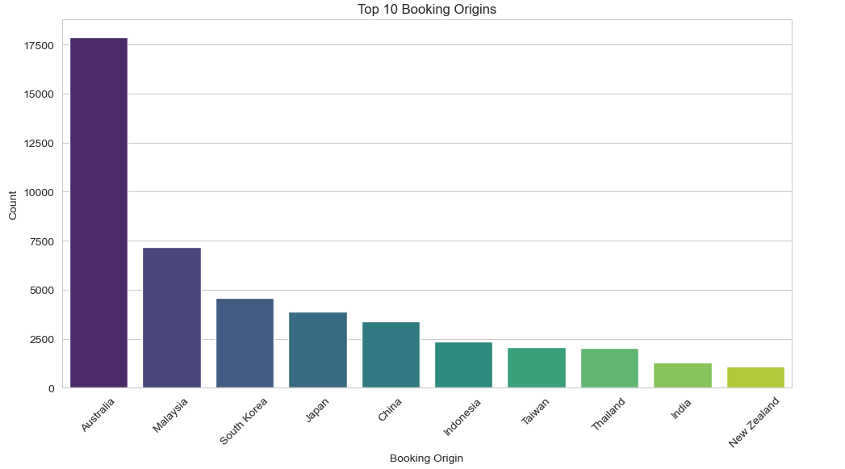
Numerical Feature Distributions.

Slide 8
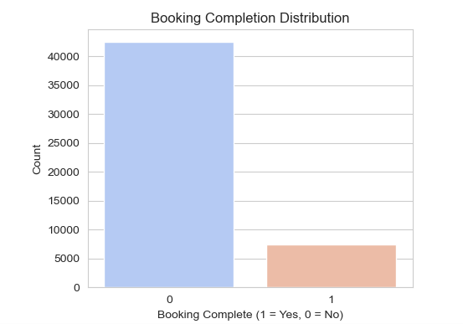
Numerical Feature Distributions.

Slide 9
RandomForestClassifier(random_state=42)
Accuracy: 0.8559
RandomForestClassifier(min_samples_leaf=2,
min_samples_split=5,
random_state=42)

Slide 10
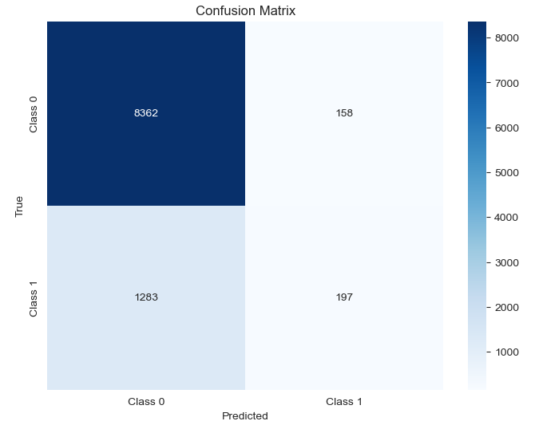
The confusion matrix

Slide 11
The confusion matrix
precision recall f1-score support
0 0.87 0.98 0.92 8520
1 0.55 0.13 0.21 1480
accuracy 0.86 10000
macro avg 0.71 0.56 0.57 10000
weighted avg 0.82 0.86 0.82 10000

Slide 12
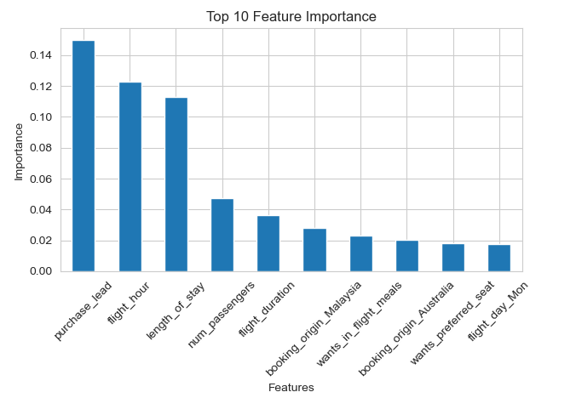
Top 10 Feature Importance

