Slide 1
Airline Review Insights
Total Reviews: 3,427
Total 5-star ratings across all categories: 2624

Slide 2
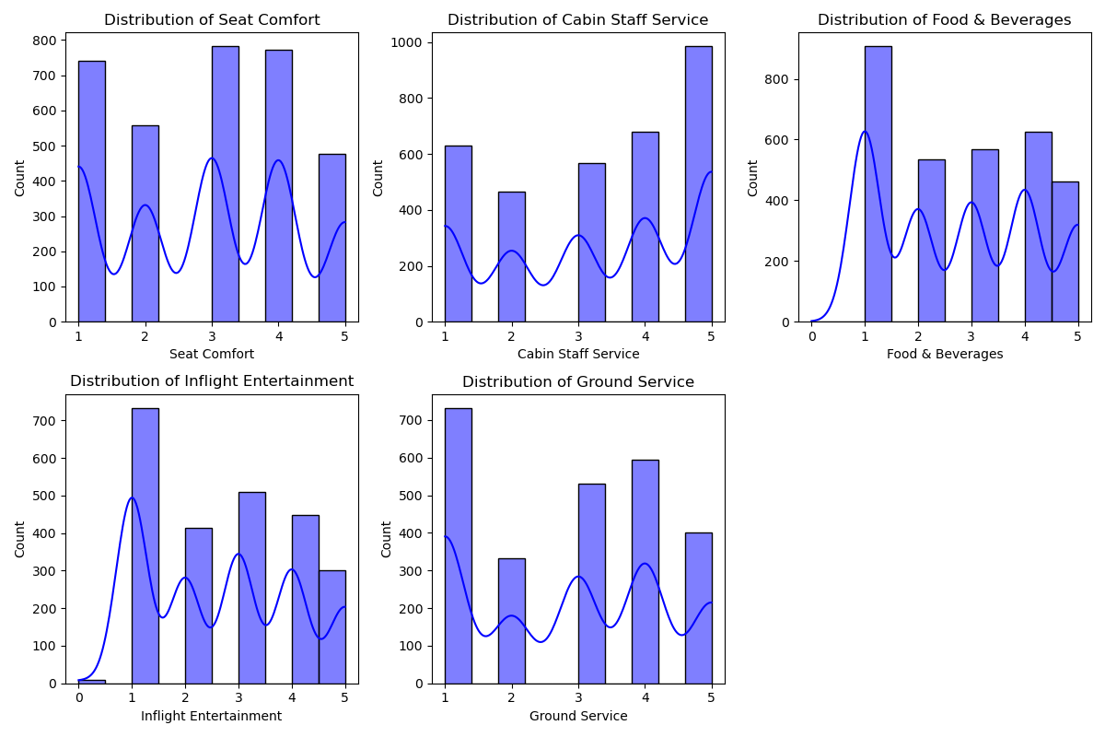
The distribution of each service rating

Slide 3
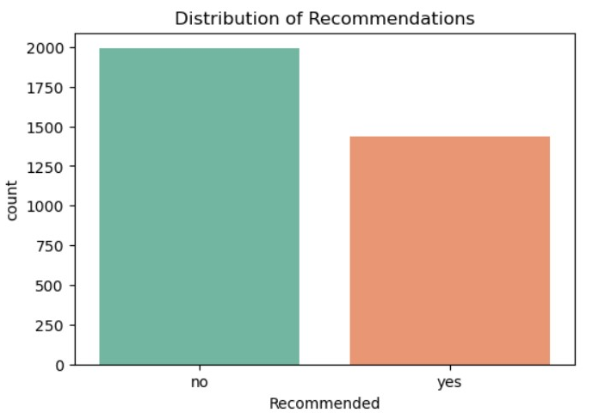
The relationship between the recommendation and the ratings

Slide 4
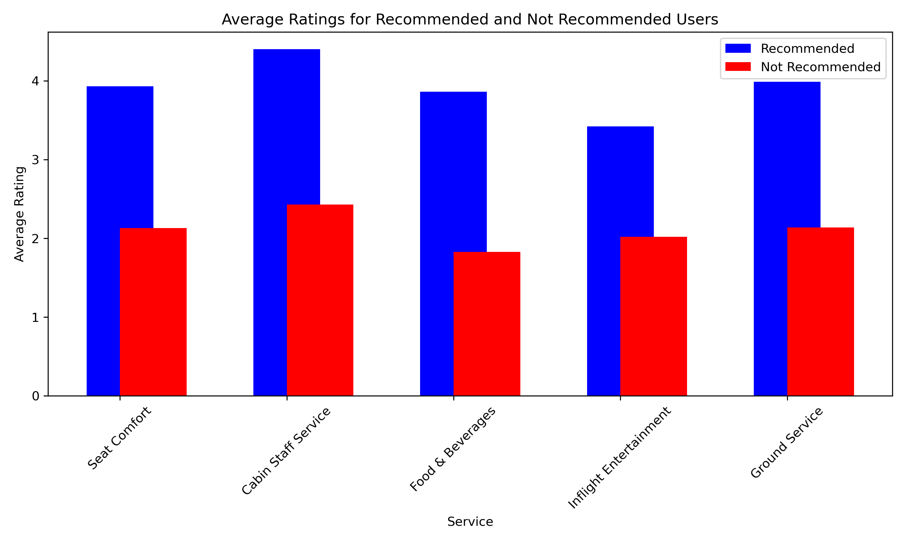
The Average Ratings for Recommended and Not Recommended Users

Slide 5
Average Ratings for Recommended and Not Recommended Users
Service | Recommended Users | Not Recommended Users
Ground Service | 3.99 | 2.14
Inflight Entertainment | 3.42 | 2.02
Cabin Staff Service | 4.40 | 2.43
Seat Comfort | 3.93 | 2.13
Food & Beverages | 3.86 | 1.83

