Slide 1
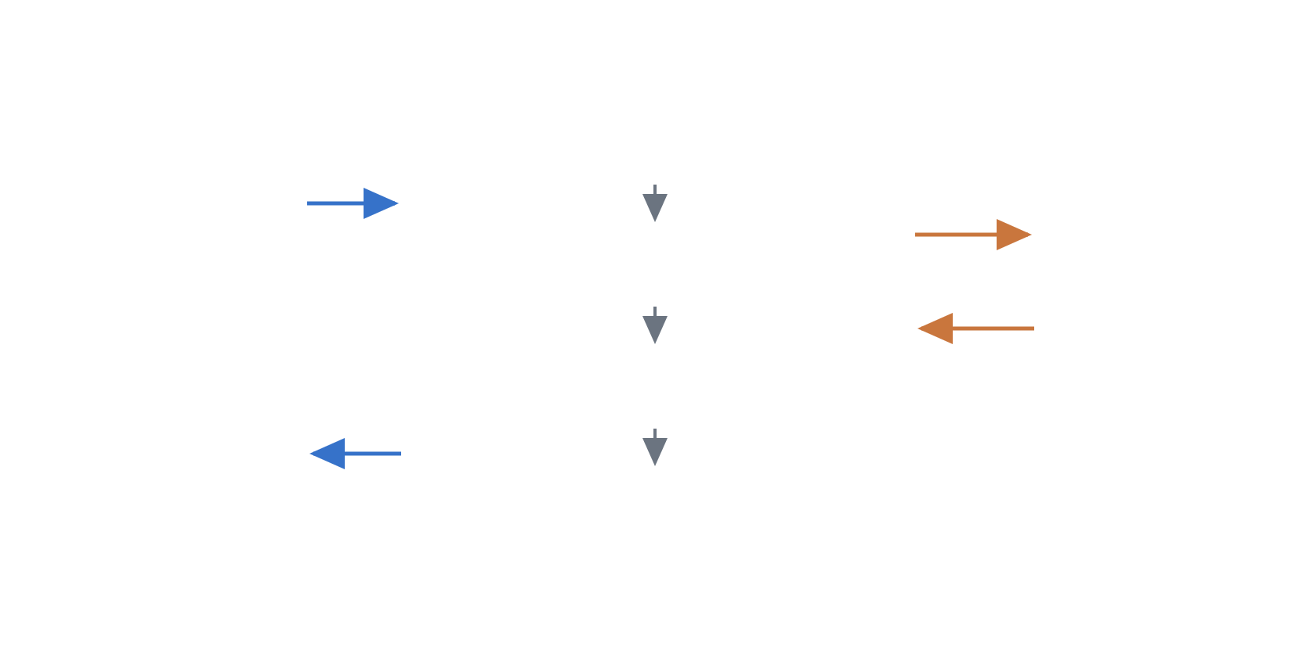
Engineering / Tools / jira-triage
Jira Defect Triage — Architecture Overview
Automated triage of new and updated Jira defects: duplicate detection, root-cause analysis, and write-back to Jira.
jira-triage is a single-process Python service that polls Jira for new or updated defects and triages each one automatically. For every defect it reads the details, comments, and screenshot attachments, checks the full defect corpus for duplicates, determines a likely root cause and suggested resolution, and logs everything back into Jira as a triage comment, labels, and a “Duplicate” issue link.
High-level architecture
jira-triage — Python service
Jira Cloud
JQL poll
Ingest
REST API v3
Poll JQL · fetch details, comments, attachments
evidence · candidates
OpenAI API
Defect issues, comments, screenshot attachments, labels, issue links
Analyze
GPT — vision + reasoning
Fuzzy duplicate ranking · vision on screenshots · root cause + fix
verdict · resolution
Screenshot analysis, duplicate confirmation, root cause + suggested fix
Write-back
comment · labels · link
Triage comment · labels · “Duplicate” link
config.yaml · .env · .triage_state.json
See the detailed component diagram for module-level structure: Jira Triage Architecture.
How a defect flows through the system
Poll — a JQL query finds new or updated defects; already-triaged and unchanged issues are skipped.
Extract evidence — screenshot attachments are analyzed with GPT vision.
Rank candidates — the defect is compared against the full corpus with fast fuzzy matching (rapidfuzz) to get top-K duplicate candidates.
Confirm & diagnose — GPT confirms duplicates, surfaces the past resolution if one exists, and proposes a root cause and suggested fix.
Write back — a triage comment, auto-triaged / auto-dup labels, and a “Duplicate” issue link are posted to Jira.
Components
main.py
Parses CLI flags (--once, --poll, --issues, --dry-run) and schedules triage cycles at the configured polling interval.
CLI entry point
engine.py
Coordinates the full pipeline per defect: fetch → analyze → decide → write-back. Honors dry-run mode by skipping all Jira writes.
Orchestrator
jira_client.py
Wraps Jira Cloud REST API v3: JQL search, downloading attachments, reading comments, and applying labels and issue links.
Jira integration
similarity.py
Fast fuzzy ranking (rapidfuzz) of the new defect against the entire defect corpus, producing top-K duplicate candidates for AI confirmation.
Duplicate retrieval
analyzer.py
All OpenAI API calls: vision analysis of screenshot attachments, duplicate confirmation against candidates, and root-cause + suggested-fix generation.
AI analysis
reporter.py
Formats the analysis results into the structured triage comment that gets posted back to the Jira issue.
Output formatting
state.py
Persists which issues were already triaged and when, so an issue is re-triaged only after it changes.
Processed-issue tracking
External systems & data files
Jira Cloud
Source of defects (issues, comments, attachments) and destination for triage output (comment, labels, duplicate link), via REST API v3.
External system
OpenAI API
GPT models provide vision (screenshot evidence extraction) and reasoning (duplicate verdicts, root cause, suggested resolution).
External system
config.yaml / .env
config.yaml holds JQL queries, thresholds, and label names; .env holds Jira and OpenAI credentials.
Configuration
.triage_state.json
Maps issue key → last-seen updated timestamp; the service's only persistent state.
Local state
Operational notes
Run modes — --once (single cycle), continuous polling (default), --issues KEY… (specific issues), and --dry-run (analyzes but writes nothing to Jira — recommended first run).
Idempotency — .triage_state.json tracks each issue's last-seen updated timestamp, and the auto-triaged label keeps processed issues out of the queue.
Configuration — project key, JQL queries, thresholds, and labels live in config.yaml; Jira and OpenAI credentials in .env.

