Slide 1
Manning School of Business
Enterprise Bank API / Middleware
Gap Analysis
ANDREW MEJIA, ASHIKA FNU, AJAY KUMAR BOLLA

Slide 2
PRESENTATION Agenda
01
INTRODUCTION & OVERVIEW
02
CURRENT ARCHITECTURE
03
Communicator Open Overview
04
VENDOR Overview /Recommendation
05
Bank Feedback/Insights
06
Communicator Open Gap Analysis
07
Conclusion / Action Items
Manning School of Business

Slide 3
Enterprise Bank API / Middleware Gap Analysis
Overview:
Enterprise Bank is working on a roadmap for their data architecture / infrastructure that will involve restructuring some of their integrations and taking on new vendors to assist in the planning and implementation.
As a first step, Enterprise Bank has enlisted the help of students from the Manning School of Business to help investigate potential vendors and present a gap analysis on Fiserv’s Communicator Open. The goal of this project is the provide Enterprise Bank with the knowledge and insights required to make meaningful decisions around their architecture, enabling them to provide additional value to their customers and improve efficiency of their operations.
Transition Note:
The topics covered in this presentation are high level, additional details and documentation will be available in the appendix and separately via documents shared by the Manning School of Business.

Slide 4
PRESENTATION Agenda
01
INTRODUCTION & OVERVIEW
02
CURRENT ARCHITECTURE
03
Communicator Open Overview
04
VENDOR Overview /Recommendation
05
Bank Feedback/Insights
06
Communicator Open Gap Analysis
07
Conclusion / Action Items
Manning School of Business

Slide 5
Enterprise Bank’s Current Data Architecture
Customer-Facing and Transactional Services
Operational and Strategic Functions
Core Middleware Infrastructure

Slide 6

Understanding Current Data Architecture
V
Core Middleware Infrastructure:
Customer-Facing and Transactional
Services:
Operational and Strategic Functions:
V
V
Financial & Risk Management: Financial health and risk tools.
Data Warehousing & BI: Storage and analysis systems for decision-making.
Fraud, AML Compliance: Fraud prevention & regulatory compliance
Content Management: Organizational document and content management.
Treasury Management: Liquidity and financial risk management.
Branch Automation: Technologies for branch operations efficiency.
Lending Solutions: Loan process support systems.
Core Middleware: Central integration system for banking services.
Notification: Specific middleware component for notifications.
Debit Solutions: Involving debit card services and related transaction processing.
IP and FOS: Item processing and Fiserv Output Solutions
Digital Channels: Encompasses online banking, mobile banking, and other digital customer interfaces.
Payment Solutions: Including Automated Clearing House (ACH) transactions, check processing, and wire transfers.

Slide 7
PRESENTATION Agenda
01
INTRODUCTION & OVERVIEW
02
CURRENT ARCHITECTURE
03
Communicator Open Overview
04
VENDOR Overview /Recommendation
05
Bank Feedback/Insights
06
Communicator Open Gap Analysis
07
Conclusion / Action Items
Manning School of Business

Slide 8
FISERV Communicator Open
OVERVIEW
Brief Description: Communicator Open from Fiserv, formerly Communicator Advantage, simplifies integration for financial institutions that use Fiserv account processing platforms, enabling them to customize their technology ecosystems, readily access third-party fintech capabilities and pursue open finance strategies.
Features & Functionality:
Normalized APIs: Enable 'once-and-done' integration, greatly simplifying access to third-party fintech solutions​​.
Sophisticated Technologies: APIs are cloud-native RESTful microservices, utilizing containerization, elastic orchestration, and an open-source framework infrastructure​​.
Industry-Specific Services and Standards: Compliance: Adheres to financial services industry standards and supports a wide range of banking functions​​.
Scalability & Capability: Processes billions of transactions annually with high accuracy, reliability, and millisecond response times​​.
Value add to banking Infrastructure:
Integration of Third-Party Innovations: Enables quick integration to leverage emerging opportunities and create distinctive products​​.
Enhanced Digital Experiences: Offers personalized, real-time, frictionless digital experiences for account holders​​.
Real-Time Analytics and Streamlined Processes: Facilitates relevant, real-time analytics for decision-makers and streamlines internal operations​​.
Extending IT Asset Value: Adds new capabilities to existing IT assets, helping execute the organization's unique vision​​.
Cost-Effectiveness: Utilizes reusable, out-of-the-box components that help meet business requirements and simplify complex integration needs​​.
Sources: Fiserv Communicator Open

Slide 9
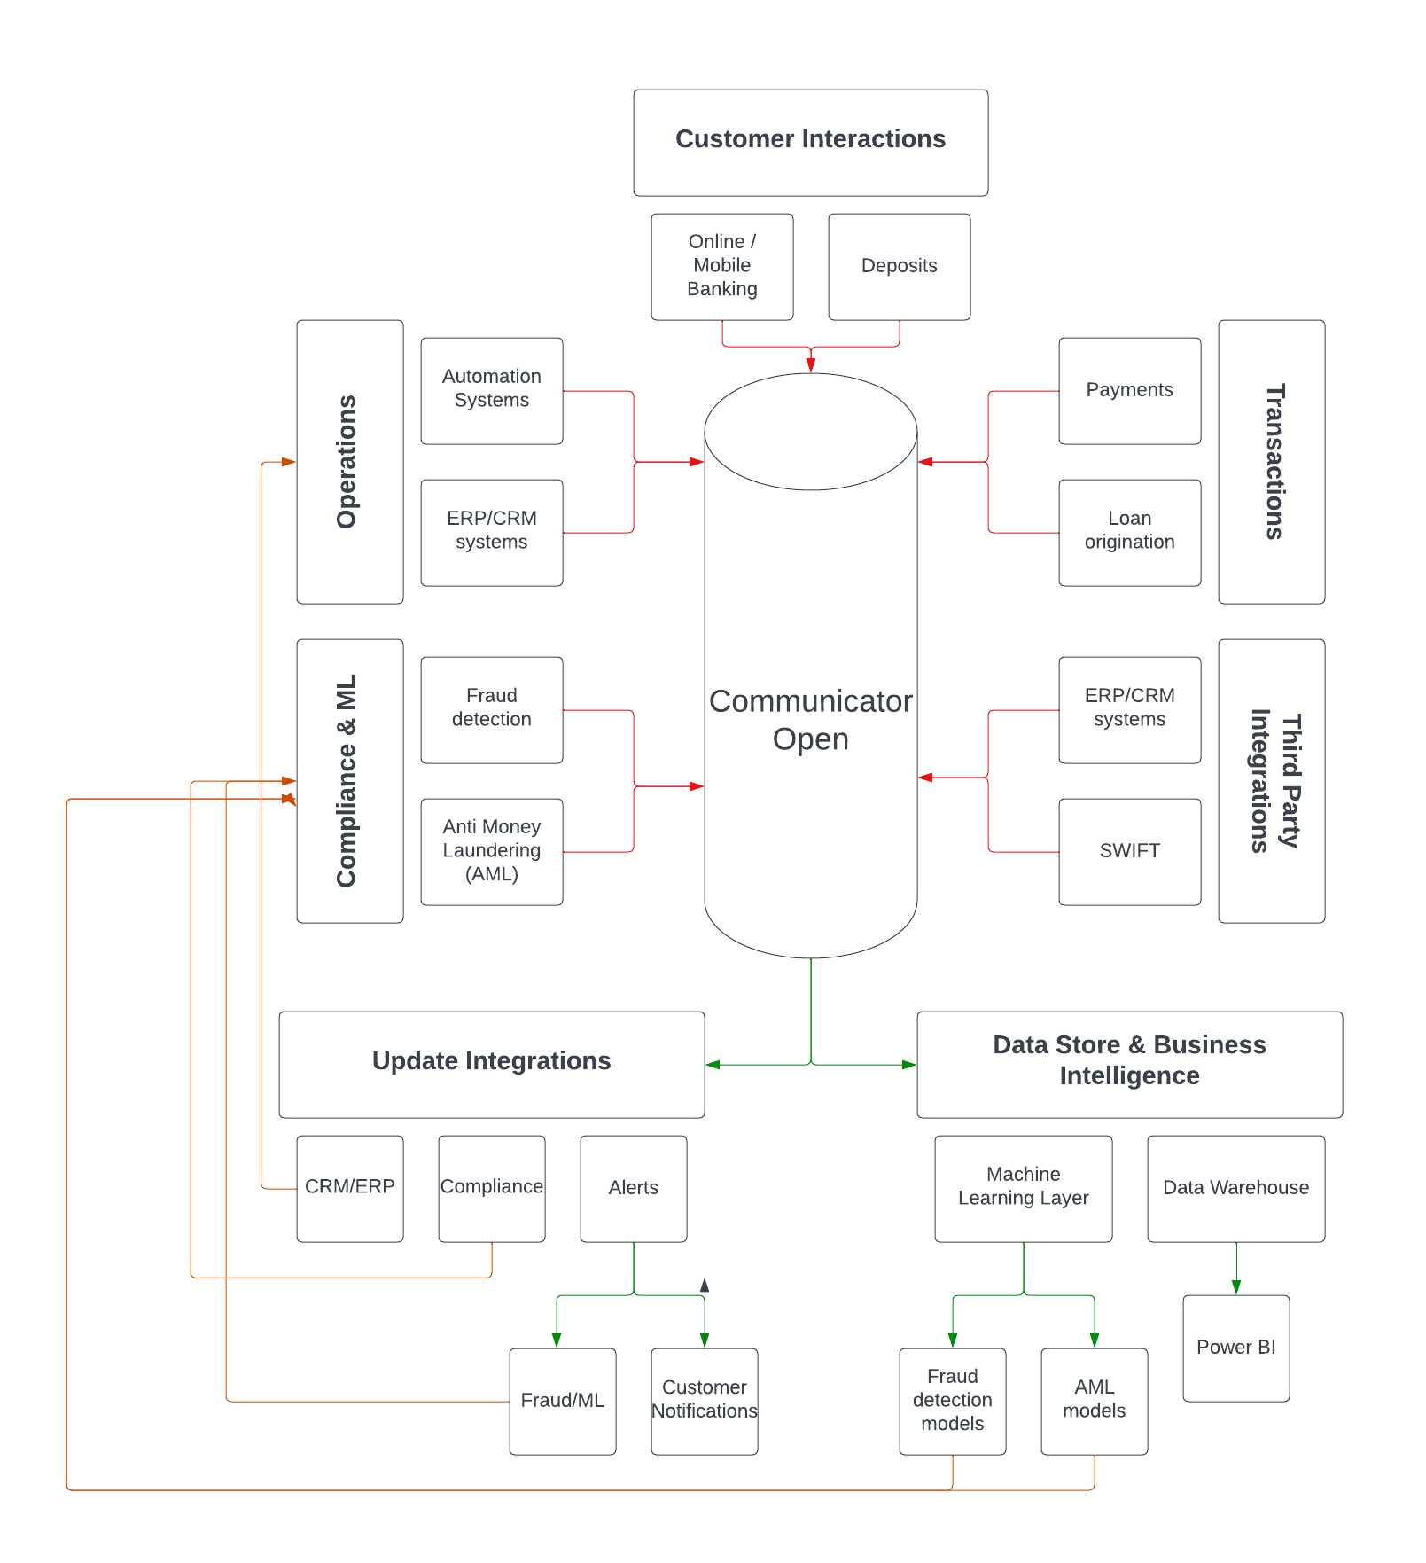
Fiserv Communicator open
Middleware architecture
Middleware Role:
Acts as an integrative bridge between diverse banking applications, facilitating seamless data and service flow.
Communicator Open Functionality:
Serves as middleware, connecting bank's core systems with operational and customer services.
Normalizes integrations with restful APIs.
Key Advantages:
Streamlines operations and reduced complexity.
Enhanced security and compliance with banking standards.
Simplification of architecture yields performance and maintenance gains.

Slide 10
PRESENTATION Agenda
01
INTRODUCTION & OVERVIEW
02
CURRENT ARCHITECTURE
03
Communicator Open Overview
04
VENDOR Overview /Recommendation
05
Bank Feedback/Insights
06
Communicator Open Gap Analysis
07
Conclusion / Action Items
Manning School of Business

Slide 11
Vendor Overview
Solution Vendors
Introduction: Solution vendors are specialized in providing integrated solutions, working directly on integration projects for banking technologies.
Vendor Highlights:
API PEOPLE: Expert in API managed services and middleware solutions, focusing on integrating various banking systems. Great feedback received from Banc of Cal
PORTX: Specializes in offering API managed services and middleware integration tailored for financial institutions.
Key Offerings:
These vendors excel in creating custom solutions for complex banking system integrations, ensuring seamless operation and connectivity.
Integration Expertise:
Have extensive experience offering integration services to banking and fintech customers, specifically those using the Fiserv suite of software.
Strategic Impact:
Their services are crucial for banks aiming to modernize their infrastructure and improve interoperability between different banking applications and services.

Slide 12
Vendor Recommendation
Solutions Vendor
Introduction: API PEOPLE has built a reputation for quality work, dependable support and managed services and expertise in banking industry, including Fiserv customers.
Why API PEOPLE?:
Proven Expertise: API People have extensive background working with Fiserv customers.
Positive Feedback: During our interviews with banks, we received very positive feedback about API People from Banc of Cal.
Customized Solutions: API People provides custom tailored solutions that involve through discovery phase to ensure quality implementation.
Key Strengths:
Fiserv integrations are API People’s core competency. They will work directly with Fiserv on implementing Communicator Open.
Platform agnostic, will work around Enterprise Bank’s integrations rather than requiring additional products or reintegration.
Strategic Advantage:
Beyond just integrations, API People also advises on best practices that will lead to cost effective, performant and reliable integrations.

Slide 13
Vendor Overview
API & Middleware Vendors
Introduction: API/Middleware vendors provide essential tools and platforms for connecting and managing data flow between various banking systems.
Vendor Highlights:
DENODO / Fiserv Open Data: Deliver a data virtualization platform for efficient data integration and management.
MULESOFT: Offers additional layer of abstraction in API architecture to improve integration implementation and maintenance.
JIFFY.AI: Specializes in automation solutions with a focus on AI and machine learning, enhancing middleware capabilities.
Key Features:
These vendors focus on scalable, secure API and middleware solutions that enable data normalization, real-time processing, and system integration.
Compatibility and Flexibility:
Designed to seamlessly integrate with a variety of banking systems and fintechs, ensuring adaptability and resilience in the rapidly evolving digital landscape.
Strategic Benefits:
Facilitate a more agile and interconnected banking ecosystem, paving the way for digital transformation and enhanced customer experiences.

Slide 14
Vendor Recommendation
API/Middleware Vendor
Introduction: MuleSoft provides a reliable, performant and user-friendly API layer that eases in development of integrations.
Why MuleSoft?:
Development : Their interface for development is user friendly, allowing for seamless integrations of new APIs.
Recommended: Highly recommended by other Banks, in addition to solution vendors we spoke to.
Scalability: Offers scalable solutions that adapt to banking's dynamic requirements.
Compatibility: Ensures seamless integration with a diverse range of fintech applications and systems.
Key Strengths:
Facilitates easy and secure data exchange between disparate systems.
Enables rapid development and deployment of new banking services.
Strategic Benefit:
Opting for MuleSoft means investing in a future-proof infrastructure, capable of evolving with technological advancements and customer expectations. MuleSoft is parented by Salesforce, so has Enterprise quality and reliability.

Slide 15
PRESENTATION Agenda
01
INTRODUCTION & OVERVIEW
02
CURRENT ARCHITECTURE
03
Communicator Open Overview
04
VENDOR Overview /Recommendation
05
Bank Feedback/Insights
06
Communicator Open Gap Analysis
07
Conclusion / Action Items
Manning School of Business

Slide 16
Bank Insights
Insights from interviews with banks
Bank of Tampa (BoT):
Initially sought more autonomy from Fiserv.
Valued Communicator Open for its middleware capabilities and third-party integrations, notably with Microsoft Dynamics CRM.
Partnered with Clarim and MuleSoft for integration, citing the high quality and ease of use​​​​.
Banc of Cal:
Needed cloud-compatible solutions, leading to the adoption of Communicator Open.
Appreciated the shift from SOAP to RESTful APIs, enhancing their cloud-based operations.
Overcame initial integration challenges by partnering with API People, leveraging their expertise for smoother implementation and scalable API structures​​​​.

Slide 17
Bank Recommendations
Recommendations from interviews with banks
Recommendations from Bank of Tampa:
Consider independent integrators like Clarim for more control over technology implementations.
Invest in robust middleware solutions like MuleSoft for quality and ease of use.
Leverage Communicator Open to reduce reliance on a single vendor and enhance third-party integrations.
Recommendations from Banc of California:
For cloud-based banking operations, embrace the RESTful nature of Communicator Open for efficiency and modern integration.
Partner with solution vendors like API People to overcome integration challenges and establish reusable API structures.
Implement robust security and governance measures around Communicator Open to ensure data security and compliance.

Slide 18
PRESENTATION Agenda
01
INTRODUCTION & OVERVIEW
02
CURRENT ARCHITECTURE
03
Communicator Open Overview
04
VENDOR Overview /Recommendation
05
Bank Feedback/Insights
06
Communicator Open Gap Analysis
07
Conclusion / Action Items
Manning School of Business

Slide 19
Communicator Open Gap Analysis
Integration and Data processing
Integration Complexity:
Current State: Enterprise Bank’s current architecture has old integrations that don’t easily integrate with each other easily and use outdated standards (S.O.A.P. APIs).
Challenges: The current architecture is difficult to implement new integrations on due to its complexity. This slows down Enterprise Bank’s ability to deliver features and improvements to their customers.
Communicator Open Benefits: Offers a centralized integration hub, simplifying connections between systems and reducing complexity.
Data Processing Efficiency:
Current State: Existing systems struggle with real-time data processing, leading to delays in critical banking operations.
Challenges: Impacts customer service responsiveness, risk management, and timely decision-making.
Communicator Open Benefits: Enables real-time data processing and analysis, significantly improving operational efficiency and decision-making speed.
Strategic Gaps:
Certain processes require different tools to operate. To change a customer’s address, employees need to use a different tool rather than their CRM (Dynamics)
Communicator Open can unlock seamless integrations that allow employees to handle everything from within their CRM.

Slide 20
Communicator Open Gap Analysis
Third-Party Integration and Customer Experience
Third-Party Integration:
Current State: Limited capability in integrating with modern fintech services, hindering innovation and expansion.
Challenges: Creating new integrations with third-party systems is time consuming and largely outside of the skillset of Enterprise Bank’s developers.
Communicator Open Benefits: Create seamless integration with a wide range of fintech services. Facilitates maintenance of those integrations.
Customer Experience Enhancement:
Overcoming Gaps:

Slide 21
PRESENTATION Agenda
01
INTRODUCTION & OVERVIEW
02
CURRENT ARCHITECTURE
03
Communicator Open Overview
04
VENDOR Overview /Recommendation
05
Bank Feedback/Insights
06
Communicator Open Gap Analysis
07
Conclusion / Action Items
Manning School of Business

Slide 22
Communicator Open Gap Analysis
Summary and Next Steps
Gap Analysis Summary:
Integration Gaps: Identified a significant need for streamlined integration across banking systems to reduce complexity and maintenance costs.
Data Processing and Real-time Analytics: Identified the need for real-time data processing capabilities to improve operational efficiency and decision-making.
Third-Party Integrations: Identified the importance of flexible third-party integration to embrace fintech innovations and competitive services."
Customer Experience : Identified the need for a unified customer data approach to deliver personalized and seamless banking experiences.
Strategic Implications:
The gaps identified present an opportunity for operational and strategic change in Enterprise Bank’s technology ecosystem.
Adopting Communicator Open addresses these gaps and future proofs Enterprise Bank’s architecture to minimize gaps in the future.
Next Steps:
The next step involves developing a detailed request for proposal template Enterprise Bank to use when engaging with Vendor’s outlined above. These templates will be influenced by the insights from this gap analysis.
PowerBI dashboard will be shared with the Enterprise Bank team with more detailed information about the Vendors outlined above.

