Slide 1
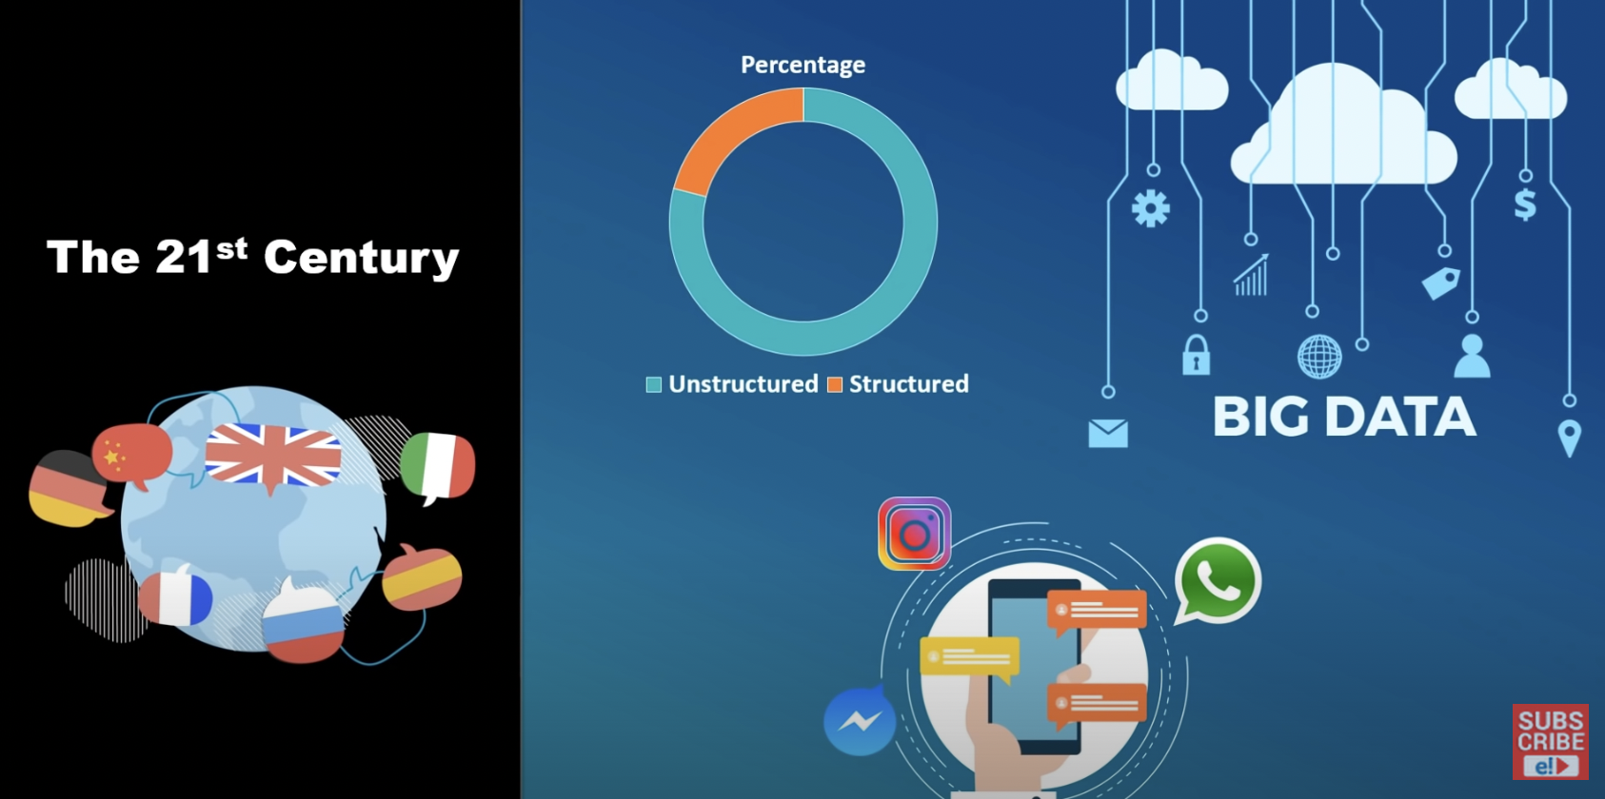

Slide 2
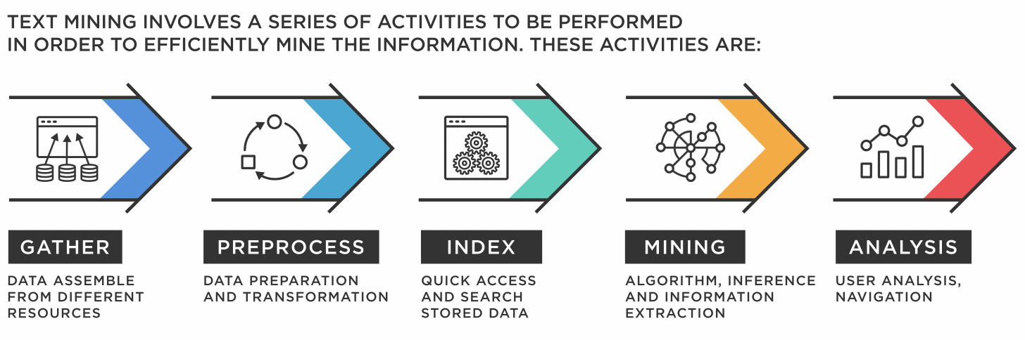
Text Mining

Slide 3
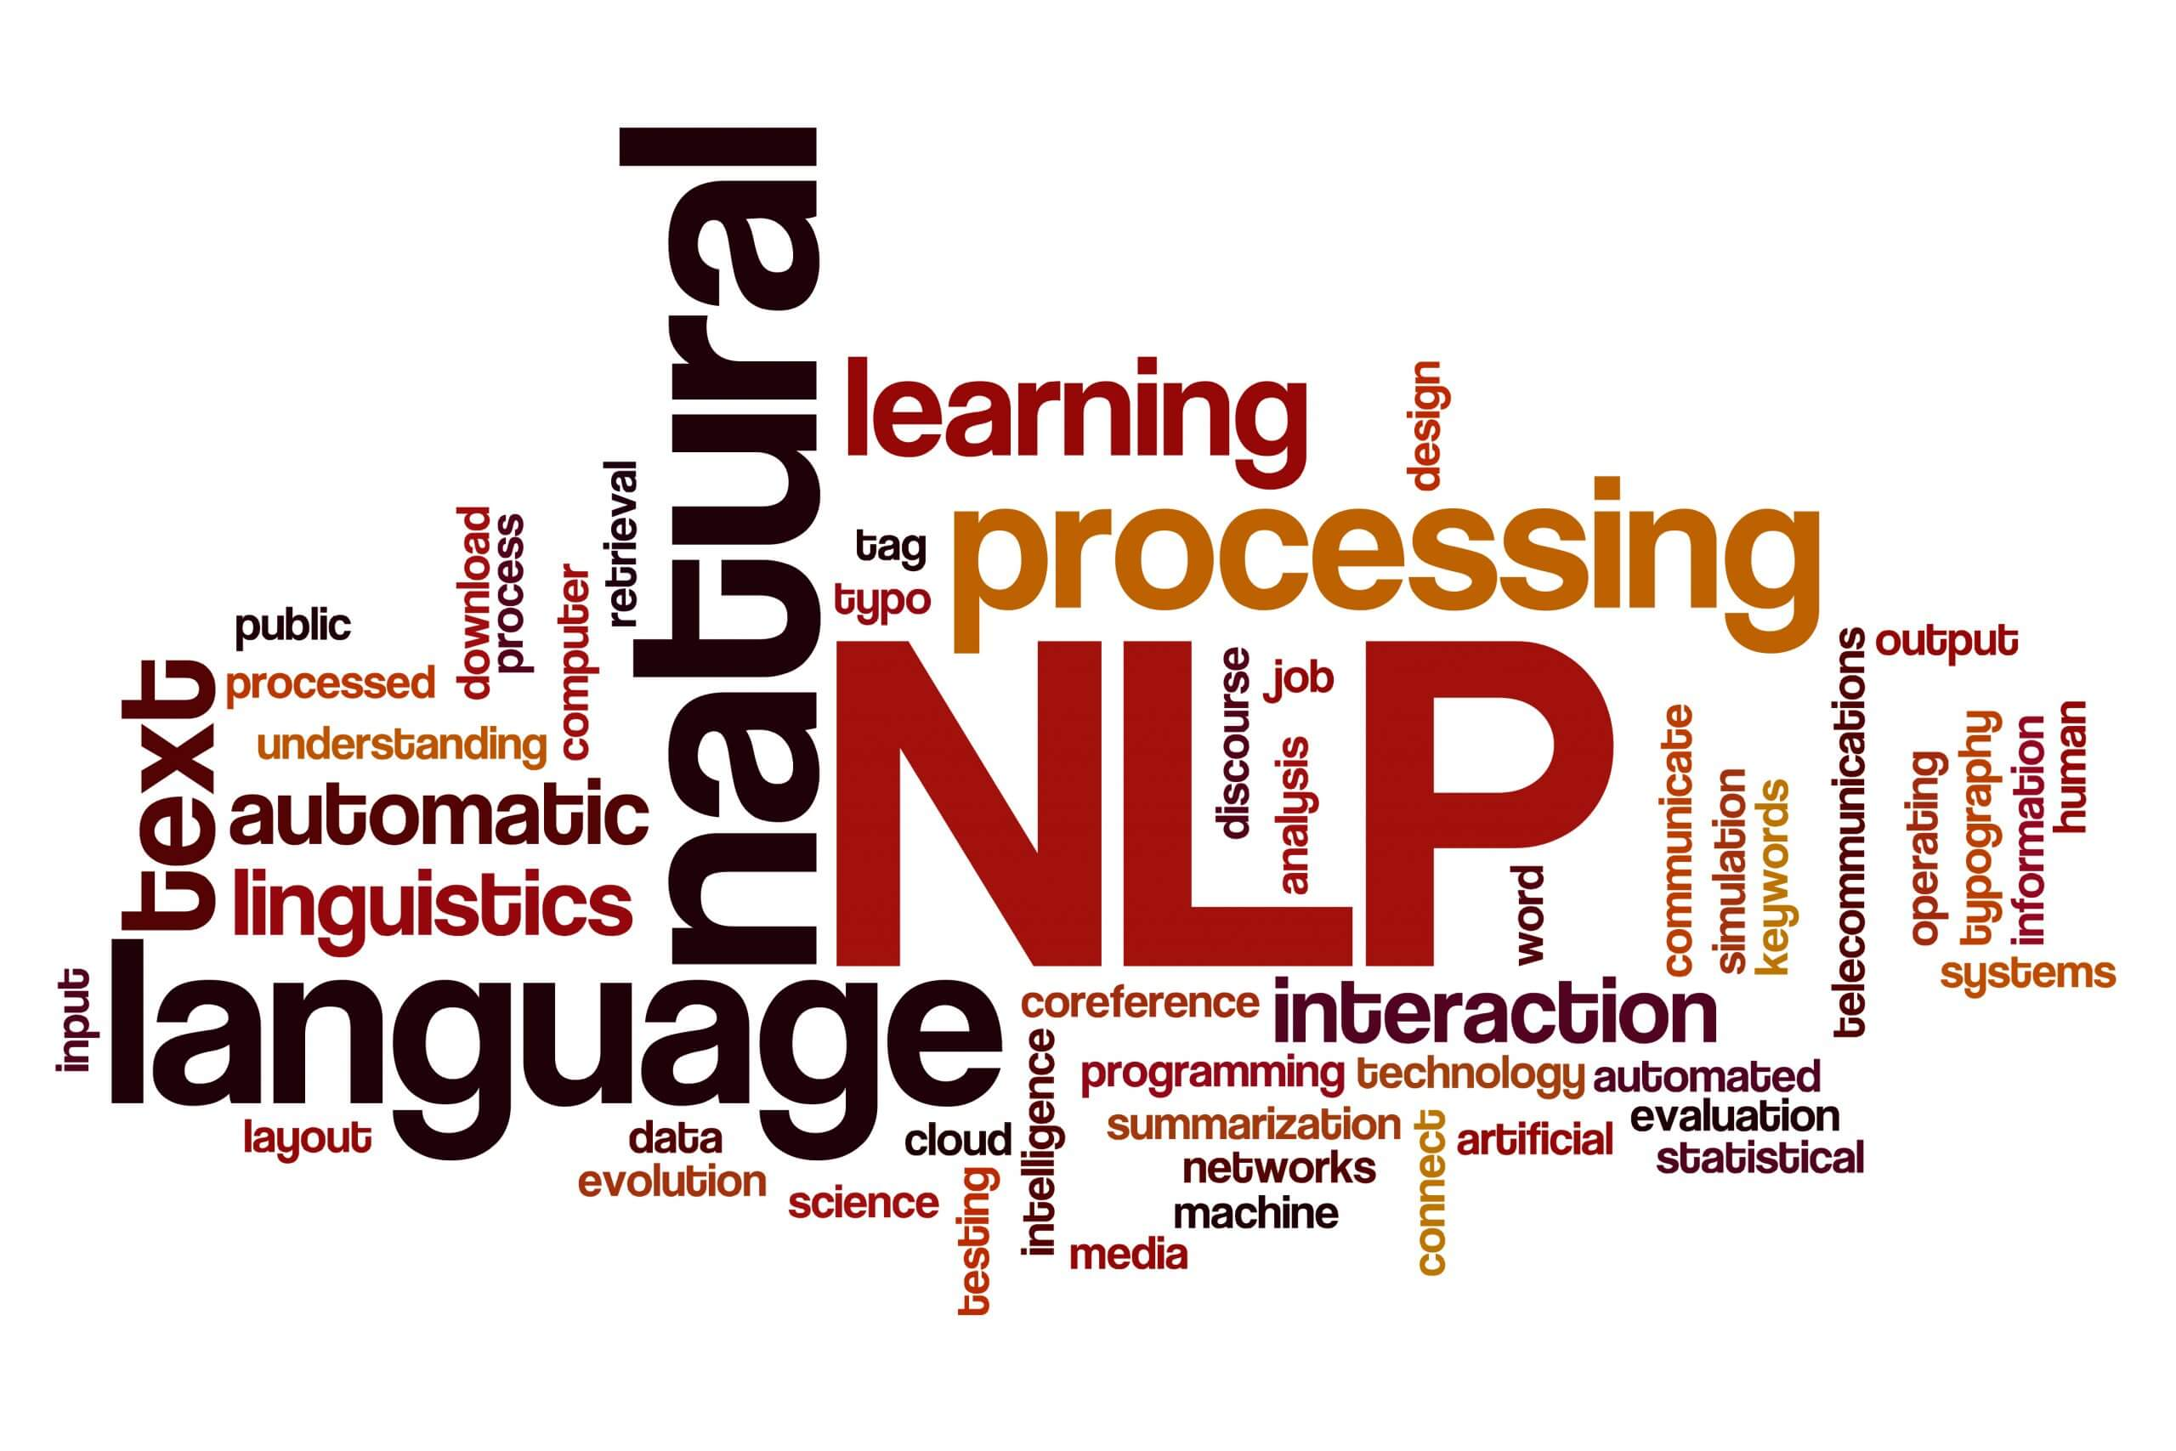
Natural Language Processing

Slide 4
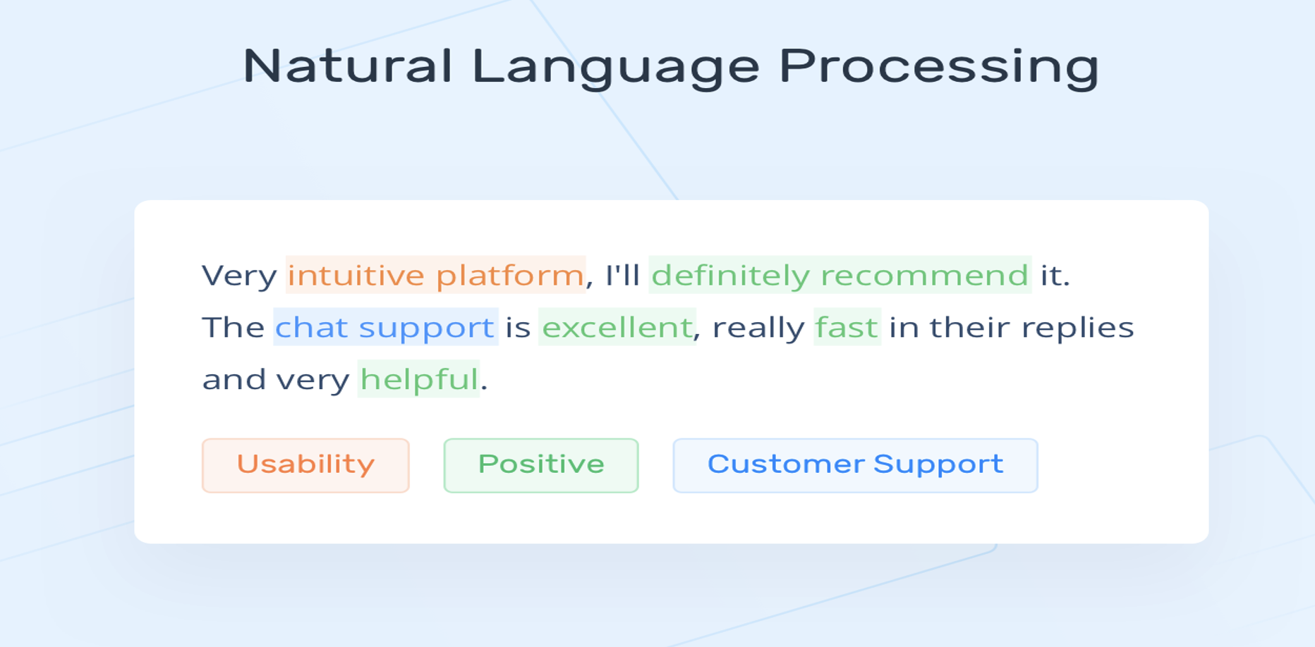

Slide 5
Components of Natural Language Processing
NLP
Natural Language Understanding
Natural Language Generation

Slide 6
Natural Language Understanding
Focuses on a machine’s ability to understand the human language. NLU refers to how unstructured data is rearranged so that machines may “understand” and analyze it.
Automatic Ticket Routing - With text analysis solutions like MonkeyLearn, machines can understand the content of customer support tickets and route them to the correct departments without employees having to open every single ticket. Not only does this save customer support teams hundreds of hours, but it also helps them prioritize urgent tickets.
Machine Translation (MT) - Accurately translating text or speech from one language to another is one of the toughest challenges of natural language processing and natural language understanding.Using complex algorithms that rely on linguistic rules and AI machine training, Google Translate, Microsoft Translator, and Facebook Translation have become leaders in the field of “generic” language translation.
Question Answering - is a subfield of NLP and speech recognition that uses NLU to help computers automatically understand natural language questions.
Sentiment Analysis - is the most common text classification tool that analyses an incoming message and tells whether the underlying sentiment is positive, negative our neutral

Slide 7
Natural Language Generation(NLG)
Natural language generation (NLG) is the use of artificial intelligence (AI) programming to produce written or spoken narratives from a data set.
Generating the responses of chatbots and voice assistants such as Google's Alexa and Apple's Siri
Converting financial reports and other types of business data into easily understood content for employees and customers
Automating lead nurturing email, messaging and chat responses
Personalizing responses to customer emails and messages
Aggregating and summarizing news reports

Slide 8
Different Parts of NLP
Lexical Analysis
Syntactic Analysis
Semantic Analysis
It involves analysis of words in the sentence for grammar and arranging words in a manner that shows the relationship among the words. The sentence such as “The school goes to boy” is rejected by English syntactic analyzer.
It draws the exact meaning or the dictionary meaning from the text. The text is checked for meaningfulness. It is done by mapping syntactic structures and objects in the task domain. The semantic analyzer disregards sentence such as “hot ice-cream”.
The meaning of any sentence depends upon the meaning of the sentence just before it. In addition, it also brings about the meaning of immediately succeeding sentence.
Discourse Integration
Pragmatics is the study of how words are used, or the study of signs and symbols. An example of pragmatics is how the same word can have different meanings in different settings. An example of pragmatics is the study of how people react to different symbols.
Pragmatic Analysis
It involves identifying and analyzing the structure of words. Lexicon of a language means the collection of words and phrases in a language. Lexical analysis is dividing the whole chunk of txt into paragraphs, sentences, and words.

Slide 9
Important Terms Used in NLP
Stop words
Corpus
Named Entity Recognition
The process of locating and classifying elements in text into predefined categories such as the names of people, organizations, places, monetary values, percentages, etc.
A set of commonly used words in a language. Examples of stop words in English are “a”, “the”, “is”, “are” and etc. Stop words are commonly used in Text Mining and Natural Language Processing (NLP) to eliminate words that are so commonly used that they carry very little useful information
Large collection of documents that can be used to infer and validate linguistic rules, as well as to do statistical analysis and hypothesis testing.
N-grams
Continuous sequences of words or symbols or tokens in a document. Type of n-gram Generated n-grams.
Unigrams – [“I”,reside”]
Bigrams - [“I reside”,”reside in”,”in Bengaluru”]
Trigrams - [“I reside in”, “reside in Bengaluru”]
Tokenization
Tokens are the building blocks of Natural Language. Tokenization is a way of separating a piece of text into smaller units called tokens. Here, tokens can be either words, characters, or subwords

Slide 10
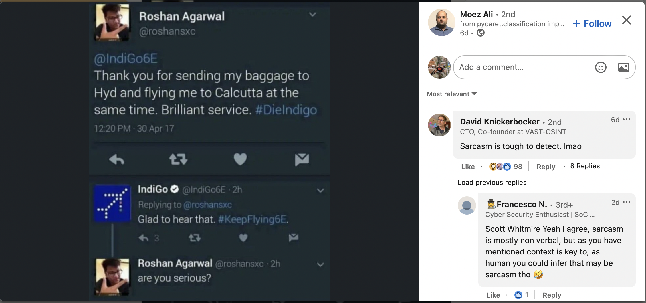
Sarcasm went wrong

Slide 11
Thank you for your attention

