Slide 1
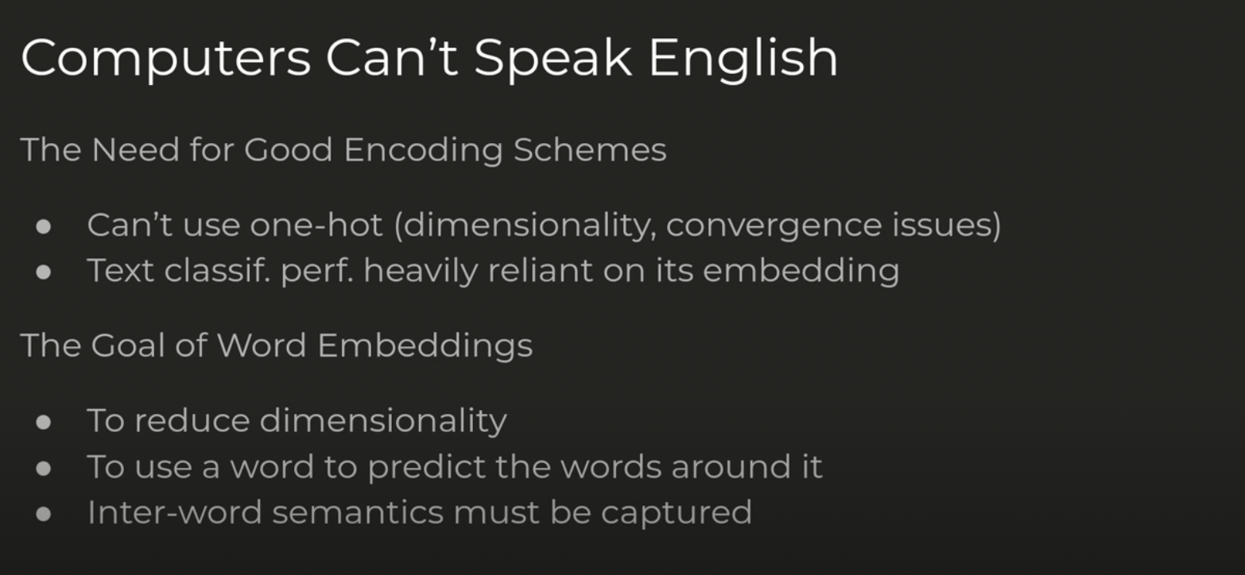

Slide 2
GloVe

Slide 3
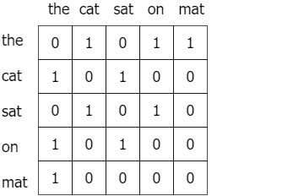
GloVe method is built on an important idea, You can derive semantic relationships between words from the co-occurrence matrix. Given a corpus having V words, the co-occurrence matrix X will be a V x V matrix, where the i th row and j th column of X, X_ij denotes how many times word i has co-occurred with word j. An example co-occurrence matrix might look as follows.
The co-occurrence matrix for the sentence “the cat sat on the mat” with a window size of 1

Slide 4
