Slide 1
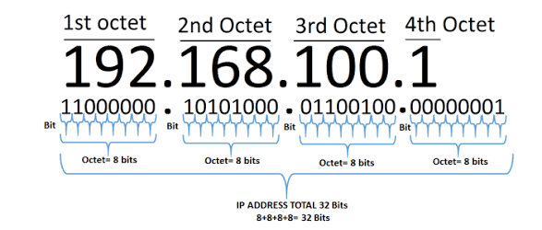
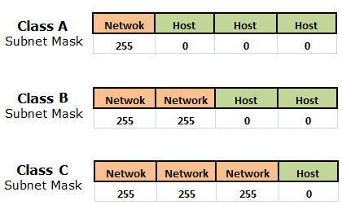



IPv4 ADDRESSING and SUBNETTING
Each IPv4 address is 32 bit and represented in decimal format in 4 octets. Each octet has 8 bits.
DECIMAL TO BINARY CONVERSION
Example 1: Covert decimal 192 into binary
192 > 128, so make the 128 bit position on i.e. 1. Next 192 – 128 = 64.
64 = 64, so make the 64 bit position to 1. Next 64 – 64 = 0, so put all the remaining bit positions to zero.
Hence, decimal 192 is equal to binary 11000000.

Slide 2

Example 2: Convert decimal 205 into binary
205 > 128, so make 128 bit position to 1. Next, 205 – 128 = 77.
77 > 64, so make 64 bit position to 1. Next, 77 – 64 = 13
13 < 32, so make 32 bit & 16 bit position to 0.
13 > 8, so make 8 bit position to 1. Next, 13 – 8 = 5.
5 > 4, so make 4 bit position to 1. Next, 5 – 4 = 1
1 < 2, so make 2 bit position to 0.
1 = 1, so make 1 bit position to 1.
Hence, decimal 205 is equal to binary 11001101.

Slide 3


BINARY TO DECIMAL CONVERSION
Example 1: Convert binary 11101101 to decimal
128 + 64 + 32 + 8 + 4 + 1 = 237
Hence, binary 11101101 is equal to decimal 237.
Example 2: Convert binary 10001001 to decimal
128 + 8 + 1 = 137
Hence, binary 10001001 is equal to decimal 137.

Slide 4
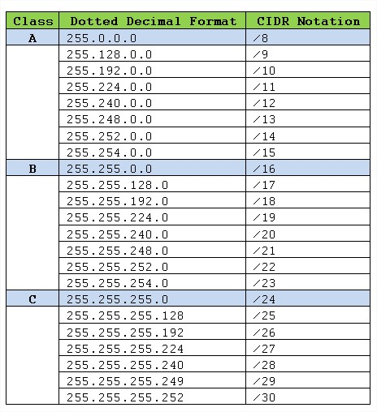
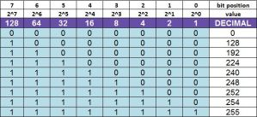
SUBNET MASK CHART

Slide 5
Broadcast Address:
The Broadcast Address is the last address of an IP network. It is used to address all the nodes at the same time. The IP packet with a broadcast address is sent to all the nodes across the network. All the bits of the host portion in an IP address is set to one to identify as the broadcast address.
Network Address:
The network address is a unique address to identify the network portion of the IP network. The network address is the same for all the hosts within the same IP network. All the bits of the host portion in an IP address are set to zero to identify as the network address of any IP network.

Slide 6
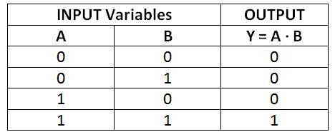
IPv4 NETWORK ADDRESS
Example 1: Find the network address to which the host 192.168.10.50/24 belongs?
Step 1: Convert IP address & subnet mask in binary format
11000000.10101000.00001010.00110010 ==> IP Address – 192.168.10.50
11111111.11111111.11111111.00000000 ==> Subnet Mask – 255.255.255.0
Step 2: Compute an “AND” operation between IP address & subnet mask
11000000.10101000.00001010.00110010 ==> IP Address – 192.168.10.50
11111111.11111111.11111111.00000000 ==> Subnet Mask – 255.255.255.0
11000000.10101000.00001010.00000000 ==> Network Address
Step 3: convert the Network Address i.e. AND result into decimal 192.168.10.0
Hence, host 192.168.10.50/24 belongs to network 192.168.10.0/24

Slide 7
Example 2: Find the network address for host 10.205.79.90/22
00001010.11001101.01001111.01011010 ==> IP Address 10.205.79.90
11111111.11111111.11111100.00000000 ==> Subnet Mask 255.255.252.0
00001010.11001101.01001100.00000000 ==> Network Address (binary) after AND operation
10.205.76.0 ==> Network Address (decimal)
Hence, host 10.205.79.90/22 belongs to network 10.205.76.0/22

Slide 8
IPv4 NETWORK ADDRESS, 1ST HOST, LAST HOST & BROADCAST ADDRESS
In IPv4 address, Network Address has all host bits 0’s & Broadcast Address has all host bits 1’s.
Host bits start from right to left.
Last host = broadcast address – 1 host
Example 1: For host 192.168.199.100/24 find network, 1st host, last host & broadcast address.
11000000.10101000.11000110.01100100 ==> IP Address 192.168.199.100
11111111.11111111.11111111.00000000 ==> Subnet Mask /24
For Network Address, in IP address make all host part bits as 0’s.
11000000.10101000.11000110.00000000 => Network Address (192.168.199.0)
For Broadcast Address, In IP address make all host part bits as 1’s
11000000.10101000.11000110.11111111 => Broadcast Address (192.168.199.255)
First host address, in network address add a host bit from right to left
11000000.10101000.11000110.00000001 => 1st Host Address (192.168.199.1)
Last host address, in broadcast address subtract a host bit
11000000.10101000.11000110.11111110 => Last Host Address (192.168.199.254)

Slide 9
Example 2: For host 102.224.96.32/20 find network, 1st host, last host & broadcast address.
/20 means network bits in 3rd octet.
102.224.01100000.00100000 ==> IP Address (102.224.96.32)
255.255.11110000.00000000 ==> Subnet Mask (255.255.240.0)
102.224.01100000.00000000 ==> Network Address (102.224.96.0)
102.224.01100000.00000001 ==> 1st Host Address (102.224.96.1)
102.224.01101111.11111111 ==> Broadcast Address (102.224.111.255)
102.224.01101111.11111110 ==> Last Host Address (102.224.111.254)

Slide 10
IPv4 NETWORK RANGE
Example 1: Find the next network range for host 192.168.10.50/24
Subnet Mask = 255.255.255.0 or /24
Network Address = 192.168.10.0/24
To find the Next network address for host 192.168.10.50/24
The 3rd octet has last network bits.
In 3rd octet, network bits = 8. so, host bits = 0
Adding Factor = 2^(no. of host bits) = 2^0 = 1
Add this factor to 3rd octet IP address value i.e. 10 + 1 = 11
Next Network Address = 192.168.11.0/24
Example 2: Find the next network range for host 190.168.10.50/21
Subnet Mask – 255.255.248.0 or /21
Network Address – 190.168.8.0/16
we have last network bits in 3rd Octet & no. of host bits = 3. Hence, Adding Factor = 2^3 = 8.
So, in 3rd octet of network address add the adding factor i.e. 8 + 8 = 16
Next Network Address = 190.169.16.0/21

Slide 11
IPv4 SUBNETTING
Subnetting is process of borrowing bits.
for subnets, borrow from host bits (left to right)
for hosts, borrow from network bits (right to left)
No. of Subnets >= 2 ^ (no. of network bits)
No. of Hosts per subnet >= { 2 ^ (no. of host bits) } – 2
Example 1: A class C address 192.168.0.0 need 7 subnets. Find the new subnet mask & network address ?
For class C, the default Subnet Mask – 255.255.255.0 or /24
No. of Subnets = 7
No. of Subnets >= 2 ^ (no. of network bits) i.e. 2^3 gives subnets which meets the need of 7 subnet.
Note: greater subnets allowed but lesser is not acceptable.
No. of network bits = 3
For 7 subnets we need to borrow 3 bits from the host part. So, new subnet mask is /27.
The 4th Octet having last network bits
In 4th Octet, no. of host bits = 5. so, adding factor = 2^5 = 32
192.168.0.0/27 ==> 1st Network Address
192.168.0.32/27 ==> 2nd Network Address (Adding factor 32 in 4th octet) 192.168.0.64/27 ==> 3rd Network Address
192.168.0.96/27 ==> 4th Network Address
192.168.0.128/27 ==> 5th Network Address
192.168.0.160/27 ==> 6th Network Address
192.168.0.192/27 ==> 7th Network Address
192.168.0.224/27 ==> 8th Network Address

Slide 12
Example 2: A class A network 10.0.0.0 require 50 subnets. find 1st three subnets.
For class A the default Subnet Mask is 255.0.0.0 or /8
No. of Network = 50
No. of Network >= 2 ^ (no. of network bits) i.e. 2^6 = 64 which can have 50 networks.
No. of Network Bits = 6
New Subnet Mask = /(8 + 6) = /14 or 255.252.0.0
The 2nd Octet has last network bits.
In 2nd octet, no. of host bits = 2. so, Adding factor = 2^2 = 4
1st Network – 10.0.0.0/14
2nd Network – 10.4.0.0/14
3rd Network – 10.8.0.0/14

