Slide 1

PING
PURPOSE
check network layer reachability i.e. IP
check round trip time to reach the destination.
PING utility (application) uses ICMP protocol (network layer)
ICMP echo request is sent by sender to destination ip address.
ICMP echo reply is responded by destination to sender ip address.

Slide 2
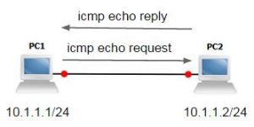
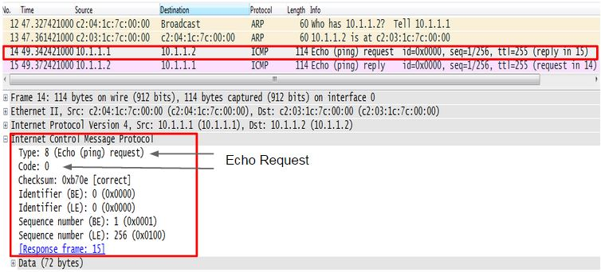
HOW PING WORKS
To check ip network reachability between PC1 to PC2.
PC1> ping PC2
Step 1: PC1 sends ICMP echo request to PC2.

Slide 3
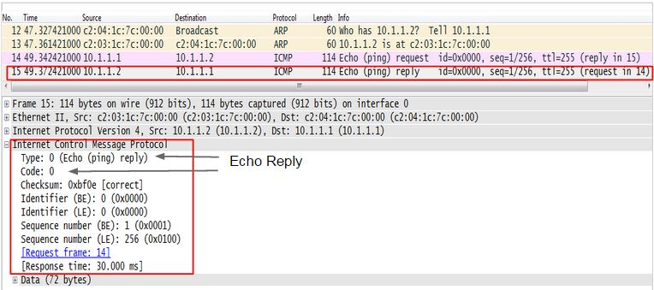
Step 2: PC2 responds with ICMP echo reply to PC1’s ICMP echo request.

Slide 4
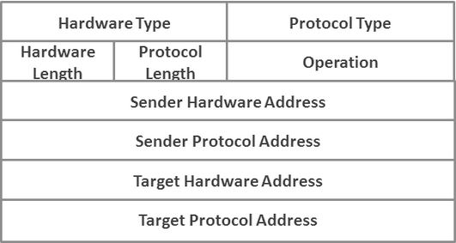
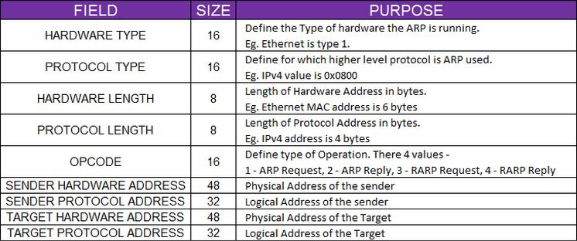
ADDRESS RESOLUTION PROTOCOL (ARP)
ARP FEATURES
ARP is defined in RFC 826.
ARP is protocol used by Layer 3 address (IP) to resolve the Layer 2 address (MAC Address) in ethernet LAN segment.
ARP is stored in arp cache on Layer 3 devices.
Sender sends ARP REQUEST to Layer 2 broadcast as destination address.
Target responds with ARP REPLY to Layer 2 unicast as destination address.
ARP HEADER

Slide 5
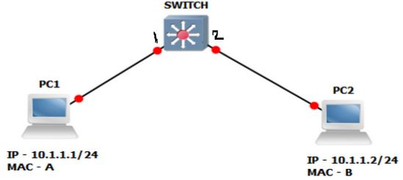
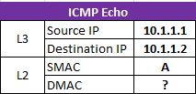
SCENARIO 1: ARP IN SAME SUBNET
Explain the packet flow to Ping PC2 from PC1. (All devices are freshly rebooted)
PC1> ping 10.1.1.2
Step 1:
PC1 does AND operation between destination IP 10.1.1.2 and own Subnet Mask 255.255.255.0 and identifies that it is in same subnet 10.1.1.0

Slide 6
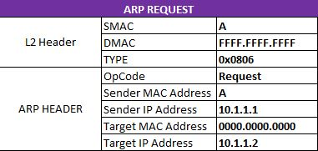
Step 2:
As it is Local/same subnet, it checks ARP Cache for MAC address of destination IP address. As PC1 is rebooted, so arp cache would not have DMAC. So, it would generate ARP request frame and it on the network.

Slide 7
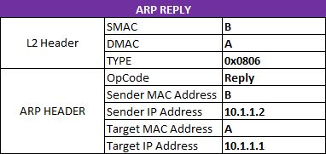
Step 3:
Switch on receiving ARP request frame, checks the I/G bit and understand it is a multicast/broadcast frame and floods to all other active port other than the port it received the frame. Before forwards the frame switch learns the SMAC “A” on Port “1” in its MAC Address table.
Step 4:
PC2 receives the ARP request broadcast frame. In ARP header section of ARP Request frame identifies it own ip address in the Target IP Address and populates it own ARP cache with PC1 IP address 10.1.1.1 and MAC address “A”.
PC2 generates a ARP reply unicast frame and sends it on the network.

Slide 8
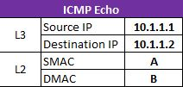
Step 5:
Switch on receiving ARP reply frame checks the I/G bit and understand it is a unicast frame and checks the MAC address table for DMAC “A” and finds the entry for it and forwards the frame towards port “1” but before forwarding the frame switch learns the SMAC “B” on Port “2” in its MAC Address table.
Step 6:
PC1 receives the ARP reply frame and populates it ARP cache with PC2’s IP address 10.1.1.2 and MAC address “B”.
Now, PC1 sends the ICMP Echo packet encapsulated in Layer 2 header on the network.

Slide 9
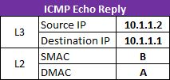
Step 7:
Switch receives the frame on port 1, checks the I/G bit. it is unicast frame check the DMAC and forwards towards port “2” and before forwarding refresh the aging timer of SMAC “A” in mac address table.
Step 8:
PC2 receives the frame, identifies the DMAC and Destination IP Address is its own address and sees it is an ICMP request packet and responds with ICMP echo reply packet on the network.
Step 9:
Switch receives the frame on port 2, checks the I/G bit. it is unicast frame check the destination mac address and forwards towards port “1” and before forwarding refresh the aging timer of smac “B” in mac address table.
Step 10:
PC1 receives the frame, checks the DMAC and Destination IP Address is its own address and sees it is an ICMP protocol and is ICMP echo reply packet from PC2.

Slide 10
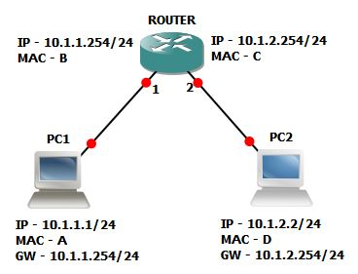
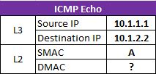
SCENARIO 2: ARP IN DIFFERENT SUBNET
Explain the packet flow to Ping PC2 from PC1. (All devices are freshly rebooted)
PC1> ping 10.1.2.2
Step 1:
PC1 does AND operation between destination IP 10.1.2.2 and own Subnet Mask 255.255.255.0 and identifies that it is in different subnet 10.1.2.0

Slide 11
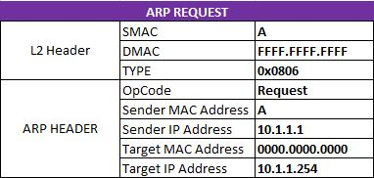
Step 2:
As it is remote/different subnet it does route lookup in following order –
a) Exact host address (match not found)
b) Network Address (Match not found)
c) Gateway Address
and then check ARP Cache for MAC address of next-hop IP address. As PC1 is rebooted, so arp cache would not have DMAC of the gateway.
So, it would generate ARP request frame for the gateway ip address and send it on the network.

Slide 12
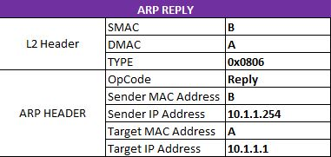
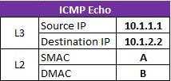
Step 3:
Router on receiving ARP request broadcast frame and finds its own ip address in target ip address field of arp header and populates it arp cache with PC1’s IP and MAC address and send an ARP reply unicast frame
Step 4:
PC1 receives the ARP reply unicast frame and populates it own ARP cache with ROUTER’s IP and MAC address.
Now, PC1 sends the ICMP Echo packet encapsulated in Layer 2 header on the network.

Slide 13
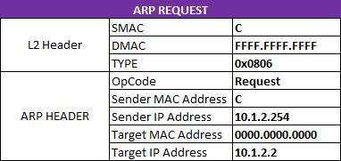
Step 5:
Router receives the frame and sees it own MAC address as DMAC de-capsulates and checks the Destination IP address in its routing table and identifies network address & exit interface towards PC2. Router checks ARP cache but does not find the MAC address for host 10.1.2.2. so it ARP request on interface towards PC2 and cache the ICMP echo sent by PC1.

Slide 14
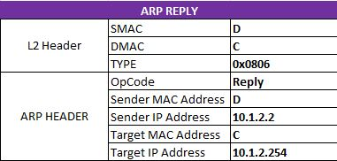
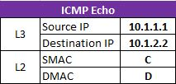
Step 6:
PC2 receives ARP request broadcast frame populates it arp cache with Router’s IP – 10.1.2.254 and MAC address “C” and generates a ARP reply unicast frame and sends it on the network.
Step 7:
Router receives the ARP reply frame and populates it ARP cache with PC2’s IP and MAC address.
Now, Router sends the ICMP Echo packet encapsulated in Layer 2 header on the network towards the PC2.

Slide 15
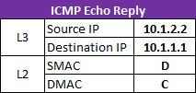
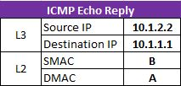
Step 8:
PC2 receives the frame, checks the DMAC and Destination IP Address is its own address and sees it is an ICMP echo packet and responds with ICMP echo reply packet on the network.
Step 9:
Router receives the frame from PC2, de-capsulates it and checks the Destination IP address in its routing table and identifies network address & exit interface towards PC1 and also find MAC address of DMAC in ARP cache and hence, forwards ICMP echo reply towards the PC1.
Step 10:
PC1 receives the frame, checks the DMAC and Destination IP Address is its own address and sees it is an echo reply packet from PC2.

Slide 16
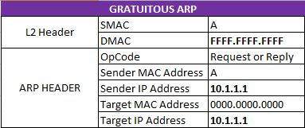
GRATUITOUS ARP (GARP)
PURPOSE
Detect duplicate IP address
Educate the switch port about the MAC address
GARP – sent to L2 broadcast address and has same sender & target ip address in arp header.

