Slide 1
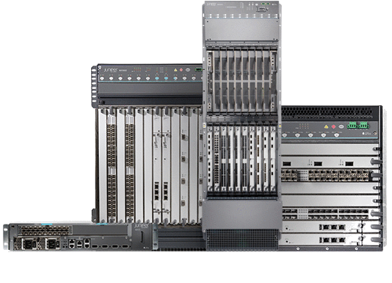
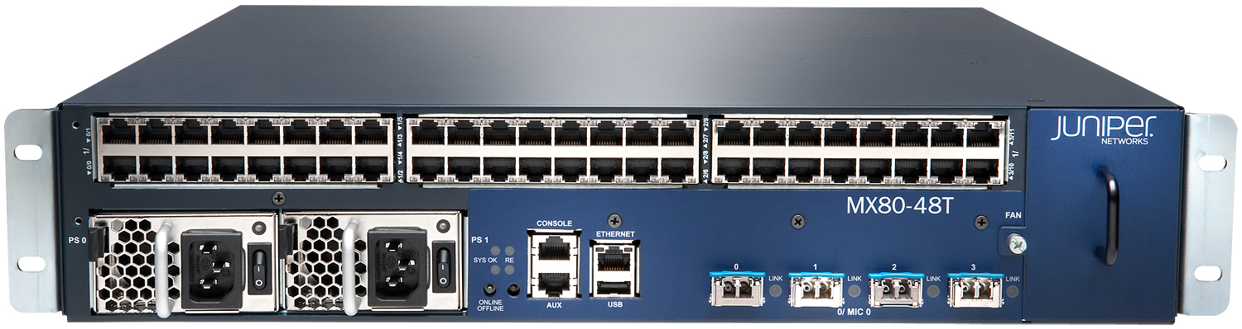
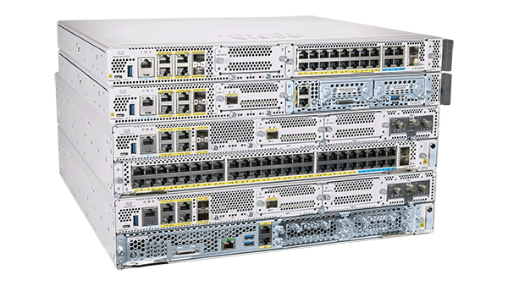

Routing Technologies:
Routers: -Layer 3 devices

Slide 2
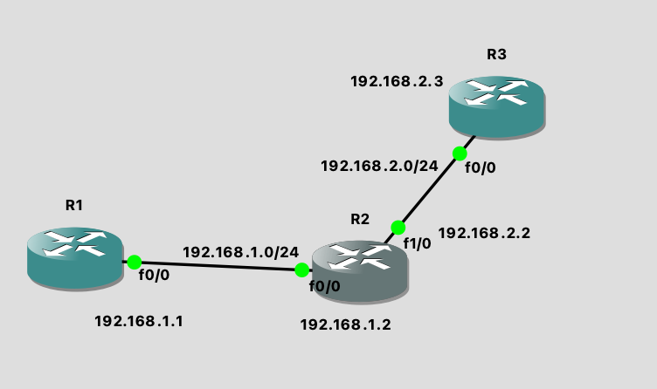
What does router do?
Router maintains the routing table
When a Router receives the packet it will do route lookup for destination IP in routing table.
Hence, the data will send and receive based on the Ip addresses
Routing : It enables the communication among the networks or between the different networks by
using routing protocols like ospf, eigrp, RIP.
Example: when R1 initiates ping for R3 IP 192.168.2.3, the ping will failed because of different network.
Hence, we need routing protocols to communicate different network IP.

Slide 3
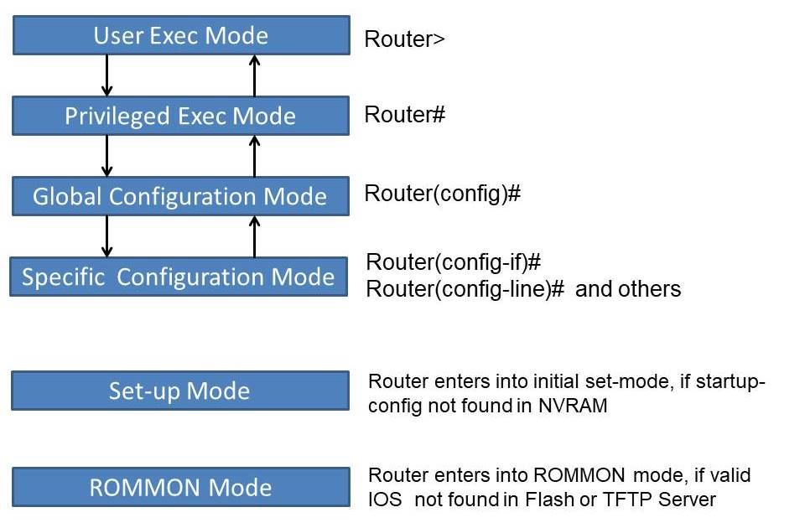
Types Routing protocols:
Default routing
Static routing
Dynamic routing protocols
When you turn ON the router you will able to see enable mode
Hyderabad>. --→ enable mode. Hyderabad#. ---→privileged mode
Hyderabad(config) ---→ conifg mode: you configure the routing protocols or anything
Basic commands:
>show version
>show ip interface brief
Loopback interface: it is virtual interface or it is a logical interface and
after configure this interface on router this interface never goes down

Slide 4
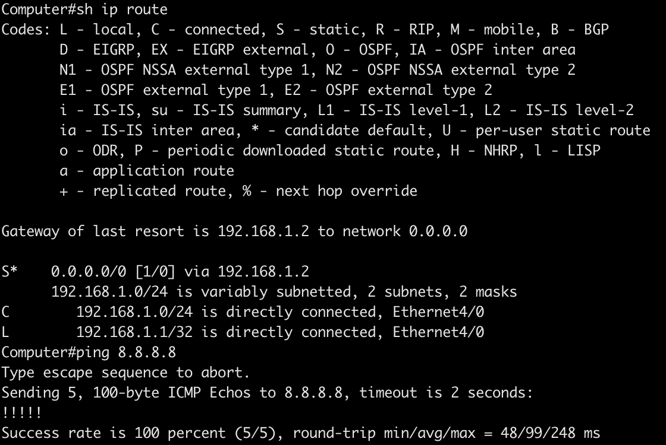
Default Routing
Default routing means, when you try to reach unknown route, for example www.google.com IP (142.250.183.132)from the layer 3 device (PC or mobile), the packet goes to gateway. The gateway IP is wifi router IP. Hence, we can access the google.com.
Similarly, after configuring default route on the router and when you try to reach any destination IP address, if that address is not in routing table, it will choose default route.
NOTE: When you don’t have a route in routing table, the packet will get dropped. Route can be learned via static route or Dynamic routing protocols such as OSPF, EIGRP, RIP, IS-IS or BGP.
Below is the routing table. “show ip route” is the command to check routing table
If you see in the image, I am trying to ping 8.8.8.8, this route is not in routing table, however, I am able to ping, because I have configured default routing (0.0.0.0/0) and the gateway is 192.168.1.2. This devices has reachability to 8.8.8.8
(0.0.0.0/0) represent unknown route.
Example of know route is any IP address from class A or B or C

Slide 5
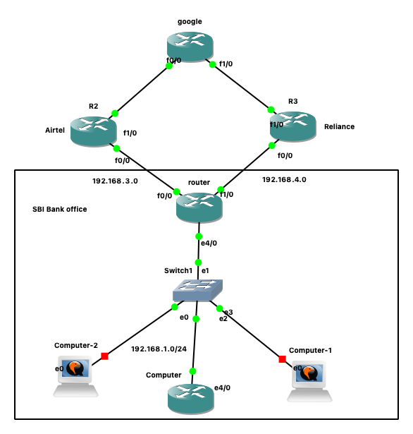
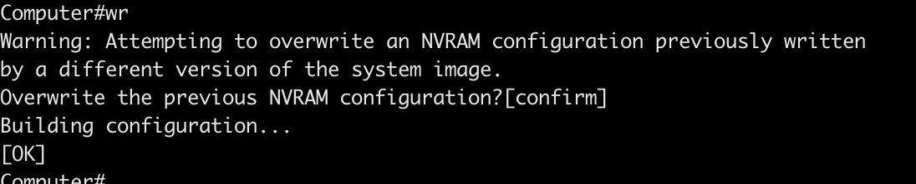
Real time scenario where the default routing is used.
Below Is the topology. Consider we have SBI Bank office network, and all PC’s are connected to switch and this is connected to router. This router have connected with two ISP’s one is Airtel and another one is Reliance. One is active and another one is for back up. Incase airtel goes down, the SBI bank office will get internet connection from reliance.
Please note that, ISP’s (airtel, Reliance) are connected to the internet through BGP protocol. Here, we are just configuring default routing for reachability.
LAB:
Topology
NOTE: consider router name is computer
computer
Computer#conf t
Computer(config)#interface e4/0
Computer(config-if)#ip address 192.168.1.1 255.255.255.0
Computer(config-if)#no shut
Computer(config-if)#end
Configure default route:
Computer(config)#ip route 0.0.0.0 0.0.0.0 192.168.1.2
Computer#wr
NOTE: once you ’write’ the config, please click ‘enter’ to save config

Slide 6
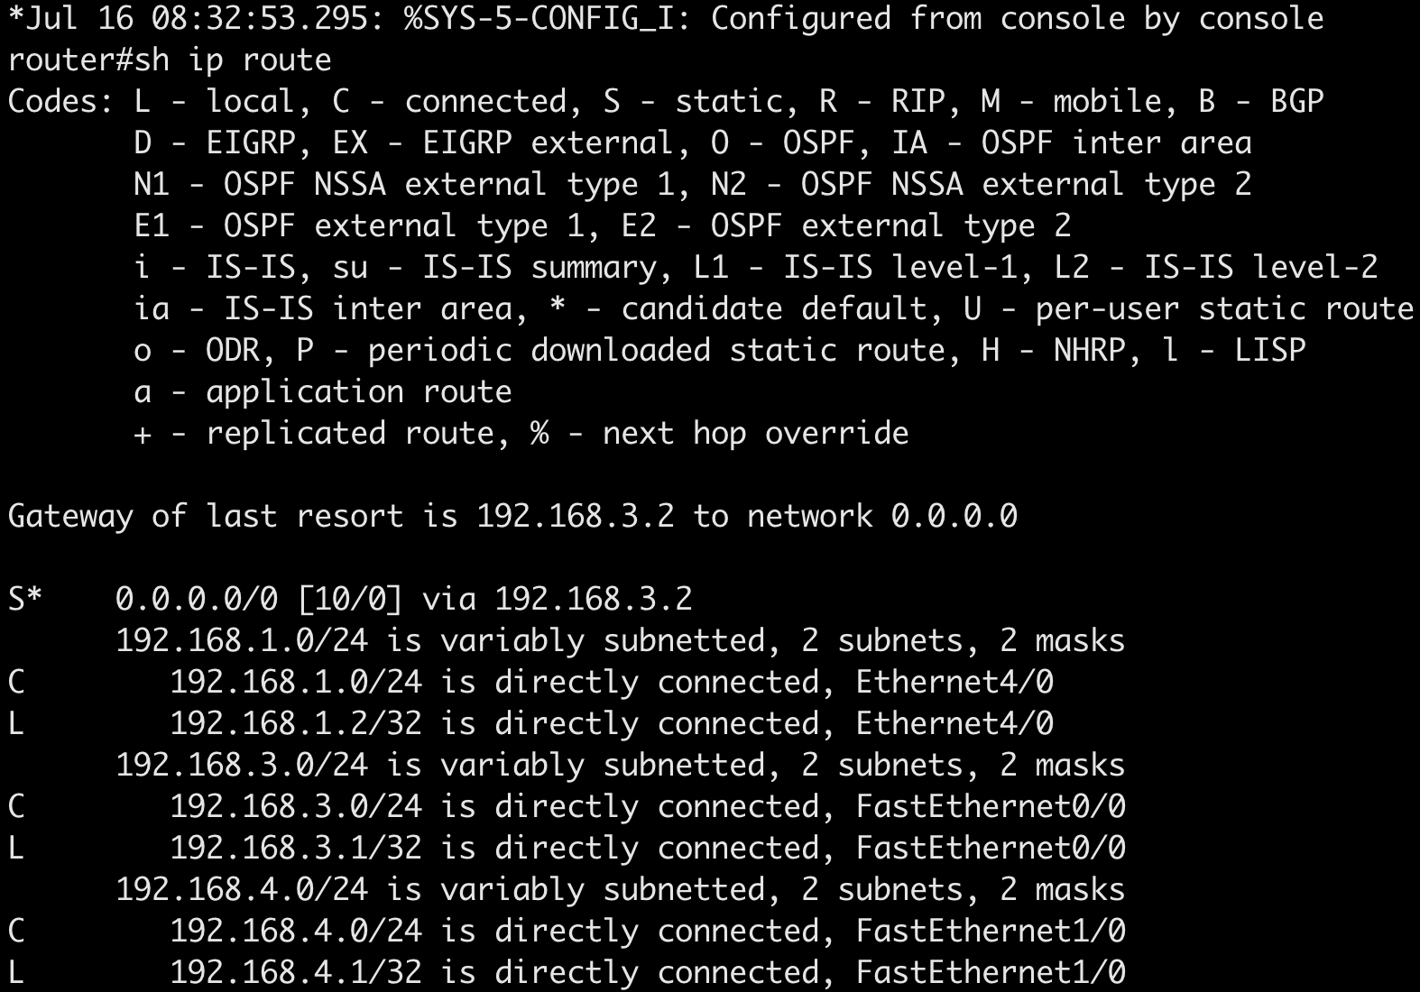
Router:
router(config)#int e4/0
router(config-if)#no shut
router(config-if)# ip address 192.168.1.2 255.255.255.0
router(config-if)#exit
router(config)#int f1/0
router(config-if)#ip address 192.168.4.1 255.255.255.0
router(config-if)#no shut
router(config-if)#exit
router(config)#int f0/0
router(config-if)#ip add
router(config-if)#ip address 192.168.3.1 255.255.255.0
router(config-if)#no shut
router(config-if)#exit
Verify with “show ip int br” to check the interface status
Configure default route for ISP’s
router(config)#ip route 0.0.0.0 0.0.0.0 192.168.3.2 10
router(config)#ip route 0.0.0.0 0.0.0.0 192.168.4.2 50
Here 192.168.3.2 is Airtel gateway and metric 10 is assigned
192.168.4.2 is reliance gateway and metric is 50. The route with lowest metric value is preferred as best route
If you see in routing table S* represent the preferred path, shown in above image.

Slide 7
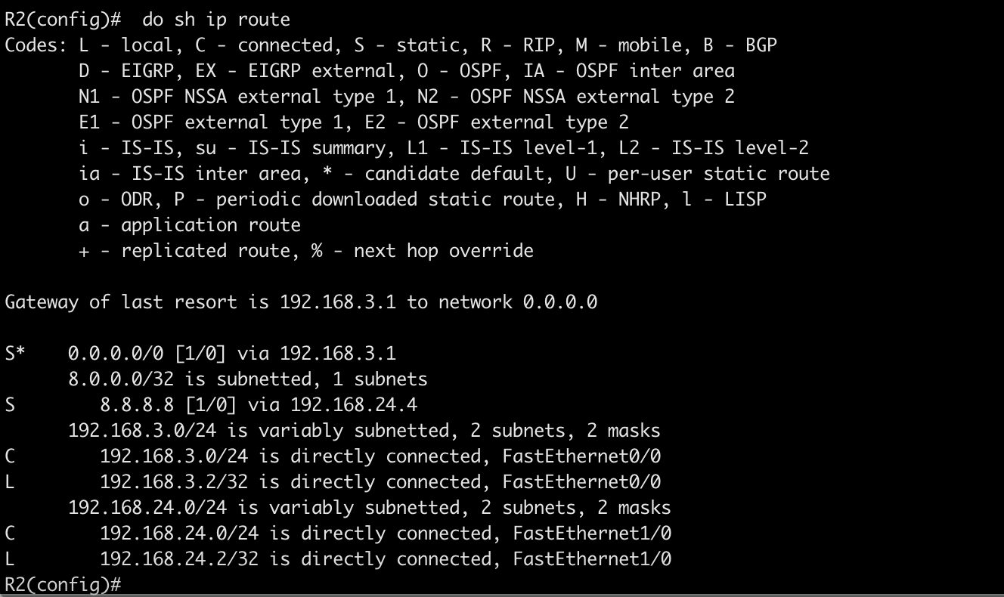
R2 Router(Airtel ISP)
Routing Table
R2(config)#int f0/0
R2(config-if)#ip add
R2(config-if)#ip address 192.168.3.2 255.255.255.0
R2(config-if)#no shut
R2(config)#int fa1/0
R2(config-if)#ip add 192.168.24.2 255.255.255.0
R2(config-if)#no shut
R2(config-if)#exit
R2(config)#ip route 0.0.0.0 0.0.0.0 192.168.3.1
R2(config)#ip route 8.8.8.8 255.255.255.255 192.168.24.4
NOTE: Here I manually added 8.8.8.8 route in routing table. This is called static routing.
Google router:
google(config)#int f0/0
google(config-if)#ip address 192.168.24.4 255.255.255.0
google(config-if)#no shut
google(config-if)#exit
google(config)#int lo0
google(config-if)#ip address 8.8.8.8 255.255.255.255
google(config-if)#exit
google(config)#int f1/0
google(config-if)#ip add
google(config-if)#ip address 192.168.23.4 255.255.255.0
google(config-if)#no shut
google(config-if)#end
Configure static routes on google router: conf terminal
ip route 192.168.1.0 255.255.255.0 192.168.24.2
ip route 192.168.1.0 255.255.255.0 192.168.23.3
ip route 192.168.3.0 255.255.255.0 192.168.24.2
ip route 192.168.4.0 255.255.255.0 192.168.23.3
Write the config

Slide 8
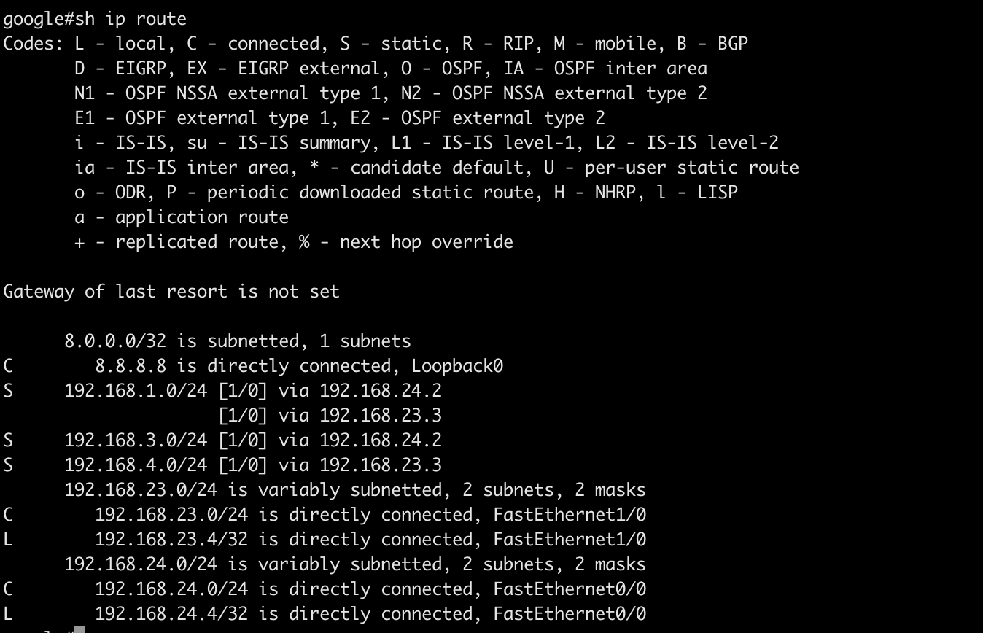
NOTE: In real time ISP use BGP for reachability, here we use static routs for LAB purpose

Slide 9
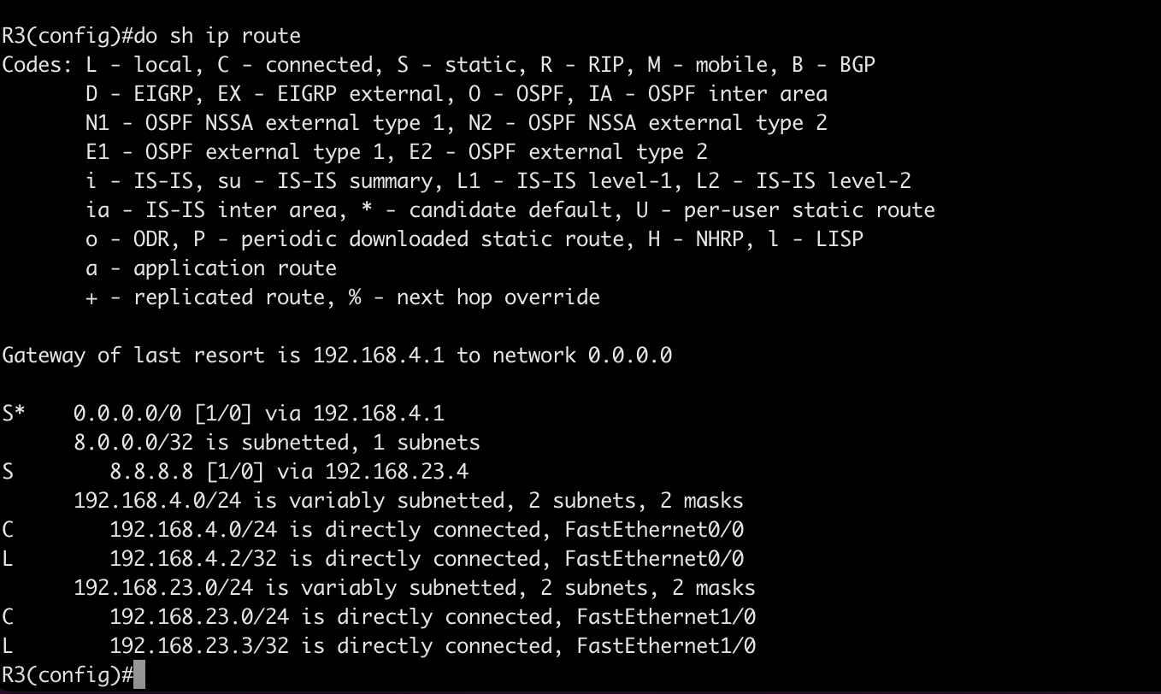
R3 Router (Reliance ISP)
R3#conf t
R3(config-if)#ip address 192.168.4.2 255.255.255.0
R3(config-if)#no shut
R3(config-router)#exit
R3(config)#int f1/0
R3(config-if)#ip add
R3(config-if)#ip address 192.168.23.3 255.255.255.0
R3(config-if)#no shut
R3(config)#ip route 0.0.0.0 0.0.0.0 192.168.4.1
R3(config)#ip route 8.8.8.8 255.255.255.255 192.168.23.4
R3(config)#do wr

Slide 10
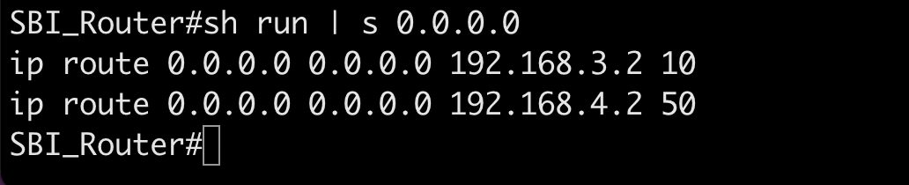
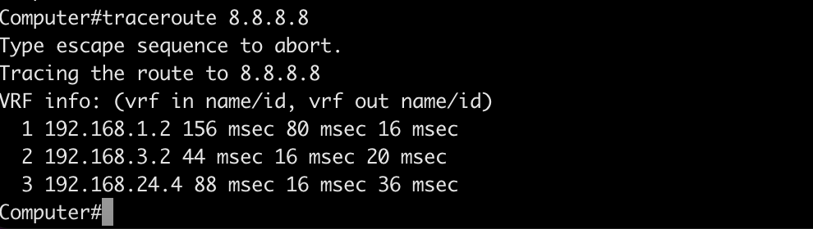
Verification
We have configured two default routes in SBI office Router, one is towards Airtel with cost 10 and
Another one is towards reliance with cost of 50 sh run
Here 192.168.3.2 is Airtel gateway and metric 10 is assigned
192.168.4.2 is reliance gateway and metric is 50. The route with lowest metric value is preferred as best route
Lets test computer:
Initiate a traceroute to google (8.8.8.8), and you seen 192.168.1.2 is SBI router gateway and from her its going towards airtel Ip 192.168.3.2 and airtel to google router IP 14.4

Slide 11
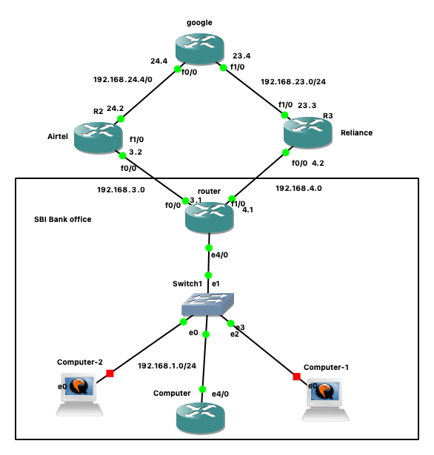
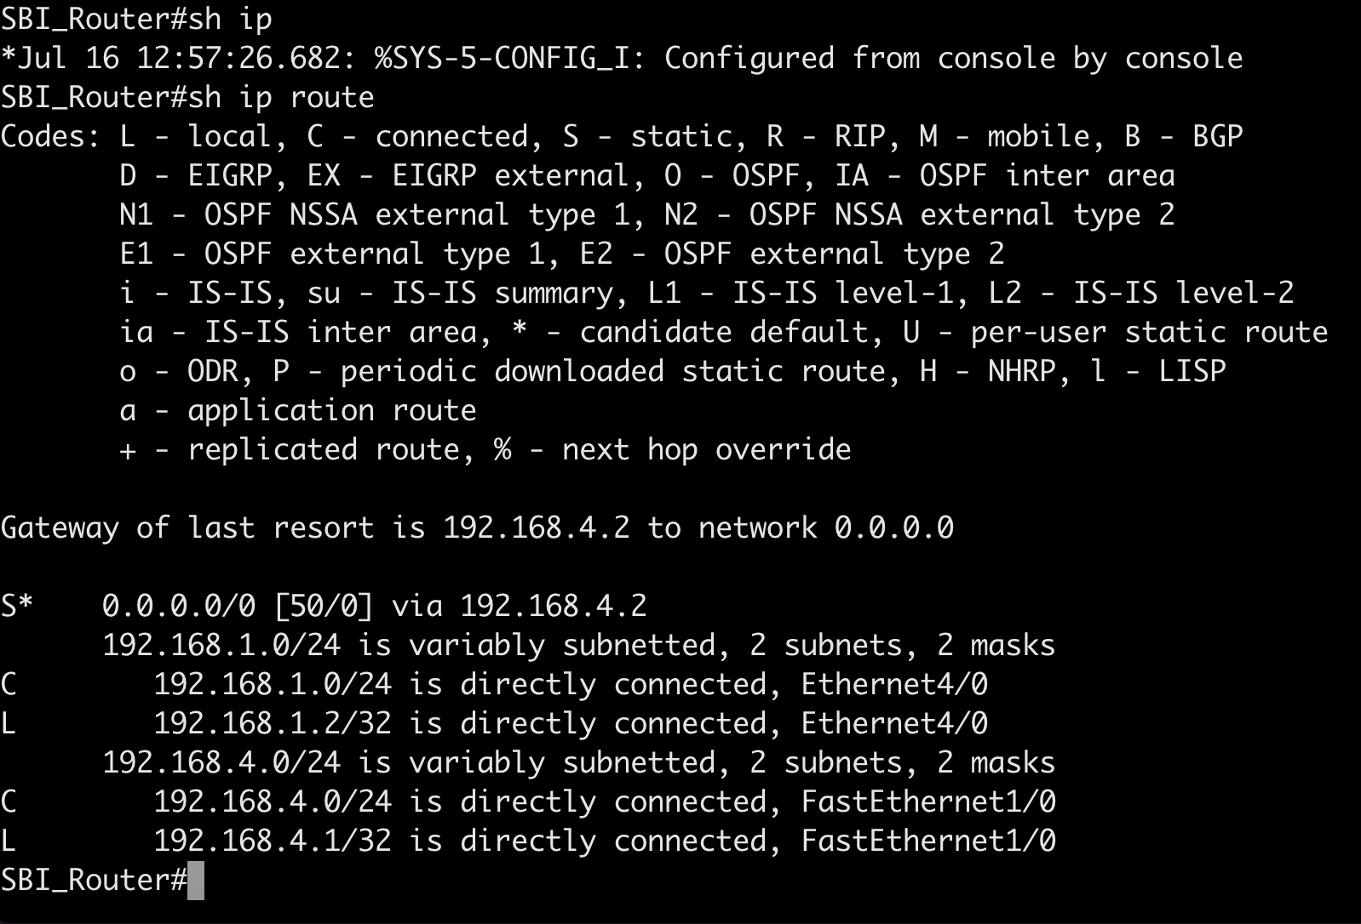
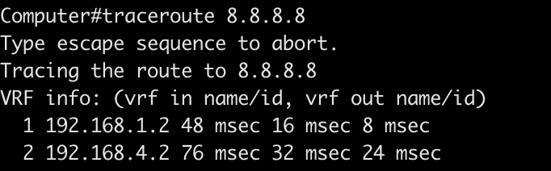
Verification
Incase if Airtel goes down, it chooses the reliance path to reach google.com
Shutdown the link f0/0 on SBI Router
SBI_Router# sh ip int br | i 0/0
FastEthernet0/0 192.168.3.1 YES manual up up
SBI_Router#conf t
Enter configuration commands, one per line. End with CNTL/Z.
SBI_Router(config)#int fa0/0
SBI_Router(config-if)#shut
SBI_Router(config-if)#
Perform traceroute on computer to validate
If you in SBI Router routing table it chooses the path via 192.168.4.2 and the metric is 50. traceroute output from computer you can see it chooses 192.168.4.2 path which is towards Reliance.

Slide 12
Conclusion:
Here we can see default routing generally configured on office routers. When you have 2 or more ISP connections, you can configure default route towards ISP and hence users can access the inerent.
NOTE: From ISP’s towards google it’s a internet connection they use BGP protocol in real time. Here we use static and default route configuration for LAB purpose. Hence, we have some routing challenges and you can safely ignore. Our verification is packets which are coming from computer to SBI_router and those packets are leaving towards Airel ISP and Realince ISP successfully.
Default routing AD value is 1. lower value prefer the best path.

