Slide 1
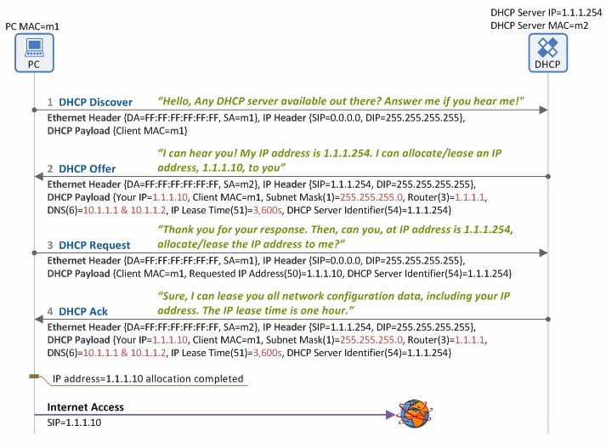
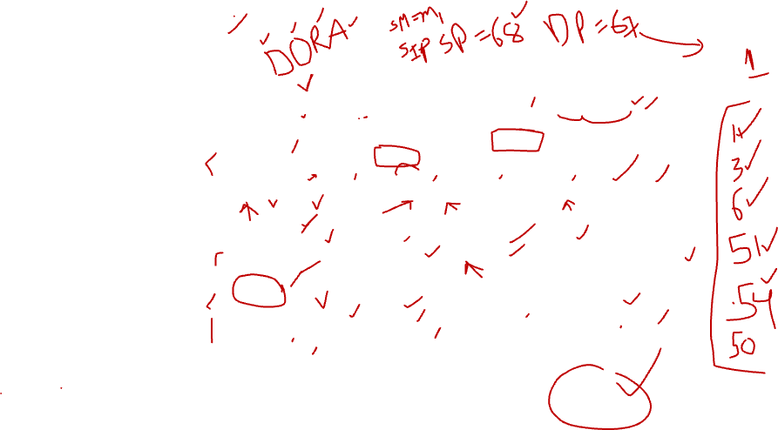
DHCP
DHCP (Dynamic Host Configuration Protocol) is a protocol used by DHCP servers in wired/wireless IP networks to dynamically allocate a variety of network configuration data, such as a user IP address, subnet mask, default gateway IP address, DNS server IP address, lease time and so on, to client devices (DHCP clients). The DHCP protocol enables DHCP clients to dynamically configure such network configuration data without any manual setup process, which makes network management much easier.
IP Address Allocation/Lease Procedure
The following four basic phases are required in DHCP operations between a DHCP server and DHCP client (e.g. a PC) in order for the client to get/lease network configuration data, such as IP address from the DHCP server.

Slide 2

1. DHCP Discover
When a client (PC) is booted, it broadcasts a DHCP Discover message over the Ethernet network to locate all available DHCP servers on the same subnet network (by setting the destination MAC address in the Ethernet header as Broadcast MAC=FF:FF:FF:FF:FF:FF), reaching all the DHCP servers on the same subnet network.
2. DHCP Offer
When a DHCP server receives the DHCP Discover message from the client, it also broadcasts a DHCP Offer message over the Ethernet network (because the client IP address has not been allocated yet), informing the client that it is available. This message contains the network information, such as client IP address, subnet mask, default gateway IP address, DNS IP address, IP lease time and DHCP server IP address. The DHCP Offer message broadcasted is delivered to all the clients on the same subnet network, including the one that sent the DHCP Discover message.
3. DHCP Request
The client, having received the DHCP Offer message, recognizes there is a DHCP server available on the same subnet. Then it broadcasts a DHCP Request message to the server over the Ethernet network, requesting network configuration data including an IP address for itself. If more than one DHCP server responds on the same subnet and hence the client receives multiple DHCP Offer messages, it selects one of the DHCP servers, and enters the IP address of the selected DHCP server in the DHCP Server Identifier (option 54) field of the DHCP Request message. Then it informs all the DHCP servers on the subnet network about such selection by broadcasting the DHCP Request message. Typically, all DHCP servers internally store the network configuration data (i.e. IP address for the client and other information) when they send a DHCP Offer message. So, the client broadcasts the DHCP Request message to all the DHCP servers, so that those not selected can also receive the message and delete the stored network configuration data from their memory.
4. DHCP Ack
The DHCP server which received the DHCP Request message from the client checks if the IP address shown in the DHCP Server Identifier (option 54) field matches its own. If it does, it broadcasts a DHCP Ack message ensuring the client can receive the message (Note: the client has NOT been allocated an IP address yet).
At this time, the DHCP server transfers all the network configuration data including the client IP address – the same data sent along with the DHCP Offer message - to the client. Then the client configures a network interface using the transferred data, finally connecting to the Internet. The typical network configuration data includes:
IP address
Subnet mask
Default gateway IP address
DNS server IP address
Lease time (during which a client can use the IP address allocated/leased by a DHCP server)

Slide 3
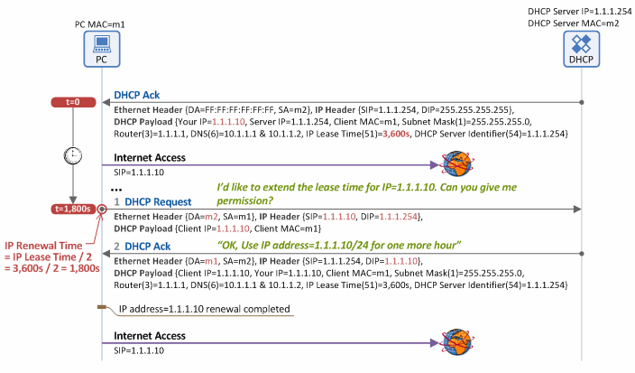

IP Address Renewal Procedure
A DHCP Ack message is the last message sent in the “IP address allocation/lease” procedure. It contains the IP Lease Time (option 51) parameter, and a client can use an allocated IP address (e.g. 1.1.1.10 in Figure 3) only for the time period (lease duration) specified in the option parameter. Thus, to use the IP address beyond the lease duration, the client has to request approval from the DHCP server to renew the IP address as shown in Figure.
1. DHCP Request
In Figure 3, the lease time is given as 1 hour. When half of it has passed (i.e. 1,800 seconds/30 minutes in Figure 3), the client sends a DHCP Request message to the DHCP server to renew its lease time (Note: In case of IP renewal, no DHCP Discover/Offer process is required). Unlike in the IP address allocation/lease procedure, the client does not broadcast the DHCP Request message (Destination MAC=FF:FF:FF:FF:FF:FF, Destination IP=255.255.255.255), but unicasts it (Destination MAC=DHCP Server MAC (m2), Destination IP=DHCP Server IP (1.1.1.254)). That is because the DHCP server and client have already known each other’s IP address. The DHCP Request message for IP address renewal should include the IP address of the client requesting the renewal in the “Client IP Address (ciaddr)” field, but should exclude Requested IP Address (option 50) and DHCP Sever Identifier (option 54) fields.
2. DHCP Ack
Upon accepting the DHCP Request message (for IP address renewal) received from the client, the DHCP server also unicasts, and does not broadcast, a DHCP Ack message (Destination MAC=PC MAC (m1), Destination IP=PC IP (1.1.1.10)), including network configuration data such as the client IP address, subnet mask, default gateway IP address, DNS IP address and lease time, to the client. Once this process is completed, the client can keep its current IP address for the extended lease time as specified in the DHCP Ack message.

Slide 4
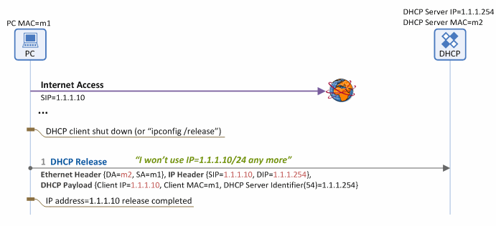
IP Address Release Procedure
When a client is shut down gracefully,¹ or ‘ipconfig/release’ command is entered in the DOS command window of Windows, the client unicasts a DHCP Request message to the DHCP server in order to return its allocated IP address, as seen in Figure 4. Then it releases the network configuration data (i.e. client IP address, subnet mask, default gateway IP address, DNS IP address, etc.), consequently having no access to the Internet any more.
DHCP Release
If the client does not need its allocated IP address any longer, it unicasts a DHCP Release message (Destination MAC=DHCP Server MAC (m2), Destination IP=DHCP Server IP (1.1.1.254)) to the DHCP server. The server then releases the client IP address (1.1.1.10) listed in the Client IP field of the received message.

Slide 5
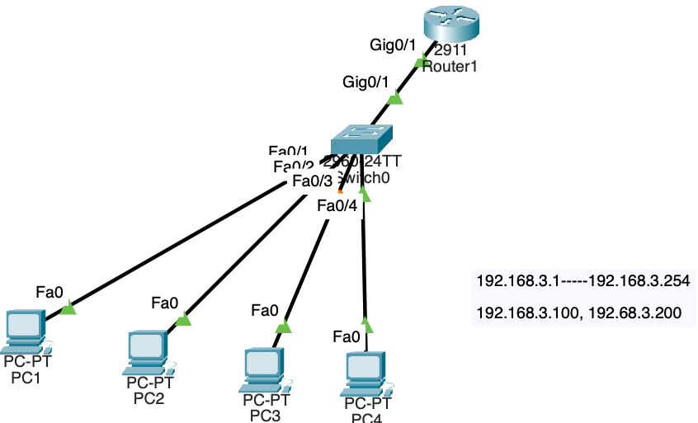
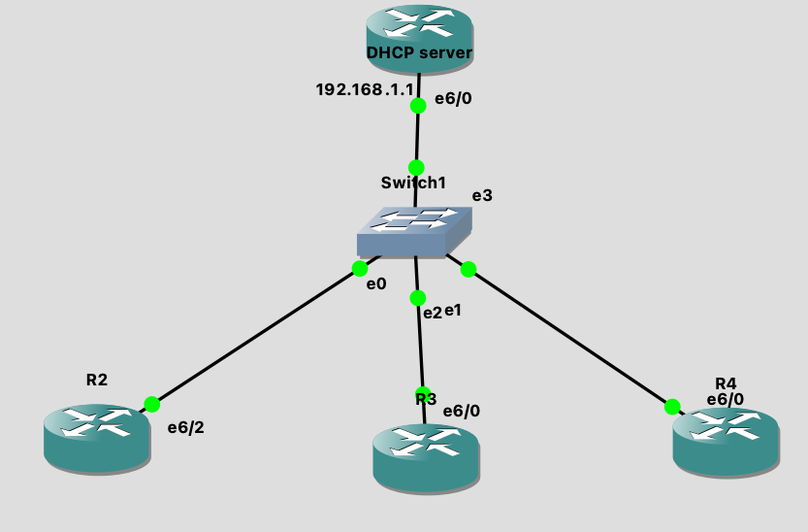
DHCP LAB:
Enter into config terminal .
>enable
DHCP_server# configure terminal
Copy paste the below commands:
ip dhcp pool rameshtechDHCP
network 192.168.3.0 255.255.255.0
default-router 192.168.3.100
dns-server 192.168.3.200
Exit
Assign the IP address on e6/0:
Conf t#
Copt paste below command:
interface Ethernet6/0
ip address 192.168.3.100

Slide 6
Also please configure the ports on R3 and R4:
Conf t#
Copt paste below commandS:
interface Ethernet6/0
ip address dhcp
Verification commands on DHCP server:
DHCP_server#show ip dhcp pool
Pool rameshtechDHCP :
Utilization mark (high/low) : 100 / 0
Subnet size (first/next) : 0 / 0
Total addresses : 254
Leased addresses : 2
Pending event : none
1 subnet is currently in the pool :
Current index IP address range Leased addresses
192.168.1.4 192.168.1.1 - 192.168.1.254 2
DHCP_server#show ip dhcp binding
Bindings from all pools not associated with VRF:
IP address Client-ID/ Lease expiration Type
Hardware address/
User name
192.168.1.2 0063.6973.636f.2d63. Jul 28 2024 04:47 PM Automatic
6130.332e.3537.3266.
2e30.3061.382d.4574.
362f.30
192.168.1.3 0063.6973.636f.2d63. Jul 28 2024 04:47 PM Automatic
6130.342e.3537.3331.
2e30.3061.382d.4574.
362f.30

Slide 7
DHCP_server# sh ip dhcp pool
Pool rameshtechDHCP :
Utilization mark (high/low) : 100 / 0
Subnet size (first/next) : 0 / 0
Total addresses : 254
Leased addresses : 2
Pending event : none
1 subnet is currently in the pool :
Current index IP address range Leased addresses
192.168.1.6 192.168.1.1 - 192.168.1.254 2
DHCP_server#

Slide 8
What is DHCP Snooping? – Explanation and Configuration
DHCP Snooping is a security technology on a Layer 2 network switch that can prevent unauthorized DHCP servers from accessing your network. It is a protection from the untrusted hosts that want to become DHCP servers. DHCP Snooping works as a protection from man-in-the-middle attacks. DHCP itself operates on Layer 3 of the OSI layer while DHCP snooping operates on Layer 2 devices to filter the traffic that is coming from DHCP clients.
Why Do We Need DHCP Snooping?
Dynamic Host Configuration Protocol (DHCP) server is a vital role in every organization’s network as most end-user devices like PC and laptops are using DHCP to learn the IP addresses automatically. The host is making an IP address lease to the DHCP server.
To protect the host within the organization’s network to establish a connection from unauthorized rogue DHCP servers, we need to configure DHCP snooping on the Layer 2 switch where the unauthorized hosts are connected.
DCHP Snooping Trusted and Untrusted Ports
In Cisco switches, DHCP snooping is enabled manually. Trusted ports should be manually configured and the rest unconfigured ports are considered untrusted ports. Most devices connected to trusted ports are routers, switches, and servers. DHCP clients like PC and laptops are commonly connected to an untrusted port.
How it works is that it will allow DHCP server messages like DHCPOFFER and DHCPACK that are coming from a trusted source. If the DHCP server messages are coming from untrusted ports, it will discard the DHCP traffic. The switch creates a table called the DHCP Snooping Binding Database. The DHCP snooping database registers the source MAC address and IP address of the hosts that are connected to an untrusted port.
NOTE DHCP clients connected to an untrusted port are expected to transmit these DHCP messages: DHCP DISCOVER and DHCP REQUEST. If it transmits DHCPOFFER and DHCPACK, then the switch discards the DHCP packets. DHCPOFFER and DHCPACK are expected to be received on the trusted ports of the switch.
Dynamic Host Configuration Protocol Snooping Configuration
For our configuration example, we will use the network topology below. There is a rouge DHCP Server trying to connect to our network through a man-in-a-middle attack.

Slide 9
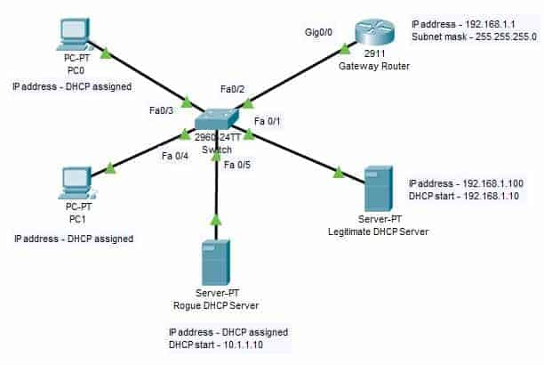
Topology

Slide 10
1. To enable DHCP snooping on the switch, we use the following command:
SW(config)#ip dhcp snooping
2. After enabling DHCP snooping, configure FastEthernet 0/1 and FastEthernet 0/2 as a trusted port.
SW(config)#interface range FastEthernet 0/1 - FastEthernet 0/2
SW(config-if-range)#ip dhcp snooping trust
SW(config-if-range)#no shutdown SW(config-if-range)#exit
3. Assign IP DHCP Snooping to the VLAN that is currently using the following command.
SW(config)#ip dhcp snooping vlan 1
4. Assign an IP address to the gateway router’s interface gigabitEthernet 0/0.
Router(config)#interface gigabitEthernet 0/0
Router(config-if)#ip address 192.168.1.1 255.255.255.0
Router(config-if)#no shutdown
DHCP Snooping Verification Commands
The following are the show commands that we can use on the switch to verify if DHCP snooping works as expected.
Switch#show ip dhcp snooping
Switch#show ip dhcp snooping binding

Slide 11
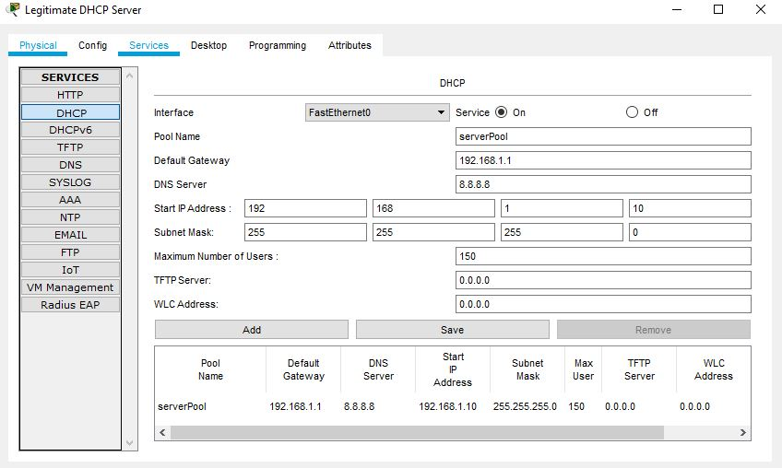
5. On the legitimate DHCP server, select the Services tab and click on DHCP. Enable the service, and assigned the IP details, subnet mask, and DNS server IP. The name serverPool cannot be changed as it is existing already.

Slide 12
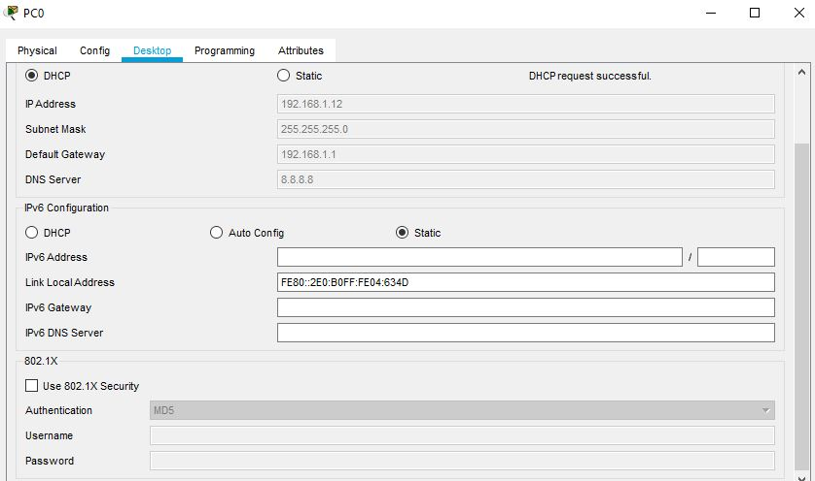
6. Enable DHCP on PC0 and PC1 and will get the IP address from the legitimate DHCP server.

Slide 13
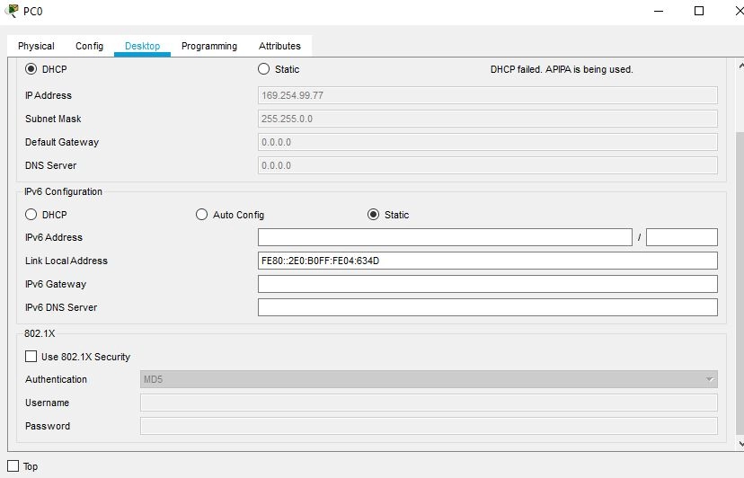
7. Disconnect the legitimate DHCP server and observe that PC0 and PC1 are not getting any IP. The below snippet shows PC0 is getting an APIPA address. The PCs will not be able to get connected to the rogue DHCP server.

