Slide 1

What happen when you type www.google.com In browser
A user is typing a domain name like google.com into their browser. The user needs an A or AAAA DNS record to resolve the domain name.
If your device’s cache has the IP address of google.com, the domain name resolution will finish here, and the user will be able to open the website. But, if it does not, there will be more steps. The devices keep DNS records for visited sites, depending on the TTL (Time to Live) values of those DNS records. After the time they indicate, they will be deleted, and a new query needs to be performed.
If your computer doesn’t have the needed IP address, it will search for the answer by performing a DNS resolution query. The next destination on the way will be the recursive DNS servers of the internet services provider. They also keep a cache with DNS records of domain names that users have accessed. If the desired site’s DNS records are still there, the user will get an answer to its query and access the site. If not, there will be a series of interactive DNS queries to find the answer.
If the domain name resolution didn’t finish with the previous step, the recursive nameserver would search for the answer. The next step will be to ask the Root server, which is indicated with a “.” sign after the TLD (top-level domain). The Root server does not have an answer about the exact domain name, but it will provide one for the part it is responsible for – it will indicate all the nameservers for the TLD that we asked for. In our case, it will show the nameservers of .net.
The TLD DNS servers will have the answer of which exactly are the authoritative nameservers for the domain you are searching. The TLD servers of .net will have that information for all of the domain names that finish with .net. They will return that answer so the query can continue.
Now that we know where the authoritative nameserver of the domain name we want is, we can ask and get the A and AAAA records to understand the site’s IP address.
The Authoritative nameservers of the domain name will provide the DNS records, the DNS resolution will be made. The recursive nameserver of our ISP and our device will both save the DNS records that we obtained based on their TTL values. That way, if we soon want to visit the site again, we will save time and access the site faster.
Visit the site. Now with the DNS record already obtained, the user can access the site.

Slide 2
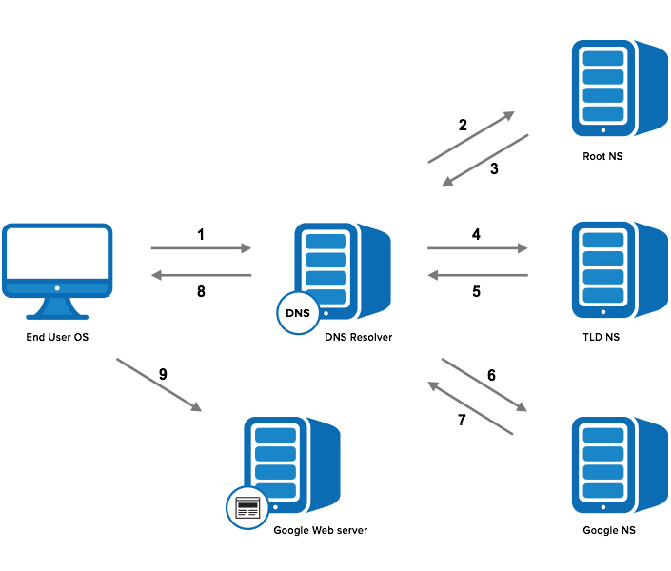
1. The client query (Google.com) goes to a DNS resolver.
2. The resolver sends a request to the root nameserver to ask for the top-level domain resolution.
3. The root server responds with an IP address of a top-level domain server for resolving .com domains.
4. The resolver sends a request to the top-level domain server.
5. The TLD server responds with an IP address of the authoritative nameserver (domain's nameserver).
6. The resolver sends a final query to the authoritative nameserver.
7. The authoritative nameserver returns the IP address for the domain name (google.com) to the resolver.
8. The resolver returns the IP address of the domain to the client.
9. The client sends an HTTP request to the provided IP address of the web server.
10. The web server returns the webpage to the client.
How DNS works

Slide 3
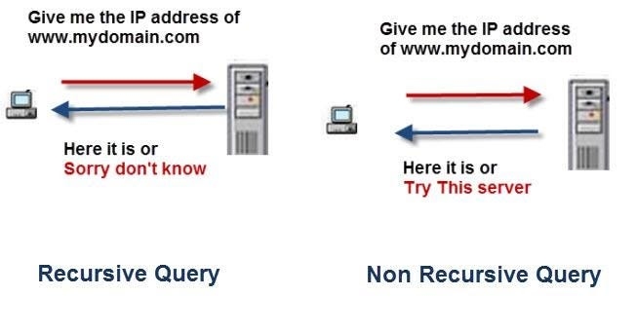
Recursive queries are generally used by clients i.e. PCs and they tell DNS server to respond only with an answer and not a referral.
Non recursive or Iterative queries are used by DNS servers and essentially instruct the other DNS server to return an answer or return the address of another DNS server that may know the answer.
Iterative. A Local DNS server asks the TLD server to provide an IP address for a given domain name. The resolver either gets an address as a response, or the IP address of another DNS server that potentially has the answer. The resolver repeats the process until the address resolution happens.

Slide 4
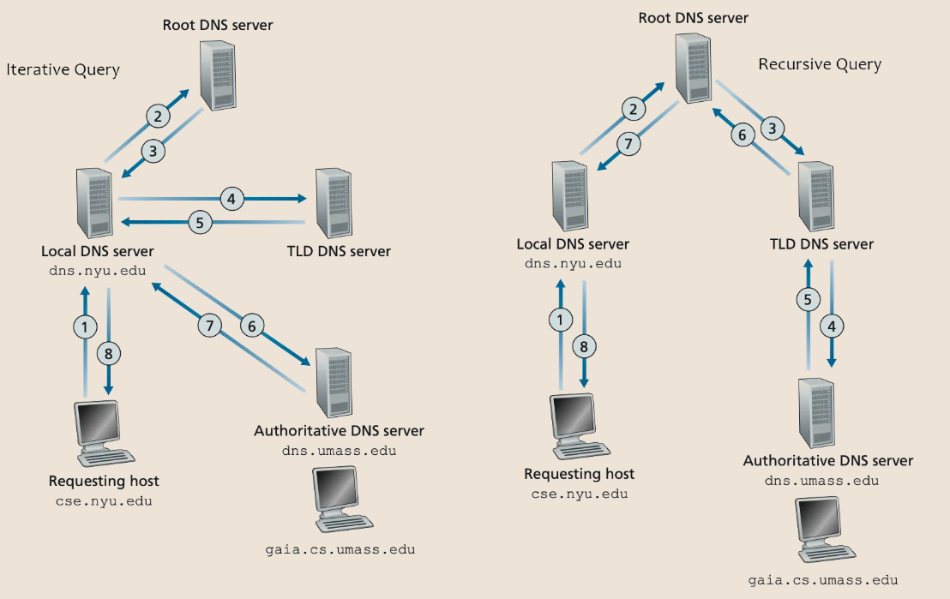
The recursive query is between a client and its local DNS server. On the other hand, iterative DNS query is between local DNS server and other DNS servers.

Slide 5
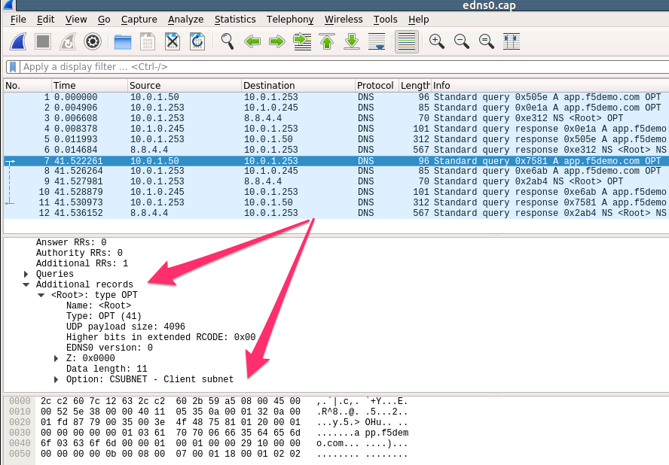
DNS Records
DNS records store information about domains and reside on DNS servers or in caches. There are many different DNS record types. The most common types are:
A record contains the IPv4 address for a domain.
AAAA record contains the IPv6 address for a domain.
CNAME record contains the alias for a domain.
PTR record maps an IP address to a domain name for reverse DNS lookup.

Slide 6
Types of DNS Servers
Various DNS server types play a different role in resolving a domain name into an IP address. Below is a brief overview of the several types of DNS servers and their function in DNS resolutions.
1. Recursive DNS Server
A recursive DNS server (or recursive DNS resolver) resolves DNS queries by querying other DNS servers. The recursive server performs this task until it locates the IP address of a domain name. The server acts as a mediator between the client and other DNS servers.
2. Root DNS Server
The first point of contact from a recursive DNS server is the root DNS server. There is a total of thirteen root server types dispersed across multiple locations. Root DNS servers are named [A-M].root-server.net and every recursive DNS resolver knows all thirteen root server types.
The root DNS server provides IP addresses for top-level domain (TLD) servers to a recursive DNS resolver based on the final part in the domain name query. The Internet Corporation for Assigned Names and Numbers (ICANN) manages root nameserver databases.
3. TLD (Top-Level Domain) DNS Server
The top-level domain (TLD) servers resolve queries for top-level domains. For example, a .com TLD server contains information for all websites ending in .com. The TLD server points the resolver to an authoritative server.
Internet Assigned Numbers Authority (IANA) is a branch of ICANN that oversees the TLD nameservers. All the domains in this category divide into three groups:
Generic top-level domains are common and not geographically specific. Examples include .com, .edu, .org, .gov, and similar.
Country-code top-level domains are specific to a country or state. Examples include .uk, .us, .ru, and others.
Infrastructure domains are transitional domains with a historical significance used for reverse DNS lookup. The domain is .arpa.
4. Authoritative DNS Server
An authoritative DNS server provides answers for DNS queries from a TLD server. The answer is based on the DNS records that it has for a specific subdomain. The authoritative DNS server is the last step before a DNS resolution.
Multiple domain names reside on authoritative DNS servers, and a single domain name may also reside on multiple authoritative servers.

Slide 7
Why do we need recursive servers?
Theoretically, authoritative nameservers are enough to keep the DNS resolution process running. You can think that the only kind of DNS servers we need is authoritative, but imagine how much load they will need to take if all the complete queries get to them.
For decreasing the load and increasing the speed, there are recursive servers (DNS resolvers) that keep the DNS records with the information needed to access a particular website for a defined period of time. This time is called TTL (time to live), and the process is named DNS cache. There are such recursive servers in the internet service providers that keep the information for many websites for the period of time defined by the TTL.
To make it easier to imagine, it generally functions as a name server, acting as a go-between the customer and the authoritative DNS server. However, without it, you won’t be able to access any website that you want to reach on.
Conclusion
DNS is a very useful system that saves a lot of time and makes our lives easier. After this article, you will know better what happens when you open a web page, how exactly the DNS resolution works, and what it means a domain name resolution.

Slide 8
