Slide 1


Slide 2
Border Gateway Protocol (BGP)
BGP is a standardized exterior gateway protocol (EGP), as opposed to RIP, OSPF, and EIGRP which are interior gateway protocols (IGP’s). BGP Version 4 (BGPv4) is the current standard deployment.
BGP is considered a “Path Vector” routing protocol. BGP was not built to route within an Autonomous System (AS), but rather to route between AS’s. BGP maintains a separate routing table based on shortest AS Path and various other attributes, as opposed to IGP metrics like distance or cost.
BGP is the routing protocol of choice on the Internet. Essentially, the Internet is a collection of interconnected Autonomous Systems. BGP Autonomous Systems are assigned an Autonomous System Number (ASN), which is a 16-bit number ranging from 1 – 65535. A specific subset of this range, 64512 – 65535, has been reserved for private (or internal) use.
BGP utilizes TCP for reliable transfer of its packets, on port 179.
BGP Peers (Neighbors):
For BGP to function, BGP routers (called speakers) must form neighbor relationships (called peers).
There are two types of BGP neighbor relationships:
• iBGP Peers – BGP neighbors within the same autonomous system.
• eBGP Peers – BGP neighbors connecting separate autonomous systems.
Note: Do not confuse an IGP, such as OSPF, with iBGP!

Slide 3
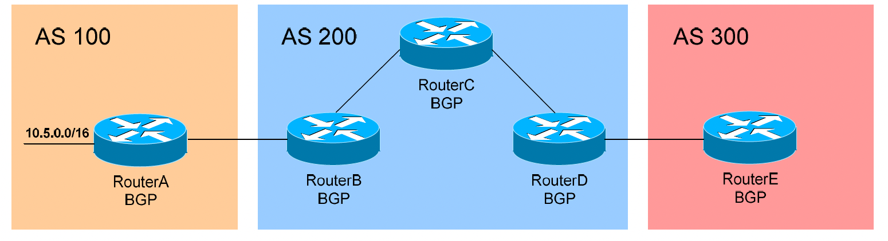
In the above figure, RouterB and RouterC in AS 200 would form an iBGP peer relationship. RouterA in AS 100 and RouterB in AS 200 would form an eBGP peering.
By default, BGP assumes that eBGP peers are a maximum of one hop away. This restriction can be bypassed using the ebgp-multihop option with the neighbor command (demonstrated later in this guide).
iBGP peers do not have a hop restriction, and are dependent on the underlying IGP of the AS to connect peers together. By default, all iBGP peers must be fully meshed within the Autonomous System.
A Cisco router running BGP can belong to only one AS. The IOS will only allow one BGP process to run on a router.
The Administrative Distance for routes learned outside the Autonomous System (eBGP routes) is 20, while the AD for iBGP and locally-originated routes is 200.

Slide 4
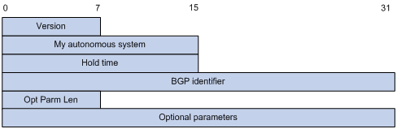
BGP Messages:
OPEN Message
KEEPALIVE Message
UPDATE Message
NOTIFICATION Message
BGP open message format
After a TCP connection is established, the first message sent by each side is an open message for peer relationship establishment.
Major fields of the BGP open message are as follows:
Version—This one-byte unsigned integer indicates the protocol version number. The current BGP version is 4.
My autonomous system—This two-byte unsigned integer indicates the autonomous system number of the sender.
Hold time—When establishing a peer relationship, two parties negotiate an identical hold time. If no Keepalive or Update is received from a peer within the hold time, the BGP connection is considered down.
BGP identifier—An IP address that identifies the BGP router.
Opt Parm Len (Optional Parameters Length)—Length of optional parameters, which is set to 0 if no optional parameter is available.
Optional parameters—Used for multiprotocol extensions and other functions.

Slide 5
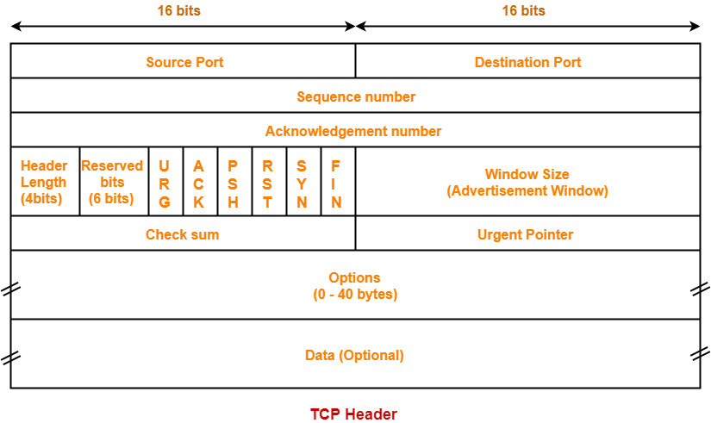

Slide 6
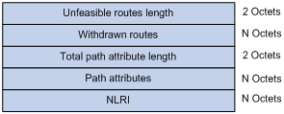
BGP update message format
The update messages are used to exchange routing information between peers. It can advertise feasible routes or remove multiple unfeasible routes. Each update message can advertise a group of feasible routes with identical attributes, and the routes are contained in the network layer reachability information (NLRI) field. The path attributes field carries the attributes of these routes. Each update message can also carry multiple withdrawn routes in the withdrawn routes field.
Major fields of the BGP update message are as follows:
Unfeasible routes length—The total length of the withdrawn routes field in bytes. A value of 0 indicates no route is withdrawn from service, nor is the withdrawn routes field present in this update message.
Withdrawn routes—This is a variable length field that contains a list of withdrawn IP prefixes.
Total path attribute length—Total length of the path attributes field in bytes. A value of 0 indicates that no NLRI field is present in this update message.
Path attributes—List of path attributes related to NLRI. Each path attribute is a triple <attribute type, attribute length, attribute value> of variable length. BGP uses these attributes to avoid routing loops, and perform routing and protocol extensions.
NLRI—Each feasible route is represented as <length, prefix>.

Slide 7

BGP notification message format
A notification message is sent when an error is detected. The BGP connection is closed immediately after sending it.
Major fields of the BGP notification message are as follows:
Error code—Type of notification.
Error subcode—Specific information about the nature of the reported error.
Data—Used to diagnose the reason for the notification. The contents of the data field depend on the error code and error subcode. Erroneous data can be recorded in the data field. The data field length is variable.
Keepalive
Keepalive messages are sent between peers to maintain connectivity. Its format contains only the message header.

Slide 8
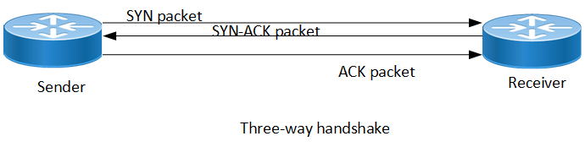
As a BGP peer session is forming, it will pass through several states. This process is known as the BGP Finite-State Machine (FSM):
• Idle – the initial BGP state
• Connect - BGP waits for a TCP connection with the remote peer. If successful, an OPEN message is sent. If unsuccessful, the session is placed in an Active state.
• Active – BGP attempts to initiate a TCP connection with the remote peer. If successful, an OPEN message is sent. If unsuccessful, BGP will wait for a ConnectRetry timer to expire, and place the session
back in a Connect State.
Idle
Connect/Active
• OpenSent – BGP has both established the TCP connection and sent
an OPEN Message, and is awaiting a reply OPEN Message. Once it receives a reply OPEN Message, the BGP peer will send a KEEPALIVE message.
• OpenConfirm – BGP listens for a reply KEEPALIVE message. messages containing routing information will now be sent.
If a peer session is stuck in an Active state, potential problems can include: no IP connectivity (no route to host), an incorrect neighbor statement, or an access-list filtering TCP port 179

Slide 9
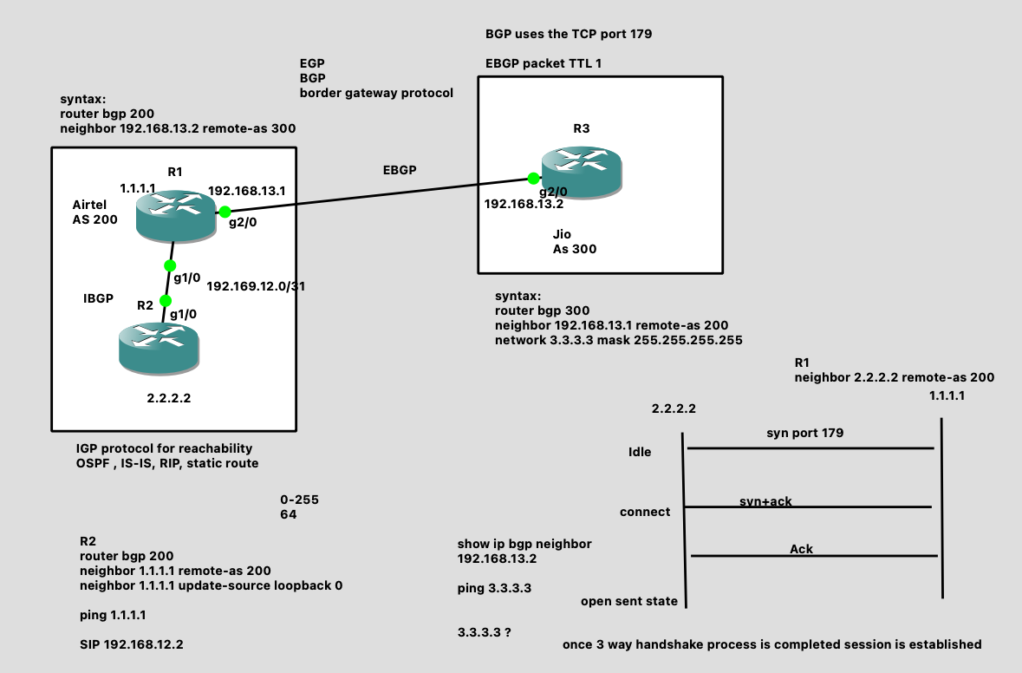
BGP configuration

Slide 10
As per the above topology, we are configuring EBGP between R1 and R3
Configuring IBGP between R1 and R2
NOTE: EBGP neighborship we are establishing with direct point to point IP addresses
IBGP neighborship we are establishing with indirect IP addresses called loopback IP addresses.
Configuring EBGP between R1 and R3 routers:
On R1 router:
interface Loopback0
ip address 1.1.1.1 255.255.255.255
!
!
interface GigabitEthernet1/0
ip address 192.168.12.1 255.255.255.0
no shut
!
interface GigabitEthernet2/0
ip address 192.168.13.1 255.255.255.0
no shut
router bgp 200
neighbor 192.168.13.2 remote-as 300
On R3 router:
interface Loopback0
ip address 3.3.3.3 255.255.255.255
router bgp 300
bgp log-neighbor-changes
network 3.3.3.3 mask 255.255.255.255
neighbor 192.168.13.1 remote-as 200
!
Verification:
#show IP bgp summary
#show ip bgp
#show IP route

Slide 11
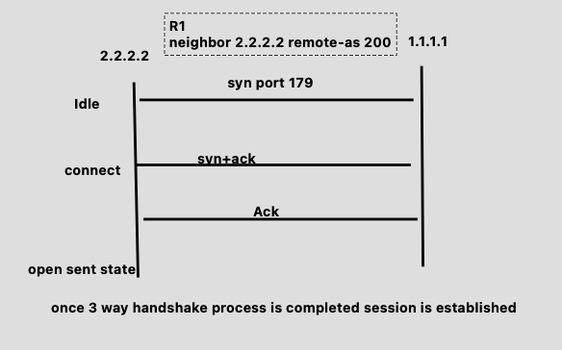
Configuring IBGP between R1 and R2 routers:
On R1 router:
interface Loopback0
ip address 1.1.1.1 255.255.255.255
!
!
interface GigabitEthernet1/0
ip address 192.168.12.1 255.255.255.0
no shut
!
interface GigabitEthernet2/0
ip address 192.168.13.1 255.255.255.0
no shut
router ospf 10
network 1.1.1.1 0.0.0.0 area 0
network 192.168.12.0 0.0.0.255 area 0
!
router bgp 200
neighbor 2.2.2.2 remote-as 200
neighbor 2.2.2.2 update-source Loopback0
On R2 router:
interface Loopback0
ip address 2.2.2.2 255.255.255.255
!
interface GigabitEthernet1/0
ip address 192.168.12.2 255.255.255.0
no shut
router ospf 10
network 2.2.2.2 0.0.0.0 area 0
network 192.168.12.0 0.0.0.255 area 0
!
router bgp 200
neighbor 1.1.1.1 remote-as 200
neighbor 1.1.1.1 update-source Loopback0
!
Verification:
#show IP bgp summary
#show ip bgp
#show IP route
R1
R2
NOTE: Here we use update-source loopback 0. because BGP uses TCP port 179. during connection
Establishment the source IP could be exit interface 192.168.12.1 , however we are trying establish
Connection with 1.1.1.1. So after giving update source loopback 0, the BGP TCP connection takes
Source address as 1.1.1.1 .

