Slide 1


Slide 2
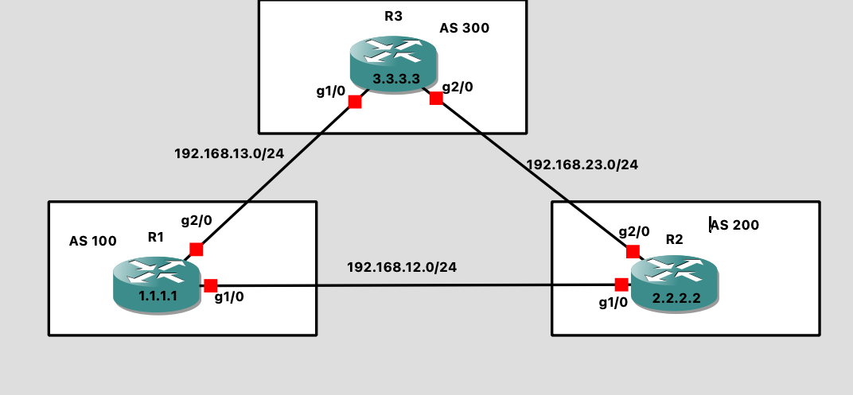
BGP Loop Avoidance Mechanisms
EBGP Loop prevention:
When a BGP router advertises a route to an eBGP peer, it adds its own AS number to the AS Path attribute of that route. This creates a list (AS Path) showing all AS numbers the route has traversed .
Loop Prevention: If a BGP router receives a route advertisement with its own AS number already in the AS Path, it discards the route. This prevents the route from looping back into the AS.
As per the diagram, R1 is advertising 1.1.1.1 route to R2. when it leaves the AS it carries the AS oath.
If check bgp routing table in R2
Show ip bgp
1.1.1.1 AS100 –
As path is the mandatory Attribute
Similar way, R2 advertise this EBGP route to
R3 and carries the as path of 200. If we check
BGP routing table in R3:
1.1.1.1 AS 200 100
R3 advertise same route 1.1.1.1 to R1 and R1
checks its own AS number as 100 and hence
This route will be discarded by R1 router.
This is how loop prevents in EBGP.

Slide 3
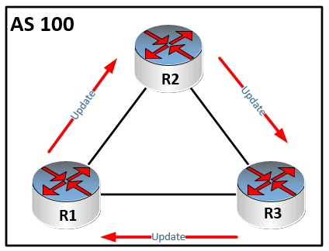
BGP Loop Avoidance Mechanisms
Split horizon Rule:
In a single Autonomous System (AS), when iBGP (Internal Border Gateway Protocol) sessions are configured, A IBGP router receives IBGP Update from peer and the same IBGP update will not send to another IBGP peer. Based on Below diagram, R2 received an IBGP update from R1 and the R2 will not send the same R1 IBGP update to R3.

Slide 4
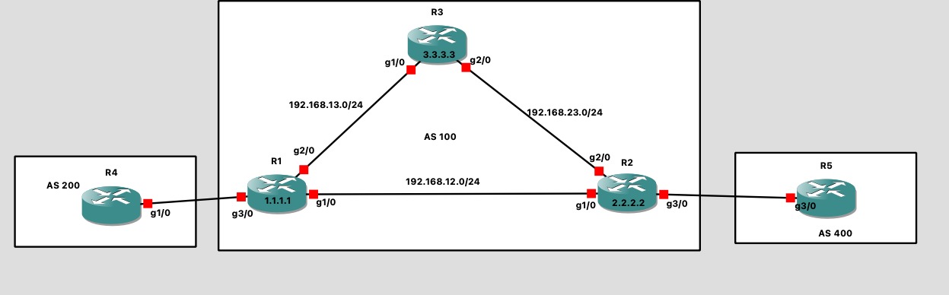
BGP Synchronization Rule:
Synchronization states that, if your AS passes traffic from another AS to a third AS, BGP must not advertise a route before all the routers in your AS have learned about the route via IGP. BGP waits until IGP has propagated the route within the AS.
40.40.40.40
OSPF
AS per the above diagram, R4 advertise 40.40.40.40 to R1 . We have BGP session between R1 and R2.
Note: R3 is a non BGP router.

Slide 5
R1 will advertise 40.40.40.40 to R2. R2 receives it and advertise to R5.Now, R5. Now R5 has the
BGP route 40.40.40.40.
Ping we initiate a ping 40.40.40.40 from R5 , R5 generate a packet as DIP is 40.40.40.40. R2 receives it and
It will check the destination IP is 40.40.40.40 in routing table. R2 learned this route from R1 via IBGP
Route Next-hop
40.40.40.40 1.1.1.1
O 1.1.1.1 (110) g2/0
To reach 1.1.1.1 it will do route lookup for 1.1.1.1 find the exit path as g2/0 via OSPF. The packet arrives on
R3 and it will check the destination IP is 40.40.40.40 in its routing table. There is no route in R3’s routing table.
Hence, the packet will get dropped here. To resolve this you need to redistribute the routes from OSPF to BGP
And BGP to OSPF. This is called BGP synch with IGP, logically called synchronization.
NOTE: if you advertise your internal IGP routes in BGP, there will be a lot of problems. Loops
Can trigger and no security for your network.
BGP synchronization rule is, in R1 router if the route 40.40.40.40 redistributed and learned in IGP , then only the the route 40.40.40.40 will advertise to R2. if there is no redistribution and as per the synch rule, R1 will not advertise EBGP route to R2.
If you disable synchronization is R1 BGP router, the R1 bgp router will advertise 40.40.40.40 R2. However, there is problem
If you try to reach R5 to R4, the traffic will block hole in AS100 because of R3 doesn’t know how to reach 40.40.40.40.
You can disable Synch rule only on below conditions.
If you do not pass traffic from a different AS through your AS, you can disable synchronization
you can also disable synchronization if all routers in your AS run BGP.
Now a days all routers are configured as a BGP router. This is called full mesh. Which will be difficult to implement.

Slide 6
BGP route advertisement rules
BGP follow these rules for route advertisement:
When multiple feasible routes to a destination exist, BGP advertises only the best route to its peers.
BGP advertises only routes that it uses.
BGP advertises routes learned from an EBGP peer to all BGP peers, including both EBGP and IBGP peers. However, Next-hop will not change. Next-hop will change only in EBGP to EBGP advertisements.
A BGP speaker advertises routes learned from an IBGP peer to EBGP peer, rather than other IBGP peers.
After establishing a session with a new BGP peer, BGP advertises all the routes matching the above rules to the peer. After that, BGP advertises only incremental routes to the peer.

Slide 7
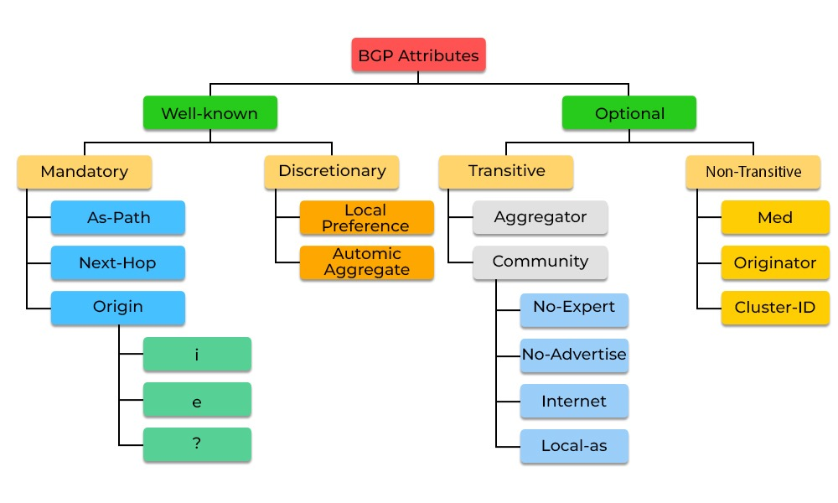
BGP Attributes
Well know Mandatory attributes
AS PATH ,
NEXT HOP= peer ip address or neighbor ip address(it should be be reachable)
Origin
2.2.2.2 --- as path
1.1.1.1

Slide 8
BGP Path selection process:
Next-hop reachability
A path with the highest “local preference” is preferred (usually set to 100).
A path with the shortest AS Path is preferred (skippable via router configuration).
A path with the lowest origin type is preferred. Origin types are preferred in this order:- IGP- EGP- Incomplete
A path with the lowest MED is preferred. By default, the MED is compared only if the neighbour AS is the same for the paths that are compared (this is configurable). There are multiple commands related to how and when to treat the MED value of the paths, which, due to its complexity, is outside the scope of this article.
A path that is an External BGP path is preferred (versus internal).
A path with the lowest IGP metric for BGP next-hop is preferred. At this point, if multipath is configured, the Router installs the routes. If not, the algorithm continues to the next step.
If both routes are external, the oldest route is preferred. This step is skipped if the BGP is configured to compare the router-ID or the paths have the same router-ID.
A path with the shortest cluster list length is preferred. This step is applicable only in a route reflector environment. If this is not the case, this step is skipped.
A path with the lowest router ID is preferred. The router-ID can be manually set or it can be set automatically using the highest IP address configured (first the loopback interfaces are considered and then the physical interfaces).
The router selects the route from the peer with the smallest numerical Peer Address.

Slide 9
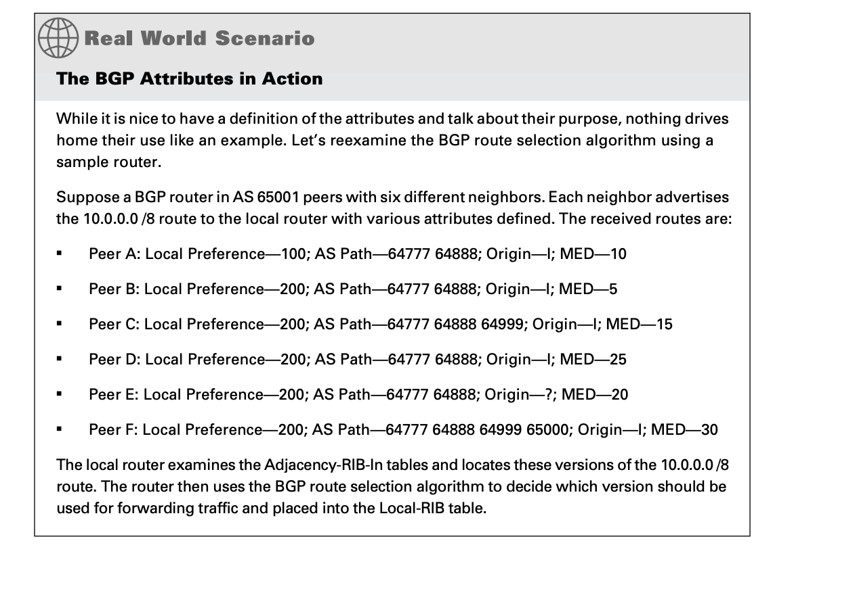
Case-Study:
Next hop –peer IP
Highest local preference
3.shortest AS path
Smallest origin value i>e>?
Smallest MED value
6.EBGP preferred over IBGP
Smallest IGP metric to reach BGP next hop
Transient attributes

Slide 10
Next-hop self.
Will do lab together
BGP path manipulation (inbound/outbound traffic).
Pre-requisite:
ACL’s
Route-maps.

Slide 11
Access control lists (ACLs) provide a means to filter packets by allowing a user to permit or deny IP packets from crossing specified interfaces. Just imagine you come to a fair and see the guardian checking tickets. He only allows people with suitable tickets to enter. Well, an access list’s function is same as that guardian.
Access lists filter network traffic by controlling whether packets are forwarded or blocked at the router’s interfaces based on the criteria you specified within the access list.
To use ACLs, the system administrator must first configure ACLs and then apply them to specific interfaces. There are 3 popular types of ACL: Standard, Extended and Named ACLs.
Standard IP Access List
Standard IP lists (1-99) only check source addresses of all IP packets.
Configuration Syntax
access-list access-list-number {permit | deny} source {source-mask}
Apply ACL to an interface
ip access-group access-list-number {in | out}

