Slide 1


Slide 2
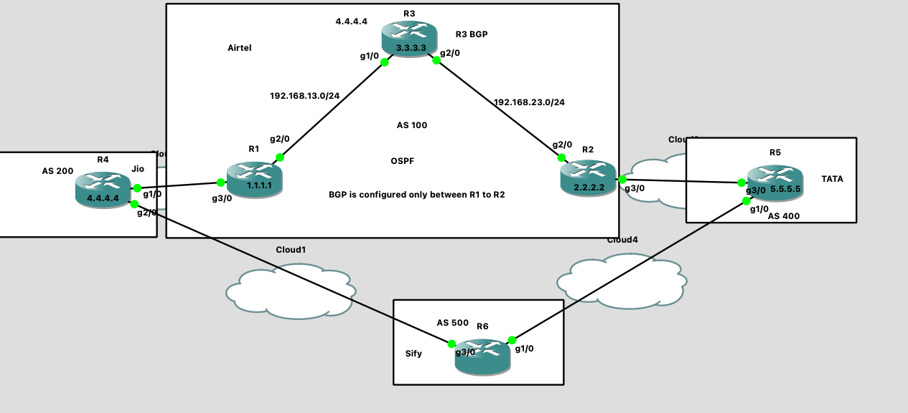
Topology

Slide 3
R1 router configuration:
R1#conf t
R1(config)#int g2/0
R1(config-if)#ip add 192.168.13.1 255.255.255.0
R1(config-if)#no shut
R1(config)#int g3/0
R1(config-if)#ip add 192.168.14.1 255.255.255.0
R1(config-if)#no shut
R1(config-if)#int lo0
R1(config-if)#ip add 1.1.1.1 255.255.255.255
R1(config)#router ospf 10
R1(config-router)#network 192.168.13.0 0.0.0.255 area 0
R1(config-router)#network 1.1.1.1 0.0.0.0 area 0
R1(config-router)#router bgp 100
R1(config-router)#neighbor 192.168.14.4 remote-as 200
R1(config-router)#neighbor 3.3.3.3 remote-as 100
R1(config-router)#neighbor 4.4.4.4 remote-as 100
R1(config-router)#neighbor 4.4.4.4 update-source lo0
R1(config-router)#neighbor 3.3.3.3 update-source lo0
R3 router configuration:
R3#conf t
R3(config)#int g1/0
R3(config-if)#ip add 192.168.13.3 255.255.255.0
R3(config-if)#no shut
R3(config-if)#int g2/0
R3(config-if)#ip add 192.168.23.3 255.255.255.0
R3(config-if)#no shut
R3(config-if)#int lo0
R3(config-if)#ip add 3.3.3.3 255.255.255.255
R3(config-if)#router ospf 10
R3(config-router)#network 3.3.3.3 0.0.0.0 area 0
R3(config-router)#network 192.168.23.0 0.0.0.255 area 0
R3(config-router)#network 192.168.23.0 0.0.0.255 area 0
R3(config-router)#network 192.168.13.0 0.0.0.255 area 0
R3(config-router)#router bgp 100
R3(config-router)#neighbor 1.1.1.1 remote-as 100
R3(config-router)#neighbor 1.1.1.1 update-source loo0
R3(config-router)#neighbor 2.2.2.2 remote-as 100
R3(config-router)#neighbor 2.2.2.2 up
R3(config-router)#neighbor 2.2.2.2 update-source lo0
R2 router configuration:
R2#conf t
R2(config)#int g2/0
R2(config-if)#ip add 192.168.23.2 255.255.255.0
R2(config-if)#no shut
R2(config-if)#int lo0
R2(config-if)#ip add 2.2.2.2 255.255.255.255
R2(config-if)#ip add 2.2.2.2 255.255.255.255
R2(config-if)#int g3/0
R2(config-if)#no shut
R2(config-if)#ip add 192.168.25.2 255.255.255.0
R2(config-if)#exit
R2(config)#router ospf 10
R2(config-router)#network 2.2.2.2 0.0.0.0 area 0
R2(config-router)#network 192.168.23.0 0.0.0.255 area 0
R2(config-router)#router bgp 100
R2(config-router)#neighbor 192.168.25.5 remote-as 400
R2(config-router)#neighbor 1.1.1.1 remote-as 100
R2(config-router)#neighbor 1.1.1.1 update-source lo0
R2(config-router)#neighbor 3.3.3.3 remote-as 100
R2(config-router)#neighbor 3.3.3.3 update-source lo0
R2(config-router)#exit

Slide 4
R4 router configuration:
R4#conf t
R4(config)#int g1/0
R4(config-if)#ip add 192.168.14.4 255.255.255.0
R4(config-if)#no shut
R4(config-if)#int loo
R4(config-if)#ip add 4.4.4.4 255.255.255.255
R4(config-if)#router bgp 200
R4(config-router)#neighbor 192.168.14.1 remote-as 100
R4(config-router)#network 4.4.4.4 mask 255.255.255.255
R4(config-router)#do wr
if you check on R5 router EBGP route 4.4.4.4
prepend the ASPATH
R5#sh ip bgp
BGP table version is 5, local router ID is 5.5.5.5
Status codes: s suppressed, d damped, h history, * valid, > best, i - internal,
r RIB-failure, S Stale, m multipath, b backup-path, f RT-Filter,
x best-external, a additional-path, c RIB-compressed,
Origin codes: i - IGP, e - EGP, ? - incomplete
RPKI validation codes: V valid, I invalid, N Not found
Network Next Hop Metric LocPrf Weight Path
*> 3.3.3.3/32 192.168.25.2 0 100 i
*> 4.4.4.4/32 192.168.25.2 0 100 200 I <----
*> 5.5.5.5/32 0.0.0.0 0 32768 i
*> 192.168.23.0 192.168.25.2 0 100 i
R5 router configuration:
R5#conf t
R5(config)#int g3/0
R5(config-if)#ip add 192.168.25.5 255.255.255.0
R5(config-if)#no shut
R5(config-if)#int lo0
R5(config-if)#ip add 5.5.5.5 255.255.255.255
R5(config-if)#no shut
R5(config-if)#router bgp 400
R5(config-router)#neighbor 192.168.25.2 remote-as 100
R5(config-router)#network 5.5.5.5 mask 255.255.255.255
R5(config-router)#do wr
Exercise: Please configure EBGP between R4 to R6 and R6 to R5
Verification commands:
Show ip bgp
Show ip route

Slide 5
Next-hop self:
As per the BGP advertisement rule, R3 receives EBGP prefix 4.4.4.4 with the next-hop of 192.168.14.4 and
5.5.5.5 with the next-hop of 192.168.25.5
R3(config-router)#do sh ip bgp
BGP table version is 1, local router ID is 3.3.3.3
Status codes: s suppressed, d damped, h history, * valid, > best, i - internal,
r RIB-failure, S Stale, m multipath, b backup-path, f RT-Filter,
x best-external, a additional-path, c RIB-compressed,
Origin codes: i - IGP, e - EGP, ? - incomplete
RPKI validation codes: V valid, I invalid, N Not found
Network Next Hop Metric LocPrf Weight Path
* i 4.4.4.4/32 192.168.14.4 0 100 0 200 i
* i 5.5.5.5/32 192.168.25.5 0 100 0 400 i
So, R3 router doesn’t know how to reach this next hop IP’s, hence, we configure next-hop self feature
On R1 and R2 IBGP peers.
R1(config-router)#neighbor 2.2.2.2 next-hop-self
R1(config-router)#neighbor 3.3.3.3 next-hop-self
R2(config-router)#neighbor 1.1.1.1 next-hop-self
R2(config-router)#neighbor 3.3.3.3 next-hop-self

Slide 6
Before Next-hop-self
R3(config-router)#do sh ip bgp
BGP table version is 1, local router ID is 3.3.3.3
Status codes: s suppressed, d damped, h history, * valid, > best, i - internal,
r RIB-failure, S Stale, m multipath, b backup-path, f RT-Filter,
x best-external, a additional-path, c RIB-compressed,
Origin codes: i - IGP, e - EGP, ? - incomplete
RPKI validation codes: V valid, I invalid, N Not found
Network Next Hop Metric LocPrf Weight Path
* i 4.4.4.4/32 192.168.14.4 0 100 0 200 i
* i 5.5.5.5/32 192.168.25.5 0 100 0 400 i
After Next-hop-self
R3(config-router)#do sh ip bgp
BGP table version is 3, local router ID is 3.3.3.3
Status codes: s suppressed, d damped, h history, * valid, > best, i - internal,
r RIB-failure, S Stale, m multipath, b backup-path, f RT-Filter,
x best-external, a additional-path, c RIB-compressed,
Origin codes: i - IGP, e - EGP, ? - incomplete
RPKI validation codes: V valid, I invalid, N Not found
Network Next Hop Metric LocPrf Weight Path
*>i 4.4.4.4/32 1.1.1.1 0 100 0 200 i
*>i 5.5.5.5/32 2.2.2.2 0 100 0 400 i

