Slide 1


Slide 2
BGP Peer Groups are a feature in Border Gateway Protocol (BGP) that allows network administrators to simplify the management of BGP configurations, particularly when dealing with multiple BGP peers that share common policies.
Why BGP Peer Groups Are Used:
Configuration Simplification:
When you have multiple BGP peers that need to apply the same policies (such as route maps, prefix lists, or filter policies), you can create a BGP peer group and apply these policies to the group. This means that instead of applying the same policies to each peer individually, you only need to configure the policies once for the peer group.
Reduced CPU Utilization:
Without peer groups, BGP has to process and apply the same set of policies for each peer separately, which can be CPU-intensive, especially in large networks with many peers. By using peer groups, the router processes the policies once for the group, reducing the overall CPU load.
Operational Efficiency:
BGP peer groups improve operational efficiency by reducing the potential for configuration errors and simplifying the overall BGP configuration. This makes it easier to manage and scale BGP in large networks.
Ease of Management:
If you need to update the policies or configuration parameters for a group of peers, you can do so by modifying the peer group configuration. All peers within the group will automatically inherit the changes, reducing administrative overhead.
How It Works:
A BGP peer group is created by defining a peer group name in the BGP configuration.
Common parameters (like remote-as, update-source, route policies) are applied to this peer group.
Individual BGP peers are then added to the peer group.
router bgp 65001
neighbor PEER_GROUP_NAME peer-group
neighbor PEER_GROUP_NAME remote-as 65002
neighbor PEER_GROUP_NAME update-source Loopback0
neighbor PEER_GROUP_NAME route-map POLICY_NAME in
neighbor 192.168.1.1 peer-group PEER_GROUP_NAME
neighbor 192.168.1.2 peer-group PEER_GROUP_NAME
In this example, the BGP peers 192.168.1.1 and 192.168.1.2 are Individual BGP peers automatically receive or apply the configuration settings that have been defined for the peer group PEER_GROUP_NAME.
BGP peer groups are particularly useful in large-scale deployments where managing individual peer configurations would be complex and prone to errors.

Slide 3
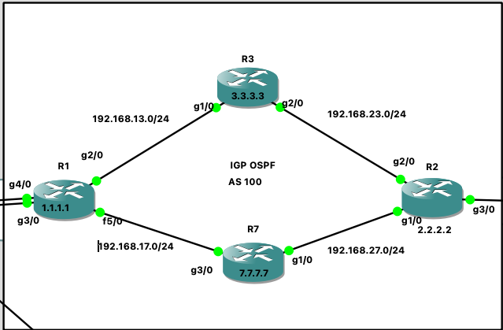
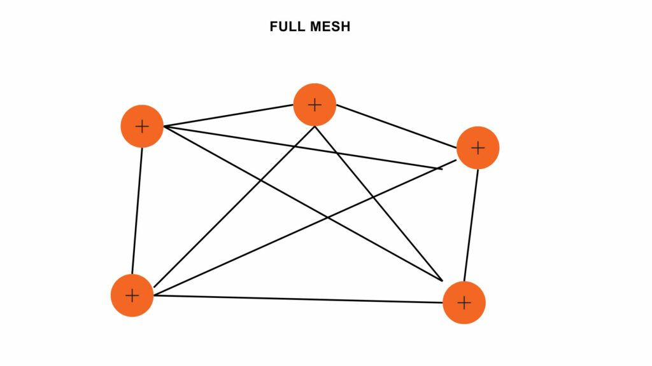
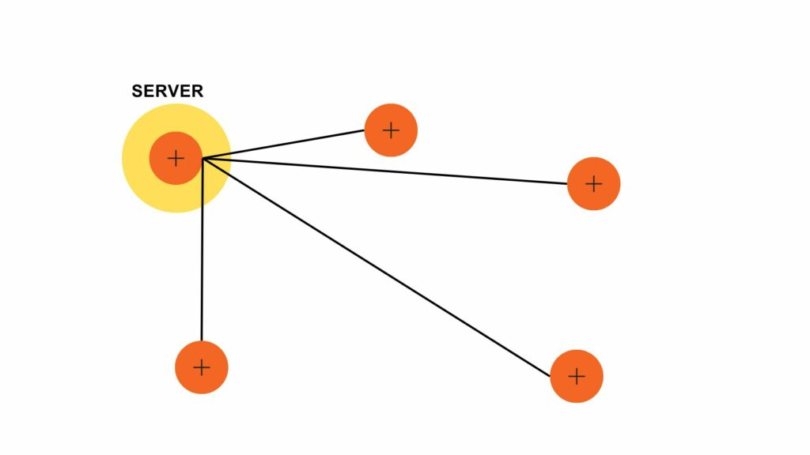
Why Route Reflectors (RRs) Are Used:
Problem: In BGP, the split horizon rule prevents a BGP router from advertising routes it learned via iBGP to other iBGP peers. To ensure all routers in an Autonomous System (AS) can exchange routes, they traditionally need to be fully meshed—meaning every router must have a direct iBGP session with every other router. This becomes impractical as the network grows because the number of connections increases rapidly.
Solution: Route Reflector is the method that helps to avoid the full mesh neighborship and reduce the number of BGP peering within an AS.
In the case of route reflector, routers get configured as Client and Server. The server is responsible for advertising the traffic to all the clients in a topology.
Topology with and without route reflector configured would look like this:-
Now each router needs to have an iBGP peering with just a server.

Slide 4
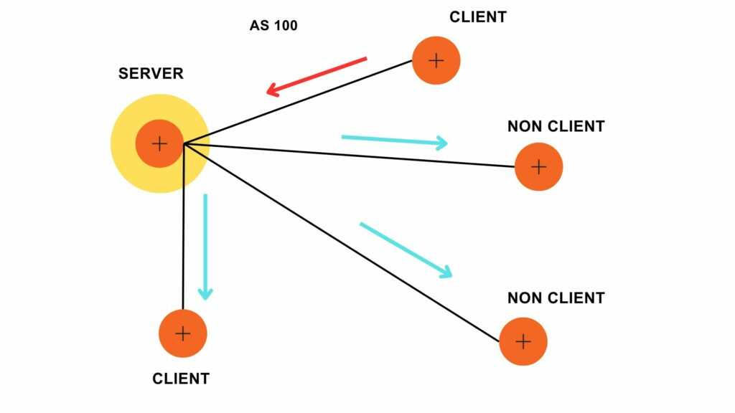
What is the role of routers in BGP Route Reflector Configuration?
The role of routers in BGP Route Reflector Configuration is as follows-
Route Reflector (RR)
The Route Reflector, also known as the Server, is responsible for reflecting BGP routes. The server receives BGP updates, stores them, and then reflects those updates to other routers accordingly. It also communicates with non-client routers directly or through client routers.
Client Routers
These are BGP routers that form a peering relationship with a Route Reflector. They advertise their routes to the Route Reflector, which then reflects these routes to other clients. Client routers do not peer directly with each other; instead, they peer with the Route Reflector. We need to configure the router as a client.
Non-Client Routers
These are BGP routers that do not peer directly with other non-client routers. They receive BGP routes from Route Reflectors, either directly or through client routers.
Based on the types of routers, we can have the following cases: -
Case – 1
If a route comes from a Client, the Route Reflector reflects it to all other clients and non-clients.

Slide 5
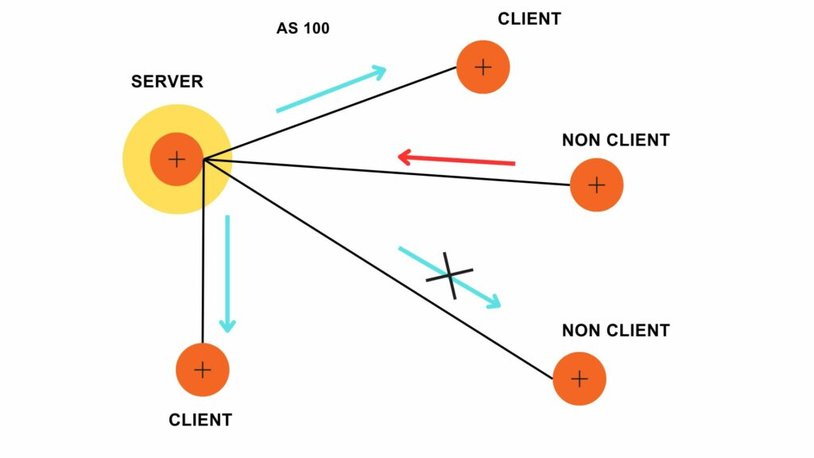
Case – 2
If a route comes from a non-client, the Route reflector reflects it to all the clients but not the non-clients.

Slide 6
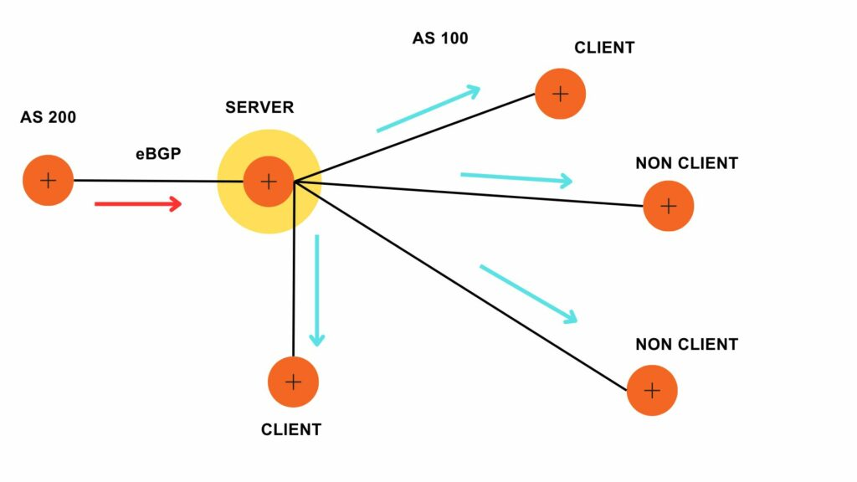
Case – 3
If a route comes from an eBGP peer, the Route reflector reflects it to all the clients and non-clients.

Slide 7
Peer groups LAB:
R1 Router:
router bgp 100
redistribute connected
neighbor IBGP peer-group
neighbor IBGP remote-as 100
neighbor IBGP update-source Loopback0
neighbor IBGP next-hop-self
neighbor 2.2.2.2 peer-group IBGP
neighbor 3.3.3.3 peer-group IBGP
neighbor 7.7.7.7 peer-group IBGP
R3 Router
router bgp 100
redistribute connected
neighbor IBGP peer-group
neighbor IBGP remote-as 100
neighbor IBGP update-source Loopback0
neighbor 1.1.1.1 peer-group IBGP
neighbor 7.7.7.7 peer-group IBGP
neighbor 2.2.2.2 peer-group IBGP
R7 Router:
router bgp 100
redistribute connected
neighbor IBGP peer-group
neighbor IBGP remote-as 100
neighbor IBGP update-source Loopback0
neighbor 1.1.1.1 peer-group IBGP
neighbor 3.3.3.3 peer-group IBGP
neighbor 2.2.2.2 peer-group IBGP
R2 Router
router bgp 100
redistribute connected
neighbor IBGP peer-group
neighbor IBGP remote-as 100
neighbor IBGP update-source Loopback0
neighbor 1.1.1.1 peer-group IBGP
neighbor 7.7.7.7 peer-group IBGP
neighbor 3.3.3.3 peer-group IBGP
Verification:
Show IP BGP Summary
Neighbor V AS MsgRcvd MsgSent TblVer InQ OutQ Up/Down State/PfxRcd
2.2.2.2 4 100 8 9 12 0 0 00:04:02 4
3.3.3.3 4 100 8 9 12 0 0 00:04:13 3
7.7.7.7 4 100 8 9 12 0 0 00:03:46 1

Slide 8
Route Reflectors LAB
As per the Topology I am going to configure R1 and R2
As a Route reflectors and R3 and R7 are clients
You can apply route-reflector-client on R1 and R2 bgp
Neighbors. Hence, R1 and R2 will become the RR’2.
Remove BGP neighbors from R3 and R7 as part of removing full mesh.
R1
Router bgp 100
no neighbor 7.7.7.7 peer-group IBGP
R7
Router bgp 100
no neighbor 3.3.3.3 peer-group IBGP
Don’t remove 1.1.1.1 and 2.2.2.2 both are RR’s.
Now you can’t see 7.7.7.7 route on R3. because of Split-horizon rule
R3(config-router)#do sh ip bgp
BGP table version is 19, local router ID is 3.3.3.3
Status codes: s suppressed, d damped, h history, * valid, > best, i - internal,
r RIB-failure, S Stale, m multipath, b backup-path, f RT-Filter,
x best-external, a additional-path, c RIB-compressed,
Origin codes: i - IGP, e - EGP, ? - incomplete
RPKI validation codes: V valid, I invalid, N Not found
Network Next Hop Metric LocPrf Weight Path
r>i 1.1.1.1/32 1.1.1.1 0 100 0 i
*> 3.3.3.3/32 0.0.0.0 0 32768 ?
*>i 4.4.4.4/32 1.1.1.1 0 100 0 200 ?
* i 192.168.13.0 1.1.1.1 0 100 0 ?
*> 0.0.0.0 0 32768 ?
*>i 192.168.14.0 1.1.1.1 0 100 0 ?
r>i 192.168.17.0 1.1.1.1 0 100 0 ?
*> 192.168.23.0 0.0.0.0 0 32768 ?
*>i 192.168.41.0 1.1.1.1 0 100 0 ?
*>i 192.168.46.0 1.1.1.1 0 100 0 200 ?

Slide 9
Configuring RR’s
As per previous setup with peer groups, all bgp neighbors
Using peer groups. So we can apply this command
route-reflector-client on BGP PEER group IBGP
R1(config-router)#neighbor IBGP route-reflector-client
R2(config-router)#neighbor IBGP route-reflector-client
Verify the route 7.7.7.7 on R3. Now you will see IBGP update on R3. This is the magic of RR’s. You no need
Full mesh configuration to send IBGP updates to another IBGP router.
R3(config-router)#do sh ip bgp
BGP table version is 54, local router ID is 3.3.3.3
Status codes: s suppressed, d damped, h history, * valid, > best, i - internal,
r RIB-failure, S Stale, m multipath, b backup-path, f RT-Filter,
x best-external, a additional-path, c RIB-compressed,
Origin codes: i - IGP, e - EGP, ? - incomplete
RPKI validation codes: V valid, I invalid, N Not found
Network Next Hop Metric LocPrf Weight Path
r i 1.1.1.1/32 1.1.1.1 0 100 0 i
r>i 1.1.1.1 0 100 0 i
r>i 2.2.2.2/32 2.2.2.2 0 100 0 ?
r i 2.2.2.2 0 100 0 ?
*> 3.3.3.3/32 0.0.0.0 0 32768 ?
* i 4.4.4.4/32 1.1.1.1 0 100 0 200 ?
*>i 1.1.1.1 0 100 0 200 ?
*>i 5.5.5.5/32 2.2.2.2 0 100 0 400 ?
* i 2.2.2.2 0 100 0 400 ?
* i 6.6.6.6/32 2.2.2.2 0 100 0 400 500 ?
*>i 1.1.1.1 0 100 0 200 500 ?
r i 7.7.7.7/32 7.7.7.7 0 100 0 i ----------------------→ RR’s are advertising IBGP UPDATE.
r>i 7.7.7.7 0 100 0 i

Slide 10
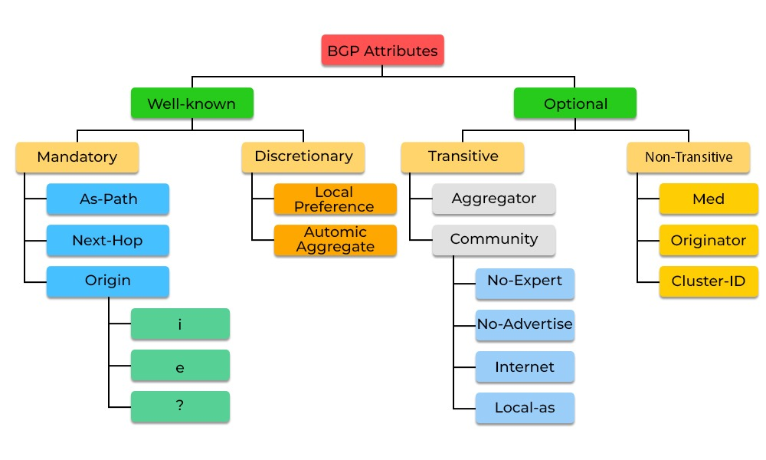
BGP Attributes
Well know Mandatory attributes
AS PATH ,
NEXT HOP= peer ip address or neighbor ip address(it should be be reachable)
Origin
2.2.2.2 --- as path
1.1.1.1

Slide 11
BGP Path selection process:
Next-hop reachability
A path with the highest “local preference” is preferred (usually set to 100).
A path with the shortest AS Path is preferred (skippable via router configuration).
A path with the lowest origin type is preferred. Origin types are preferred in this order:- IGP- EGP- Incomplete
A path with the lowest MED is preferred. By default, the MED is compared only if the neighbour AS is the same for the paths that are compared (this is configurable). There are multiple commands related to how and when to treat the MED value of the paths, which, due to its complexity, is outside the scope of this article.
A path that is an External BGP path is preferred (versus internal).
A path with the lowest IGP metric for BGP next-hop is preferred. At this point, if multipath is configured, the Router installs the routes. If not, the algorithm continues to the next step.
If both routes are external, the oldest route is preferred. This step is skipped if the BGP is configured to compare the router-ID or the paths have the same router-ID.
A path with the shortest cluster list length is preferred. This step is applicable only in a route reflector environment. If this is not the case, this step is skipped.
A path with the lowest router ID is preferred. The router-ID can be manually set or it can be set automatically using the highest IP address configured (first the loopback interfaces are considered and then the physical interfaces).
The router selects the route from the peer with the smallest numerical Peer Address.

Slide 12
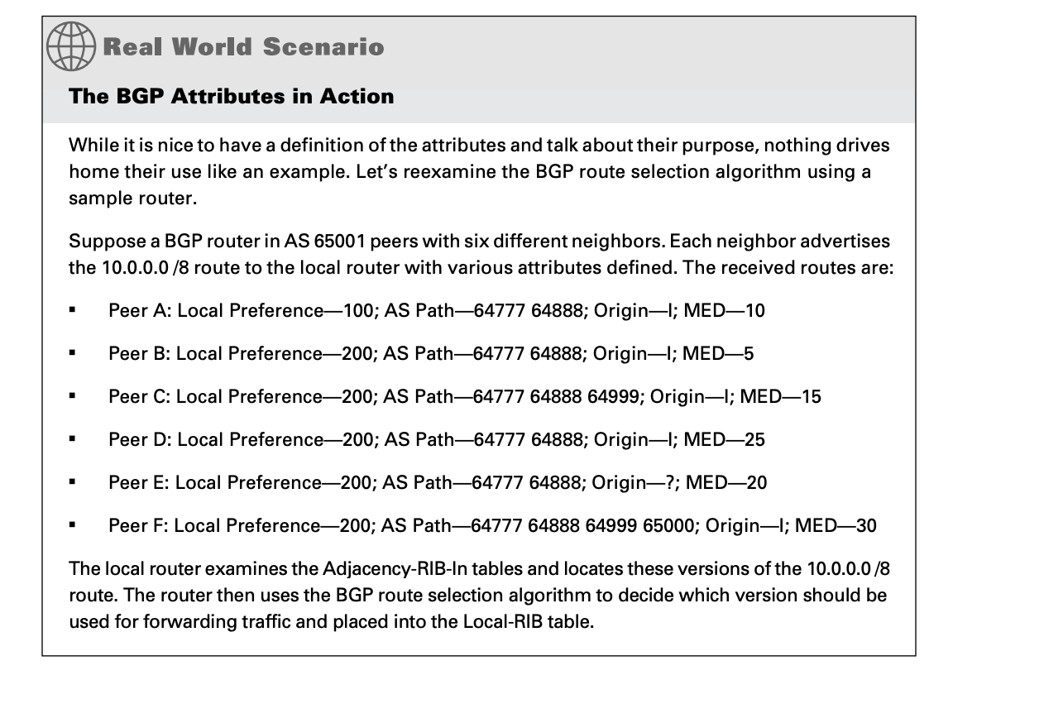
Case-Study:
Next hop –peer IP
Highest local preference
3.shortest AS path
Smallest origin value i>e>?
Smallest MED value
6.EBGP preferred over IBGP
Smallest IGP metric to reach BGP next hop
Case Study

