Slide 1


Slide 2
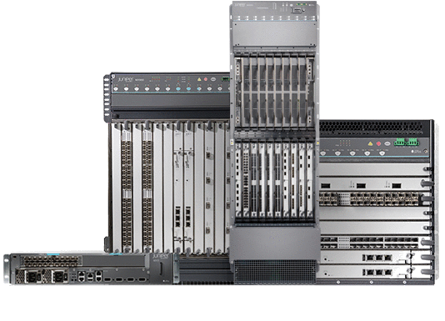
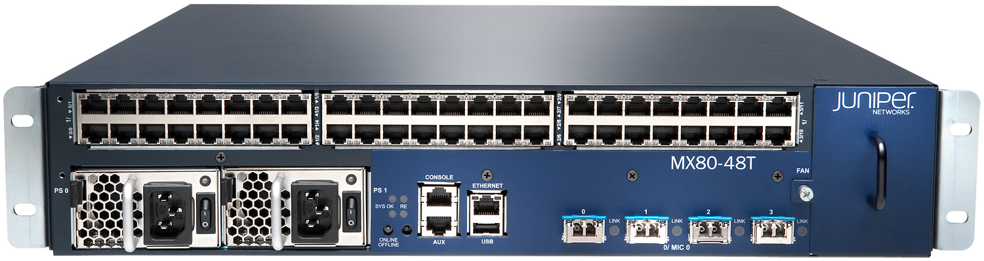
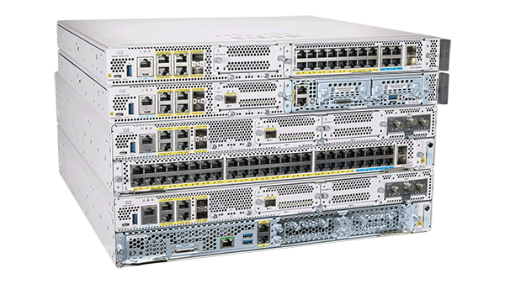

Routing Technologies:
Routers: -Layer 3 devices

Slide 3
Dynamic Routing protocols:
In the previous class, we have discussed about static routing. We saw how the router finds the best path to a network. We configured static routes manually and traffic was able to flow from Hyderabad router to Bangalore router.
The disadvantage of static routing is we must know the destination address and subnet mask and next-hop IP addresses and need to add routes manually on each and every router. Consider if it s big network, example service provider network AIRTEL, which spread across the India. It uses 1000’s of routers and you can’t configure static route for big network. Hence, We use dynamic routing protocols.
Dynamic routing protocols learned the routes automatically. You just need to advertise your local routes.
Routing protocols are used to enable the routers exchange routing information, they allow routers to learn about remotely connected networks dynamically. This information is then added to their routing tables and forwarding the packets to the next-hop’s.
Below are the general steps routers will take. However, the processes differ with each routing protocol and will be discussed at a later stage.
Exchange of information on interfaces to discover neighboring routers
Exchange of routes that have been advertised
Running of the algorithm so as to determine the best path
Adding of best paths to the routing table
Detection of topology changes and making the necessary changes

Slide 4
Advantages and disadvantages
Now that we have seen the dynamic routing protocols to be covered in this course, we need to know the advantages and disadvantages of using dynamic routing protocols. We also need to compare them to static routes.
Advantages
Exchange of routing information when there is a topology change is dynamic.
Less administrative overhead as compared to static routes which have to be manually configured
Less error prone than static routing which.
Scalability, since there is less administrative overhead than static routes.
Disadvantages
Require more expertise by the administrator, they are not as simple to configure as static routes.
They use more of the routers resources; such as CPU and RAM.

Slide 5
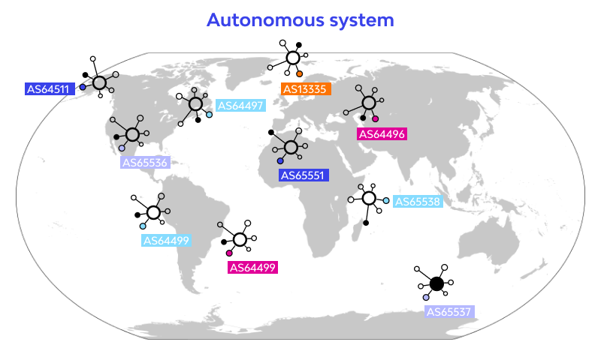
EGP vs IGP
As mentioned earlier, routing protocols fall into two main categories which are;
EGP – Exterior Gateway Protocols
IGP – Interior Gateway Protocols
This categorization, is based on the Autonomous Systems. Autonomous systems also known as routing domains, are collections of routers under the same administration. It means the routers that are owned by one company.
Each company maintains their own autonomous system number. Example we have lot of service providers
Such as Airtel, Jio, Tata communications, google, Facebook etc.
There are two different formats to represent ASNs: 2-byte and 4-byte.
A 2-byte ASN is a 16-bit number. This format provides for 65,536 ASNs (0 to 65535). The Public AS numbers range from 1 to 64511 and the Private AS numbers range from 64512 to 65535.
Interior Gateway Protocol (IGP)
IGP is designed and intended for use inside a single autonomous system.
It means, IGP can use within the Airtel routers.
IGP is further divided into multiple types-
Distance vector routing protocol (DVRP): – Routing Internet protocol (RIP), Interior gateway routing protocol (IGRP)
Advanced distance vector routing protocol (ADVRP): – Enhance interior gateway routing protocol (EIGRP)
Link state routing protocol (LSRP): – Open shortest path first (OSPF), IS-IS (Intermediate system-intermediate system).

Slide 6
Exterior Gateway Protocol (EGP):
EGP is designed to be used between the same as well as different autonomous systems over the internet.
NOTE: Path vector routing protocol (PVRP) i.e. Border gateway protocol comes under this category.
From IGP protocols, we will discuss OSPF protocol, which is most used in Realtime environment. Also, IS-IS
Protocol also used in Internet service providers. Both are using same algorithm.
OSPF (Open Shortest Path First)
OSPF routers maintain a complete map of the network topology. Each OSPF router has information about all the routers in the network and their connections, allowing it to compute the shortest path to every destination.
OSPF uses Dijkstra's Shortest Path First (SPF) Algorithm to compute the shortest path to each destination based on the complete network map. Each router independently calculates the best paths, ensuring optimal routing decisions.
OSPF sends updates only when there are changes in the network, such as a link going up or down. This efficiency contrasts with distance-vector protocols, which periodically broadcast entire routing tables.

Slide 7
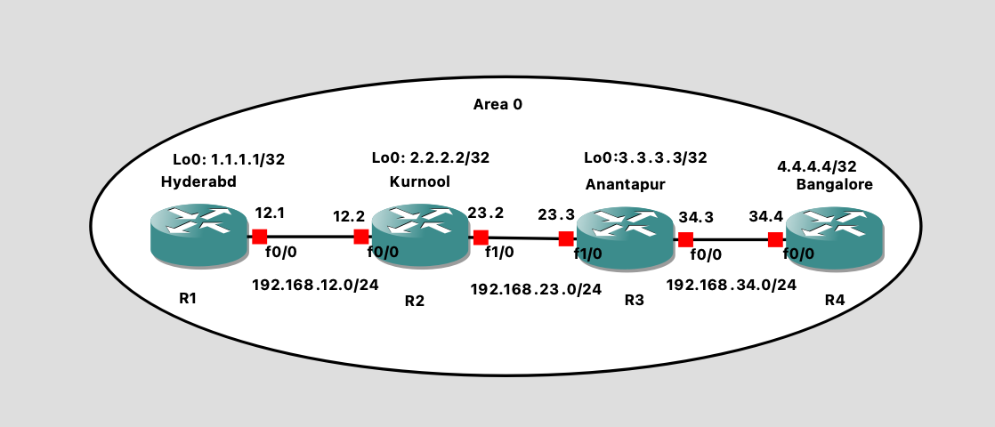
How OSPF learn routes dynamically? We will do basic lab to test.
Syntax:
Configure terminal
Router ospf <process ID>
Network <N/W> <wildcard mask> area 0
process-id: A locally significant number used to identify the OSPF process on the router. If you configure multiple areas, you can configure different process ID for each area. This is just to identify the OSPF area process.
ip-address: The IP address or subnet to be included in the OSPF process.
wildcard-mask: Used to specify which bits of the IP address must match. It is the inverse of a subnet mask.
Example:
255.255.255.255
255.255.255.0
0.0.0.0- wildcard mask
area-id: Identifies the OSPF area. OSPF networks can be divided into areas to optimize performance. Each router in area 0 maintains the same database.

Slide 8
Hyderabad Router
Kurnool_R2 Router:
Enter in configure terminal mode and execute below commands:
Enter in configure terminal mode and execute below commands:
interface Loopback0
ip address 1.1.1.1 255.255.255.255
exit
interface Loopback0
ip address 2.2.2.2 255.255.255.255
exit
interface FastEthernet0/0
ip address 192.168.12.2 255.255.255.0
exit
interface FastEthernet1/0
ip address 192.168.23.2 255.255.255.0
exit
interface FastEthernet0/0
ip address 192.168.12.1 255.255.255.0
exit
Configure OSPF
Configure terminal
router ospf 10
network 1.1.1.1 0.0.0.0 area 0
network 192.168.12.0 0.0.0.255 area 0
Configure OSPF
Anantapur_R3 Router
Configure terminal
router ospf 10
network 2.2.2.2 0.0.0.0 area 0
network 192.168.12.0 0.0.0.255 area 0
network 192.168.23.0 0.0.0.255 area 0
Enter in configure terminal mode and execute below commands:
interface Loopback0
ip address 3.3.3.3 255.255.255.255
exit
interface FastEthernet0/0
ip address 192.168.34.3 255.255.255.0
exit
interface FastEthernet1/0
ip address 192.168.23.3 255.255.255.0
exit

Slide 9
Configure OSPF
router ospf 10
network 3.3.3.3 0.0.0.0 area 0
network 192.168.23.0 0.0.0.255 area 0
network 192.168.34.0 0.0.0.255 area 0
Bangalor_R4 Rouer
Enter in configure terminal mode and execute below commands:
interface Loopback0
ip address 4.4.4.4 255.255.255.255
exit
interface FastEthernet0/0
ip address 192.168.34.4 255.255.255.0
exit
Configure OSPF
router ospf 10
network 4.4.4.4 0.0.0.0 area 0
network 192.168.34.0 0.0.0.255 area 0

Slide 10
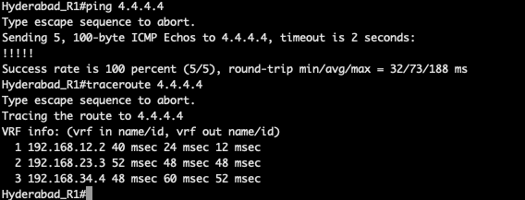
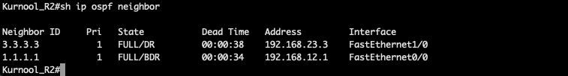
Verification:
Initiate ping and traceroute from Kurnool to bangalore
We are able to ping 4.4.4.4 by configuring dynamic routing protocol OSPF.
Its just easy to configure OSPF. However, how they learn routes dynamically ? We should know the process behind Route learning.
Each router discover the neighbors, example Hyderabad neighbor is Kurnool and Kurnool neighbor is both
Hyderabad and Anantapur
Shown in picture-----→

Slide 11
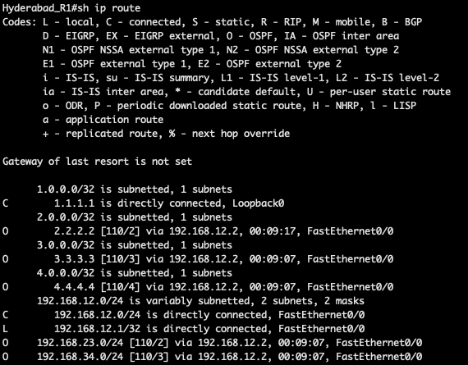
If you see routing table, all routes learned by OSPF showing O symbol and AD value is 110

Slide 12
OSPF Important contents:
OSPF- Header
OSPF Packets and its headers
Hello Packet
DBD –Database description packet
LSR –link state request
LSU – Link state update
LSA – Link state Acknowledgement
OSPF Adjacency process and OSPF states.
OPSF Area’s (single area and multiple OSPF area’s)
Types OSPF Area (stubby , NSSA)
LSA Types
Virtual Link
Real time scenario based LABS
OSPF Troubleshooting.

Slide 13
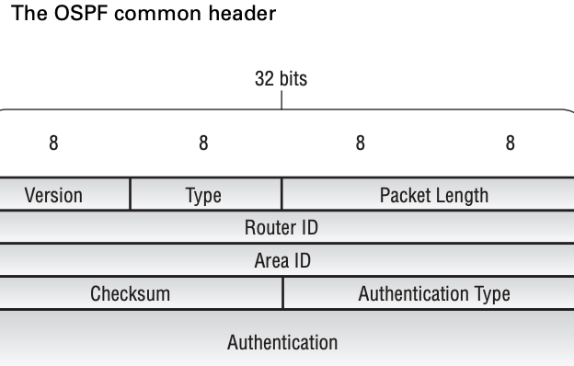
Please learn packet Headers before we discuss OSPF adjacency process
OSPF- Header:
Version
Router ID
Area ID
Authentication type
Authentication data

Slide 14
Common Packet Header:
All OSPF packets share a common 24-octet header. This header allows the receiving router to determine whether the packet is valid and should be processed. Figure shows the OSPF header fields, which include the following:
Version (1 octet) This field details the current version of OSPF used by the local router. It is set to a value of 2, the default value.
Type (1 octet) This field specifies the type of OSPF packet. Possible values include:
1—Hello packet
2—Database descriptor
3—Link-state request
4—Link-state update
5—Link-state acknowledgment
Packet Length (2 octets) This field displays the total length, in octets, of the OSPF packet.
Router ID (4 octets) The router ID of the advertising router appears in this field.
Area ID (4 octets) This field contains the 32-bit area ID assigned to the interface used to send the OSPF packet.
Checksum (2 octets) This field displays a standard IP checksum for the entire OSPF packet, excluding the 64-bit authentication field.
Authentication Type (2 octets) The specific type of authentication used by OSPF is encoded in this field. Possible values are:
0—Null authentication
1—Simple password
2—MD5 cryptographic authentication
Authentication (8 octets) This field displays the authentication data to verify the packet’s integrity.

Slide 15
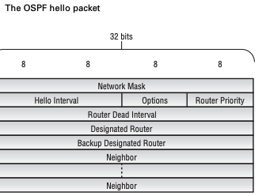
OSPF Packets:
Hello Packet
DBD –Database description packet
LSR –link state request
LSU – Link state update
LSA – Link state Acknowledgement
Version
Router ID
Area ID
Authentication type
Authentication data
Network mask

Slide 16
OSPF Packets:
Hello Packet
Network Mask (4 octets) This field contains the subnet mask of the advertising OSPF interface. Unnumbered point-to-point interfaces and virtual links set this value to 0.0.0.0.
Hello Interval (2 octets) This field displays the value of the hello interval requested by the advertising router. Possible values range from 1 to 255, with a default value of 10 seconds.
Options (1 octet) The local router advertises its capabilities in this field. Each bit in the Options field represents a different function.
Router Priority (1 octet) This field contains the priority of the local router. The value is used in the election of the designated router and backup designated router. Possible values range from 0 to 255, with a default value of 128.
Router Dead Interval (4 octets) This field shows the value of the dead interval requested by the advertising router. Possible values range from 1 to 65,535. The JUNOS software uses a default value of 40 seconds.
Designated Router (4 octets) The interface address of the current designated router is displayed in this field. A value of 0.0.0.0 is used when no designated router has been elected.
Backup Designated Router (4 octets) The interface address of the current backup designated router is displayed in this field. A value of 0.0.0.0 is used when no backup designated router has been elected.
Neighbor (Variable) This field displays the router ID of all OSPF routers for which a hello packet has been received on the network segment.

Slide 17
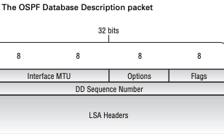
OSPF Packets:
2. DBD –Database description packet
Interface MTU (2 octets) This field contains the MTU value, in octets, of the outgoing interface. When the interface is used on a virtual link, the field is set to a value of 0x0000.
Options (1 octet) The local router advertises its capabilities in this field. The bit values are discussed in the “Hello Packet” section earlier in this chapter.
Flags (1 octet) This field provides an OSPF router with the capability to exchange multiple DD packets with a neighbor during an adjacency formation. The flag definitions include the following:
Bits 3 through 7 These bit values are currently undefined and must be set to a value of 0.
Bit 2 The I bit, or Initial bit, designates whether this DD packet is the first in a series of packets. The first packet has a value of 1, while subsequent packets have a value of 0.
Bit 1 The M bit, or More bit, informs the remote router whether the DD packet is the last in a series. The last packet has a value of 0, while previous packets have a value of 1.
Bit 0 The MS bit, or Master/Slave bit, is used to indicate which OSPF router is in control of the database synchronization process. The master router uses a value of 1, while the slave uses a value of 0.
DD Sequence Number (4 octets) This field guarantees that all DD packets are received and processed during the synchronization process through use of a sequence number. The Master router initializes this field to a unique value in the first DD packet, with each subsequent packet being incremented by 1.
LSA Headers (Variable) This field carries the LSA headers describing the local router’s database information. Each header is 20 octets in length and uniquely identifies each LSA in the database. Each DD packet may contain multiple LSA headers.

Slide 18
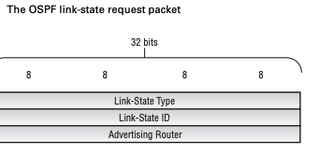
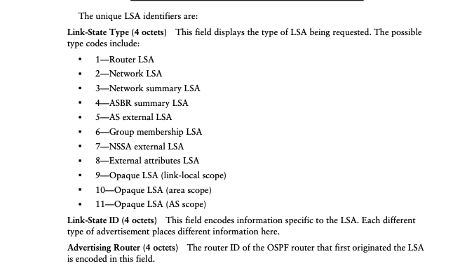
3. Link state Request packet

Slide 19
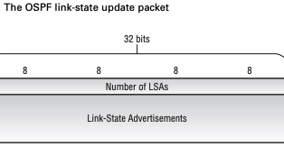
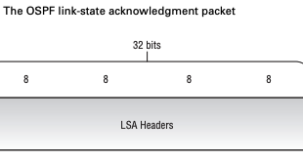
Link-State Update Packet
The two fields in the packet are:
Number of LSAs (4 octets) This field displays the number of LSAs carried within the linkstate update packet.
Link-State Advertisements (Variable) The complete LSA is encoded within this variable-length field. Each type of LSA has a common header format along with specific data fiel
Link-State Acknowledgment Packet

Slide 20
OSPF Adjacency Formation Process
When two OSPF routers form an adjacency, they transition through several states before becoming fully operational neighbors. The states are as follows:
Down
This is the initial state for all OSPF routers. A start event, such as configuring the protocol, moves the router to the Init state.The router lists a neighbor in this state when no hello packets have been received within the specified router dead interval for that interface.
Init
The router reaches the Init state upon receiving a hello packet. The local router's ID is not listed in the received Neighbor field, indicating that bidirectional communication has not been established.
Attempt
This state is applicable only for Non-Broadcast Multi-Access (NBMA) networks. No hello packet has been received from the neighbor. The local router sends a unicast hello packet to the neighbor within the specified hello interval period.
2-Way
The local router enters the 2-Way state when it receives a hello packet with its own router ID in the Neighbor field. Bidirectional communication is established, and the peers are now OSPF neighbors.

Slide 21
ExStart
In this state, the local router and its neighbor determine which router will manage the database synchronization process. The router with the higher router ID becomes the master
Exchange
The routers exchange Database Description (DD) packets describing their local databases.
Loading
If the local router needs complete Link-State Advertisement (LSA) information from its neighbor, it transitions to the Loading state.
The router begins sending link-state request packets to obtain the required information.
Full
This is the final state of OSPF adjacency formation.
The local router has received a complete link-state database from its peer.
Both routers in this state add the adjacency to their local database and advertise the relationship in a link-state update packet.
This sequence of states ensures that OSPF routers can establish reliable and complete adjacencies to facilitate efficient routing within a network.

Slide 22
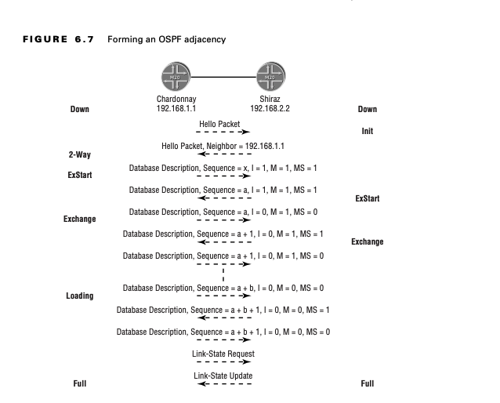
Hyderabad
Kurnool

Slide 23
1. Hyderabad initiates the conversation by sending a hello packet to Kurnool using the 224.0.0.5 multicast address. The DR and BDR fields are set to 0.0.0.0, and the Neighbor field is empty because Hyderabad has yet to receive any OSPF packets from Kurnool. Kurnool transitions to the Init state (bidirectional communication has not been established) and responds to Hyderabad with a hello packet. Kurnool lists the router ID of Hyderabad, 192.168.1.1, in the Neighbor field of the packet and sets the DR and BDR fields to 0.0.0.0.
2. Hyderabad briefly transitions to the 2-Way state (bidirectional communication has been established) but quickly moves to the ExStart state. Hyderabad and Kurnool are now OSPF neighbors. At this point, Hyderabad sends a DD packet to Kurnool. The flags of the DD packet are set to negotiate the Master/Slave relationship to determine which router controls the synchronization process. The I bit, the M bit, and the MS bit are all set to 1; Hyderabad is starting the conversation, has more information to send, and is going to control the conversation. In addition, a sequence number (x) is chosen to identify the DD packets in this conversation.
3. Kurnool has a higher router ID (192.168.2.2) than Hyderabad and should be the Master for the process. It therefore responds with its own DD packet using a different sequence number (a). Kurnool also sets the I, M, and MS bits to 1 to designate its role in the synchronization process.
4. Hyderabad recognizes Kurnool’s higher router ID and role as the Master by generating a new DD packet containing the sequence number advertised by Kurnool (a) and having both the MS and I bits set to 0. At this time, Hyderabad transitions to the Exchange state.
5. Having completed the Master/Slave negotiation process, Kurnool also transitions to the Exchange state and begins sending DD packets with higher sequence numbers that contain the database information.

Slide 24
6. Hyderabad acknowledges the receipt of all DD packets by sending its own DD packets with the same sequence number. These new DD packets contain the information in Hyderabad’s link-state database. As each router receives a DD packet, it notes which LSA headers in the received packet are not in its own local database. This header information is contained in a memory structure called the link-state request list.
7. Kurnool receives a DD packet with the M bit set to 0, which indicates that Hyderabad has sent all of the information in its database. Kurnool examines its link-state request list and finds no entries. It then transitions to the Full state and continues sending DD packets to Hyderabad.
8. Hyderabad continues to advertise DD packets with the M bit set to 0 to Kurnool as acknowledgments. This indicates that it is still receiving DD packets from Kurnool and potentially adding information to its link-state request list. When Kurnool finally sends a DD packet with the M bit set to 0, Hyderabad examines its request list and finds multiple headers for which it needs information.
9. Hyderabad transitions to the Loading state and begins requesting its missing data structures using link-state request packets. It receives the needed information from Kurnool in the form of a link-state update packet. This process continues until Hyderabad has emptied the link-state request list, at which point it transitions to the Full state.
After both peers reach an OSPF adjacency state of Full, they maintain that adjacency using hello packets at the specified hello interval. Changes to the link-state database on either router are advertised using a link-state update; reliability is assured with a link-state acknowledgment packet.

