Slide 1

OSPF Important contents:
OSPF- Header
OSPF Packets and its headers
Hello Packet
DBD –Database description packet
LSR –link state request
LSU – Link state update
LSA – Link state Acknowledgement
OSPF Adjacency process
OPSF Area’s (single area and multiple OSPF area’s)
Types OSPF Area (stubby , NSSA)
LSA Types
Virtual Link
Real time scenario based LABS
OSPF Troubleshooting.

Slide 2
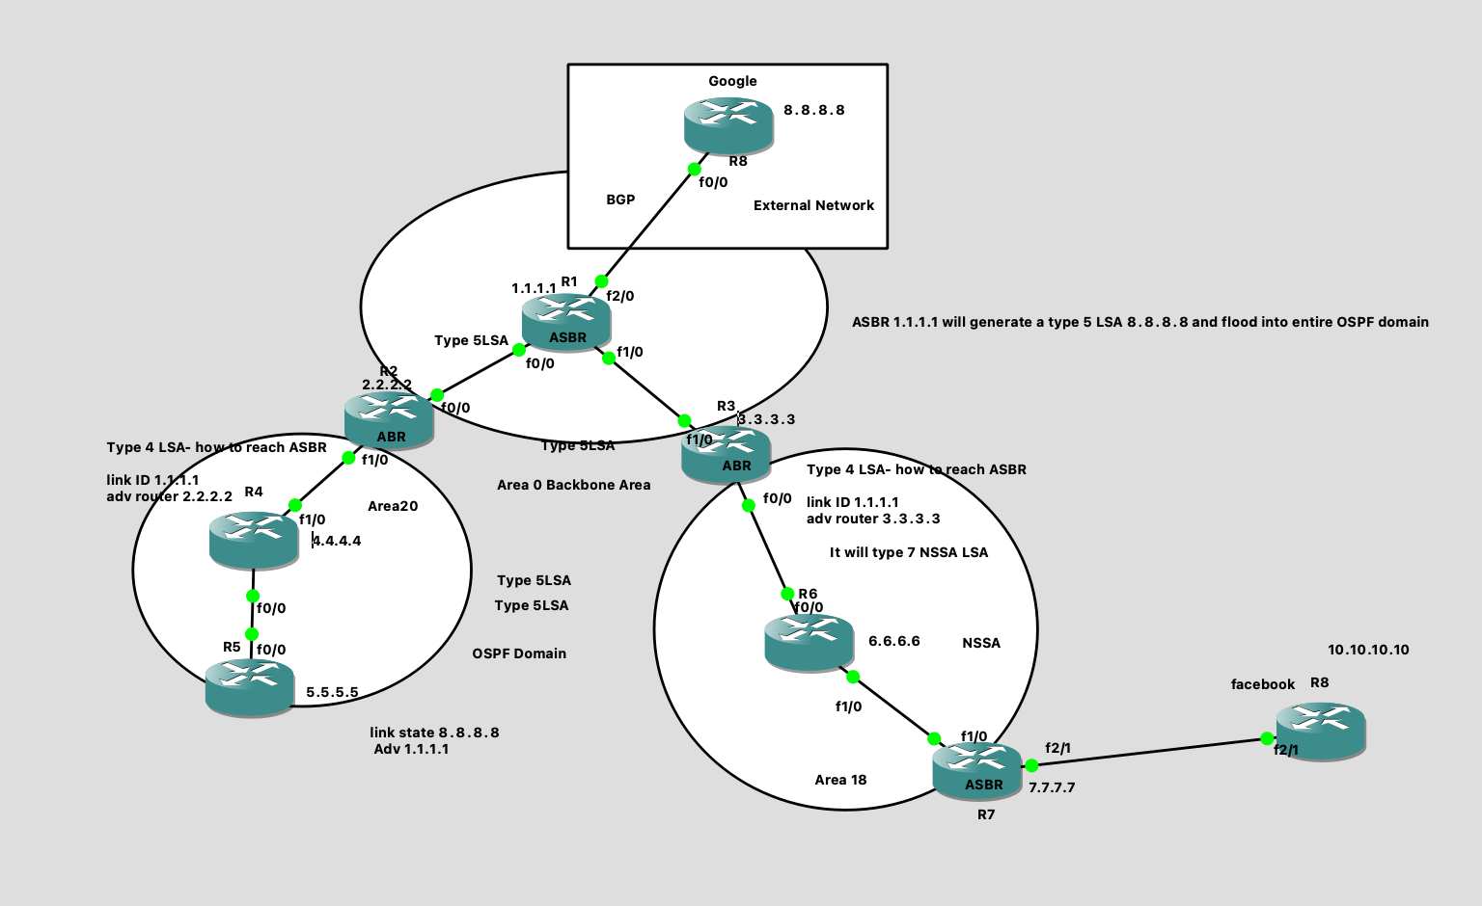
OSPF LAB with External Prefixes:

Slide 3
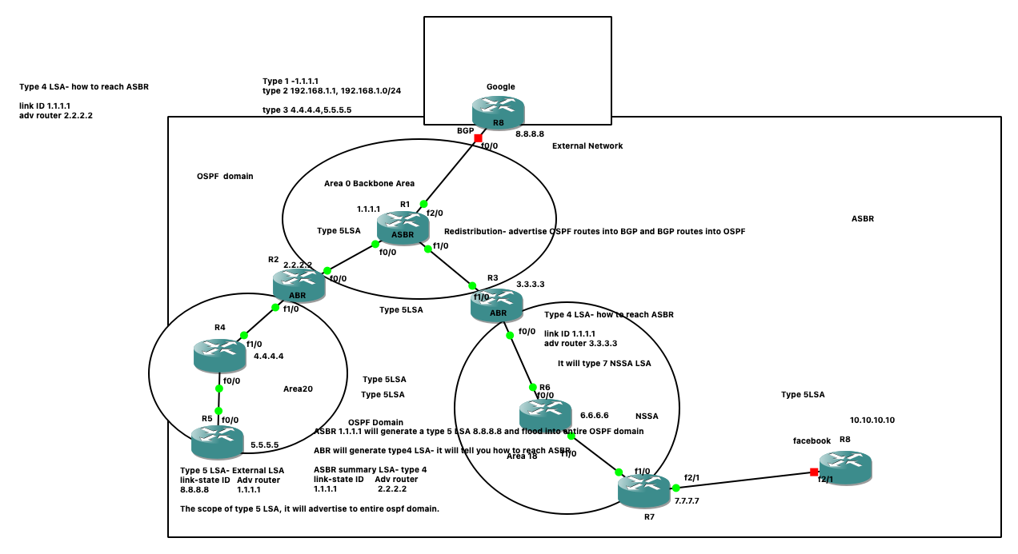

Slide 4
R2 Router
R1 router
interface Loopback0
ip address 1.1.1.1 255.255.255.255
!
interface FastEthernet0/0
ip address 192.168.12.1 255.255.255.0
No shut
!
interface FastEthernet1/0
ip address 192.168.13.1 255.255.255.0
!
No shut
interface FastEthernet2/0
ip address 192.168.18.1 255.255.255.0
!
No shut
router ospf 110
redistribute bgp 100 subnets
network 1.1.1.1 0.0.0.0 area 0
network 192.168.12.0 0.0.0.255 area 0
network 192.168.13.0 0.0.0.255 area 0
!
router bgp 100
bgp log-neighbor-changes
network 1.1.1.1 mask 255.255.255.255
redistribute ospf 110
neighbor 192.168.18.8 remote-as 300
interface Loopback0
ip address 2.2.2.2 255.255.255.255
!
interface FastEthernet0/0
ip address 192.168.12.2 255.255.255.0
No shut
!
interface FastEthernet1/0
ip address 192.168.24.2 255.255.255.0
No shut
router ospf 110
network 2.2.2.2 0.0.0.0 area 0
network 192.168.12.0 0.0.0.255 area 0
network 192.168.24.0 0.0.0.255 area 20
!
R3 Router
interface Loopback0
ip address 3.3.3.3 255.255.255.255
!
interface FastEthernet0/0
ip address 192.168.36.3 255.255.255.0
No shut
interface FastEthernet1/0
ip address 192.168.13.3 255.255.255.0
No shut
!
router ospf 110
network 3.3.3.3 0.0.0.0 area 0
network 192.168.13.0 0.0.0.255 area 0
network 192.168.36.0 0.0.0.255 area 18
!
Google Router:
Int lo0
Ip add 8.8.8.8 255.255.255.0
interface FastEthernet0/0
ip address 192.168.18.8 255.255.255.0
No shut
router bgp 300
bgp log-neighbor-changes
network 8.8.8.8 mask 255.255.255.255
neighbor 192.168.18.1 remote-as 100
!

Slide 5
R6 Router
R4 router
interface Loopback0
ip address 6.6.6.6 255.255.255.255
!
interface FastEthernet0/0
ip address 192.168.36.6 255.255.255.0
No shut
!
interface FastEthernet1/0
ip address 192.168.67.6 255.255.255.0
No shut
!
router ospf 110
network 6.6.6.6 0.0.0.0 area 18
network 192.168.36.0 0.0.0.255 area 18
network 192.168.67.0 0.0.0.255 area 18
!
interface Loopback0
ip address 4.4.4.4 255.255.255.255
!
interface FastEthernet0/0
ip address 192.168.45.4 255.255.255.0
No shut
!
interface FastEthernet1/0
ip address 192.168.24.4 255.255.255.0
No shut
!
router ospf 110
network 4.4.4.4 0.0.0.0 area 20
network 192.168.24.0 0.0.0.255 area 20
network 192.168.45.0 0.0.0.255 area 20
R8 Router
R5 Router
R7 Router
interface FastEthernet1/0
ip address 192.168.67.7 255.255.255.0
No shut
interface FastEthernet2/1
ip address 192.168.78.7 255.255.255.0
no shut
!
router ospf 110
redistribute bgp 100
network 7.7.7.7 0.0.0.0 area 18
network 192.168.67.0 0.0.0.255 area 18
!
router bgp 100
redistribute ospf 110
neighbor 192.168.78.8 remote-as 500
interface Loopback0
ip address 5.5.5.5 255.255.255.255
!
interface FastEthernet0/0
ip address 192.168.45.5 255.255.255.0
No shut
!
router ospf 110
network 5.5.5.5 0.0.0.0 area 20
network 192.168.45.0 0.0.0.255 area 20
!
Int f2/1
Ip add 192.168.78.8 255.255.255.0
No shut
Intlo0
Ip add 100.100.100.100 255.255.255.255
Ramesh_server(config)#router bgp 500
Ramesh_server(config-router)#neighbor 192.168.78.7 remote-as 100
Ramesh_server(config-router)#network 100.100.100.100 mask 255.255.255.255

Slide 6
Verification:
Check the ospf data base in area0 , area20 and area18 routers
R1#sh ip ospf data
OSPF Router with ID (1.1.1.1) (Process ID 110)
Router Link States (Area 0)
Link ID ADV Router Age Seq# Checksum Link count
1.1.1.1 1.1.1.1 11 0x80000017 0x005DB1 3
2.2.2.2 2.2.2.2 59 0x8000000E 0x0029E3 2
3.3.3.3 3.3.3.3 203 0x80000011 0x0057A2 2
Net Link States (Area 0)
Link ID ADV Router Age Seq# Checksum
192.168.12.2 2.2.2.2 59 0x8000000A 0x007D28
192.168.13.3 3.3.3.3 691 0x8000000A 0x006C2F
Summary Net Link States (Area 0)
Link ID ADV Router Age Seq# Checksum
4.4.4.4 2.2.2.2 143 0x80000001 0x00A87A
5.5.5.5 2.2.2.2 133 0x80000001 0x008499
6.6.6.6 3.3.3.3 203 0x80000009 0x001EF0
7.7.7.7 3.3.3.3 203 0x80000009 0x00F910
192.168.24.0 2.2.2.2 143 0x80000001 0x009C16
192.168.36.0 3.3.3.3 93 0x80000001 0x00F9A8
192.168.45.0 2.2.2.2 143 0x80000001 0x00BEDD
192.168.67.0 3.3.3.3 65 0x80000001 0x00ADD4
Type-5 AS External Link States
Link ID ADV Router Age Seq# Checksum Tag
8.8.8.8 1.1.1.1 497 0x8000000B 0x00B1A6 300
R1#

Slide 7
R4#sh ip ospf data
OSPF Router with ID (4.4.4.4) (Process ID 110)
¯ Router Link States (Area 20)
Link ID ADV Router Age Seq# Checksum Link count
2.2.2.2 2.2.2.2 297 0x8000000E 0x004DBE 1
4.4.4.4 4.4.4.4 279 0x80000018 0x00F494 3
5.5.5.5 5.5.5.5 276 0x80000010 0x002877 2
Net Link States (Area 20)
Link ID ADV Router Age Seq# Checksum
192.168.24.4 4.4.4.4 292 0x8000000E 0x001768
192.168.45.5 5.5.5.5 276 0x8000000E 0x008DCB
Summary Net Link States (Area 20)
Link ID ADV Router Age Seq# Checksum
1.1.1.1 2.2.2.2 372 0x80000009 0x002304
2.2.2.2 2.2.2.2 372 0x80000009 0x00EA39
3.3.3.3 2.2.2.2 372 0x80000009 0x00D04D
6.6.6.6 2.2.2.2 372 0x80000009 0x0050C0
7.7.7.7 2.2.2.2 372 0x80000009 0x002CDF
192.168.12.0 2.2.2.2 372 0x80000009 0x0011A5
192.168.13.0 2.2.2.2 372 0x80000009 0x0010A4
192.168.36.0 2.2.2.2 232 0x80000001 0x002C78
192.168.67.0 2.2.2.2 204 0x80000001 0x00DFA4
Summary ASB Link States (Area 20)
Link ID ADV Router Age Seq# Checksum
1.1.1.1 2.2.2.2 372 0x80000001 0x001B14
Type-5 AS External Link States
Link ID ADV Router Age Seq# Checksum Tag
8.8.8.8 1.1.1.1 638 0x8000000B 0x00B1A6 300
R4#

Slide 8
R7(config)#do sh ip ospf data
OSPF Router with ID (7.7.7.7) (Process ID 110)
Router Link States (Area 18)
Link ID ADV Router Age Seq# Checksum Link count
3.3.3.3 3.3.3.3 346 0x80000010 0x0028BE 1
6.6.6.6 6.6.6.6 214 0x80000016 0x00D84E 3
7.7.7.7 7.7.7.7 265 0x80000013 0x00262E 2
Net Link States (Area 18)
Link ID ADV Router Age Seq# Checksum
192.168.36.6 6.6.6.6 341 0x8000000B 0x00BEA1
192.168.67.7 7.7.7.7 265 0x8000000F 0x00F037
Summary Net Link States (Area 18)
Link ID ADV Router Age Seq# Checksum
1.1.1.1 3.3.3.3 441 0x8000000F 0x00F824
2.2.2.2 3.3.3.3 441 0x8000000C 0x00DA40
3.3.3.3 3.3.3.3 441 0x8000000D 0x009681
4.4.4.4 3.3.3.3 382 0x80000001 0x009E7E
5.5.5.5 3.3.3.3 372 0x80000001 0x007A9D
192.168.12.0 3.3.3.3 441 0x8000000C 0x00F6B7
192.168.13.0 3.3.3.3 441 0x8000000D 0x00DFCD
192.168.24.0 3.3.3.3 347 0x8000000B 0x007E24
192.168.45.0 3.3.3.3 381 0x80000001 0x00B4E1
Summary ASB Link States (Area 18)
Link ID ADV Router Age Seq# Checksum
1.1.1.1 3.3.3.3 456 0x80000001 0x00FC2E
Type-5 AS External Link States
Link ID ADV Router Age Seq# Checksum Tag
8.8.8.8 1.1.1.1 738 0x8000000B 0x00B1A6 300
R7(config)#

Slide 9
Important points
As per topology, Type 5 is generated by ASBR Router(1.1.1.1). Type 5 LSA fields are link state ID is 8.8.8.8 and Adv router is 1.1.1.1 . And this type 5 LSA will flood into entire OSPF domain in other area’s (area 20 and area 18)
Area 0 Already know how to reach 1.1.1.1, because R1 will announce himself as ASBR router by setting E bit =1 in type 1 LSA. So other routers in area 0 will come to know who ASBR. Hence, we don’t need any ASBR summary LSA.
Similarly ABR router generates a type1 LSA, in that type1 LSA the B bit (border) set to 1. Hence other routers in that area will come to know R2 is the ABR
Other area’s area 18 and area 20 routers receive this type 5 LSA and these routers doesn’t know how to reach 1.1.1.1 whey they try to reach external prefix 5.5.5.5. Hence, ABR Routers R2 and R3 will generate type 4 ASBR summary LSA and advertise to their area’s routers.
Example. R2 is ABR and it will generate type 4 LSA and advertise into area 20 routers.
Type 4 LSA fields are link state ID 1.1.1.1 adv router 2.2.2.2
Similarly, R3 is the ABR and it will generate type 4 LSA and advertise into area 18 routers.
Type 4 LSA fields are link state ID 1.1.1.1 adv router 3.3.3.3
Area Types
Stub area
Total stubby area
NSSA area
These area’s can configure only on non backbone area’s. It means we can’t configure any area type in area 0

Slide 10
Stub Area:
If you configure an area as stub area, it will block the type 5 LSA and generates new default summary LSA towards their ABR.
Example: if you configure area 20 as a stub area , the ABR R2 router will no advertise type 5 into are 20. instead it will advertise default summary LSA (link state ID=0.0.0.0; adv router =2.2.2.2)
Syntax to configure stub area: router ospf 110
area 20 stub
Once you configure stub area on area 20 routers please check “show ip ospf database”
You will not see any type 5 LSA’s
Total stubby Area:
If you configure area 20 as a totally stubby area , the ABR border router will stop advertising Type 3 LSA into area 30. instead it will advertise default summary LSA (link state ID=0.0.0.0; adv router =2.2.2.2)
Syntax to configure stub area: router ospf 110
area 20 stub no-summary --→ Do not send summary LSA into stub area
Once you configure totally stub area on area 20 routers please check “show ip ospf database”
You will not see any type 5 LSA’s as well as type 3 LSA’s

Slide 11
NSSA (not so stubby Area)
As per the topology, once you redistributed the BGP routes 8.8.8.8 in OSPF on R1 router the R1 router consider as ASBR router. the function of ASBR is it will generate a type 5 LSA and flood into entire OSPF domain.
Condition 1: Area 18 don’t want type5 LSA and it don’t want to reach google server. However, R7 is connected to Facebook server and area 18 and other area’s want to reach Facebook server. At this moment to block any type 5 we use stubby or totally stub feature. However, if you configure area 18 as stub area it won’t install any type 5 LSA and we don’t reach Facebook server.
In this situation we can use NSSA feature. If you configure area 18 as a NSSA area, R7 is connected to external network(Facebook 10.10.10.10) and R7 will be the ASBR router and it will generate type 7 LSA instead of type5 LSA. This type 7 LSA will flood only in area 18. The ABR router R3 will convert this type7 LSA into type5 LSA and flood into entire OSPF domain except NSSA area. Also, parallel, The ASBR router R7 will generate type1 LSA and it sets the nssa bit=1 and it advertise to area 18 routers and these routers come to know R7 is having NSSA capabilities.
Area 0 receives type5 LSA of Facebook 10.10.10.10 as a link state ID and 3.3.3.3 and area 0 knows how to reach 3.3.3.3 when they ping 10.10.10.10
Area 20 also receives type5 LSA of Facebook 10.10.10.10 as a link state ID and 3.3.3.3 However area 20 doesn’t know how to reach 3.3.3.3 when they ping 10.10.10.10. so the ABR router R2 (2.2.2.2) will generate the type4 ASBR summary LSA for type5 LSA of Facebook 10.10.10.10.
Syntax to configure NSSA area: router ospf 110
area 18 nssa. and area 18 nssa no-summary→ will block type 3 lsa’s
Once you configure NSSA area on area20 routers please check “show ip ospf database”
On area 18, area 0 and area 20 routers. You will see NSSA type7 LSA on area 18 routers and type5 LSA (10.10.10.10) in
Area0 and area20 router. Also you will see type 4 LSA (3.3.3.3) on Area 20 router. Please verify properly

Slide 12
Case 1: configure area 20 as a stub area and verify OSPF data base. It (ABR-2.2.2.2) will block the
Type 5 LSA’s.
Case 2: configure are 20 as totally stub area, it will block both type 3 and type 5.
Case 3. configure Area 18 as a NSSA area and it will not allow type 5 LSA(8.8.8.8) and instead
It will create type 7 LSA for 100.100.100.100 and flood into area 18 routers. And ABR R3 router converts
Type 7LSA into Type 5 and flood into entire ospf domain except area 18.
Case4: Configure area as NSSA no-summary, it(ABR-3.3.3.3) will block type 3 LSA’s in area 18.
Verification:
Show ip ospf neighbor
Show ip ospf database
Show ip route
Show ip interfaces brief

