Slide 1
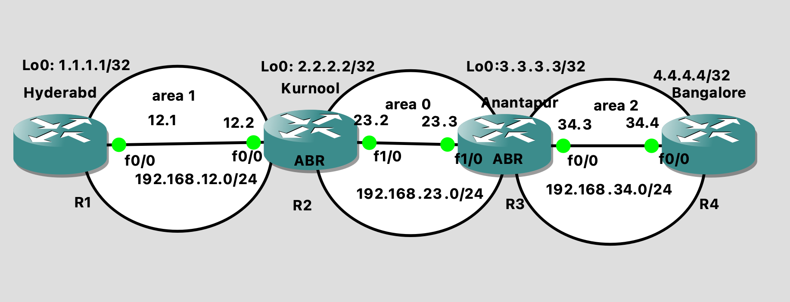
OSPF Multi area lab:
Type 3 LSA: It consists of other area routes and advertised by ABR router.
Example: Kurnool router is connected to two areas (area 1 and area0) and its called area border router(ABR)
So Kurnool ABR router converts other area LSA’s area0 and area 2(type 1 and type 2 and other type 3 routes) into new type 3 LSA and advertise this type 3 LSA into entire OSPF area 1 domain.
Scope of type 1 and type 2 LSA’s are within the OSPF area
Scope of type 3 LSA is across the areas

Slide 2
Hyderabad Router
interface Loopback0
ip address 1.1.1.1 255.255.255.255
exit
Kurnool_R2 Router:
Enter in configure terminal mode and execute below commands:
Enter in configure terminal mode and execute below commands:
interface Loopback0
ip address 2.2.2.2 255.255.255.255
exit
interface FastEthernet0/0
ip address 192.168.12.2 255.255.255.0
exit
interface FastEthernet1/0
ip address 192.168.23.2 255.255.255.0
exit
interface FastEthernet0/0
ip address 192.168.12.1 255.255.255.0
exit
Configure OSPF
Configure terminal
router ospf 10
network 1.1.1.1 0.0.0.0 area 1
network 192.168.12.0 0.0.0.255 area 1
Configure OSPF
Anantapur_R3 Router
Configure terminal
router ospf 10
network 2.2.2.2 0.0.0.0 area 1
network 192.168.12.0 0.0.0.255 area 1
network 192.168.23.0 0.0.0.255 area 0
Enter in configure terminal mode and execute below commands:
interface Loopback0
ip address 3.3.3.3 255.255.255.255
exit
interface FastEthernet0/0
ip address 192.168.34.3 255.255.255.0
exit
interface FastEthernet1/0
ip address 192.168.23.3 255.255.255.0
exit

Slide 3
Configure OSPF
router ospf 10
network 3.3.3.3 0.0.0.0 area 0
network 192.168.23.0 0.0.0.255 area 0
network 192.168.34.0 0.0.0.255 area 2
Bangalor_R4 Rouer
Enter in configure terminal mode and execute below commands:
interface Loopback0
ip address 4.4.4.4 255.255.255.255
exit
interface FastEthernet0/0
ip address 192.168.34.4 255.255.255.0
exit
Configure OSPF
router ospf 10
network 4.4.4.4 0.0.0.0 area 2
network 192.168.34.0 0.0.0.255 area 2

Slide 4
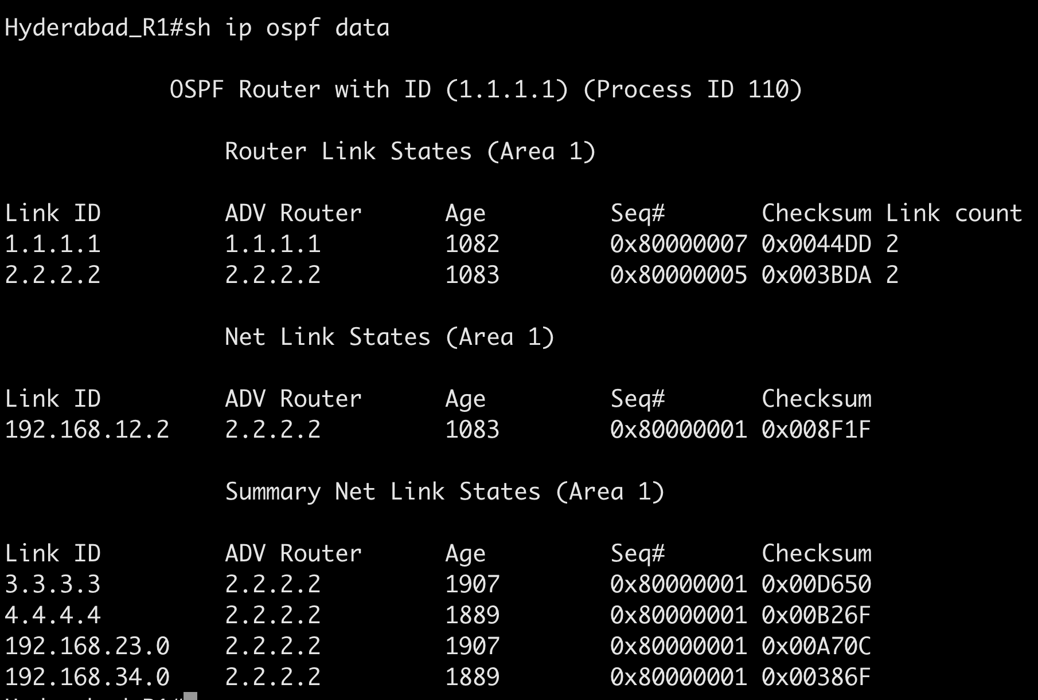
Verification
Check ospf data base on Hyderabad Router
Hyderabad_R1# ping 4.4.4.4
Type escape sequence to abort.
Sending 5, 100-byte ICMP Echos to 4.4.4.4, timeout is 2 seconds:
!!!!!
Success rate is 100 percent (5/5), round-trip min/avg/max = 36/81/168 ms
Hyderabad_R1#sh ip route
Codes: L - local, C - connected, S - static, R - RIP, M - mobile, B - BGP
D - EIGRP, EX - EIGRP external, O - OSPF, IA - OSPF inter area
N1 - OSPF NSSA external type 1, N2 - OSPF NSSA external type 2
E1 - OSPF external type 1, E2 - OSPF external type 2
i - IS-IS, su - IS-IS summary, L1 - IS-IS level-1, L2 - IS-IS level-2
ia - IS-IS inter area, * - candidate default, U - per-user static route
o - ODR, P - periodic downloaded static route, H - NHRP, l - LISP
a - application route
+ - replicated route, % - next hop override
Gateway of last resort is not set
1.0.0.0/32 is subnetted, 1 subnets
C 1.1.1.1 is directly connected, Loopback0
2.0.0.0/32 is subnetted, 1 subnets
O 2.2.2.2 [110/2] via 192.168.12.2, 00:24:01, FastEthernet0/0
3.0.0.0/32 is subnetted, 1 subnets
O IA 3.3.3.3 [110/3] via 192.168.12.2, 00:24:01, FastEthernet0/0
4.0.0.0/32 is subnetted, 1 subnets
O IA 4.4.4.4 [110/4] via 192.168.12.2, 00:24:01, FastEthernet0/0
192.168.12.0/24 is variably subnetted, 2 subnets, 2 masks
C 192.168.12.0/24 is directly connected, FastEthernet0/0
L 192.168.12.1/32 is directly connected, FastEthernet0/0
O IA 192.168.23.0/24 [110/2] via 192.168.12.2, 00:24:01, FastEthernet0/0
O IA 192.168.34.0/24 [110/3] via 192.168.12.2, 00:24:01, FastEthernet0/0
Hyderabad_R1#traceroute 4.4.4.4
Type escape sequence to abort.
Tracing the route to 4.4.4.4
VRF info: (vrf in name/id, vrf out name/id)
1 192.168.12.2 8 msec 32 msec 44 msec
2 192.168.23.3 112 msec 28 msec 24 msec
3 192.168.34.4 48 msec 48 msec 52 msec
Hyderabad_R1#
If you see all other are area routes converted
Into Type 3 summary LSA by ABR router Kurnool(2.2.2.2).

Slide 5
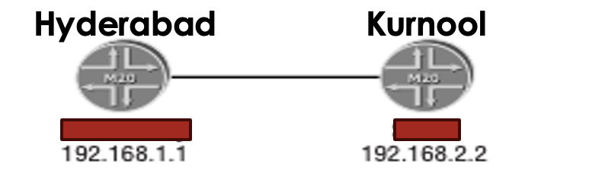
Assignments:
Configure Hello packet parameters and test the ospf adjacency status between
Hyderabad and Kurnool
Authentication wrong- it will stuck down state: below is the config to test. Just config authentication on one side. So authentication will be mismatch.
Hyderabad_R1#conf t
Enter configuration commands, one per line. End with CNTL/Z.
Hyderabad_R1(config)#router ospf 110
Hyderabad_R1(config-router)#area 1 authentication message-digest
Router ID same -it will stuck down state
Configure same loopback ip address on both the router
IP address same/ but subnet mask wrong-- it will stuck down state –show ip ospf neigbor
Area 0 one sind area 1 other side - it will stuck down state
Mtu mismatch MTU> received MTU --→ it will stuck in exstart state (use gi interface to test this)
Int gi0/0
Mtu 1600
router priority same on both sides 100--- it will stuck in 2 way state. The default priority is 1
Hyderabad_R1(config)#int fa0/0
Hyderabad_R1(config-if)#ip ospf priority 100
Loading - If the router send LSR and waiting for update. If update is not received it will stuck in loading state. There system resources are 100% utilized

Slide 6
why we need areas in OSPF
Areas in OSPF (Open Shortest Path First) are essential for managing and optimizing the performance of large and complex networks. Here's a practical analysis to illustrate why areas are needed in OSPF:
1. Scalability
Problem: In a large network, as the number of routers and links increases, the size of the OSPF database (Link-State Database) grows. Every router in the OSPF domain would have to maintain a full map of the entire network, leading to high memory usage and CPU processing.
Solution: By dividing the network into areas, OSPF can limit the size of the Link-State Database for each router. Routers only need to know the detailed topology of their own area, reducing the amount of information they must process.
2. Reduced Routing Table Size
Problem: Without areas, every router would have to maintain a complete routing table for the entire OSPF domain. This can result in large routing tables, especially in very large networks, which increases memory consumption and CPU cycles.
Solution: OSPF areas help to summarize routes. Routers can advertise a summary of routes from one area to another, rather than advertising every individual route. This reduces the size of the routing tables.
3. Stability and Faster Convergence
Problem: In a large flat OSPF network, any change in the network topology (e.g., a link failure) would trigger recalculation of the entire network’s OSPF routes. This can lead to high CPU usage and slow convergence times.
Solution: By using areas, topology changes within one area do not affect other areas. Only routers in the area where the change occurred need to recalculate the routes, while other areas remain stable.
4. Control of LSA Flooding
Problem: In OSPF, whenever there is a change in the network, Link-State Advertisements (LSAs) are flooded throughout the network. In a large network, this can result in excessive flooding, overwhelming routers and causing delays.
Solution: OSPF areas limit the scope of LSA flooding. LSAs generated in one area do not need to be flooded to other areas, which controls the amount of LSA traffic and reduces the load on routers.
5. Administrative Control
Problem: Managing a large, flat OSPF network can be complex and error-prone. Every router would have to be configured to handle the entire network topology.
Solution: By using areas, network administrators can logically segment the network. Each area can be managed independently, simplifying network management and making troubleshooting easier.
Practical Example
Consider a large enterprise network with multiple branch offices connected via a central data center. If OSPF is deployed without areas, every branch router would need to know the full topology of the entire network, including every other branch. This results in large routing tables and slow convergence.
By dividing the network into areas:
Area 0 (Backbone Area) might include the data center.
Area 1, Area 2, etc., could represent different branch offices.
Each branch router only needs detailed knowledge of its own area. Routes to other branches can be summarized in the backbone area (Area 0) and advertised to the rest of the network. This approach reduces routing table sizes, minimizes LSA flooding, and isolates issues within individual areas, improving overall network performance and stability.
Conclusion
Using areas in OSPF is critical for ensuring the scalability, stability, and manageability of large networks. It allows for efficient use of resources, faster convergence, and better administrative control, all of which are essential in complex enterprise environments.

Slide 7
why we called area 0 as a backbone area
Controlled Flooding of LSAs
Problem: In a large OSPF network without a structured area design, Link-State Advertisements (LSAs) could flood the entire network indiscriminately, potentially leading to loops if not all routers update their LSAs consistently.
Solution: In an OSPF network with a backbone area, LSAs are flooded within their respective areas and controlled at the boundary routers (Area Border Routers or ABRs). These ABRs inject summary LSAs into Area 0, which then propagates them to other areas. This controlled flooding ensures that all routers have a consistent view of the network, preventing loops caused by outdated or conflicting LSAs.
Example: Multi-Area OSPF Network
Network Setup:
Area 1: A set of routers handling a branch office network.
Area 2: Another set of routers for a different branch office.
Area 0: The central backbone connecting these two areas.
Routing Process:
When a router in Area 1 needs to send data to a router in Area 2, it does not try to find a direct path to Area 2. Instead, it sends the data to its ABR, which forwards it to Area 0.
The data then travels through Area 0 and reaches the ABR connected to Area 2.
The ABR in Area 2 then forwards the data to the destination router within Area 2.
Loop Prevention:
If there were no Area 0, routers in Area 1 might try to route data directly to Area 2 through multiple redundant paths, creating a loop.
By enforcing the rule that all inter-area traffic must pass through Area 0, OSPF ensures that there is a single, loop-free path for all inter-area routing.
Practical Example: A Large Enterprise Network
Consider a large enterprise with multiple branch offices:
Area 1 might represent the branch offices on the East Coast.
Area 2 might represent the branch offices on the West Coast.
Area 0 (Backbone) is located in the central data center.
All branch offices (Area 1 and Area 2) connect to the central data center (Area 0) to communicate with each other. If a branch office in Area 1 wants to communicate with a branch office in Area 2, the traffic must pass through Area 0. This design ensures that the network is stable, manageable, and scalable.

