Slide 1
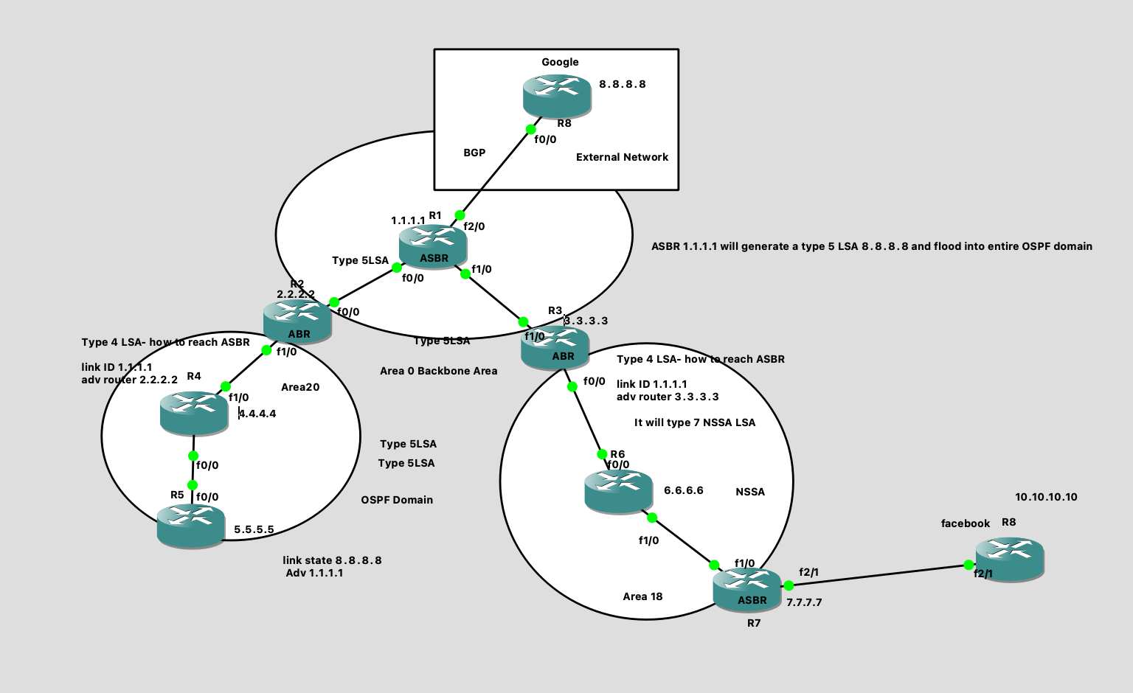
OSPF LAB with External Prefixes:

Slide 2
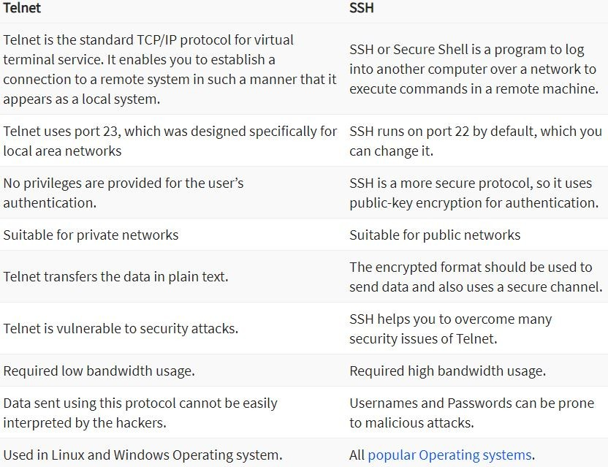
SSH (secure shell):
SSH is a network protocol that is widely used to access and manage a device remotely. The full form of SSH is Secure Shell is a major protocol to access the network devices and servers over the internet and it uses the TCP port number 22 to establish secure connection.
As per the diagram if we want to login R1 router from R5 router remotely, you need to
Configure SSH or Telnet services on all the routers from R1 to R5.
When you join in any company you have to configure, troubleshoot the routers, switches other networking devices by login the devices remotely. You can login the device using Putty tool or your computer terminal.

Slide 3
Configuration and verification:
R5 Router
R5(config)#ip domain-name rameshtechlibrary.com
R5(config)#crypto key generate rsa
The name for the keys will be: R5.rameshtechlibrary.com
Choose the size of the key modulus in the range of 360 to 4096 for your
General Purpose Keys. Choosing a key modulus greater than 512 may take
a few minutes.
How many bits in the modulus [512]: 2048
R5(config)#line vty 0 4
R5(config-line)#transport input ssh
R5(config-line)#transport output ssh
R5(config-line)#login local
R5(config)#username ramesh password ramesh@123
R5(config)#username reshmitha password reshmitha@123
R5(config)#username jagadeesh password jagadeesh@123
R5(config)#username varungoud password varun@123
Please repeat the same configuration on R4,R2 and R1 router.
Verification: login R1 router from R5 router using SSH.
R5#ssh -l ramesh 1.1.1.1
Password: (Ramesh password)
R1>en
R1>enable --→ we are able to login R1 router successfully.

