Slide 1
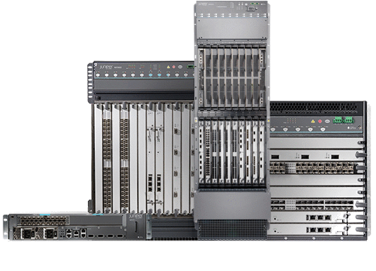
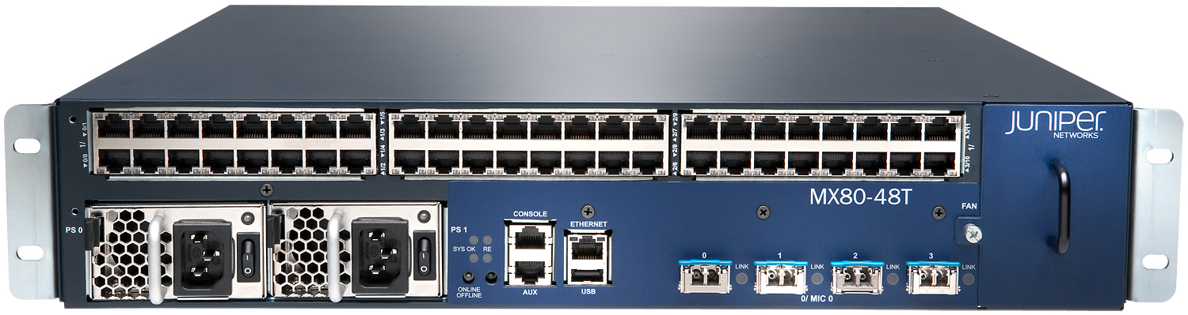
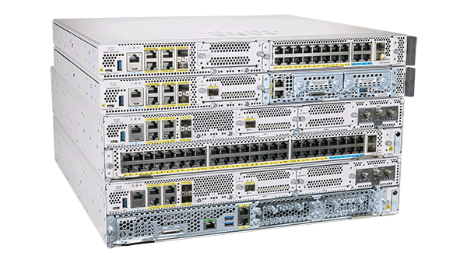

Routing Technologies:
Routers: -Layer 3 devices

Slide 2
Static or manual routing:
The static or manual method to add entries to the routing table is known as static or manual routing. In static or manual routing, the administrator manually adds entries to the routing table. The administrator creates a virtual map of all routes and manually adds them to each router’s routing table.
Routes that are manually added by an administrator to the routing table are known as static routes. In other words, a static route is a route that you manually add to the router’s routing table.
Basic guide to setting up static routing rules:
Destination Network: The network address for which the route is being defined.
Subnet Mask: Determines the network portion of the address.
Next Hop: The IP address of the next router or gateway to which packets should be forwarded.
Interface: The network interface through which the packets should be sent.

Slide 3
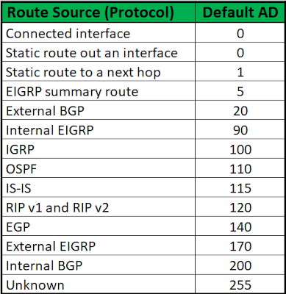
Administrative Distance (AD): A value that indicates the trustworthiness of a route source. Lower AD values are preferred. Common AD values for different routing protocols are:
8.8.8.8/30 learning ospf AD 110
8.8.8.8/24 learning static AD 1
8.8.8.8/23 learning BGP AD 20
Route selection process rules
1.Longest prefix match will prefer
2. Smallest AD value will be preferred

Slide 4
Routing Table Components
Destination Network: The network address of the destination.
Subnet Mask: Defines the network portion of the IP address.
Next Hop: The IP address of the next router to which packets should be forwarded.
Metric: A value that helps determine the best route. Lower metrics are preferred.
Interface: The network interface through which the packet should be sent.
Route Selection Criteria
Longest Prefix Match: The most specific route is chosen. For example, a route to 192.168.1.0/24-AD-1 will be chosen over a route to 192.168.0.0/16 for a destination IP of 192.168.1.5.
Administrative Distance (AD): A value that indicates the trustworthiness of a route source. Lower AD values are preferred. Common AD values for different routing protocols are:
Directly connected interface: 0
Static route: 1
EIGRP: 90
OSPF: 110
RIP: 120
Metric: When multiple routes to the same destination exist with the same prefix length and AD, the route with the lowest metric (cost) is chosen. Metrics vary by routing protocol:
RIP uses hop count.
OSPF uses cost based on bandwidth.
EIGRP uses a composite metric of bandwidth, delay, load, and reliability.

Slide 5
Syntax:
Router(config)# ip route [destination network] [subnet mask] [next hop address]
Advantages of static routing
Static routing allows the administrator to save money. In static routing, the router does not use CPU and RAM to learn the routes and calculate the best route to each destination. Since static routing does not put overhead on the router's CPU and RAM, the administrator can use a cheaper router.
In static routing, routers do not exchange routing information. Since routers do not exchange routing information, they save the network bandwidth. If in a network, routers are connected through a paid WAN link, static routing can reduce the bill amount that the network pays for WAN connectivity.
Static routing is the safest method of routing. The administrator manually adds routes for authorized networks. Since the administrator manually decides which network can reach which network, a network can only access the authorized network.

Slide 6
Disadvantages of static routing
In static routing, since the administrator adds and manages all routes, the administrator must have in-depth knowledge of the internetwork.
To add all routes correctly, the administrator has to learn how each router is connected to the network.
The process of adding each route on each router is tedious.
If the administrator changes the location of a router in the network, the administrator has to update routing information on all routers manually.
If a link goes up or down, the administrator has to manually update this information on all routers. On a flipping link, this will cause a huge problem.
If you have a backup route, the router doesn't automatically switch to the backup route if the main route fails. The administrator must have to reconfigure the router to use the backup route.
Usages of static routing
Static routing is a good option when the network size is small. In a small network, static routing offers many benefits at the cost of little manual work. You can use static routing to reduce the overhead from routers or save bandwidth on paid WAN connections. Static routing is not a good choice when the network size is big. In a big network, where you have hundreds of routes, static routing is not scalable, since you would have to configure each route and any redundant paths for that route on each router.

Slide 7
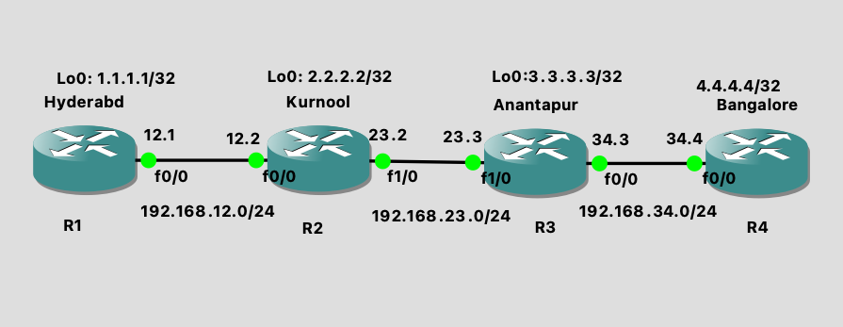
LAB:
Topology
Please assign the IP addresses based on above topology

Slide 8
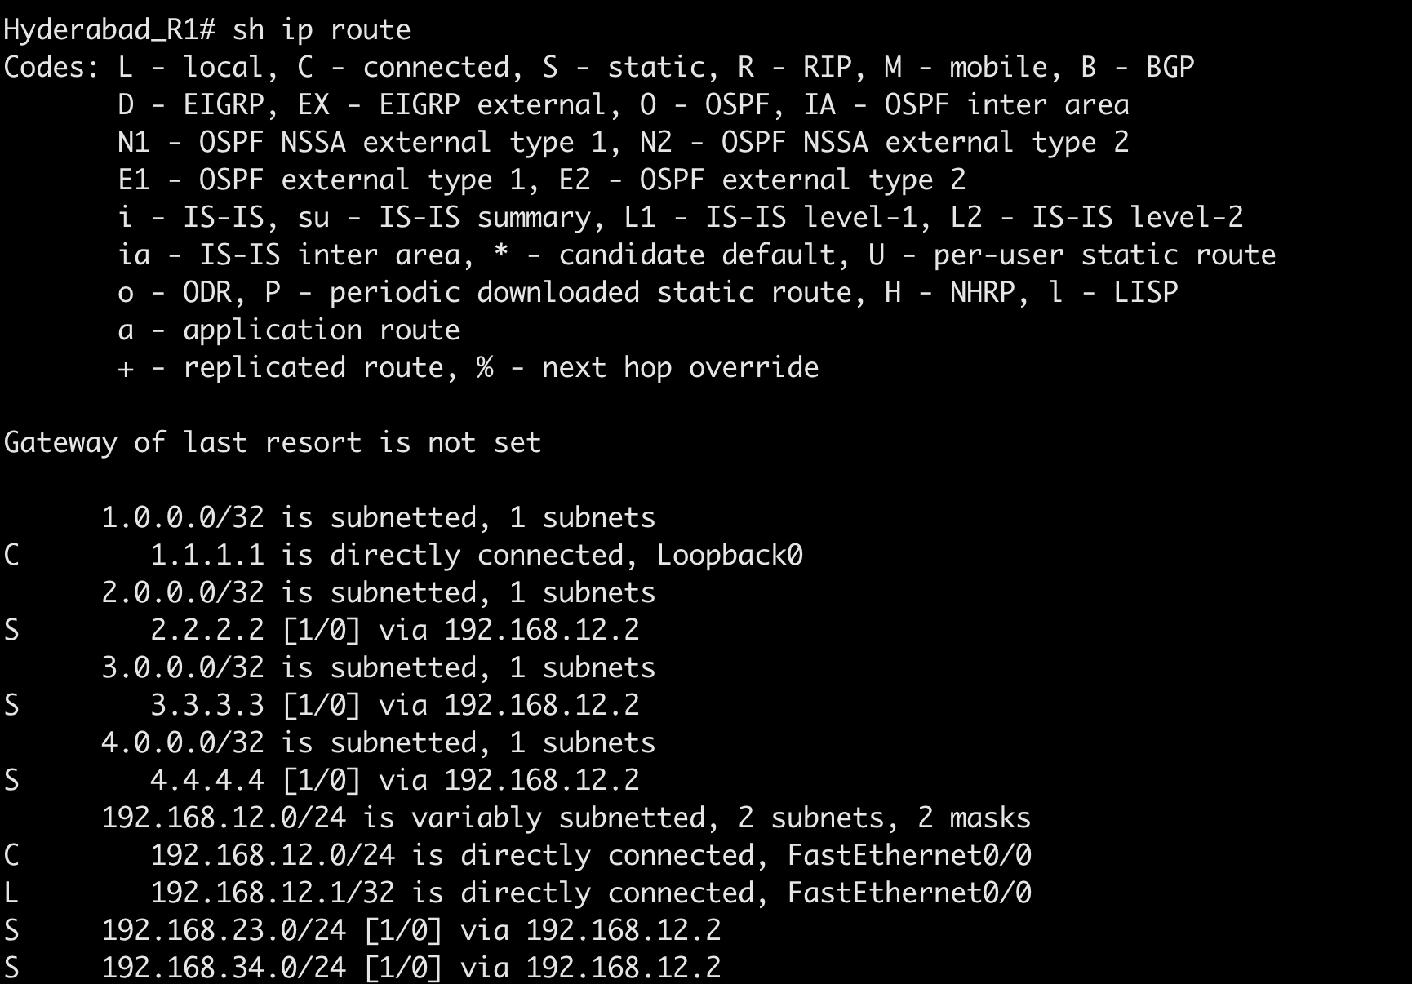
LAB:
Hyderbad_R1 Router
Enter in configure terminal mode and execute below commands:
interface Loopback0
ip address 1.1.1.1 255.255.255.255
exit
Routing Table
interface FastEthernet0/0
ip address 192.168.12.1 255.255.255.0
exit
Static routing configuration:
ip route 2.2.2.2 255.255.255.255 192.168.12.2
ip route 3.3.3.3 255.255.255.255 192.168.12.2
ip route 4.4.4.4 255.255.255.255 192.168.12.2
ip route 192.168.23.0 255.255.255.0 192.168.12.2
ip route 192.168.34.0 255.255.255.0 192.168.12.2
exit
Once done write configuration and run ‘show IP route’ to check the routing table.

Slide 9
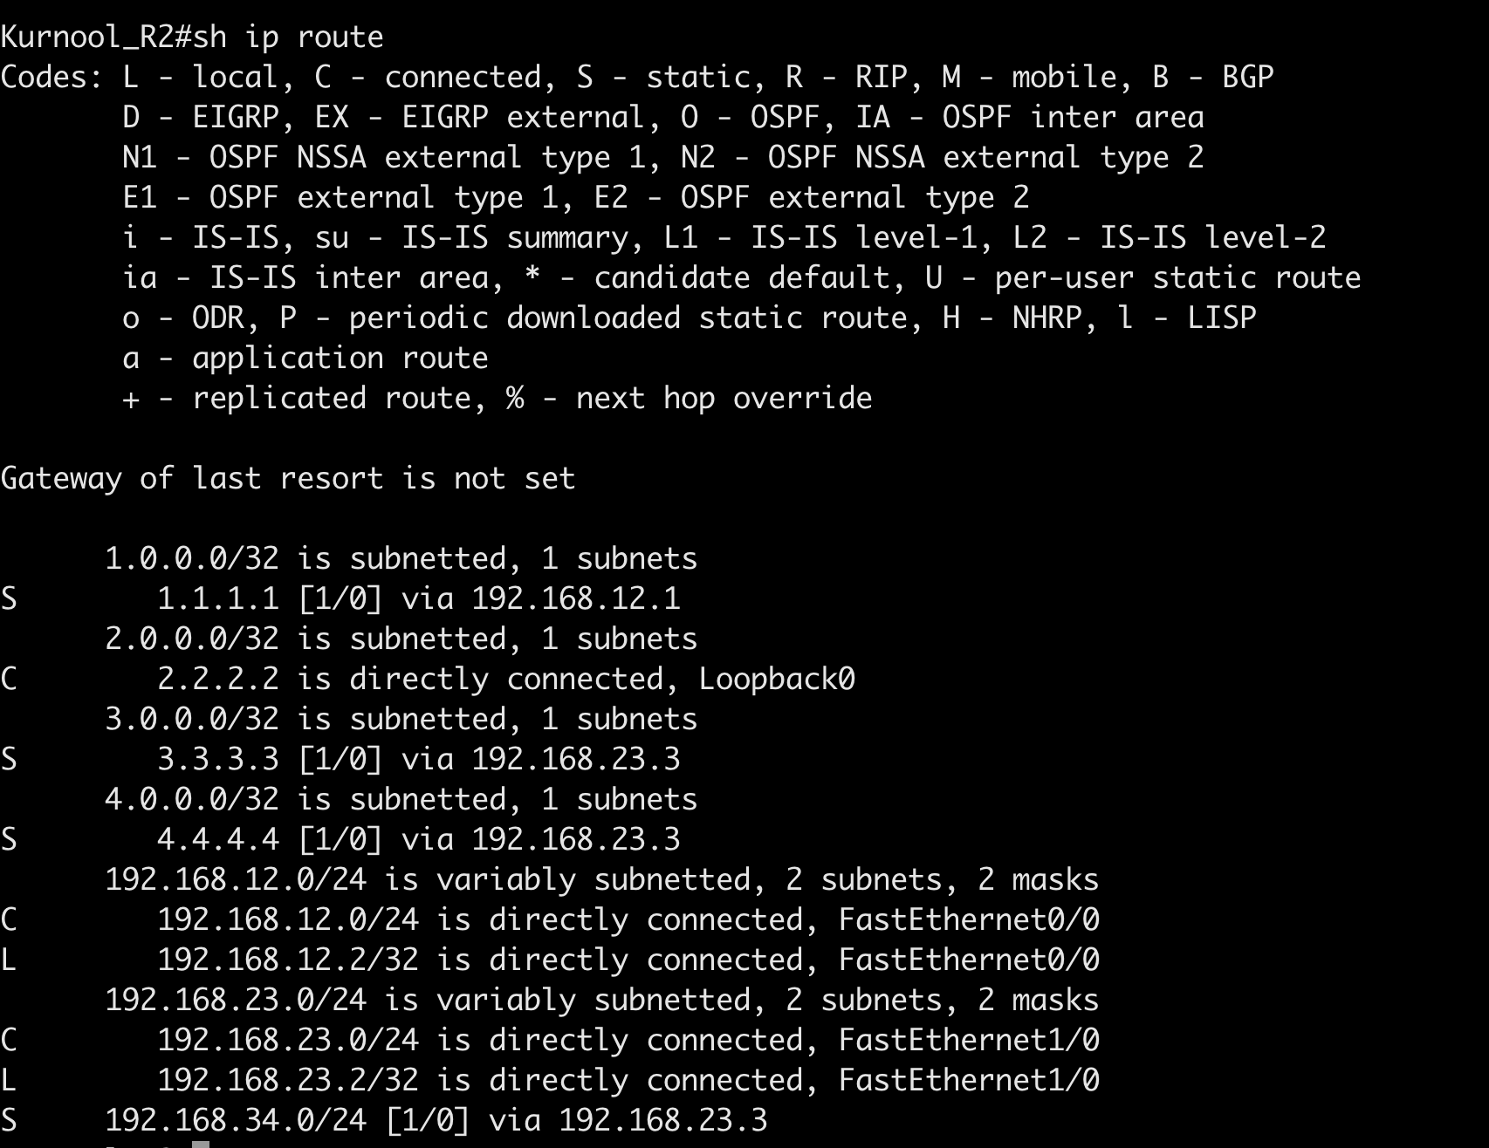
Kurnool_R2 Router:
Enter in configure terminal mode and execute below commands:
Routing Table
interface Loopback0
ip address 2.2.2.2 255.255.255.255
exit
interface FastEthernet0/0
ip address 192.168.12.2 255.255.255.0
exit
interface FastEthernet1/0
ip address 192.168.23.2 255.255.255.0
exit
Static routing configuration:
ip route 1.1.1.1 255.255.255.255 192.168.12.1
ip route 3.3.3.3 255.255.255.255 192.168.23.3
ip route 4.4.4.4 255.255.255.255 192.168.23.3
ip route 192.168.34.0 255.255.255.0 192.168.23.3
exit
Once done write configuration and run ‘show IP route’ to check the routing table.

Slide 10
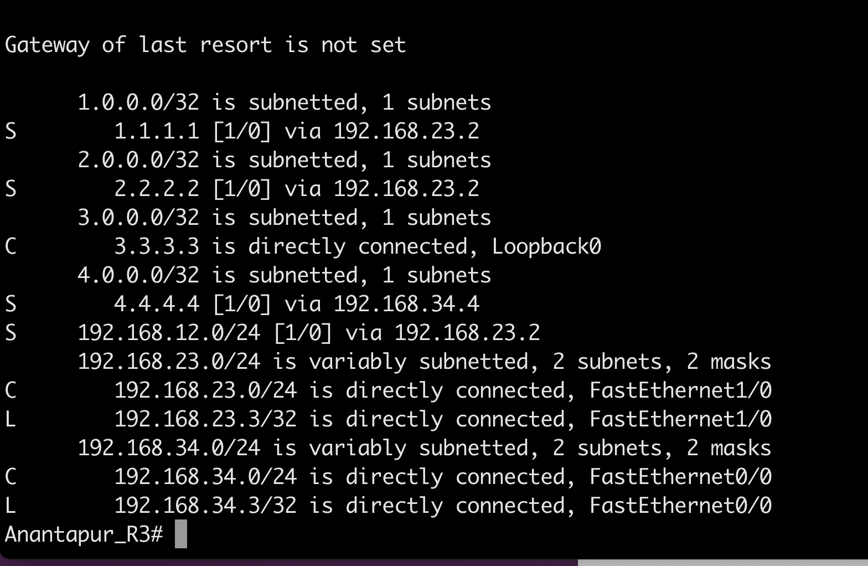
Anantapur_R3 Rouer
Enter in configure terminal mode and execute below commands:
interface Loopback0
ip address 3.3.3.3 255.255.255.255
exit
interface FastEthernet0/0
ip address 192.168.34.3 255.255.255.0
exit
interface FastEthernet1/0
ip address 192.168.23.3 255.255.255.0
exit
Routing Table
Static routing configuration:
ip route 1.1.1.1 255.255.255.255 192.168.23.2
ip route 2.2.2.2 255.255.255.255 192.168.23.2
ip route 4.4.4.4 255.255.255.255 192.168.34.4
ip route 192.168.12.0 255.255.255.0 192.168.23.2
Once done write configuration and run ‘show IP route’ to check the routing table.

Slide 11
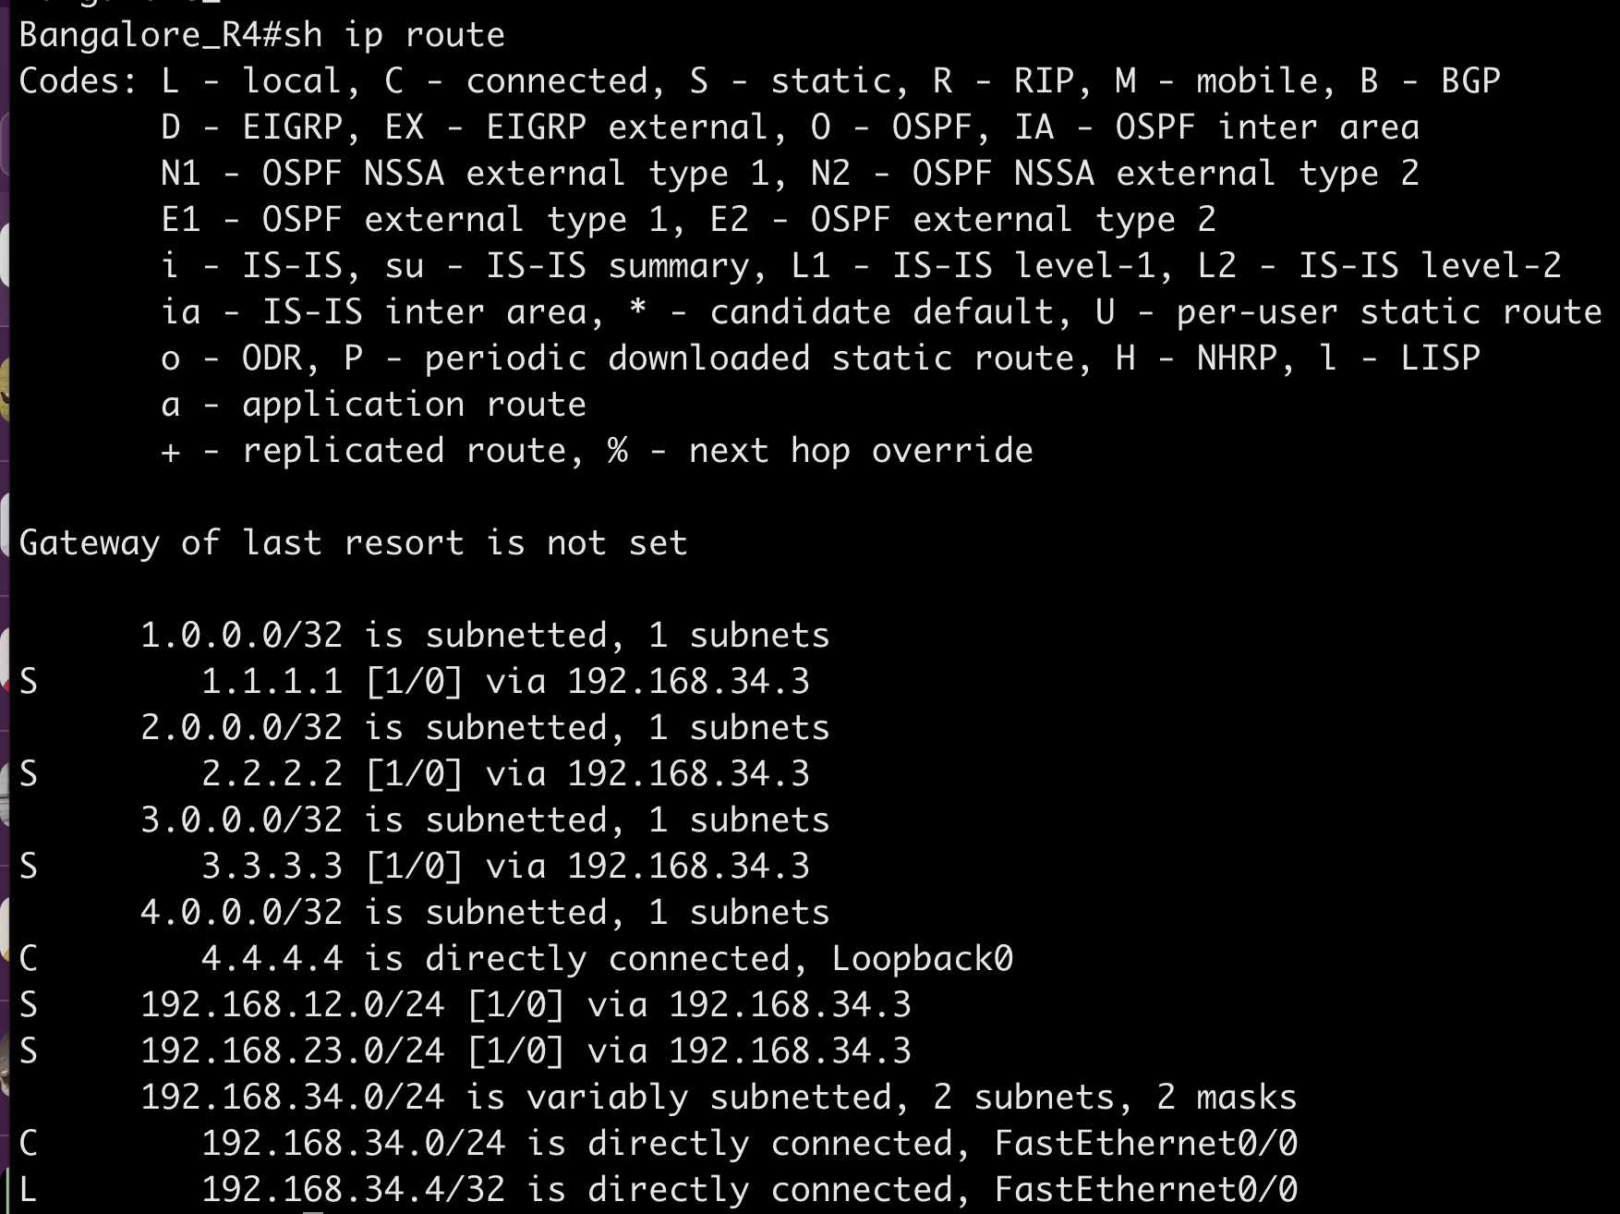
Bangalor_R4 Rouer
Enter in configure terminal mode and execute below commands:
Routing Table
interface Loopback0
ip address 4.4.4.4 255.255.255.255
exit
interface FastEthernet0/0
ip address 192.168.34.4 255.255.255.0
exit
Static routing configuration:
ip route 1.1.1.1 255.255.255.255 192.168.34.3
ip route 2.2.2.2 255.255.255.255 192.168.34.3
ip route 3.3.3.3 255.255.255.255 192.168.34.3
ip route 192.168.12.0 255.255.255.0 192.168.34.3
ip route 192.168.23.0 255.255.255.0 192.168.34.3
Once done write configuration and run ‘show IP route’ to check the routing table.

Slide 12
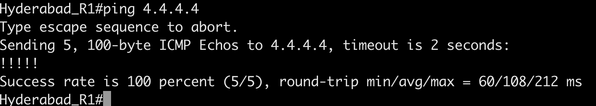
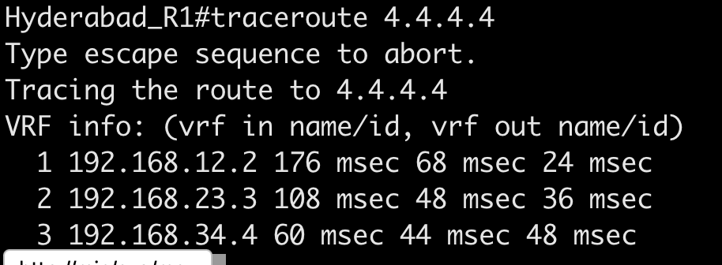
Verification
1. Initiate ping from Hyderabd to Banaglore IP 4.4.4.4
2. Do Traceroute to 4.4.4.4 to check the path
If you see the path is going via Kurnool IP (192.168.12.2) and then 192.168.23.3 is the Anantapur IP and last next-hop is 192.168.34.4 is the Bangalore IP

