Slide 1


Slide 2
What is a Bridge Protocol Data Unit (BPDU)?
A bridge protocol data unit (BPDU) is a data message forwarded across a Local Area Network (LAN) to detect loops in a spanning tree topology. A BPDU contains information about ports, switches, port priority, and addresses.
PortFast:
PortFast enables the switch to instantaneously transition from blocking state to forwarding state immediately through bypassing the listening and learning state. However, PortFast is highly recommended only on non-trunking access ports, such as edge ports, because these ports typically do not send nor receive BPDU.
Configuring PortFast on an Access Port:
We can configure the PortFast command on an access switch port interface
Sw1(config)# interface f0/10.
Sw1(config-if)# spanning-tree portfast --→ for faster convergence, BPDU gaurd
Sw1(config)# spanning-tree portfast default

Slide 3
BPDU Guard
BPDU Guard feature protects the port from receiving STP BPDUs, however the port can transmit STP BPDUs. When a STP BPDU is received on a BPDU Guard enabled port, the port is shutdown and the state of the port changes to ErrDis (Error-Disable) state. The port remains in the ErrDis state until the port status is manually changed by using the configuration command shut followed by a no-shut applied on the interface.
Commands to enable BPDU Guard by default on all PortFast Edge Ports :
system#configure terminal
system(config)#spanning-tree portfast edge bpduguard default
system(config)#exit
system#
Commands to disable BPDU Guard on all PortFast Edge Ports :
system#configure terminal
system(config)#no spanning-tree portfast edge bpduguard default
system(config)#exit
system#
Commands to enable BPDU Guard for an interface
system#configure terminal
system(config)#interface giga 0/0
system(config-if)#spanning-tree bpduguard enable
system(config-if)#exit system(config)#exit
system#
Commands to disable BPDU Guard for an interface
system#configure terminal
system(config)#interface giga 0/0
system(config-if)#spanning-tree bpduguard disable
system(config-if)#exit
system(config)#exit
system#
Advantages
BPDU Guard prevents switching devices from being accidentally connected to PortFast-enabled ports.
If someone tries to connect an L2 device to the network, the BPDU guard ensures that it will be rejected. Before the spanning tree is disrupted, it is clipped.

Slide 4
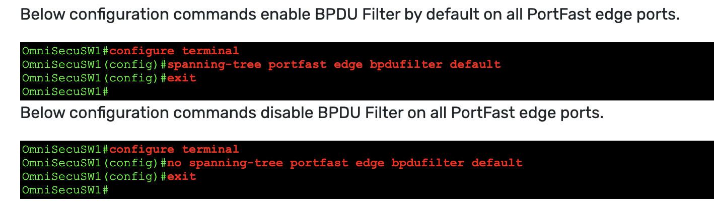
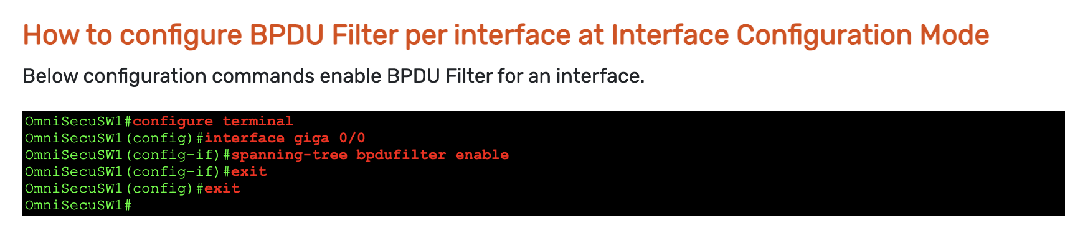
BPDU Filter feature act in two different ways when it is configured on Global level or Interface level. If BPDU Filter feature is enabled on a Global level, BPDU Filter is applied to all Spanning Tree Protocol (STP) PortFast enabled ports. If any BPDUs are received on that port, the PortFast feature is disabled and the port will become a normal STP port.
When BPDU Filter is enabled on Interface level, BPDU Filter will not send out BPDUs and avoid the processing of received BPDUs. This behaviour can completely disable Spanning Tree Protocol (STP) on that interface. Beware... This can potentially create damage to the network by forming a layer 2 switching loop, if switches are connected to BPDU Filter enabled port (at interface level) accidently.
As the name says, BPDU filter filters BPDUs in both directions. BPDU filter will prevent inbound and outbound BPDU but will remove portfast state on a port if a BPDU is received. Enabling BPDU filtering on an interface is the same as disabling spanning tree on it and can cause spanning-tree loops.
On the other hand, BPDU Guard keeps an eye open for any BPDU’s entering the interfaces that are enabled this feature. The port will disable as soon as the first BPDU is received, by shutting the port down.

Slide 5
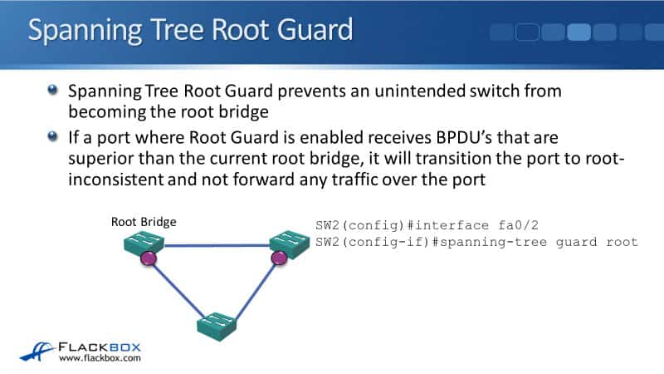
NOTE: Root guard puts the port in the root-inconsistent STP state. No traffic passes through the port in this state. Administrator can decide which port he want enable root guard to protect root bridge.
In case , if we enable root guard on both the ports, both are went to listing state and will root bridge will be isolated. You will see full impact on network.

Slide 6
Verification commands:
R1#sh spanning-tree ?
WORD bridge group list, example 1,3-5,7,9
active Report on active interfaces only
backbonefast Show spanning tree backbonefast status
blockedports Show blocked ports
bridge Status and configuration of this bridge
detail Detailed information
inconsistentports Show inconsistent ports
interface Spanning Tree interface status and configuration
mst Multiple spanning trees
pathcost Show Spanning pathcost options
root Status and configuration of the root bridge
summary Summary of port states
uplinkfast Show spanning tree uplinkfast status
vlan VLAN Switch Spanning Trees
| Output modifiers
<cr>
R1#sh spanning-tree
Execute the detail command to see interface role(designated or root port)

Slide 7
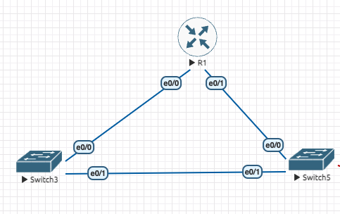
Consider above is the topology and by default STP is enabled.
sh spanning-tree active
show spanning-tree detail
CASE1: configure the port fast feature on switch5 e0/0 and enable BPDU guard and check the interface
Status
>show interface e0/0. ( you will see err-disable state)
CASE 2. configure BPDU filter on R1 at interface e0/1 and verify the interface status on switch5 e0/0.
The err-disable state will be gone. Once it is done, please preform shut and no shut on int e0/0 switch5.
NOTE: BPDU filters and BPDU guard features not available in cisco packet-tracer. So please ignore case2.
CASE 3: practice with root guard feature to protect your root bridge.

