Slide 1
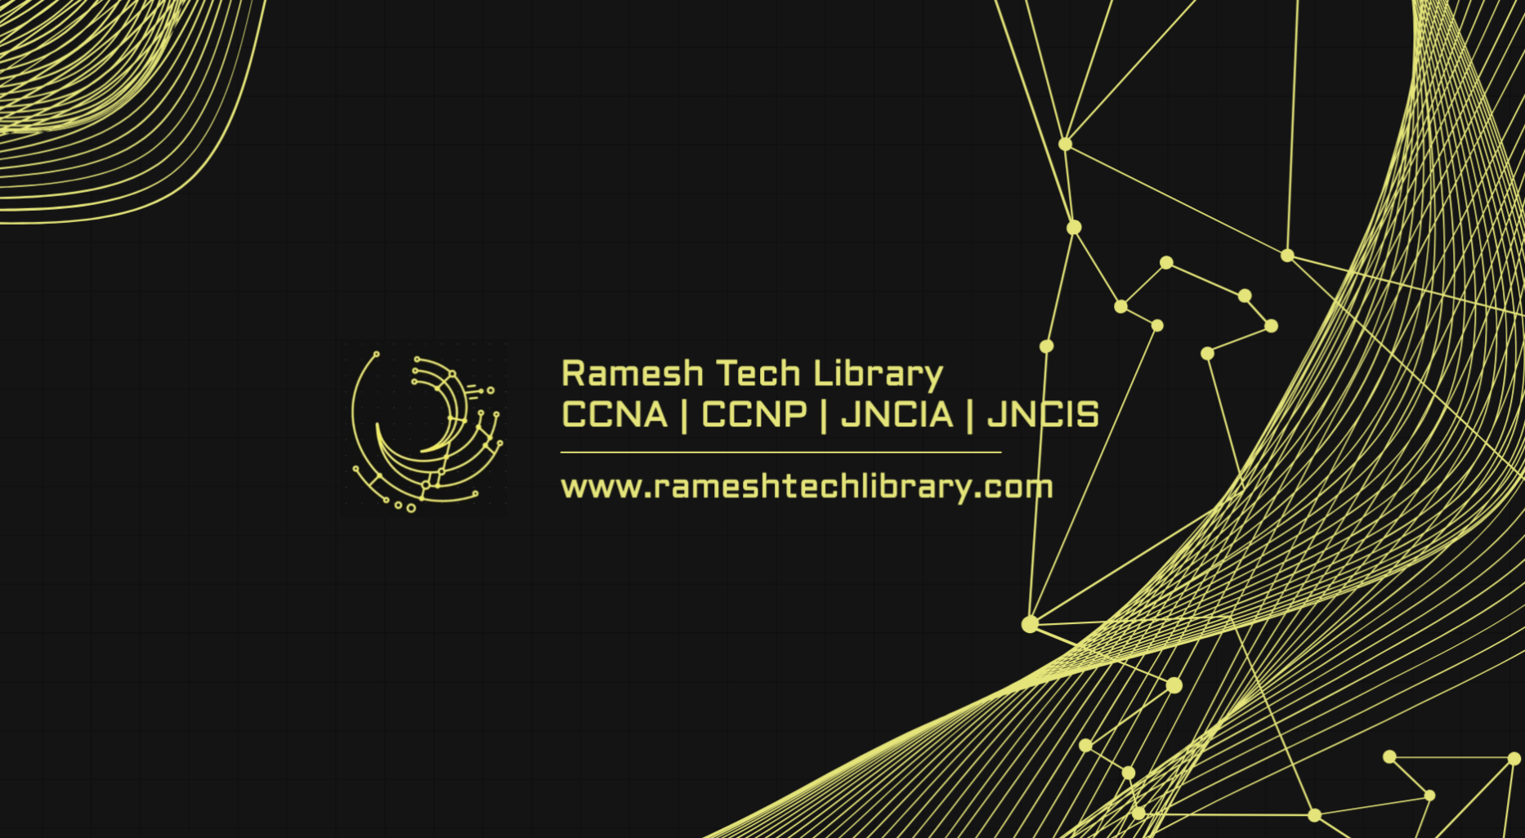

Slide 2
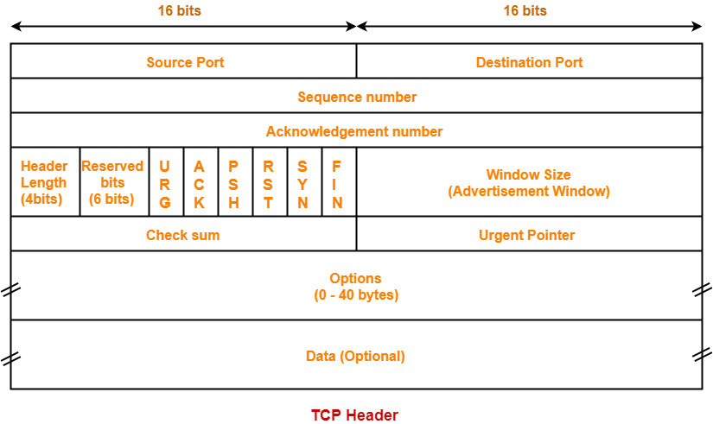

TCP(Transmission control protocol
5 mnts

Slide 3
3. Transport Layer
The TCP/IP transport layer protocols exchange data receipt acknowledgments and retransmit missing packets to ensure that packets arrive in order and without error. End-to-end communication is referred to as such. Transmission Control Protocol (TCP) and User Datagram Protocol are transport layer protocols at this level (UDP).
TCP: Applications can interact with one another using TCP as though they were physically connected by a circuit. TCP transmits data in a way that resembles character-by-character transmission rather than separate packets. A starting point that establishes the connection, the whole transmission in byte order, and an ending point that closes the connection make up this transmission.
UDP: The datagram delivery service is provided by UDP, the other transport layer protocol. Connections between receiving and sending hosts are not verified by UDP. Applications that transport little amounts of data use UDP rather than TCP because it eliminates the processes of establishing and validating connections.

Slide 4
Types of Port
By using ports, the computer is able to distinguish between all incoming traffic, including web pages and emails that flow to separate ports. Let’s now examine several port number ranges after determining the port number.
1. Well Known Port
Known as system ports or well-known ports, ports 0 through 1023 are specifically linked to specific services.
It is set aside for frequently utilised and specific services.
Certain commonly used protocols and services, such as HTTP (port 80), HTTPS(port 443), DNS (port 53), and SSH (port 22), use it.
2. Registered Port
The Internet Assigned Numbers Authority allows ports in the range of 1024 to 49151 to be registered for a particular purpose.
These ports are referred to as registered ports.These are utilised by fewer apps or services, but they are utilised by those that need the particular port.
Organisations can request any specific port number in this range from IANA (Internet Assigned Number Authority).
3. Dynamic Port
Unassigned ports, often known as dynamic or ephemeral ports, are those that range from 49152 to 65535 and can be used for any kind of service.
It is employed for transient or fleeting connections.
It can be utilised by any process and is not registered nor assigned.

Slide 5
What is TCP (Transmission Control Protocol)?
TCP (Transmission Control Protocol) is one of the main protocols of the TCP/IP suite. It lies between the Application and Network Layers which are used in providing reliable delivery services. Transmission Control Protocol (TCP) ensures reliable and efficient data transmission over the internet. TCP plays a crucial role in managing the flow of data between computers, guaranteeing that information is delivered accurately and in the correct sequence.
What is three-way handshake in Transmission Control Protocol (TCP)?
Three Way Handshake is a process that is used to establish a connection between Client and Server. It has three steps of process.
Ramesh PC
Rameshtechlibrary server

Slide 6
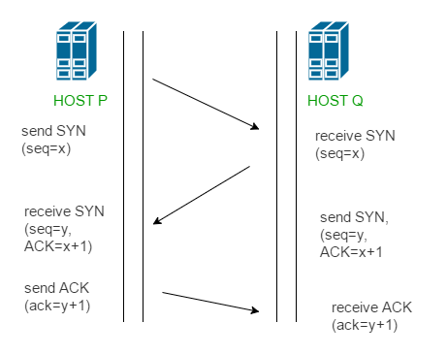
Step 1 (SYN): In the first step, the client wants to establish a connection with a server, so it sends a segment with SYN(Synchronize Sequence Number) which informs the server that the client is likely to start communication and with what sequence number it starts segments with
Step 2 (SYN + ACK): Server responds to the client request with SYN-ACK signal bits set. Acknowledgement(ACK) signifies the response of the segment it received and SYN signifies with what sequence number it is likely to start the segments with
Step 3 (ACK): In the final part client acknowledges the response of the server and they both establish a reliable connection with which they will start the actual data transfer

Slide 7
Services and Segment structure in TCP
The Transmission Control Protocol is the most common transport layer protocol. It works together with IP and provides a reliable transport service between processes using the network layer service provided by the IP protocol. The various services provided by the TCP to the application layer are as follows:
Process-to-Process Communication – TCP provides a process to process communication, i.e, the transfer of data that takes place between individual processes executing on end systems. This is done using port numbers or port addresses. Port numbers are 16 bits long that help identify which process is sending or receiving data on a host.
Stream oriented – This means that the data is sent and received as a stream of bytes(unlike UDP or IP that divides the bits into datagrams or packets). However, the network layer, that provides service for the TCP, sends packets of information not streams of bytes. Hence, TCP groups a number of bytes together into a segment and adds a header to each of these segments and then delivers these segments to the network layer. At the network layer, each of these segments is encapsulated in an IP packet for transmission. The TCP header has information that is required for control purposes which will be discussed along with the segment structure.
Full-duplex service – This means that the communication can take place in both directions at the same time.
Connection-oriented service – Unlike UDP, TCP provides a connection-oriented service. It defines 3 different phases:
Connection establishment
Data transfer
Connection termination
Reliability – TCP is reliable as it uses checksum for error detection, attempts to recover lost or corrupted packets by re-transmission, acknowledgement policy and timers. It uses features like byte number and sequence number and acknowledgement number so as to ensure reliability. Also, it uses congestion control mechanisms.
Multiplexing – TCP does multiplexing and de-multiplexing at the sender and receiver ends respectively as a number of logical connections can be established between port numbers over a physical connection.

Slide 8
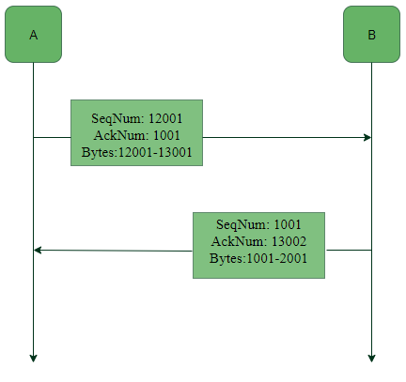
Byte number, Sequence number and Acknowledgement number: All the data bytes that are to be transmitted are numbered and the beginning of this numbering is arbitrary. Sequence numbers are given to the segments so as to reassemble the bytes at the receiver end even if they arrive in a different order. The sequence number of a segment is the byte number of the first byte that is being sent. The acknowledgement number is required since TCP provides full-duplex service. The acknowledgement number is the next byte number that the receiver expects to receive which also provides acknowledgement for receiving the previous bytes. Example:
4MB

Slide 9
TCP Connection Establishment
TCP is a connection-oriented protocol and every connection-oriented protocol needs to establish a connection in order to reserve resources at both the communicating ends.
Connection Establishment –
1. Sender starts the process with the following:
Sequence number (Seq=521): contains the random initial sequence number generated at the sender side.
Syn flag (Syn=1): request the receiver to synchronize its sequence number with the above-provided sequence number.
Maximum segment size (MSS=1460 B): sender tells its maximum segment size, so that receiver sends datagram which won’t require any fragmentation. MSS field is present inside Option field in TCP header.
Window size (window=14600 B): sender tells about his buffer capacity in which he has to store messages from the receiver.
2. TCP is a full-duplex protocol so both sender and receiver require a window for receiving messages from one another.
Sequence number (Seq=2000): contains the random initial sequence number generated at the receiver side.
Syn flag (Syn=1): request the sender to synchronize its sequence number with the above-provided sequence number.
Maximum segment size (MSS=500 B): receiver tells its maximum segment size, so that sender sends datagram which won’t require any fragmentation. MSS field is present inside Option field in TCP header. Since MSS_{receiver} < MSS_{sender}, both parties agree for minimum MSS i.e., 500 B to avoid fragmentation of packets at both ends.
Therefore, receiver can send maximum of 14600/500 = 29 packets. This is the receiver's sending window size.Window size (window=10000 B): receiver tells about his buffer capacity in which he has to store messages from the sender.
Therefore, sender can send a maximum of 10000/500 = 20 packets. This is the sender's sending window size.Acknowledgement Number (Ack no.=522): Since sequence number 521 is received by the receiver so, it makes a request for the next sequence number with Ack no.=522 which is the next packet expected by the receiver since Syn flag consumes 1 sequence no.
ACK flag (ACk=1): tells that the acknowledgement number field contains the next sequence expected by the receiver.
3. Sender makes the final reply for connection establishment in the following way:
Sequence number (Seq=522): since sequence number = 521 in 1st step and SYN flag consumes one sequence number hence, the next sequence number will be 522.
Acknowledgement Number (Ack no.=2001): since the sender is acknowledging SYN=1 packet from the receiver with sequence number 2000 so, the next sequence number expected is 2001.
ACK flag (ACK=1): tells that the acknowledgement number field contains the next sequence expected by the sender.

Slide 11
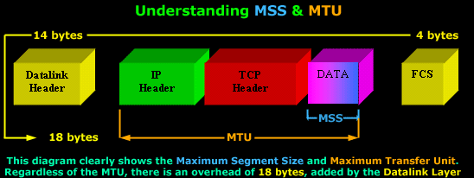
Here's a brief view of the TCP Options we are going to analyse:
Maximum Segment Size (MSS)
Window Scaling
Selective Acknowledgements (SACK)
Maximum Segment Size (MSS)
The Maximum Segment Size (MSS) is used to define the maximum segment that will be used during a connection between two hosts. As such, you should only see this option used during the SYN and SYN/ACK phase of the 3-way-handshake. The MSS TCP Option occupies 4 bytes (32 bits) of length.
If you have previously come across the term "MTU" which stands for Maximum Transfer Unit, you will be pleased to know that the MSS helps define the MTU used on the network.
If your scratching your head because the MSS and MTU field doesn't make any sense to you, or it is not quite clear, don't worry, the following diagram will help you get the big picture:

Slide 12
You can see the Maximum Segment Size consists of the Data segment, while the Maximum Transfer Unit includes the TCP Header, MSS and the IP Header.
It would also benefit us to recognise the correct terminology that corresponds to each level of the OSI Model: The TCP Header and Data is called a Segment (Layer 4), while the IP Header and the Segment is called an IP Datagram (Layer 3).
Furthermore, regardless of the size the MTU will have, there is an additional 18 bytes overhead placed by the Datalink layer. This overhead includes the Source and Destination MAC Address, the Protocol type, followed by the Frame Check Sequence placed at the end of the frame.
This is also the reason why we can only have a maximum MTU of 1500 bytes. Since the maximum size of an Ethernet II frame is 1518 bytes, subtracting 18 bytes (Datalink overhead) leaves us with 1500 bytes to play with.
TCP usually computes the Maximum Segment Size (MSS) that results in IP Datagrams that match the network MTU. In practice, this means the MSS will have such a value that if we add the IP Header as well, the IP Datagram (IP Header+TCP Header+DATA) would be equal to the network MTU.
If the MSS option is omitted by one or both ends of the connection, then the value of 536 bytes will be used. The MSS value of 536 bytes is defined by RFC 1122 and is calculated by taking the default value of an IP Datagram, 576 bytes, minus the standard length of the IP and TCP Header (40 bytes), which gives us 536 bytes.
In general, it is very important to use the best possible MSS value for your network because your network performance could be extremely poor if this value is too large or too small. To help you understand why, lets look at a simple example:
If you wanted to transfer 1 byte of data through the network, you would need to create a datagram with 40 bytes of overhead, 20 for the IP Header and 20 for the TCP Header. This means that your using 1/41 of your available network bandwidth for data. The rest is nothing but overhead!
On the other hand, if the MSS is very large, your IP Datagrams will also be very large, meaning that they will most probably fail to fit into one packet should the MTU be too small. Therefore they will require to be fragmented, increasing the overhead by a factor of 2.

Slide 13
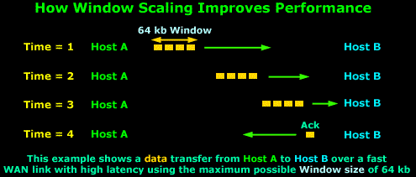
Window Scaling
We briefly mentioned Window Scaling in the previous section of the TCP analysis, though you will soon discover that this topic is quite broad and requires a great deal of attention.
After gaining a sound understanding of what the Window size flag is used for, Window Scaling is, in essence, an extention to the Window size flag. Because the largest possible value in the Window size flag is only 65,535 bytes (64 kb), it was clear that a larger field was required in order to increase the value to a whopping 1 Gig! Thus, Window Scaling was born.
The Window Scaling option can be a maximum of 30 bits in size, which includes the original 16 bit Window size field covered in the previous section. So that's 16 (original window field) + 14 (TCP Options 'Window Scaling') = 30 bits in total.
If you're wondering where on earth would someone use such an extremely large Window size, think again. Window Scaling was created for high-latency, high-bandwidth WAN links where a limited Window size can cause severe performance problems.
To consolidate all these technological terms and numbers, an example would prove to be beneficial:

Slide 14
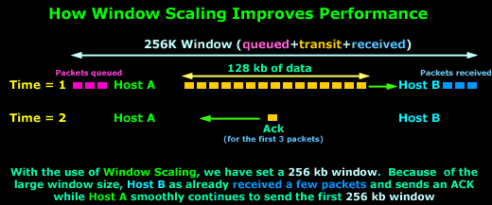
The above example assumes we are using the maximum Window size of 64 kbs and because the WAN link has very high latency, the packets take some time to arrive to their destination, that is, Host B. Due to the high latency, Host A has stopped transmitting data since there are 64 kbs of data sent and they have not yet been acknowledged.
When the Time = 4, Host B has received the data and sends the long awaited acknowledgement to Host A so it can continue to send data, but the acknowledgement will not arrive until somewhere around Time = 6.
So, from Time = 1 up until Time = 6, Host A is sitting and waiting. You can imagine how poor the performance of this transfer would be in this situation. If we were to transfer a 10 Mb file, it would take hours!
Let's now consider the same example, using Window Scaling:

Slide 15
As you can see, with the use of Window Scaling, the window size has increased to 256kb! Since the value is quite large, which translates to more data during transit, Host B has already received the first few packets, while Host A is still sending the first 256 kb window.
On Time = 2, Host B sends an Acknowledgement to Host A, which is still busy sending data. Host A will receive the Acknowledgement before it finishes the 256 kb window and will therefore continue sending data without pause since it will soon receive another Acknowledgement from Host B.
Clearly the difference that a large window size has made is evident, increasing the network performance and minimising the ideal time for the sending host.
The Window Scale option is defined in RFC 1072, which lets a system advertise 30-bit (16 from the original window + 14 from the TCP Options) Window size values, with a maximum buffer size of 1 GB. This option has been clarified and redefined in RFC 1323, which is the specification that all implementations employ today.
Lastly, for those who deal with Cisco routers, it may benefit you to know that you are also able to configure the Window size on Cisco routers running the Cisco IOS v9 and greater. Also, routers with versions 12.2(8)T and above support Window Scaling, which is automatically enabled for Window sizes above 65,535 bytes (64 kb), with a maximum value of 1,073,741,823 bytes (1 GByte)!

Slide 16
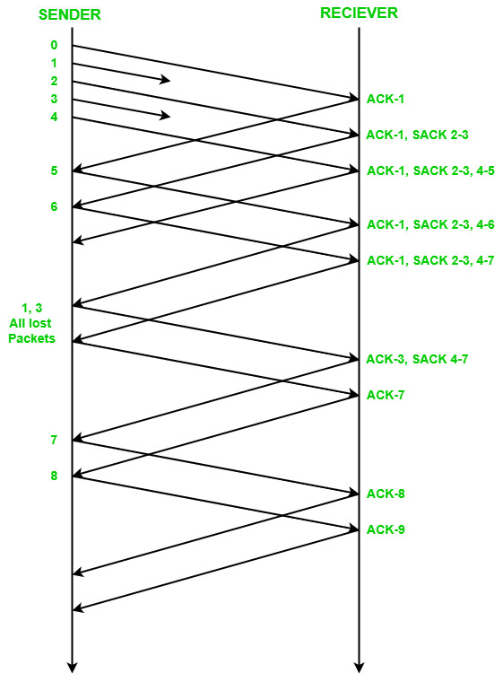
SACK
SACK feature helps the sender to identify ‘gaps’ in the receiver buffer. When the receiver does not receive packets in order then there exist some holes(missing points) in the buffer. SACK helps the sender to know about these holes in the receiver buffer at an early time. When the sender knows about the holes or lost packets, it retransmits them at the same time. Unlike Fast Recovery, SACK does not inform the sender very late about the lost packets.

Slide 17
Advantages of TCP
It is a reliable protocol.
It provides an error-checking mechanism as well as one for recovery.
It gives flow control.
It makes sure that the data reaches the proper destination in the exact order that it was sent.
Open Protocol, not owned by any organization or individual.
It assigns an IP address to each computer on the network and a domain name to each site thus making each device site to be distinguishable over the network.
Disadvantages of TCP
TCP is made for Wide Area Networks, thus its size can become an issue for small networks with low resources.
TCP runs several layers so it can slow down the speed of the network.
It is not generic in nature. Meaning, it cannot represent any protocol stack other than the TCP/IP suite. E.g., it cannot work with a Bluetooth connection.
No modifications since their development around 30 years ago.
Conclusion
TCP (Transmission Control Protocol) is a vital component of internet communication, ensuring that data is transmitted reliably and accurately between devices. Its ability to manage data packet transmission, error correction, and proper sequencing underpins the smooth and efficient exchange of information that we rely on every day.

