Slide 1


TRACEROUTE:
PURPOSE
trace the path to reach the destination ip address.
find the round trip time to reach the destination ip address.
TRACEROUTE (application) utility uses UDP protocol & has reserved port 33434 to 33523.
TRACEROUTE can trace path up to 30 hops.
TRACEROUTE utility is available on Unix, Linux systems.
How Traceroute works? Packet Level Analysis:
Consider a simple topology as below:
R1> traceroute 4.4.4.4 source 1.1.1.1
Step 1:
R1 sends 3 UDP packets with TTL value 1.
R2 receives the UDP packet with TTL value of 1, does a route lookup try to forward the packet towards by reducing the TTL value by 1 but TTL value becomes Zero. Hence, generates ICMP error message “TTL exceeded” or “TTL expired in transit” to inform originator (R1) with TYPE = 11 and Code = 0 for each UDP packet.

Slide 2
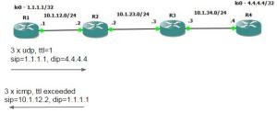
R1 receives the ICMP error message and comes to know about the 1st Hop address (R2).
Step 2:
R1 sends 3 UDP packets with TTL value 2.
R2 receives the UDP packet with TTL value of 2, does a route lookup forward the packet towards R3 with TTL value of 1 by reducing the TTL value by 1.
R3 receives the UDP packet with TTL value of 1, does a route lookup and find the destination IP address in the routing table but the UDP destination port . Hence, generates ICMP error message “TTL exceeded” or “TTL expired in transit” to inform originator (R1) with TYPE = 11 and Code = 0 for each UDP packet.

Slide 3
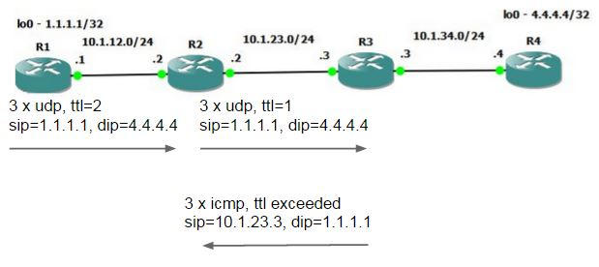
R1 receives the ICMP error message and comes to know about the 2nd Hop address (R3).
Step 3:
R1 sends 3 UDP packets with TTL value 3.
R2 receives the UDP packet with TTL value of 3, does a route lookup forward the packet towards R3 with TTL value of 2 by reducing the TTL value by 1.
R3 receives the UDP packet with TTL value of 2, does a route lookup forward the packet towards R4 with TTL value of 1 by reducing the TTL value by 1.
R4 receives the UDP packet with TTL value of 1, does a route lookup and find the destination ip address in the routing table but the UDP port in not open. Hence, generates ICMP error message to inform originator (R1) with TYPE = 3 (Destination Unreachable) and Code = 3 (Port Unreachable) for each UDP packet.

Slide 4
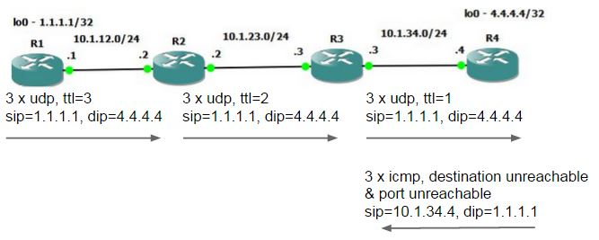
R1 receives the ICMP error message and comes to know about the 3rd Hop address (R4) but ICMP error message with Destination Unreachable & Port Unreachable, R1 understands it has reached the destination and further no need send any UDP packet with higher TTL value.
TRACERT : It is also works same like traceroute however, it uses ICMP echo request packet
trace the path to reach the destination ip address.
find the round trip time to reach the destination ip address.
TRACERT (application) utility uses ICMP protocol.
TRACERT can trace path up to 30 hops.
TRACERT utility is available on Windows systems only.

Slide 5
PLEASE WAIT FOR 10 MINUTES. LET OTHERS ALSO JOIN

