Slide 1


Slide 2
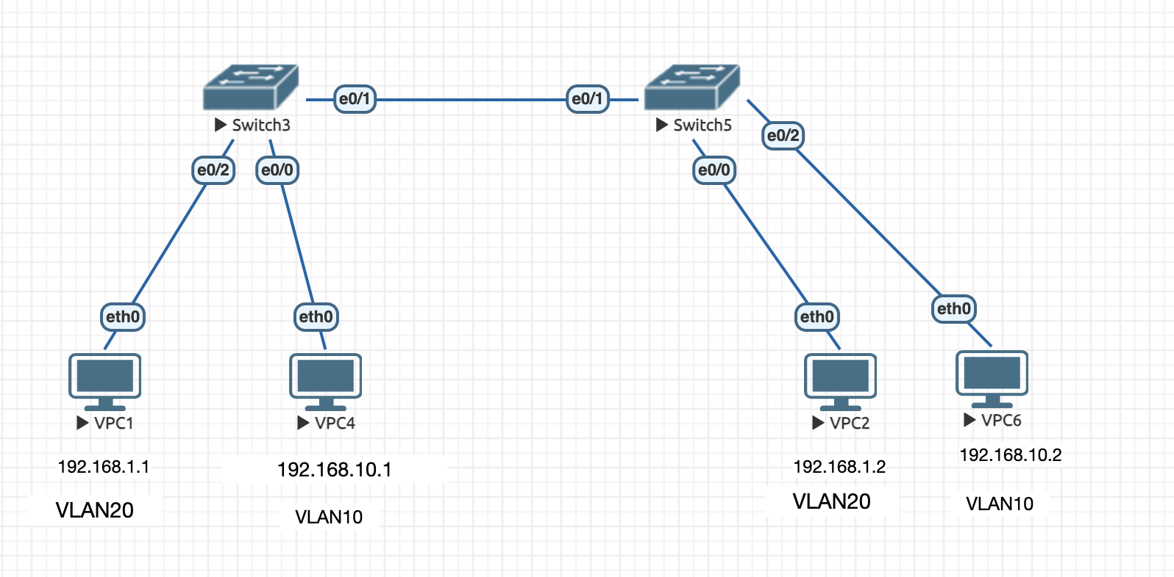
VLAN scenario based Interview questions
Topology
Create a LAB setup:
Create vlans on switch3
switch3(config)#vlan 10
switch3(config-vlan)#name blue
switch3(config-vlan)#exit
switch3(config)#vlan 20
switch3(config-vlan)#exit
Create vlans on switch5
switch5(config)#vlan 10
switch5(config-vlan)#name blue
switch5(config-vlan)#exit
Switch5(config)#vlan 20
switch5(config-vlan)#exit
assign the e0/2 under vlan 20 and e0/0 under vlan10 on swtich3
switch3(config)#int e0/2
switch3(config-if)#switchport mode access
switch3(config-if)#switchport access vlan 20
switch3(config-if)#exit
switch3(config)#int e0/0
switch3(config-if)#switchport mode access
switch3(config-if)#switchport access vlan 10
Verification commands:
switch3#sh vlan brief
VLAN Name Status Ports
---- -------------------------------- --------- -------------------------------
1 default active Et0/3, Et1/0, Et1/1, Et1/2
Et1/3, Et2/0, Et2/1, Et2/2
Et2/3, Et3/0, Et3/1, Et3/2
Et3/3
10 blue active Et0/0
20 red active Et0/2
assign the e0/0 under vlan 20 and e0/2 under vlan10 on swtich5
switch5(config)#int e0/2
switch5(config-if)#switchport mode access
switch5(config-if)#switchport access vlan 10
switch5(config-if)#exit
switch5(config)#int e0/0
switch5(config-if)#switchport mode access
switch5(config-if)#switchport access vlan 20

Slide 3
Case study 1:
Initiate ping from VPC1 to destination IP 192.168.1.2
VPCS> ping 192.168.1.2
host (192.168.1.2) not reachable
Ping is not successful. The reason is, When you initiate a ping from VPC1, the ICMP packet will go to switch3 e0/2 and this port is
Under vlan 20. There is no other ports under vlan 20 to send the packet out. So assign the port e0/1 under vlan 20 and other hand on switch5, assign the e0/1 under vlan 20 then your able to reach 192.168.1.2
NOTE: when the packet is sending out it will untag the vlan 20 and send just a normal frame.
VPCS> ping 192.168.1.2
84 bytes from 192.168.1.2 icmp_seq=1 ttl=64 time=5.346 ms
84 bytes from 192.168.1.2 icmp_seq=2 ttl=64 time=10.419 ms
84 bytes from 192.168.1.2 icmp_seq=3 ttl=64 time=24.153 ms
84 bytes from 192.168.1.2 icmp_seq=4 ttl=64 time=14.082 ms
84 bytes from 192.168.1.2 icmp_seq=5 ttl=64 time=20.717 ms
Case study 2:
NOTE: you can’t ping from VPC4 to VPC6. because we configured e0/1 on both the switches under VLAN20 only
So to carry multiple vlan traffic(vlan 10 and vlan 20), we need to configure trunk port on both ends.
Switch3(config)# interface e0/1
Switch3(config-if)# switchport mode trunk
Switch5(config-if)# end
show interfaces trunk
Switch5(config)# interface e0/1
Switch5(config-if)# switchport mode trunk
Switch5(config-if)# end
show interfaces trunk

Slide 4
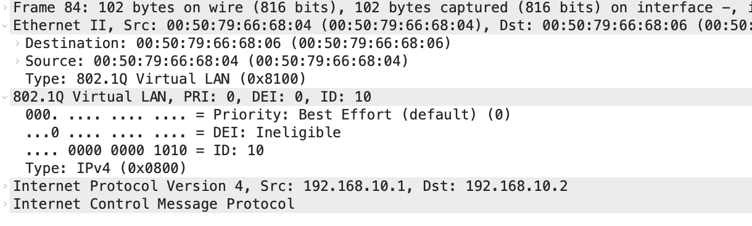
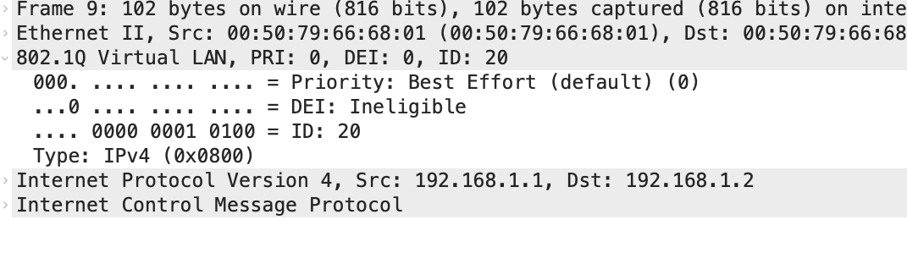

Now you are able to ping vpc2 from VPC1 and vp6 from vpc4 at a same time.
VPCS> ping 192.168.10.2
84 bytes from 192.168.10.2 icmp_seq=1 ttl=64 time=16.687 ms
84 bytes from 192.168.10.2 icmp_seq=2 ttl=64 time=36.231 ms
84 bytes from 192.168.10.2 icmp_seq=3 ttl=64 time=21.786 ms
84 bytes from 192.168.10.2 icmp_seq=4 ttl=64 time=10.125 ms
84 bytes from 192.168.10.2 icmp_seq=5 ttl=64 time=41.536 ms
VPCS> ping 192.168.1.1
84 bytes from 192.168.1.1 icmp_seq=1 ttl=64 time=20.813 ms
84 bytes from 192.168.1.1 icmp_seq=2 ttl=64 time=25.732 ms
84 bytes from 192.168.1.1 icmp_seq=3 ttl=64 time=17.134 ms
84 bytes from 192.168.1.1 icmp_seq=4 ttl=64 time=11.433 ms
84 bytes from 192.168.1.1 icmp_seq=5 ttl=64 time=37.409 ms
VLAN TAG
VLAN TAG
If you see packet capture, when you initiate a ping, the trunk port carries the tagged frames such as
VLAN10 and VLAN20.

Slide 5
NOTE: make sure both the ends trunk is configured. if you want to allow only either
Vlan 20 or vlan 10, you can use below command.
switch3(config)#sw
switch3(config)#swi
switch3(config)#int e0/1
switch3(config-if)#switchport trunk allowed vlan ?
WORD VLAN IDs of the allowed VLANs when this port is in trunking mode
add add VLANs to the current list
all all VLANs
except all VLANs except the following
none no VLANs
remove remove VLANs from the current list
switch3(config-if)#switchport trunk allowed vlan 10
You can use above options according to your requirement.
Useful commands:
show vlan brief
show interfaces trunk
show interfaces switchport
show interfaces status
show spanning-tree

