Slide 1


Slide 2
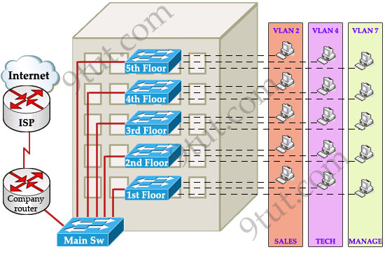
VLAN Trunking protocol(VTP)
VTP (VLAN Trunking Protocol) is a protocol used in network management to simplify the configuration of VLANs across a network of switches. It allows changes made to VLAN settings on one switch to be automatically propagated to all other switches in the same VTP domain, ensuring consistency and reducing the need for manual updates.
VTP minimizes misconfigurations and configuration inconsistencies that can cause problems, such as duplicate VLAN names or incorrect VLAN-type specifications. VTP helps you simplify management of the VLAN database across multiple switches.
VTP is a Cisco-proprietary protocol and is available on most of the Cisco switches.
Why we need VTP?
To answer this question, let’s discuss a real and popular network topology.
Suppose you are working in a medium company in a 5-floor office. You assigned each floor to a switch for easy management and of course they can be assigned to different VLANs. For example, your bosses can sit in any floor and still access Manage VLAN (VLAN 7). Your technical colleagues can sit anywhere on the floors to access Technical VLAN (VLAN 4). This is the best design because each person’s permission is not limited by the physical location.
How VTP Works
To make switches exchange their VLAN information with each other, they need to be configured in the same VTP domain. Only switches belonging to the same domain share their VLAN information. When a change is made to the VLAN database, it is propagated to all switches via VTP advertisements.
To maintain domain consistency, only one switch should be allowed to create (or delete, modify) new VLANs. This switch is like the “master” of the whole VTP domain and it is operated in Server mode. This is also the default mode.
Other switches are only allowed to receive and forward updates from the “server” switch. They are operated in Client mode. Switches in this mode cannot create, delete or modify VLANs.

Slide 3
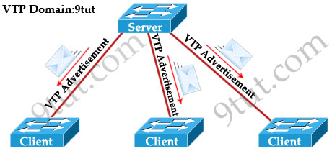
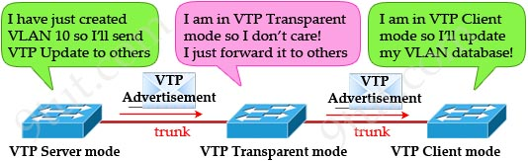
In some cases, the network manager doesn’t want a switch to learn VTP information from other switches. He can set it to Transparent mode. In this mode, a switch maintains its own VLAN database and never learn any VTP information from other switches (even from the switch in VTP server mode). However, it still forwards VTP advertisements from the server to other switches (but doesn’t read that advertisement). A transparent switch can add, delete and modify VLAN database locally.
1.Configure the VTP-SERVER switch as a VTP server 2.Connect to the 3 other switches and configure them as VTP clients. All links between swiches must be configured as trunk lines. 3.Configure VTP domain name as "TESTDOMAIN" and VTP password as "cisco" 4.Configure VLAN 10 with name "STUDENTS" and VLAN 50 with name "SERVERS" 5. Check propagation on all switches of the VTP domain.
VTP Configuration
Main Sw(config)#vtp version 2 Main Sw(config)#vtp domain rameshtech Main Sw(config)#vtp mode server Main Sw(config)#vtp password keepitsecret
On client switches
Client(config)#vtp version 2 Client(config)#vtp domain rameshtech Client(config)#vtp password keepitsecret Client(config)#vtp mode client
show vtp status

Slide 4
VTP (VLAN Trunking Protocol) can be very useful, but it also introduces several potential issues in real-world network environments:
VLAN Deletion: If a switch with a higher VTP revision number (e.g., one that has been reset and reconfigured) is introduced into the network, it can overwrite the VLAN configuration of all switches in the domain, potentially deleting important VLANs.
Inconsistent VLANs: Changes in VTP domain names, passwords, or modes can lead to inconsistent VLAN configurations across the network, causing communication problems and outages.
VTP Pruning Issues: VTP pruning, designed to reduce unnecessary VLAN traffic, can sometimes cause issues if it inadvertently prunes necessary VLANs, leading to connectivity problems.
Unintended Changes: Mistakes in VTP configuration can propagate unintended changes quickly across the entire network, making troubleshooting more challenging.
Security Risks: VTP can pose a security risk if unauthorized devices are connected to the network, as they can potentially alter VLAN configurations if they join the VTP domain.
VTP Version Compatibility: Different versions of VTP (version 1, 2, and 3) have varying features and compatibility issues. Mixing different versions in the same network can cause unpredictable behavior.
Resource Consumption: In large networks, VTP advertisements can consume significant bandwidth and CPU resources, potentially impacting network performance.
Loss of Control: Centralized control through VTP means that local changes to VLAN configurations on individual switches are not possible without changing the VTP configuration on the central switch.

Slide 5




EtherChannel
EtherChannel is the technology which is used to combine several physical links between switches or routers into one logical connection and treat them as a single link. Let’s take an example to see the benefits of this technology: Suppose your company has two switches connecting with each other via a FastEthernet link (100Mbps):
Your company is growing and you need to transfer more than 100 Mbps between these switches. If you only connect other links between the two switches it will not work because Spanning-tree protocol (STP) will block redundant links to prevent a loop:
To extend the capacity of the link you have two ways: + Buy two 1000Mbps (1Gbps) interfaces + Use EtherChannel technology to bundle them into a bigger link The first solution is expensive with the new hardware installed on the two switches. By using EtherChannel you only need some more unused ports on your switches:
EtherChannel bundles the physical links into one logical link with the combined bandwidth and it is awesome! STP sees this link as a single link so STP will not block any links! EtherChannel also does load balancing among the links in the channel automatically. If a link within the EtherChannel bundle fails, traffic previously carried over the failed link is carried over the remaining links within the EtherChannel. If one of the links in the channel fails but at least one of the links is up, the logical link (EtherChannel link) remains up. EtherChannel also works well for router connections:
When an EtherChannel is created, a logical interface will be created on the switches or routers representing for that EtherChannel. You can configure this logical interface in the way you want. For example, assign access/trunk mode on switches or assign IP address for the logical interface on routers…
Note: A maximum of 8 Fast Ethernet or 8 Gigabit Ethernet ports can be grouped together when forming an EtherChannel. There are three mechanisms you can choose to configure EtherChannel: + Port Aggregation Protocol (PAgP) + Link Aggregation Control Protocol (LACP) + Static (“On”)

Slide 6
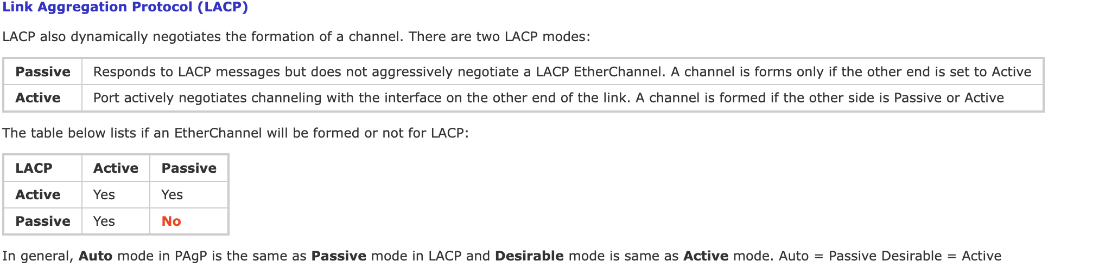
LACP is the IEEE Standard (IEEE 802.3ad) and is the most common dynamic ether-channel protocol, whereas PAgP is a Cisco proprietary protocol and works only between supported vendors and Cisco devices. All ports in an EtherChannel must use the same protocol; you cannot run two protocols on two ends. In other words, PAgP and LACP are not compatible so both ends of a channel must use the same protocol.
The Static Persistence (or “on” mode) bundles the links unconditionally and no negotiation protocol is used. In this mode, neither PAgP nor LACP packets are sent or received. (Reference: http://www.cisco.com/en/US/tech/tk389/tk213/technologies_tech_note09186a0080094714.shtml)
EtherChannel Configuration
To assign and configure an EtherChannel interface to an EtherChannel group, use the channel-group command in interface mode: channel-group number mode { active | on | {auto [non-silent]} | {desirable [non-silent]} | passive} For example we will create channel-group number 1:
Switch(config-if)#channel-group 1 mode ?
active Enable LACP unconditionally
auto Enable PAgP only if a PAgP device is detected
desirable Enable PAgP unconditionally
on Enable Etherchannel only
passive Enable LACP only if a LACP device is detected
If a port-channel interface has not been created before using this command, it will be created automatically and you will see this line: “Creating a port-channel interface Port-channel 1”. In this example, we will create an EtherChannel via LACP between SwA & SwB with the topology shown below:

Slide 7

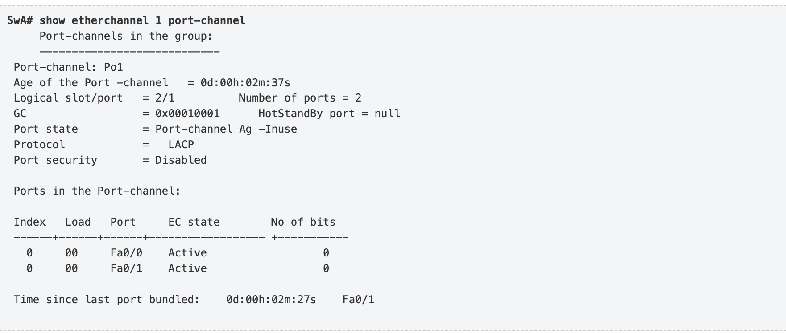
SwA Configuration SwB Configuration //Assign EtherChannel group 1 to fa0/0 and fa0/1 and set Active mode on them SwA(config)#interface range fa0/0 – 1 SwA(config-if-range)#channel-group 1 mode active Creating a port-channel interface Port-channel 1 //Next configure the representing port-channel interface as trunk SwA(config)#interface port-channel 1 SwA(config-if)#switchport trunk encapsulation dot1q SwA(config-if)#switchport mode trunk //Assign EtherChannel group 2 to fa0/5 and fa0/6 and set Passive mode on them SwB(config)#interface range fa0/5 – 6 SwB(config-if-range)#channel-group 2 mode passive Creating a port-channel interface Port-channel 2 //Next configure the representing port-channel interface as trunk SwB(config)#interface port-channel 2 SwB(config-if)#switchport trunk encapsulation dot1q SwB(config-if)#switchport mode trunk

Slide 8
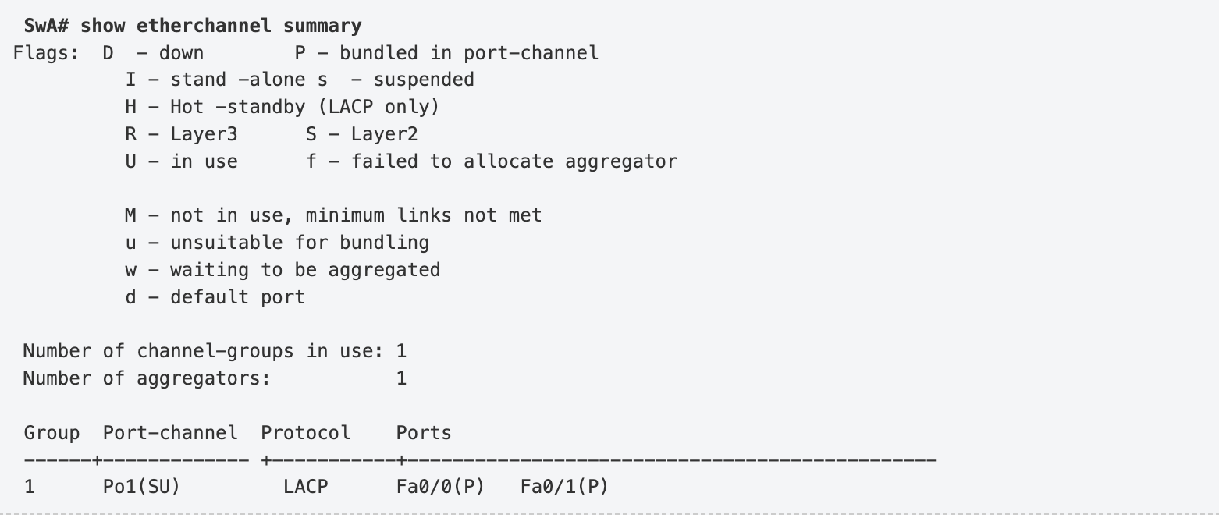
The “show etherchannel number port-channel” command can be used to display information about a specific port channel (in this case port-channel 1). From the command above we can see Port-channel 1 consists of Fa0/0 & Fa0/1 and they are in Active state.
EtherChannel Load-Balancing
EtherChannel load-balances traffic among port members of the same channel. Load balancing between member interface is based on: + Source MAC address + Destination MAC address + Source IP address + Destination IP address + Combination of Source and Destination MAC address + Combination of Source and Destination IP address
Note: Some old switch/router flatforms do not support all the load-balancing methods above. To configure load-distribution method, use the command port-channel load-balance under global configuration mode. For example to load-balance based on destination MAC use the command:
Router(config)#port-channel load-balance dst-mac
How the router/switch load-balances traffic among member interface is out of the scope of this article. For more information about EtherChannel load-balancing please visit http://www.cisco.com/en/US/tech/tk389/tk213/technologies_tech_note09186a0080094714.shtml#topic1.

Slide 9
LLDP configuration example (Cisco)
LLDP (Link Layer Discovery Protocol ) is a neighbor discovery protocol that is used for network devices to advertise information about themselves to other devices on the network. This protocol runs over the data-link layer.
Details, such as device capabilities or device identity can be advertised using this protocol. You can configure the frequency of LLDP updates, the amount of time to hold the information before discarding it or the initialization delay time. You can also select the LLDP TLVs for sending and receiving. Let’s take a look at LLDP configuration example for Cisco.
By default LLDP is disabled globally on Cisco devices. To enable it issue:
Switch# configure terminal Switch(config)# lldp run
LLDP uses TLVs (Type, Length, Value) to advertise and receive specific information to/from neighbors. Some of these TLVs are mandatory LLDP TLVs and all the swithces support these TLVs given below:
Port description TLV
System name TLV
System description
System capabilities TLV
Management address TLV
Port VLAN ID TLV
MAC/PHY configuration/status TLV

