Slide 1


Slide 2
Access control lists (ACLs) provide a means to filter packets by allowing a user to permit or deny IP packets from crossing specified interfaces.
Access lists filter network traffic by controlling whether packets are forwarded or blocked at the router’s interfaces based on the criteria you specified within the access list.
To use ACLs, the system administrator must first configure ACLs and then apply them to specific interfaces. There are 3 popular types of ACL: Standard, Extended and Named ACLs.
Standard IP Access List
Standard IP lists (1-99) only check source addresses of all IP packets.
Configuration Syntax
access-list access-list-number {permit | deny} source {source-mask}
Apply ACL to an interface
ip access-group access-list-number {in | out}

Slide 3
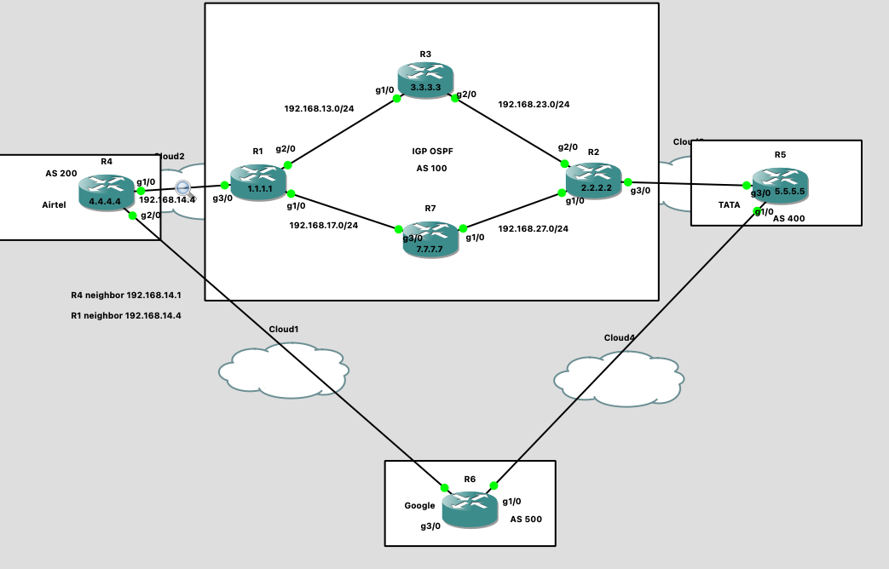
Below is the topology. Here we have 4 AS’s, AS 100, AS 200, AS 400 and AS 500. In the previous LAB we
Setup this LAB , AS 100 we configured IBGP using RR’s and peer groups. Also, for Next-hop reachability we use IGP as OSPF. Make sure if you initiate ping form R3 to 6.6.6.6, it should reachable. Please complete the RR’s LAB before you practice this LAB

Slide 4
Example of Standard IP Access List
As per the Topology, I want to allow only R6 router to ping 1.1.1.1. The path selected is
R6---R4---R1. Hence, I am shutting down the interface g1/0 on R6 for LAB purpose.
Checking traceroute form R6:
R6#traceroute 1.1.1.1
Type escape sequence to abort.
Tracing the route to 1.1.1.1
VRF info: (vrf in name/id, vrf out name/id)
1 192.168.46.4 96 msec 88 msec 112 msec. --------------R4
2 192.168.14.1 [AS 200] 88 msec 100 msec 92 msec ----------R1
Now I want to create a standard IP access-list to allow only 192.168.46.0/24 network and rest all should block
On R1 router:
R1(config)#access-list 1 permit 192.168.46.0 0.0.0.255
R1(config)#int g3/0
R1(config-if)#ip access-group 1 in
R1#sh ip access-lists
Now initiate a ping 1.1.1.1 on R4
R4#ping 1.1.1.1
Type escape sequence to abort.
Sending 5, 100-byte ICMP Echos to 1.1.1.1, timeout is 2 seconds:
UUUUU
Success rate is 0 percent (0/5)
Now initiate a ping 1.1.1.1 on R6
R6#ping 1.1.1.1
Type escape sequence to abort.
Sending 5, 100-byte ICMP Echos to 1.1.1.1, timeout is 2 seconds:
!!!!!
Success rate is 100 percent (5/5), round-trip min/avg/max = 24/48/92 ms
The ping is successful from R6 and unsuccessful from R1. Hence, our LAB is completed.
NOTE: when you initiate a traffic from R6, the Source IP it will take as 192.168.46.6 (exit interface IP). SO we allowed entire 192.168.46.0/24 subnet. So the traffic which is coming from this subnet will be allowed on interface g3/0 at R1 router .other traffic will be denied.

Slide 5
Extended IP Access List
Extended IP lists (100-199) check both source and destination addresses, specific UDP/TCP/IP protocols, and destination ports.
Configuration Syntax
access-list access-list-number {permit | deny} protocol source {source-mask} destination {destination-mask} [eq destination-port]
Before going to do LAB, please remove previous access-list 1 on R1 router and do extended access-list LAB
R1(config)# int g3/0
R1(config-if)#no ip access-group 1 in
R1(config-if)#exit
R1(config)#no access-list 1
NOTE, on R6 device the port g1/0 is still down. We made this for LAB purpose to avoid multiple paths.

Slide 6
Extended access-list LAB:
As per the topology, I want to block the traffic which is coming from R6 to R1. It means
Source addresses are 192.168.46.0/24 and destination is 1.1.1.1
On R1
R1(config)#access-list 101 deny icmp 192.168.46.0 0.0.0.255 1.1.1.1 0.0.0.0
R1(config)#access-list 101 permit ip any any. ---→ this to allow other traffic
R1(config)#int g3/0
R1(config-if)#ip access-group 101 in
R1#sh ip access-lists
Now testing On R6 router:
R6#ping 1.1.1.1
Type escape sequence to abort.
Sending 5, 100-byte ICMP Echos to 1.1.1.1, timeout is 2 seconds:
UUUUU
Success rate is 0 percent (0/5)
We block the ICMP traffic and allowed other traffic is called UDP traffic.
R6#traceroute 1.1.1.1
Type escape sequence to abort.
Tracing the route to 1.1.1.1
VRF info: (vrf in name/id, vrf out name/id)
1 192.168.46.4 24 msec 44 msec 12 msec
2 192.168.14.1 [AS 200] 16 msec 48 msec 36 msec
Traceroute used UDP packets. Hence the R1 router is allowing UDP packets and blocking ICMP packets.

Slide 7
Similar way you can block TCP traffic using TCP ports you can block any protocol traffic.
Below are the possible completions to block the other protocol traffic on interfaces.
R1(config)#access-list 101 deny ?
<0-255> An IP protocol number
ahp Authentication Header Protocol
eigrp Cisco's EIGRP routing protocol
esp Encapsulation Security Payload
gre Cisco's GRE tunneling
icmp Internet Control Message Protocol
igmp Internet Gateway Message Protocol
ip Any Internet Protocol
ipinip IP in IP tunneling
nos KA9Q NOS compatible IP over IP tunneling
object-group Service object group
ospf OSPF routing protocol
pcp Payload Compression Protocol
pim Protocol Independent Multicast
sctp Stream Control Transmission Protocol
tcp Transmission Control Protocol
udp User Datagram Protocol

Slide 8
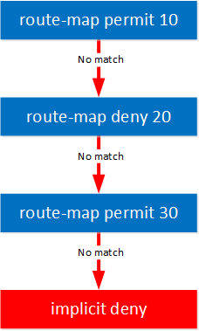
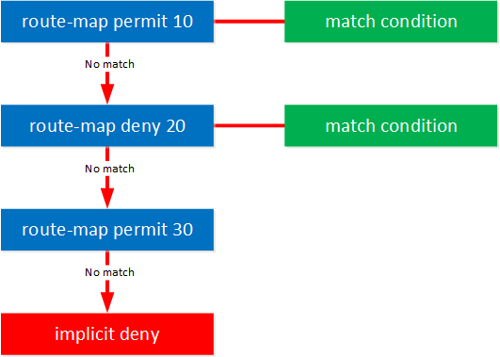
Route-maps
Route maps are tools used to modify the default behavior of the routing table. For example, if you receive a route to 100.100.100.100 through BGP, it comes with certain attributes like local preference, AS path, and MED. Suppose the local preference is set to 100, but you want to change it to 200 or 300; you can use a route map to make that adjustment.
Similarly, if there’s a route you don’t want to accept into your routing table, you can use a route map to block that route from being injected.
Here are some simple definitions related to route maps:
Permit or Deny: Each statement in a route map either permits or denies the matched routes. If a route is permitted, the route map allows the route to be advertised or applied to the next step in the routing process. If denied, the route is not advertised or applied.
Match: This defines the criteria or conditions that a route must meet for the route map to apply a particular action. For example, you can match based on an IP address, prefix list, AS path, or route tag.
Match: there is a match, we apply our action and that’s it. We don’t check the other route-map statements to see if there is another match.
No match: we continue and check the next route-map statement.
When you don’t have any matches, we hit the invisible implicit deny at the bottom of the route-map. This is similar to how an access-list works.
Set: This specifies the action to take on the matched routes. Actions can include setting a different metric, AS path, next-hop IP address, or modifying route attributes like local preference or weight.
Route Manipulation: Route maps allow you to control how routes are imported, exported, or redistributed by modifying route attributes based on specific conditions.
Policy-Based Routing (PBR): Route maps can also be used for policy-based routing, where packets are routed based on criteria other than the destination IP address, such as source IP address or traffic type.
Our first two statements (10 and 20) have a match condition. There are a lot of possible match conditions. To name a few:
prefix-list
access-list
BGP local preference
BGP AS path
Packet Length
And many more…

Slide 9
BGP Path manipulation using Local preference and AS path attributes.
We have to do BGP path Manipulation using ACL’s and route-maps. Please remove existing ACL’s in our LAB. AS per the topology, we need two paths to reach the destination. We blocked on port g1/0 on R6 router. Please unshut the port and make sure R3 should have 2 paths to reach 6.6.6.6
R6(config)#int g1/0
R6(config-if)#no shut
R1(config)#no access-list 101
R1#sh ip access-lists ----------------Make sure all ACL’s are removed.
In our topology AS 100 is the IBGP domain and here we have R1 and R2 are connected to another AS’s. so AS 100 have 2 Exit path, one is via Airtel and one is via TATA.
Based on BGP path selection process by default the R3 router choosing the airtel Path.
R3#traceroute 6.6.6.6
Type escape sequence to abort.
Tracing the route to 6.6.6.6
VRF info: (vrf in name/id, vrf out name/id)
1 192.168.13.1 4 msec 96 msec 12 msec
2 192.168.14.4 92 msec 136 msec 24 msec. ---------------------→ Airtel Path
3 192.168.46.6 [AS 200] 104 msec 108 msec 12 msec
In Realtime, we have an issue with airtel, there is a interface drops on airtel link and BGP peer is still UP ,
however , there is a packet loss in this path, we need to switch over the path to TATA. we use local preference attribute, which will tell you how to exit your own AS, so highest local preference value will prefer the best path. So can configure a route-map and change the path towards TATA. This is called path manipulation.

Slide 10
Now you want to create route-map with local-preference value. Before going to do that Where exactly you need to configure? By default Local preference value is 100. so if you Want increase LP value to 200 create route-map or R2, I you want decrease LP value below 100 you can Create route-map on R1. Its up to you where you want to configure.
Checking IP BGP table for 6.6.6.6 on R3 router
R3# sh ip bgp 6.6.6.6
BGP routing table entry for 6.6.6.6/32, version 95
Paths: (2 available, best #2, table default)
Not advertised to any peer
Refresh Epoch 6
400 500
2.2.2.2 (metric 2) from 2.2.2.2 (2.2.2.2)
Origin incomplete, metric 0, localpref 100, valid, internal
rx pathid: 0, tx pathid: 0
Refresh Epoch 1
200 500
1.1.1.1 (metric 2) from 1.1.1.1 (1.1.1.1)
Origin incomplete, metric 0, localpref 100, valid, internal, best
rx pathid: 0, tx pathid: 0x0
R3#
Here the route 6.6.6.6 is learning from 1.1.1.1 path and 2.2.2.2 path also, LP is 100 for both the paths. However, it chooses the best path as 1.1.1.1 (airtel). We can change to TATA now.
Configuring route-map with highest LP on R2 router:
Configure terminal
route-map LP permit 10
set local-preference 300
exit
route-map LP permit 20
Apply route-map
neighbor IBGP route-map LP out. ---------→ the LP should advertise in AS 100 (IBGP domain)

Slide 11
Verification: Check the bgp table on R3
R3# sh ip bgp 6.6.6.6
BGP routing table entry for 6.6.6.6/32, version 101
Paths: (2 available, best #1, table default)
Not advertised to any peer
Refresh Epoch 7
400 500
2.2.2.2 (metric 2) from 2.2.2.2 (2.2.2.2)
Origin incomplete, metric 0, localpref 300, valid, internal, best
rx pathid: 0, tx pathid: 0x0
Refresh Epoch 1
200 500
1.1.1.1 (metric 2) from 1.1.1.1 (1.1.1.1)
Origin incomplete, metric 0, localpref 100, valid, internal
rx pathid: 0, tx pathid: 0
R3#
Now you can see LP value is 300 for 6.6.6.6 which is learning from 2.2.2.2 (TATA). This is the best path
to reach the 6.6.6.6
R3#traceroute 6.6.6.6
Type escape sequence to abort.
Tracing the route to 6.6.6.6
VRF info: (vrf in name/id, vrf out name/id)
1 192.168.23.2 56 msec 44 msec 20 msec
2 192.168.25.5 60 msec 96 msec 24 msec
3 192.168.65.6 [AS 400] 124 msec 108 msec 12 msec
R3#

Slide 12
NOTE: By using Local preference we can only do outbound traffic manipulation. If you
Want to do both inbound and outbound traffic you use AS path attribute.
Shortest as path will choose the best path in BGP path selection process. So when you advertise AS 100
Routes to AS 200, it will prepend the AS. So you can prepend your own AS with [100 100 100] and increase
The AS path by using route-maps. So he revers traffic (incoming traffic) from R6 route will choose TATA path
Create route-map on R1
Conf t
route-map AS_PREP permit 10
set as-path prepend 100 100 100 100 100
route-map AS_PREP permit 20
R1(config)#router bgp 100
R1(config-router)#neighbor 192.168.14.4 route-map AS_PREP out
Here if you want to apply as path prepend for specific route example 3.3.3.3, you can create a prefix-list
And call that prefix-list in route-map. So the as path prepend will only apply to 3.3.3.3. if you don’t configure
Prefix list it will apply to all the routes. Below is the config with prefix list
Create route-map on R1
Conf t
ip prefix-list R3 seq 5 permit 3.3.3.3/32
route-map AS_PREP permit 10
match ip address prefix-list R3
set as-path prepend 100 100 100 100 100
route-map AS_PREP permit 20
R1(config)#router bgp 100
R1(config-router)#neighbor 192.168.14.4 route-map AS_PREP out

Slide 13
Verification
Here on R4, you can before apply as path
Prepend, it chooses best path as 1.1.1.1,
By using path prepend, I can choose now best
Path from 192.168.46.6
R4#sh ip bgp 3.3.3.3
BGP routing table entry for 3.3.3.3/32, version 156
Paths: (2 available, best #2, table default)
Advertised to update-groups:
2
Refresh Epoch 2
500 400 100, (received & used)
192.168.46.6 from 192.168.46.6 (6.6.6.6)
Origin incomplete, localpref 100, valid, external
rx pathid: 0, tx pathid: 0
Refresh Epoch 1
100
192.168.14.1 from 192.168.14.1 (1.1.1.1)
Origin incomplete, localpref 100, valid, external, best
rx pathid: 0, tx pathid: 0x0
After AS path prepend
R4#sh ip bgp 3.3.3.3
BGP routing table entry for 3.3.3.3/32, version 157
Paths: (2 available, best #1, table default)
Advertised to update-groups:
2
Refresh Epoch 2
500 400 100, (received & used)
192.168.46.6 from 192.168.46.6 (6.6.6.6)
Origin incomplete, localpref 100, valid, external, best
rx pathid: 0, tx pathid: 0x0
Refresh Epoch 1
100 100 100 100 100 100
192.168.14.1 from 192.168.14.1 (1.1.1.1)
Origin incomplete, localpref 100, valid, external
rx pathid: 0, tx pathid: 0
R4#
R4#traceroute 3.3.3.3
Type escape sequence to abort.
Tracing the route to 3.3.3.3
VRF info: (vrf in name/id, vrf out name/id)
1 192.168.46.6 84 msec 32 msec 8 msec
2 192.168.65.5 [AS 500] 44 msec 8 msec 24 msec
3 192.168.25.2 [AS 100] 52 msec 56 msec 44 msec
4 192.168.23.3 [AS 100] 68 msec 80 msec 60 msec
R4#
Reverse path from R6 to R3 it chooses TATA path
R6#traceroute 3.3.3.3
Type escape sequence to abort.
Tracing the route to 3.3.3.3
VRF info: (vrf in name/id, vrf out name/id)
1 192.168.65.5 24 msec 44 msec 12 msec
2 192.168.25.2 [AS 400] 8 msec 36 msec 28 msec
3 192.168.23.3 [AS 100] 88 msec 12 msec 32 msec
R6#
Here by using AS Path prepend we did inbound
Traffic filtering as well.

