Slide 1
EIGRP
EIGRP is referred to as a hybrid routing protocol because it has the characteristics of both distance-vector and link-state protocols but now Cisco refers it as an advanced distance vector protocol.
Notice: the term “hybrid” is misleading because EIGRP is not a hybrid between distance vector and link-state routing protocols. It is a distance vector routing protocol with enhanced features.
EIGRP is a powerful routing protocol and it is really standout from its ancestor IGRP. The main features are listed below:
+ Support VLSM and discontiguous networks + Use Reliable Transport Protocol (RTP) to delivery and reception of EIGRP packets + Use the best path selection Diffusing Update Algorithm (DUAL), guaranteeing loop-free paths and backup paths throughout the routing domain + Discover neighboring devices using periodic Hello messages to discover and monitor connection status with its neighbors + Exchange the full routing table at startup and send partial* triggered updates thereafter (not full updates like distance-vector protocols) and the triggered updates are only sent to routers that need the information. This behavior is different from the link-state protocol in which an update will be sent to all the link-state routers within that area. For example, EIGRP will send updates when a new link comes up or a link becoming unavailable + Supports multiple protocols: EIGRP can exchange routes for IPv4, IPv6, AppleTalk and IPX/SPX networks + Load balancing: EIGRP supports unequal metric load balancing, which allows administrators to better distribute traffic flow in their networks.
* Notice: The term “partial” means that the update only includes information about the route changes.
EIGRP use metrics composed of bandwidth, delay, reliability, and load. By default, EIGRP uses only bandwidth and delay.

Slide 2
EIGRP use five types of packets to communicate:
+ Hello: used to identify neighbors. They are sent as periodic multicasts + Update: used to advertise routes, only sent as multicasts when something is changed + Ack: acknowledges receipt of an update. In fact, Ack is Hello packet without data. It is always unicast and uses UDP. + Query: used to find alternate paths when all paths to a destination have failed + Reply: is sent in response to query packets to instruct the originator not to recompute the route because feasible successors exist. Reply packets are always unicast to the originator of the query
EIGRP sends every Query and Reply message using RTP, so every message is acknowledged using an EIGRP ACK message.
EIGRP Route Discovery
Suppose that our network has 2 routers and they are configured to use EIGRP. Let’s see what will happen when they are turned on.
Firstly, the router will try to establish a neighboring relationships by sending “Hello” packets to others running EIGRP. The destination IP address is 224.0.0.10 which is the multicast address of EIGRP. By this way, other routers running EIGRP will receive and proceed these multicast packets. These packets are sent over TCP.

Slide 3
EIGRP Configuration
Router(config)#router eigrp 1
Syntax: router eigrp <AS number>
Turn on the EIGRP process
1 is the Autonomous System (AS) number. It can be from 1 to 65535.
All routers in the same network must use the same AS number.
Router(config-router)#network 192.168.1.0
Router will turn on EIGRP 1 process on all the interfaces belonging to 192.168.1.0/24 network.

Slide 4
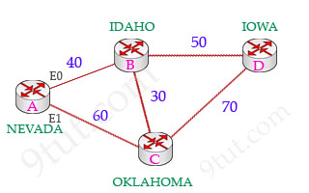
1st path A------B-----D FD= AD + cost from local router to next-hop (40) =90 → successor
2nd path A---C----D FD= 130 → feasible successor
3rd path A----B---C---D FD= 140
4th path A-----C----B----D FD= 140
Advertised distance (AD): the cost from the neighbor to the destination. Feasible distance (FD): The sum of the AD plus the cost between the local router and the next-hop router Successor: The primary route used to reach a destination. The successor route is kept in the routing table. Notice that successor is the best route to that destination. Feasible successor: The backup route. To be a feasible successor, the route must have an AD less than the FD of the current successor route
“To qualify as a feasible successor, a router must have an AD less than the FD of the current successor route“

Slide 5
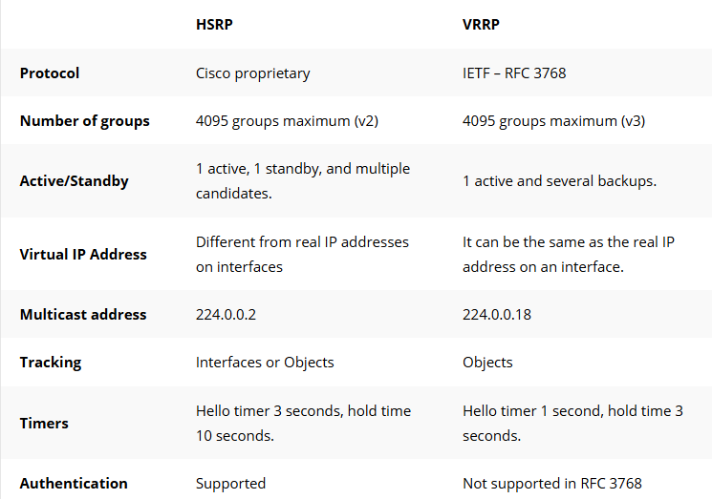
VRRP (Virtual Router Redundancy Protocol)
VRRP (Virtual Router Redundancy Protocol) is very similar to HSRP (Hot Standby Routing Protocol) and can be used to create a virtual gateway. If you don’t know why we use virtual gateways then I suggest to watch recorded session.
Difference Between VRRP and HSRP

Slide 6
Understanding VRRP (Virtual Router Redundancy Protocol)
Why We Use VRRP
Purpose: VRRP is used to provide high availability (HA) for default gateways. It ensures that if your main router fails, another backup router can take over without disrupting the network.
Simple Real-World Example
Scenario: Office Network with Two Routers
Imagine you have an office with 50 computers. These computers need to reach the internet. You have two routers: - Router A (Primary) - Router B (Backup) Normally, all computers use Router A (192.168.1.1) as their default gateway. But what if Router A fails? All internet access would go down.
Solution: Use VRRP
- Configure Router A and B to share a Virtual IP (e.g., 192.168.1.254). - All computers set their default gateway as 192.168.1.254. - Router A is the Master; Router B is the Backup. - If Router A fails, Router B automatically takes over, using the same virtual IP. - Users won’t even notice — internet access continues without interruption.
Summary
VRRP = Router backup system that provides redundancy for the default gateway, ensuring continuous network connectivity even if one router fails.

Slide 7
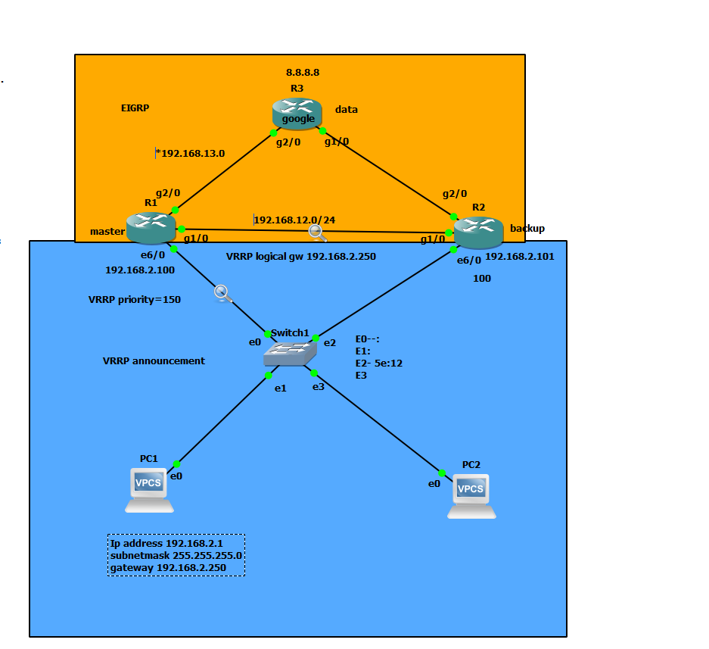
VRRP with EIGRP Topology

Slide 8
Configure Point to point IP addresses as per the topology EIGRP configuration
R1#
R1# router eigrp 90
network 192.168.2.0 0.0.0.255
network 192.168.12.0 0.0.0.255
network 192.168.13.0 0.0.0.255
R3# router eigrp 90
network 8.8.8.8 0.0.0.0
network 192.168.13.0
network 192.168.23.0
R2#
router eigrp 90
network 192.168.2.0
network 192.168.12.0
network 192.168.23.0
VRRP configuration on R1 and R2 NOTE: VRRP should configure on LAN connected interfaces
R1# vrrp 10 ip 192.168.2.250
vrrp 10 priority 150
R2# vrrp 10 ip 192.168.2.250
Now assign Ip address and gateway on PC1 NOTE: PC1 gateway is VRRP IP address (192.168.2.250)
PC1#
PC1> ip 192.168.2.1/24 192.168.2.250

