Slide 1
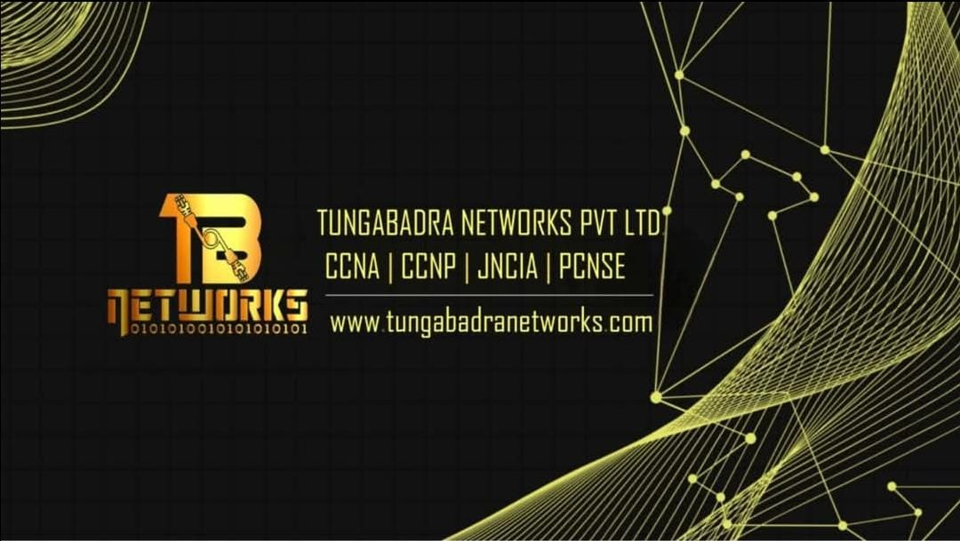

Slide 2
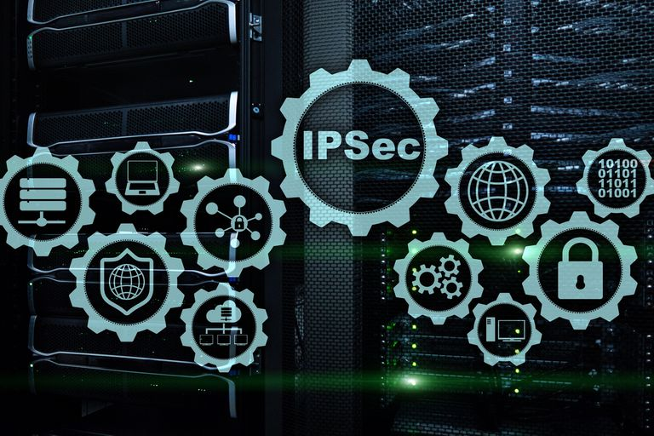
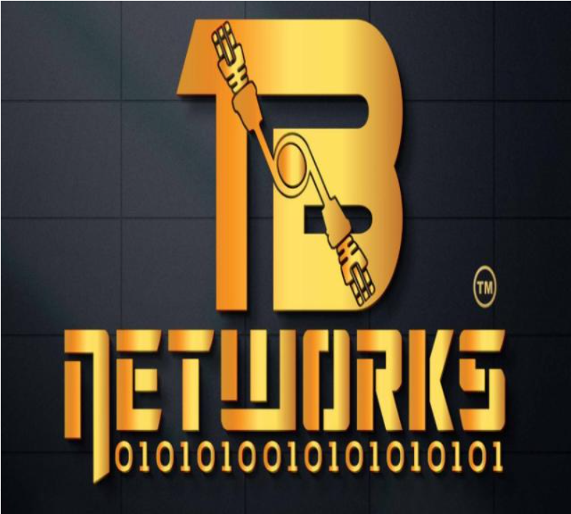
IPSEC (Internet Protocol Security)

Slide 3
AGENDA
IPsec
IKE (Internet Key Exchange)
IKE Phase 1
Main Mode
Aggressive Mode
IKE Phase 2
Quick Mode
IPsec Modes
Transport mode
Tunnel mode
IPsec Protocols
Authentication Header Protocol
ESP (Encapsulating Security Payload) Protocol

Slide 4
IPsec:
IPsec (Internet Protocol Security) is a framework that helps us to protect IP traffic on the network layer. Because the IP protocol itself doesn’t have any security features at all. IPsec can protect our traffic with the following features:
Confidentiality: By encrypting our data, nobody except the sender and receiver will be able to read our data.
Integrity: We want to make sure that nobody changes the data in our packets. By calculating a hash value, the sender and receiver will be able to check if changes have been made to the packet.
Authentication: The sender and receiver will authenticate each other to make sure that we are really talking with the device we intend to.
Anti-replay: Even if a packet is encrypted and authenticated, an attacker could try to capture these packets and send them again. By using sequence numbers, IPsec will not transmit any duplicate packets.

Slide 5
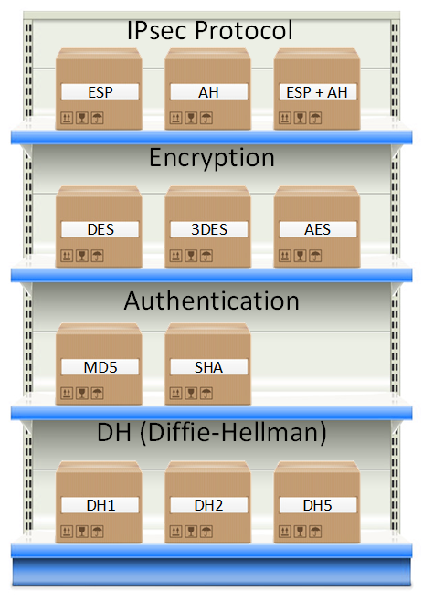

Slide 6
Types of VPNs:
IPsec can be used on many different devices, it’s used on routers, firewalls, hosts and servers
Between two routers to create a site-to-site VPN that “bridges” two LANs together.
Between a firewall and windows host for remote access VPN.
Between two Linux servers to protect an insecure protocol like telnet.
Before we can protect any IP packets, we need two IPsec peers that build the IPsec tunnel. To establish an IPsec tunnel, we use a protocol called IKE (Internet Key Exchange).
There are two phases to build an IPsec tunnel:
IKE phase 1
IKE phase 2
In IKE phase 1, two peers will negotiate about the encryption, authentication, hashing, group, life time that they want to use and some other parameters that are required. In this phase, an ISAKMP (Internet Security Association and Key Management Protocol) session is established. This is also called the ISAKMP tunnel or IKE phase 1 tunnel. The collection of parameters that the two devices will use is called a SA (Security Association).

Slide 7
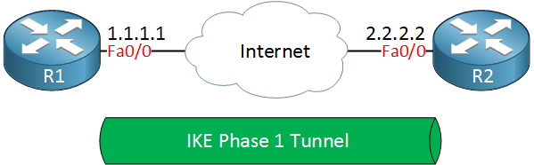
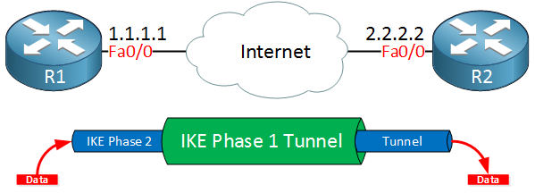
The IKE phase 1 tunnel is only used for management traffic. We use this tunnel as a secure method to establish the second tunnel called the IKE phase 2 tunnel or IPsec tunnel and for management traffic like keepalives.
Once IKE phase 2 is completed, we have an IKE phase 2 tunnel (or IPsec tunnel) that we can use to protect our user data. This user data will be sent through the IKE phase 2 tunnel.

Slide 8
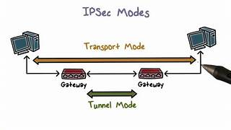
IPsec Modes:
Both protocols support two different modes:
Transport mode
Tunnel mode
Tunnel Mode:
IPSec tunnel mode is the default mode. With tunnel mode, the entire original IP packet is protected by IPSec. This means IPSec wraps the original packet, encrypts it, adds a new IP header and sends it to the other side of the VPN tunnel (IPSec peer).
Tunnel mode is most commonly used between site-to-site gateways, the gateway acting as a proxy for the hosts behind it.
Transport Mode:
IPSec Transport mode is used for end-to-end communications, for example, for communication between a client and a server or between a workstation and a gateway (if the gateway is being treated as a host). A good example would be an encrypted Telnet or Remote Desktop session from a workstation to a server.

Slide 9
IKE Phase 1:
Step 1 : Negotiation
The peer that has traffic that should be protected will initiate the IKE phase 1 negotiation. The two peers will negotiate about the following items:
Hashing: we use a hashing algorithm to verify the integrity, we use MD5 or SHA for this.
Authentication: each peer has to prove who he is. Two commonly used options are a pre-shared key or digital certificates.
DH (Diffie Hellman) group: the DH group determines the strength of the key that is used in the key exchange process. The higher group numbers are more secure but take longer to compute.
Lifetime: how long does the IKE phase 1 tunnel stand up? the shorter the lifetime, the more secure it is because rebuilding it means we will also use new keying material. Each vendor uses a different lifetime, a common default value is 86400 seconds (1 day).
Encryption: what algorithm do we use for encryption? For example, DES, 3DES or AES.

Slide 10
Step 2: DH Key Exchange
Once the negotiation has succeeded, the two peers will know what policy to use. They will now use the DH group that they negotiated to exchange keying material. The end result will be that both peers will have a shared key.
Step 3: Authentication
The last step is that the two peers will authenticate each other using the authentication method that they agreed upon on in the negotiation. When the authentication is successful, we have completed IKE phase 1. The end result is a IKE phase 1 tunnel (aka ISAKMP tunnel) which is bidirectional. This means that both peers can send and receive on this tunnel.
The three steps above can be completed using two different modes:
Main mode
Aggressive mode

Slide 11
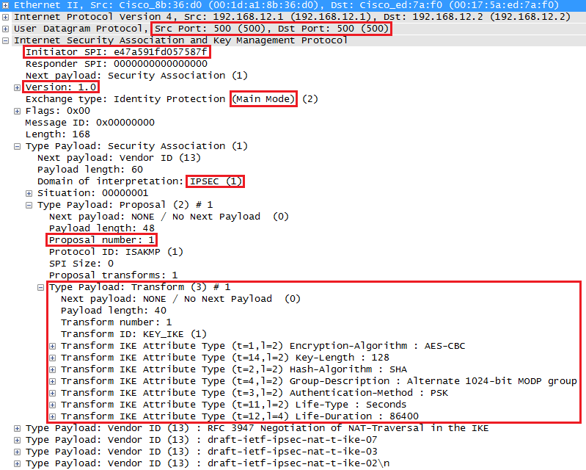
Main Mode:
IKEv1 main mode uses 6 messages
Message 1:
The initiator (peer that wants to build the tunnel)
will send the first message. This is a proposal for
the security association. The IKE uses UDP
port 500 for this. In the output above you can see
an initiator SPI (Security Parameter Index), this is
a unique value that identifies this security
association.
We can see the IKE version (1.0) and that we are
using main mode. The domain of interpretation is
IPsec and this is the first proposal. In the
transform payload you can find the attributes
that we want to use for this security association.

Slide 12
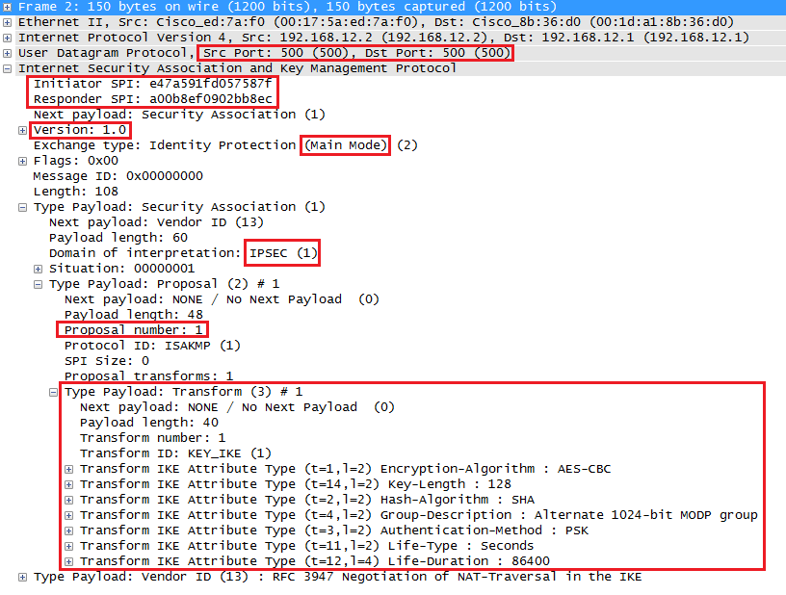
Message 2:
When the responder receives the first message from the initiator, it will reply. This message is used to inform the initiator that we agree upon the attributes in the transform payload. You can also see that the responder has set its own SPI value.

Slide 13
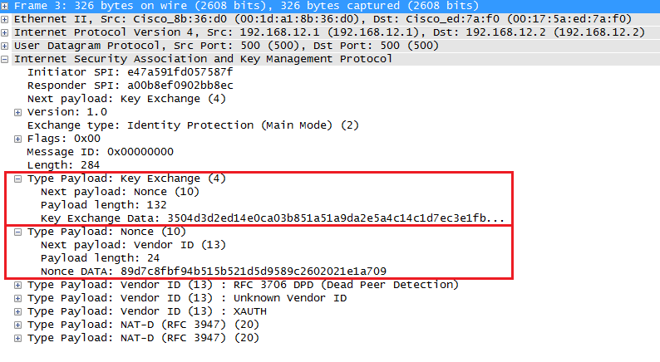
Message 3:
Since our peers agree on the security association to use, the initiator will start the Diffie Hellman key exchange. In the output above you can see the payload for the key exchange and the nonce.

Slide 14
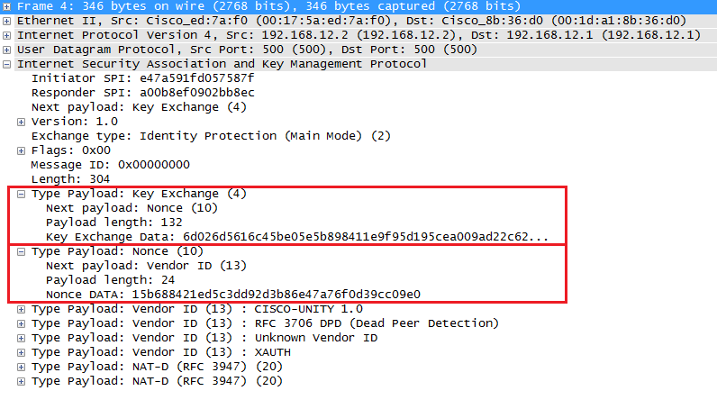
Message 4:
The responder will also send the Diffie Hellman and nonces to the initiator, our two peers can now calculate the Diffie Hellman shared key.

Slide 15
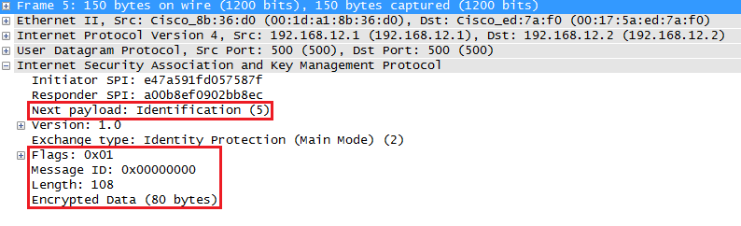
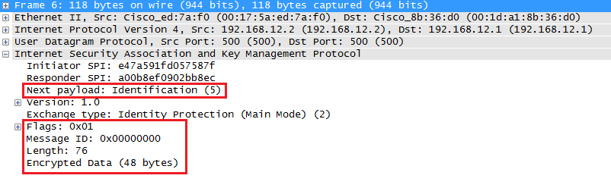
Message 5:
The fifth message is encrypted so we can’t see its contents anymore. The last two messages are used for identification and authentication of each peer. The initiator starts.
Message 6:
And above we have the 6th message from the responder with its identification and authentication information. IKEv1 main mode has now completed and we can continue with IKE phase 2.

Slide 16
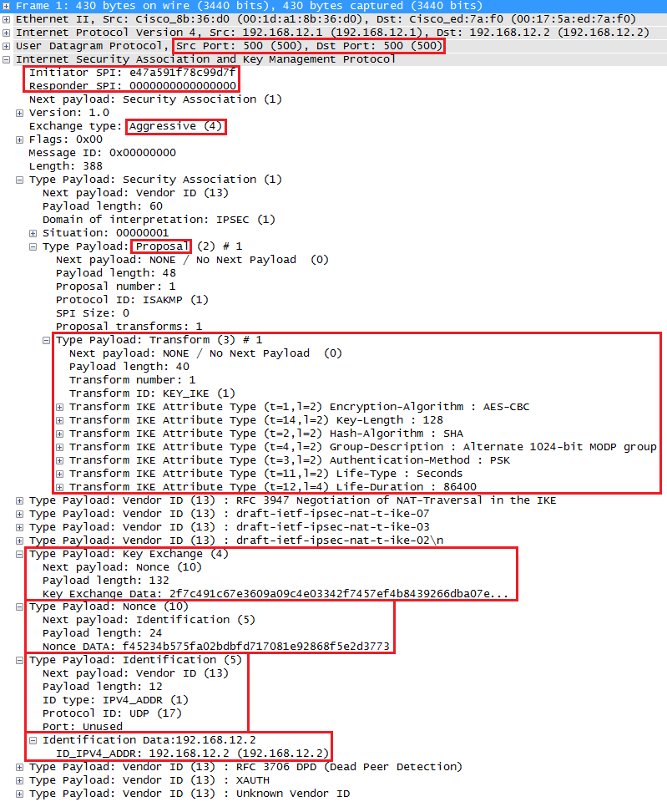
Aggressive Mode:
IKEv1 aggressive mode only requires three messages to establish
the security association. It’s quicker than main mode since it adds
all the information required for the DH exchange in the first two
messages. Main mode is considered more secure since identification
is encrypted, aggressive mode does this in clear-text.
Message 1:
The first message is from the initiator to the responder. You can see
the transform payload with the security association attributes ,
DH nonces and the identification (in clear text) in this single
message.

Slide 17
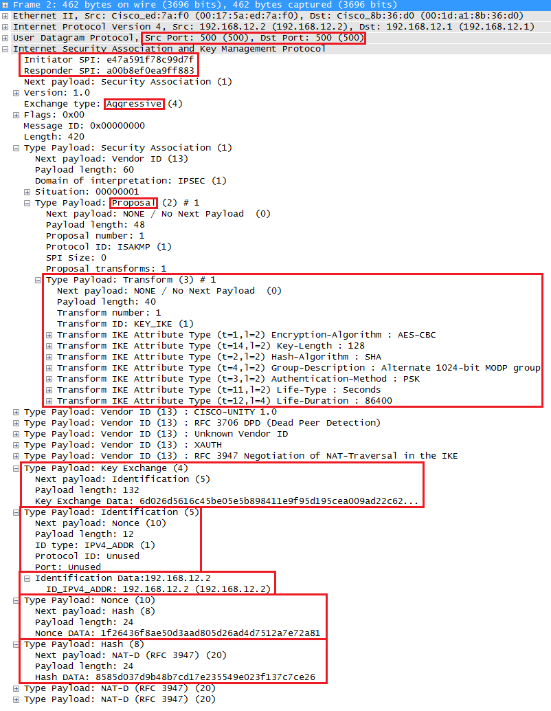
Message 2:
The responder now has everything in needs to generate the DH shared key and sends some nonces to the initiator so that it can also calculate the DH shared key. It also calculates a hash that is used for authentication.

Slide 18
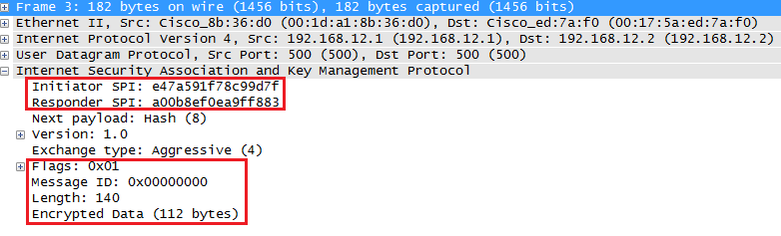
Message 3:
Both peers have everything they need, the last message from the initiator is a hash that is used for authentication.
Our IKE phase 1 tunnel is now up and running and we are ready to continue with IKE phase 2.
IKE Phase 2:
The IKE phase 2 tunnel (IPsec tunnel) will be actually used to protect user data. There is only one mode to build the IKE phase 2 tunnel which is called Quick mode.
Just like in IKE phase 1, our peers will negotiate about a number of items:
IPsec Protocol: do we use AH or ESP?
Encapsulation Mode: transport or tunnel mode?
Encryption: what encryption algorithm do we use? DES, 3DES or AES?
Authentication: what authentication algorithm do we use? MD5 or SHA?
Lifetime: how long is the IKE phase 2 tunnel valid? When the tunnel is about to expire, we will refresh the keying material.
(Optional) DH exchange: used for PFS (Perfect Forward Secrecy).

Slide 19
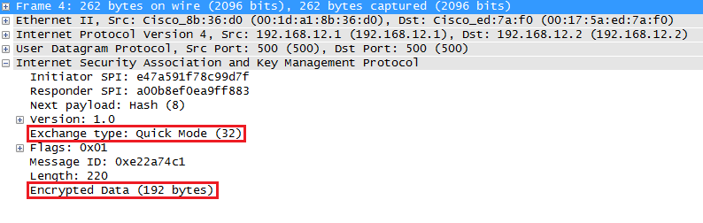
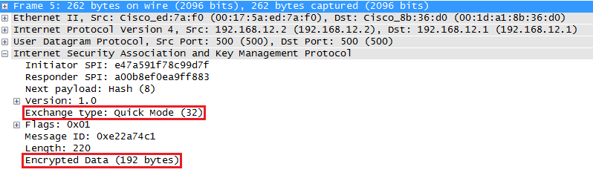
This negotiation happens within the protection of our IKE phase 1 tunnel so we can’t see anything.
Message 1:
Message 2:

Slide 20
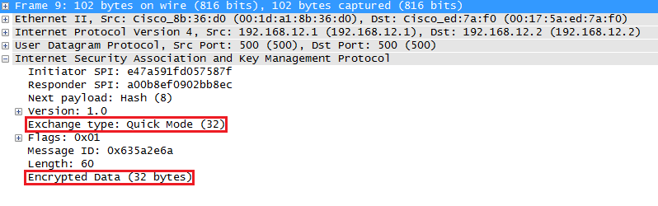
Message 3:
Once IKE phase 2 has completed, we are finally ready to protect some user data.
IPsec Protocols:
AH and/or ESP are the two protocols that we use to actually protect user data. Both of them can be used in transport or tunnel mode, let’s walk through all the possible options.
Authentication Header Protocol:
AH offers authentication and integrity but it doesn’t offer any encryption. It protects the IP packet by calculating a hash value over almost all fields in the IP header. The fields it excludes are the ones that can be changed in transit (TTL and header checksum).

Slide 21
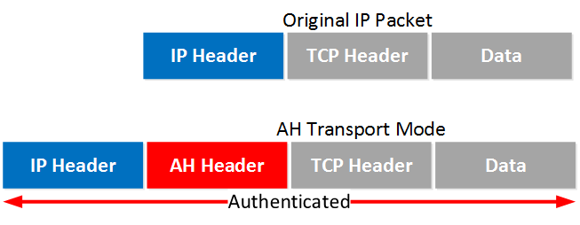
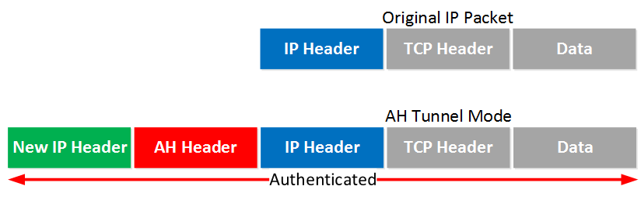
Transport Mode:
Transport mode is simple, it just adds an AH header after the IP header. Here’s an example of an IP packet that carries some TCP traffic
Tunnel Mode:
With tunnel mode we add a new IP header on top of the original IP packet. This could be useful when you are using private IP addresses and you need to tunnel your traffic over the Internet. It’s possible with AH but it doesn’t offer encryption:

Slide 22
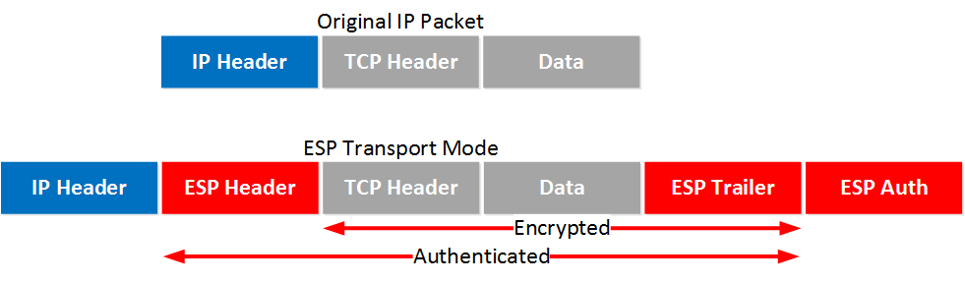
ESP (Encapsulating Security Payload) Protocol:
ESP is the more popular choice of the two since it allows you to encrypt IP traffic along with Authentication and Integrity. We can use it in transport or tunnel mode.
Transport Mode:
When we use transport mode, we use the original IP header and insert an ESP header. Here’s what it looks like:
Above you can see that we add an ESP header and trailer. Our transport layer (TCP for example) and payload will be encrypted. It also offers authentication but unlike AH, it’s not for the entire IP packet.

Slide 23
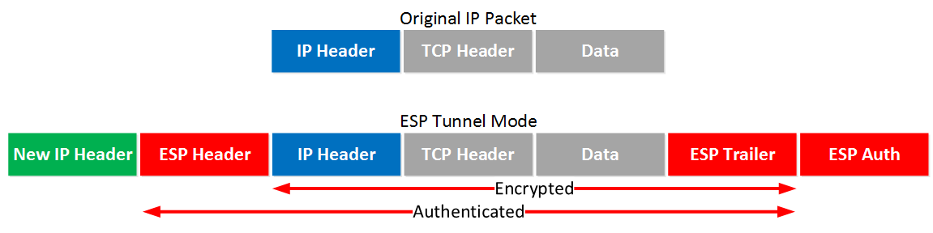
Tunnel Mode:
This is where we use a new IP header which is useful for site-to-site VPNs. It’s similar to transport mode but we add a new header. The original IP header is now also encrypted.

Slide 24
Configuration:
Before configuring the IPsec make sure you will have the reachability between the remote networks.
R1:
First step is to configure an ISAKMP Phase 1 policy:
crypto isakmp policy 1
encr 3des
hash md5
authentication pre-share
group 2
lifetime 86400
exit
crypto isakmp key RTL address 1.1.1.2
ip access-list extended VPN-TRAFFIC
permit ip 10.10.10.0 0.0.0.255 20.20.20.0 0.0.0.255
exit
ISAKMP Phase 2 policy:
crypto ipsec transform-set TS esp-3des esp-md5-hmac
crypto map CMAP 10 ipsec-isakmp
set peer 1.1.1.2
set transform-set TS
match address VPN-TRAFFIC
exit
interface GigabitEthernet3/0
crypto map CMAP
exit

Slide 25
R2:
First step is to configure an ISAKMP Phase 1 policy:
crypto isakmp policy 1
encr 3des
hash md5
authentication pre-share
group 2
lifetime 86400
exit
crypto isakmp key RTL address 1.1.1.1
ip access-list extended VPN-TRAFFIC
permit ip 20.20.20.0 0.0.0.255 10.10.10.0 0.0.0.255
exit
ISAKMP Phase 2 policy:
crypto ipsec transform-set TS esp-3des esp-md5-hmac
exit
crypto map CMAP 10 ipsec-isakmp
set peer 1.1.1.1
set transform-set TS
match address VPN-TRAFFIC
exit
interface GigabitEthernet3/0
crypto map CMAP
exit

