Slide 1
Power BI Internship Task Batch - 10
Internship Program: Soulvibe.Tech
Submitted By – Ajay Kumar Sahu
Date : 1 July , 2025

Slide 2
Dataset Overview
File: DA Batch 10 Dataset.csv
Key columns: District, Taluka, College Name, College Type, University, Course Name, Type, Duration, Category
Data volume: 60,000+ records
Single flat table (no relationships)

Slide 3
Data Preparation
Loaded the .csv file into Power BI.
Then Clicked on Transformed Data which redirected to the Power Query Editor .
Performed the following actions using power query editor :
1. Removed or fill missing values in College Type
2. Renamed columns to remove spaces (e.g., Course_Name, Course_Duration_Months)
3. Created a new column Specialization by extracting the portion after the hyphen in Course Name
4. Created a column Duration Category:
Short (<12 months)
Medium (12–36 months)
Long (>36 months)

Slide 4
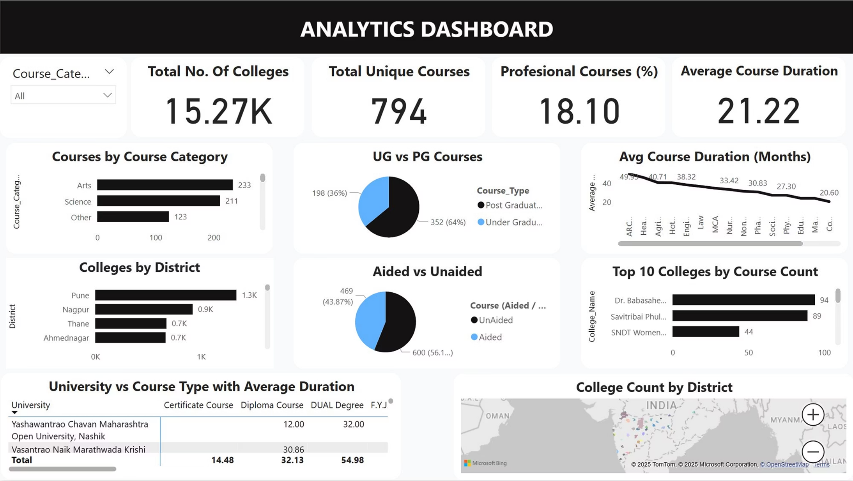
Dashboard in Power BI

Slide 5
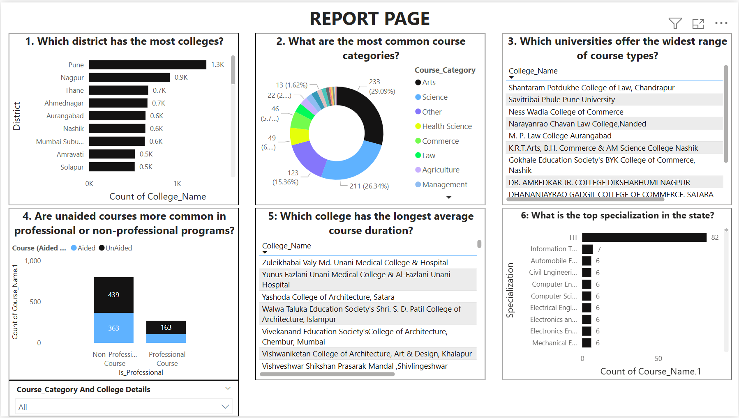
Report Page (Q&A) in Power BI

Slide 6
Key Insights Identified
Pune has the highest number of colleges (1.3K).
Arts & Science are the most common course categories.
Majority of courses are unaided & non-professional.
ITI is the top specialization (82 courses).
Avg course durations range from 12 to 54 months.

Slide 7
CONCLUSION
Completed the Power BI dashboard and Q&A report exactly as given in the internship tasks.
Learned a lot about cleaning data, transforming it, and building visuals from scratch.
Got confident in showing insights through charts and interactive dashboards.
Now ready to apply this experience to real projects and help make better business decisions.

Slide 8
Thank You

