Slide 1
SQL Internship Task Batch - 10
Internship Program: Soulvibe.Tech
Submitted By – Ajay Kumar Sahu
Date : 25 June , 2025

Slide 2
Data Cleaning & Setup
I have Replaced all the missing values with 'NA' using the Power Query Editor
I have also renamed column names
Then I have saved the .csv in the 'C:/ProgramData/MySQL/MySQL Server 8.0/Uploads/Workfile.csv'
Created database and table using SQL
Loaded data using LOAD DATA INFILE
Disabled row limit in MySQL Workbench for full view

Slide 3
Q1. Find the top 5 districts with the highest number of colleges offering professional courses.
District | Total_professional_colleges
Pune | 619
Nagpur | 308
Nashik | 206
Ahmednagar | 203
Aurangabad | 194
CONCLUSION :
This shows that Pune, Nagpur, and Nashik are leading in terms of professional college availability, making them key education centers.

Slide 4
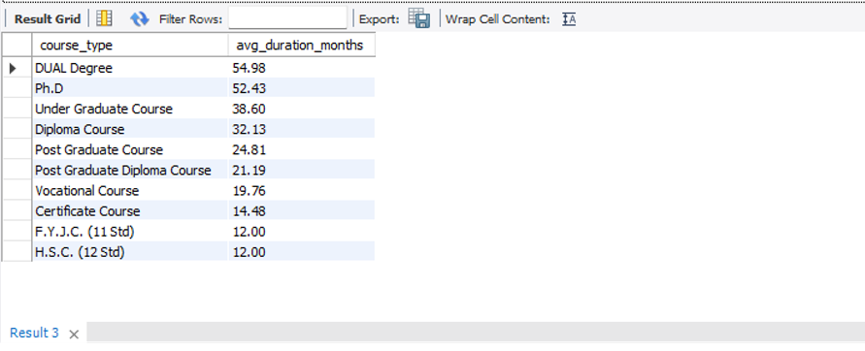
Q2. Calculate the average course duration (in months) for each Course Type and sort them in descending order.
CONCLUSION :
It’s clear that DUAL Degree and Ph.D. programs take longer to complete, while certificate and diploma courses are shorter, which makes sense.

Slide 5
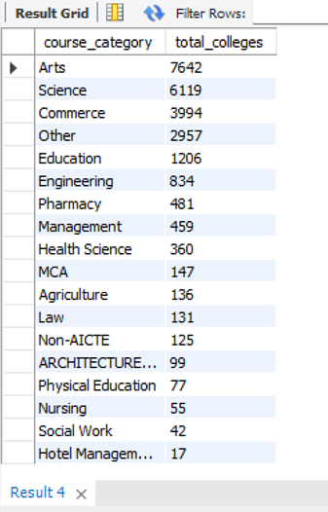
Q3. Count how many unique College Names offer each Course Category.
CONCLUSION :
Arts , Science and Commerce courses are the most common across colleges, showing high interest and demand

Slide 6
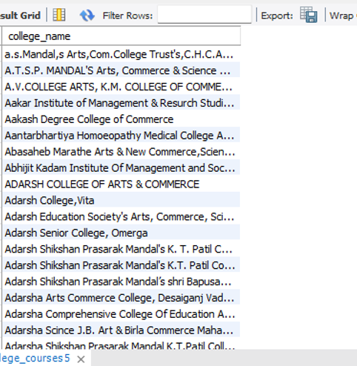
Q4. Find the names of colleges offering both Post Graduate and Under Graduate courses.
CONCLUSION :
Many colleges offer both UG and PG programs, proving they support students through multiple academic stages.

Slide 7
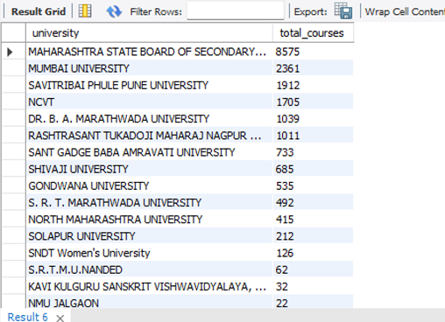
Q5. List all universities that have more than 10 unaided courses that are not professional.
CONCLUSION :
Some universities are focusing more on unaided, non-professional courses, which means they’re offering general education without government support.

Slide 8

Q6. Display colleges from the "Engineering" category that have at least one course with a duration greater than the category’s average.
CONCLUSION :
All colleges in the Engineering category seem to follow a similar pattern in course length — none go above average.

Slide 9
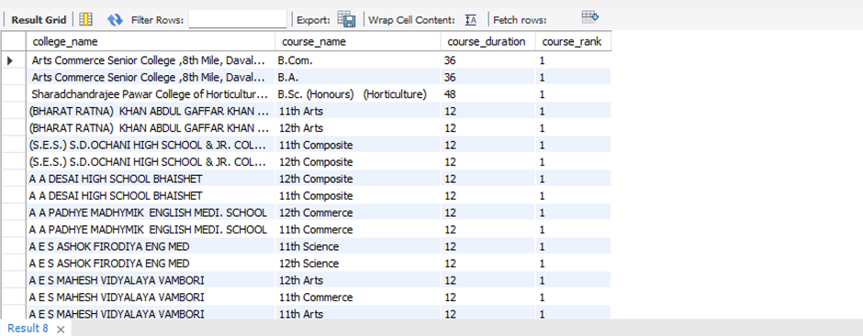
Q7. Assign a rank to each course within a College Name based on course duration, longest first.
CONCLUSION :
Ranking shows that longer courses are usually UG or PG, while shorter ones come lower in the list.

Slide 10
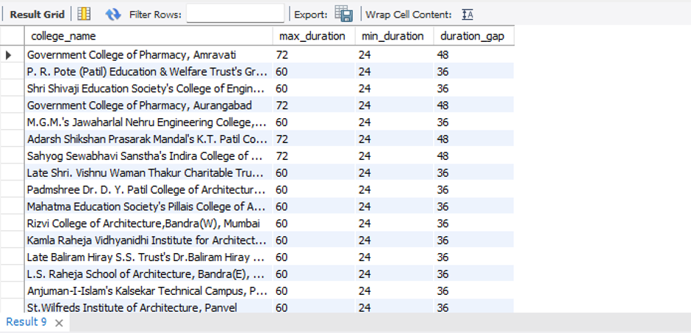
Q8. Find colleges where the longest and shortest course durations are more than 24 months apart .
CONCLUSION :
There are colleges offering both short and long-duration programs, showing a good mix for different types of students.

Slide 11
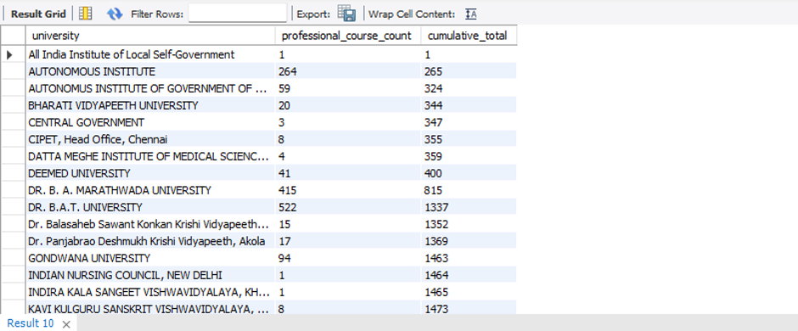
Q9. Show the cumulative number of professional courses offered by each university sorted alphabetically.
CONCLUSION :
A few universities are major contributors to the total number of professional courses, especially when viewed cumulatively.

Slide 12
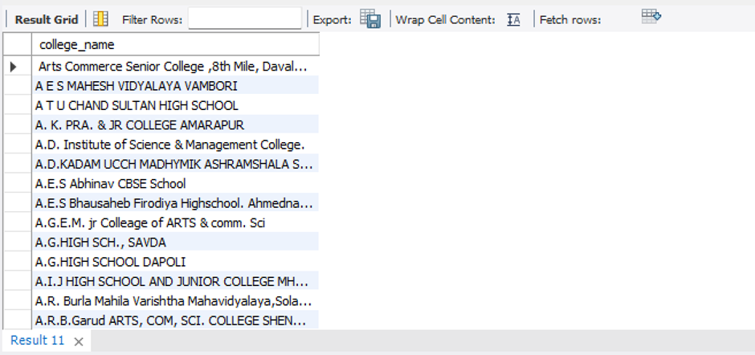
Q10. Using a self-join or CTE, find colleges offering more than one course category.
CONCLUSION :
It’s interesting to see that many colleges don’t just stick to one area — they offer multiple streams to attract a variety of students.

Slide 13
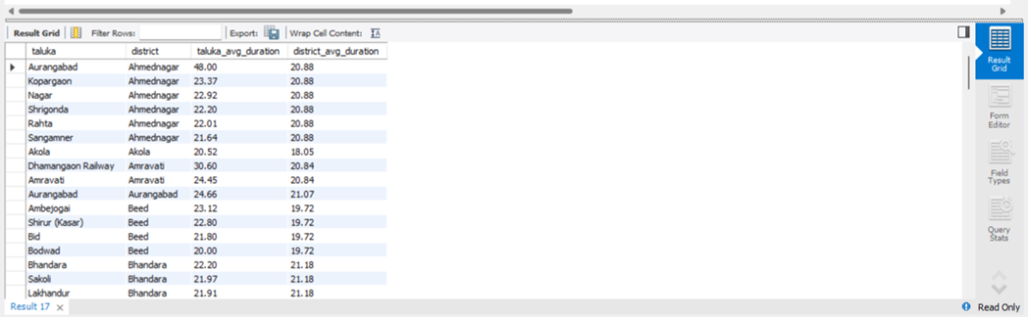
Q11. Create a temporary table (CTE) that includes average duration of courses by district and use it to list talukas where the average course duration is above the district average.
CONCLUSION :
Talukas like Aurangabad and Kopargaon go beyond district averages in course length, possibly offering more in-depth programs.

Slide 14
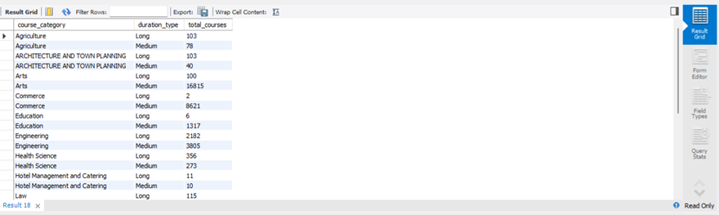
Q12. Create a new column classifying course duration as:
Short (< 12 months)
Medium (12-36 months)
Long (> 36 months)
Then count the number of each duration type per course category.
CONCLUSION :
Most courses fall in the 1–3 year range, showing that medium-length programs are the standard.

Slide 15
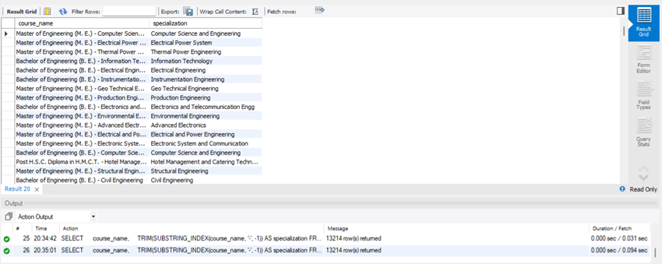
Q13. Extract only the course specialization from Course Name. (e.g., from "Bachelor of Engineering (B. E.) - Electrical", extract "Electrical")
CONCLUSION :
Specializations like Computer Science or Electrical were pulled out from the course names, which can help categorize them better.

Slide 16
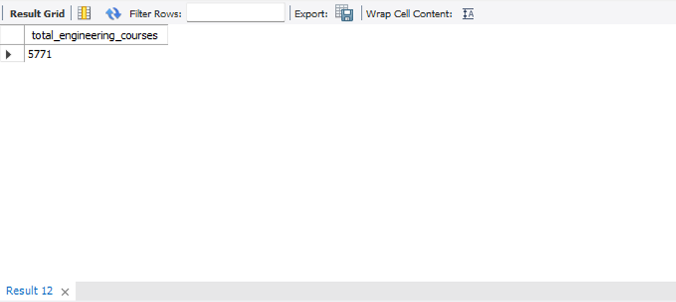
Q14. Count how many courses include the word Engineering in the name.
CONCLUSION :
A total of 5771 courses contain the word “Engineering,” proving the field is highly offered and in demand.

Slide 17
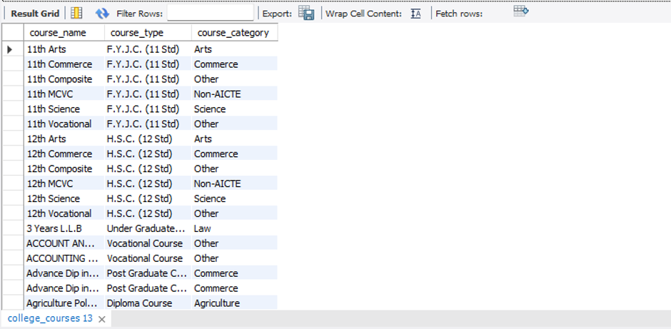
Q15. List all unique combinations of Course Name, Course Type, and Course Category.
CONCLUSION :
There are many different course combinations, and seeing them helps understand how colleges structure their academic programs.

Slide 18
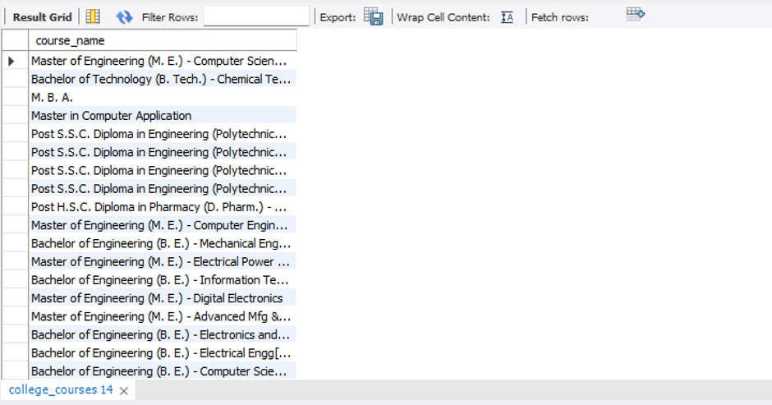
Q16. Write a query to get all courses that are not offered by any Government college.
CONCLUSION :
Some courses are only found in private or aided colleges and not in government institutions, which makes them niche.

Slide 19
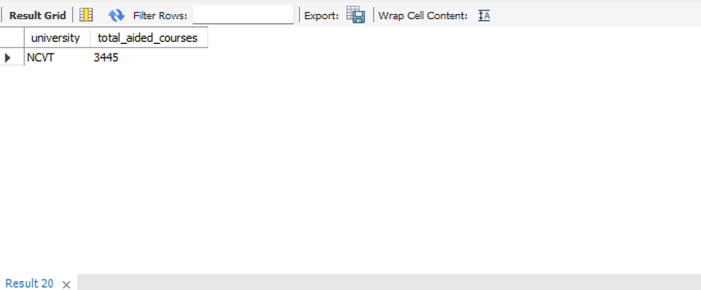
Q17. Find the university that has the second-highest number of aided courses.
CONCLUSION :
The university with the second-most aided courses is NCVT, showing its strong participation in supported programs.

Slide 20
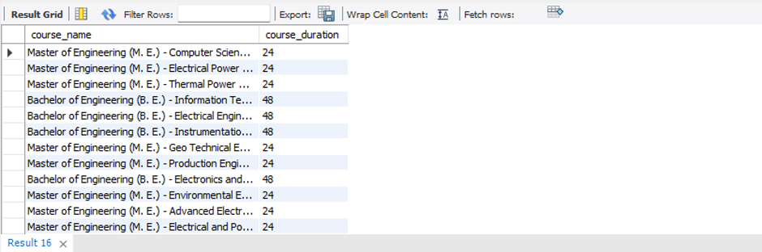
Q18. Show courses whose durations are above the median course duration.
CONCLUSION :
Longer-than-median courses are mostly degrees and PG programs, showing their advanced level

Slide 21
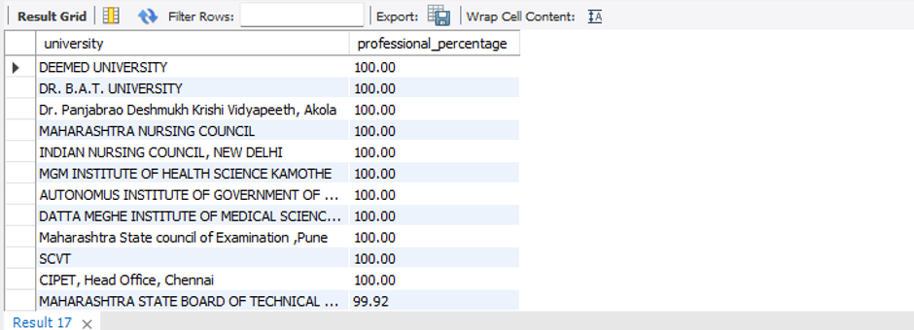
Q19. For each University, find the percentage of unaided courses that are professional.
CONCLUSION :
A few universities offer mostly professional unaided courses, suggesting they are job-oriented even without funding.

Slide 22
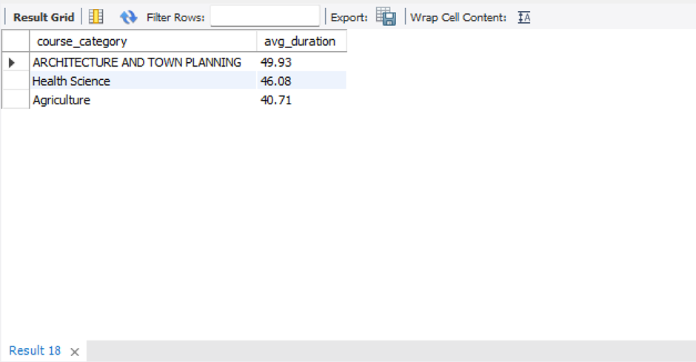
Q20. Determine which Course Category has the highest average course duration and display the top 3.
CONCLUSION :
Categories like Architecture, Health Science, and Agriculture have longer average durations — likely because they require more depth.

Slide 23
CONCLUSION :
Working on this SQL task gave me practical experience in handling real-world data. I learned how to clean data, load it into MySQL, and write queries to extract meaningful insights. Through 20 different questions, I explored various areas like customer behavior, course patterns, and institutional performance.
Gained hands-on experience with real datasets using SQL
Cleaned, loaded, and queried data using MySQL
Explored customer behavior, course duration, college performance, etc.
Improved skills in JOIN, GROUP BY, CTE, RANK, and aggregate functions
Built confidence in solving data problems through SQL
Created a strong base for learning tools like Power BI and Tableau

Slide 24
Thank You

