Slide 1
GlobalCO2Emission
File created on: 06/03/23 11:40:15 CET

Slide 2
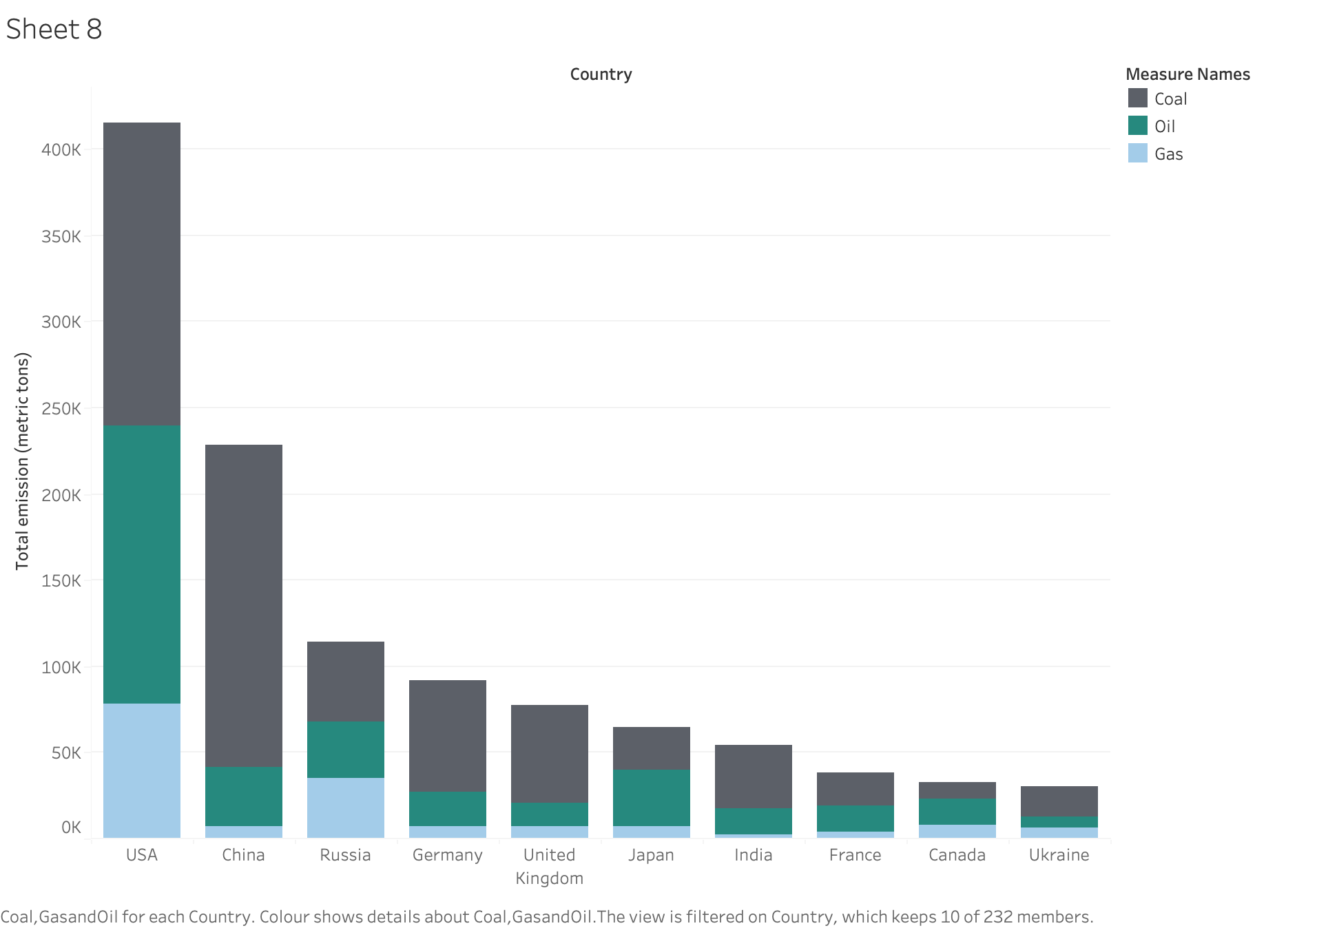

Slide 3
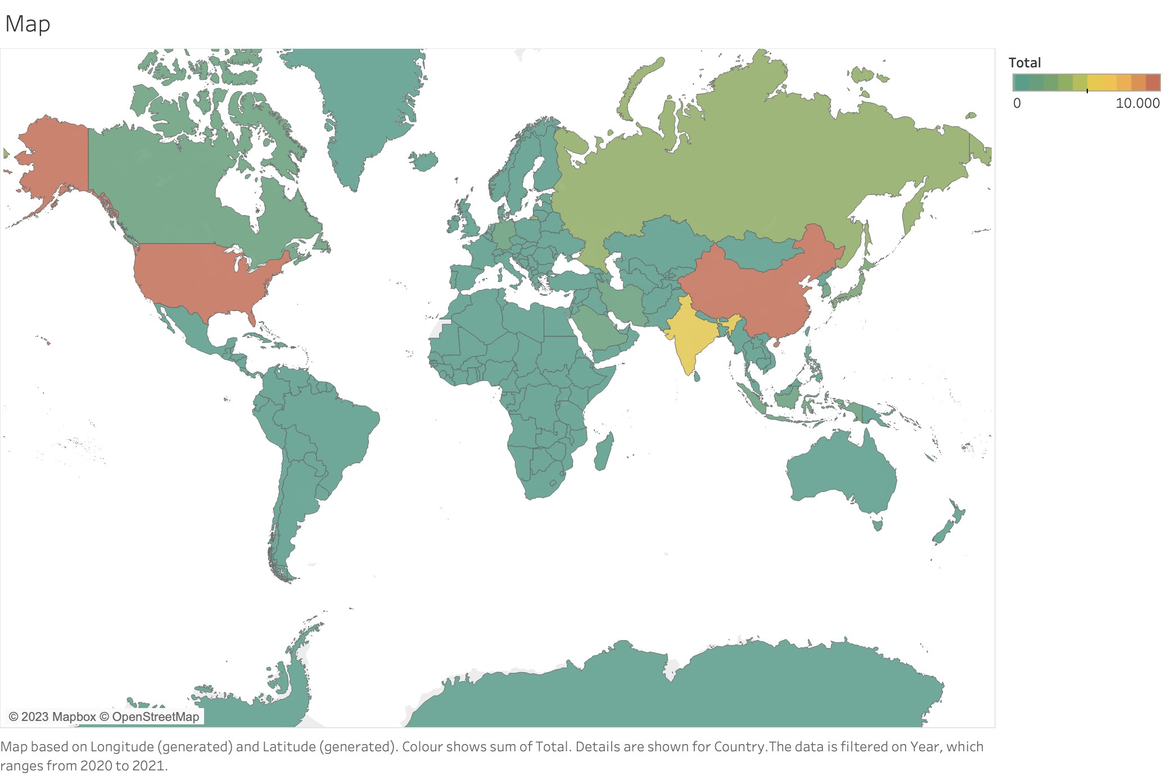

Slide 4
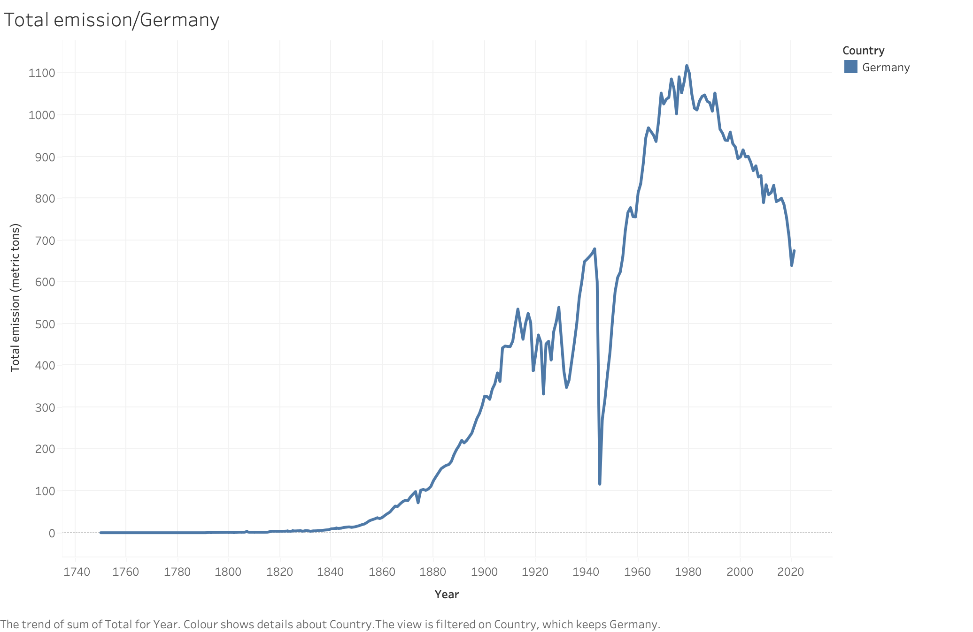

Slide 5
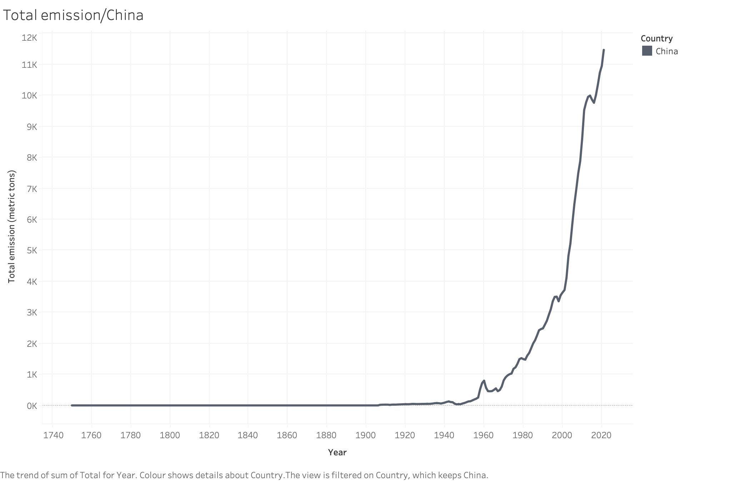

Slide 6
