Slide 1

Predict the future of our world
A ML-based time series forecasting for carbon emissions

Slide 2

Introduction
Carbon emissions?
- measured in metric tons

Slide 3
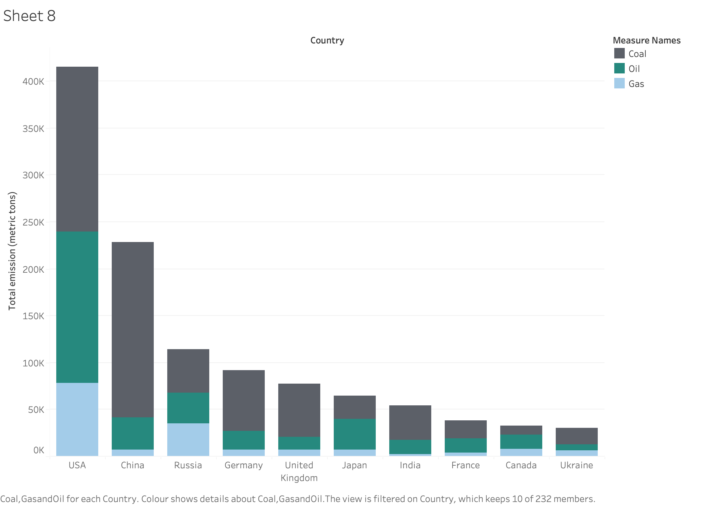
Contributors to global carbon emissions

Slide 4
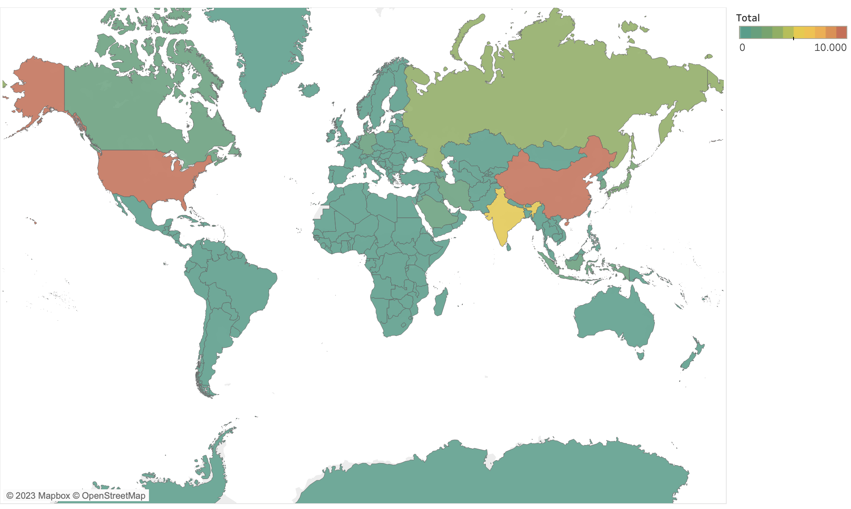
Carbon emissions: a global heatmap
Notes:
Show countries emissions for the main ones

Slide 5
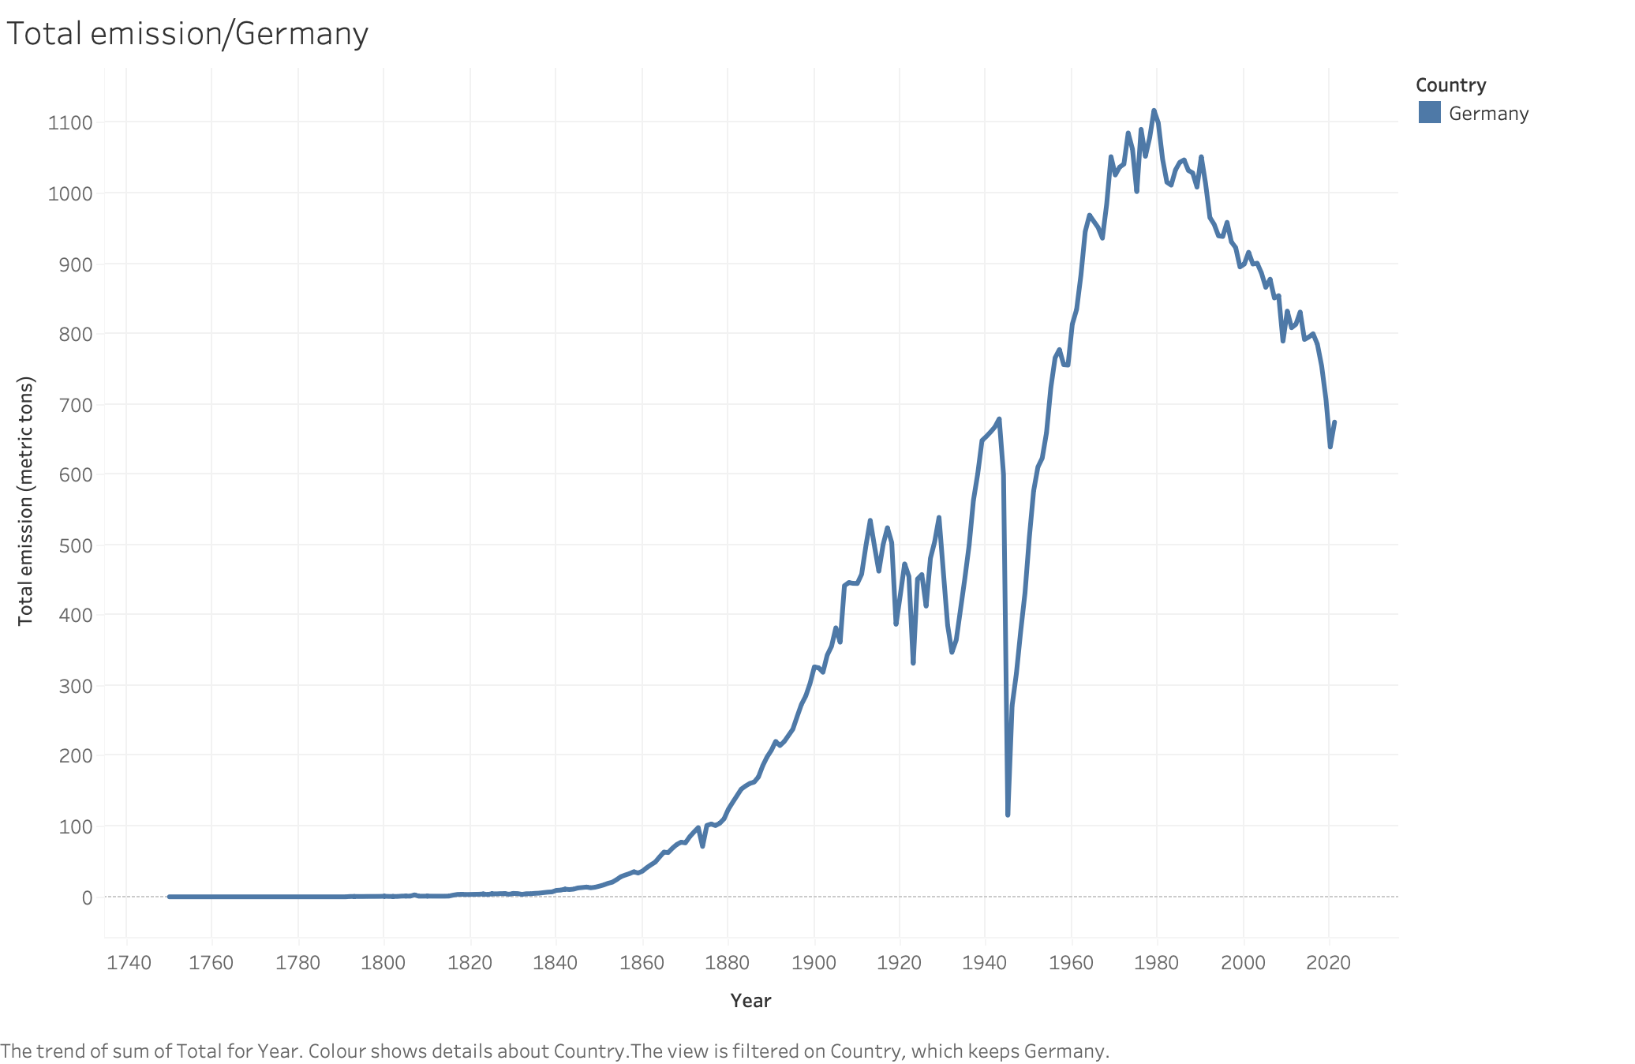
Carbon emissions for Germany

Slide 6
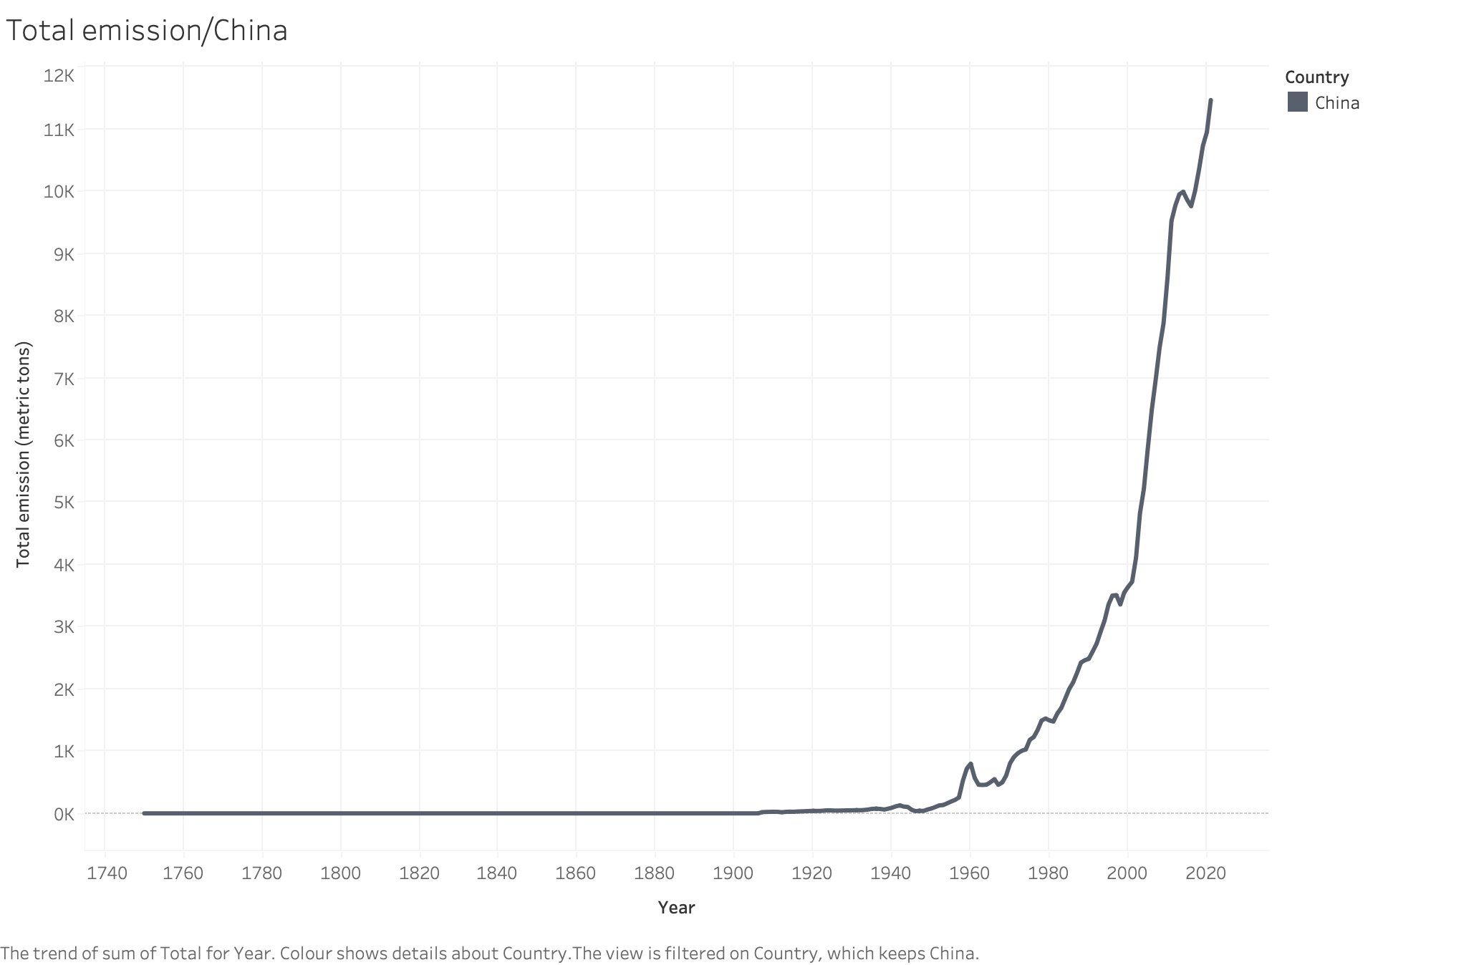
Carbon emissions for China

Slide 7
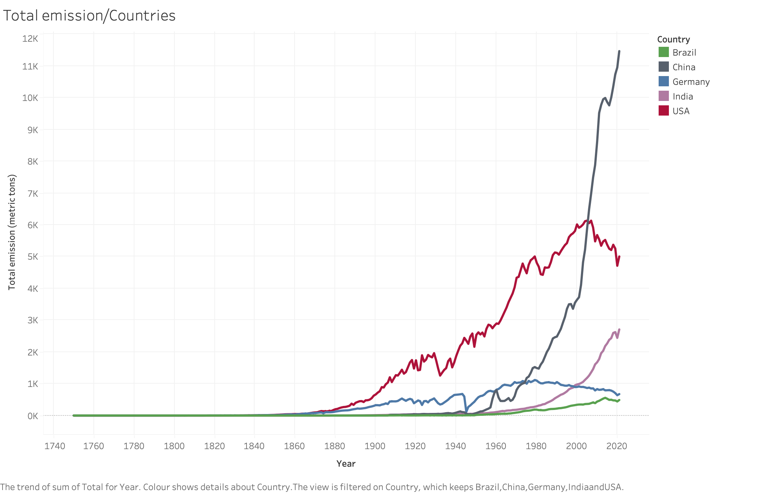
Carbon emissions:
A comparison

Slide 8
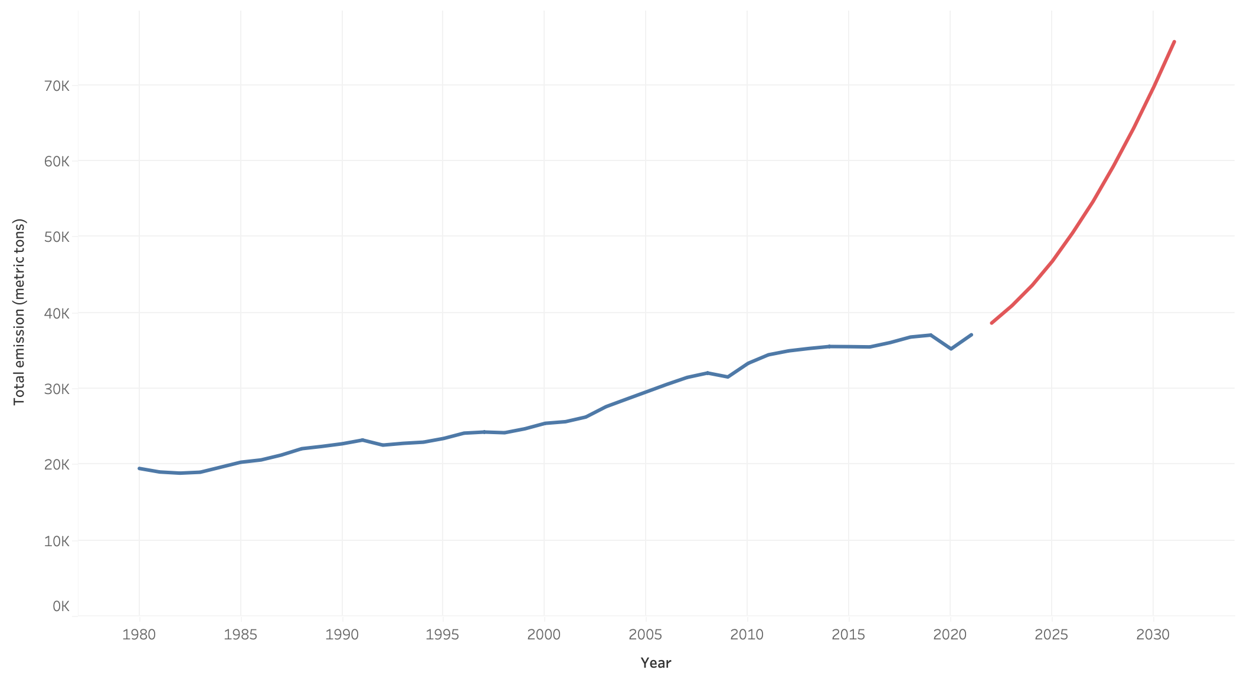
Global trend
Prediction, baby, prediction!

Slide 9
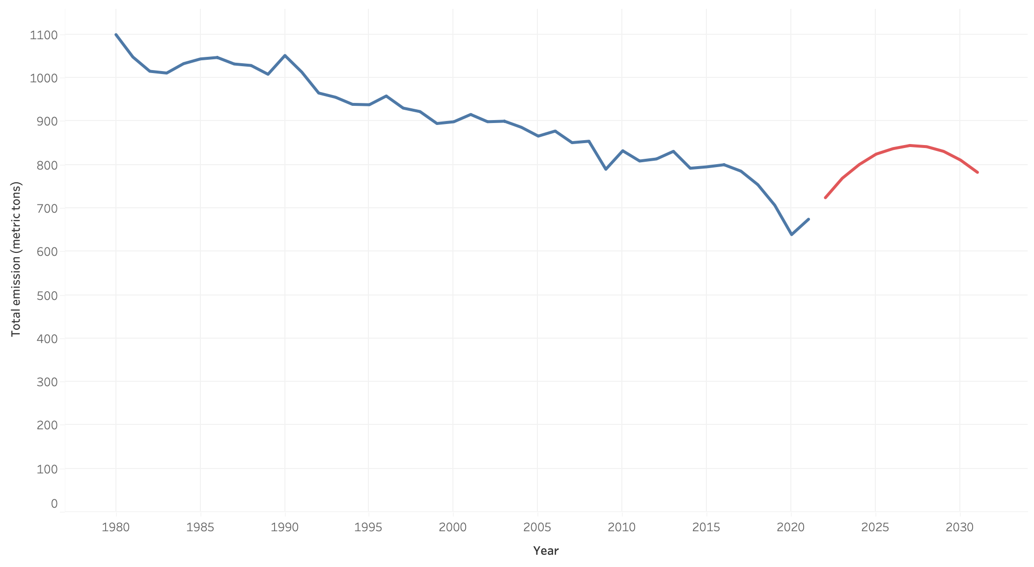
Carbon emissions prediction for Germany

Slide 10
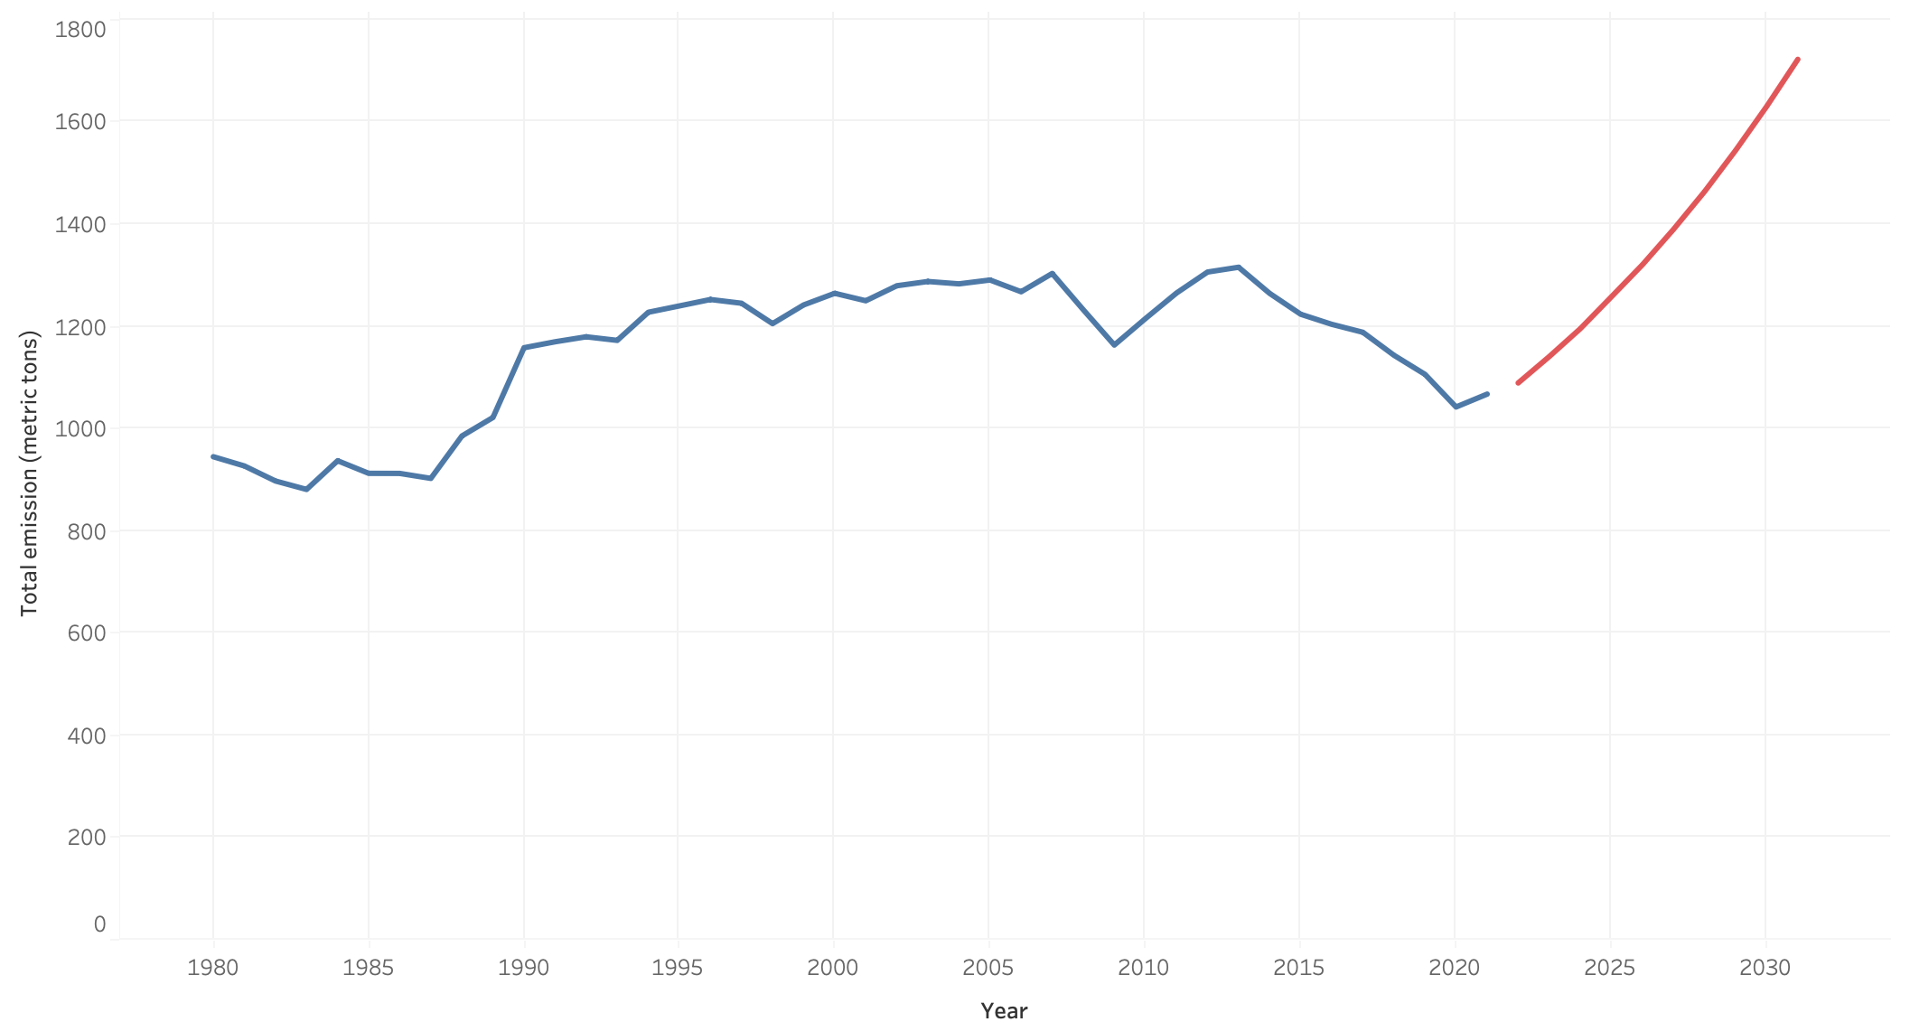
Carbon emissions prediction for Japan

Slide 11
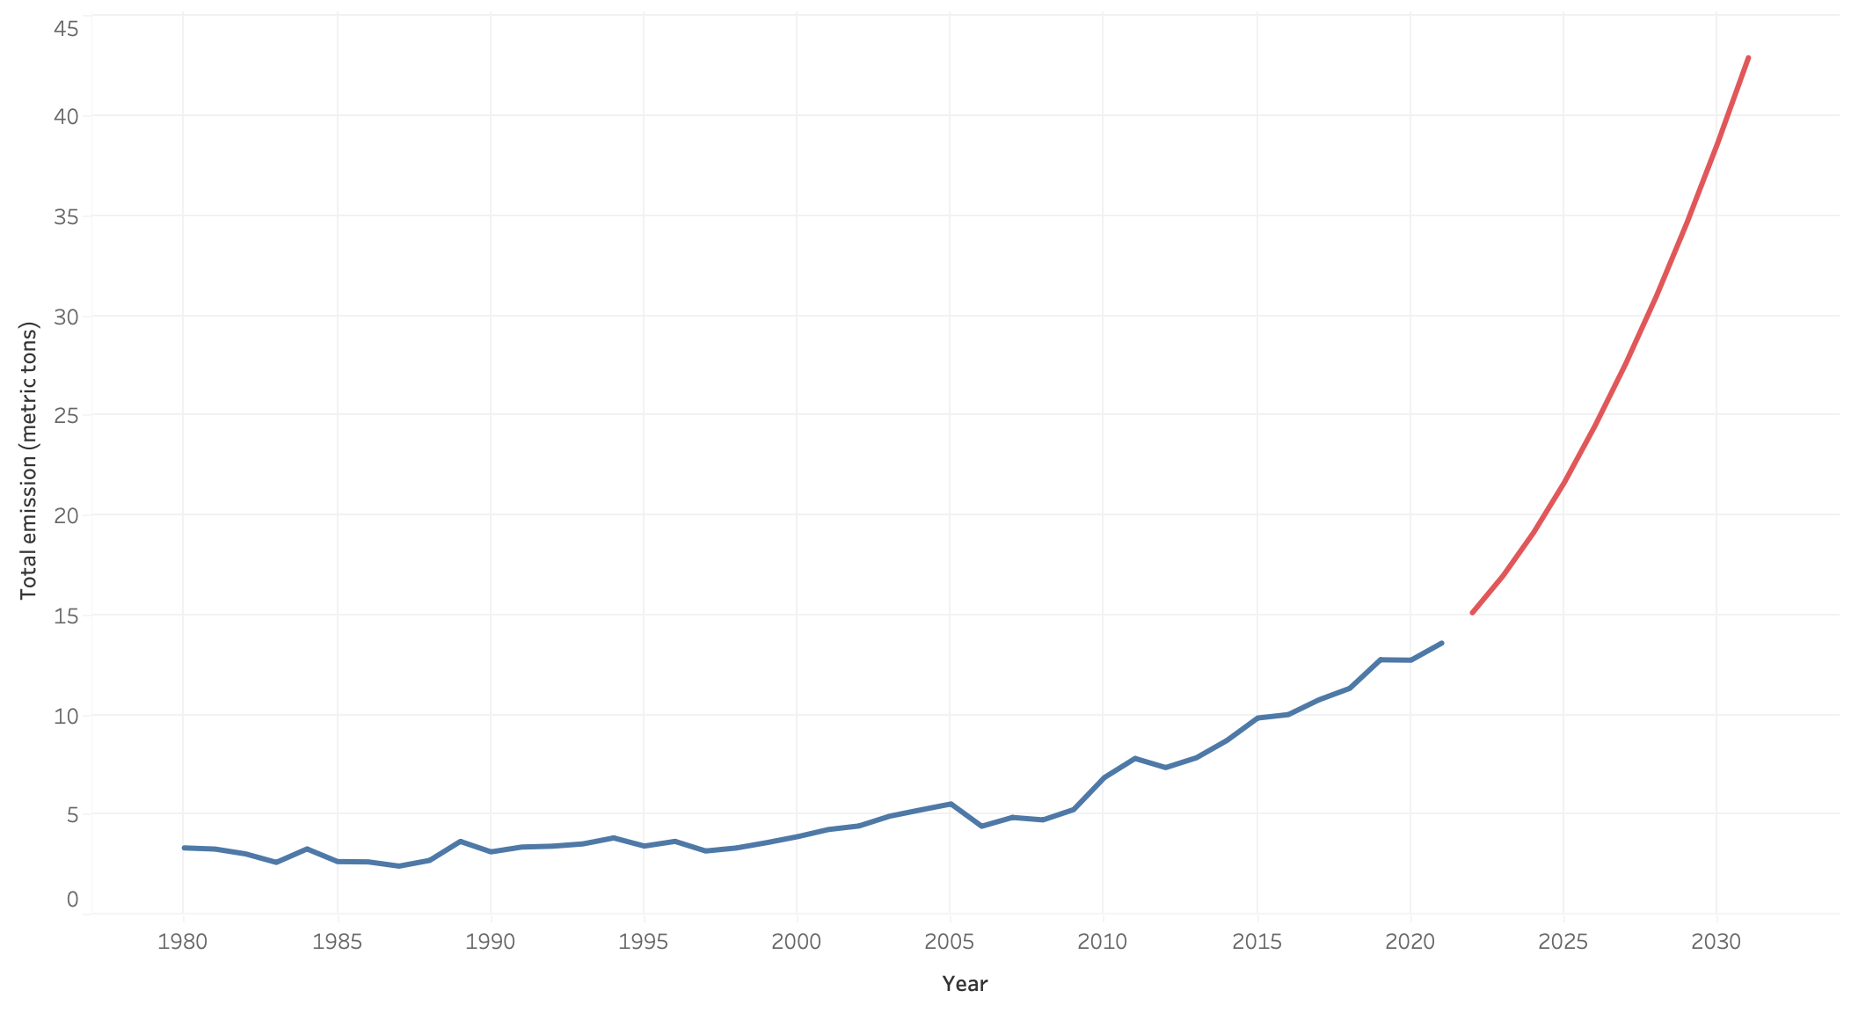
Carbon emissions prediction for Senegal

Slide 12
Are we fucked? YES!

