Slide 1

Predict the future of our world
A ML-based time series forecasting for carbon emissions
Danilo Giarlini & Ajay Krishna

Slide 2
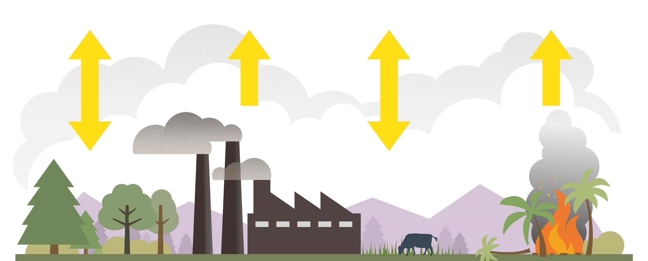
Carbon emissions
CO2 and CO in the atmosphere, produced by vehicles and industrial processes
measured in metric tons

Slide 3
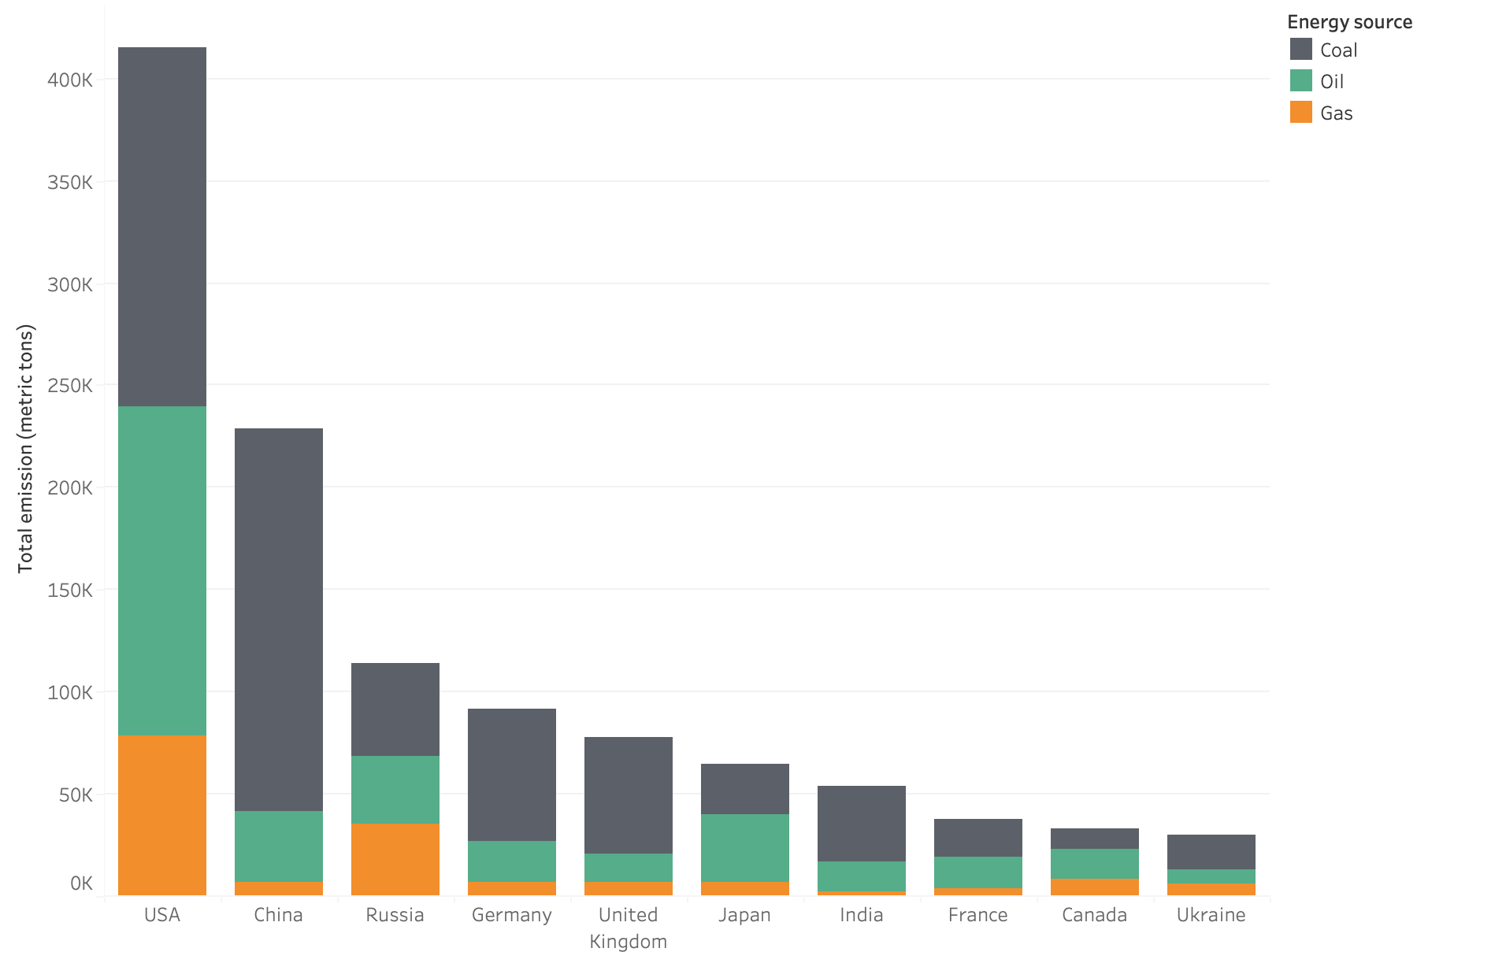
Top 10 contributors to global carbon emissions

Slide 4
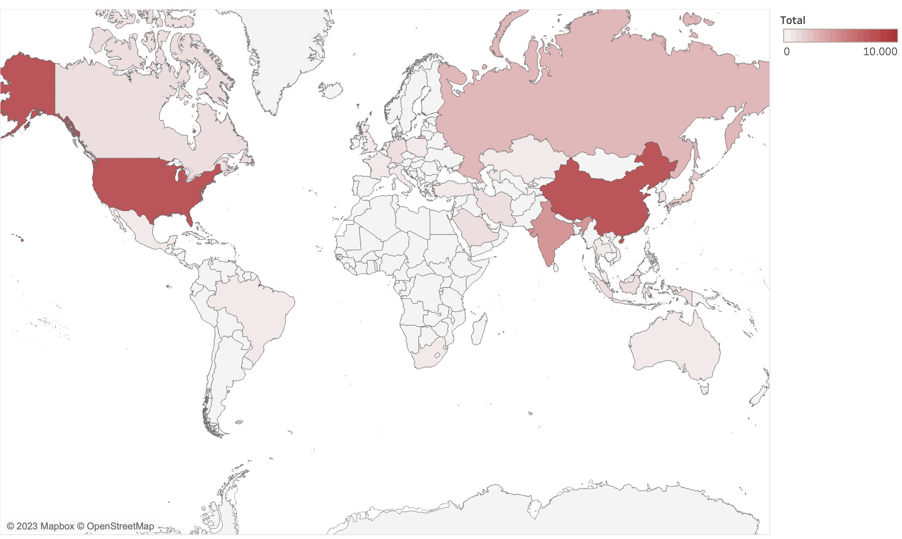
Carbon emissions: a global heatmap
Notes:
Show countries emissions for the main ones

Slide 5
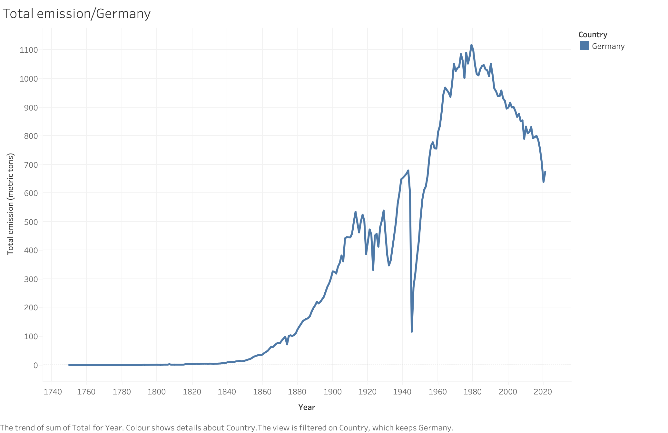
Carbon emissions for Germany

Slide 6
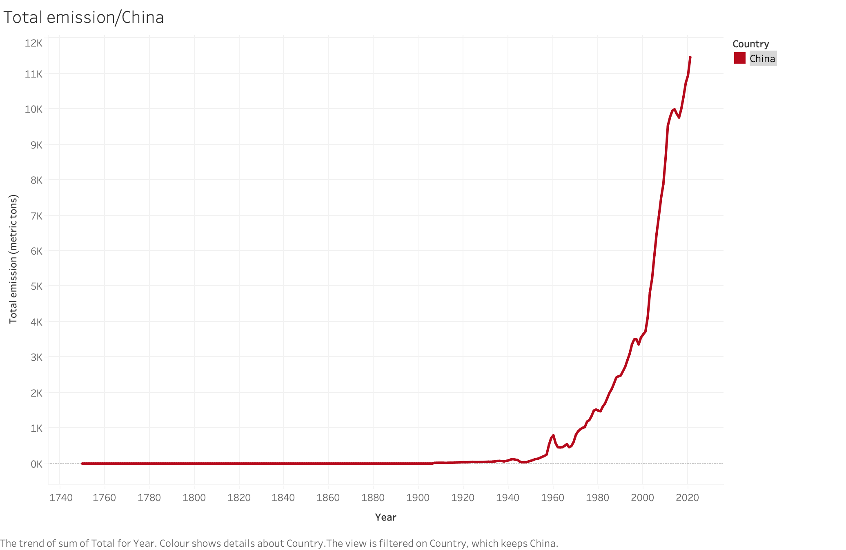
Carbon emissions for China

Slide 7
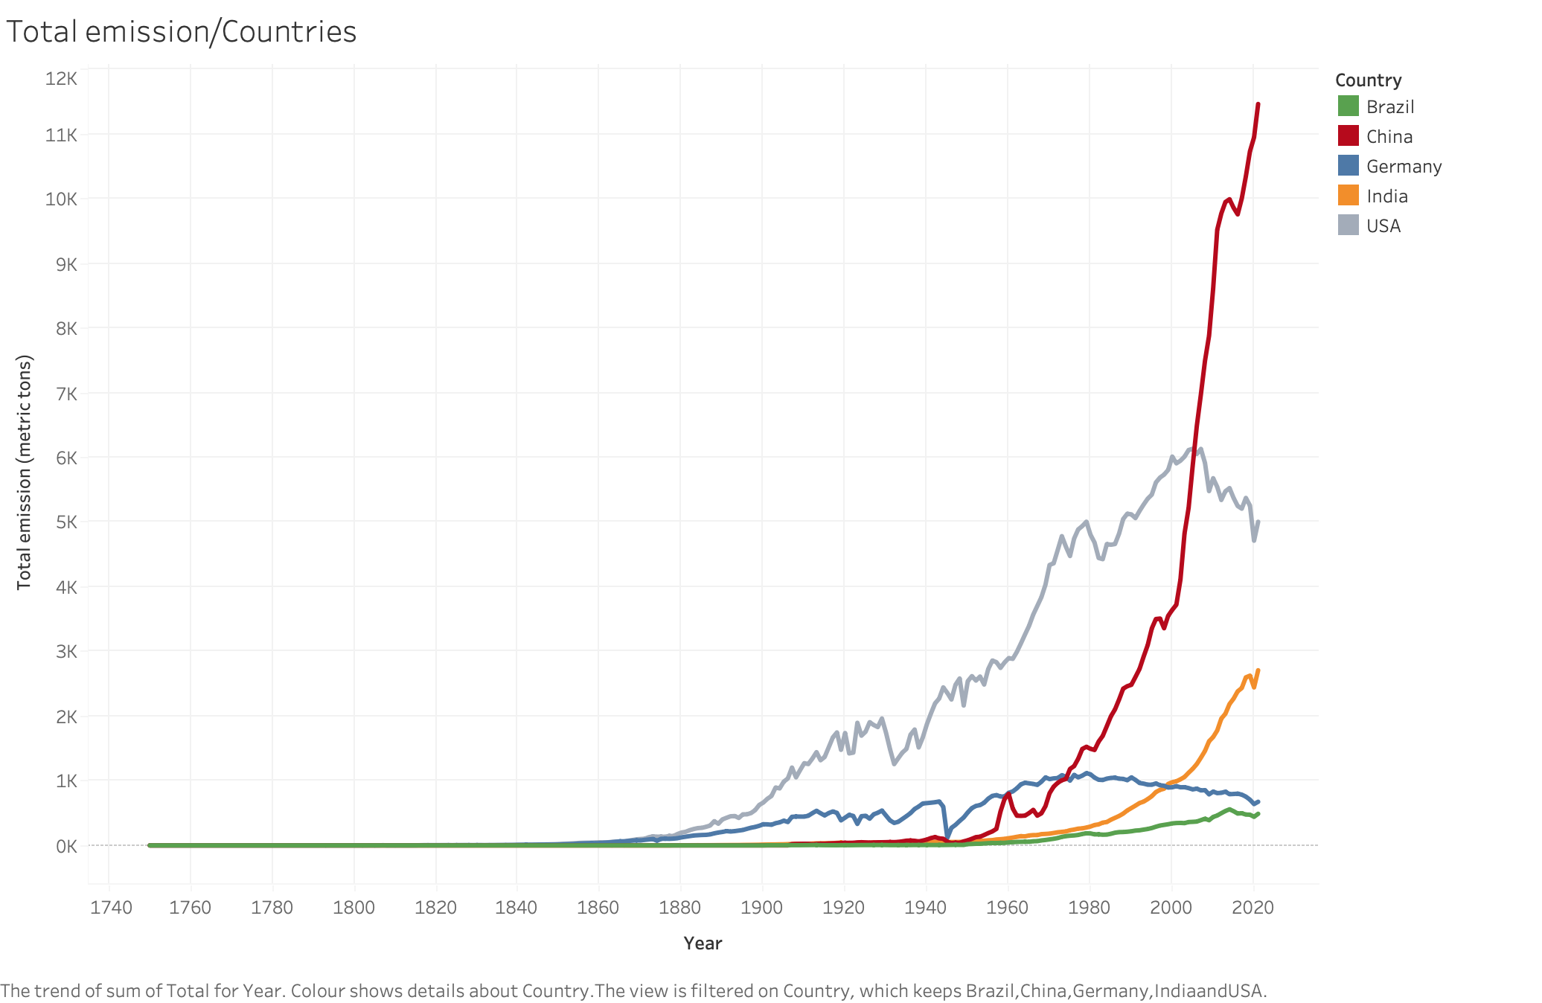
Carbon emissions:
a comparison

Slide 8
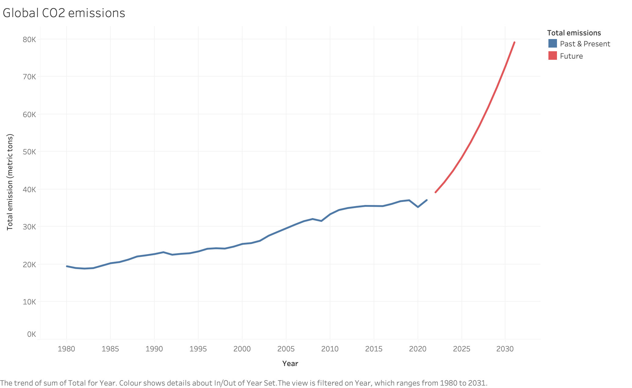
Global emissions forecasting
113 %

Slide 9
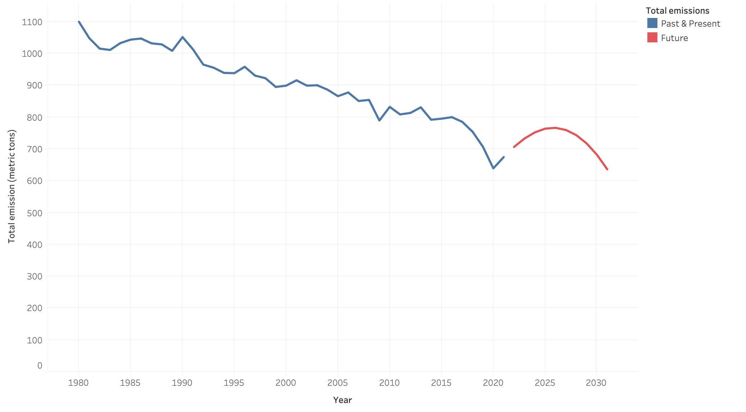
Germany emissions forecasting
6 %

Slide 10
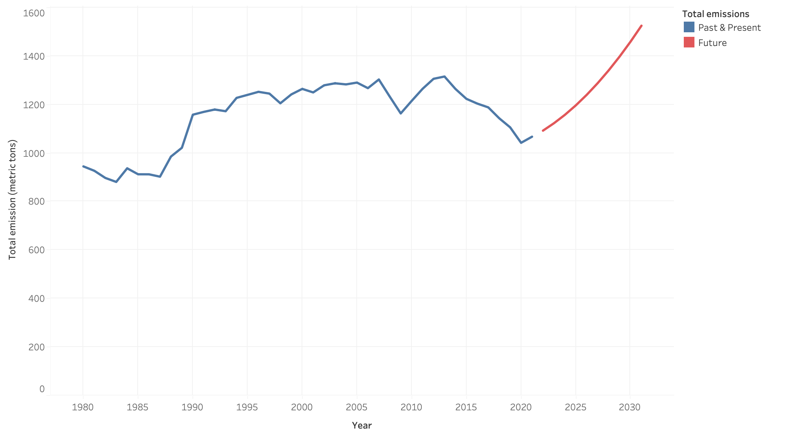
Japan emissions forecasting
43 %

Slide 11
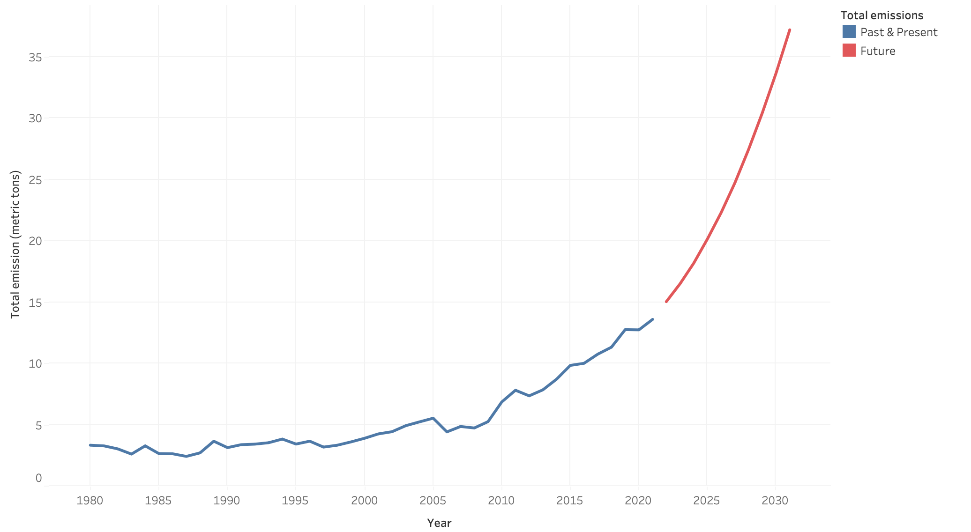
Senegal emissions forecasting
174 %

Slide 12
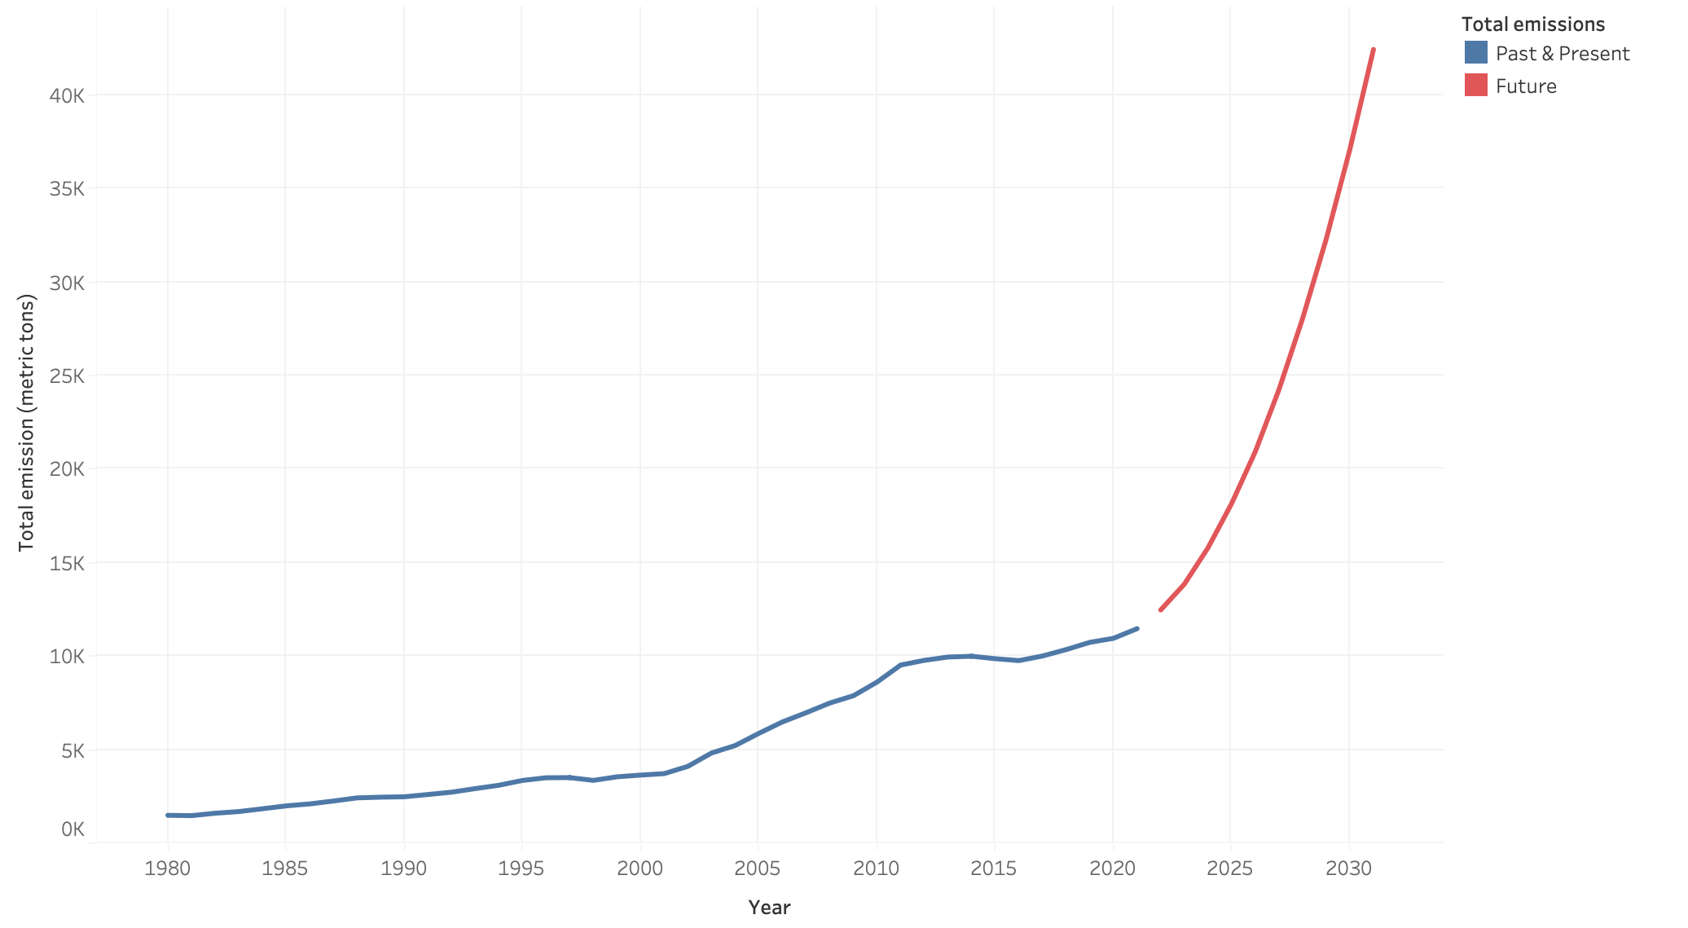
China emissions forecasting
267 %

Slide 13
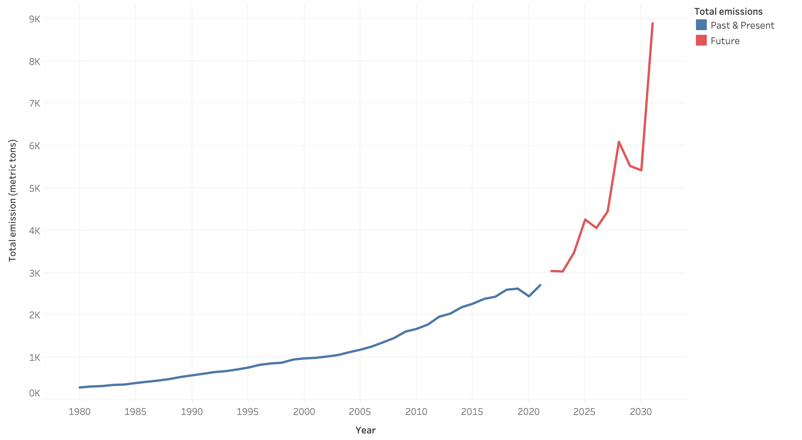
India emissions forecasting
228 %

Slide 14

SO WHAT?
Collective and holistic action plan
Control our consumption of goods
Use eco-friendly methods for transportation and energy
Our food and carbon emission: choose wisely
Education and awareness

