Slide 1

Predict the future of our world
A ML-based time series forecasting for carbon emissions

Slide 2
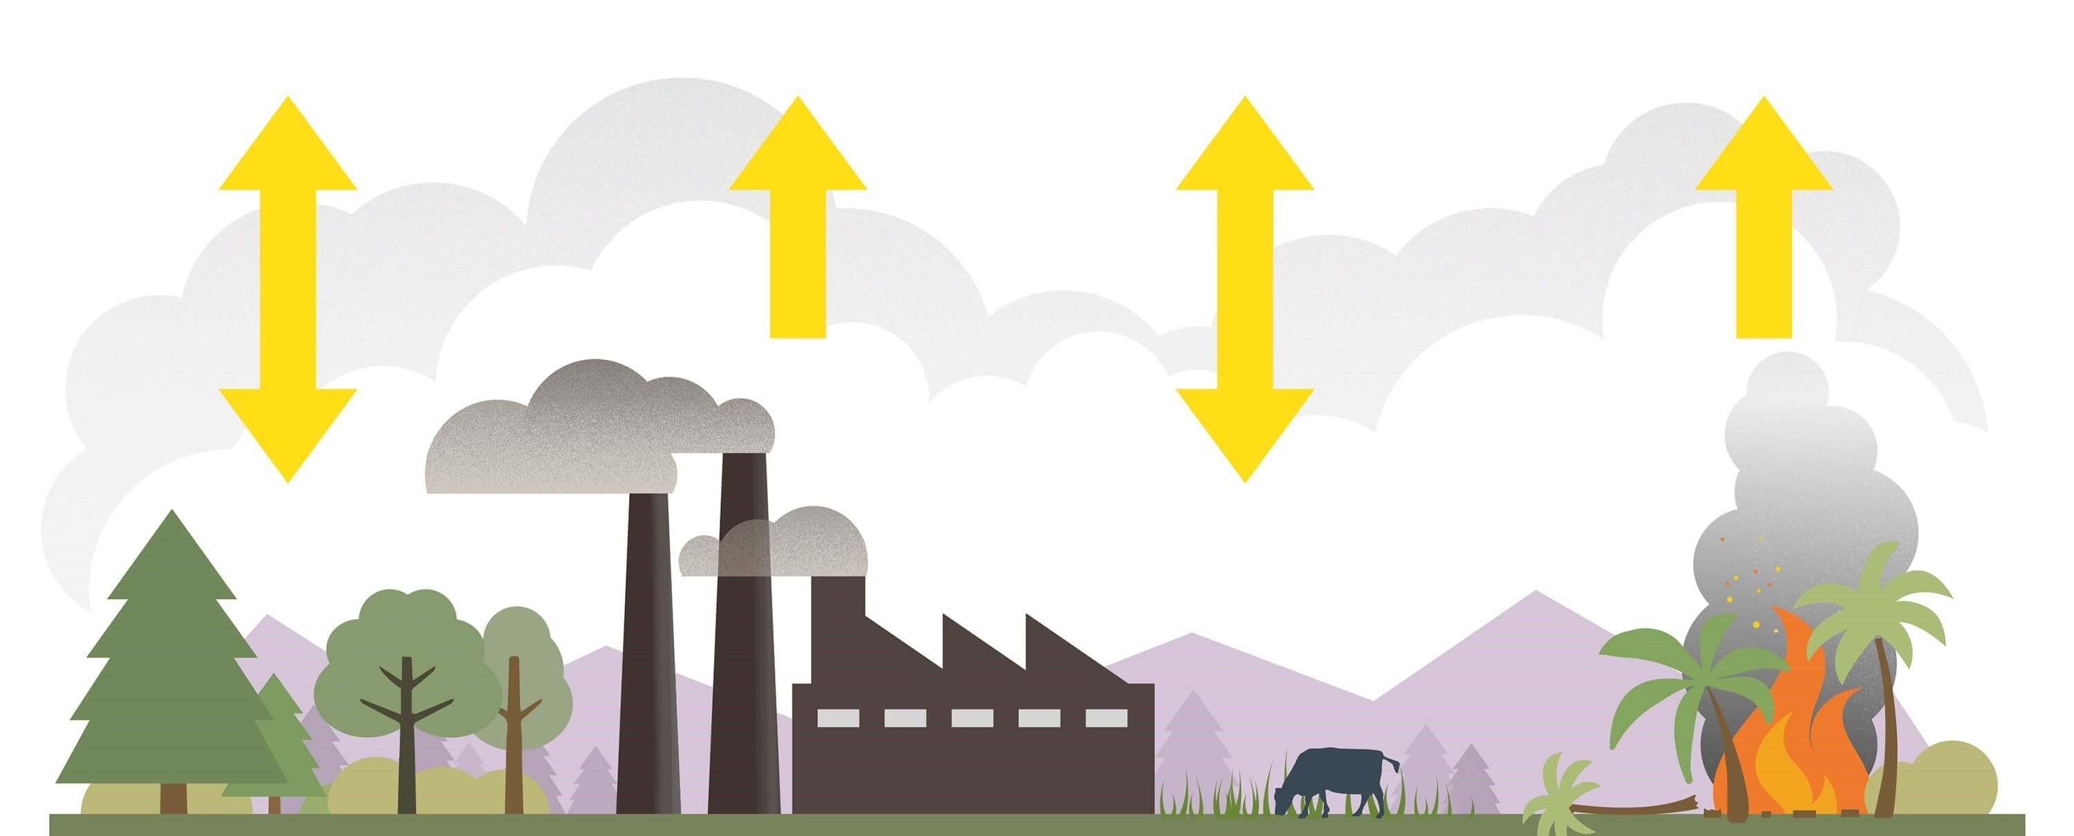
Carbon emissions
CO2 and CO in the atmosphere, produced by vehicles and industrial processes
measured in metric tons

Slide 3
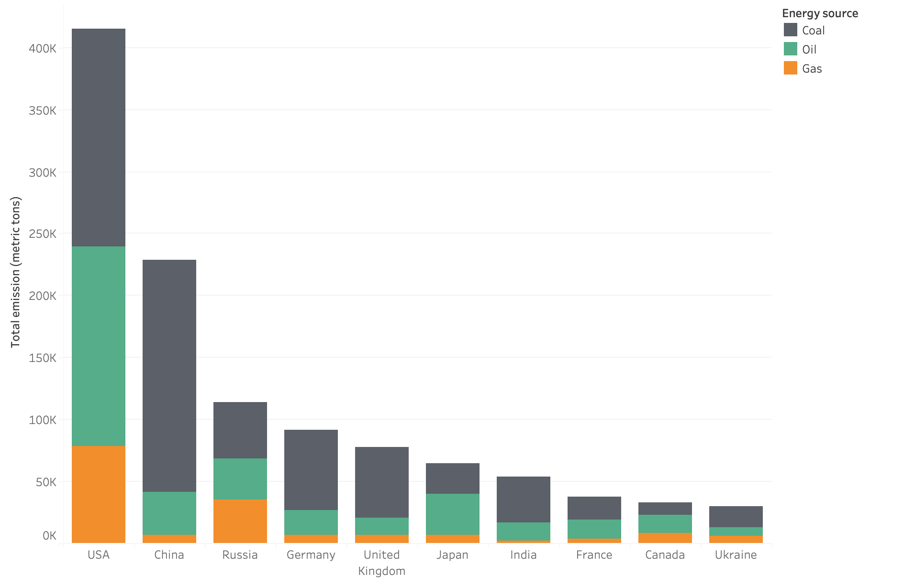
Contributors to global carbon emissions

Slide 4
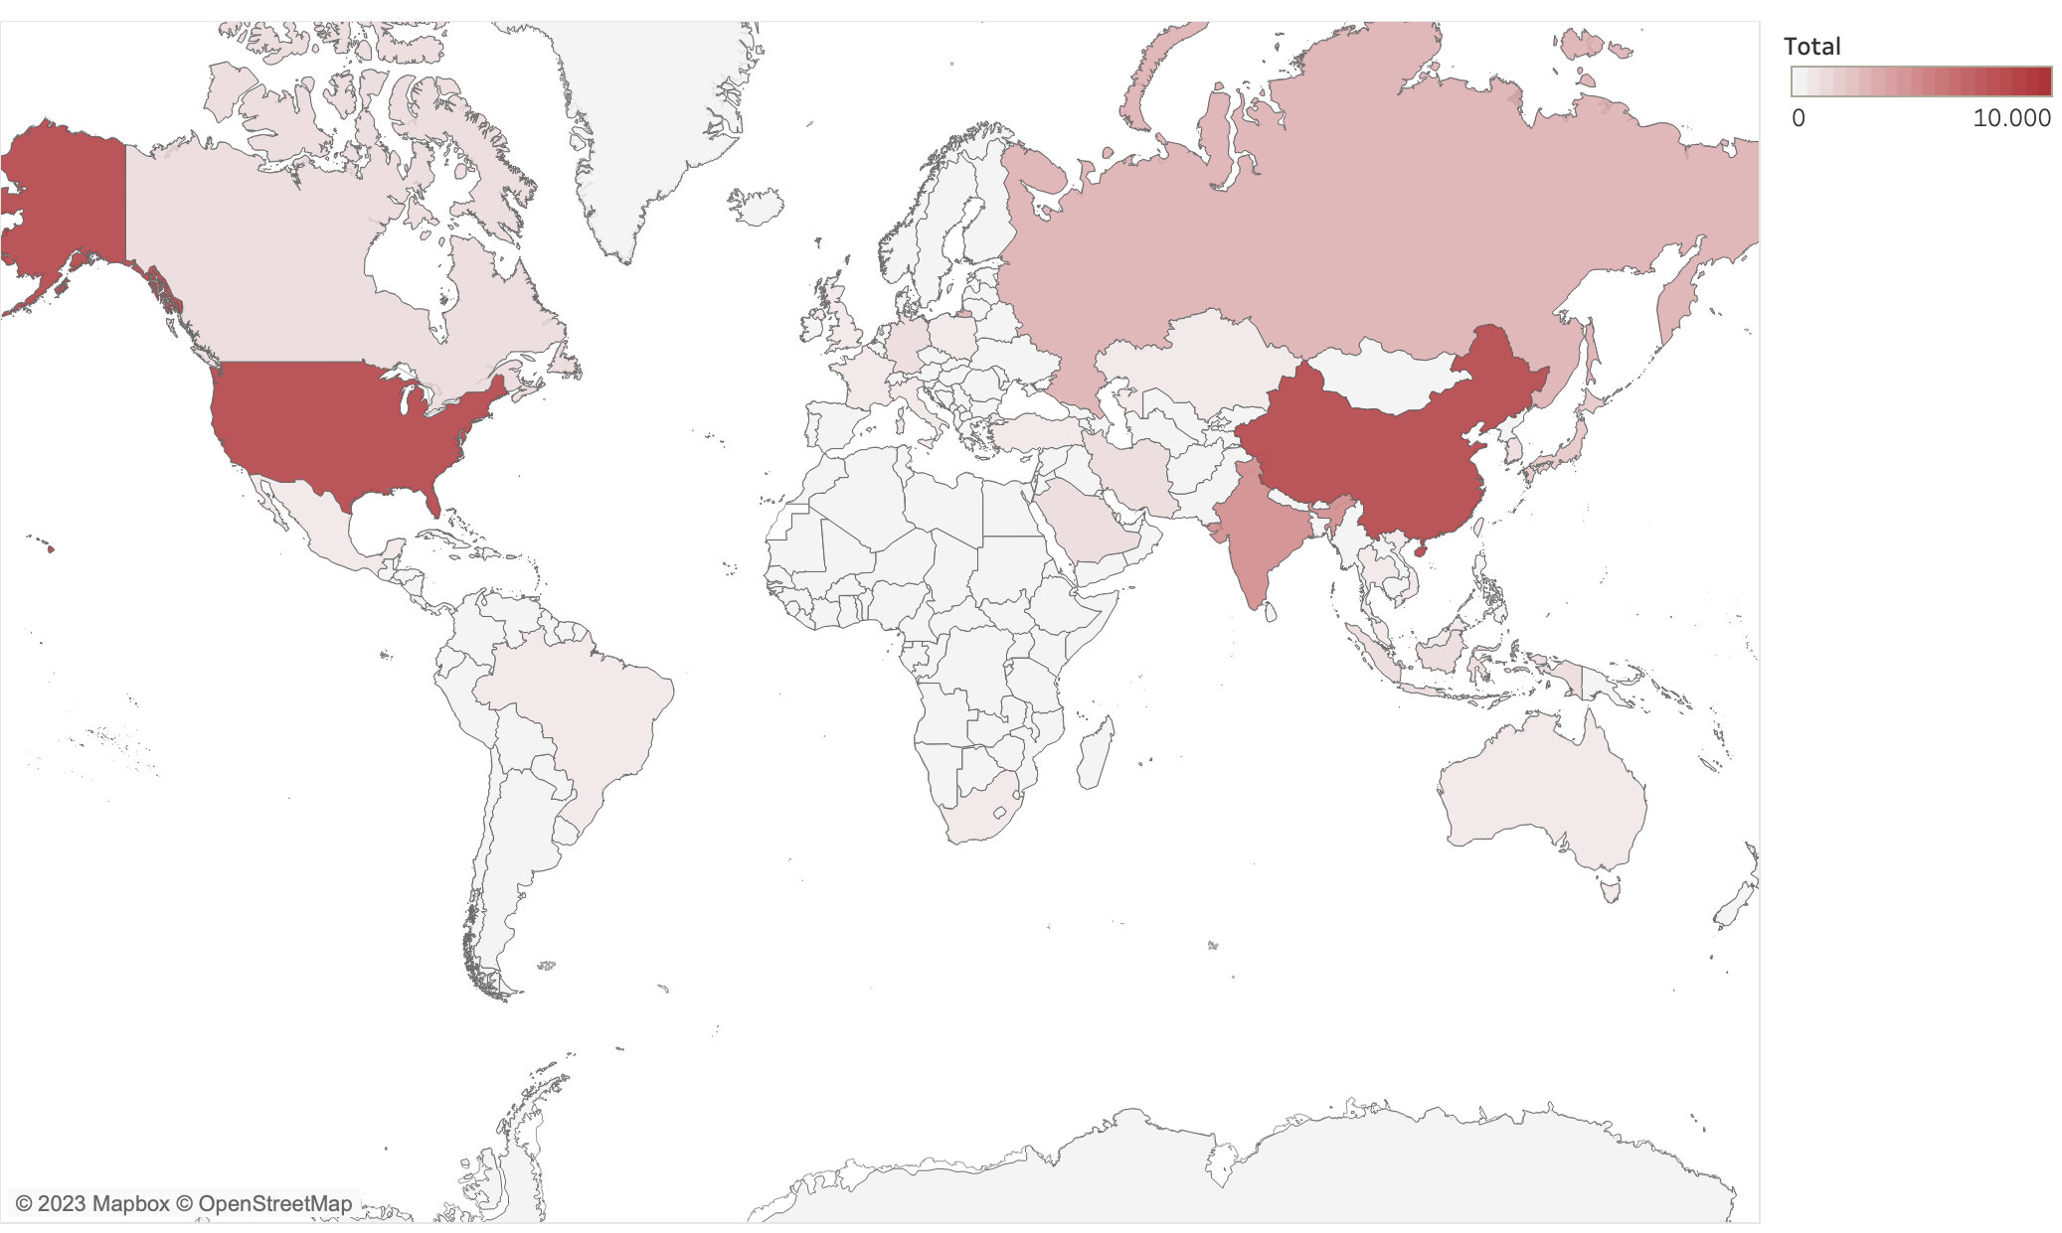
Carbon emissions: a global heatmap
Notes:
Show countries emissions for the main ones

Slide 5
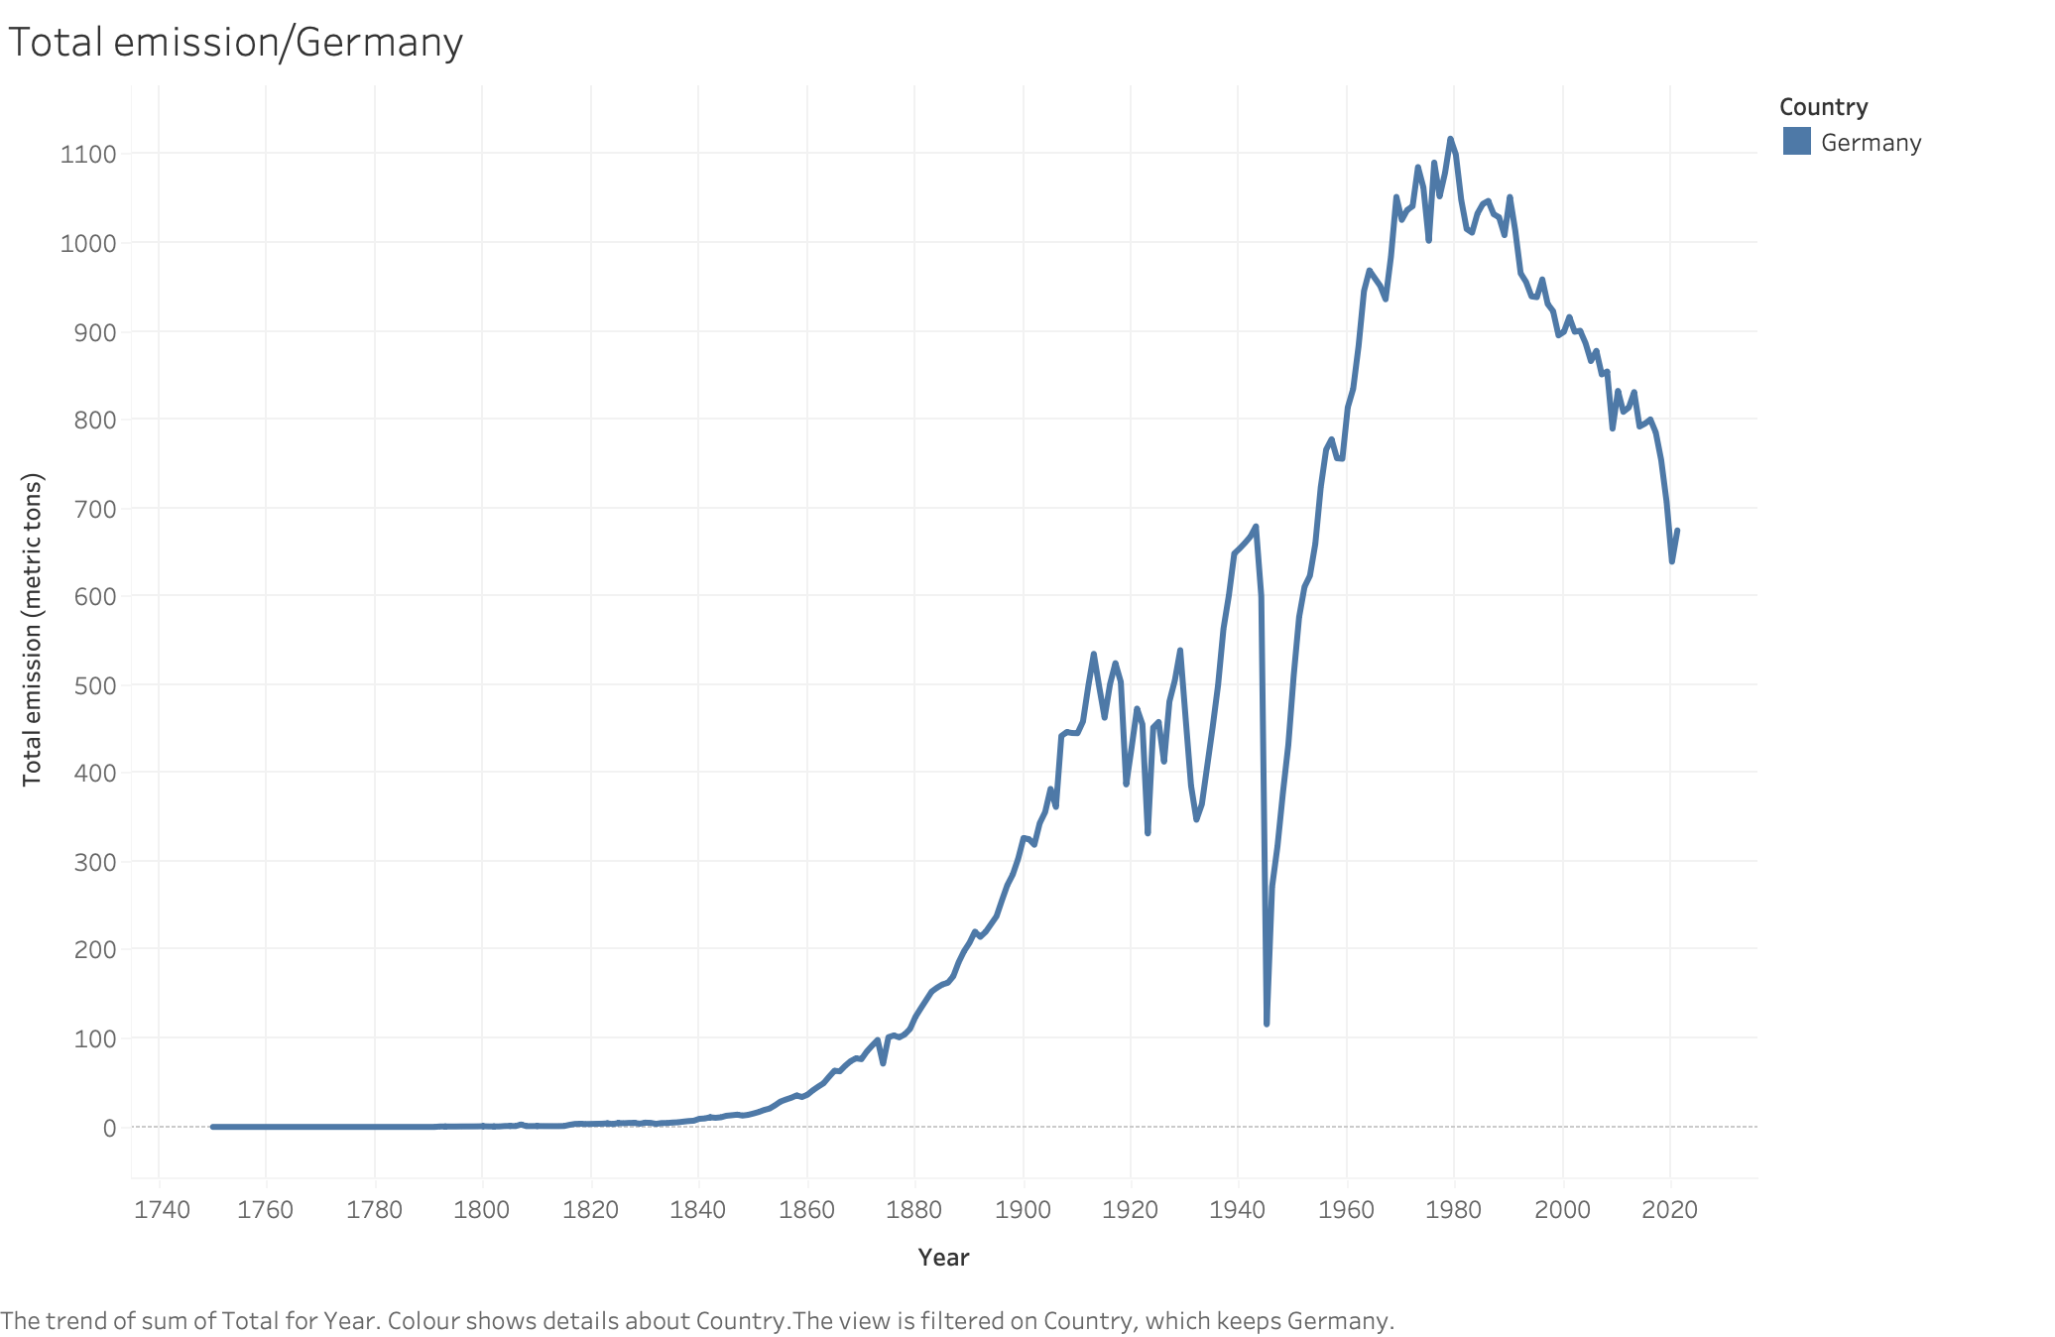
Carbon emissions for Germany

Slide 6
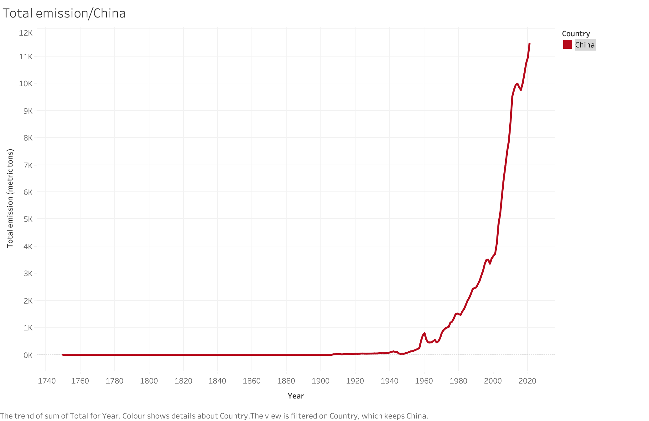
Carbon emissions for China

Slide 7
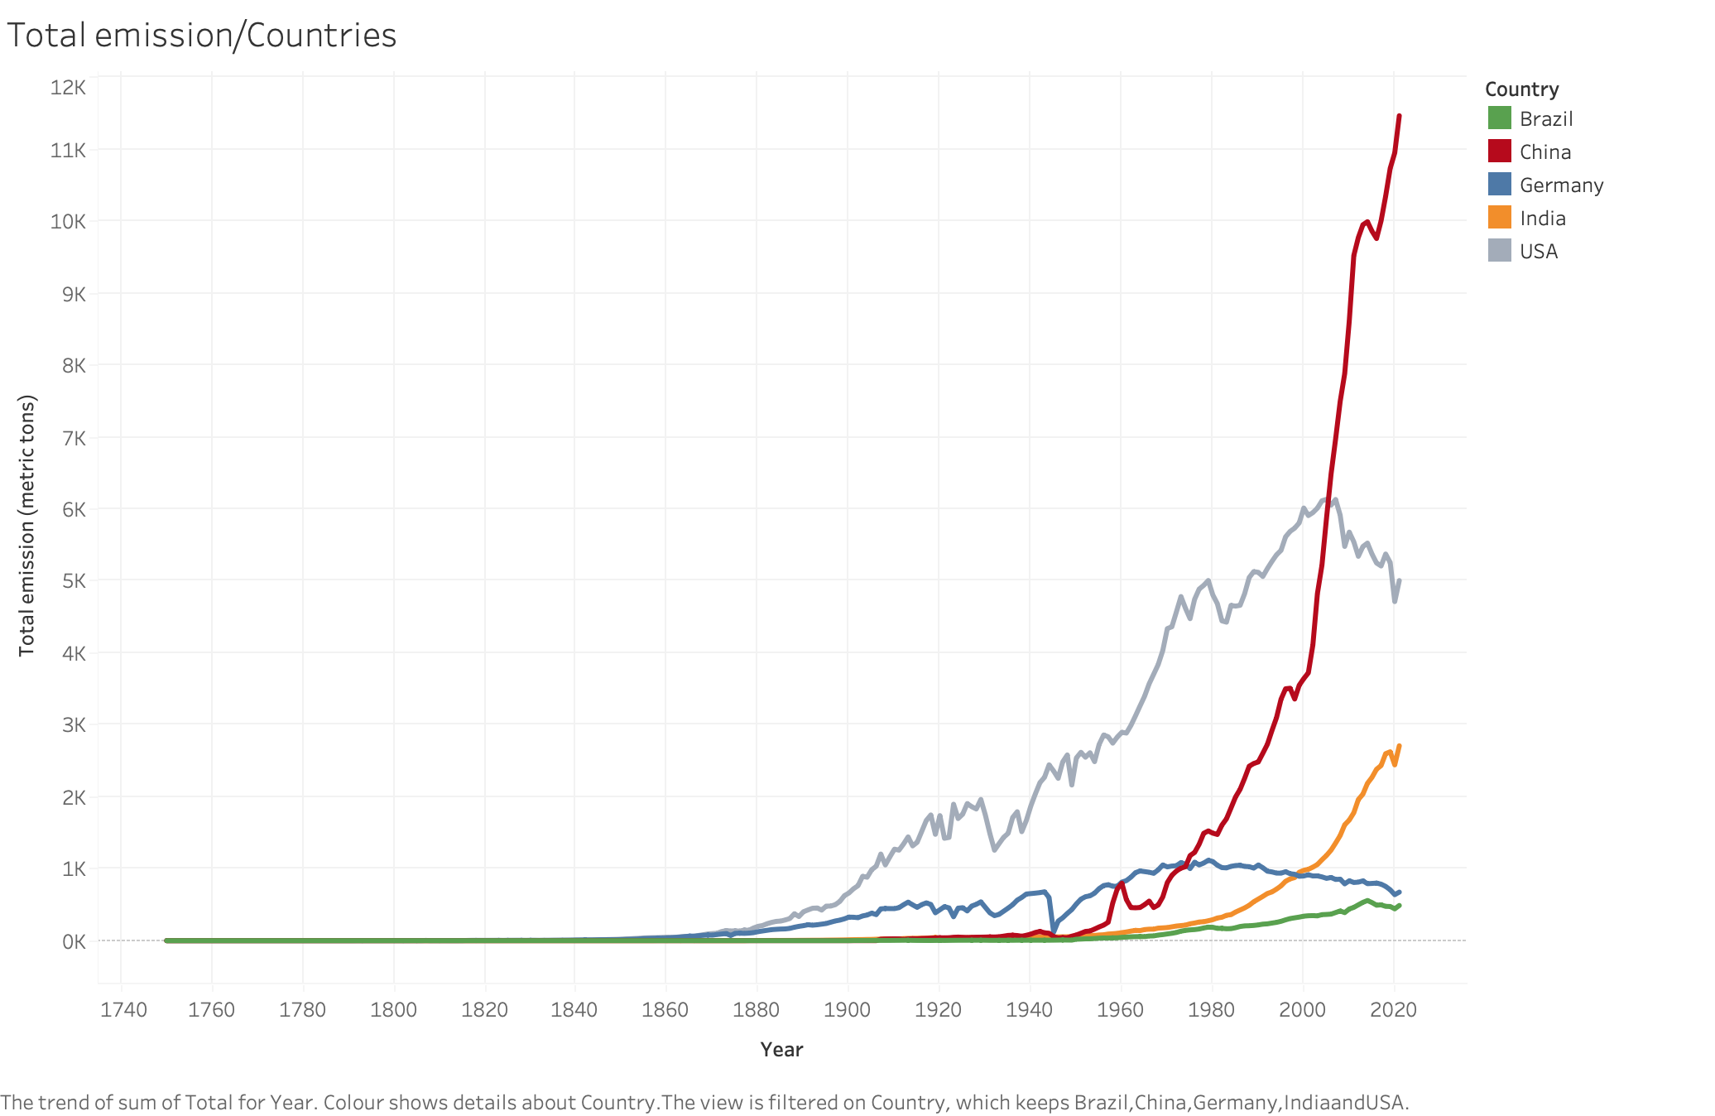
Carbon emissions:
A comparison

Slide 8
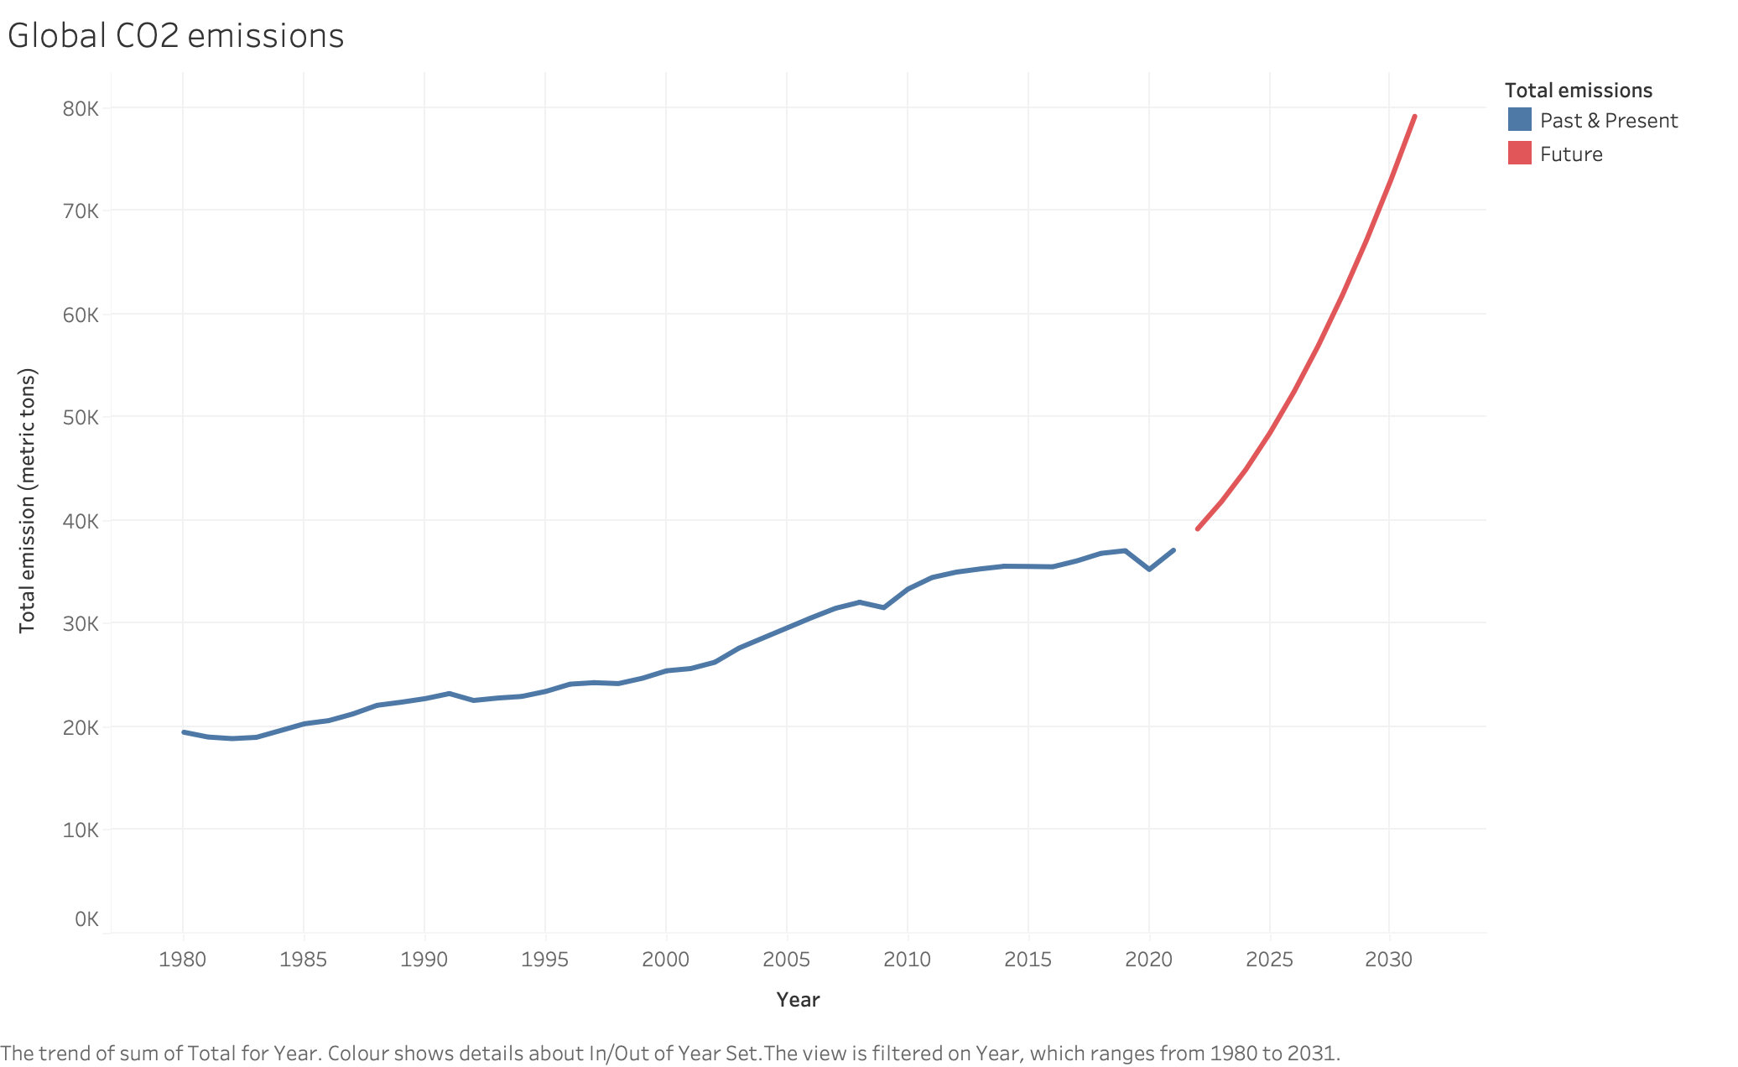
Global future trend forecasting
113 %

Slide 9
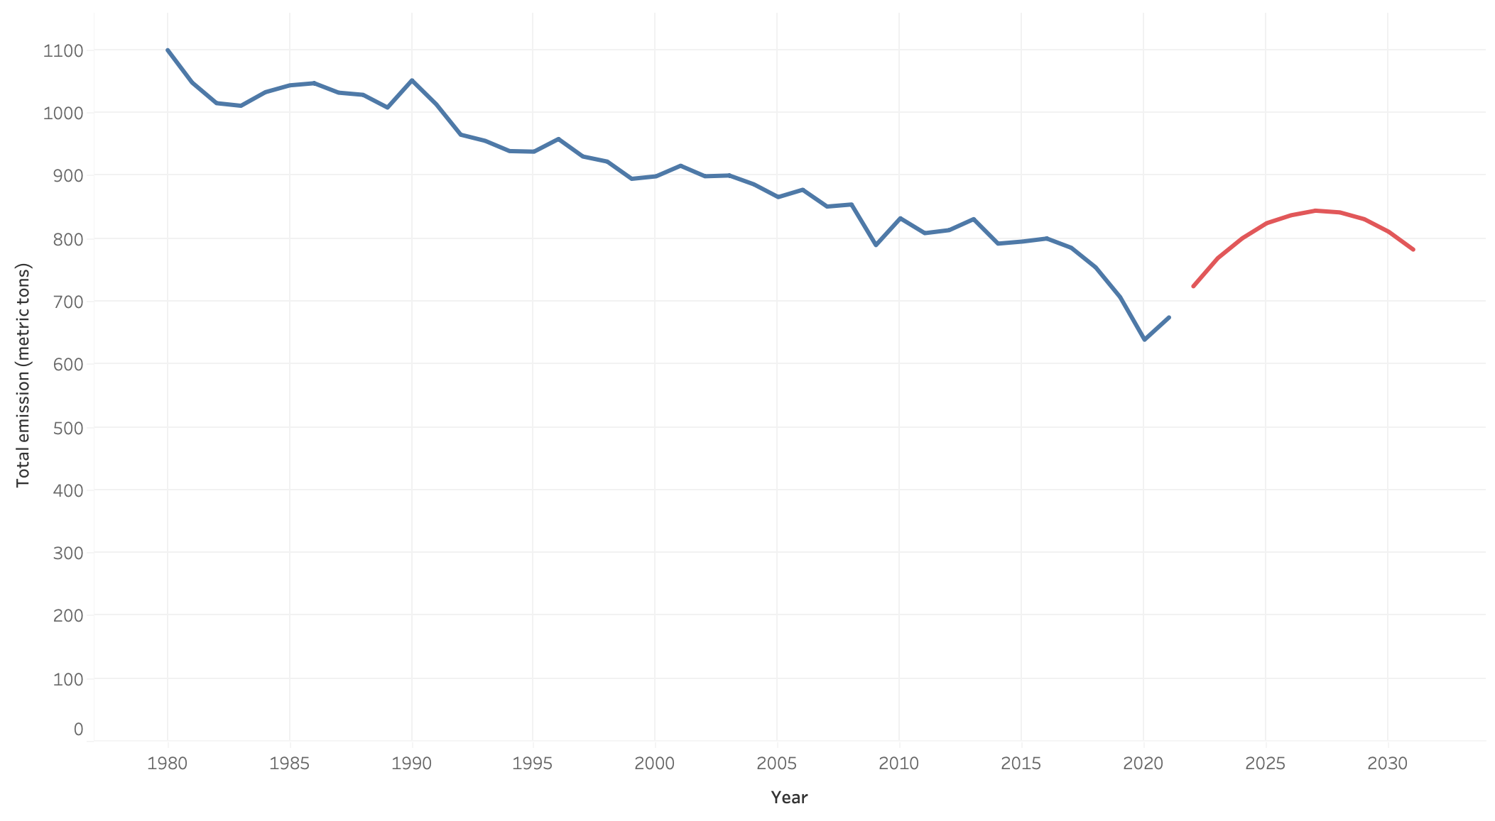
6 %
Carbon emissions prediction for Germany

Slide 10
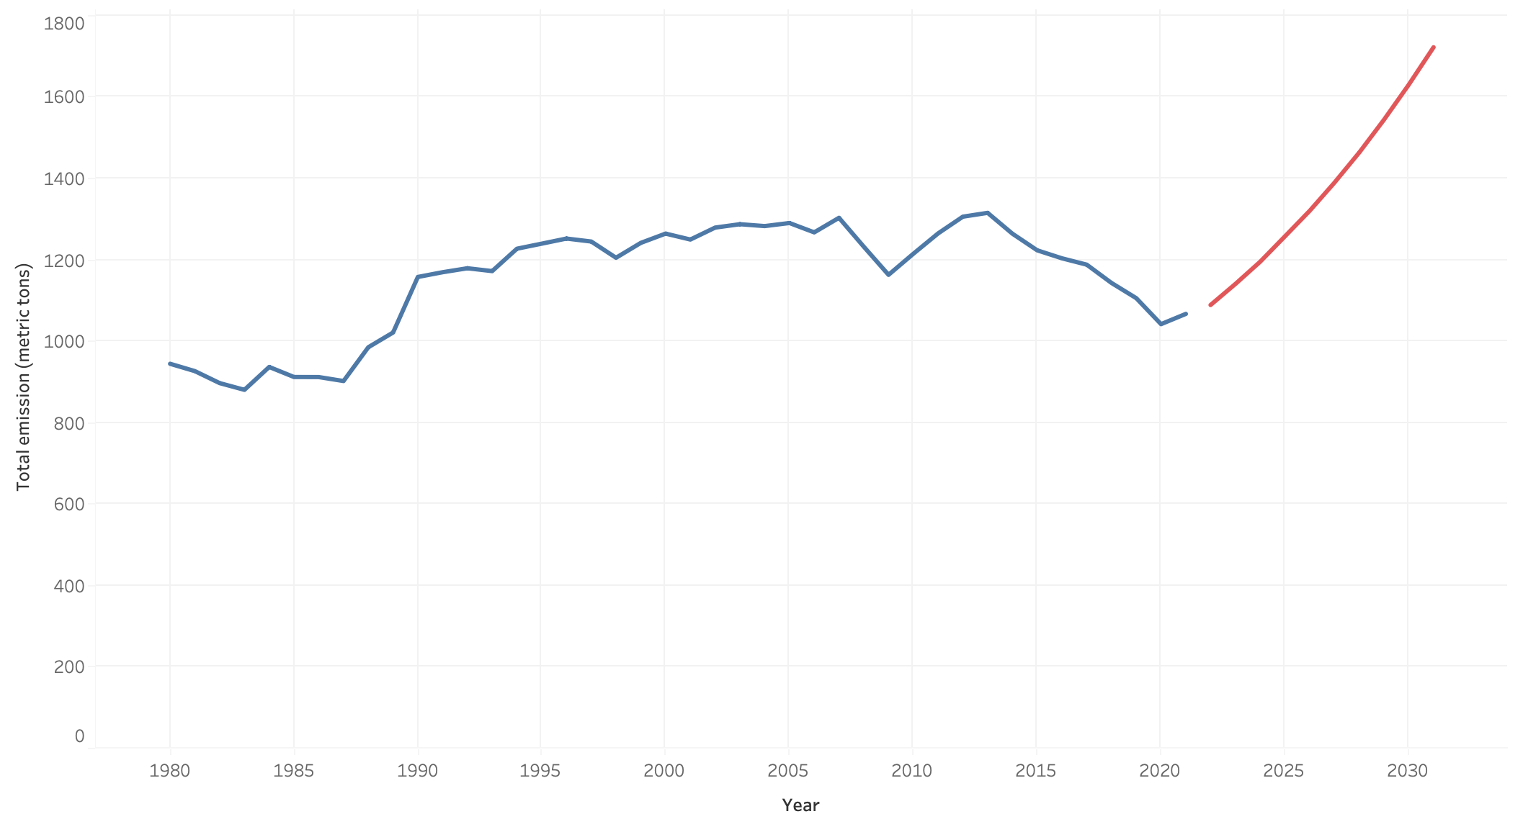
Carbon emissions prediction for Japan
43 %

Slide 11
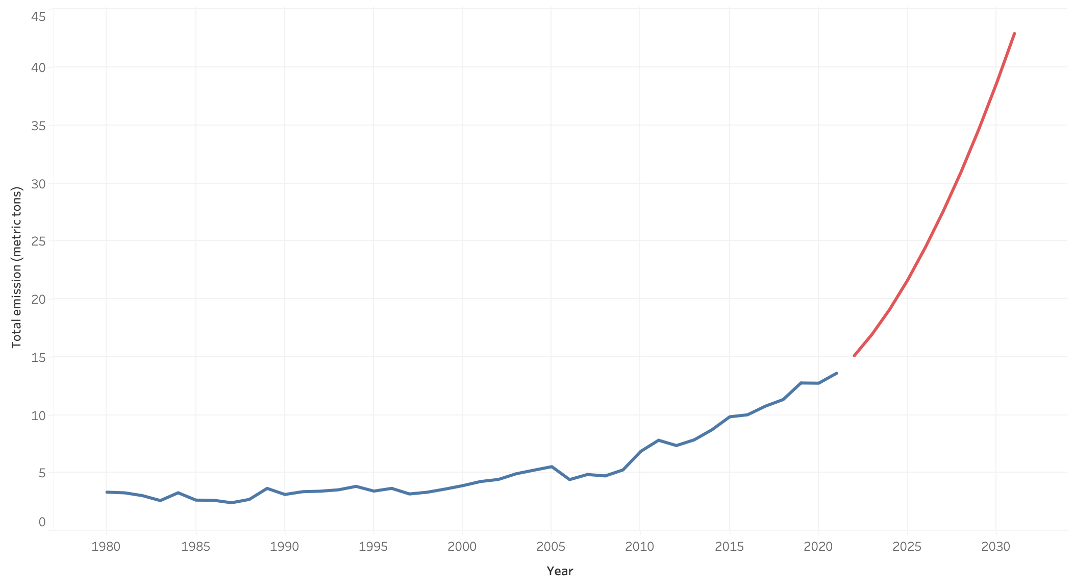
Carbon emissions prediction for Senegal
174 %

Slide 12
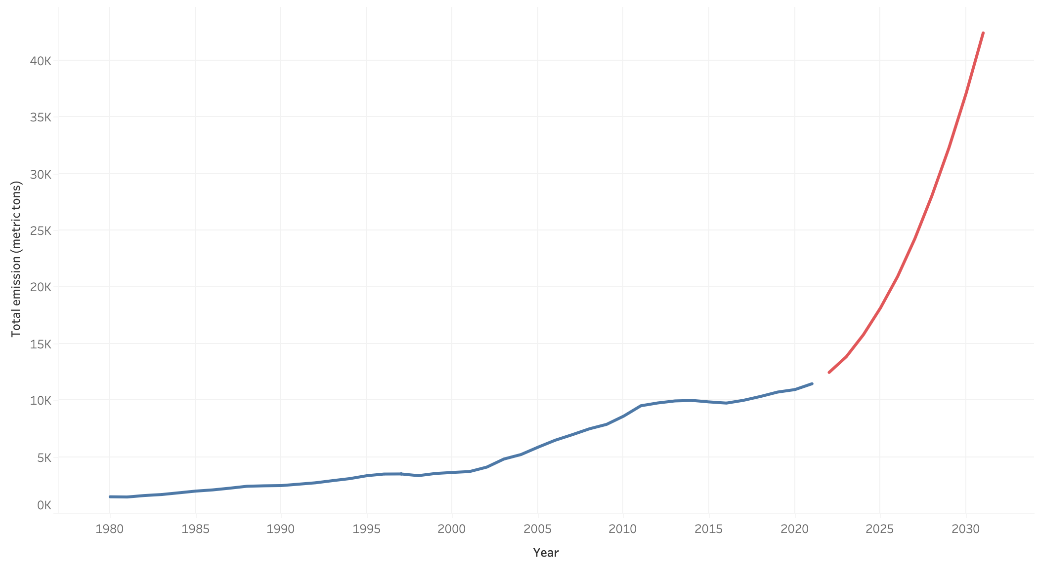
Carbon emissions prediction for China
267 %

Slide 13
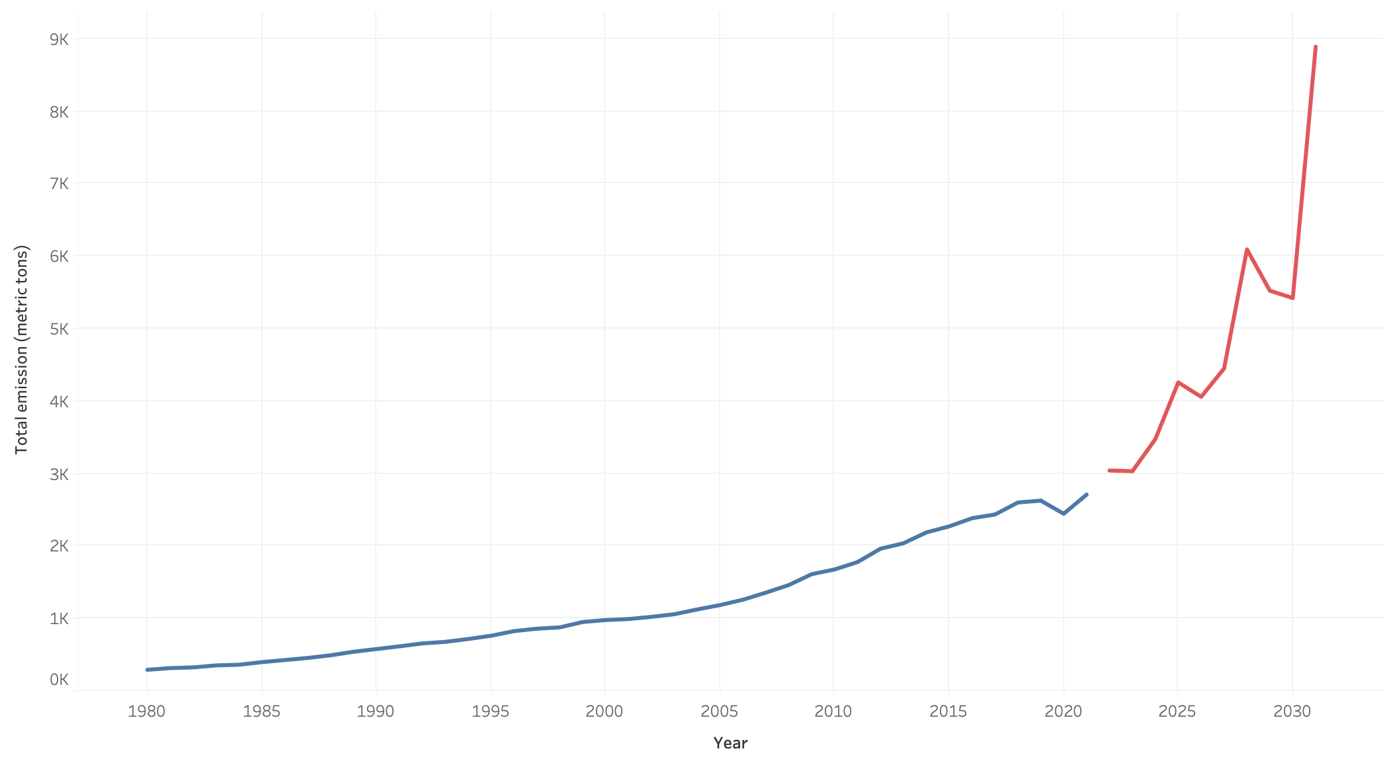
Carbon emissions prediction for India
228 %

Slide 14
(CLONCLUSIONS AND QUESTIONS)

