Slide 1
GlobalCO2Emission
File created on: 08/03/23 11:28:08 CET

Slide 2
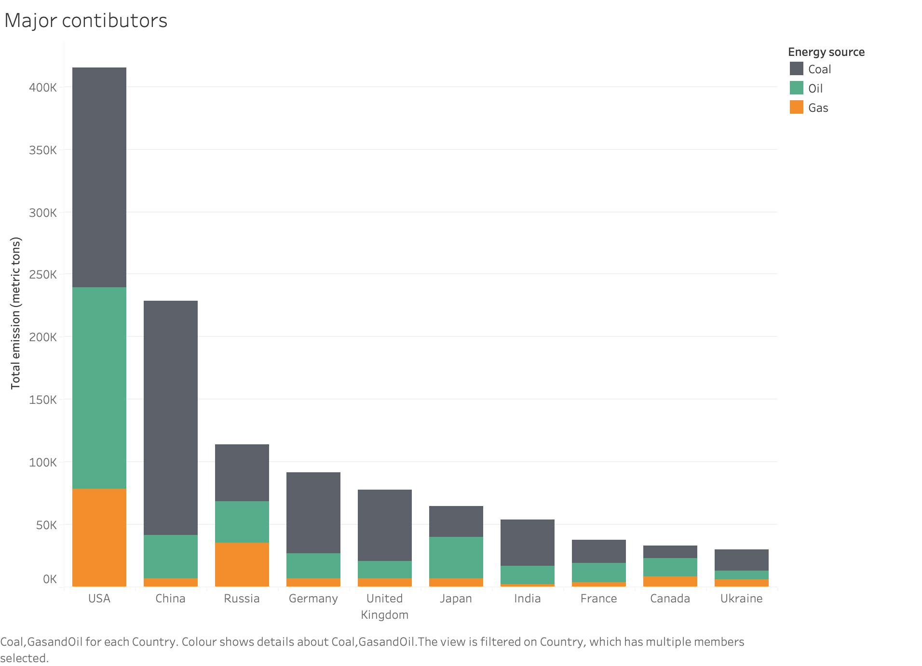

Slide 3
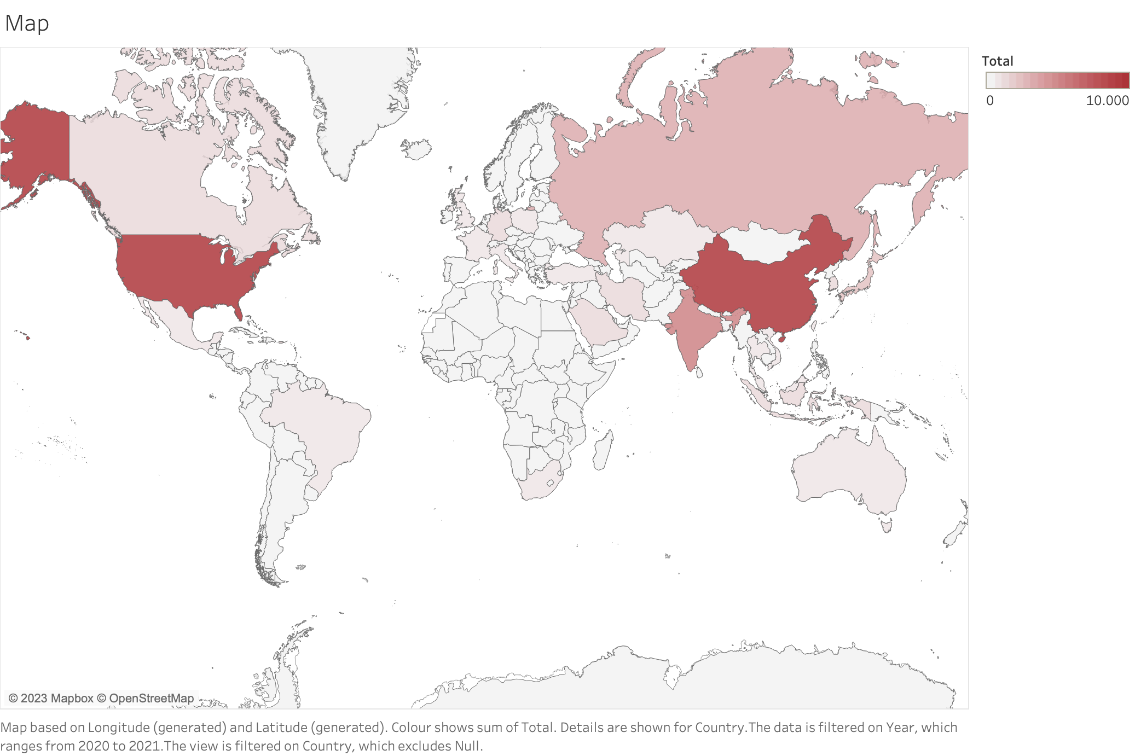

Slide 4
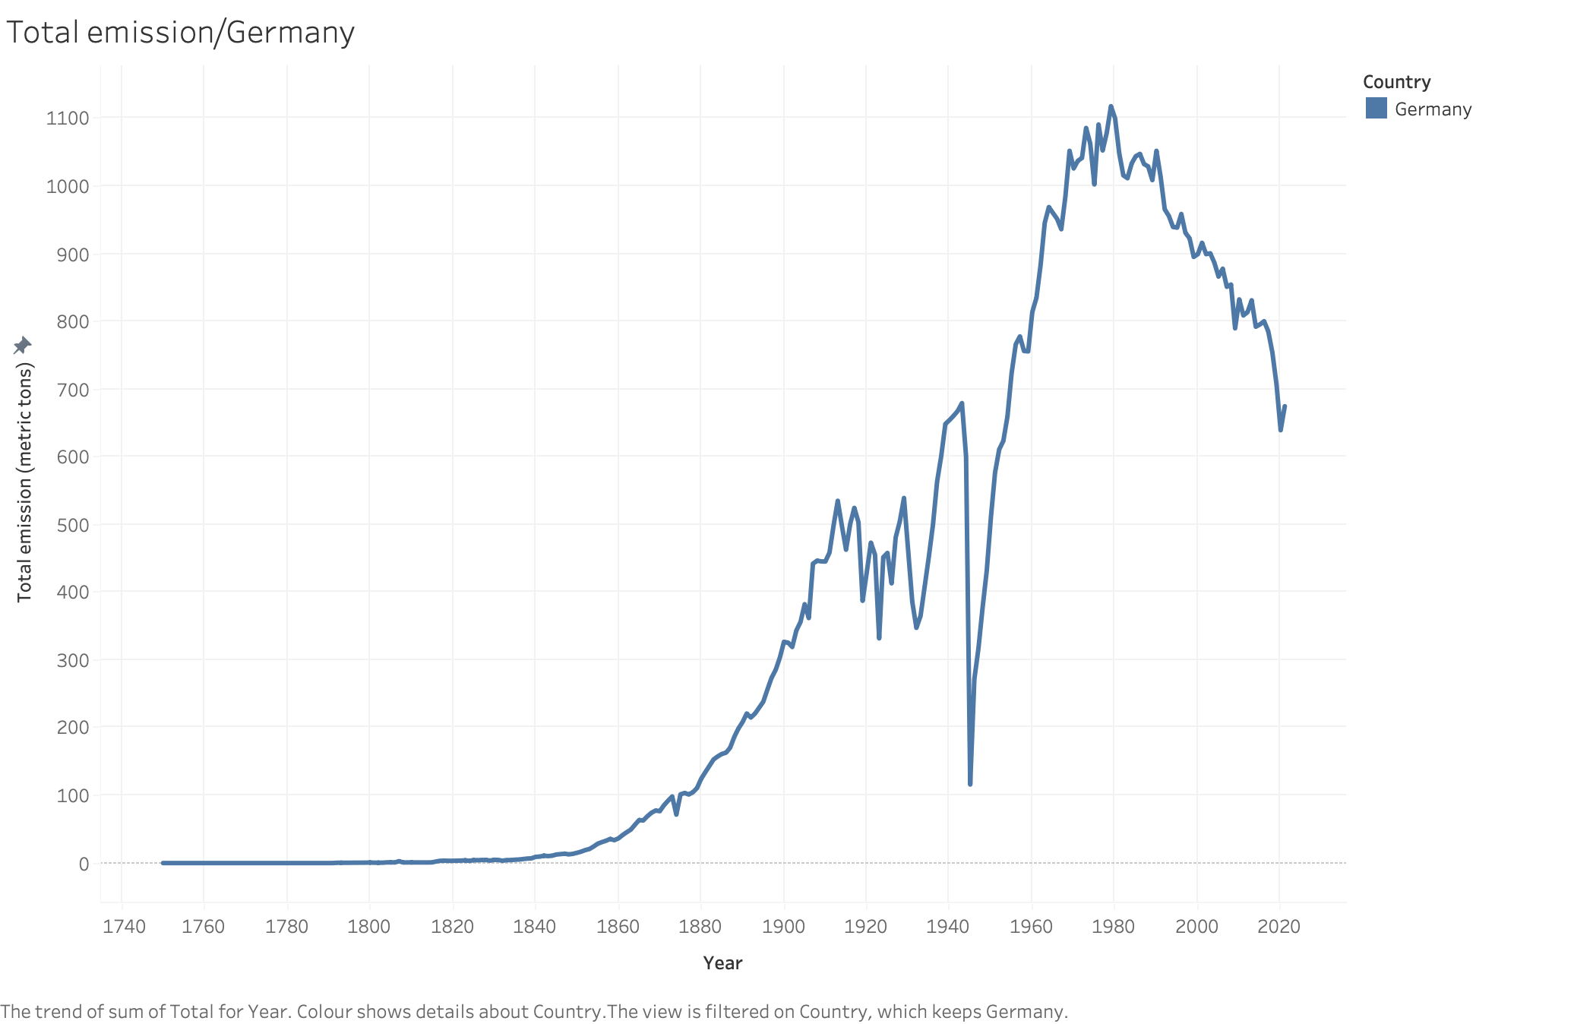

Slide 5
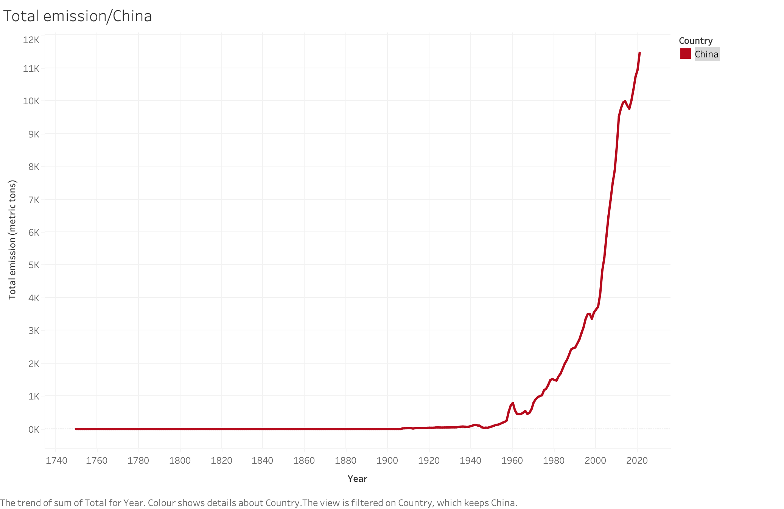

Slide 6
