Slide 1
GlobalCO2Forecasting
File created on: 08/03/23 11:41:58 CET

Slide 2
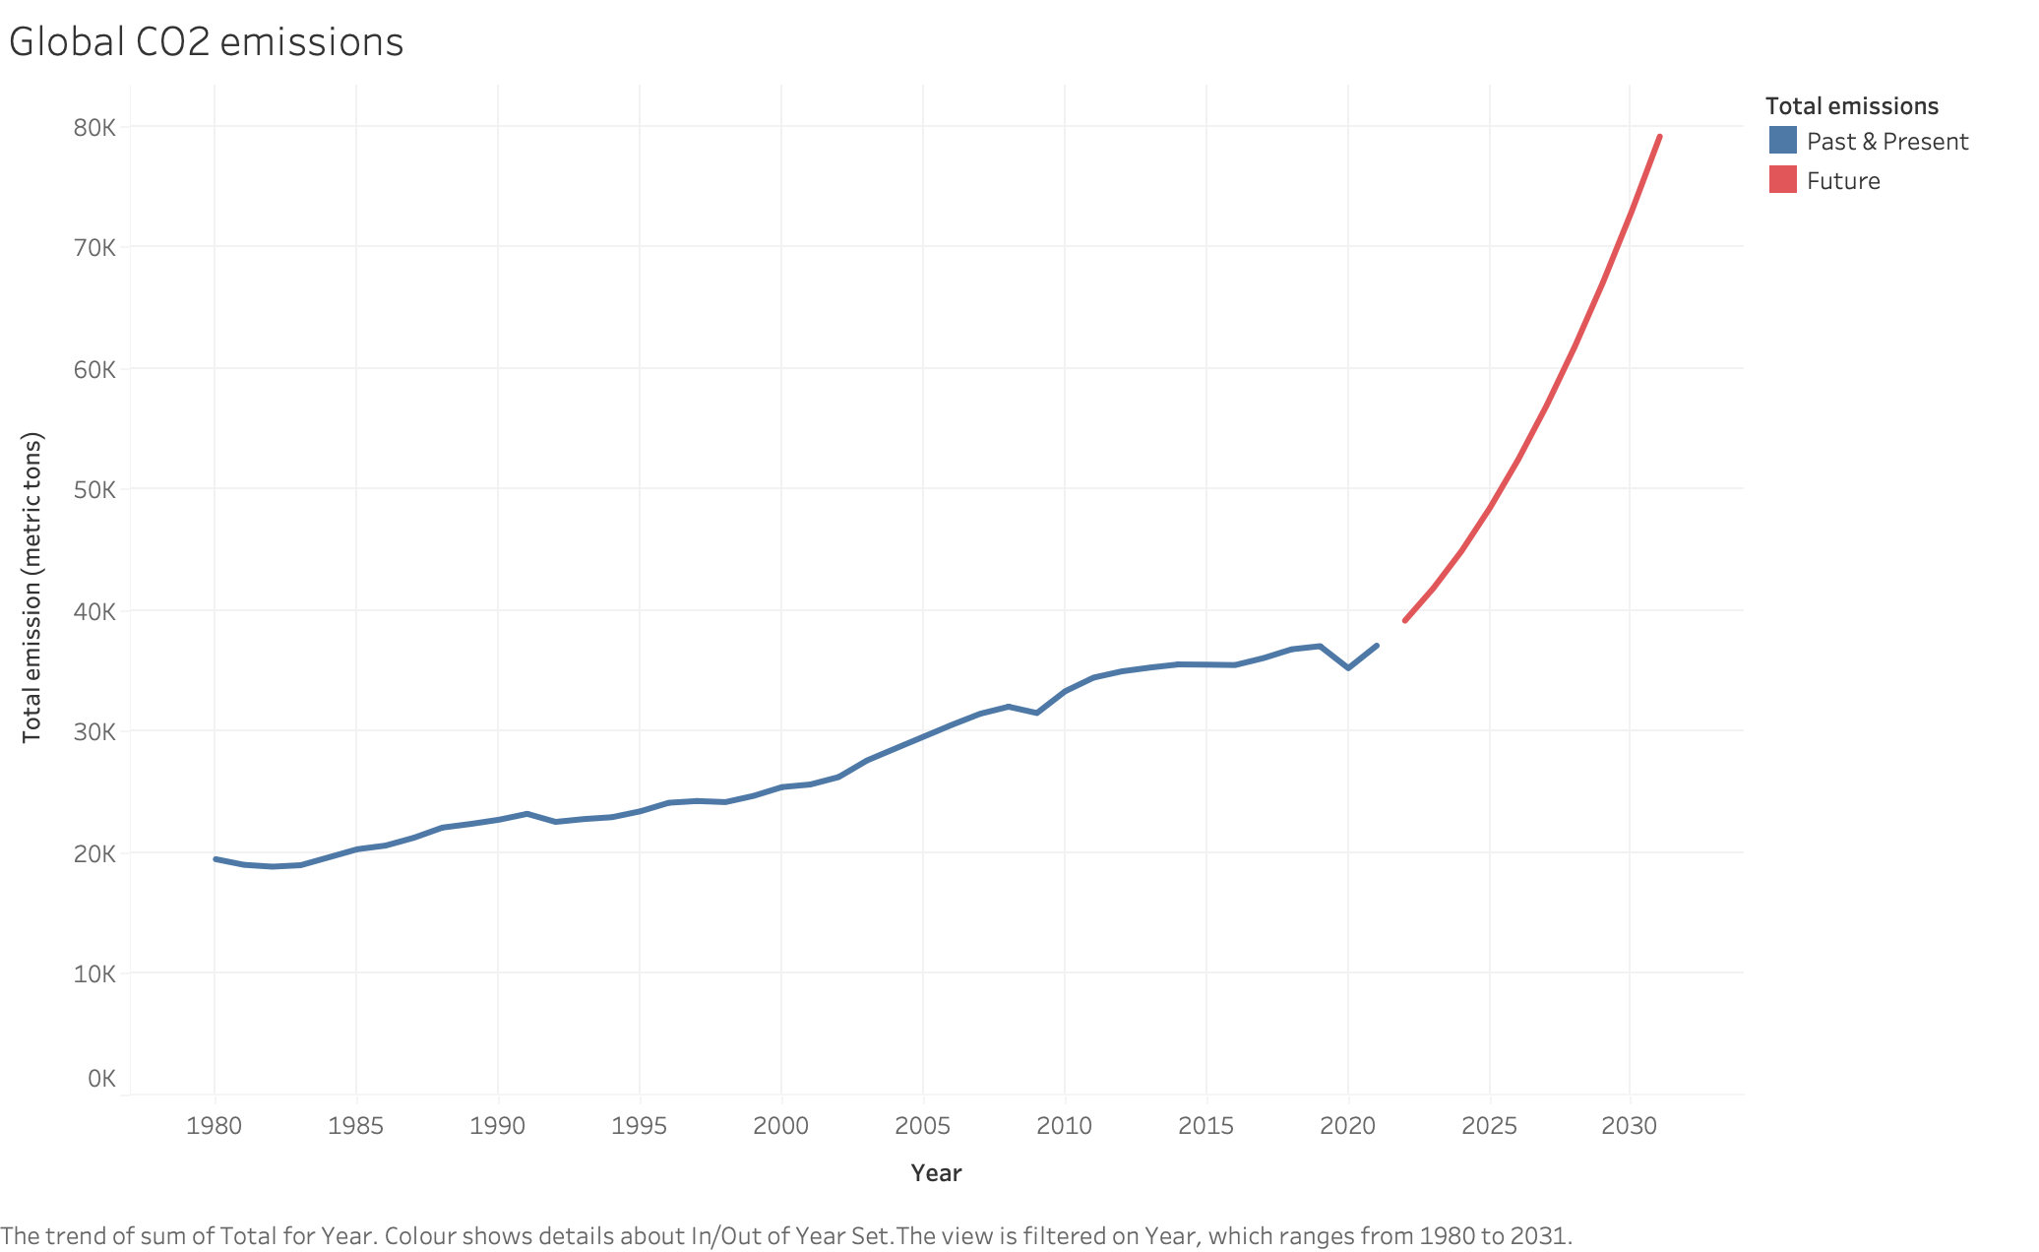

Slide 3
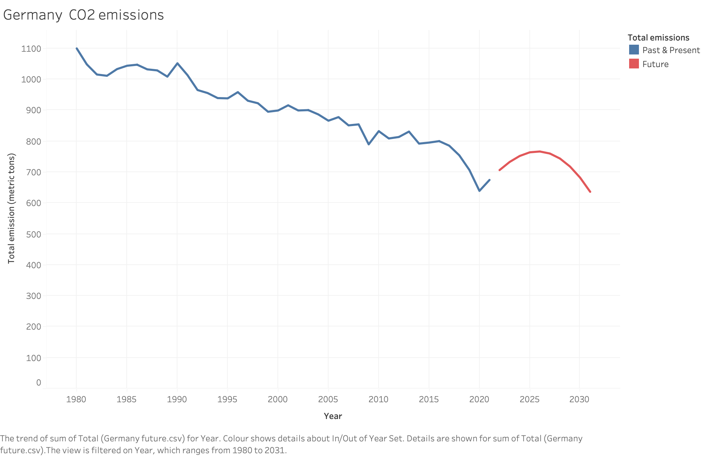

Slide 4
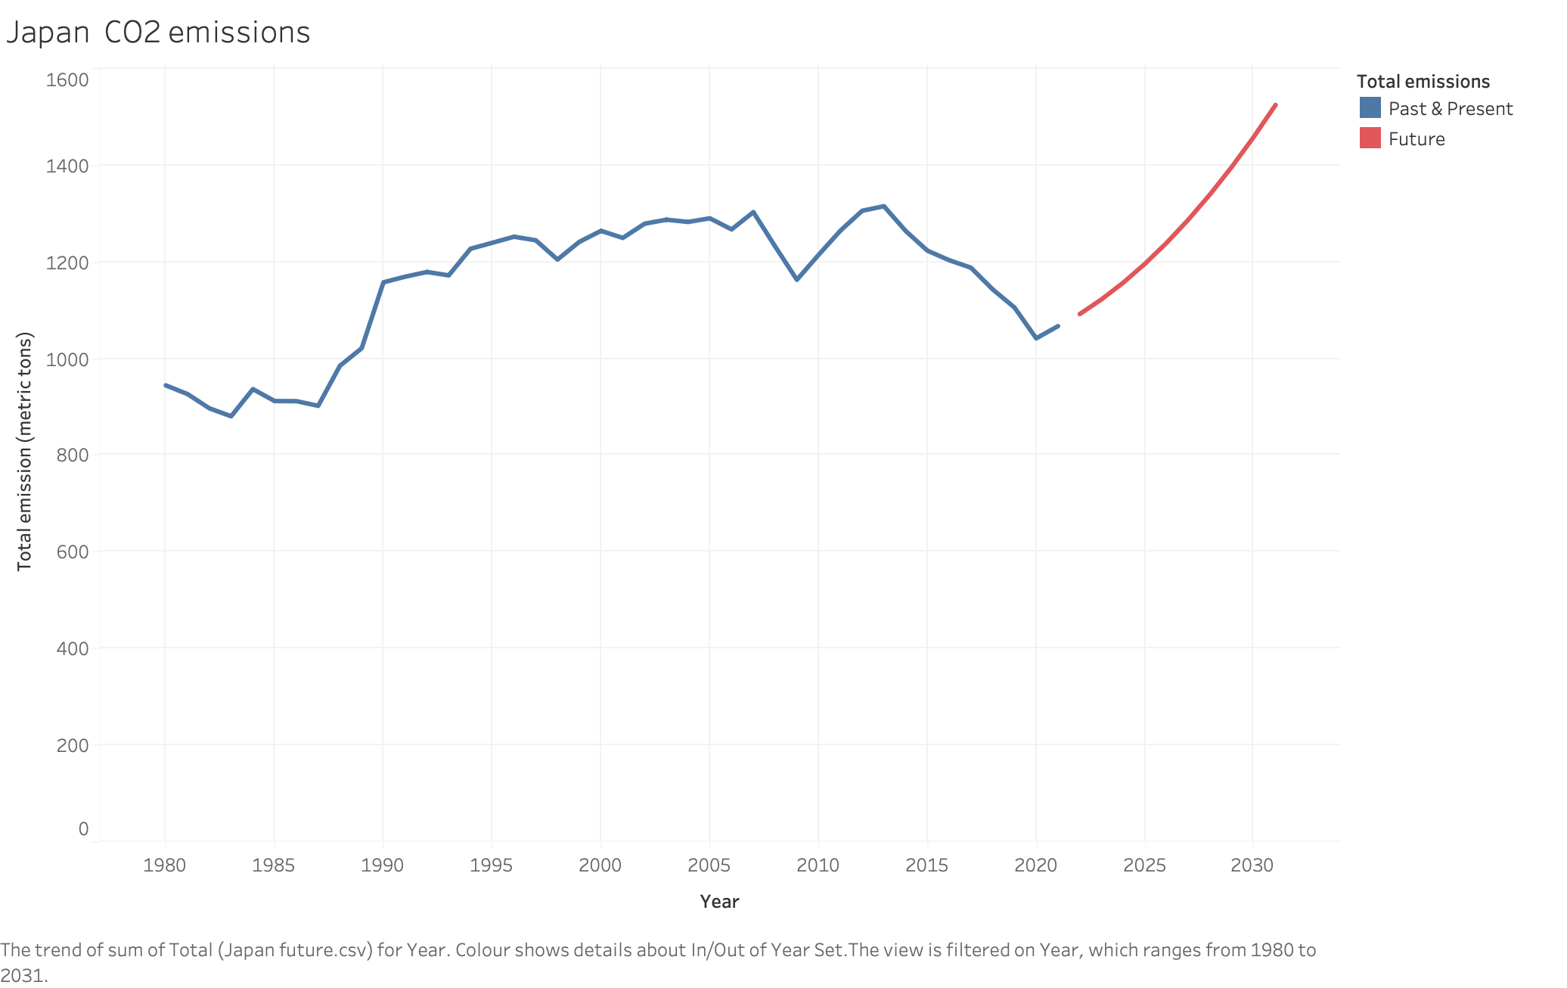

Slide 5
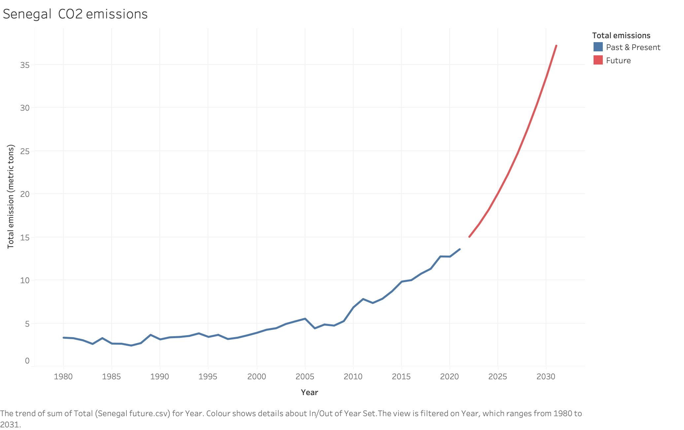

Slide 6
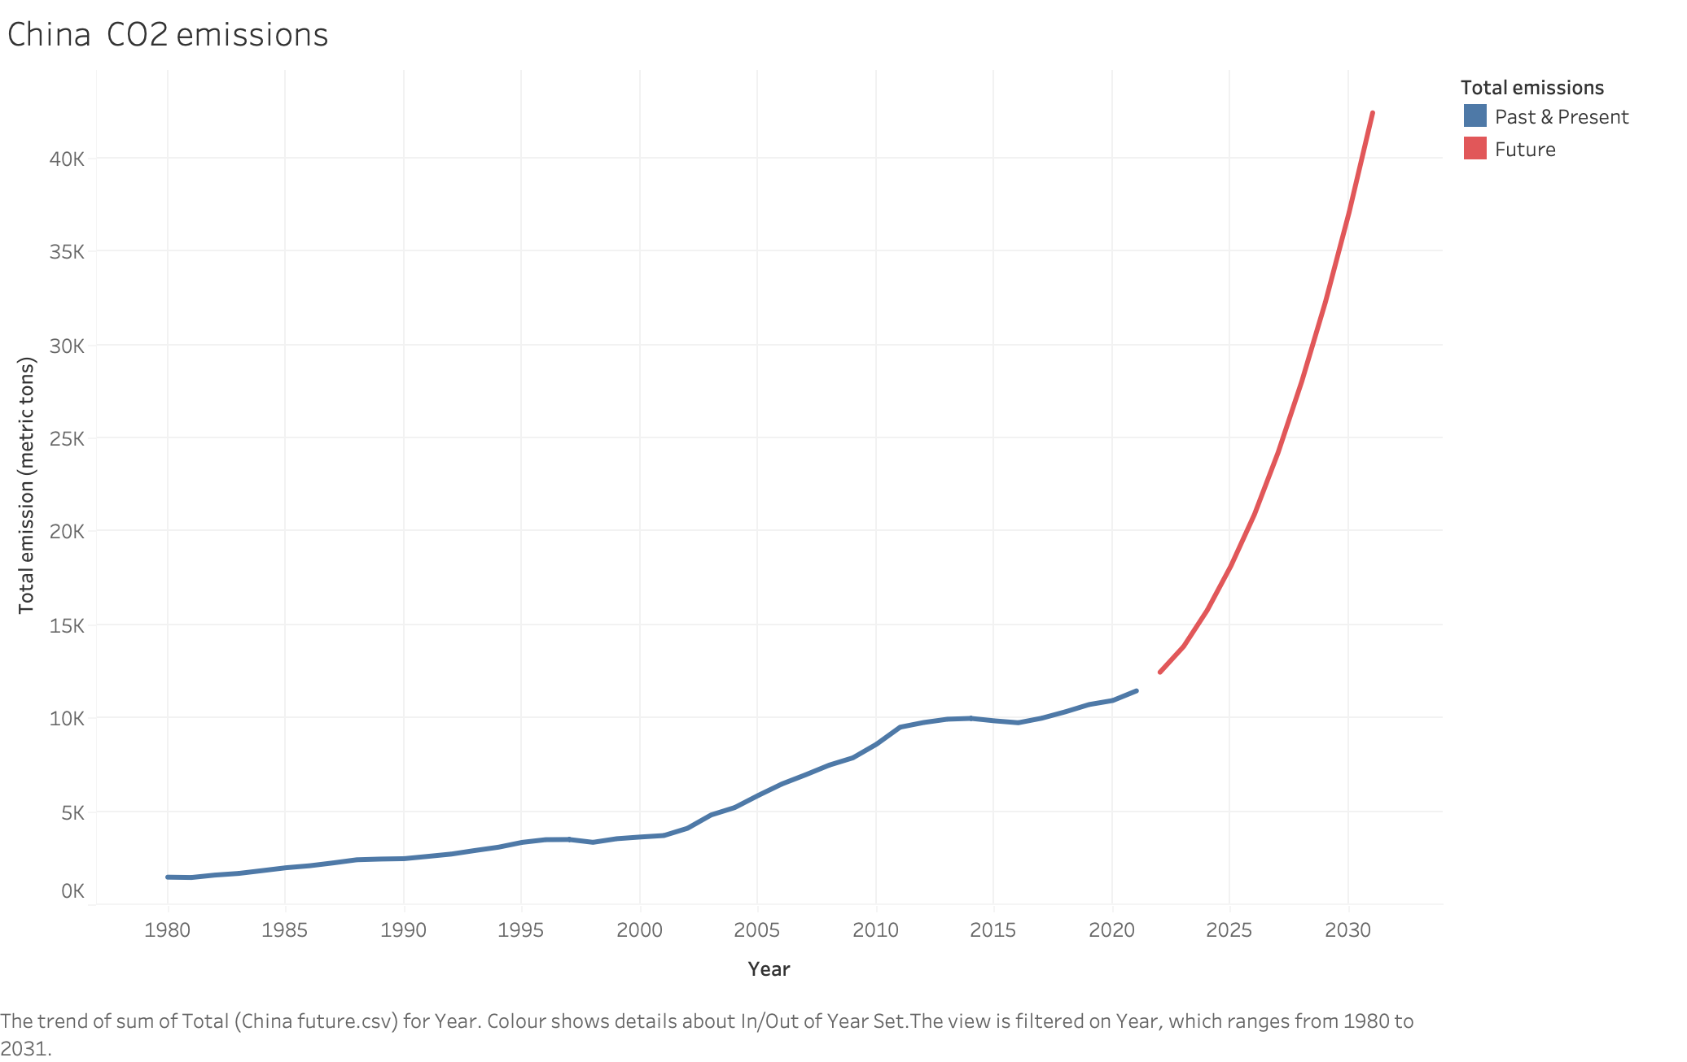

Slide 7
