Slide 1
GlobalCO2Forecasting
File created on: 09/03/23 15:05:52 CET

Slide 2
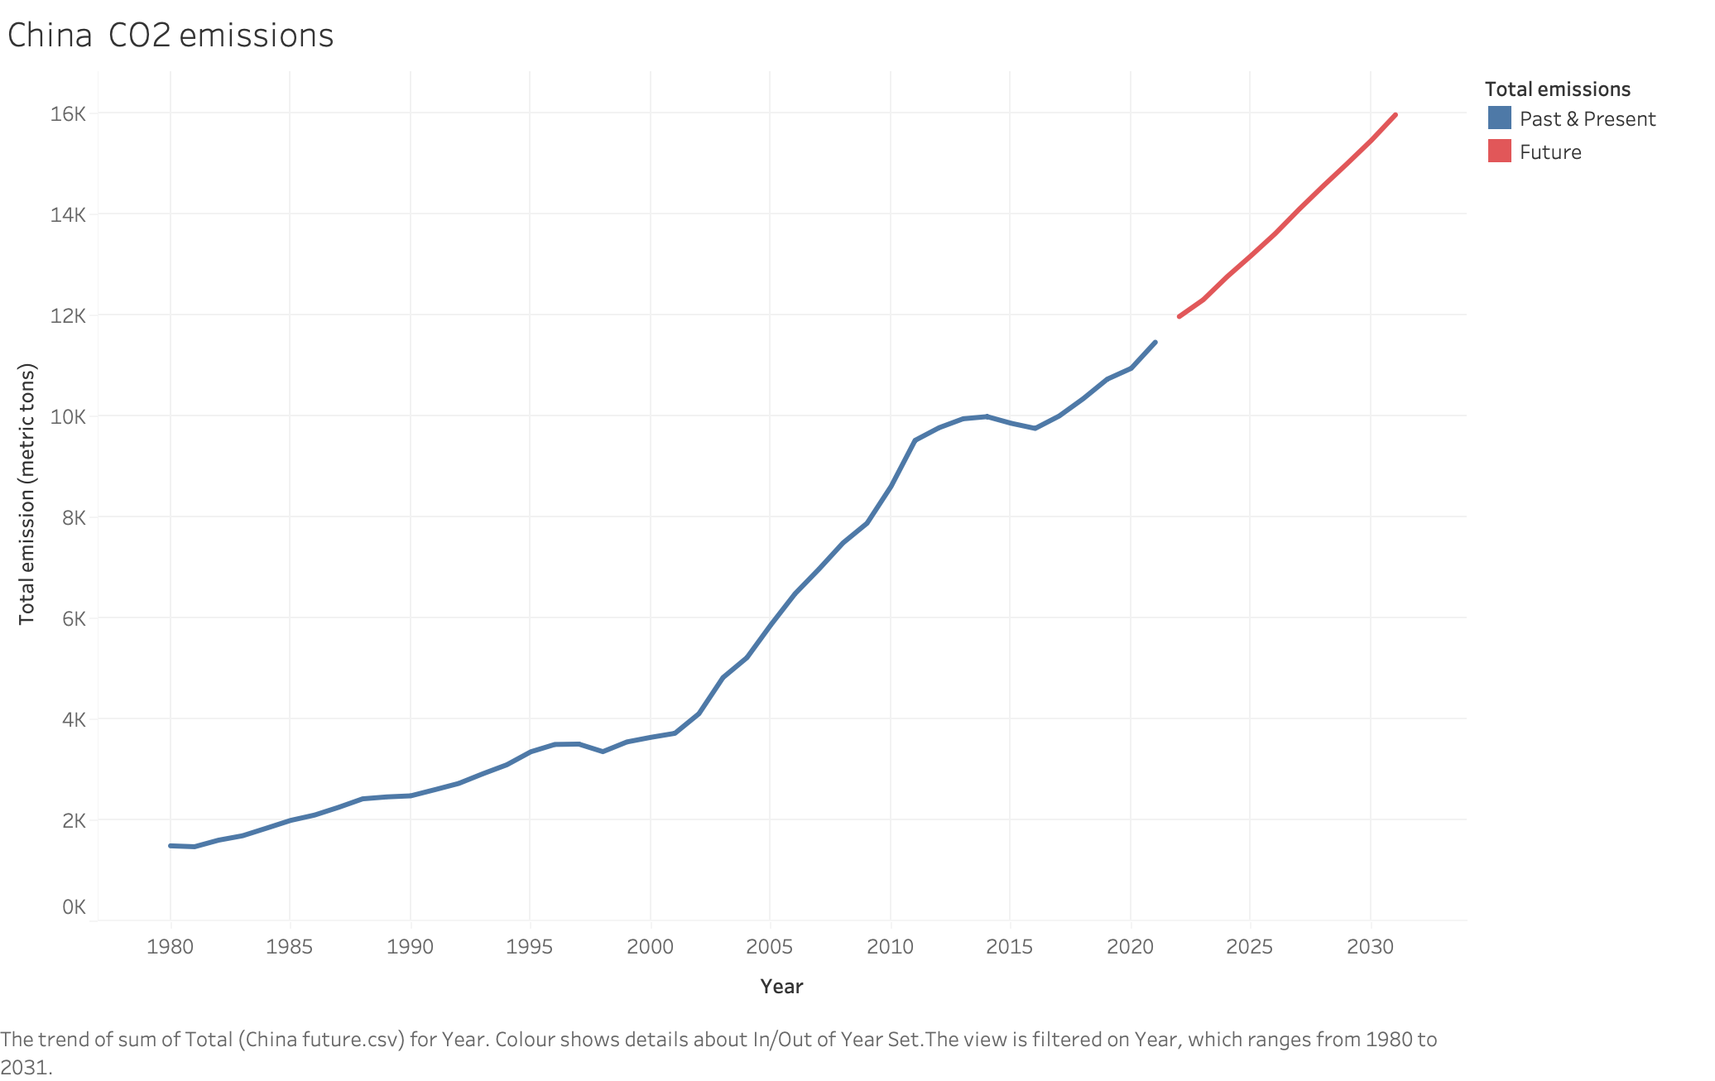

Slide 3
