Slide 1

Predict the future of our world
A ML-based time series forecasting for carbon emissions

Slide 2

Introduction
Carbon emissions?
- measured in metric tons

Slide 3
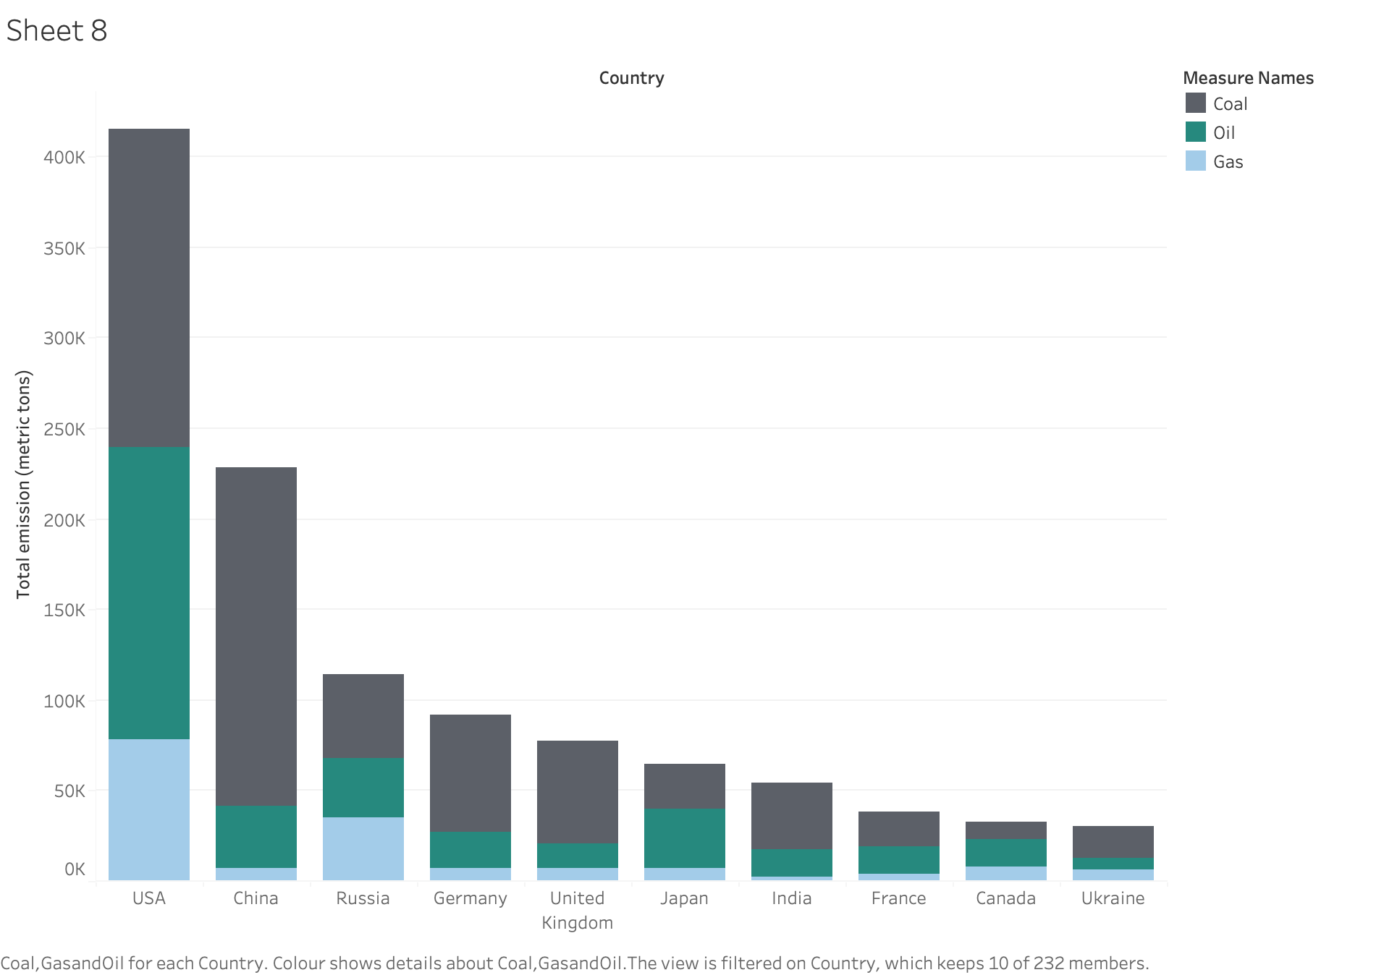
Contributors to global carbon emissions

Slide 4
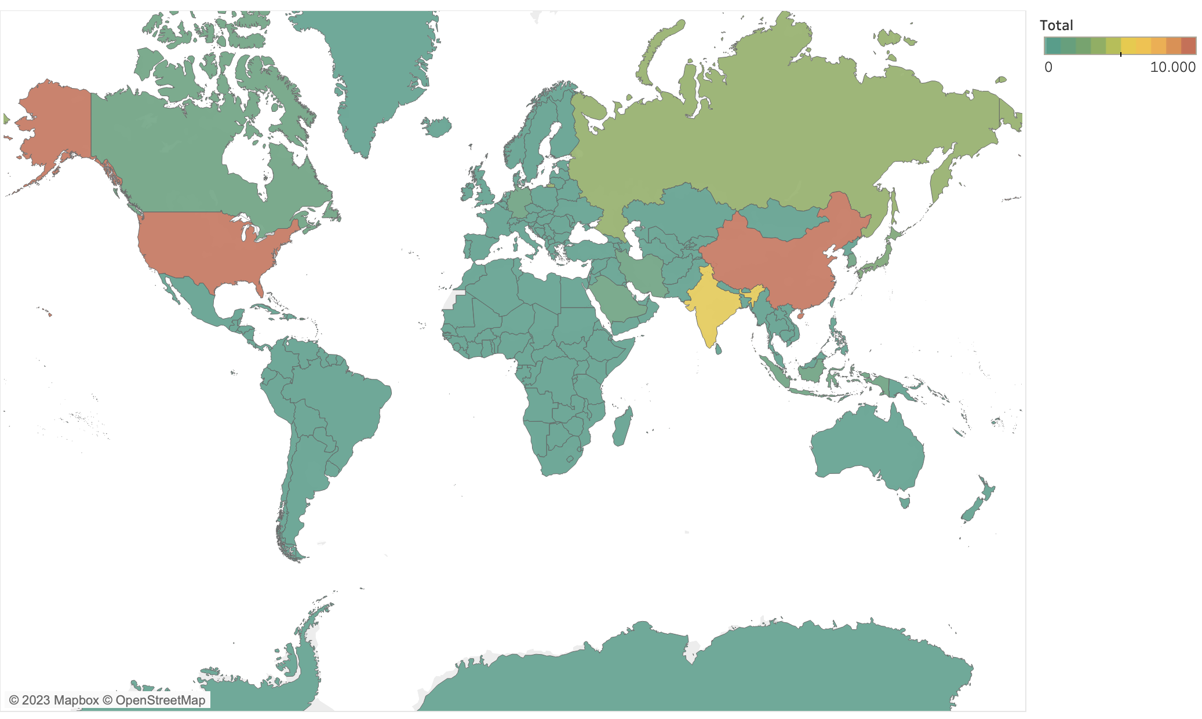
Carbon emissions: a global heatmap
Notes:
Show countries emissions for the main ones

Slide 5
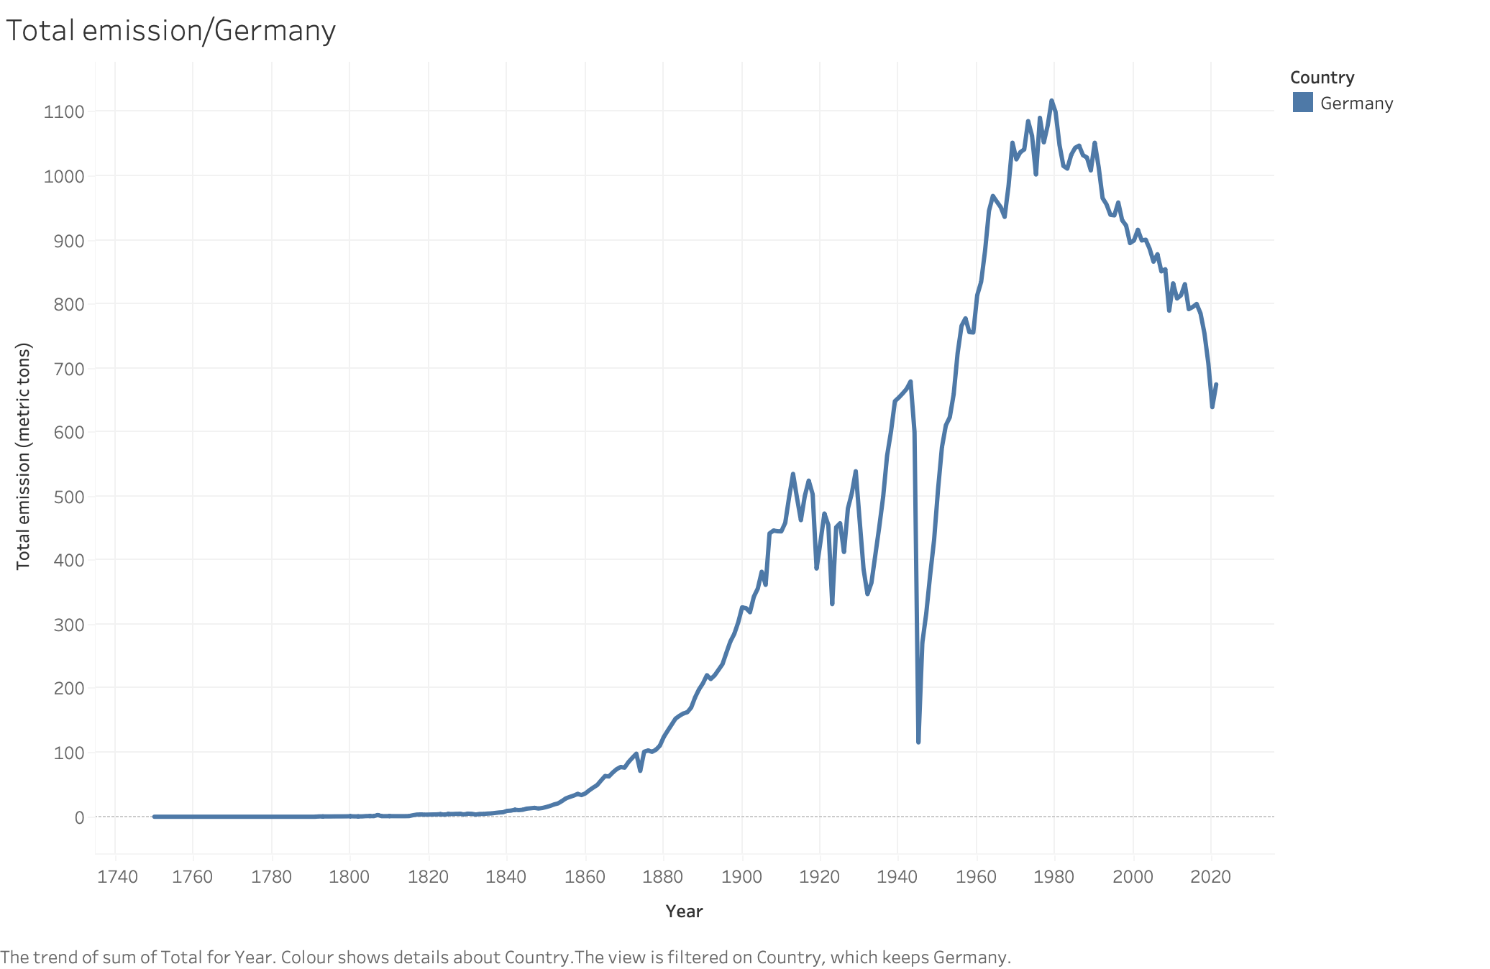
Carbon emissions for Germany

Slide 6
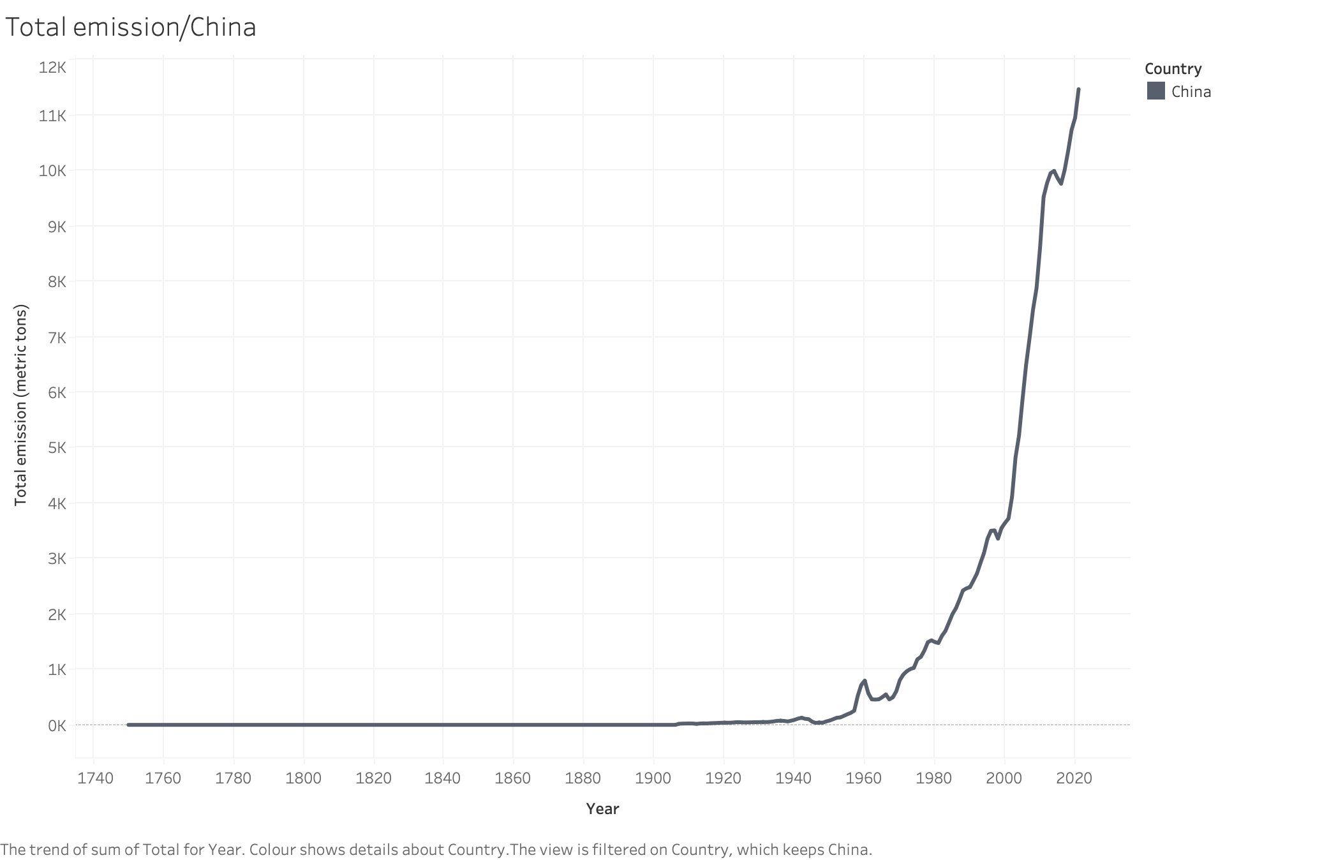
Carbon emissions for China

Slide 7
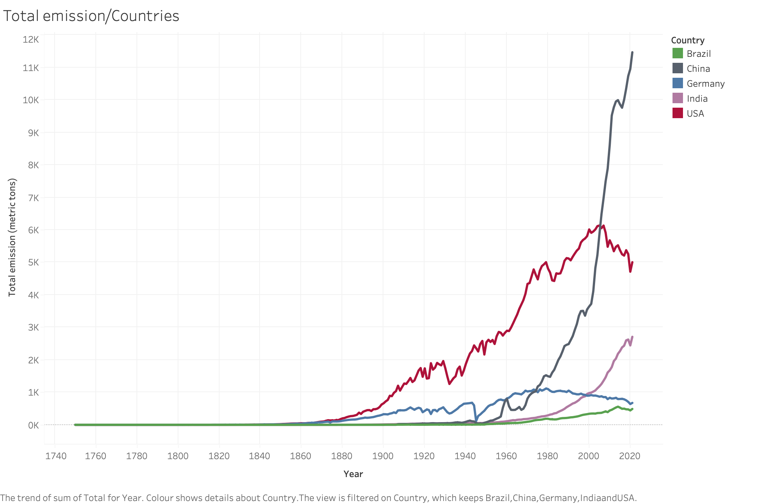
Carbon emissions:
A comparison

Slide 8
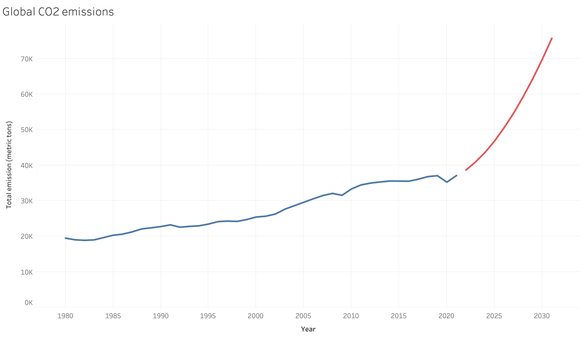

Slide 9
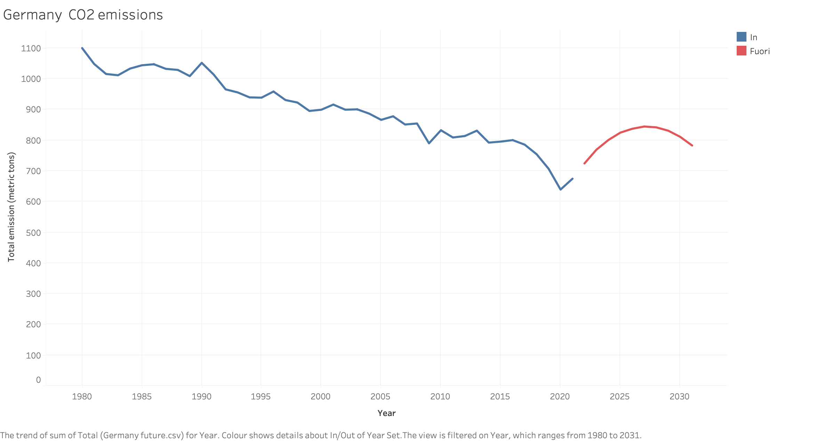

Slide 10
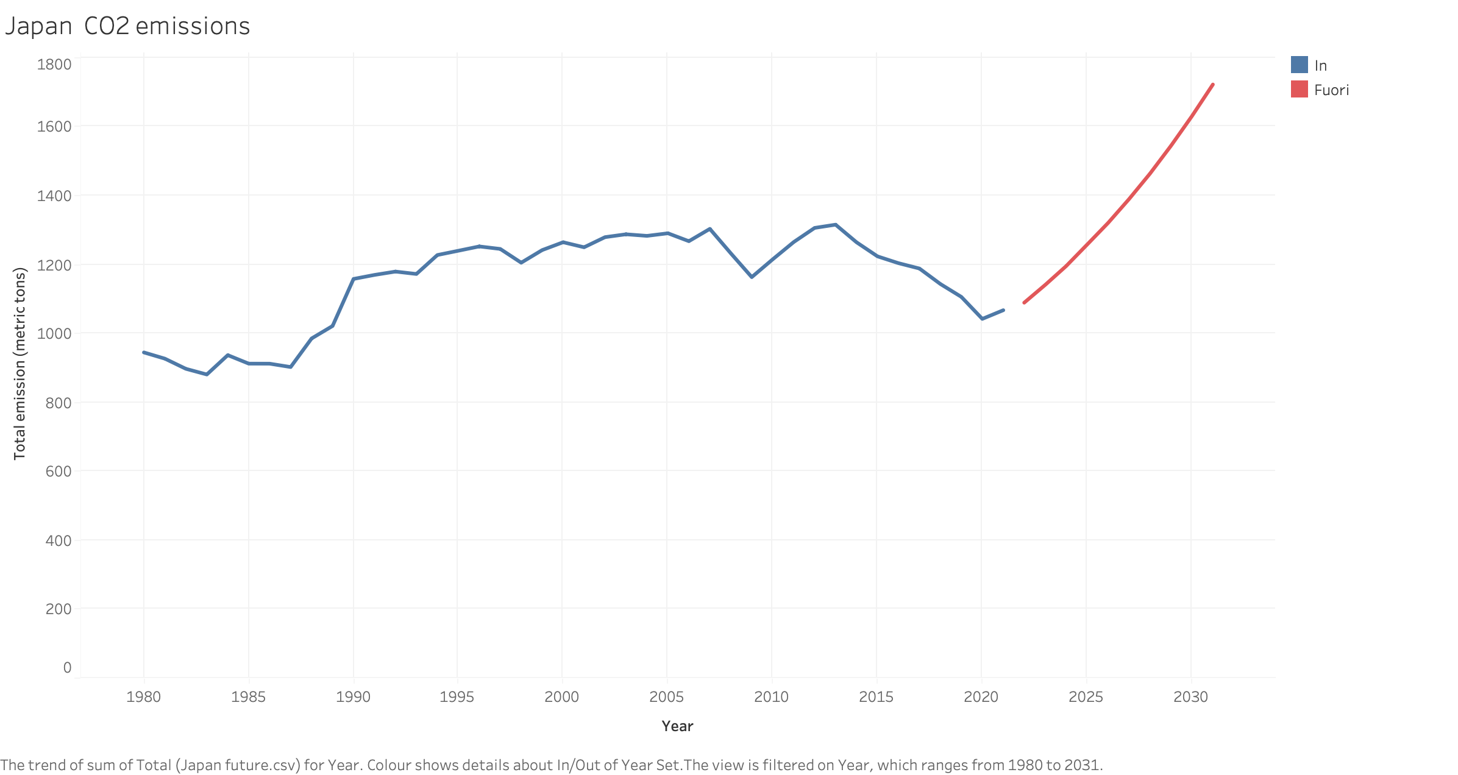

Slide 11
