Slide 1

Predict the future of our world
A ML-based time series forecasting for carbon emissions

Slide 2
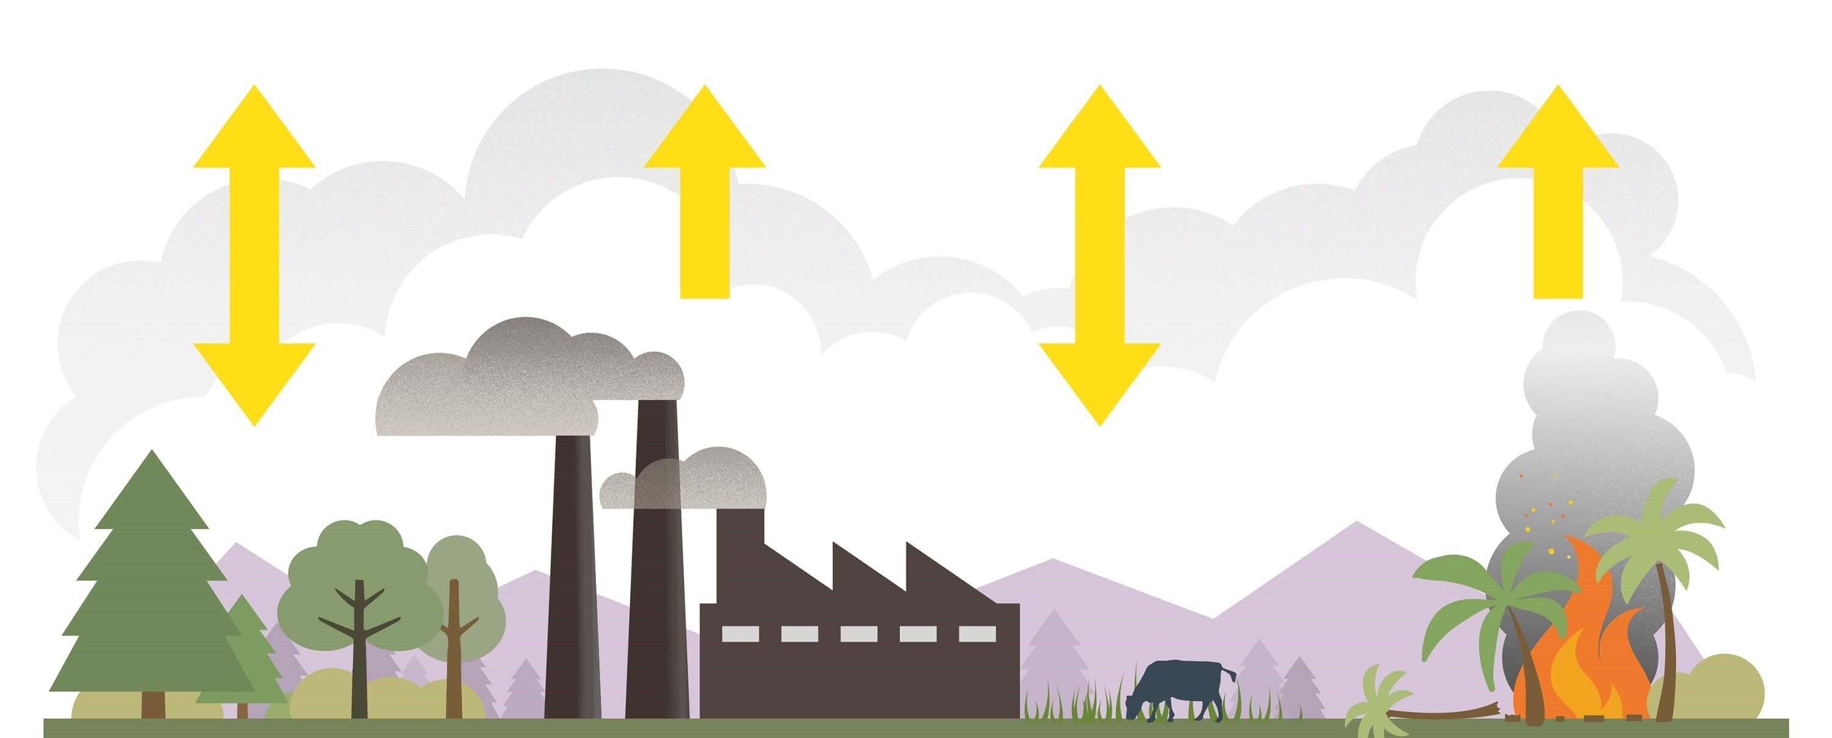
Carbon emissions
CO2 and CO in the atmosphere, produced by vehicles and industrial processes
measured in metric tons

Slide 3
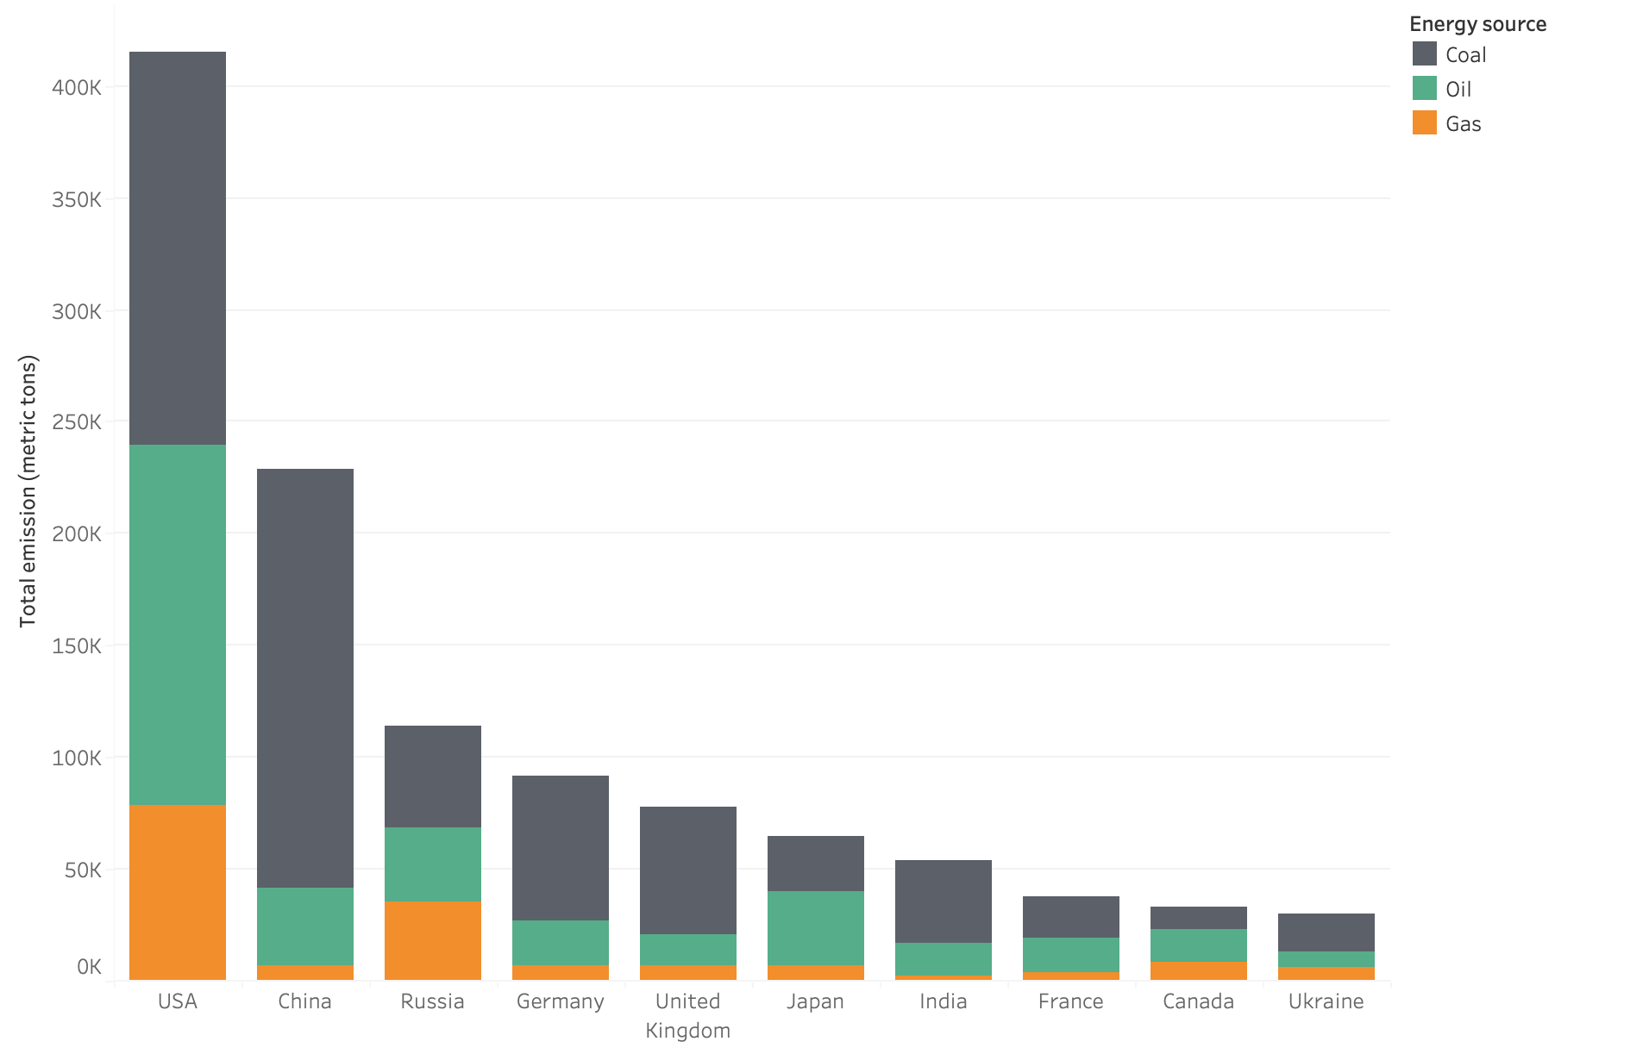
Contributors to global carbon emissions

Slide 4
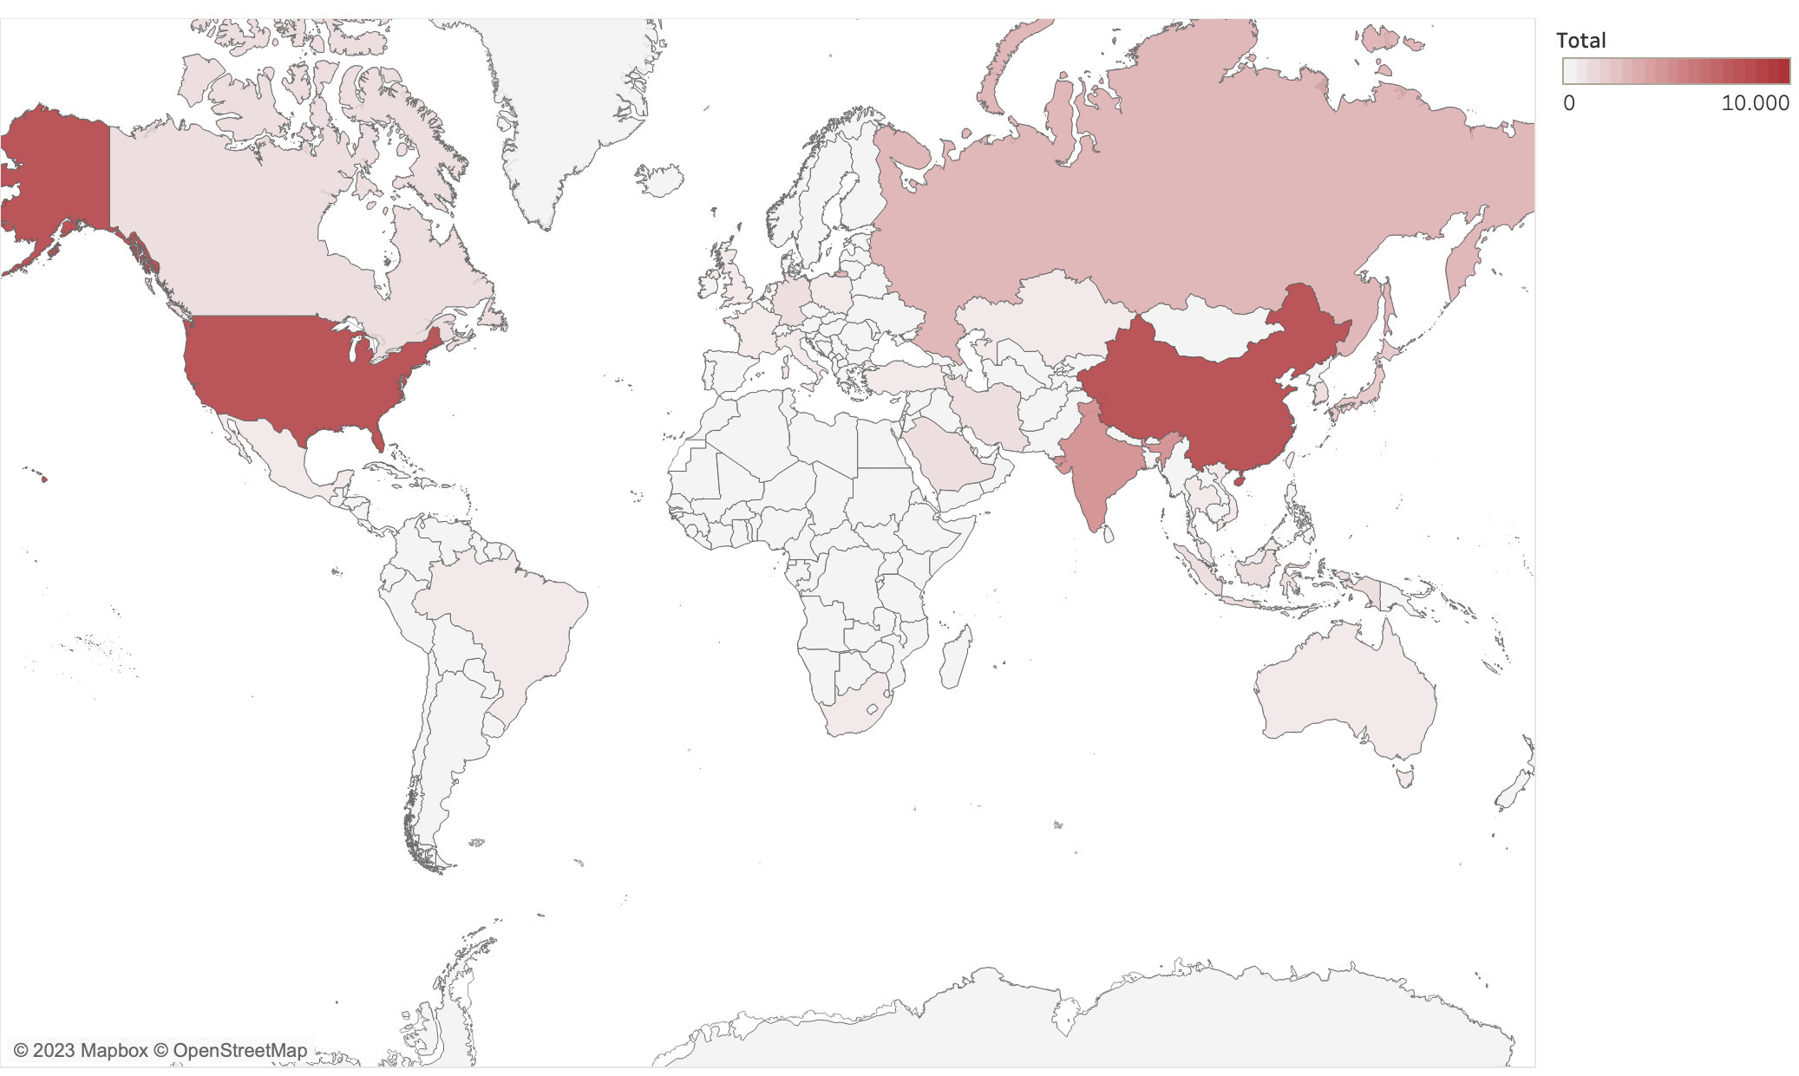
Carbon emissions: a global heatmap
Notes:
Show countries emissions for the main ones

Slide 5
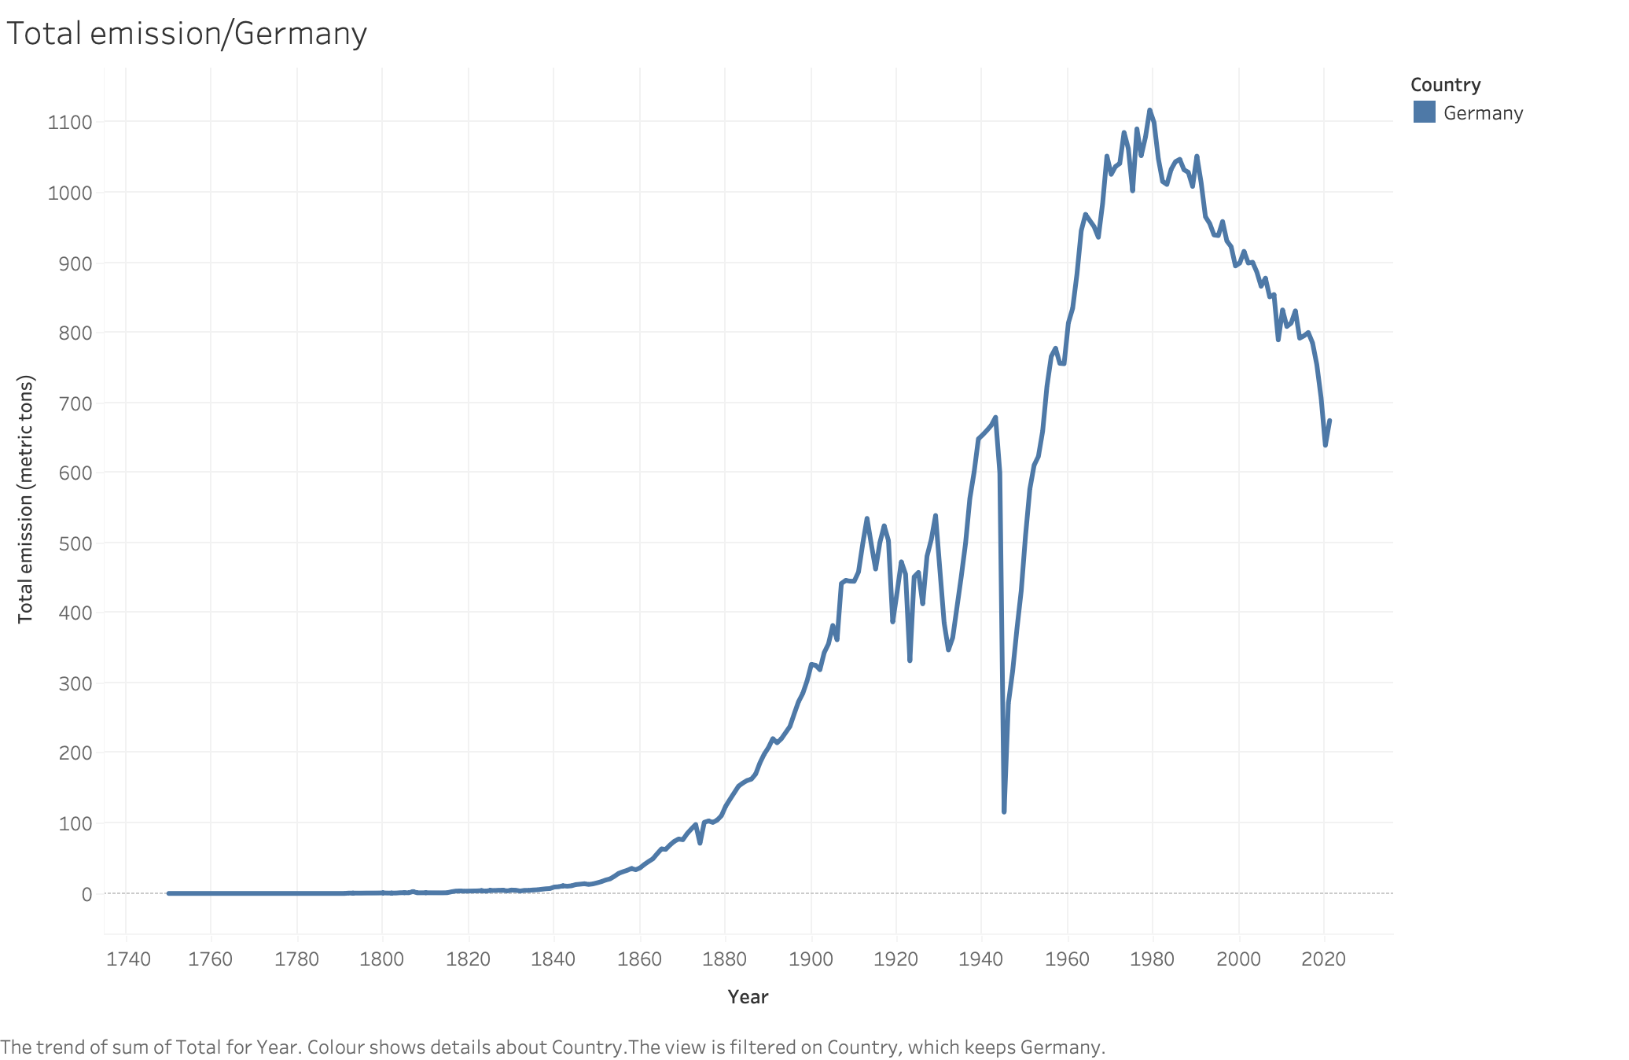
Carbon emissions for Germany

Slide 6
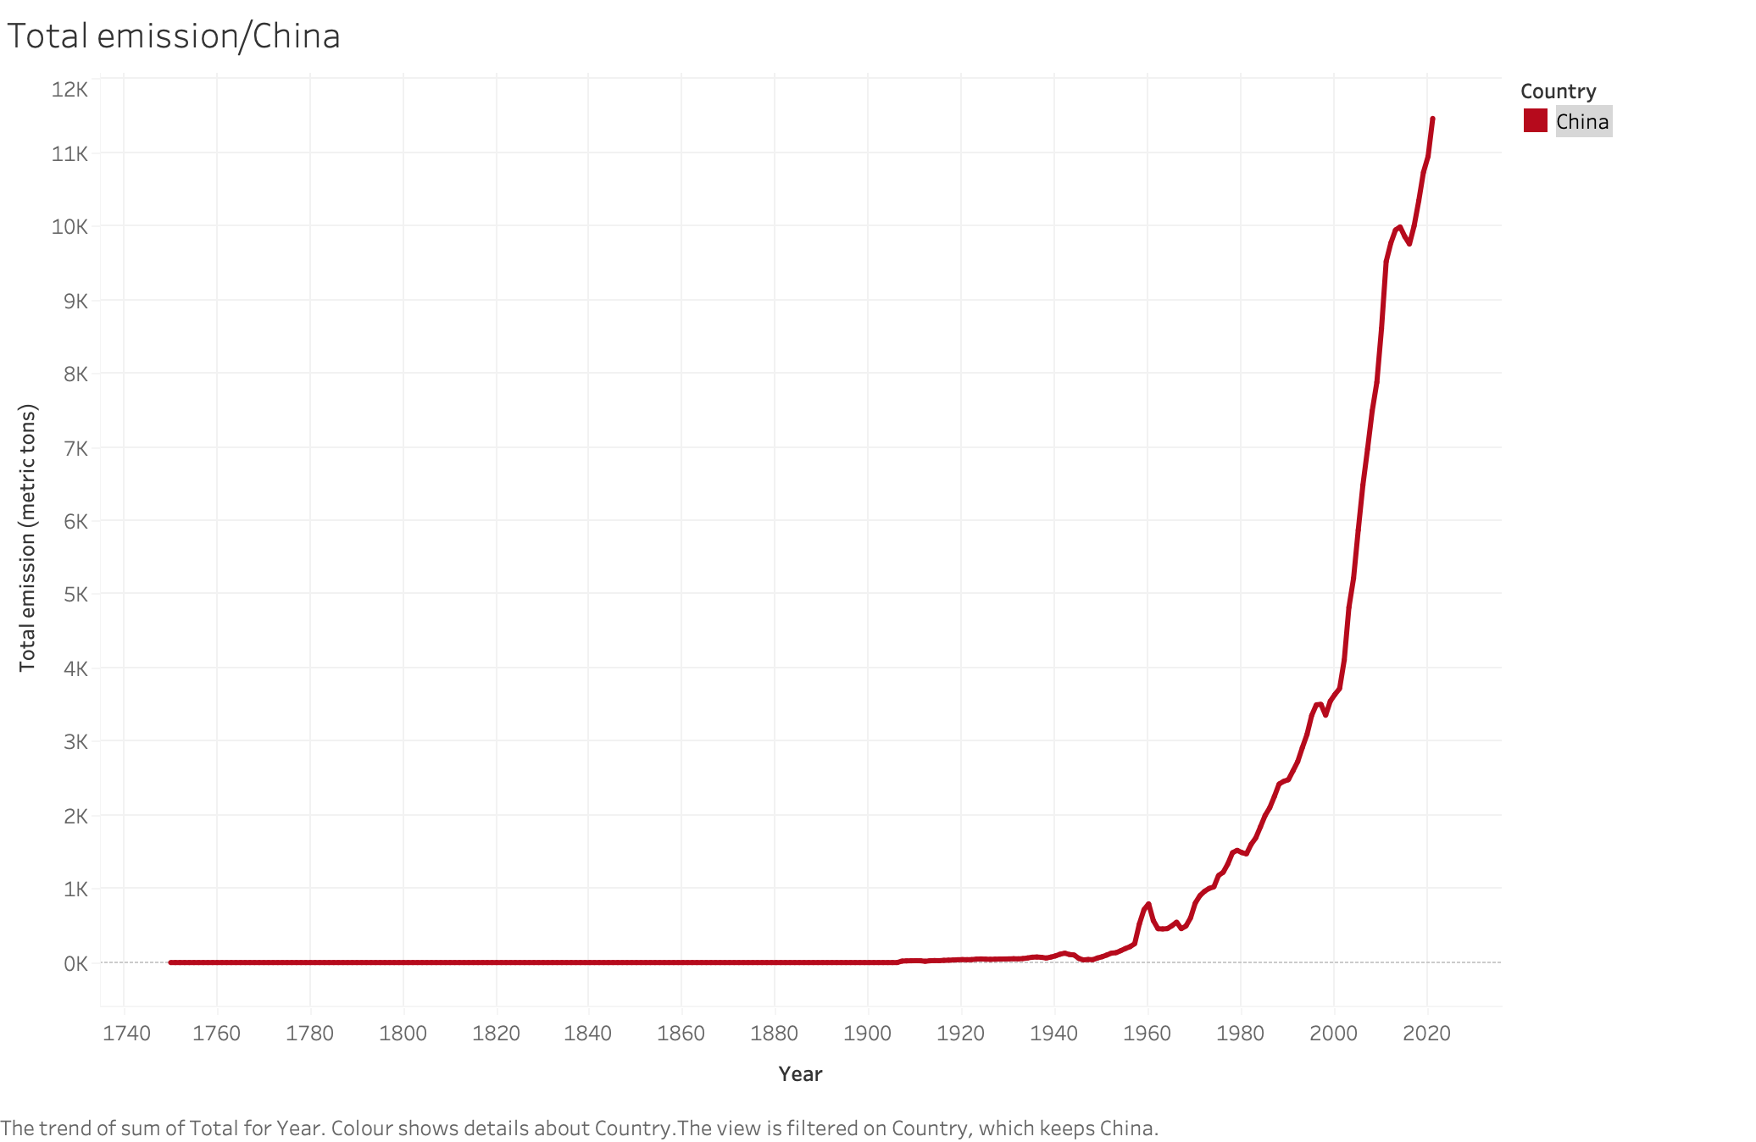
Carbon emissions for China

Slide 7
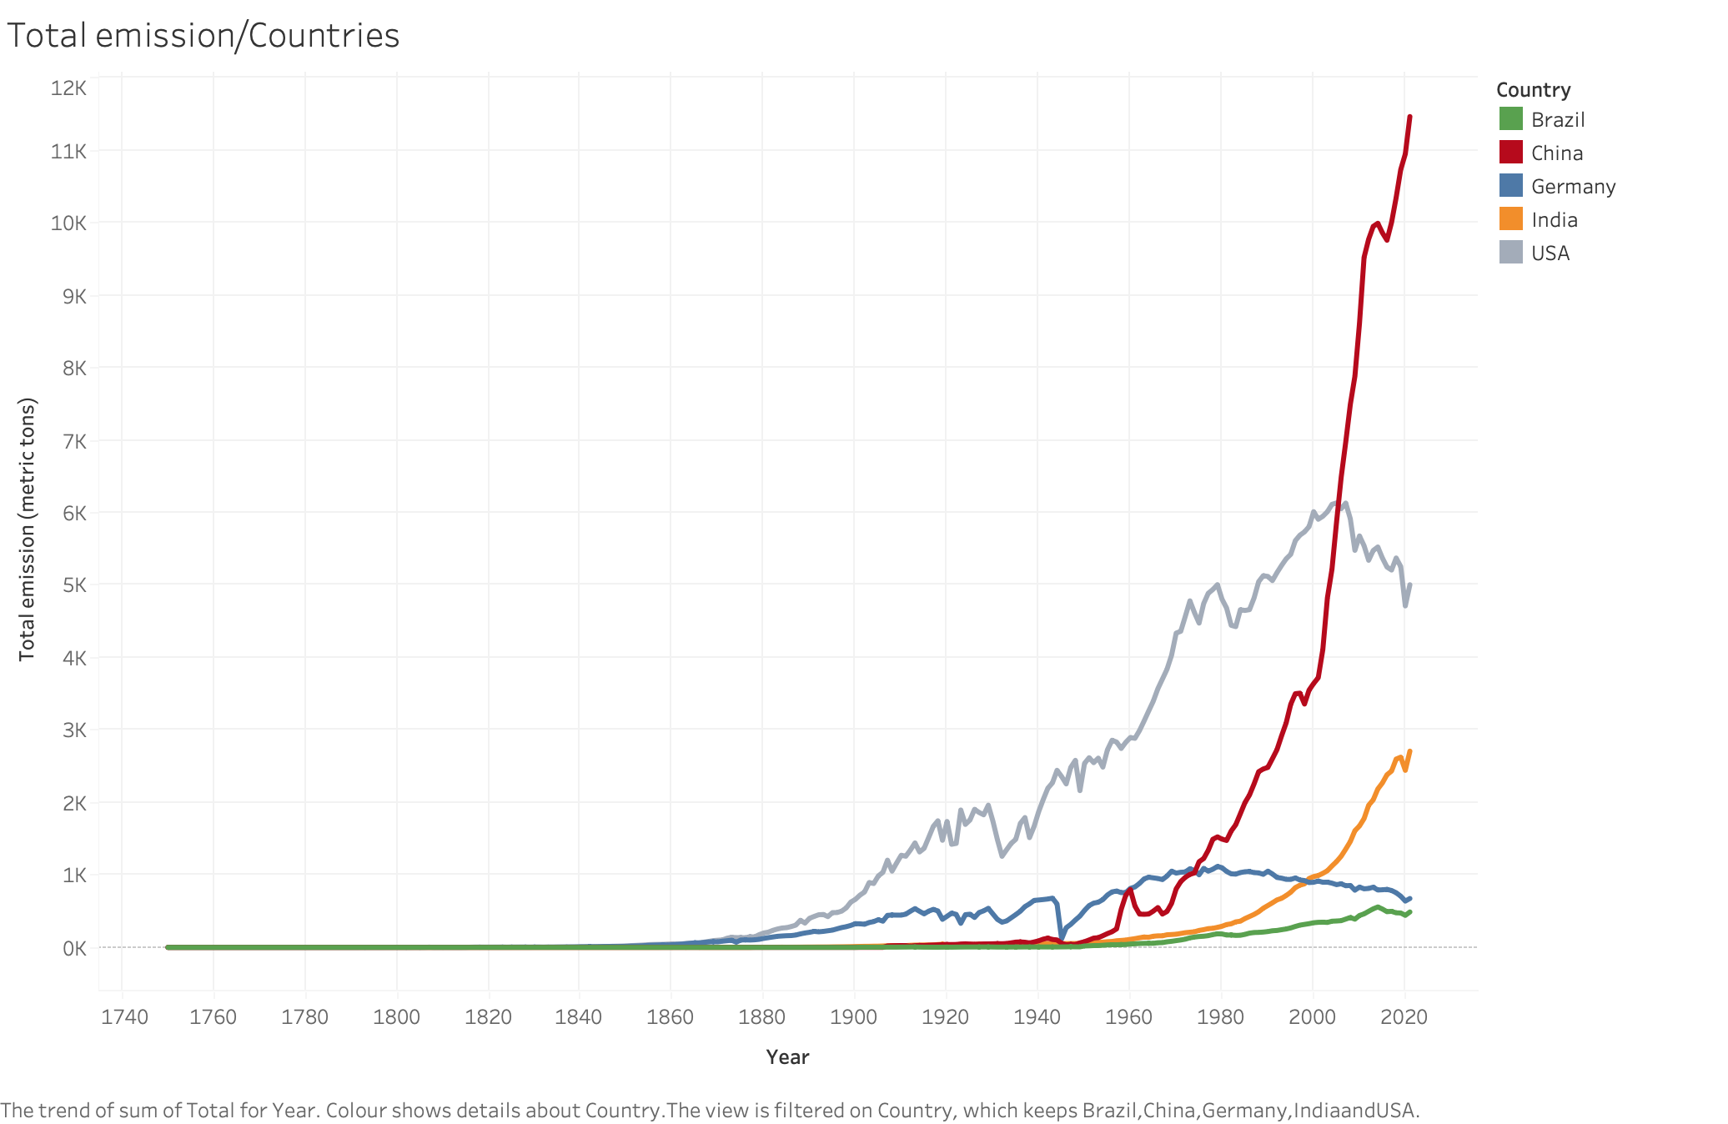
Carbon emissions:
A comparison

Slide 8
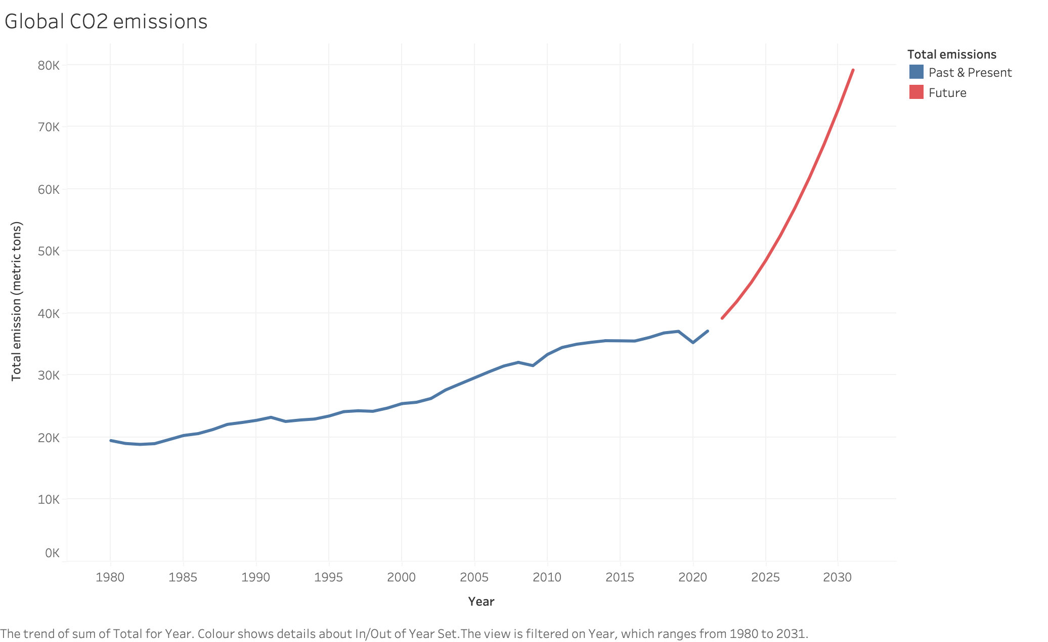
Global future trend forecasting
113 %

Slide 9
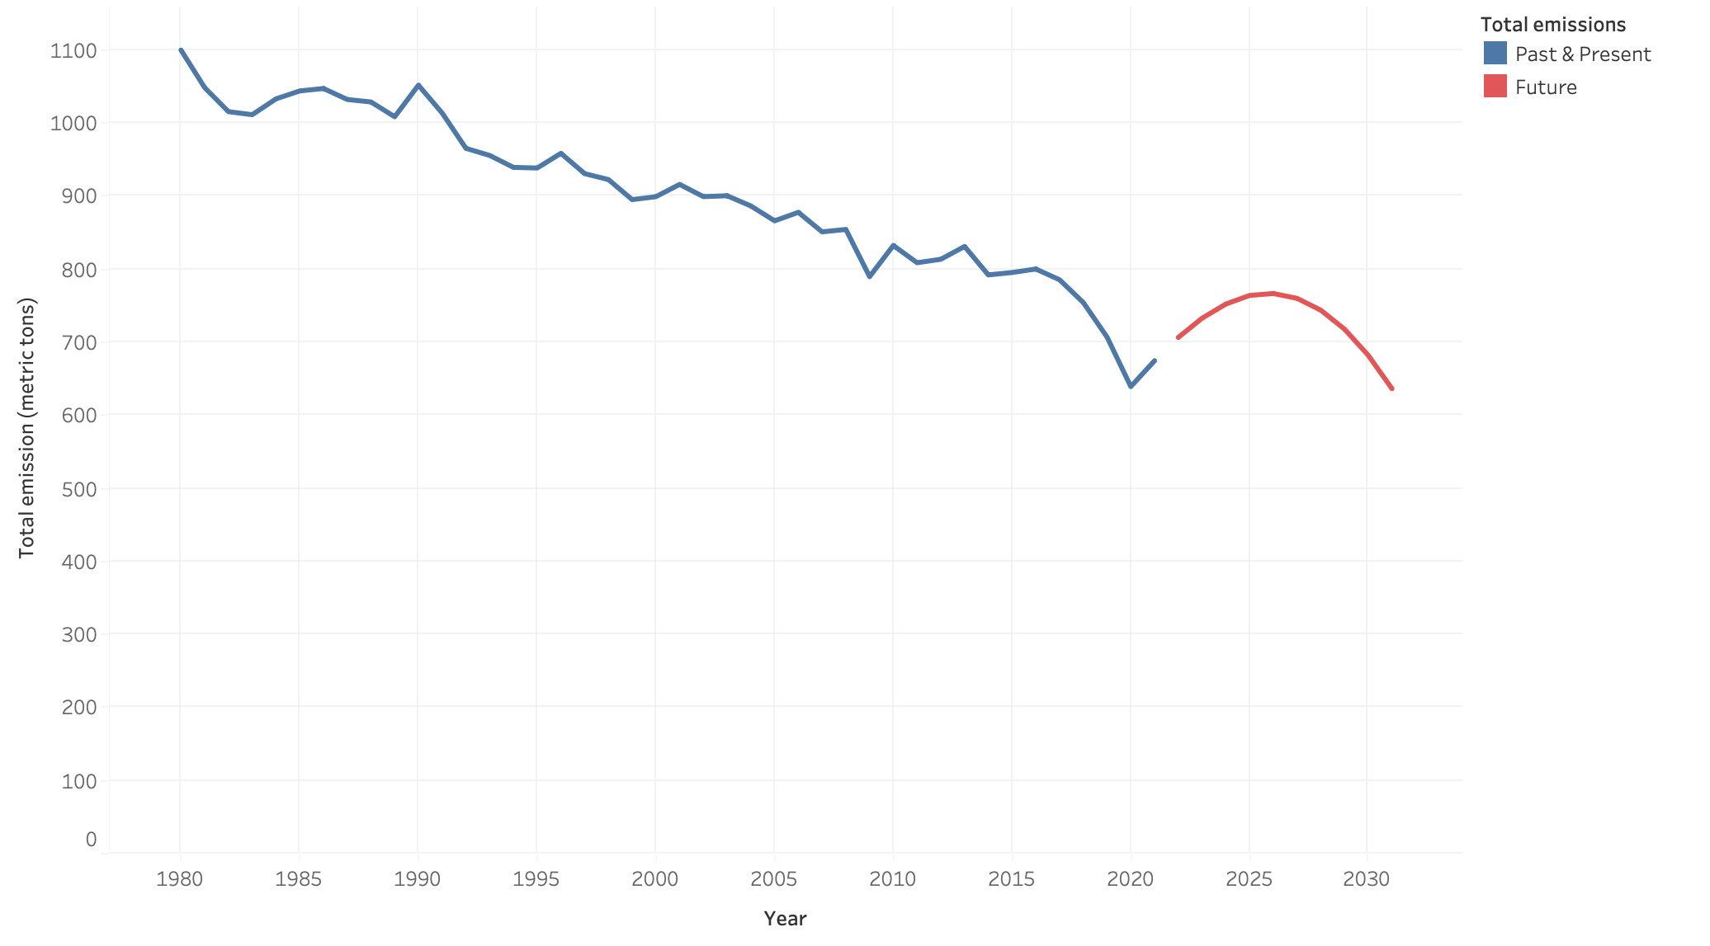
Germany future trend forecasting
6 %

Slide 10
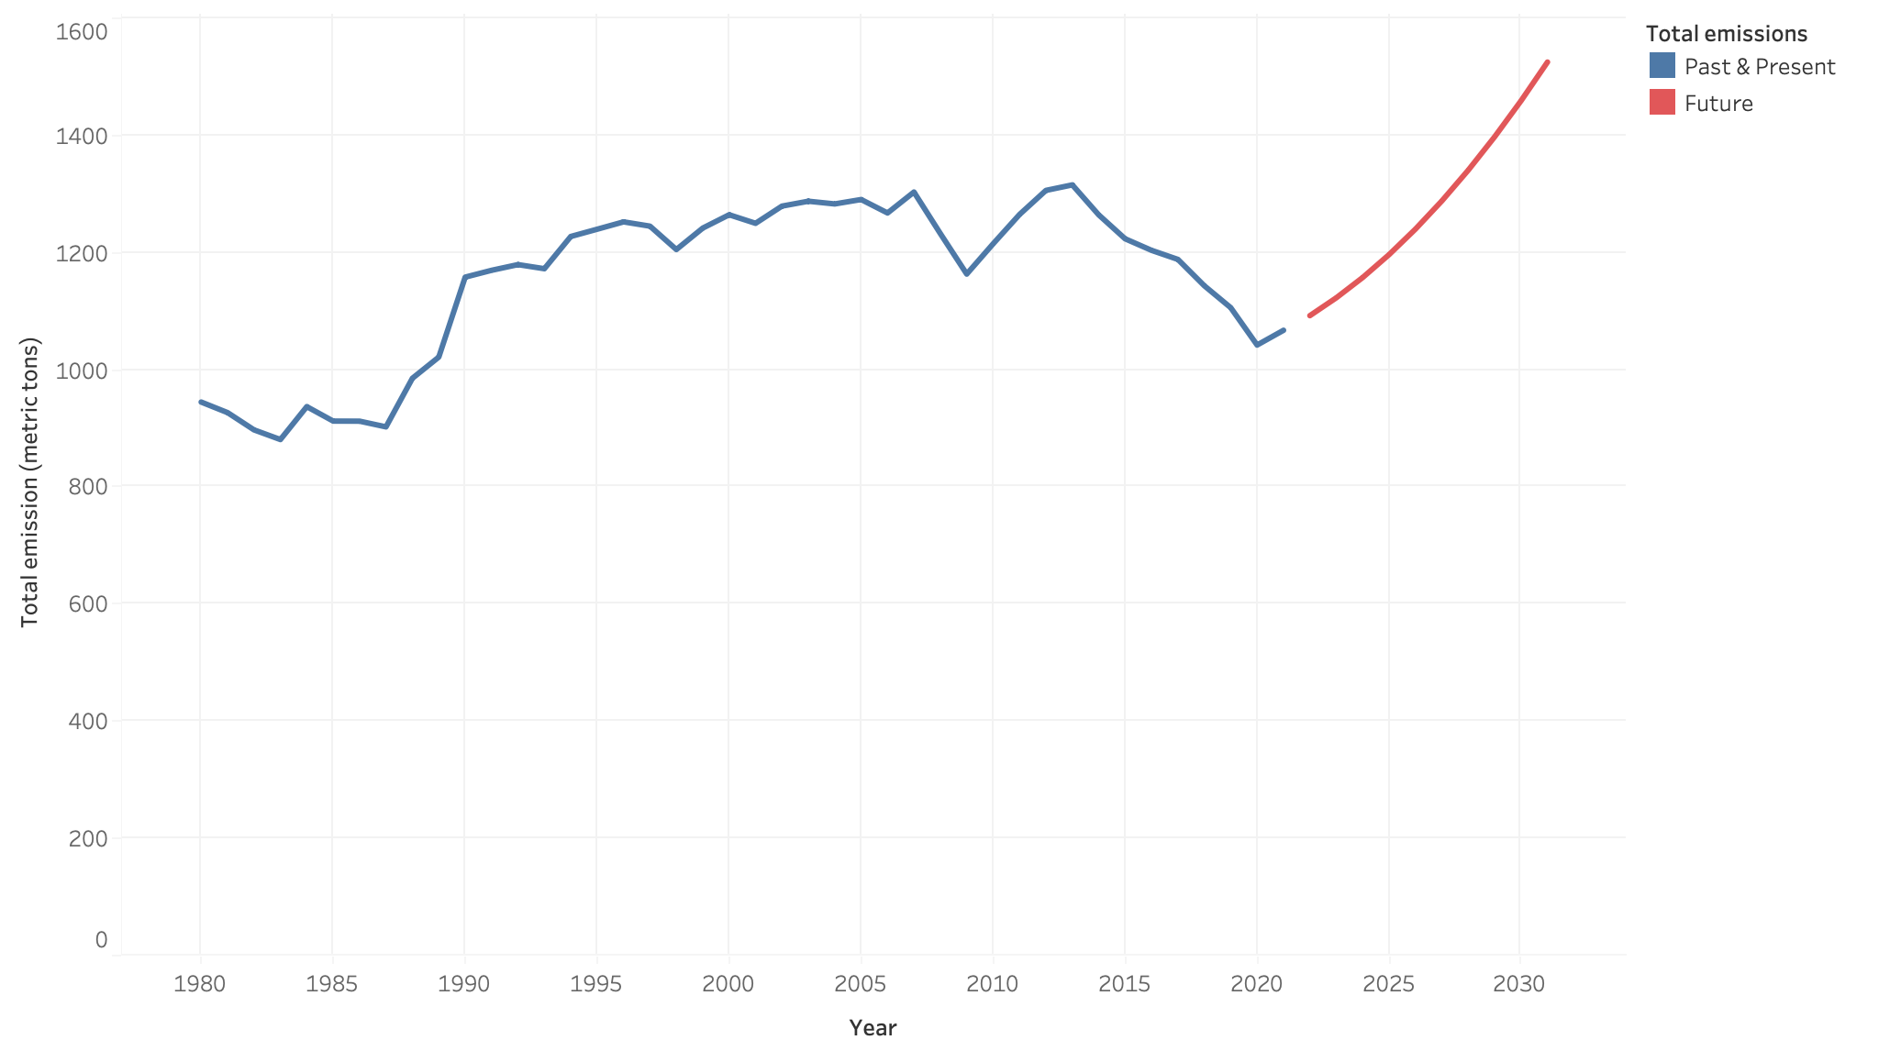
Japan future trend forecasting
43 %

Slide 11
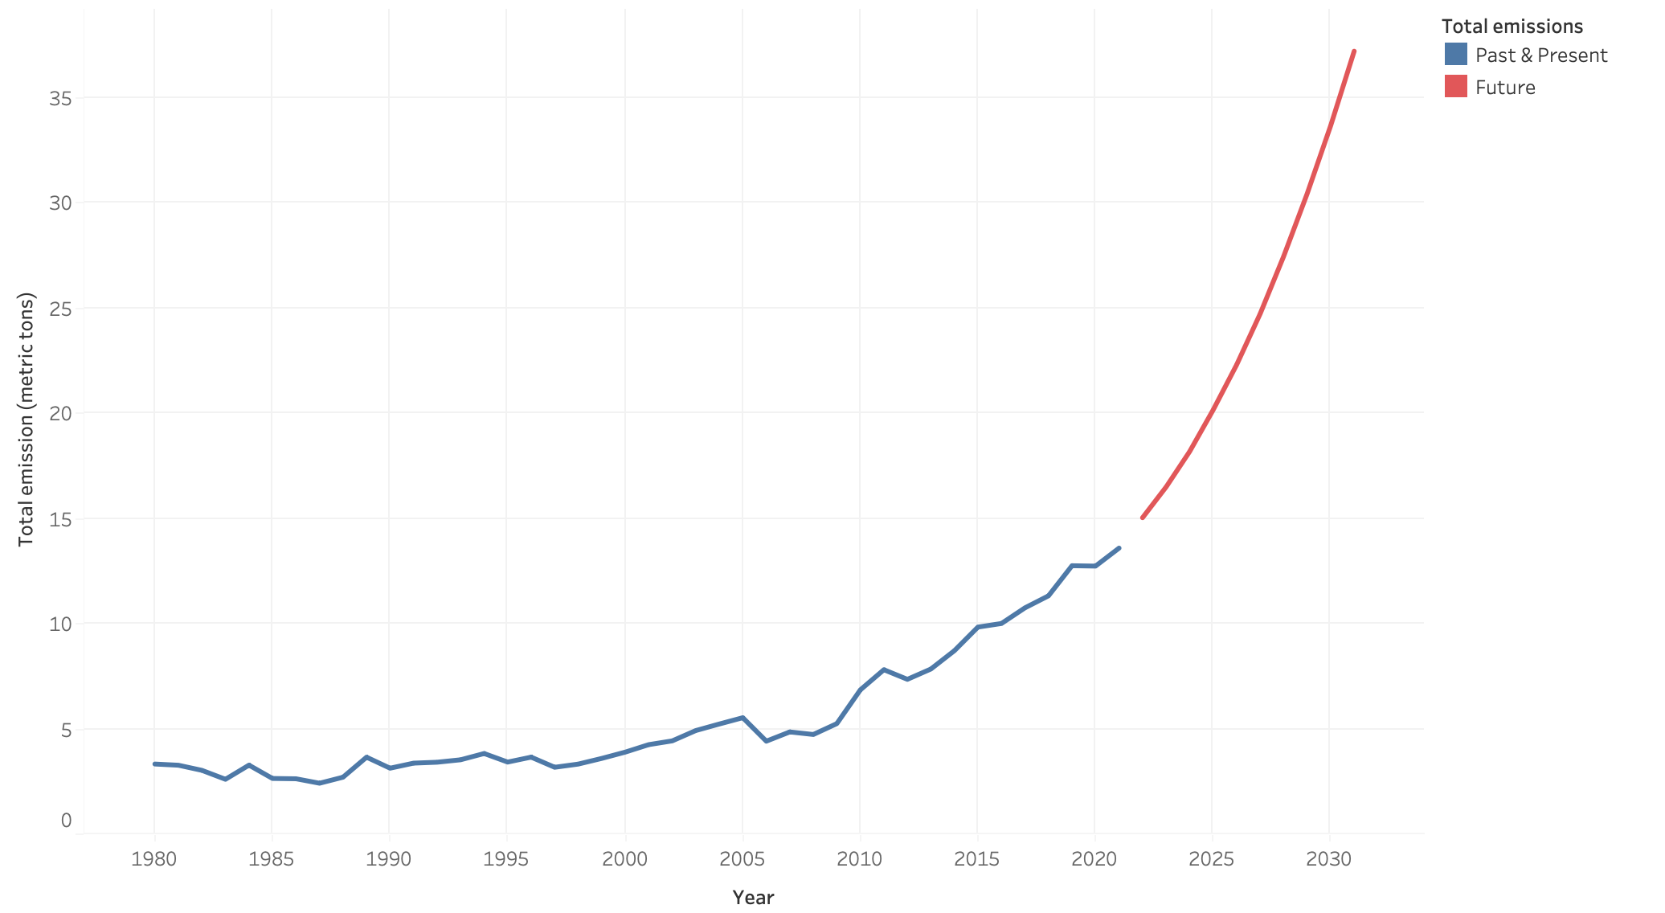
Senegal future trend forecasting
174 %

Slide 12
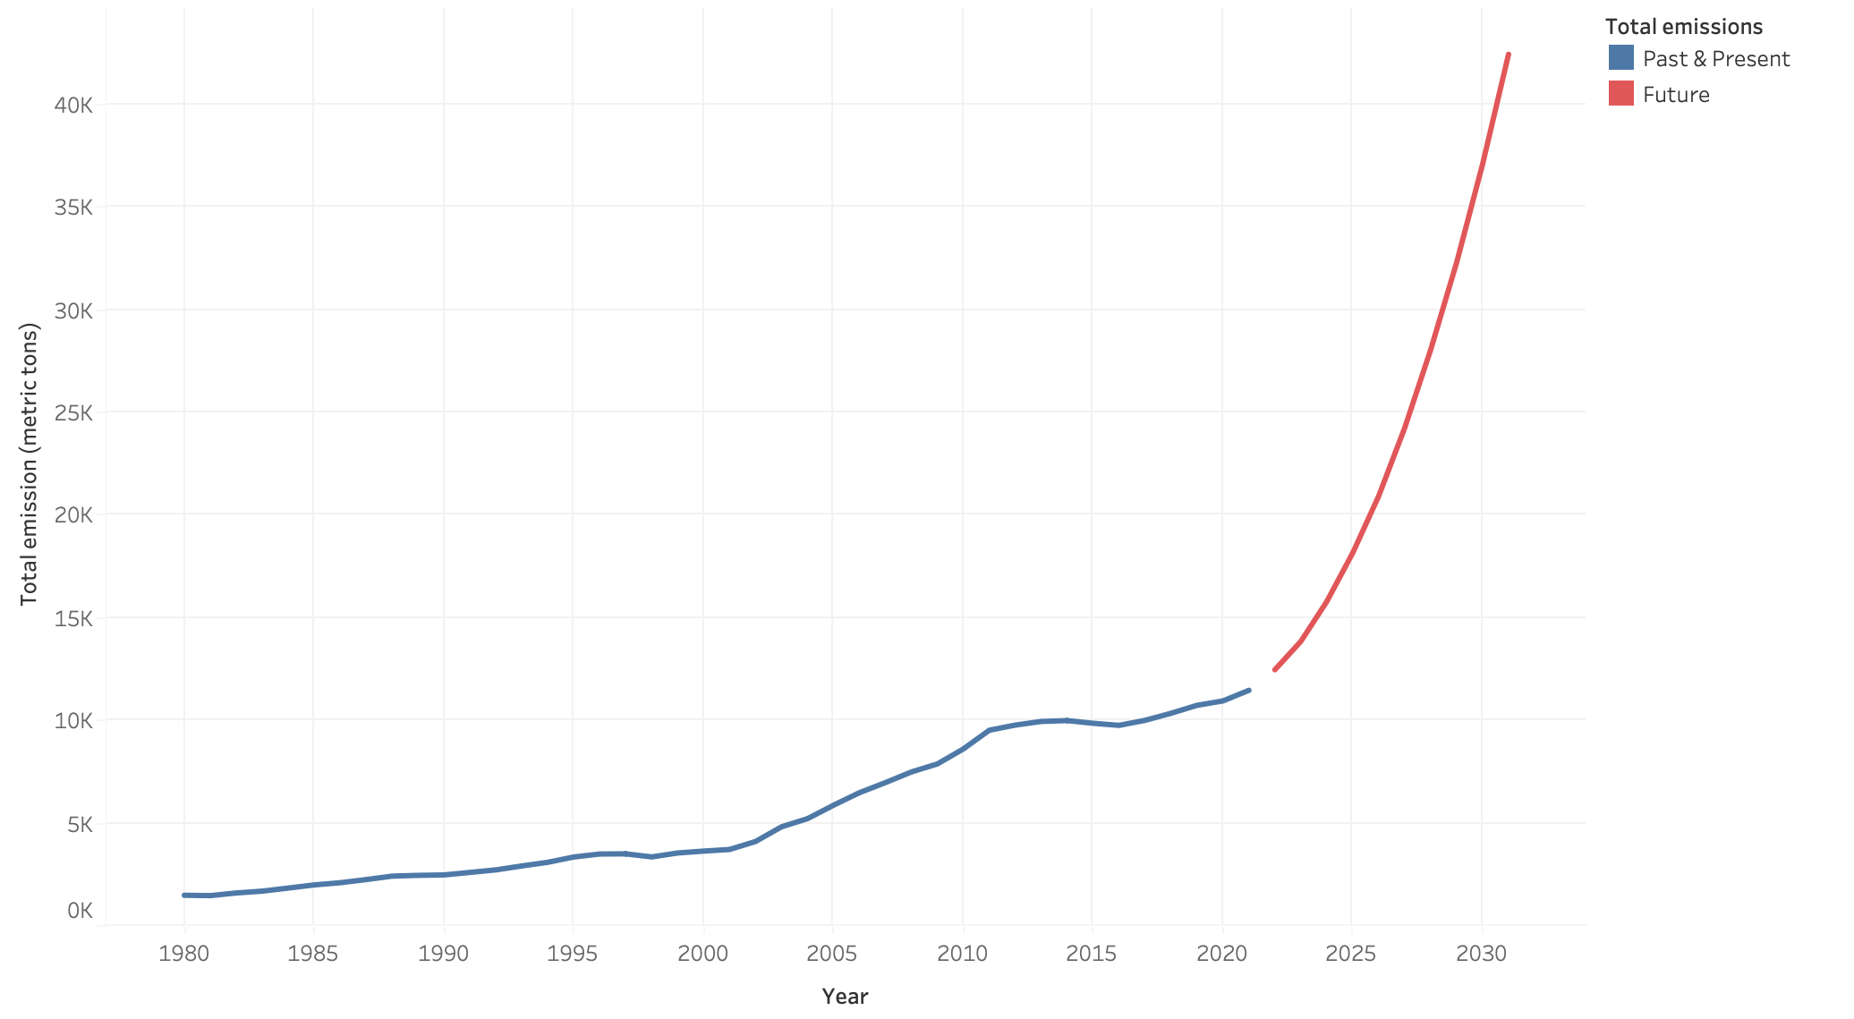
China future trend forecasting
267 %

Slide 13
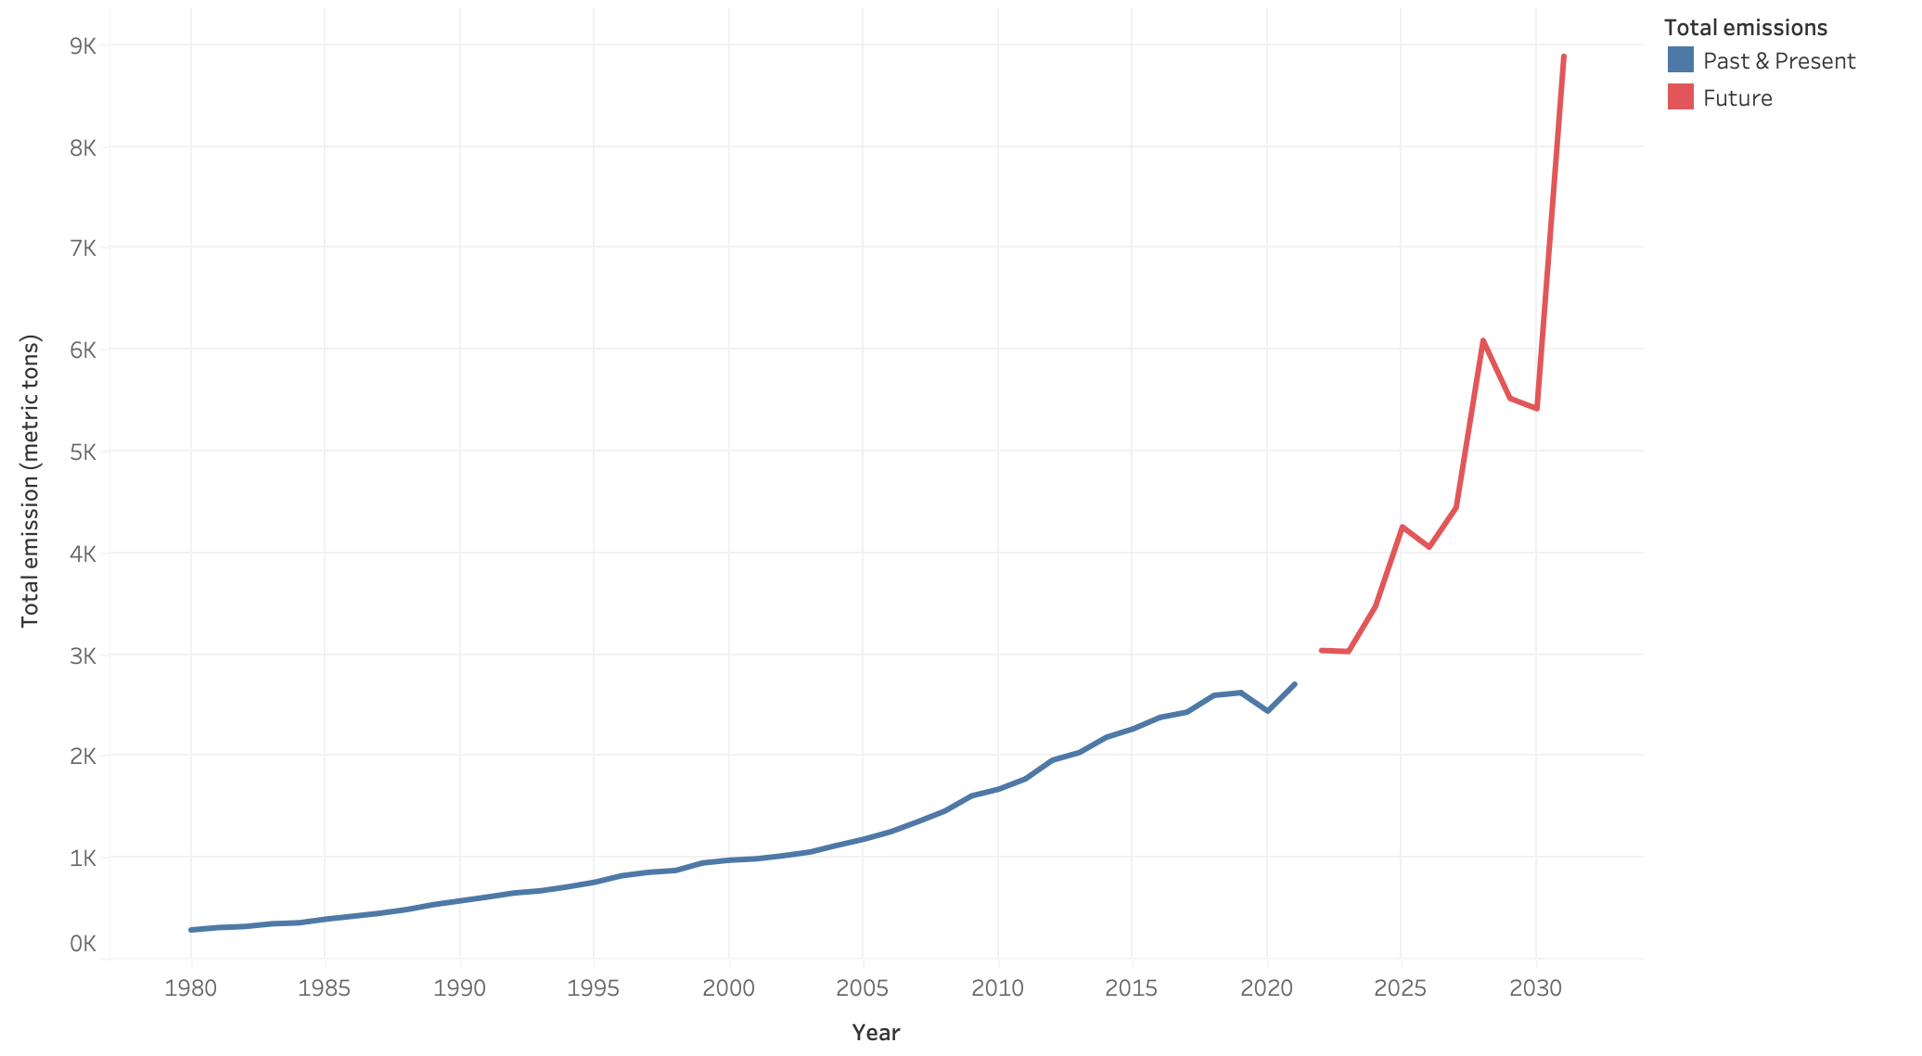
India future trend forecasting
228 %

Slide 14
(CLONCLUSIONS AND QUESTIONS)

