Slide 1
GlobalCO2Forecasting
File created on: 06/03/23 11:58:37 CET

Slide 2
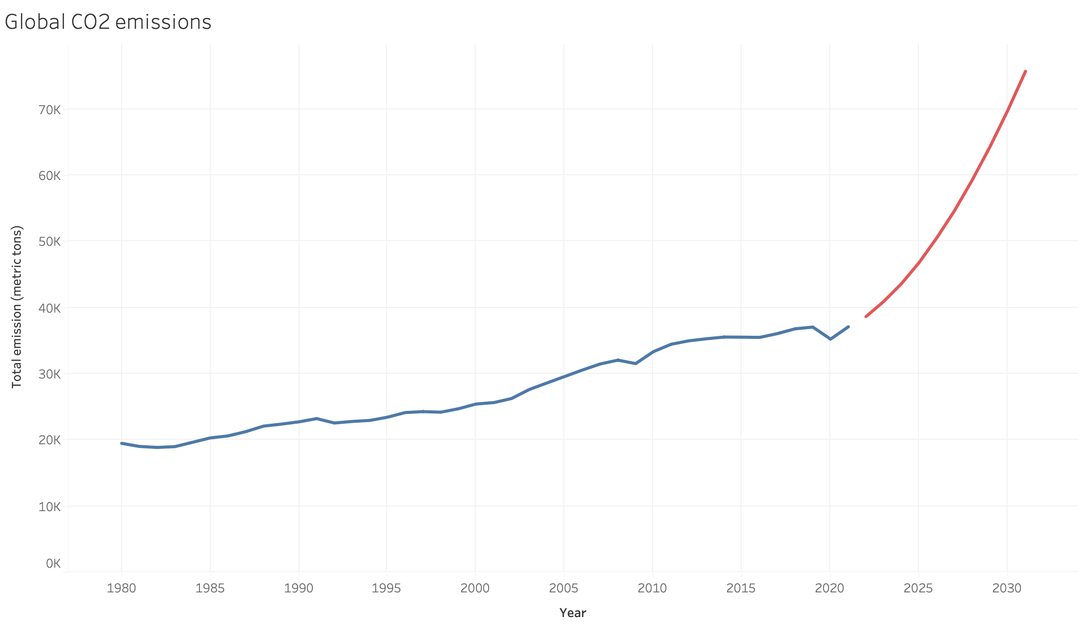

Slide 3
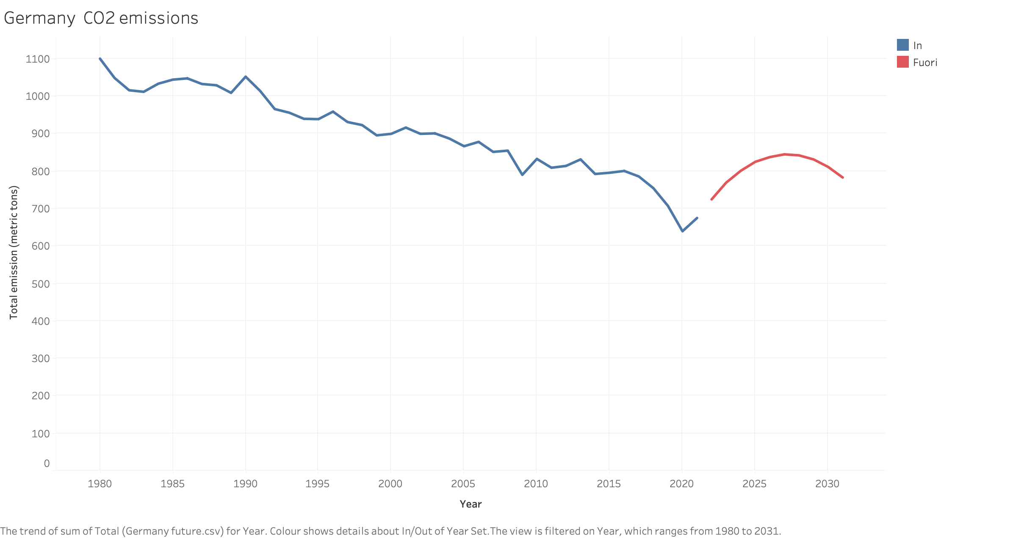

Slide 4
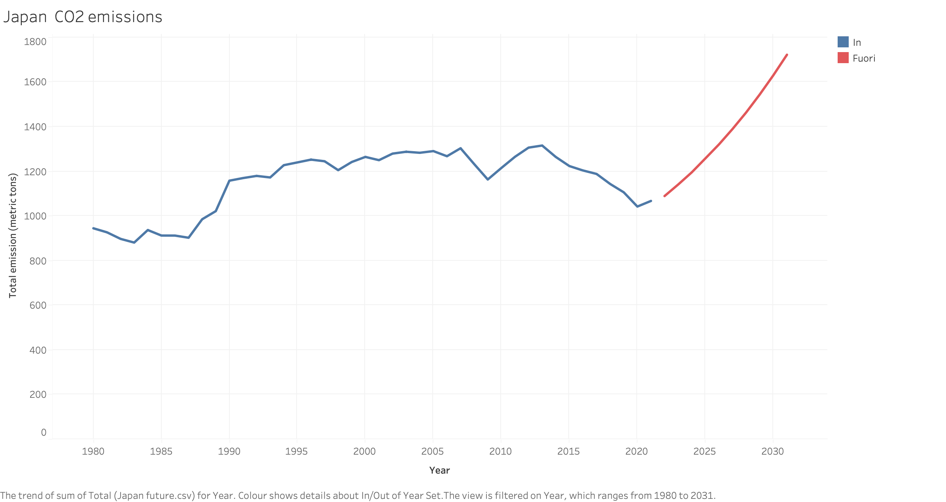

Slide 5
