Slide 1
GlobalCO2Forecasting
File created on: 07/03/23 15:48:11 CET

Slide 2
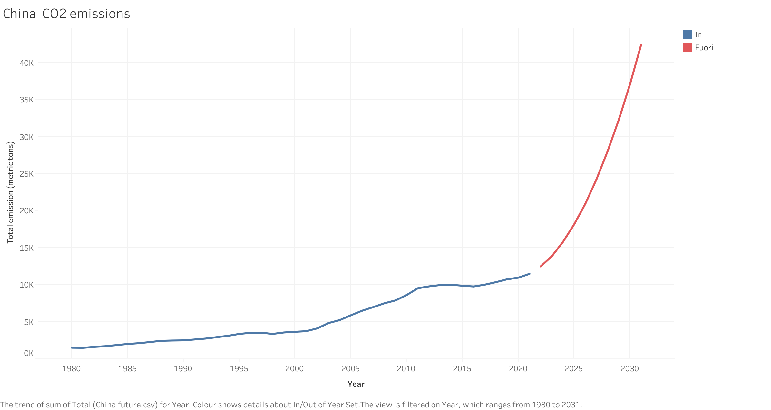

Slide 3
