Slide 1

Predict the future of our world
A ML-based time series forecasting for carbon emissions

Slide 2

Introduction
Carbon emissions?
- measured in metric tons

Slide 3
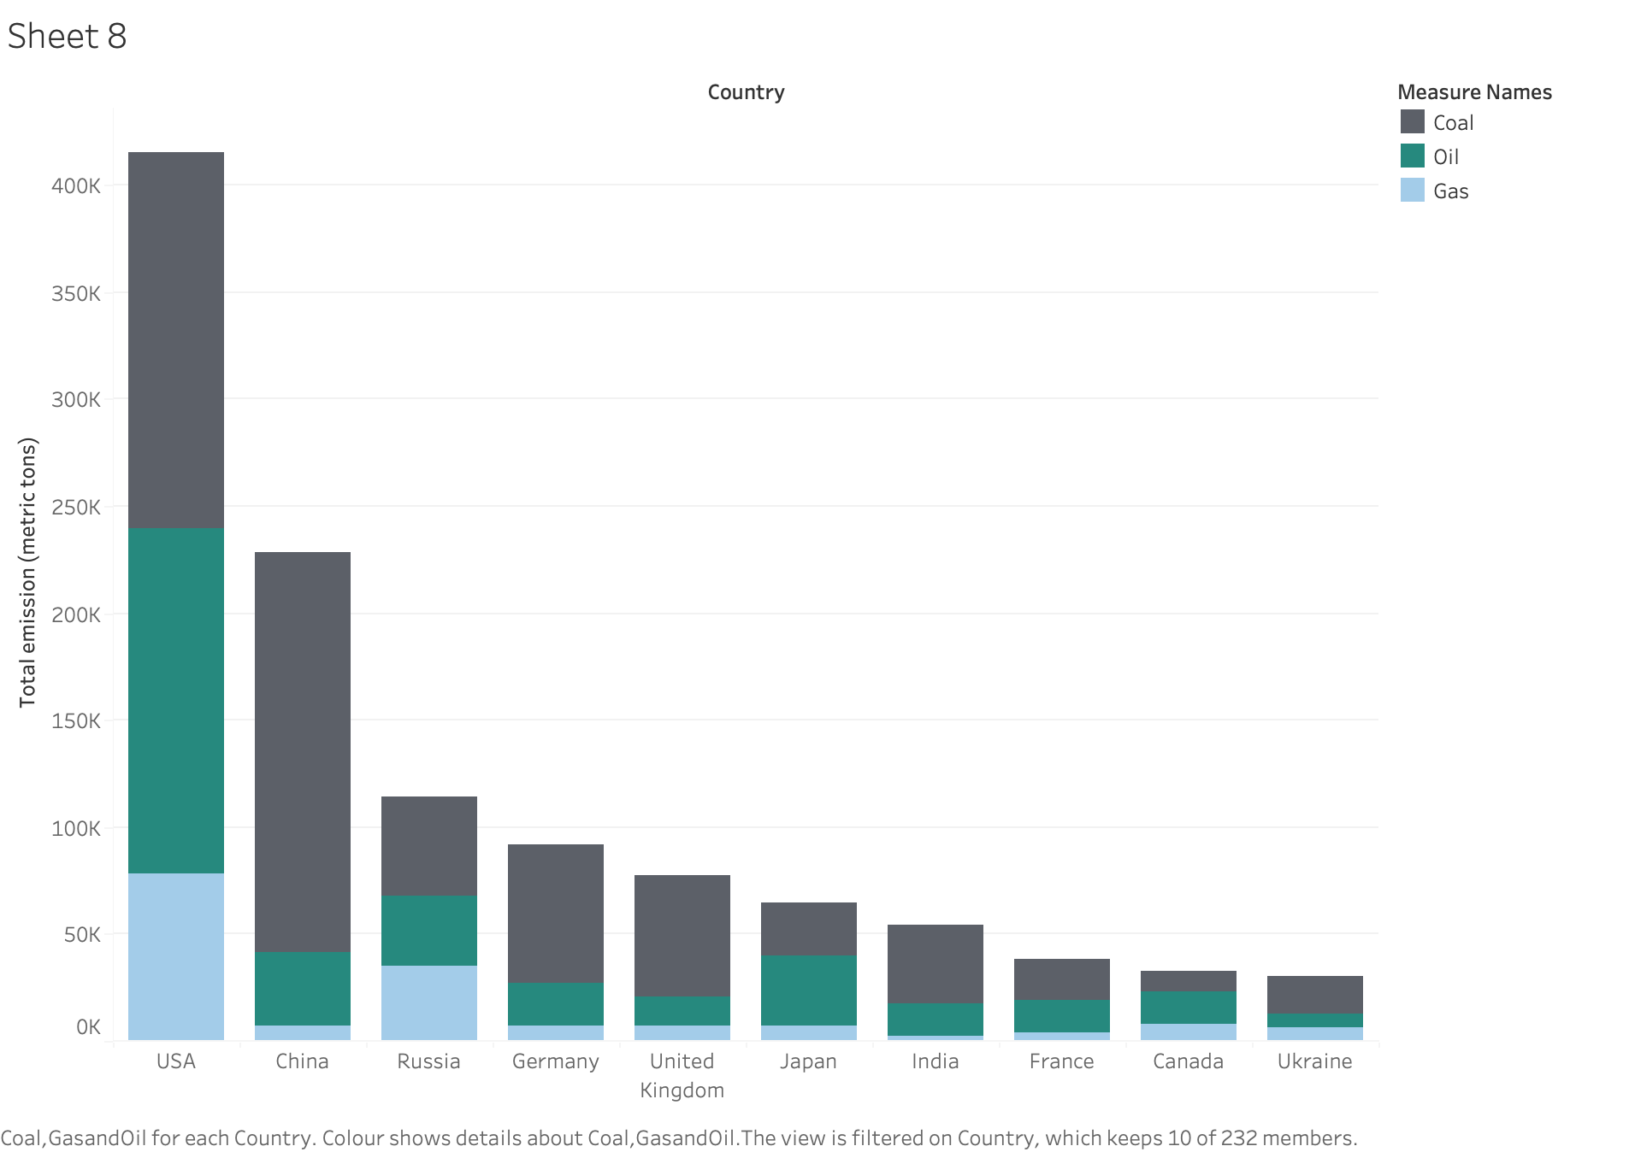
Contributors to global carbon emissions

Slide 4
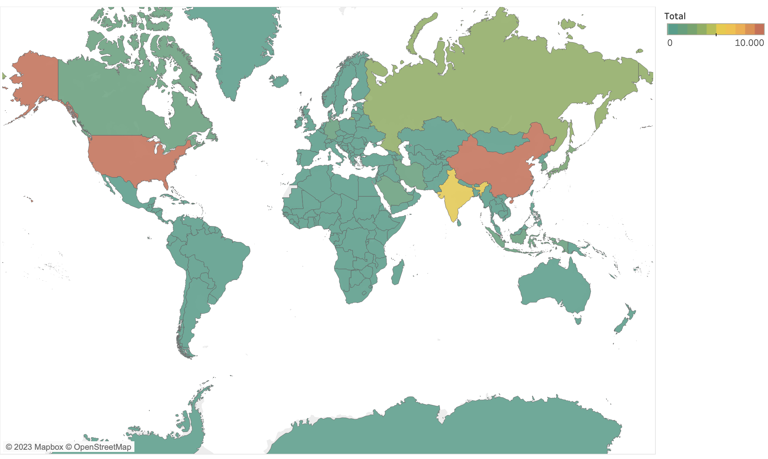
Carbon emissions: a global heatmap
Notes:
Show countries emissions for the main ones

Slide 5
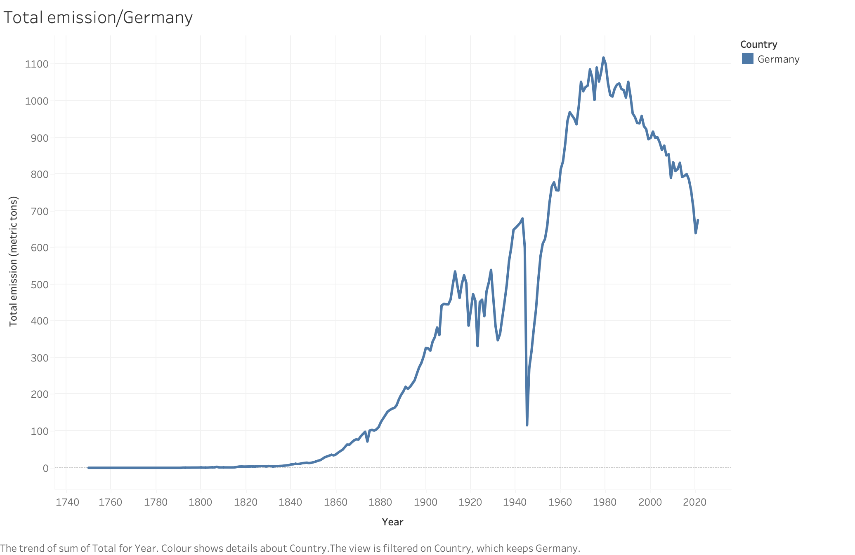
Carbon emissions for Germany

Slide 6
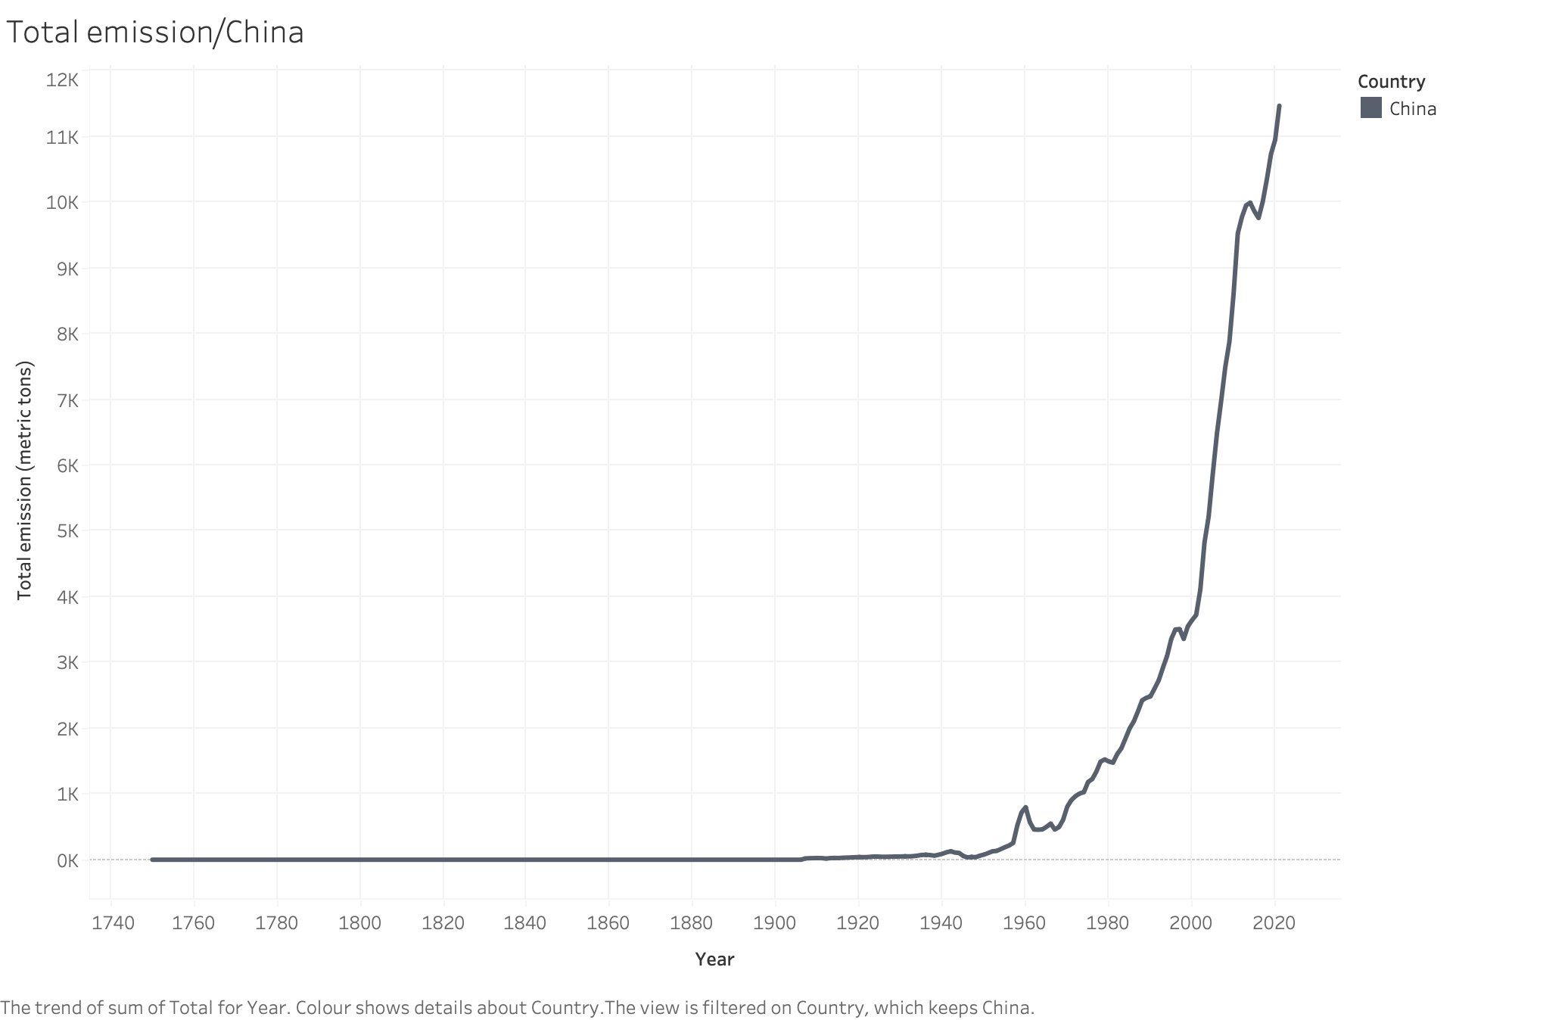
Carbon emissions for China

Slide 7
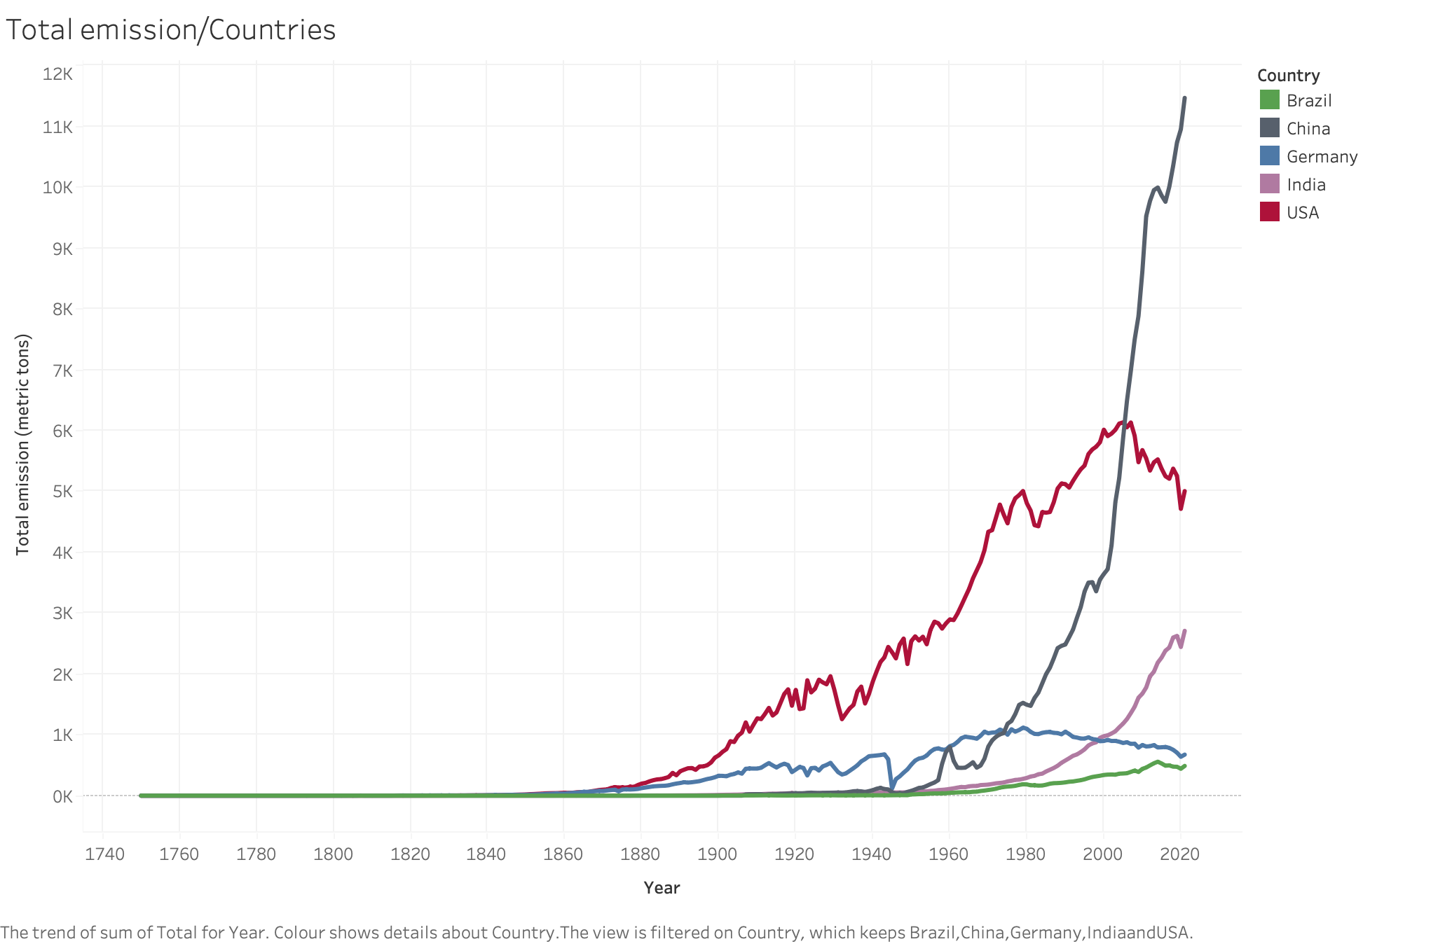
Carbon emissions:
A comparison

Slide 8
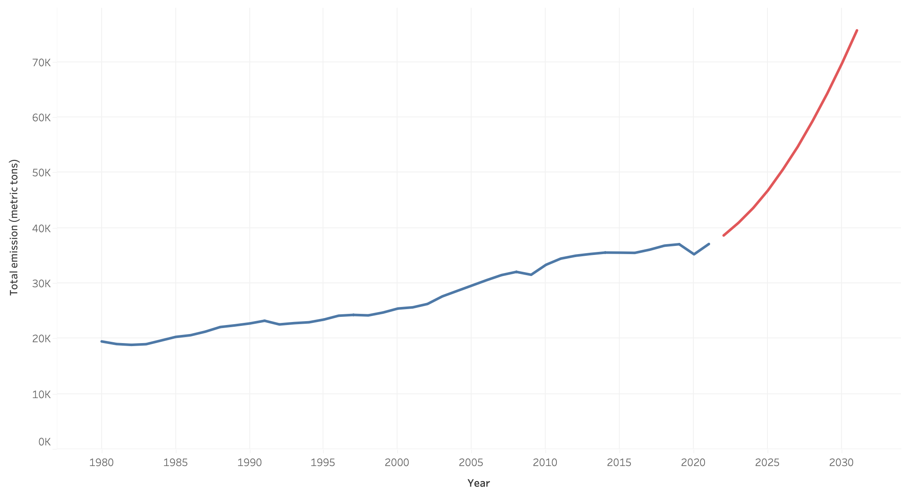
Global trend
Prediction, baby, prediction!

Slide 9
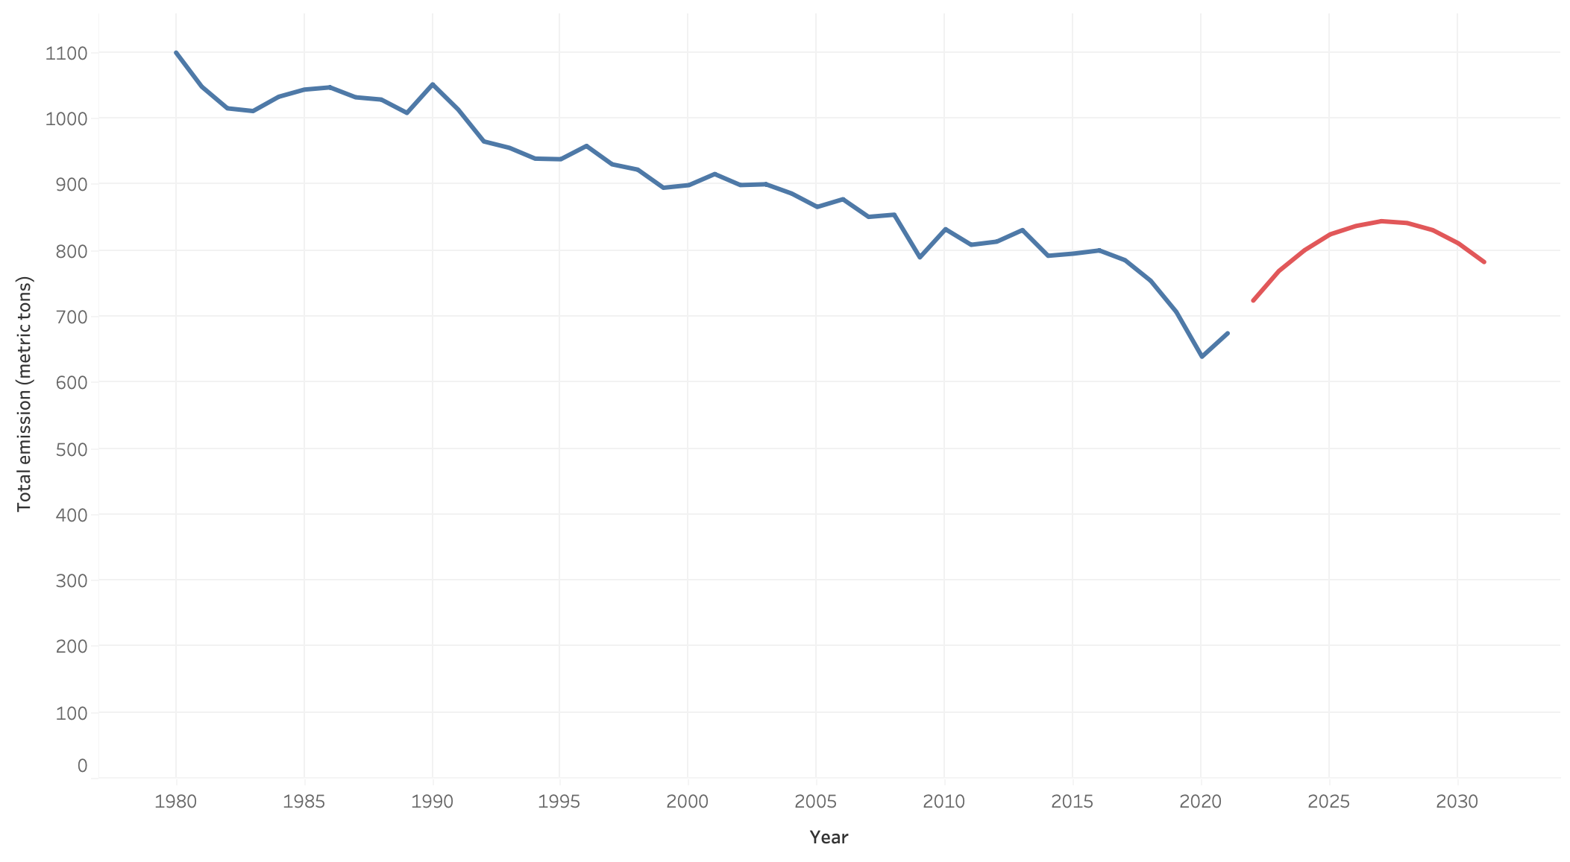
Carbon emissions prediction for Germany

Slide 10
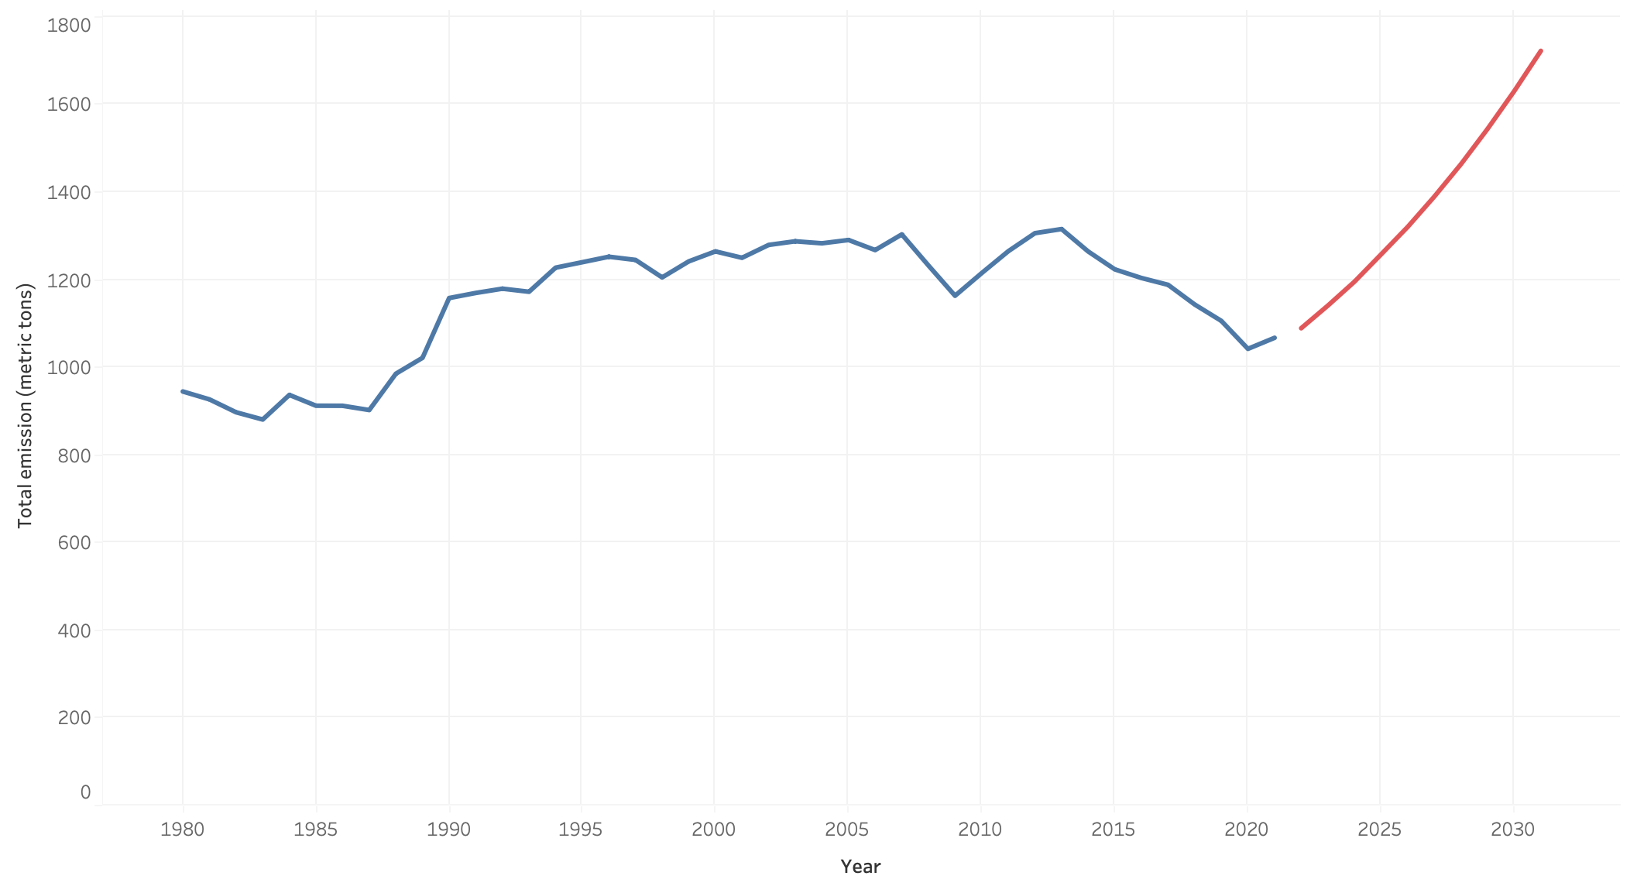
Carbon emissions prediction for Japan

Slide 11
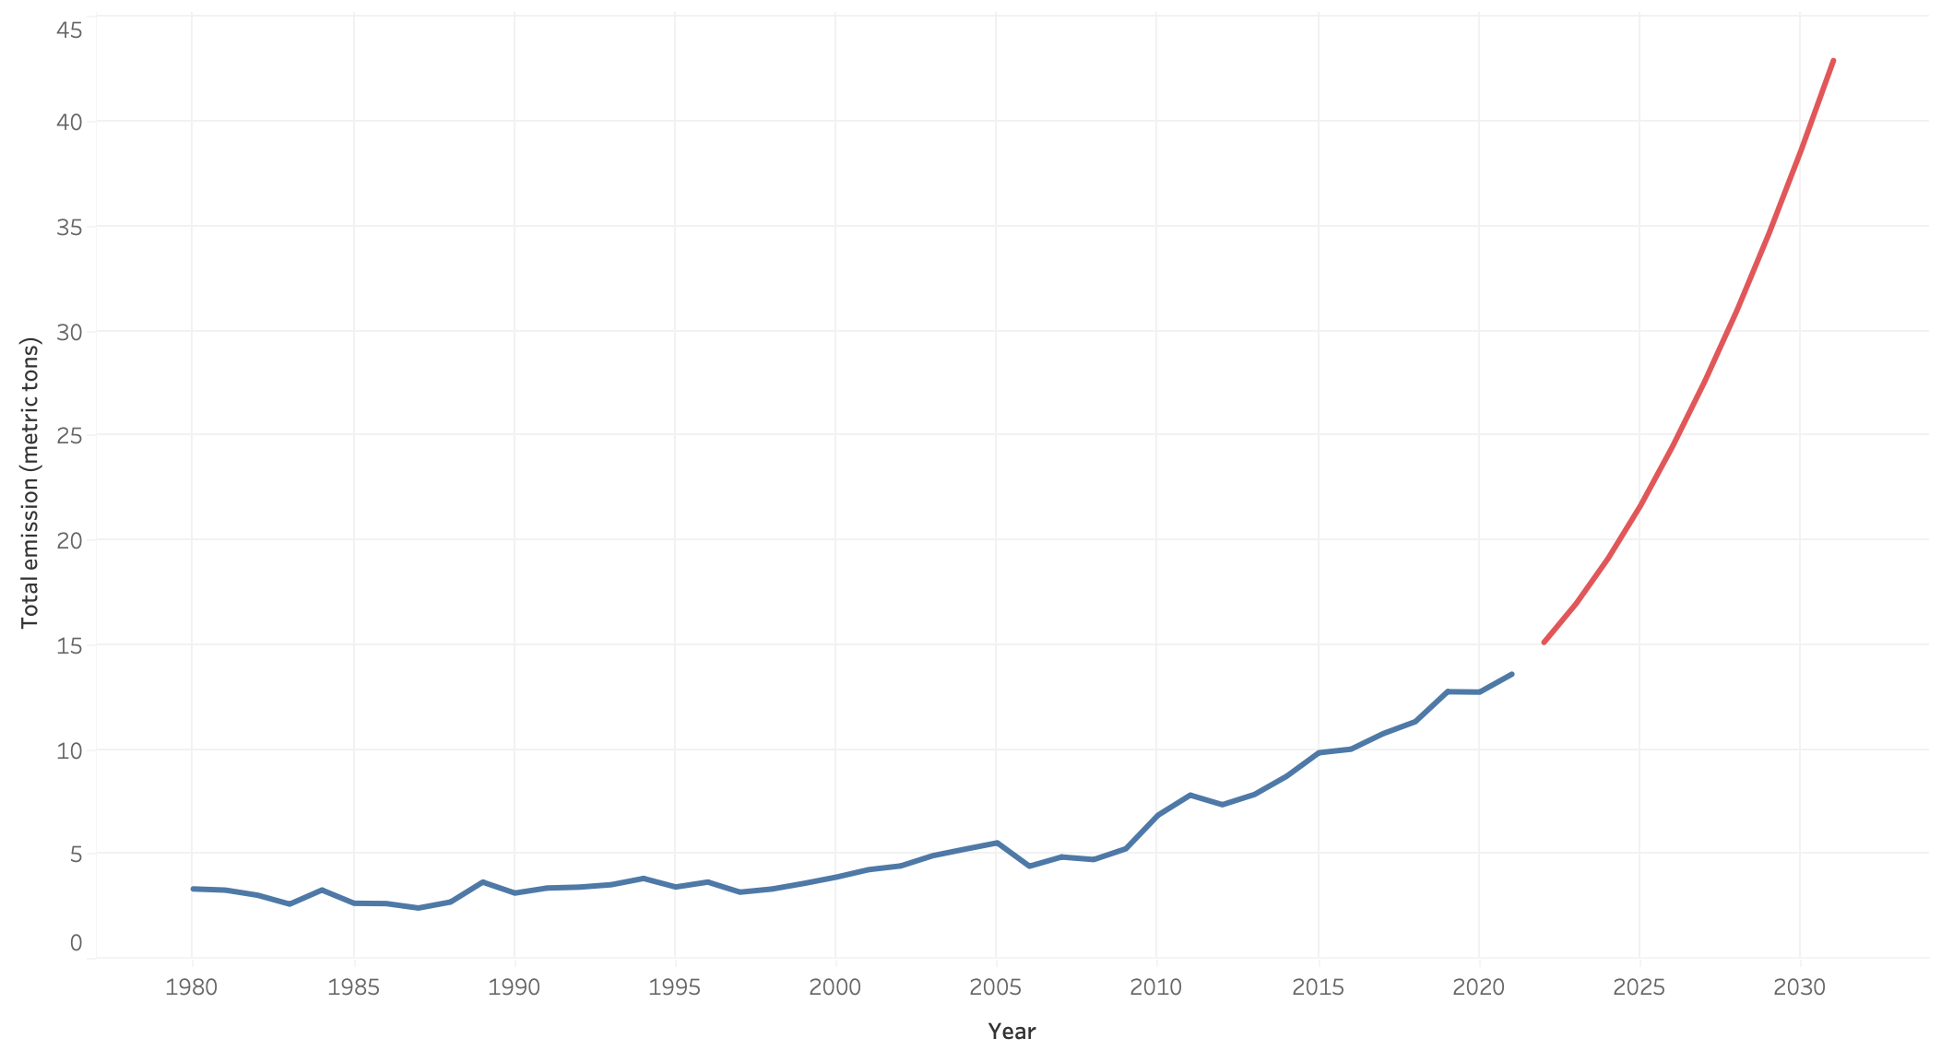
Carbon emissions prediction for Senegal

Slide 12
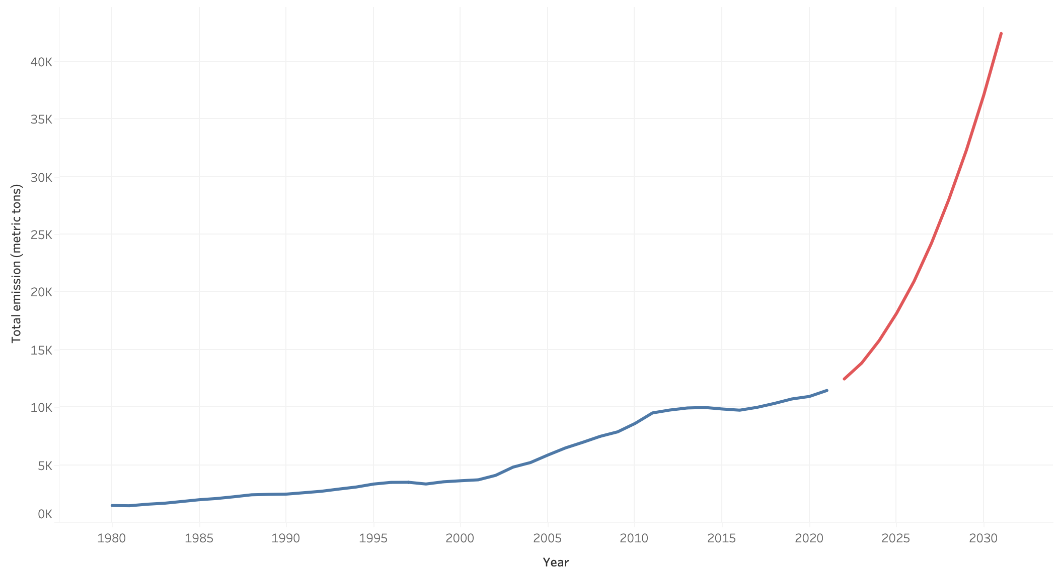
Carbon emissions prediction for China

Slide 13
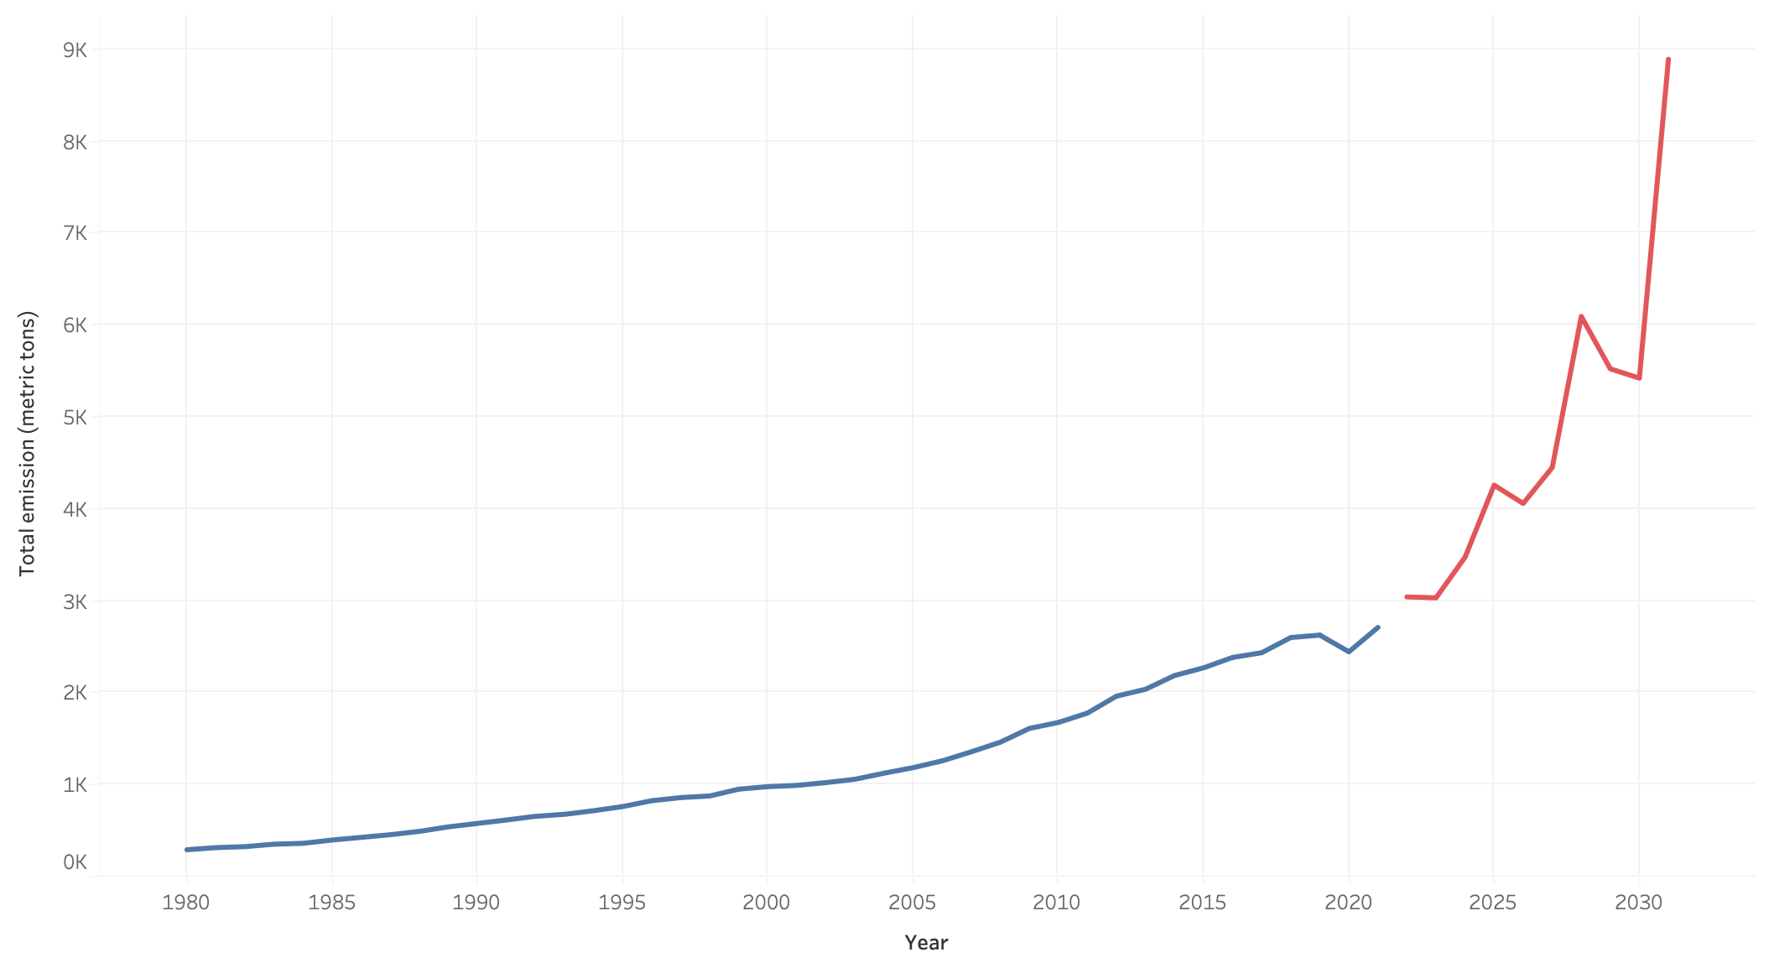
Carbon emissions prediction for India

Slide 14
Are we fucked? YES!

