Slide 1
A study of Large Cap Schemes of selected Mutual Funds
Internship/Project Presentation
Ajay Krishna M(22MB002)

Slide 2
Introduction to the Project
Asset management companies (AMCs) are firms pooling investments from various individual and institutional investors.
The company manages the investment by investing in capital assets such as stocks, real estate, bonds, debt funds.
To analyse the performance of five large-cap mutual fund for 3 years.

Slide 3
Funds under Study:
DSP Top 100 Equity Fund
IDFC Large Cap Fund
L&T India Large Cap Fund
Nippon India Large Cap Fund
SBI Blue-chip Fund

Slide 4
SBI Mutual Fund
SBI Funds Management Pvt Limited is a joint venture between the State Bank of India (SBI) and financial services company Amundi, a European Asset Management company in France.
It was launched in 1987.Ms. Anuradha Rao is the Managing Director and CEO. In 2013, SBI Fund Guru, an investor education initiative was launched.

Slide 5
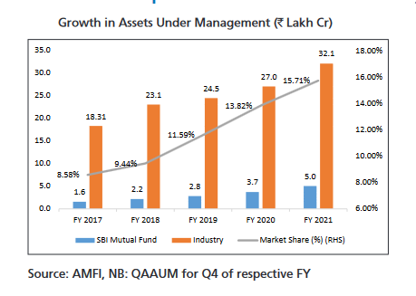
SBI Mutual Fund – AUM Growth (in Rs) (Industry vs SBIMF)

Slide 6
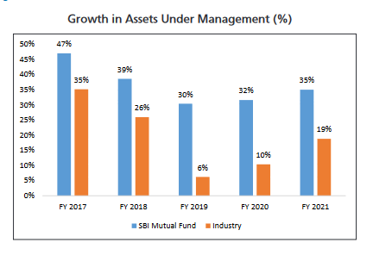
SBI Mutual Fund – AUM (in %) (Industry vs SBIMF)

Slide 7
Nippon India Mutual Fund
Nippon India Mutual Fund a part of Reliance Anil Dhirubhai Ambani (ADA) Group, Reliance Capital Limited (RCL) is the sponsor and Reliance Capital Trustee Co. Limited is the trustee of Reliance Mutual Fund (RMF).
It was registered on June 30, 1995. Nippon India Mutual Fund was originally Reliance Capital Mutual Fund and changed its name in 2004.

Slide 8
IDFC Mutual Fund
IDFC Asset Management Company Ltd. was established in 2000. IDFC Financial Holding Company Limited holds the entire shareholding in IDFC Asset Management Company.
IDFC continues to be the sponsor of IDFC Mutual Fund. Moreover, it also continues to hold a controlling interest in IDFC AMC.

Slide 9
L&T Mutual Fund
L&T Investment Management Limited is the Asset Management Company (AMC) for all L&T Mutual Fund schemes.
L&T Finance Holdings Limited (LTFH), a listed company, is the sponsor for the AMC. It started its operations in 2010.

Slide 10
DSP Mutual Fund
DSP BlackRock is a joint venture between DSP Group and BlackRock, the world’s largest investment management firm.
DSP BlackRock Trustee Company Private Ltd. is the trustee for the DSP BlackRock Mutual Fund.

Slide 11
Sharp Ratio
Named after its founder William F. Sharpe, the Sharpe Ratio measures the risk adjusted performance of a mutual fund.
It is calculated by dividing the excess returns of a mutual fund scheme over a risk-free rate with the standard deviation of fund’s returns over a specific period.

Slide 12
Sharp Ratio
Formula for Sharpe Ratio = (Average fund return – risk free rate of return) / standard deviation of the fund’s returns over a given period.
A higher Sharpe ratio denotes that a fund is performing well.
If the Sharpe Ratio is negative, it implies that the fund is underperforming with respect to the risk-free rate of return.

Slide 13
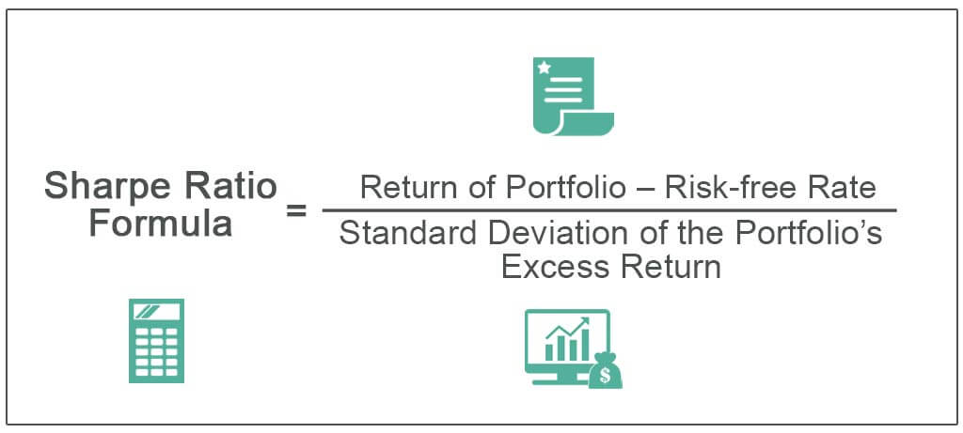
Sharpe Ratio

Slide 14
Sharp Ratio values
Sharpe Ratio | Inference
Less than 1 | Poor
1 to 1.99 | Good
2 to 2.99 | Very Good
Greater than 3 | Excellent

Slide 15
Selected funds performance
Fund name | Sharpe Ratio
DSP Top 100 Equity Fund | -0.86229
IDFC Large Cap Fund | -0.79754
L&T India Large Cap Fund | -0.76290
Nippon India Large Cap Fund | -0.69145
SBI Blue-chip Fund | -0.69754

Slide 16
Conclusion
Based on the three year time the MF with best risk adjusted rate is in order
Nippon India Large Cap Fund
SBI Blue-chip Fund
L&T India Large Cap Fund
IDFC Large Cap Fund
DSP Top 100 Equity Fund

Slide 17
Thank you

