Slide 1

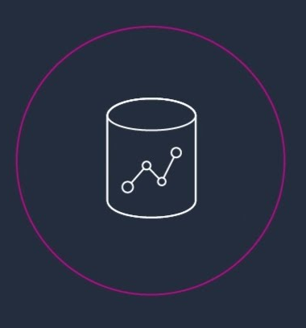

AWS Redshift
Welcome

Slide 2
AWS Redshift – Not just a Data warehousing Solution
Notes:
Redshift uses Massively Parallel Processing (MPP) technology to process massive volumes of data at lightning speeds & costs a fraction of the cost of other data platforms.

Slide 3

Big Opportunities : Bigger Challenges
Truth or Dare : Organizations choose Dare.
The blend of unprecedented exponential data growth with rapid development of new technologies capable of storing and processing this information is transforming the way enterprises run their businesses.
Realizing the value of data has increased over years and so has the associated risk in managing this data.
Exploiting data is the need .
Notes:
Digitally-defined world is continuing to generate massive amount of data and this growth has been phenomenal in recent past. This growth has challenged enterprises and has asked them a question- Do you Dare to use me ? Along with evolving technologies, storage industries are trying to understand the requirements and how much data needs to be stored and how.
As the graph shows, the worldwide installed raw storage capacity has taken a leap from 2,596EB (2012) to 7,235EB (2017).
The usefulness of this unprecedented but available massive data depends on the ability of organizations to priortize, capture, store & retrieve data easily as they intend to leverage the value it provides.
The desire to do this also brings with it the associated risks.

Slide 4
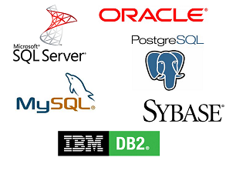
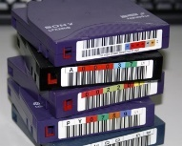


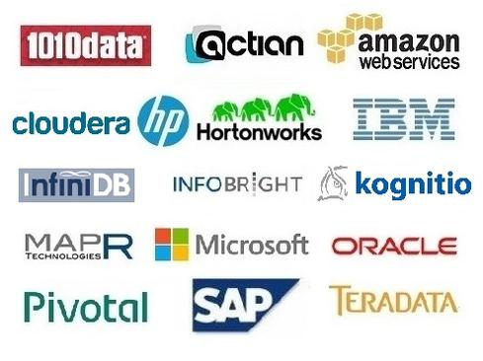

Replace or Be Replaced
Tradition solutions : Existing RDBMS, inexpensive tapes and storage solutions for long term archiving of data.
Newer solutions /replacements : Solutions that offer capabilities to store more data online, parallelism, allow streaming , support agility & dynamism : Big data Technologies, NoSql Data stores.
Organizations seek to glean intelligence from data and translate that into business advantage. Increasing Digitization of business activities, newer sources of information and probable usage of cheaper equipment bring us into a new era – Replace or Be Replaced.
“We don’t have better algorithms, we just have more data” – Peter Norvig
(Google's director of research)
Notes:
Tradition solutions like existing RDBMS, inexpensive tapes and storage solutions for long term archiving are being replaced with solutions that offer capabilities to store more data online, allow streaming , support agility & dynamism such as big data technologies , nosql data stores.
Organizations now seek to glean intelligence from data and translate that into business advantage. Increasing Digitization of business activities, newer sources of information and probable usage of cheaper equipments bring us into a new era – Replace or Be Replaced.
Mobile devices, online sources, electronic communication , instrumented machineries & ofcourse ‘we the individuals’ are all walking data generators.
Data consumers have become more of data generators.
Well! Data was being generated earlier also, however now businesses are interested in any/every data being generated and would like to work on all of it to uncover any hidden treasure in the form of insights and make better decisions to benefit the businesses.
Google’s director of research Peter Norvig has well said – “We don’t have better algorithms, we just have more data”

Slide 5
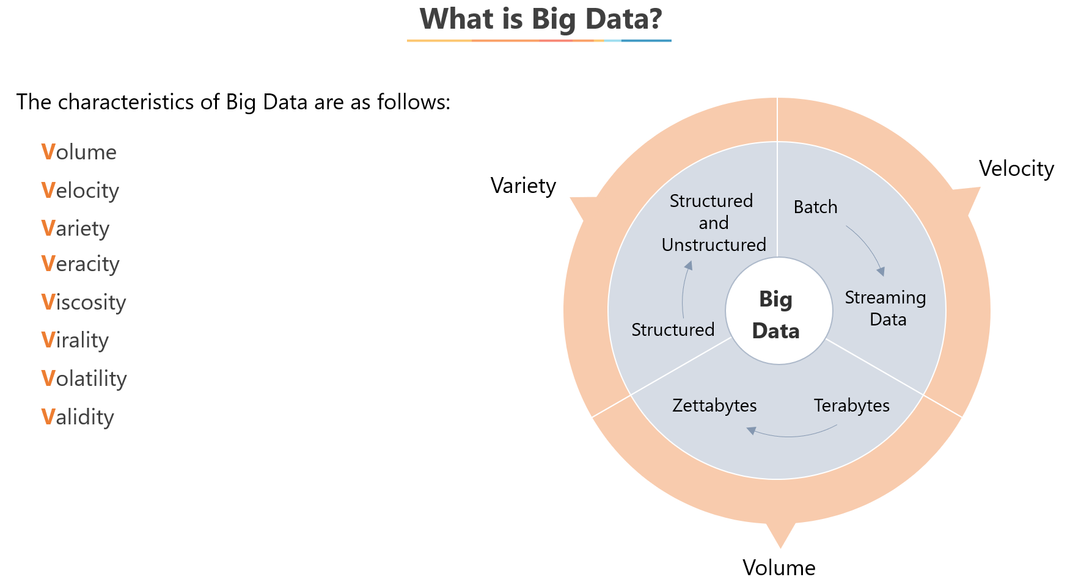

Slide 6
Data at Rest
Data collected from various sources and analyzed after the event.
Data collection and Data analysis happens at different location and times.
Batch Processing methodology.
No need for “always on” infrastructure.
Data in Motion
Data collected from various sources and analyzed in real time as event happens.
Data collection and Data analysis may happen at different locations, but at same times.
Near real time/ Stream processing methodology with emphasis on reduced latency.
A need for “always on” infrastructure/ scalable services.
https://techmagie.wordpress.com/category/big-data/data-formats/

Slide 7
Google File System: Motivation and Lessons
Treat whole cluster as single file system
Minimal set of features needed
Large blocks
Append-only
Replication built-in
No POSIX compliance
Data is distributed, metadata is centralized
Lesson: don’t solve everything at once

Slide 8
Google File System Design
Replicas
Master manages metadata (directory structure, file names, file placement).
Chunkservers hold files parts of 64M (chunks); replicated across 3 machines.
Direct file contents transfers between clients and Chunkservers.
GFS Master
GFS Master
Chunkserver 1
C0
C1
C2
Client
Chunkserver N
C0
C2
C5

Slide 9
Apache Hadoop
an open-source software framework for distributed storage ,distributed & parallel processing of very large datasets on commodity machines forming a cluster.
an ecosystem comprising of open source components that change the way enterprises store, process and analyze data
The core of Apache Hadoop consists of Storage layer : Hadoop Distributed File System & Processing layer : MapReduce.
As an ecosystem it is a collection of other open source components/software packages that can be installed on top of Hadoop and which can leverage the benefits of distributed file system & distributed processing.
Some of the packages are : Apache Hive, HBase, Flume, Pig, spark, zookeeper, Sqoop, Kafka, storm etc..
Notes:
Now that we have learnt on importance of BIG DATA and learnt from the statistics that Big Data is not just a fad, let’s learn about the solution, the framework which allows us to work on Big Data.- Apache Hadoop.
Apache Hadoop is an open-source software framework from open source community “apache.org” . Various vendor specific distributions also exist in market such as Cloudera Distribution of Hadoop, Hortonworks data platform, IBM Biginsight, MapR etc.
Apache hadoop or well known as “hadoop” allows distributed storage, horizontal scalability, distributed & parallel processing of large datasets on commodity machines which form a cluster. As an ecosystem Hadoop comprises of other open source components/packages that change the way enterprise store, process and analyze data. These packages can be installed on top of hadoop to leverage benefits from distributed file system and distributed processing.
Apache Hadoop consists of storage layer: hadoop distributed file system (HDFS) and processing layer: MapReduce.

Slide 10

AWS Redshift
An approach to move away from “Big Red”.
Initially built by ‘ParAccel’ – later acquired by ‘Actian’.
Capable of processing structured and unstructured data in the range of PBs/EBs.
A service that can be used for large scale migrations.
Can handle analytic workloads on big data sets stored by a column-oriented principle.
Based on older version of PostgreSQL 8.0.2
Uses parallel-processing and compression to decrease command execution time.

Slide 11
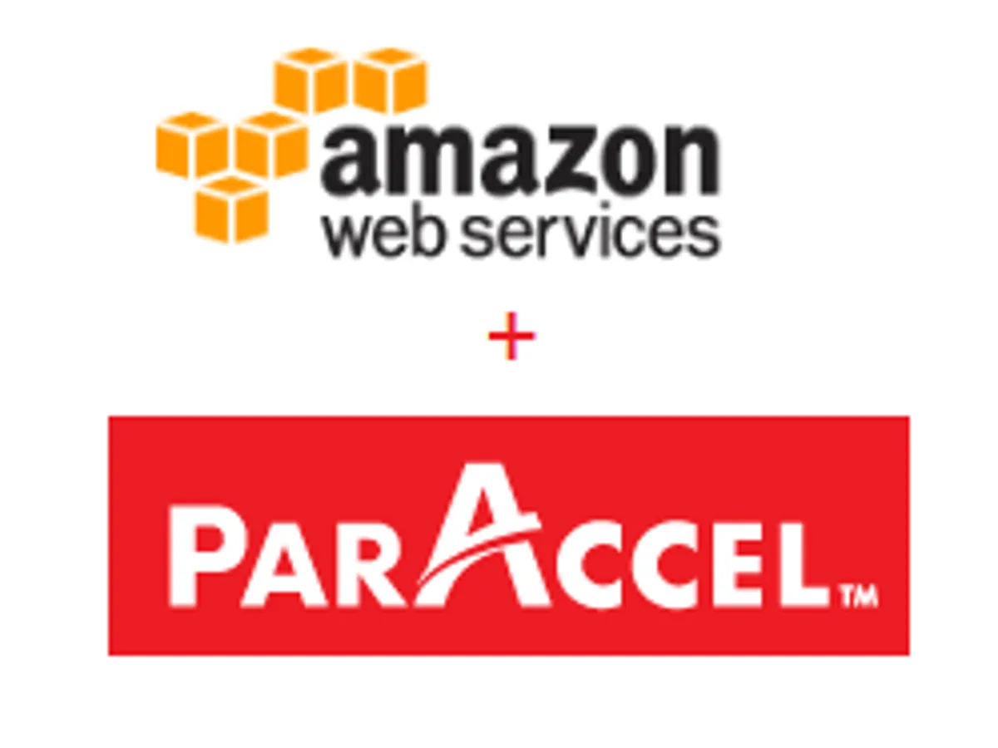
History & Present
About ParAccel
Took a radical approach compared to other vendors in the Massively Parallel Processing (MPP) Data Warehouse category i.e. the company designed its software to run on commodity hardware.
MPP vendors (including Teradata, HP/ Vertica, IBM/ Netezza, EMC/ Greenplum and Microsoft) either sold their MPP products or storage only in the form of appliances, or were owned by hardware or storage companies that preferred to sell it that way.
Inside those MPP appliance cabinets ,lies a cluster of finely tuned server, storage and networking hardware.
It’s an optimized, high-performance approach to data warehousing. It’s also expensive, and it keeps certain customers out.
ParAccel decoupled MPP technology from expensive appliance hardware.
Notes:
Hadoop also took commodity approach but had its native query mechanism based on MapReduce code.
But question was - why hybridize SQL with Hadoop, when MPP data warehouses that can handle Petabyte-scale big data workloads
use SQL natively?

Slide 12
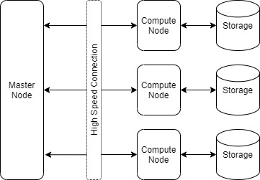
Quick Note on MPP System
An MPP system is also known as a "loosely coupled" or "shared nothing" system.
A massively parallel processing (MPP) system consists of a large number of small homogeneous processing nodes interconnected via a high-speed network.
These processing nodes are independent & typically do not share memory, each processor may run its own instance of an operating system & are connected directly to their own I/O devices.
Communication between nodes occurs in a coordinated fashion, where all nodes stop processing and participate in an exchange of data across the network, or in an uncoordinated fashion, with messages targeted for specific recipients being injected into the network independently.
Data can be streamed through the network and targeted for specific nodes thus it is nicely suited for data parallel applications where all processors execute the same program on different data streams.
Notes:
As discussed, MPP is the coordinated processing of a program by multiple processors that work on different parts of the program, with each processor
using its own operating system and memory . Typically, MPP processors communicate using some messaging interface.
In some implementations, up to 200 or more processors can work on the same application.
An "interconnect" arrangement of data paths allows messages to be sent between processors.
An MPP system is considered better than a symmetrically parallel system ( SMP ) for applications that allow a number of databases to be searched in parallel.
SMP -
SMP is a multi processor system where multiple processors share resources i.e. instances of memory, I/O devices (Storage) and Operating System. These resource are connected using a common bus. The processing happens within the processor cores in parallel, however, the other system resources are shared. In an SMP system - it is a single physical machine having multiple CPU cores and support vertical scalability.

Slide 13
History & Present
Internal discussion was held in Amazon to build their own MPP SQL database from scratch or to take an existing solution and make it cloud ready.
Amazon invested in ParAccel(mid-2011)and decided to build an OLAP-as-a-Service offering on top of it.
Amazon purchased the license for ParAccel’s source code in one lump sum.
Earlier MPP carried the appliance barrier-to-entry.
Later Amazon made ParAccel's MPP technology elastic by making it available on cloud & on-demand.
Although Redshift leveraged a lot of ParAccel code, a significant amount of work has gone into operationalizing it within AWS such as the process for loading data from S3, the CloudWatch integration, the auto failure recovery, and the creation of new box types for hosting.
Notes:
MPP Systems:
Consists of a master node and multiple compute nodes.
Master node is responsible for co-ordinating the processes among compute nodes & communicates using a high speed messaging interface.
Storage can be shared or not, and based on this it is called shared storage (disk) or shared nothing MPP architecture.
Shared Nothing MPP - This is the most popular MPP architecture used by most commercially available MPP systems.
In this, there is no single point of contention across the system. Each node has its separate memory and disk storage.
Data is partitioned across the nodes i.e. data from one table can span over multiple nodes based on the distribution methodology used.
For processing, each node only processes the data rows on its corresponding disks. For scalability we can add more nodes as needed.

Slide 14
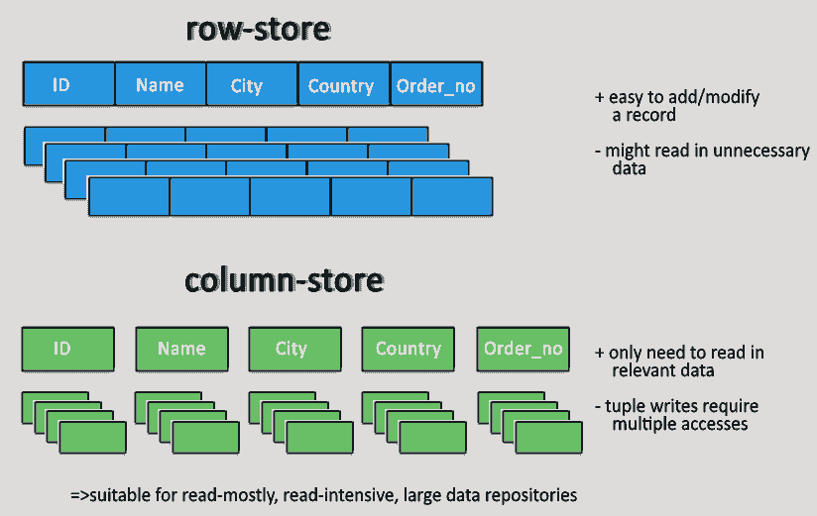
Some optimizations which make Redshift as preferred choice for BI or OLAP
Data storage:
Redshift Database uses Columnar storage for database tables.
Because SQL queries for analytics are normally limited to certain columns and never
the entire row. With the data for the entire column stored in a single block, we have fewer blocks to read/write.
Data Compression: Compressing data saves storage space. Redshift by default compresses the columns in the table using RAW, AZ64 or LZO encoding. The encoding type is chosen based on the data type of the columns.
Query engine: The query execution engine leverages Redshift specific Massive Parallel Processing (MPP), results caching and compiled code distribution feature in addition to the columnar storage to increase execution speed, reduce execution time and improve system performance.
Notes:
Amazon's claim : the cost of Redshift is under $1000/Terabyte/year.
Thus we can spin up a MPP data warehouse and let querying happen via existing BI tools.
$1000/TB/year means we’ll be paying at least $1 million/year for a Petabyte data warehouse.
But when you factor in the hardware, storage, personnel/management, power and other costs of running such a large warehouse
on premise, that isn't bad.
On-premise setup would still depend on other factors such as bandwidth requirements, integration with other services etc.

Slide 15
Redshift Deployments & Options
Redshift
Provisioned Option (Predictable workloads)
Serverless Option (for unpredictable workloads) : an endpoint without all configurations of DWH.
Redshift Spectrum
Additional inbuilt feature/service provided with Redshift which allows running SQL queries on data stored in S3. (more on this later..)
Redshift with RA3 instances with managed storage.(scaling compute & storage separately).
Other options would be based on DC2(local SSDs) or DS2 (HDD based)
Redshift ML with SageMaker (create models based on patterns and generate predictions)
AWS Redshift can integrate with Amazon S3, AWS Glue, Amazon Kinesis Data Firehose, Amazon Quicksight, and over 170 other AWS services.

Slide 16
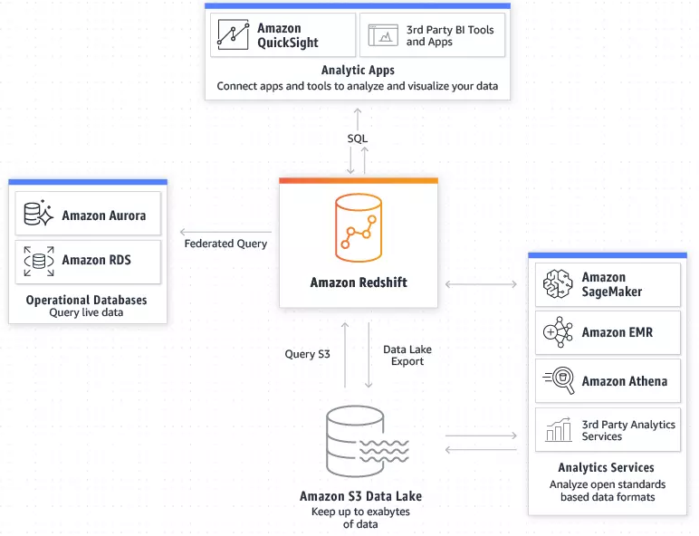
Need > Features
Real-time analytics & Cost benefits.
Combining data sources or integration with different services/applications/platforms.
- Business intelligence needs. (Redshift, S3 & Amazon Quicksight combination).
- Log analysis. (Redshift & S3 in combination).
- SQL / unstructured data analysis.
Speed (benefits of underlying MPP technology & ML to predict and analyze queries).
Data encryption at any level and for any operation within Redshift.
Automation of repetitive tasks ( via Workload Management)
Concurrent scaling to handle increasing concurrent workloads or dynamic query volumes.

Slide 17
Limitations/ Drawbacks
Parallel Uploads - Redshift does not support all databases for parallel upload. Amazon S3, EMR, and DynamoDB are supported for parallel uploads using ultra-fast MPP. For other sources, use separate scripts.
Uniqueness - AWS Redshift does not provide any tool or means to ensure the uniqueness of data. If you are migrating overlapping data from different sources to Redshift, there may/will be redundant data points.
Indexing - This becomes a problem when Redshift is used for data warehousing needs. Redshift uses distribution and sorts keys to index and store data instead of regular indexes.
OLAP Limitations -It is often easier to recreate a table with changes than to insert/update tables in Redshift. While OLAP works well with static data, OLTP databases perform better for data modification operations.
Migration cost - At large scale bandwidth becomes a problem. You will need to transfer this data to AWS locations before you can begin the project. This could be a potential problem for businesses that have network caps for bandwidth.

Slide 18
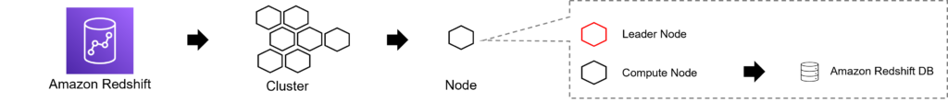
Architecture
At its core, Amazon Redshift is a cluster in turn made up of one or more nodes. These nodes can be categorized into leader nodes and compute nodes.
The leader node does the job of coordination and communication(engine), while the compute node does the heavy lifting (database).

Slide 19
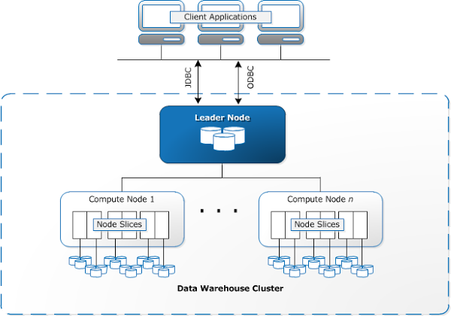
Architecture
Client applications
Amazon Redshift integrates with various data loading, ETL & BI tools & thus multiple existing SQL client applications will work with minimal or no changes.

Slide 20
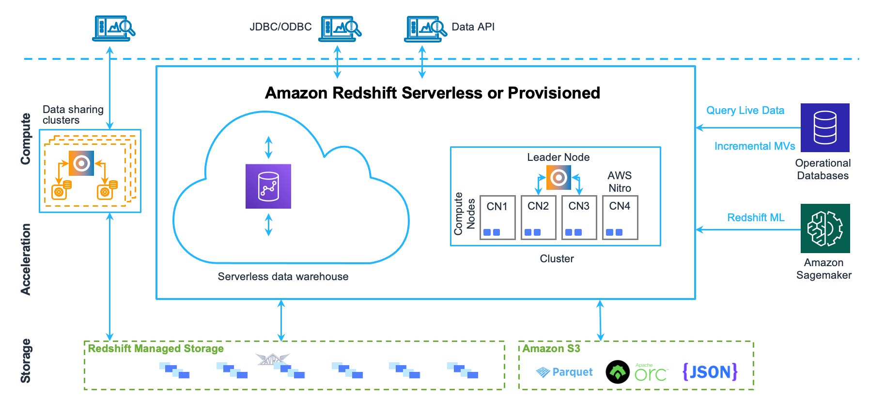
Architecture
If a cluster is provisioned with two or more compute nodes, an additional leader node coordinates the compute nodes and handles external communication. Your client application interacts directly only with the leader node. The compute nodes are transparent to external applications.

Slide 21
Leader node
The entry point for all queries and manages the overall coordination of the cluster.
It performs three major functions:
Communication with Client Applications & compute nodes.
‍
Distribution of workloads - The leader node is responsible for parsing queries, developing execution plans, and compiling SQL into C++ code. Finally, it distributes the compiled code to the compute nodes only when query references the data stored on compute node .
‍Caching of query results - Upon query execution, the leader node stores the query and its results in its memory cache. If a query or underlying data remains unchanged, the leader node doesn't distribute it to compute nodes and returns the cached result instantly for a faster response.
Note** It is designed to implement certain SQL functions only on the leader node. A query that uses any of these functions will return an error if it references tables that reside on the compute nodes.

Slide 22
‍Compute Node:
These nodes handle all query processing in parallel execution.
They run the compiled code and return the interim results to the leader node for final aggregation.
Each compute node has its CPU, memory, and storage.
The leader node compiles code for individual elements of the execution plan and assigns the code to individual compute nodes.
As your workload grows, you can increase the compute capacity of a cluster by increasing the number of nodes, upgrading the node type, or both.

Slide 23
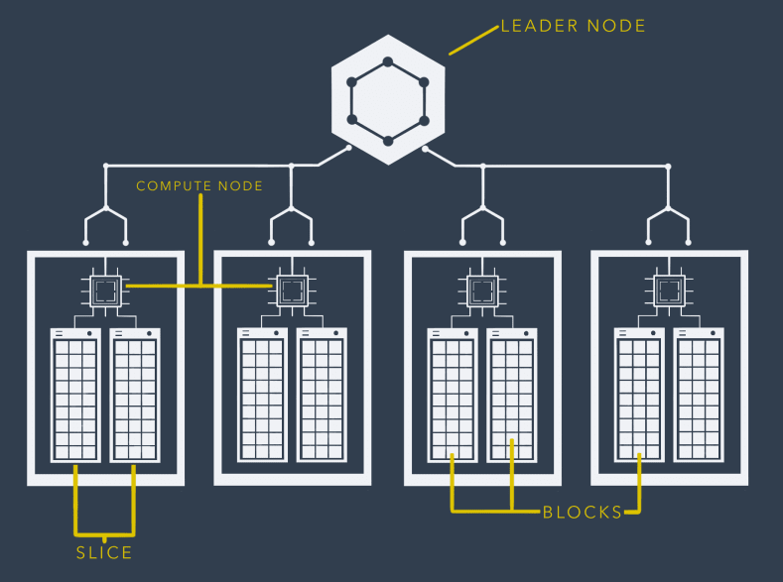
Node slices
Every Compute node is partitioned into slices.
Each slice is allocated a portion of the node's memory and disk space, where it processes a portion of the workload assigned to the node.
The leader node manages distributing data to the slices and apportions the workload for any queries or other database operations to the slices. The slices then work in parallel to complete the operation.
The number of slices per node is determined by the node size of the cluster.
When the table is loaded with data, the rows are distributed to the node slices according to the distribution key (column specified during creation) .
Notes:
The number of slices per node might change if the cluster is resized using elastic resize. However the total number of slices on all the compute nodes in the cluster remains the same after elastic resize.
When you create a cluster with the restore from snapshot operation, the number of slices of the resulting cluster might change from the original cluster if you change the node type.

Slide 24
Data is stored on the slices from the bottom of the slice up.
So if you build a table with at least one sort key, it will also store that data on the slice in that sorted order.
Blocks
Slices are broken down into blocks.
Each block is 1MB in size.
You could imagine that one cell in a table is a Block, however most data that you would find in a cell would only make up a few bytes in size and so Redshift will attempt to fit as much data as it can inside a 1 MB Block.
This is also one of the things that can make Redshift so quick. Redshift stores, in a meta-data store, the minimum and maximum value of the information inside a Block, which allows the Compute Node to skip blocks of data that it doesn't need without actually looking at the underlying data. (pruning). Compression adds to benefits.

Slide 25
RA3 node types & slices
Node type | vCPU | RAM (GiB) | Default slices per node | Managed storage limit per node (hard limit) | Node range with create cluster | Total managed storage capacity
ra3.xlplus (single-node) | 4 | 32 | 2 | 4 TB | 1 | 4 TB
ra3.xlplus (multi-node) | 4 | 32 | 2 | 32 TB | 2–16 | 1024 TB
ra3.4xlarge | 12 | 96 | 4 | 128 TB | 2–32 | 8192 TB
ra3.16xlarge | 48 | 384 | 16 | 128 TB | 2–128 | 16,384 TB
Notes:
Ra3.xplus & ra3.4xlarge support elastic resize to 32 or 64 nodes respectively.

Slide 26
Dense storage node types & slices
Node type | vCPU | RAM (GiB) | Default slices per node | Storage per node | Node range | Total capacity
ds2.xlarge | 4 | 31 | 2 | 2 TB HDD | 1–32 | 64 TB
ds2.8xlarge | 36 | 244 | 16 | 16 TB HDD | 2–128 | 2 PB
Dense compute node types & slices
Node type | vCPU | RAM (GiB) | Default slices per node | Storage per node | Node range | Total capacity
dc2.large | 2 | 15 | 2 | 160 GB NVMe-SSD | 1–32 | 5.12 TB
dc2.8xlarge | 32 | 244 | 16 | 2.56 TB NVMe-SSD | 2–128 | 326 TB
dc1.large¹ | 2 | 15 | 2 | 160 GB SSD | 1–32 | 5.12 TB
dc1.8xlarge¹ | 32 | 244 | 32 | 2.56 TB SSD | 2–128 | 326 TB

Slide 27
Caching
2 Types : Execution and Results.
Execution
When you first run a query the Leader Node will construct an execution plan, which is it's best guess of how to run this query efficiently .It will then store that execution plan (to avoid re-work when same query is re-run).
Results
Redshift will also store the results of a query in short term memory, so if the same query is re-run ,it will provide the results stored in the cache rather than running the query.

Slide 28
Workload Management or WLM - How Redshift manages it's resources.
How many people can run a query at the same time?
How much CPU or RAM we can use up in our query?
This is all managed through user groups and queues.
Redshift can also be configured to manage workload on the fly, not needing DBA's to set any hard rules, instead relying on Redshifts own Machine Learning to predict incoming query run times, and assigns them to the optimal queue for the faster processing. (more later..)

Slide 29
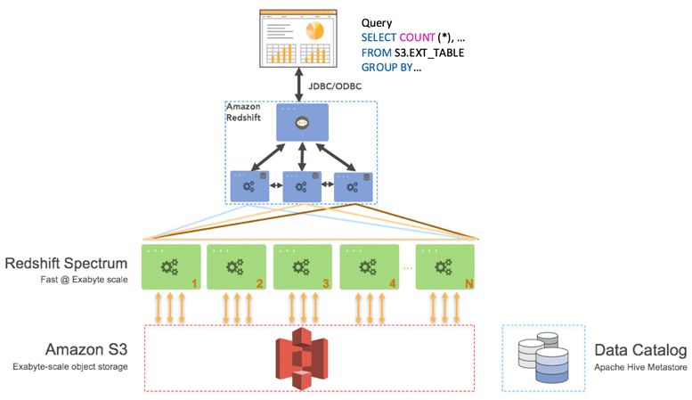
Redshift Spectrum
Redshift Spectrum is a feature of the Amazon Redshift.
allows for fast, complex, and efficient analysis of objects stored in the AWS cloud (S3).
allows for a seamless analysis since it is directly embedded into the Amazons framework.
Redshift Spectrum reduces the time and effort required to perform analysis on data as it eliminates the requirement to move the stored data from the storage service to a database

Slide 30
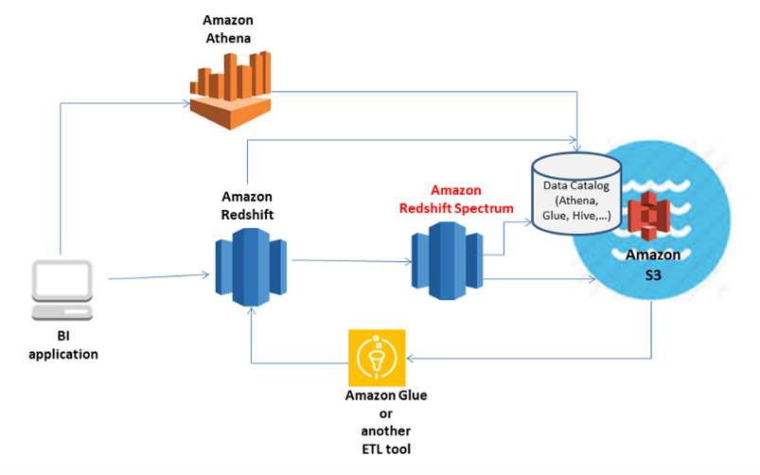
Spectrum
Redshift spectrum works on top of redshift architecture. It is added after the storage Phase.

Slide 31
With Redshift Spectrum
Internally the process begins with submitting ​Redshift Spectrum queries to the leader node.
Leader node then optimizes, compiles, and delegates the query execution to the compute nodes in your cluster.
These compute nodes refer to your data catalog to obtain information about the external tables and dynamically prune non-relevant partitions based on the filters and joins your queries.
In addition, they analyze the locally available data and push down predicates to scan only the relevant objects in ​Amazon S3.
Compute nodes generate multiple requests based on the number of objects that need processing and concurrently submit them to Spectrum, which collects thousands of ​Amazon EC2 instances per ​AWS Region.
The Redshift Spectrum worker nodes then scan, filter, and aggregate data from Amazon S3, streaming the required data back to your cluster for processing. Finally, join and merge operations are subsequently performed locally in the cluster, and the results are returned to your client.

Slide 32
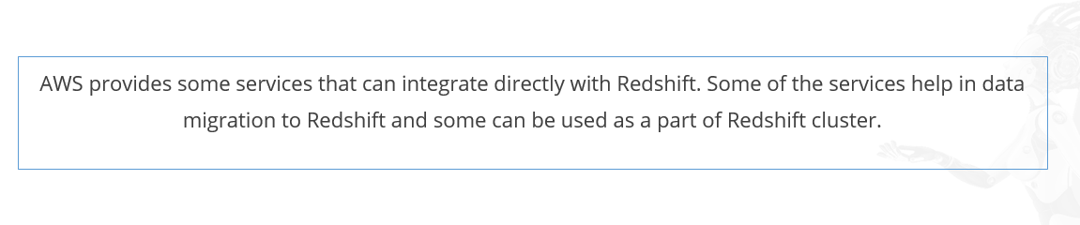

Slide 33
AWS S3
An important service that acts as main source of/for loading data into Redshift. (copy, load commands)
Data can directly be queried from S3 too using Redshift spectrum.
Relevant roles need to be established to ensure connectivity.
AWS EMR
Data can be loaded into Redshift from Amazon EMR using copy command through SSH.
Data can be loaded from EC2 instances (with/ without EMR), local instances using copy command through SSH
AWS Data Pipeline
Data can be moved in and out of Redshift using data pipelines.
AWS Quicksight
We can directly connect to Redshift as datasource from Quicksight for Business Intelligence needs.

Slide 34
Setup CLI and connect to S3
Setup Redshift cluster on specific nodes.
Explore query editor.

Slide 35
References/Good to read:
https://www.sciencedirect.com/topics/computer-science/massively-parallel-processing#:~:text=Massively%20parallel%20processing%20is%20a,in%20separate%2C%20distantly%20located%20computers.
https://www.informationweek.com/data-management/actian-acquires-paraccel-fuel-behind-amazon-redshift#close-modal
https://press.aboutamazon.com/2019/12/aws-announces-new-analytics-capabilities-to-help-customers-embrace-data-at-scale

Slide 36
Continued in Part -2

