Slide 1

Data Warehouse
Centralized repository for integrated data for analytical needs.

Slide 2
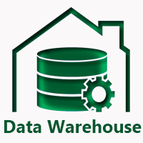
Data Warehouse
Is a RDBMS construct or like relational database designed for analytical needs.
A centralized repository which can be queried for business benefits.
It stores information oriented to satisfy decision-making requests.
Extremely useful for data analysts to make & take business and data related decisions.
In addition to a relational database, a data warehouse environment can include an extraction, transportation, transformation, and loading (ETL) solution, statistical analysis, reporting, data mining capabilities, client analysis tools, and other applications that manage the process of gathering data, transforming it into useful, actionable information, and delivering it to business users.
Notes:
A data warehouse is a database designed to enable business intelligence activities.

Slide 3
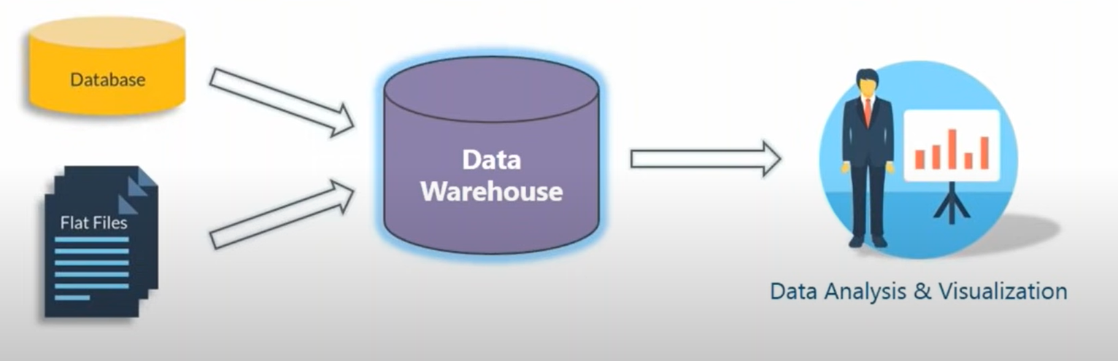
Central location/Centralized repository where data consolidated from various homo/heterogeneous sources & locations is stored to facilitate analysis.
It is primary component of business intelligence and also known as Enterprise Data warehouse.
Notes:
To achieve the goal of enhanced business intelligence, the data warehouse works with data collected from multiple sources. The source data may come from internally developed systems, purchased applications, third-party data syndicators and other sources. It may involve transactions, production, marketing, human resources and more. In today's world of big data, the data may be many billions of individual clicks on web sites or the massive data streams from sensors built into complex machinery.

Slide 4
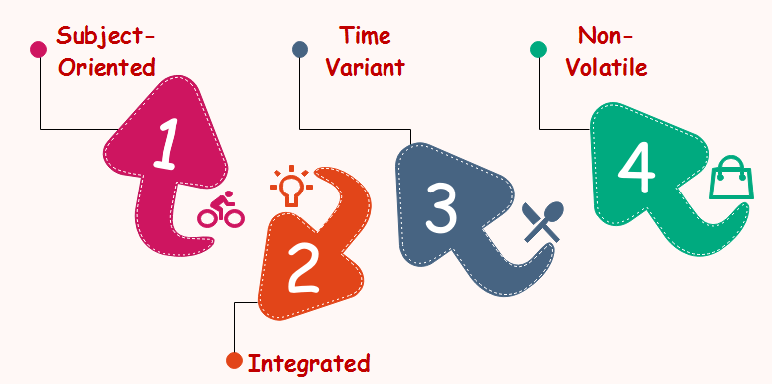
DWH works to create a single, unified system of truth for an entire organization.
Not used for daily operations or transaction processing , rather is used for analysis and decision making.
It stores current & historical data about businesses and organization to allow analysis and glean intelligence from data.
As defined by Inmon, it is subject-oriented,
Integrated,
time-variant &
non-volatile collection of data.
Notes:
With a data warehouse you separate analysis workload from transaction workload. Thus data warehouses are very much read-oriented systems. They have a far higher amount of data reading versus writing and updating. This enables far better analytical performance and avoids impacting your transaction systems.

Slide 5
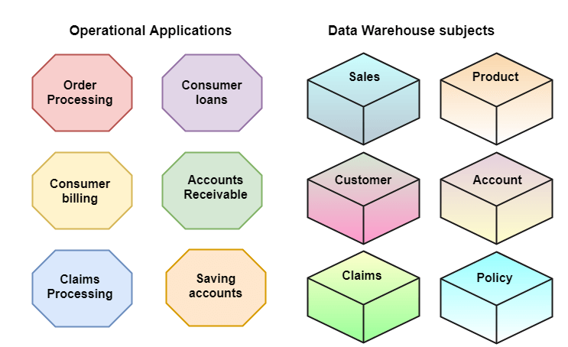
Subject-Oriented
A data warehouse targets on the modelling and analysis of data for decision-makers.
Typically provide a concise and straightforward view around a particular subject, such as customer, product, or sales, instead of the global organization's ongoing operations.
This is done by excluding data that are not useful concerning the subject and including all data needed by the users to understand the subject.
Subject-oriented means that the information revolves around some subject.
Notes:
Subject-oriented means that the information in a data warehouse revolves around some subject.
Therefore, it does not contain all company data ever, but only the subject matters of interest.
For instance, data on your competitors need not appear in a data warehouse, however, your own sales data will most certainly be there.
Data warehousing gives you an option of building your warehouse including the data as and what you want to extract and analyze. Thus, a subject matter expert can answer relevant questions from the data.
For instance, a sales executive for an online website can develop a subject-oriented database including the data fields he wants to query.
The salesperson can then extract data writing different queries like, “How many customers purchased Database Tool today?”

Slide 6
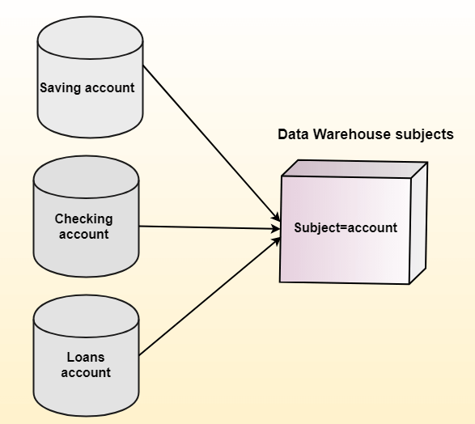
Integrated
A data warehouse integrates various heterogeneous data sources like RDBMS, flat files, and online transaction records.
It requires performing data cleaning and integration during data warehousing to ensure consistency in naming conventions, attributes types, etc., among different data sources.
Notes:
Each database, or each team, or even each person has their own preferences when it comes to naming conventions. That is why common standards are developed to make sure that the data warehouse picks the best quality data from everywhere.
Data warehouses supports consistency by arranging data from diverse sources in a uniform and rational forms so It should not allow any conflicts in field names and other units of measure. Having accomplished this steadiness, we can refer it to be an integrated data warehouse.
The data in a data warehouse is typically loaded through an extraction, transformation, and loading (ETL) process from multiple data sources. Nowadays data warehouses are moving toward an extract, load, transformation (ELT) architecture in which all or most data transformation is performed on the database that hosts the data warehouse.
Defining the ETL process is a very large part of the design effort & the speed and reliability of ETL operations are the foundation of the data warehouse once it is ready.

Slide 7
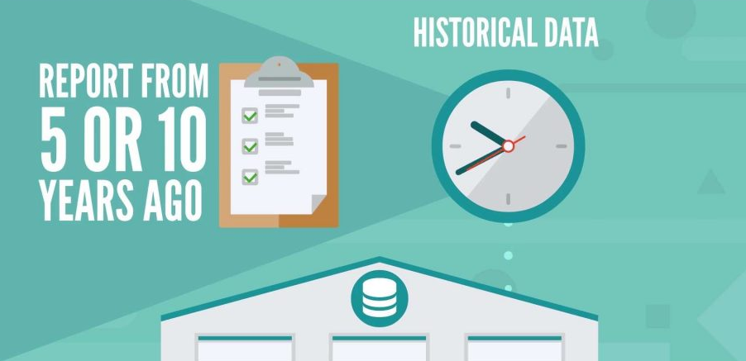
Time-Variant
Historical information is kept in a data warehouse. For example, one can retrieve files from 3 months, 6 months, 12 months, or even previous data from a data warehouse unlike a transactions system, where often only the most current file is kept.
Notes:
The data warehouse provides a single, consistent view of historical operations. This is the foundation for measuring KPIs and KRs, and for spotting trends
The data warehouse provides a reliable and integrated source of facts. This means it can be used to feed into correlation and prediction machine learning algorithms too.
The ability to support both those things means that the Data Warehouse needs to know when every item of data was recorded. This is the essence of time variance.

Slide 8
Aligning past customer activity with current operational data
Let’s say we had a customer who lived at Street 100, Sydney 2000, Australia, and who bought products from us. In 2020 they moved to Tower Rd, London , United Kingdom, and continued to buy products from us.
Most operational systems keep data accurate and up to date. In this example, to minimise the risk of accidentally sending correspondence to the wrong address.
So if data from the operational system was used to assess the effectiveness of a 2019 marketing campaign, the analyst would be wondering why a customer in the United Kingdom responded to a marketing campaign that targeted Australian residents.
Thus analysis done would be inaccurate, and could lead to false conclusions and bad business decisions.
The root cause is that operational systems are mostly not time variant.
For reasons including performance, accuracy, and legal compliance, operational systems tend to keep only the latest, current values. Old data is simply overwritten.

Slide 9
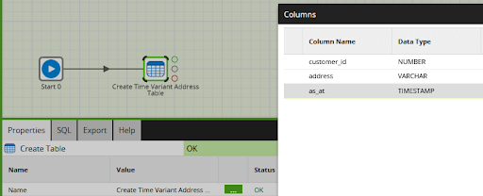
Time variance means that the data warehouse also records the timestamp of data. So inside a data warehouse, a time variant table can be structured almost exactly the same as the source table, but with the addition of a timestamp column.
The extra timestamp column is often named something like “as-at”, reflecting the fact that the customer’s address was recorded as at some point in time.
More on this later..

Slide 10
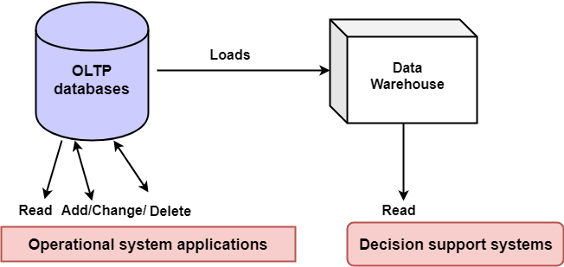
Non-Volatile
The data warehouse is a physically separate data storage, which is transformed from the source operational RDBMS.
The operational updates of data do not occur in the data warehouse.
It usually requires only two procedures in data accessing: Initial loading of data and access to data. Therefore, the DW does not require transaction processing, recovery, and concurrency capabilities, which allows for substantial speedup of data retrieval.
Non-Volatile defines that once entered into the warehouse the data should not change.
Notes:
As the name suggests, nonvolatile DW refers to the no data change once created. It is an important and relevant feature since the aim of developing a warehouse is to evaluate what has occurred until then.

Slide 11
Need and Goal of Data Warehouse
Data warehousing idea was planned to support an architectural model for the flow of information from the operational system to decisional support environments.
The concept attempted to address the various problems associated with the flow, mainly the high costs associated with it.
In the absence of data warehousing architecture, a vast amount of space was required to support multiple decision support environments.
In large corporations, it was ordinary for various decision support environments to operate independently.
Notes:
Users sometimes need highly aggregated data, and other times they need to drill down to details.

Slide 12
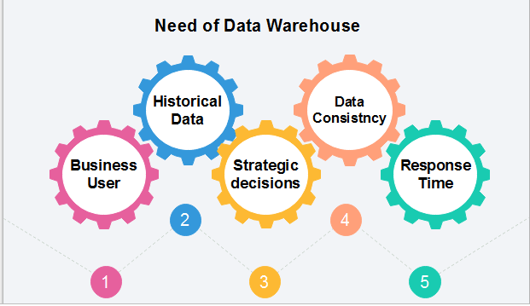
Business User: Business users need to view summarized data from the past. Since these people are non-technical, the data may be presented to them in an elementary form.
Store historical data: It is required to store the time variable data from the past. This input can be used for various purposes.
Make strategic decisions: Some strategies explicitly depend on data ,So, data warehouse contributes to making strategic decisions.
For data consistency and quality: Bringing the data from different sources at a commonplace, the user can effectively undertake to bring the uniformity and consistency in data.
High response time: Data warehouse has to be ready for somewhat unexpected loads and types of queries, which demands a significant degree of flexibility and quick response time.

Slide 13
Benefits of Data Warehouse
Understand business trends and make better forecasting decisions.
Data Warehouses are designed to perform analysis on enormous amounts of data.
The structure of data warehouses is more accessible for end-users to navigate, understand, and query.
Queries that would be complex in many normalized databases could be easier to build and maintain in data warehouses.
Data warehousing is an efficient method to manage demand for lots of information from lots of users.
Data warehousing provide the capabilities to analyze a large amount of historical data.

Slide 14
You may wonder: If you already have your data in a database, should you duplicate it by copying it to a data warehouse? Isn’t it unwise to keep multiple copies of the same data?
That’s not what we are doing when we maintain a data warehouse.
Data in a database is updated frequently, one record at a time, and represents transactions and events in the real world.
Data in a data warehouse is updated only in batches as new data comes in for analysis, and represents systems as a whole.
Databases show the current state of a system.
Data warehouses can provide a historical perspective useful for data analysis.
Data in your OLTP systems is a kind of living organism.
In that analogy, the data in your OLAP system, in your data warehouse, is an X-ray — a near real-time image of a particular subset of the organism.
Notes:
There are other types of creatures in this data ecosystem as well, including data lakes and data-marts, as well as a newer hybrid, the data lakehouse.

Slide 15
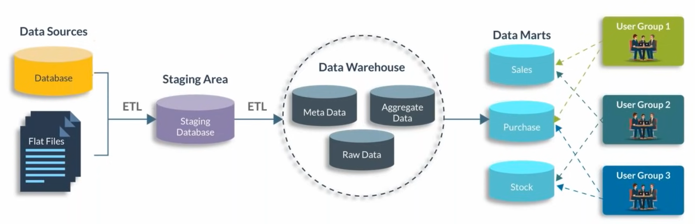
Data warehousing:
Act of organizing and storing data in a way so as to make its retrieval easy, efficient & insightful.
Also called as process of transforming data into information.
Architecture

Slide 16
Raw Data: actual data that is being transferred.
Metadata is something which differentiates between database and data warehouse. It is data about your data (raw data).[attributes, schema etc.]
Act of performing queries against data warehouse is called OLAP.
Queries could be against data warehouse or against data marts (created from data warehouse and permitting restricted access to data of particular domain).
Notes:
Raw Data: actual data that is being transferred.
Metadata is something which differentiates between database and data warehouse. It is data about your data (raw data).[attributes, schema etc]
Act of performing queries against data warehouse is called OLAP.
Queries could be against data warehouse or against data marts (created from data warehouse and permitting restricted access to data of particular domain).

Slide 17
Collected data from various sources, locations and in formats lands into Staging area which could be a database or data lake, which then via ETL is pushed into data warehouse.
This data can then be queried or pushed into data marts for querying and analysis.
Data Lake
Collect
Store
Analyze
Consume

Slide 18
Data Mart
A data mart serves the same role as a data warehouse, but it is intentionally limited in scope.
It can particularly for a specific department or line of business.
Advantage : It can be created much faster due to its limited coverage.
Disadvantage: Creates problems with inconsistency.
It takes tight discipline to keep data and calculation definitions consistent across data marts. Thus data marts exist in two styles.
Independent data marts are those which are fed directly from source data. They can turn into islands of inconsistent information.
Dependent data marts are fed from an existing data warehouse. These can avoid the problems of inconsistency, but they require an existing enterprise-level data warehouse .
Notes:
A data mart serves the same role as a data warehouse, but it is intentionally limited in scope.
It can particularly for a specific department or line of business.
Data mart’s advantage is that it can be created much faster due to its limited coverage. However, data marts also create problems with inconsistency. It takes tight discipline to keep data and calculation definitions consistent across data marts. This problem has been widely recognized, so data marts exist in two styles.
Independent data marts are those which are fed directly from source data. They can turn into islands of inconsistent information.
Dependent data marts are fed from an existing data warehouse. Dependent data marts can avoid the problems of inconsistency, but they require that an enterprise-level data warehouse already exist.
Operational data stores exist to support daily operations. The ODS data is cleaned and validated, but it is not historically deep: it may be just the data for the current day. Rather than support the historically rich queries that a data warehouse can handle, the ODS gives data warehouses a place to get access to the most current data, which has not yet been loaded into the data warehouse. The ODS may also be used as a source to load the data warehouse. As data warehousing loading techniques have become more advanced, data warehouses may have less need for ODS as a source for loading data.

Slide 19
OLTP VS Data warehouses
Data warehouses are not exclusively in third normal form (3NF), a type of data normalization common in OLTP environments. (we will discuss on Normalization forms soon..)
Differences between typical data warehouses and OLTP systems:
Workload
Data warehouses : Designed to accommodate ad hoc queries and data analysis.
Workload is not known in advance thus DWH should be optimized to perform well for a wide variety of possible query and analytical operations.
OLTP systems : Designed for only predefined operations. Your applications might be specifically tuned or designed to support only these operations.

Slide 20
OLTP VS Data warehouses
Differences between typical data warehouses and OLTP systems:
Data modifications
Data warehouse : is updated on a regular basis by the ETL process (run nightly or weekly) using bulk data modification techniques. The end users of a data warehouse do not directly update the data warehouse except when using analytical tools, such as data mining, to make predictions with associated probabilities, assign customers to market segments, and develop customer profiles.
OLTP systems : End users routinely perform data modifications to the database. Thus it is always up to date, and reflects the current state of each business transaction.

Slide 21
Schema design
Data warehouses often use partially denormalized schemas to optimize query and analytical performance.
OLTP systems often use fully normalized schemas to optimize update/insert/delete performance, and to guarantee data consistency.
Typical operations
Data warehouse query scans thousands or millions of rows.
OLTP operation accesses only a handful of records
Historical data
Data warehouses usually store many months or years of data. This is to support historical analysis and reporting.
OLTP systems usually store data from only a few weeks or months. The OLTP system stores only historical data as needed to successfully meet the requirements of the current transaction.

Slide 22
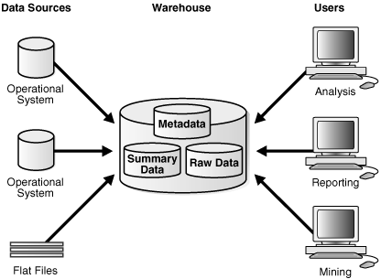
Simple Architecture
End users directly access data derived from several source systems through the data warehouse.
The metadata and raw data of a traditional OLTP system is present along with summary data. Summaries are a mechanism to pre-compute common expensive, long-running operations for sub-second data retrieval.
An EDW/consolidated raw data provides a 360-degree view into the business of an organization by holding all relevant business information in the most detailed format.
Notes:
For example, a typical data warehouse query is to retrieve something such as Yearly/monthly sales. A summary is called a materialized view.

Slide 23
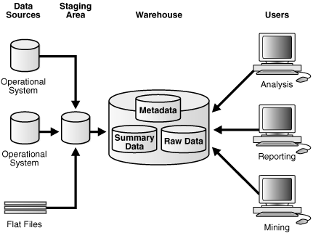
DWH with Staging Area
Data is collected, cleaned and processed before pushing it into the warehouse.
This can be done programmatically or using a staging area.
Notes:
A staging area simplifies data cleansing and consolidation for operational data coming from multiple source systems, especially for enterprise data warehouses where all relevant information of an enterprise is consolidated.

Slide 24
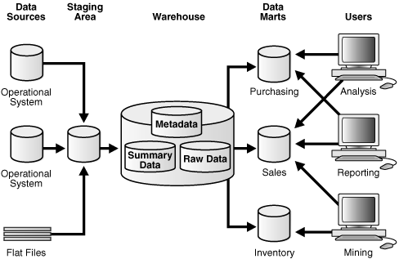
DWH with Staging Area & Data Marts
When warehouse's architecture is customized for different groups within your organization by adding data marts, which are systems designed for a particular line of business.
Notes:
Here purchasing, sales, and inventories are separated.
A financial analyst might want to analyse historical data for purchases and sales or mine historical data to make predictions about customer behaviour.

Slide 25
Data Warehouse | Data Mart
Data warehouse is a Centralized system. | While it is a decentralised system.
In data warehouse, lightly denormalization takes place. | While in Data mart, highly denormalization takes place.
Data warehouse is top-down model. | While it is a bottom-up model.
To built a warehouse is difficult. | While to build a mart is easy.
In data warehouse, Fact constellation schema is used. | While in this, Star schema and snowflake schema are used.
Data Warehouse is flexible. | While it is not flexible.
Data Warehouse is the data-oriented in nature. | While it is the project-oriented in nature.
Data Ware house has long life. | While data-mart has short life than warehouse.
In Data Warehouse, Data are contained in detail form. | While in this, data are contained in summarized form.
Data Warehouse is vast in size. | While data mart is smaller than warehouse.
It collects data from various data sources. | It generally stores data from a data warehouse.
Long time for processing the data because of large data. | Less time for processing the data because of handling only a small amount of data.
Complicated design process of creating schemas and views. | Easy design process of creating schemas and views.

Slide 26
Moving Beyond Traditional Data Architectures &
Why We Need Data Lakes

Slide 27
Challenges with Traditional Approach
For more than 30 years, organizations have invested in data integration and analytics platforms to achieve competitive advantage thru quantifiable and strategic benefits.
A traditional approach to information management has become problematic in terms of :
Overall costs
Inability to adapt to emerging changes in the proliferation of data
Integration with new ,emerging technologies and business needs.
Agility and Dynamism involved with explosion of data.
Delivering relevant business insights and competitive advantage.

Slide 28
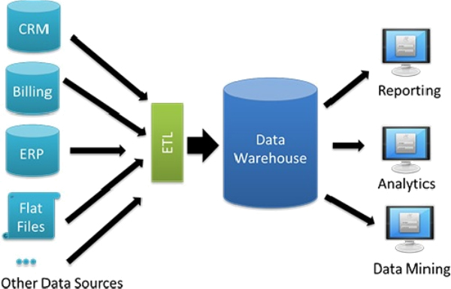
From a cost perspective, traditional data warehouses rely on relational databases (RDBMS) as a primary storage option where in :
Initial capital investment for hardware, software licensing for databases, data integration and analytics platform is huge.
Over 70% of development costs from ETL include effort to consolidate, prepare, standardize, and transform data for downstream analytics.

Slide 29
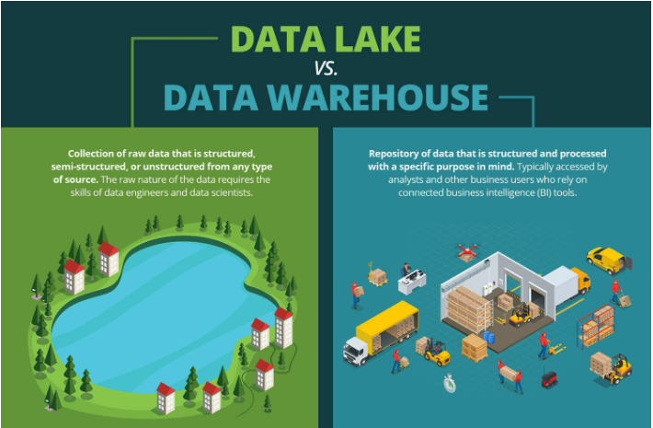

Slide 30
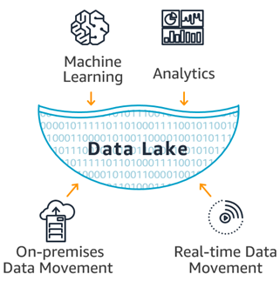
Highly diversified scenarios (Big Data and its use cases ) require a variety of integrated tools and services for storage, process, and compute requirements tailored to specific requirements.
Traditional architectures with an RDBMS-only mindset cannot accommodate more advanced forms of data processing.
Many organizations are shifting to a Data lake architecture.

Slide 31
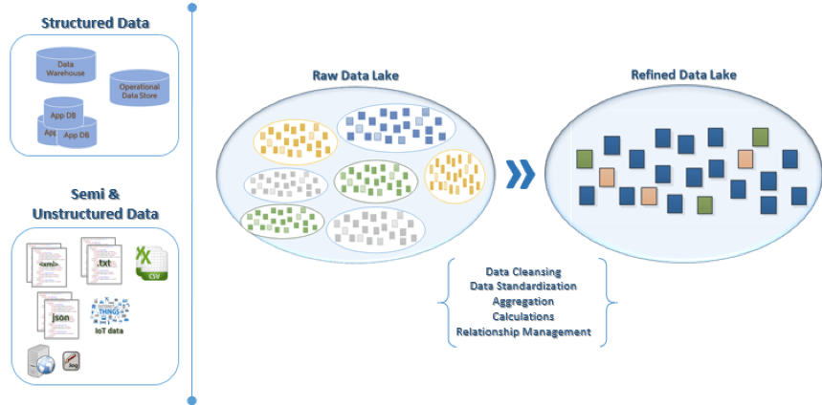
Concept of Data Lake

Slide 32
Data Lake
An architectural approach specifically designed to handle data of every variety, ingestion velocity, and storage volume into a central location so it's readily available to be categorized, processed, analyzed, and consumed by diverse groups within an organization.
Benefit : Since data can be stored as-is, no conversion to a predefined schema is required as done in traditional RDBMS-driven architectures.
What Needs to be done:
Data will typically need to be prepared for the widest variety of consumer usage patterns.
Consumer usage patterns and the sourcing of the data itself directly influence how data is collected, stored, processed, moved, transformed, automated, and visualized.

Slide 33
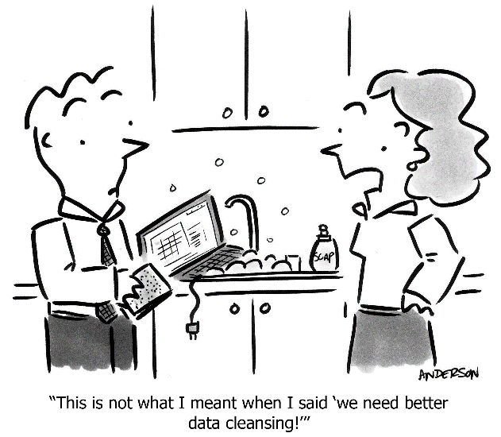
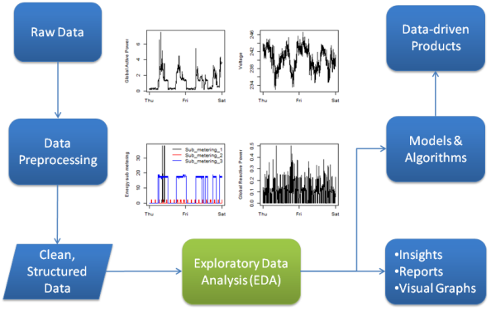
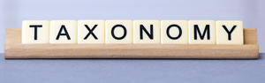
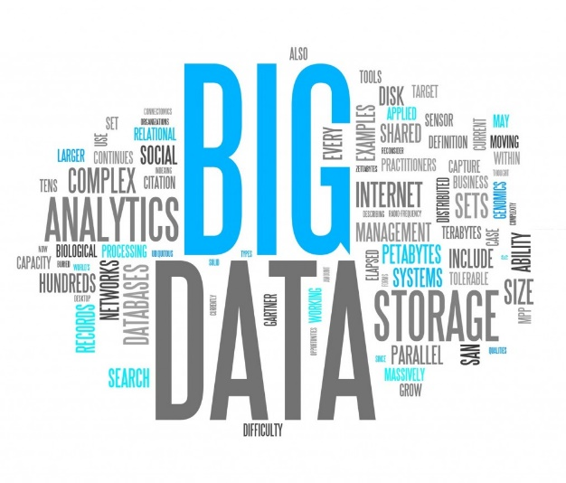
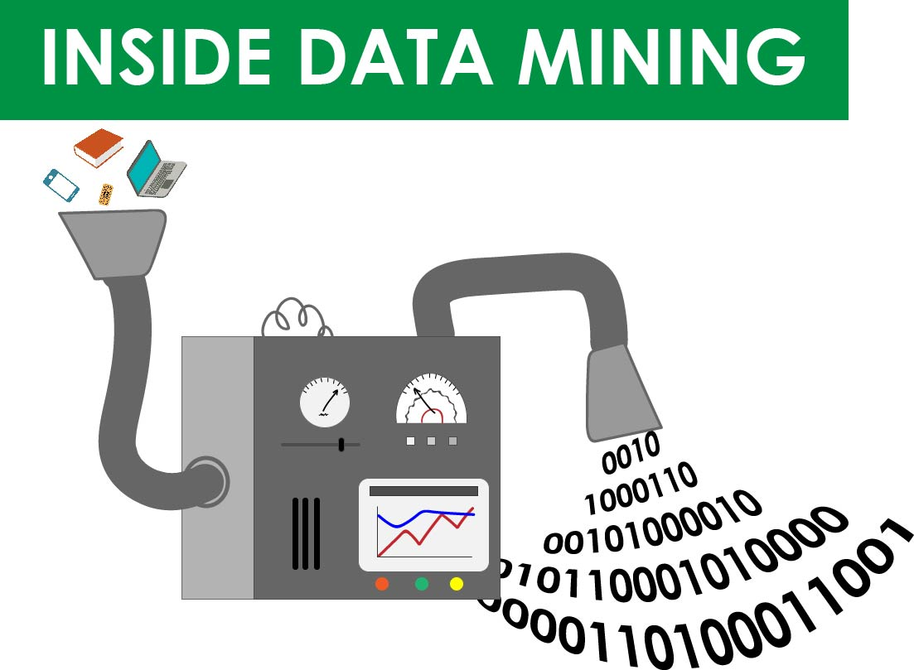
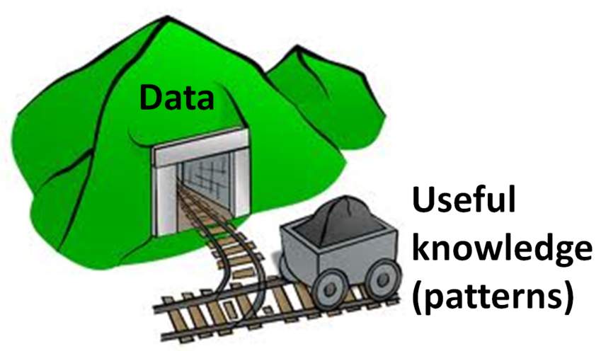
A data lake is a centralized repository that allows you to store all your structured and unstructured data at any scale.

Slide 34
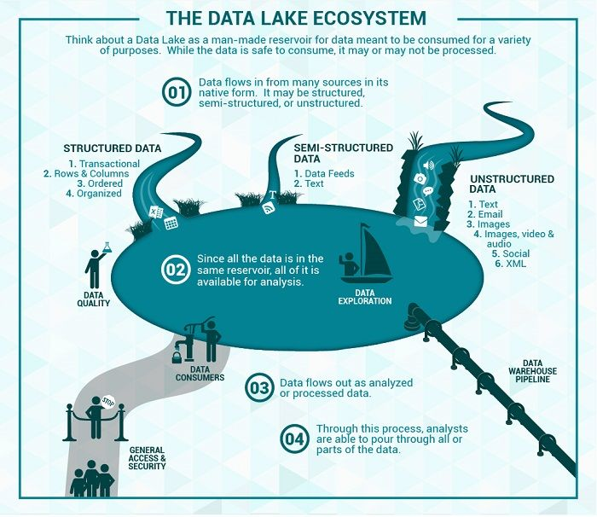
Why do you need a data lake?
Organizations who implemented a Data Lake outperformed similar companies by 9% in organic revenue growth.
Notes:
These organizations were able to do new types of analytics like machine learning over new sources like log files, data from click-streams, social media, and internet connected devices stored in the data lake. This helped them to identify, and act upon opportunities for business growth faster by attracting and retaining customers, boosting productivity, proactively maintaining devices, and making informed decisions.

Slide 35
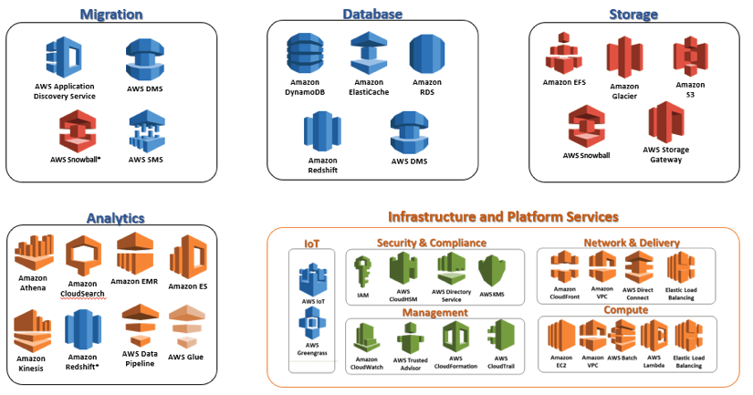
Data preparedness directly influences choice of storage, data movement, infrastructure choices, and analytics services.
The process for preparing data for its intended use requires a toolbox mentality in terms of integrated services, tools and platforms.
Notes:
The Data Lake is very much a disconnected storage concept at various levels of data preparedness. Data is stored in a raw state initially, and some use cases will use raw data as is.
More often, solutions required varying degrees of data preparedness based on a collection of query usage profiles which correlate to our use cases.
Based on the solution, data may be refined and staged with the intent to promote modularity and reuse .
AWS RedShift for relational analytics,
AWS Elasticsearch for text search,
or an optimized distributed file system for low cost active archive storage which can be queried with an MPP SQL engine

Slide 36
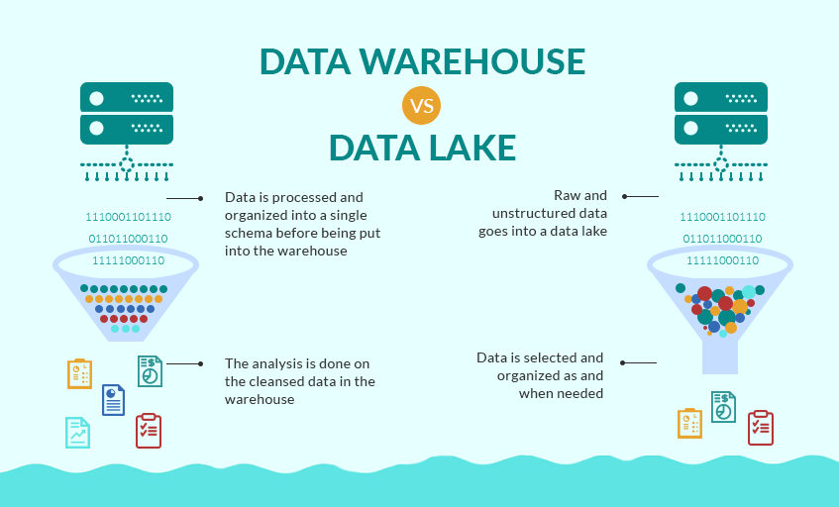

Slide 37
Characteristics | Data Warehouse | Data Lake
Data | Relational from transactional systems, operational databases, and line of business applications | Non-relational and relational from IoT devices, web sites, mobile apps, social media, and corporate applications
Schema | Designed prior to the DW implementation (schema-on-write) | Written at the time of analysis (schema-on-read)
Price/Performance | Fastest query results using higher cost storage | Query results getting faster using low-cost storage
Data Quality | Highly curated data that serves as the central version of the truth | Any data that may or may not be curated (ie. raw data)
Users | Business analysts | Data scientists, Data developers, and Business analysts (using curated data)
Analytics | Batch reporting, BI and visualizations | Machine Learning, Predictive analytics, data discovery and profiling

Slide 38
Capabilities expected from Data Lakes
Data movement
Data Lakes allow you to import any amount of data that can come in real-time.
Data is collected from multiple sources, and moved into the data lake in its original format.
Data Lakes allow you to scale to data of any size, while saving time of defining data structures, schema, and transformations.

Slide 39
Capabilities expected from Data Lakes
Analytics
Data Lakes allow various roles in your organization like data scientists, data developers, and business analysts to access data with their choice of analytic tools and frameworks.
This includes open source frameworks such as Apache Hadoop, Presto, and Apache Spark, and commercial offerings from data warehouse and business intelligence vendors.
Data Lakes allow you to run analytics without the need to move your data to a separate analytics system.

Slide 40
Capabilities expected from Data Lakes
Machine Learning
Data Lakes allow organizations to generate different types of insights including reporting on historical data, or building machine learning models to forecast likely outcomes, and suggest a range of prescribed actions to achieve the optimal result.

Slide 41
Challenges of Data Lakes
Raw data is stored with no oversight of the contents.
Data is usable only if it has defined mechanisms to catalog, and secure data.
Without these elements, data cannot be found, or trusted resulting in a data swamp .
Data lakes need to have governance, semantic consistency, and access controls to handle varied use cases.
Data Swamp : When intended data lake turns highly disorganized.
Lack of Metadata
Presence of irrelevant data
No data governance
Lacking automation
No data cleaning strategy
Notes:
Metadata : When appropriately used within a data lake, it acts as a tagging system that enables people to search for different kinds of data.
Metadata can also create a tiered storage structure that stops a data lake from turning into a data swamp.
It’s also worthwhile to depend on metadata to help describe time frames or the age of the data.
Irrelevant Data:
A data lake can transform into a data swamp when companies don’t set parameters about the kinds of data they want to gather and why.
When enterprises can’t or won’t set limits on data amounts, they could find that what was once a well-organised data lake is now a data swamp flooded with information they may never need.
Governance:
The absence of rules stipulating how to handle the data means that everything gets dumped in one place with no thought of how that practice negatively affects the future use of the data. Failing to implement data governance also puts organisations at risk for landing in regulatory hot water

Slide 42
All data is loaded from source systems. No data is turned away.
Data is stored at the leaf level in an untransformed or nearly untransformed state.
Data is transformed and schema is applied to fulfill the needs of analysis.
All data is retained
Support All Data Types, approach known as “Schema on Read” vs. the “Schema on Write” approach used in the data warehouse.'
Support All users
Adapt easily to changes
Provide faster insights

Slide 43
Understanding Data warehouse architecture

Slide 44
A data warehouse system has two main architectures:
The data flow architecture
The data flow architecture is about how the data stores are arranged within a data warehouse and how the data flows from the source systems to the users through these data stores.
The system architecture
The system architecture is about the physical configuration of the servers, network, software, storage, and clients.

Slide 45
Data Flow Architecture
It is a configuration of data stores within a data warehouse system, along with the arrangement of how the data flows from the source systems through these data stores to the applications used by the end users.
This includes how the data flows are controlled, logged, and monitored, as well as the mechanism to ensure the quality of the data in the data stores.
Based on the user accessibility, we can classify data warehouse data stores into three types:
User-facing data store : That is available to end users and is queried by the end users and end-user applications.
Internal data store : That is used internally by data warehouse components for the purpose of integrating, cleansing, logging, and preparing data, and it is not open for query by the end users and end-user applications.
Hybrid data store : That is used for both internal data warehouse mechanisms and for query by the end users and end-user applications.

Slide 46
Based on the data format, we can classify data warehouse data stores into four types:
Stage : is an internal data store used for transforming and preparing the data obtained from the source systems.
NDS : is normalized data store (NDS) , an internal master data store in the form of one or more normalized relational databases for the purpose of integrating data from various source systems captured in a stage.
ODS : is operational data store (ODS) , a hybrid data store in the form of one or more normalized relational databases, containing the transaction data and the most recent version of master data.
DDS : is dimensional data store (DDS) , a user-facing data store, in the form of one or more relational databases, where the data is arranged in dimensional format for the purpose of supporting analytical queries.

Slide 47
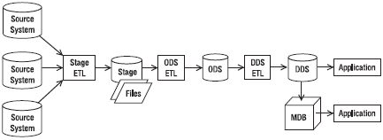
Data flow architecture with a stage, ODS, DDS, and MDB
Here ,there are three ETL packages between the four data stores.
A stage ETL retrieves data from the source systems and loads it into a stage.
ODS ETL retrieves data from a stage and loads it into ODS.
DDS ETL retrieves data from ODS and loads it into DDS.

Slide 48
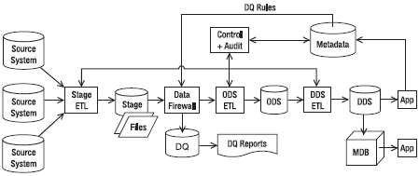
A data flow architecture with control system, metadata, and data quality process
The data flow architecture here contains the control system, the metadata, and the components of data quality processes.
Notes:
A data flow architecture is one of the first things you need to decide when building a data warehouse system because the data flow architecture determines what components need to be built and therefore affects the project plan and costs.

Slide 49
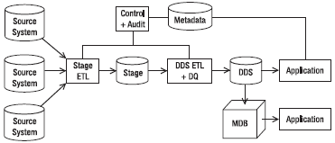
Single DDS Data warehouse architecture
Here the “Control + Audit” box contains the ETL control system and audit, the data warehouse applications, such as business intelligence (BI) reports, read the data in the DDS and bring the data to the users.
The data in the DDS can also be uploaded into multidimensional databases, such as SQL Server Analysis Services, and then accessed by the users via OLAP and data mining applications.

Slide 50
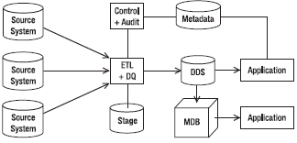
Data architecture where the stage ETL and DDS ETL are combined
Here the stage ETL, the DDS ETL, and the data quality processes are combined into one ETL.
The advantage of combining them into one package is to have more control over the timing of when the data is written to and retrieved from the stage.
Notes:
Additional:
NDS + DDS
In NDS + DDS data flow architecture, there are three data stores: stage, NDS, and DDS. This architecture is similar to the single DDS architecture, but it has a normalized data store in front of the DDS. The NDS is in third normal relational form or higher. The purpose of having NDS is twofold. First, it integrates data from several source systems. Second, it is able to load data into several DDSs.
ODS + DDS
In the ODS + DDS architecture, the DDS is the master data store. Unlike an NDS + DDS architecture, in an ODS + DDS architecture you have only one DDS. The DDS contains a complete set of fact tables and the dimension tables. The DDS contains both the current version and all historical versions of master data.
In the ODS + DDS architecture, applications can access the data warehouse in three places in three different formats: those that need the data in normalized form can access the ODS, those that need the data in relational dimensional format can access the DDS, and those that need the data in multidimensional format can access the MDBs.
This architecture has these advantages:
The third normal form is slimmer than the NDS because it contains only current values. This makes the performance of both ODS ETL and DDS ETL better than the ones in the NDS + DDS architecture.
Like the NDS + DDS architecture, in the ODS + DDS architecture you have a central place to integrate, maintain, and publish master data.
The normalized relational store is updatable by the end-user application, making it capable of supporting operational applications at the transaction level.

Slide 51
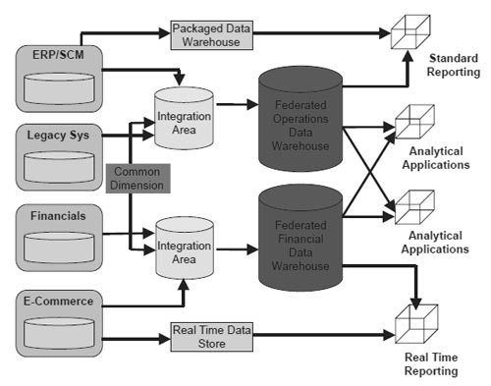
Federated Data Warehouse
A federated data warehouse consists of several data warehouses with a data retrieval layer on top of them.
A federated data warehouse retrieves data from existing data warehouses using an ETL and loads the data into a new dimensional data store.
For example: The first one is a dimensional data warehouse, the second one is a third normal form normalized data warehouse, and the third one is a relational data warehouse with a few big transaction tables referencing many reference tables.
Notes:
A federated data warehouse is a tool that provides an end-user a unified perspective on a finite set of independent data warehouses. This requires creating a global schema from partial schemas, which remains purely virtual. This is a result of iterative integration of participating data warehouses.

Slide 52
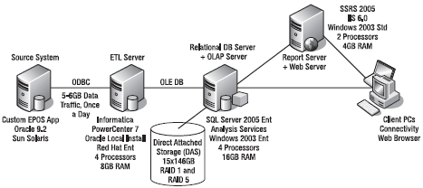
System Flow Architecture
The system architecture is about the physical configuration of the servers, network, software, storage, and clients.
Designing a system architecture requires knowledge about hardware (especially servers), networking (especially with regard to security and performance and in the last few years also fiber networks), and storage (especially storage area networks [SANs], redundant array of inexpensive disks [RAID], and automated tape backup solutions).
Notes:
The system architecture consists of three servers: one ETL server, one database server, and one reporting server. The source system is an electronic point-of-sale system that records retail sales in the stores running on Oracle 9.2 on Sun Solaris.

Slide 53
When we get the requirements, we can further detail the design.
For example:
High-availability requirements (how many hours can they tolerate the data warehouse to be down) affect the clustering decision of the database servers.
The volume of the data from the source systems affects the number of processors and the memory of the ETL server and whether we need to put SSIS on a separate machine.
The volume of the data in the data warehouse affects the storage size and backup requirements. The SAN raw disk size may be less or more depending on the actual requirements.
The number and sizes of the OLAP cubes affect the memory and processors of the OLAP server and whether you need to put Analysis Services on a separate server.

Slide 54
Understanding Data warehouse Approaches

Slide 55
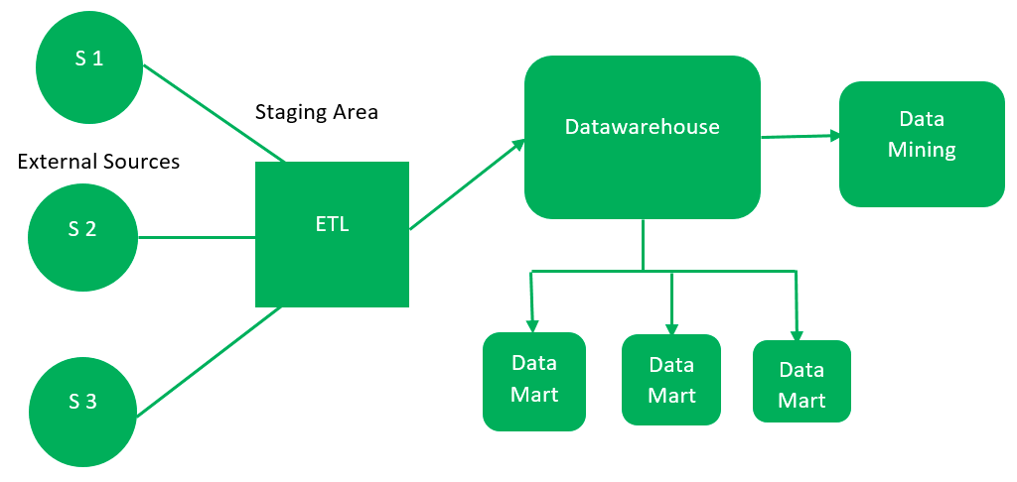
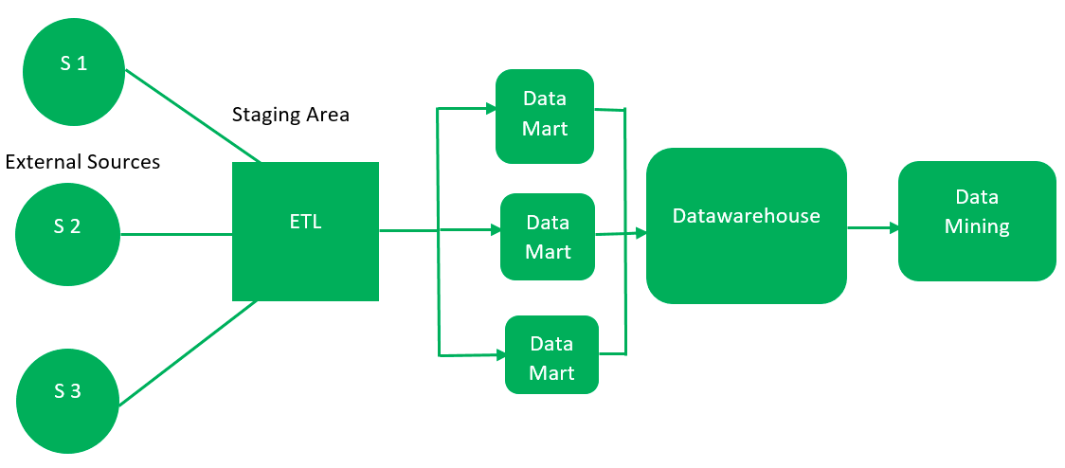
Top Down Approach
-- By Inmon
Bottom up Approach
-- By Ralph Kimball

Slide 56
Data warehouse design approaches:
From questions of scaling, the total cost of ownership, flexibility, and accessibility, the design patterns involved in building and maintaining the data warehousing environment can be demanding.
The two main approaches to designing the data warehouse architecture are the
Inmon approach or the Kimball approach.

Slide 57
Continued..

