Slide 1
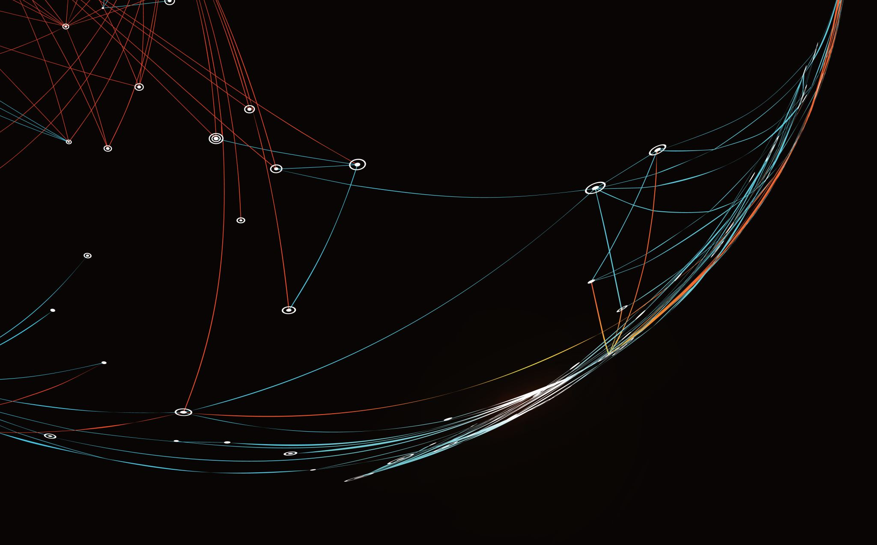
AWS
Working Notes

Slide 2
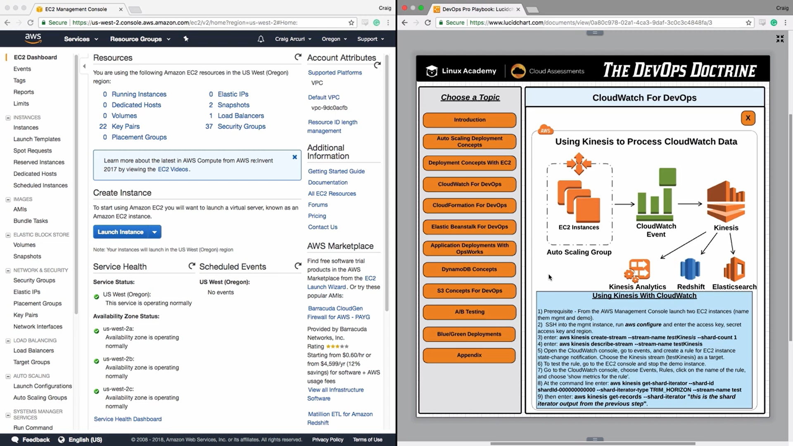

Slide 3
Follow instructions from “Processing_Logs_Using_Kinesis”

Slide 4
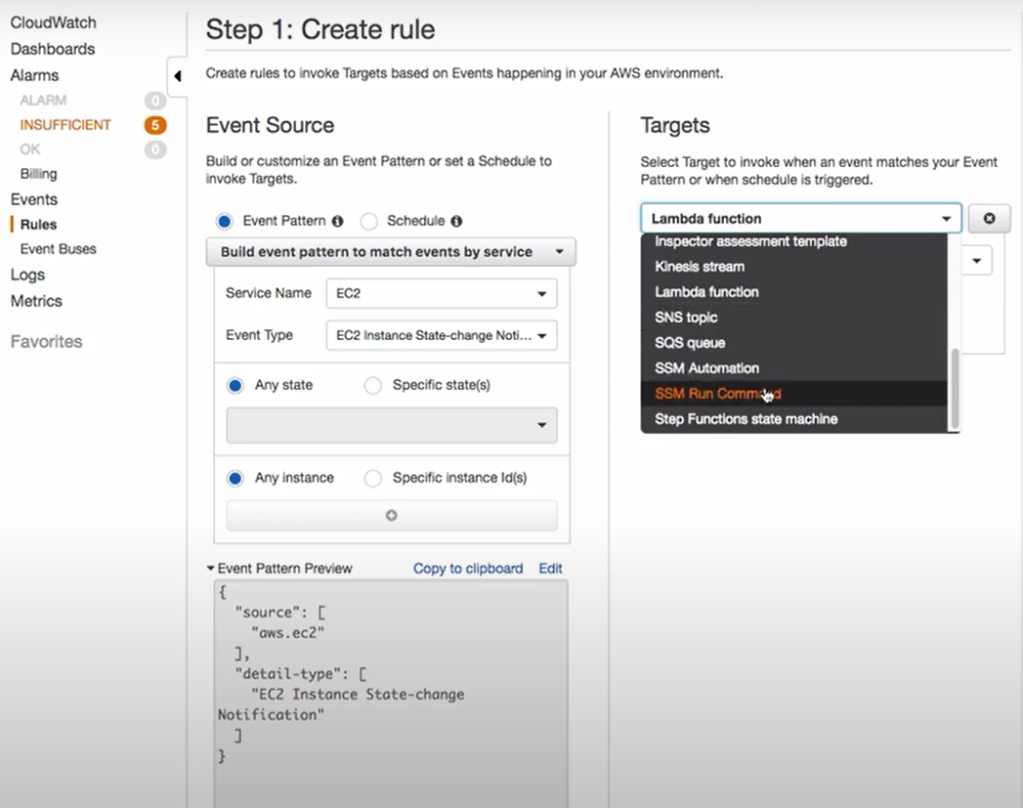
Here we will choose ‘Kinesis stream’ while selecting Targets.

Slide 5
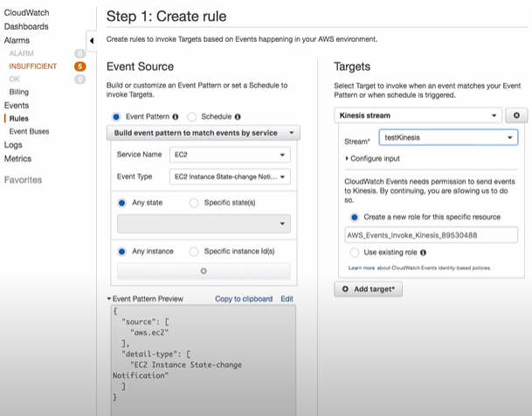

Slide 6
Follow instructions from “Processing_Logs_Using_Kinesis”

